Slide 1
Alternative Methods
Reinforcement Learning

Slide 2
Beyond Online Model-Free RL
Model-based RL
Offline RL
Behavior cloning & imitation learning
Sequence/trajectory modeling (Decision Transformer, diffusion models for policies)
Vision-language-action models
Vision encoders (ResNet, ViT)
Language models (side note: RLHF for LLM post-training)
Multimodal fusion
Tokenization of sensorimotor sequences

Slide 3
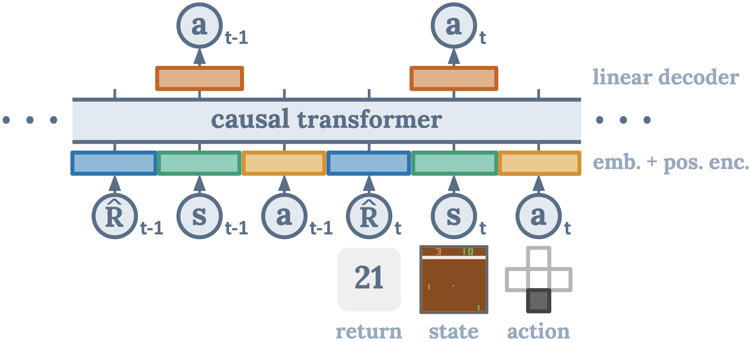
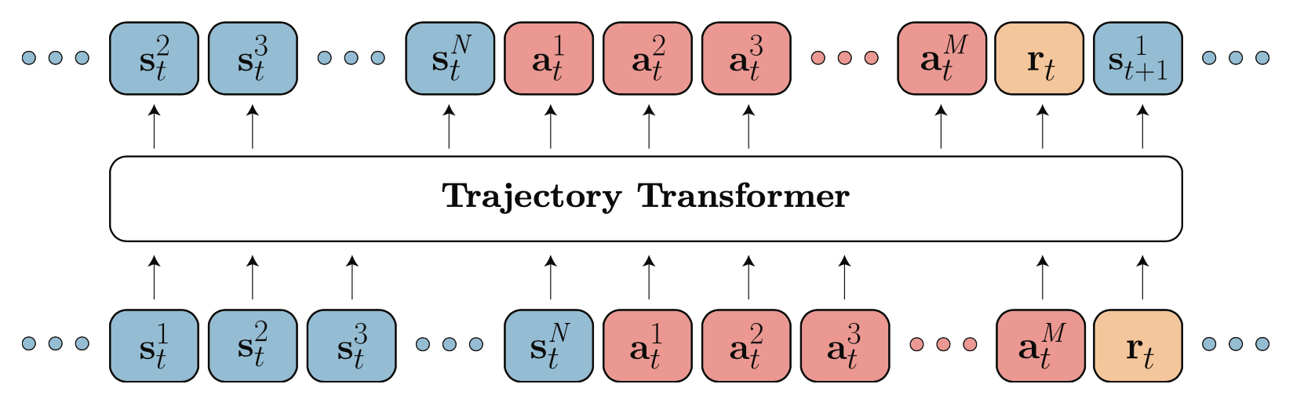
Sequence Modeling for Decisions/Actions
overcome Markov property
generative: transformer decoder architecture to autoregressively model trajectories
credit assignment directly via self-attention: implicitly forming state-return associations via similarity of query and key vectors (maximizing the dot product)
desired return tokens as prompt for action generation
Decision Transformer: conditioning on desired return, past states and actions to generate future actions
Trajectory Transformer: predicting also states and returns (adding model-based components, planning with beam search)
source
source

Slide 4
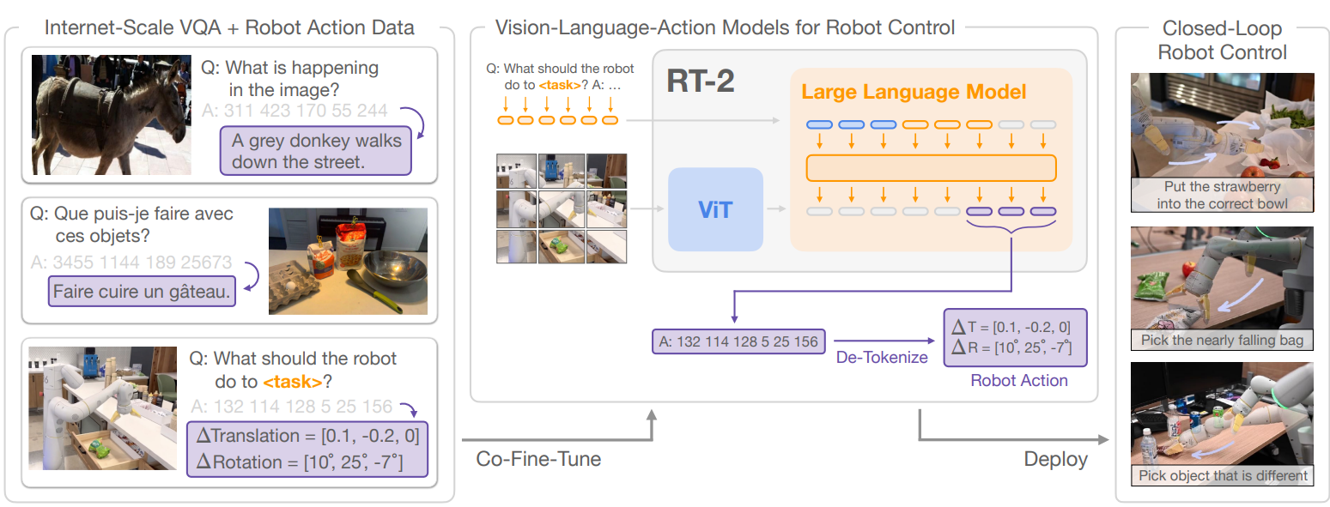
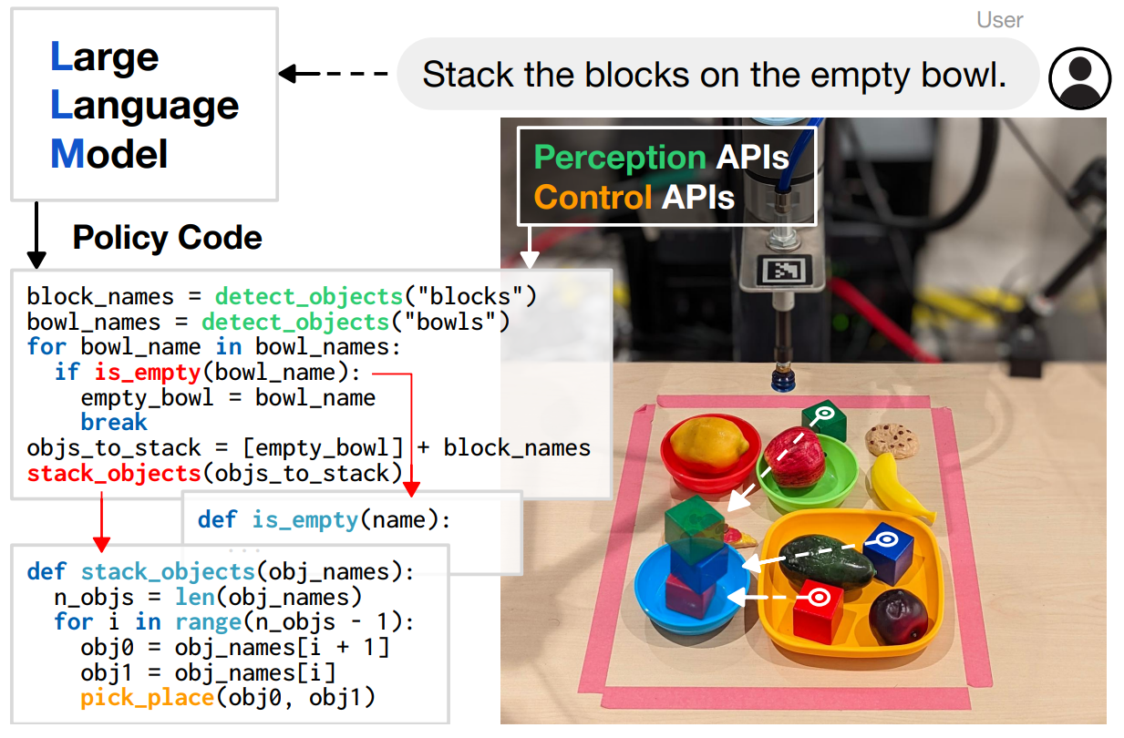
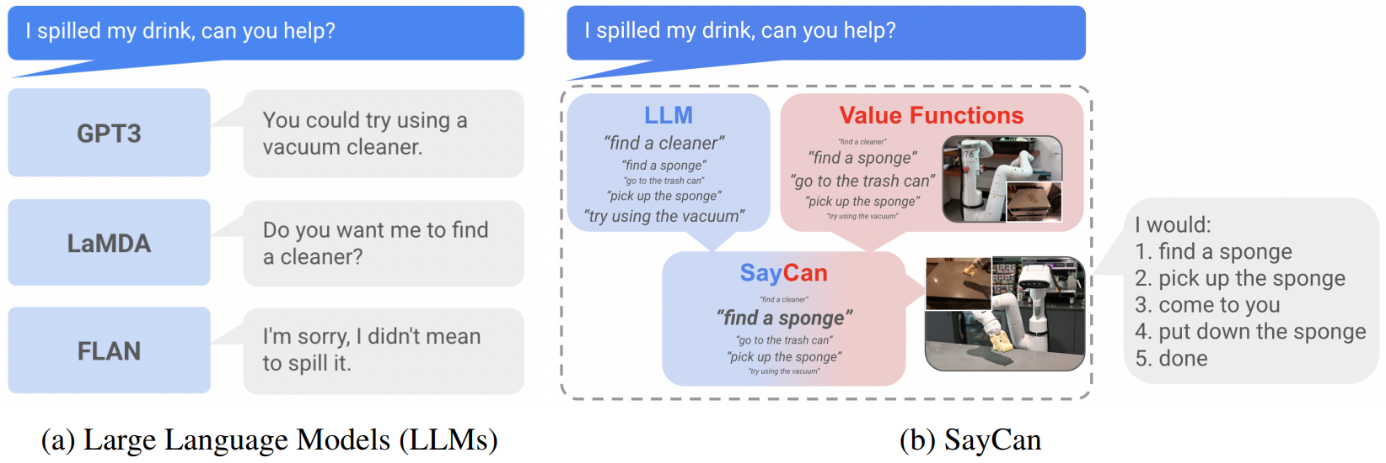
Robotic Control via LLMs (and Vision)
can also condition imitation learning
diffusion objective for multimodal outputs
RT-2: vision-language-action model learning from web and robotics data
representation of actions as tokens
generalization by using pre-trained vision-language models
Code as Policies:
grounding with pre-trained skills (SayCan):

Slide 5
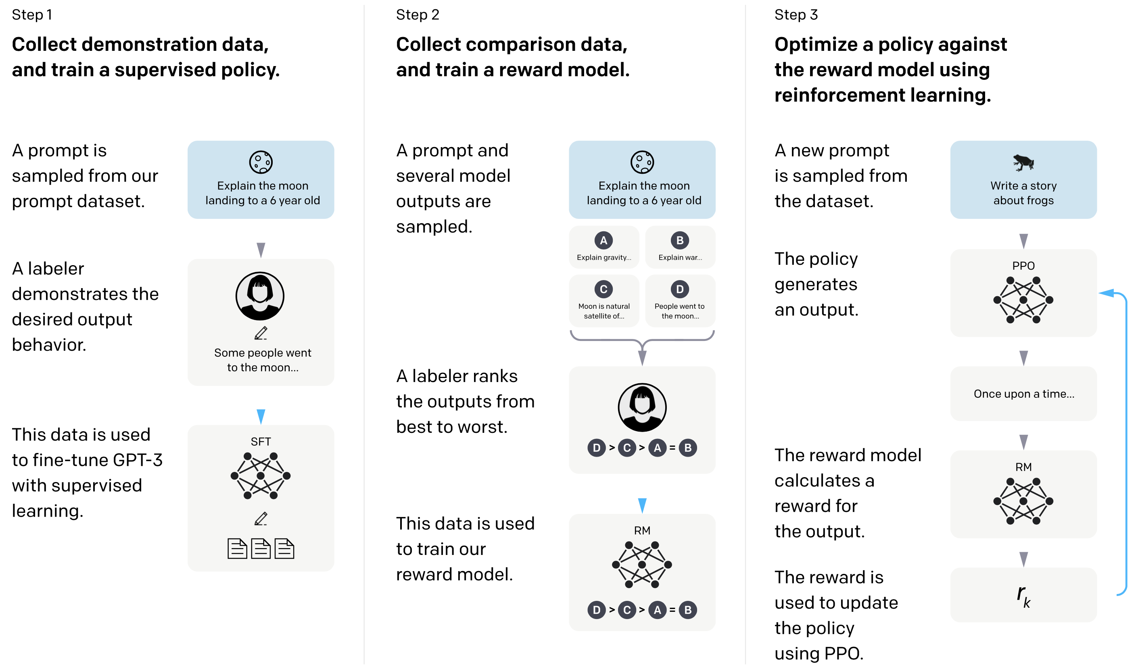
RL from Human Feedback
examples: ChatGPT, Bard
example for supporting large language models (transformers) with RL
used in famous ChatGPT
goal: improve alignment with user intentions
→ learn from human preferences
RL looks at reward of text output passages as a whole
(rather than token-level loss in supervised learning)
source

Slide 6
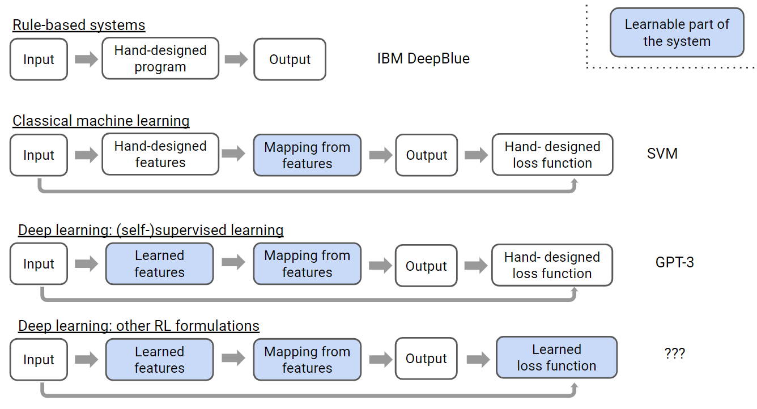
Reward Model
loss function for supervised learning sometimes difficult to define
RL allows learning (instead of manually setting) of loss function
(e.g., RLHF)
source

Slide 7
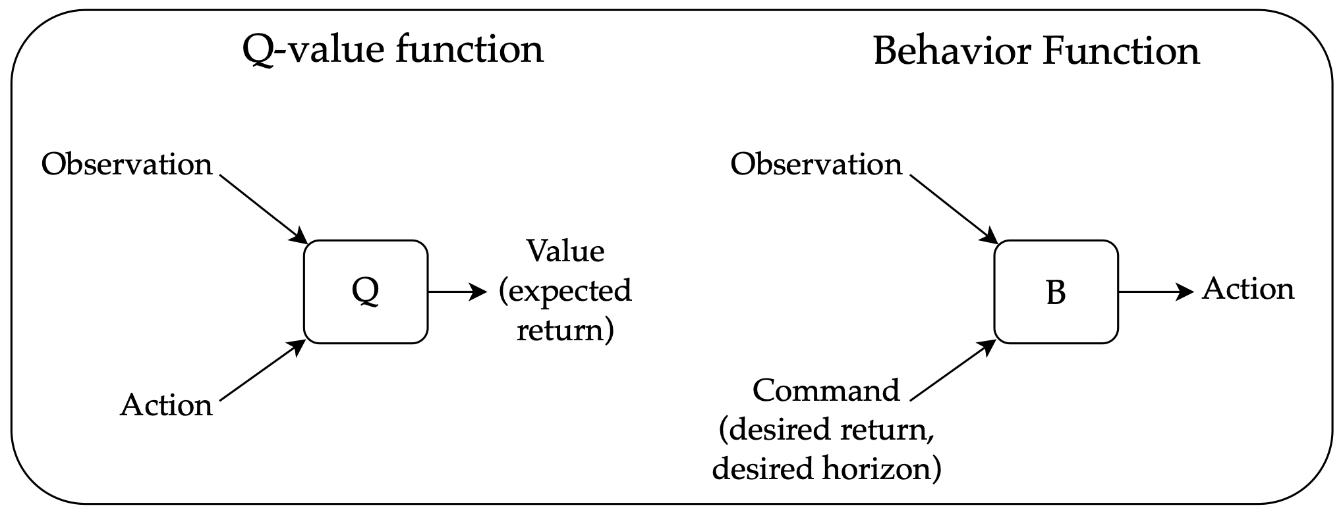
Upside–Down RL
alternative to conventional RL
→ no bootstrapping, just supervised learning with “command” features (hindsight return in training, kind of prompt in inference)
offline RL: no interaction with environment, just fixed data set of trajectory rollouts of arbitrary policies
But policy improvement (i.e., higher return) beyond training examples (extrapolation) usually still requires policy iteration (here: iteratively updated trainings with new data with higher returns).
source

