Slide 1
Applications
Reinforcement Learning

Slide 2
RL_electric …

Slide 3
Simulation-Based RL

Slide 4
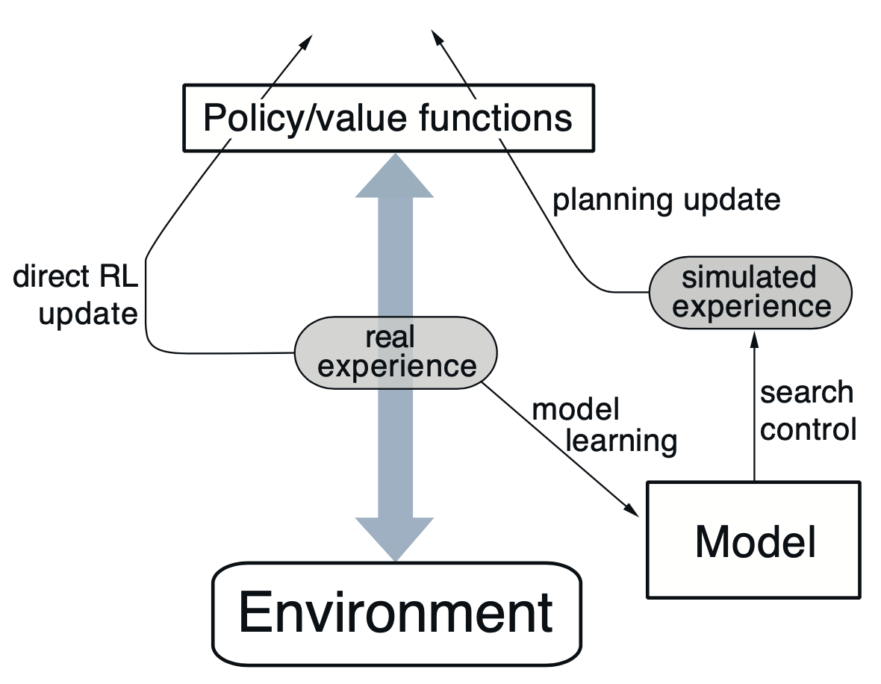

…
from Sutton

Slide 5
Sim-to-Real Gap
simulation → real transfer

Slide 6
Real-World RL Constraints
safety, sample efficiency, online data collection

Slide 7
Embodied RL

Slide 8
Imitation Learning for Robotics

Slide 9
Generalist Robot Policies
e.g., SmolVLA

