Slide 1
Foundations
Reinforcement Learning

Slide 2
Course Schedule
Foundations
Tabular Methods
Function Approximation
Deep Q-Learning
Policy Gradient Methods
Actor-Critic Methods
Beyond Online Model-Free RL
Embodied RL

Slide 3
Foundations
Markov Decision Processes
Rewards, returns, horizon, discounting
Policies (deterministic, stochastic)
Exploration vs exploitation
On-policy vs off-policy
Episodic vs continuing tasks

Slide 4
Sequential Decision Making
reinforcement learning (RL):
formalization of sequential decision making (action policy) of software agent interacting with environment
corresponds to search for best (or rather good) action policy to reach a given goal (e.g., win a game)
using learning from examples (data) to guide the search
RL usually more difficult (e.g., non-differentiable as a whole) than supervised learning (which can be seen as “generalized optimization”, often of proxy metric)

Slide 5
Main Elements of RL
goal: find action policy maximizing reward from environment
action policy
exploration-exploitation trade-off
e.g., epsilon-greedy: random exploration at small fraction of the time
feedback from environment
goal-directed, no supervision
scalar reward signal, cumulative and delayed (credit assignment problem)

Slide 6
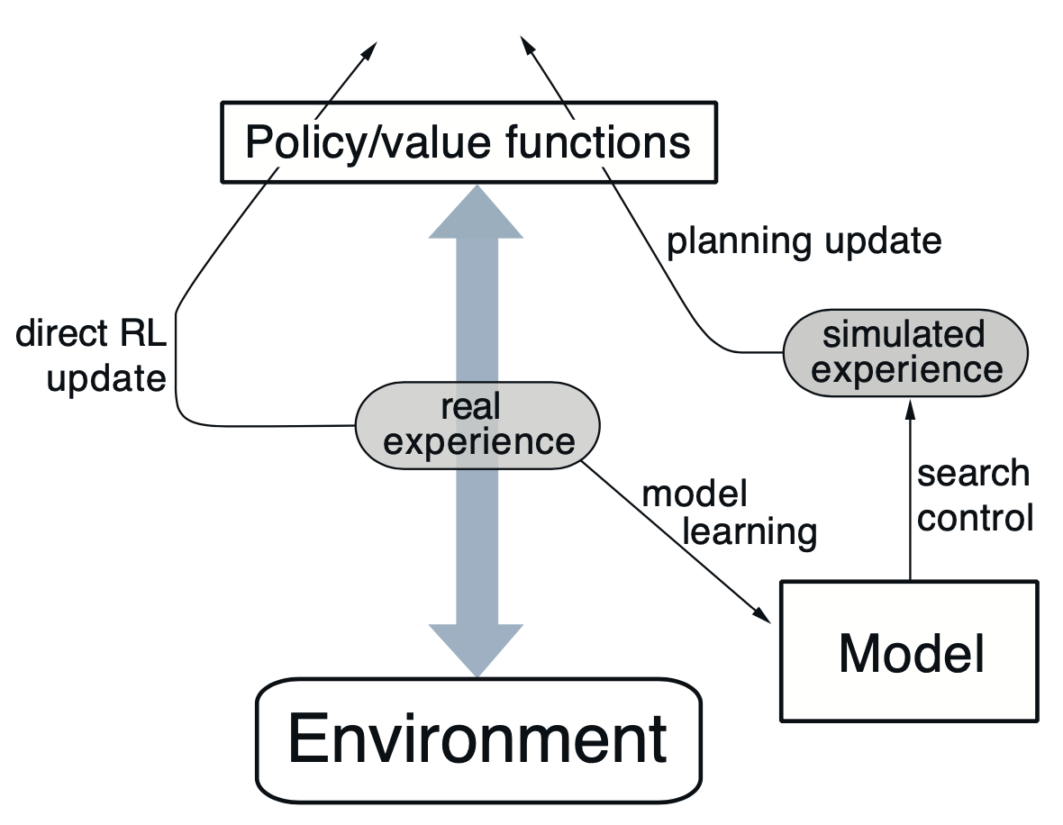

Optional Elements of RL
value functions for states or actions: improve efficiency of search in vast action policy space (alternative: direct policy search)
model of environment: (model-free) learning from trial-and-error or (model-based) planning
model of environment can be used in different ways:
simulate experience from model (for learning)
decision-time planning (e.g., heuristic search or model predictive control)
from Sutton

Slide 7
Markov Decision Process (MDP)
idea: current state includes all information about past
transition probabilities between states describe dynamics of given MDP
action policy: mapping from states to probabilities for selection of different actions

Slide 8
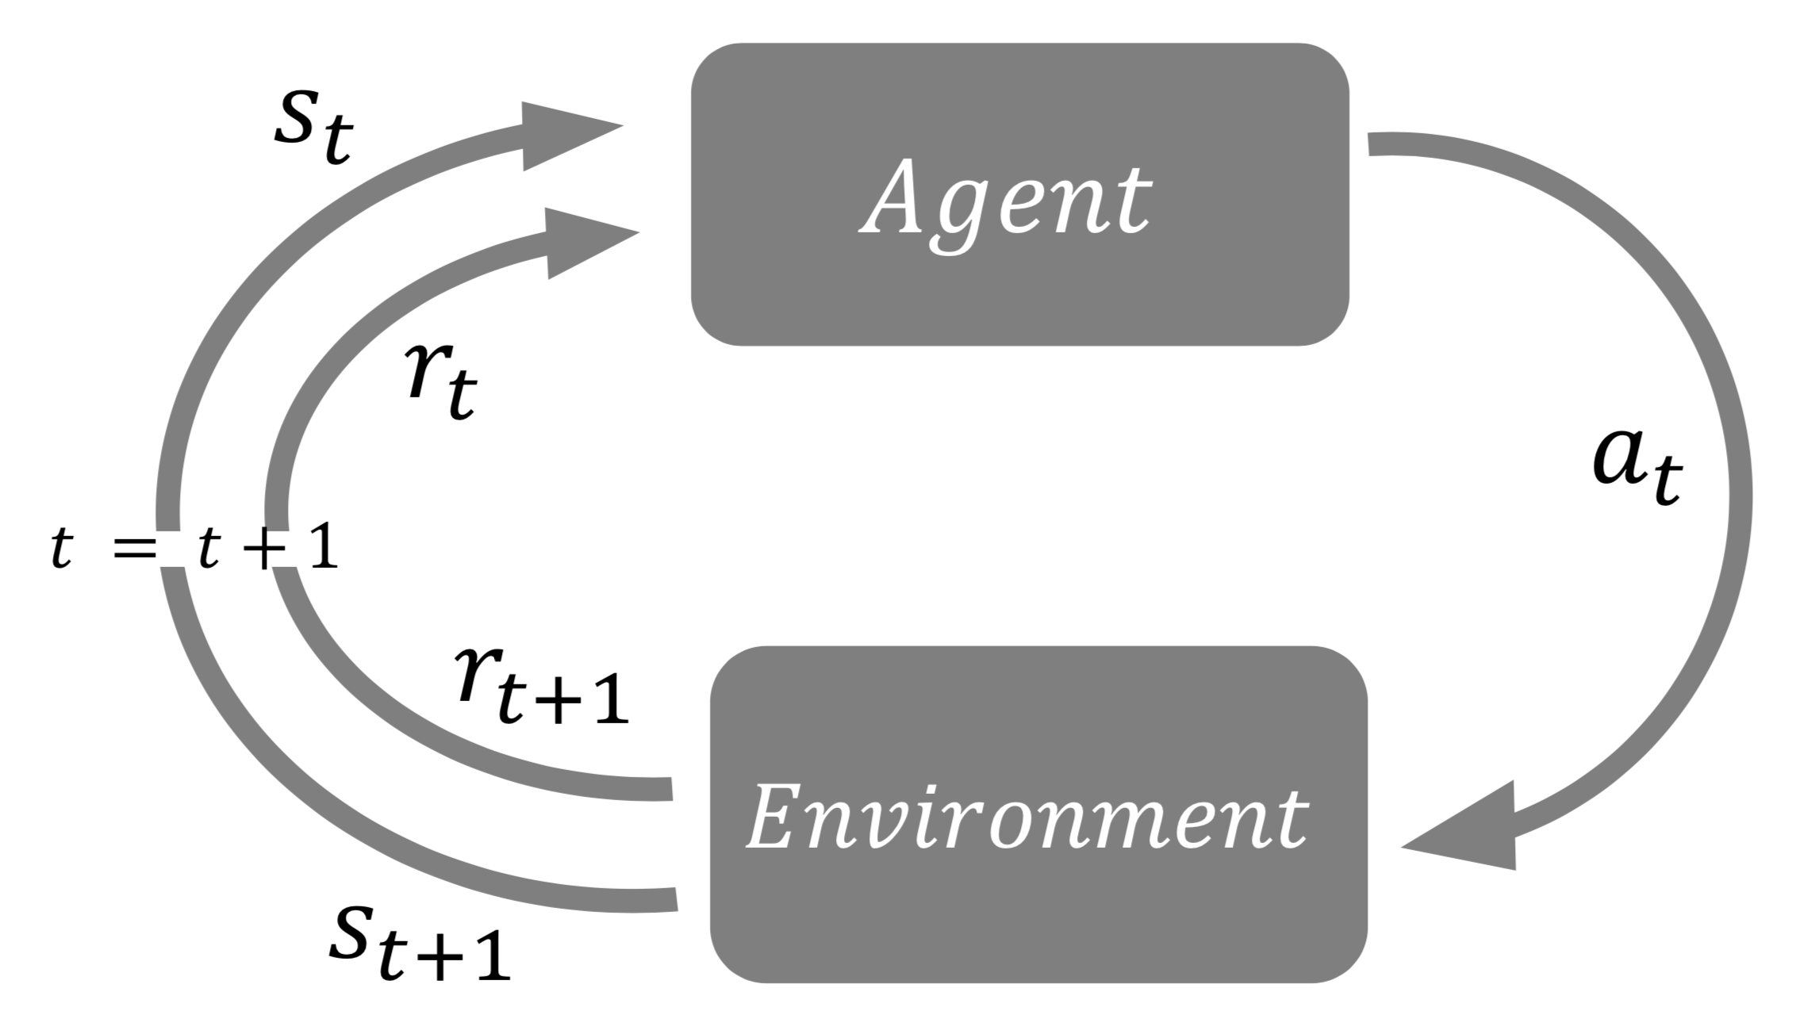
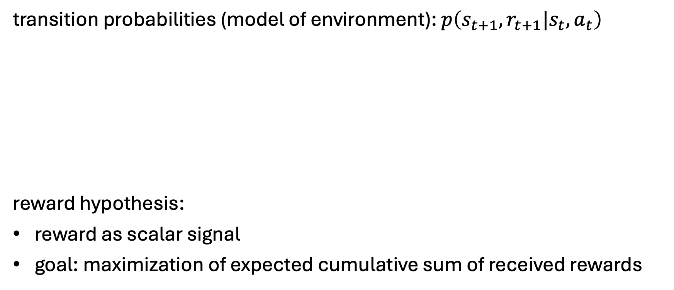
States, Actions, and Rewards
transition probabilities (model of environment): $p\left(s_{t+1},r_{t+1}|s_{t},a_{t}\right)$
reward hypothesis:
reward as scalar signal
goal: maximization of expected cumulative sum of received rewards

