Slide 1
Tabular Methods
Reinforcement Learning

Slide 2
Course Schedule
Foundations
Tabular Methods
Function Approximation
Deep Q-Learning
Policy Gradient Methods
Actor-Critic Methods
Beyond Online Model-Free RL
Embodied RL

Slide 3
Tabular Methods
State-value & action-value functions
Bellman equations
Policy evaluation and improvement, Value iteration, policy iteration
Dynamic programming
Monte Carlo methods
Temporal-Difference learning (TD(0), TD(λ))
SARSA and Q-Learning

Slide 4
State and Action Values
state/action value: total amount of expected future reward starting from given state/action (usually with discounting of later steps)
→ indicating long-term desirability of states/actions
main motivation: improve efficiency of search in policy space
(for comparison: evolutionary methods search directly by evaluating entire policies)

Slide 5
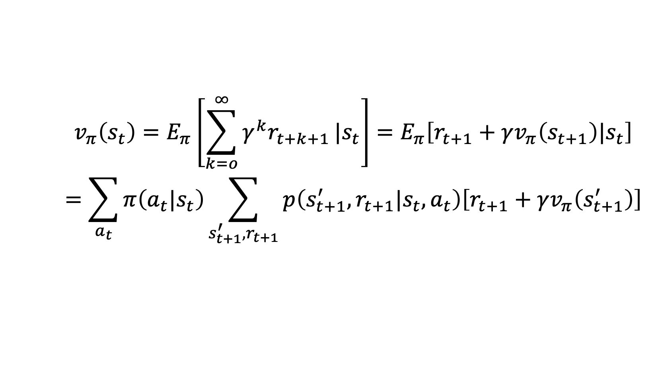
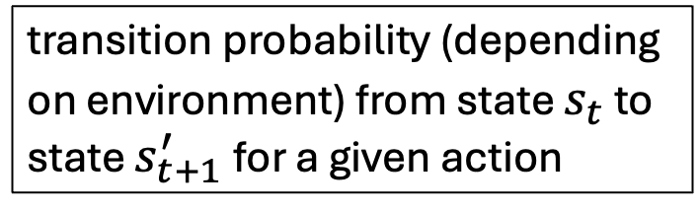
State-Value Function
return
discount rate
(needed for all states)
$$v_{π}\left(s_{t}\right)=E_{π}\left[\sum_{k=o}^{∞}{γ^{k}r_{t+k+1}}|s_{t}\right]=E_{π}\left[r_{t+1}+γv_{π}\left(s_{t+1}\right)|s_{t}\right]$$
$$=\sum_{a_{t}}{π\left(a_{t}|s_{t}\right)\sum_{s_{t+1}^{′},r_{t+1}}{p\left(s_{t+1}^{′},r_{t+1}|s_{t},a_{t}\right)\left[r_{t+1}+γv_{π}\left(s_{t+1}^{′}\right)\right]}}$$
policy: probabilitiy to take specific action being in a given state
transition probability (depending on environment) from state $s_{t}$ to state $s_{t+1}^{′}$for a given action
Bellman (expectation) equation: recursion
(sweep through entire state space)

Slide 6
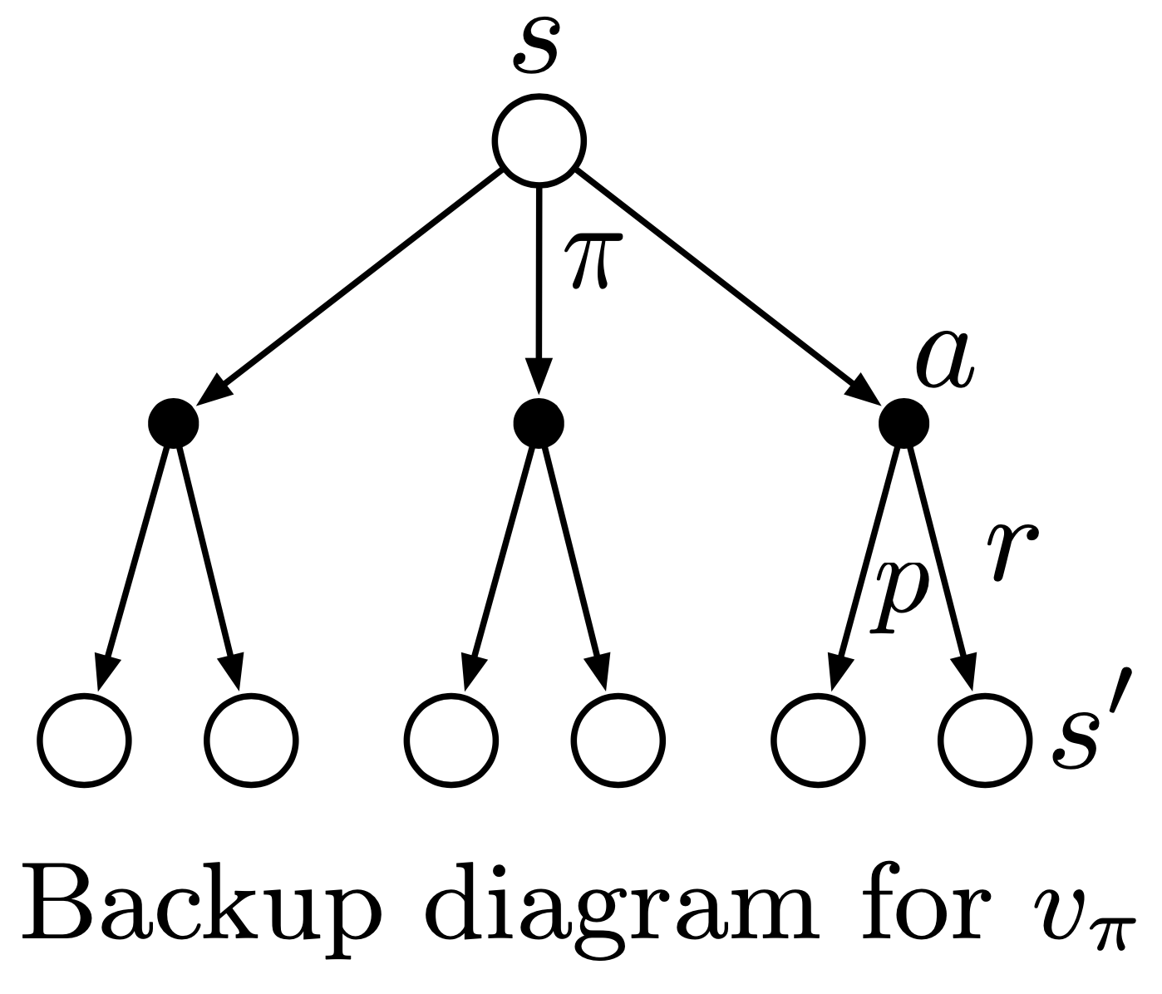
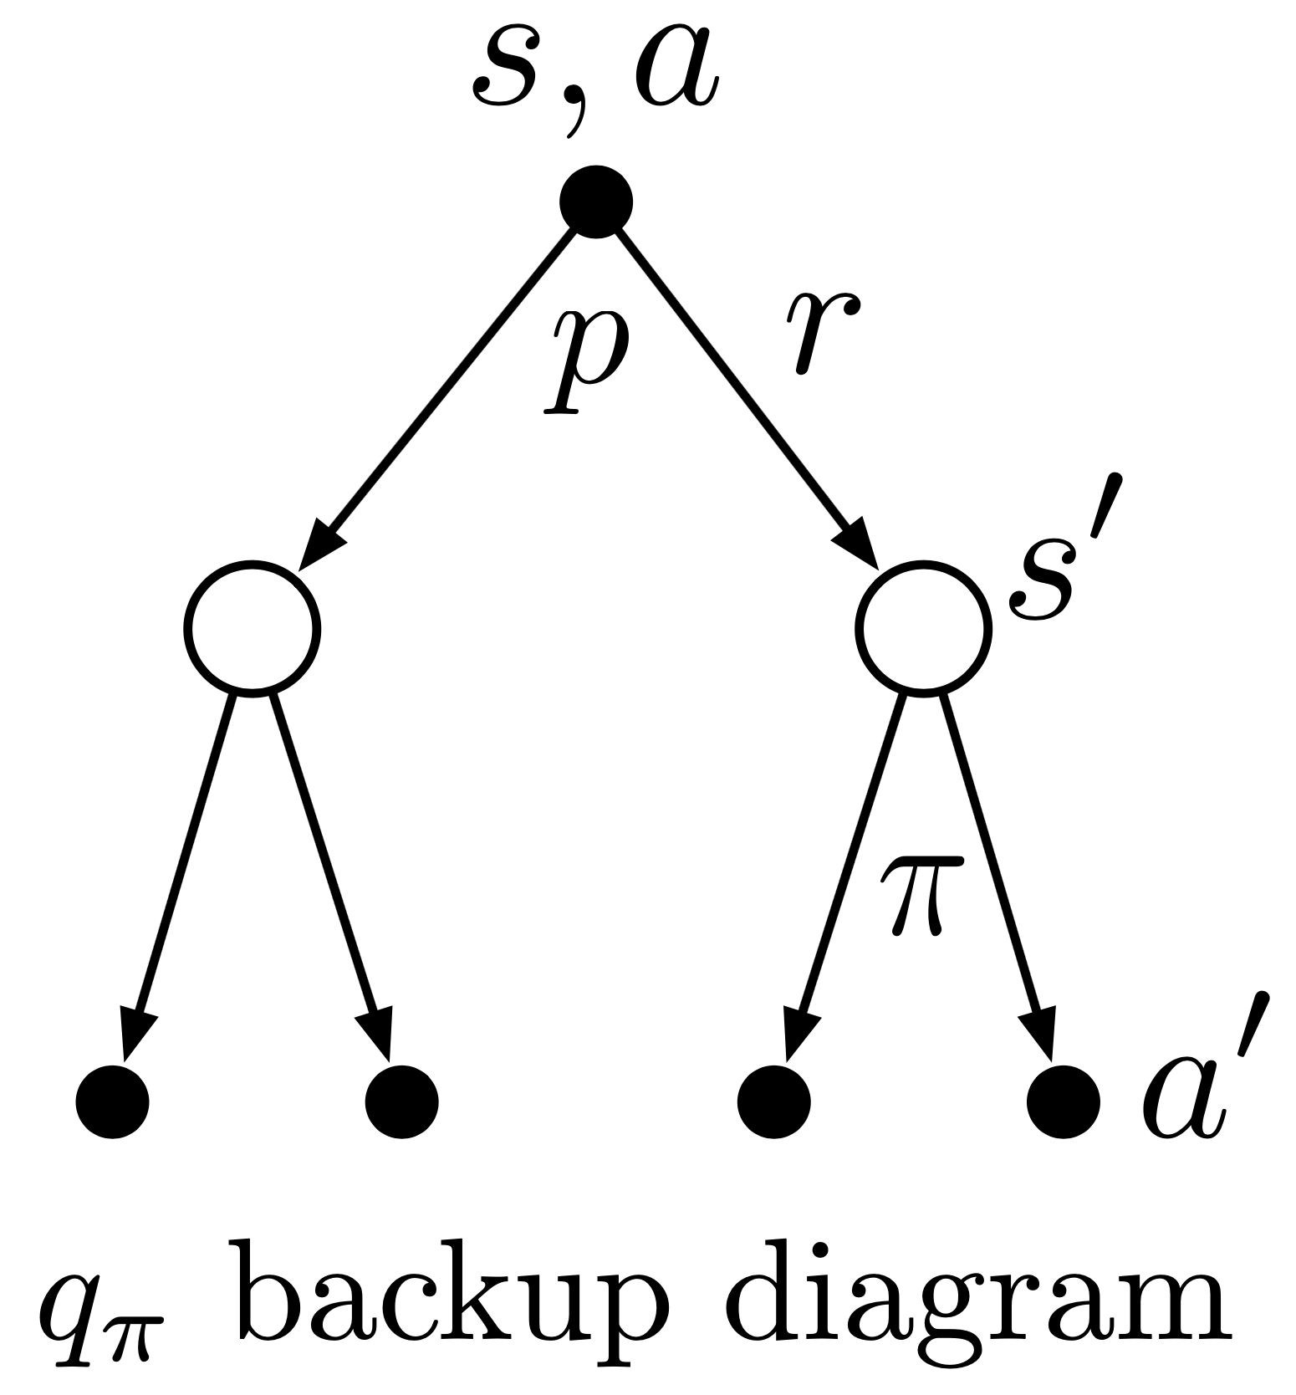
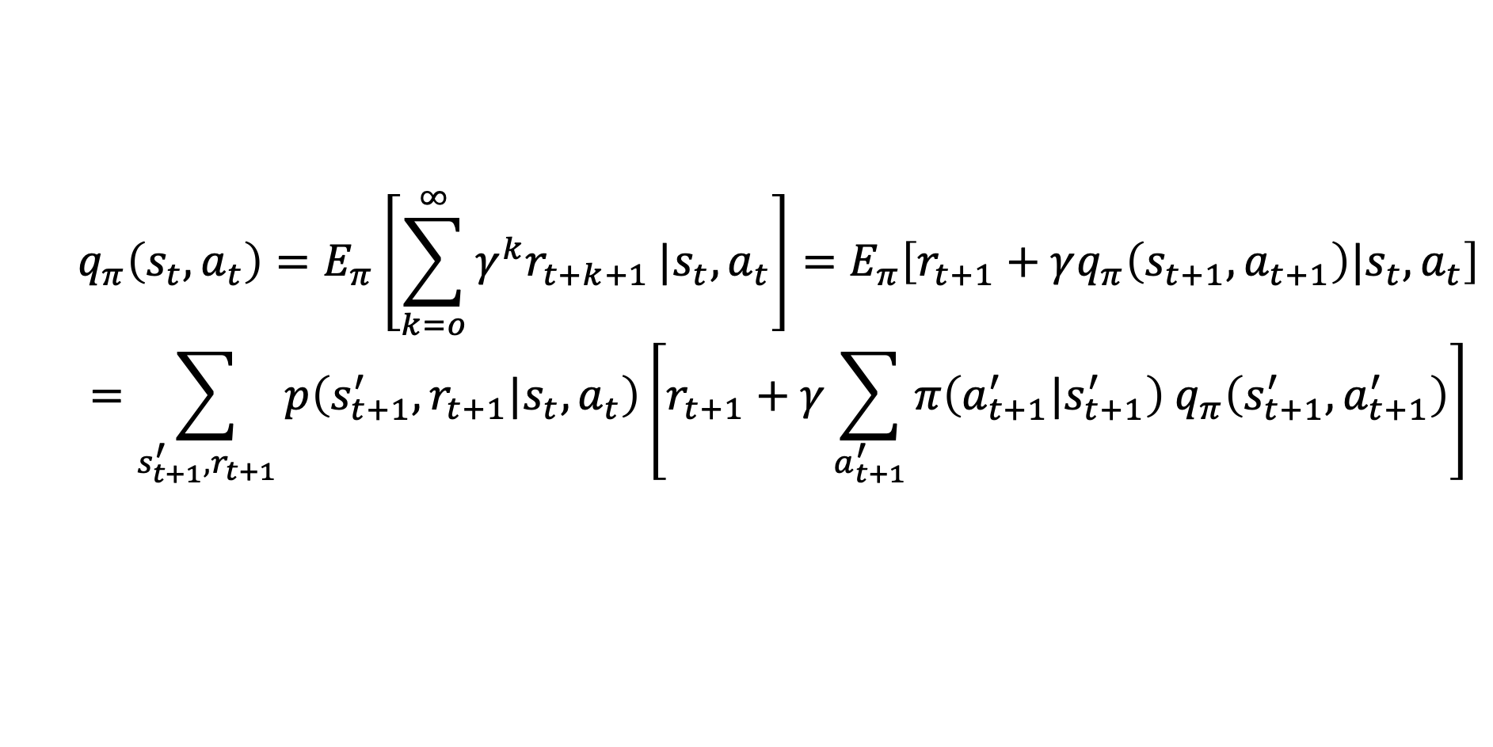
Action-Value Function
$$q_{π}\left(s_{t},a_{t}\right)=E_{π}\left[\sum_{k=o}^{∞}{γ^{k}r_{t+k+1}}|s_{t},a_{t}\right]=E_{π}\left[r_{t+1}+γq_{π}\left(s_{t+1},a_{t+1}\right)|s_{t},a_{t}\right]$$
$$=\sum_{s_{t+1}^{′},r_{t+1}}{p\left(s_{t+1}^{′},r_{t+1}|s_{t},a_{t}\right)\left[r_{t+1}+γ\sum_{a_{t+1}^{′}}{π\left(a_{t+1}^{′}|s_{t+1}^{′}\right) q_{π}\left(s_{t+1}^{′},a_{t+1}^{′}\right)}\right]}$$
from Sutton

Slide 7
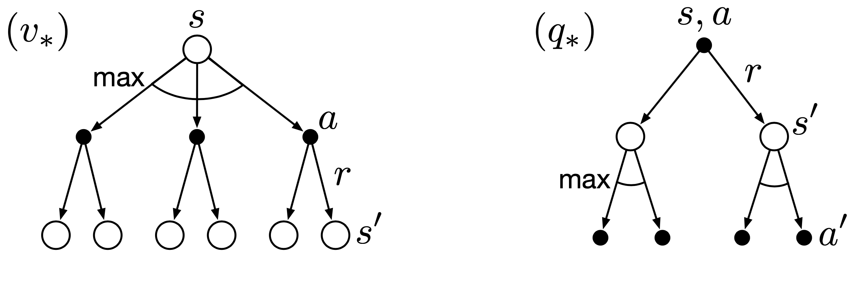
Bellman Optimality Equations
optimal solutions to Bellman equations (directly defining optimal policy):
rarely possible to find in practice (due to missing model of environment, invalid Markov property, limited computational resources)
→ approximate solutions
from Sutton

Slide 8
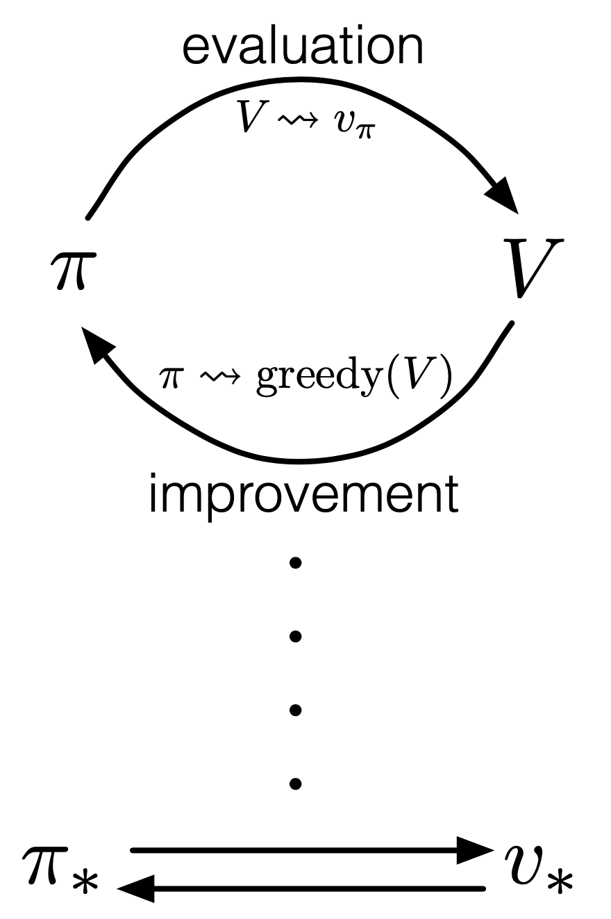
Dynamic Programming (DP)
generalized policy iteration (GPI):
iterative approaches to find approximations for optimal value functions
policy evaluation: calculate value function with current policy (Bellman equation as update rule)
policy improvement: adjusting policy to act greedy (pick actions with maximum values) with respect to value function of current policy
putting both components together:
policy iteration:
value iteration: truncated policy evaluation using Bellman optimality equation as update rule (stopped after one update of each state)
from Sutton
GPI also followed by MC and TD methods …

Slide 9
Limited Utility of DP
requires full model of environment
computationally expensive
expected update operation (based on values of all possible successor states and their probability)
for each state (in potentially huge state space)
(asynchronous DP at least avoids systematic sweeps over entire state space)
→ need for more efficient methods achieving the same effect as DP, without (perfect) model of environment

Slide 10
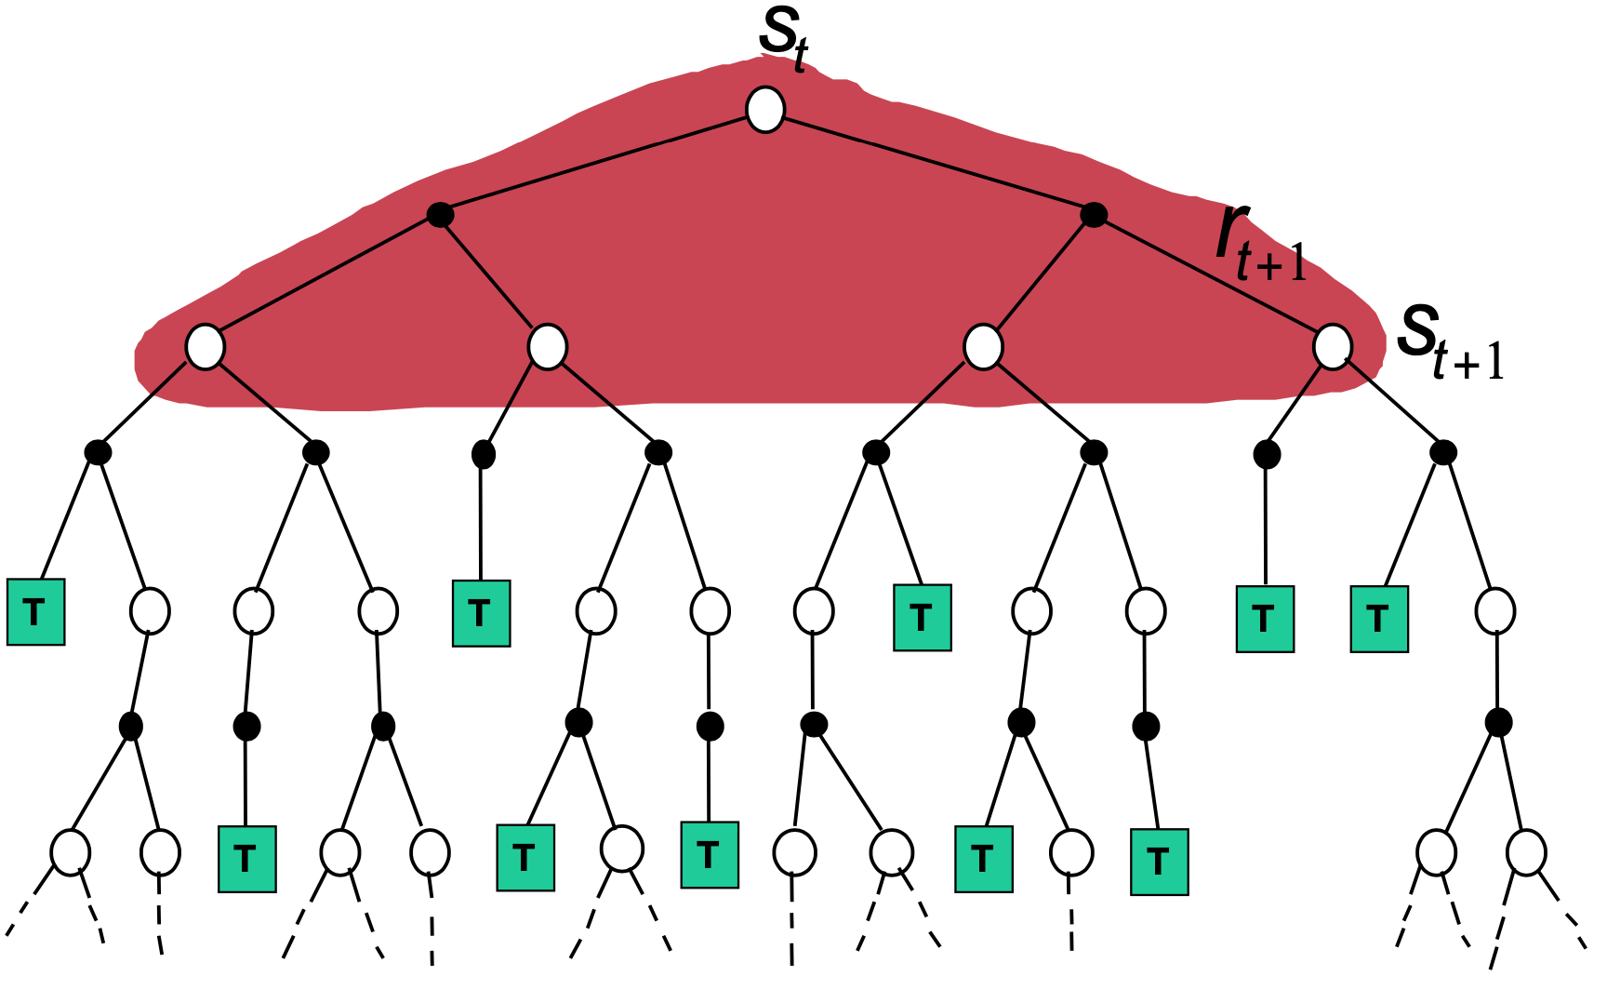
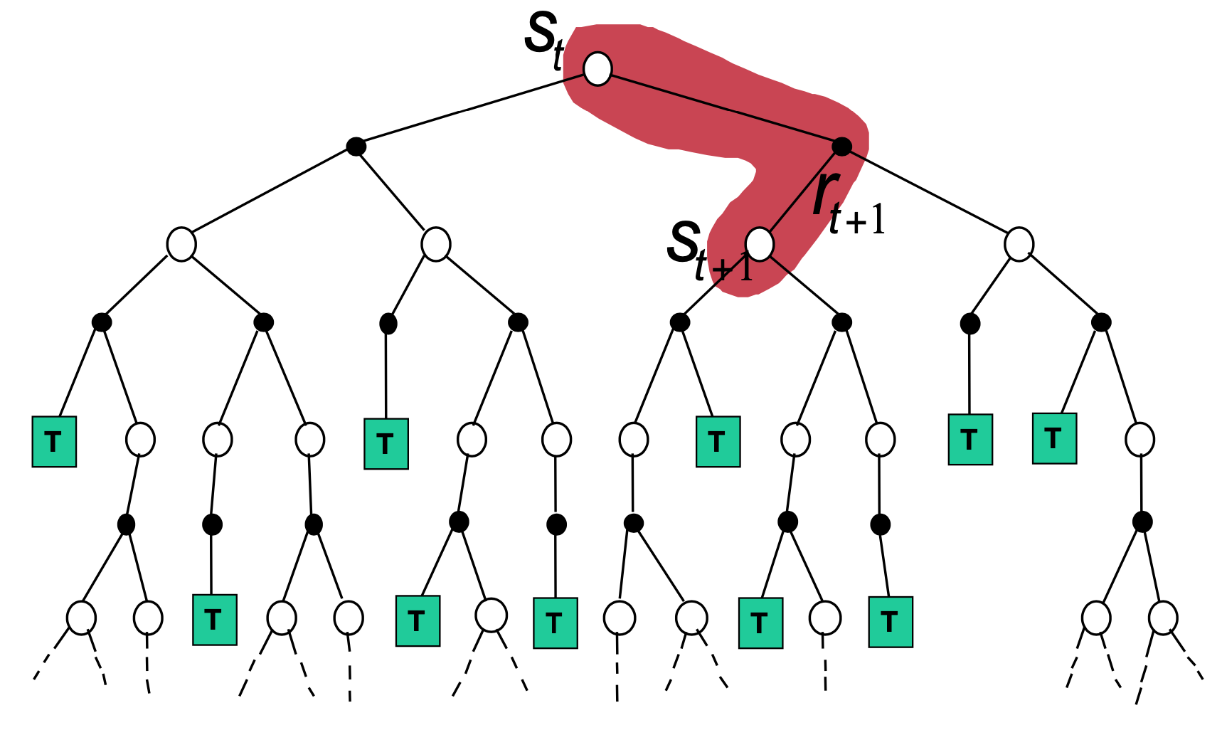
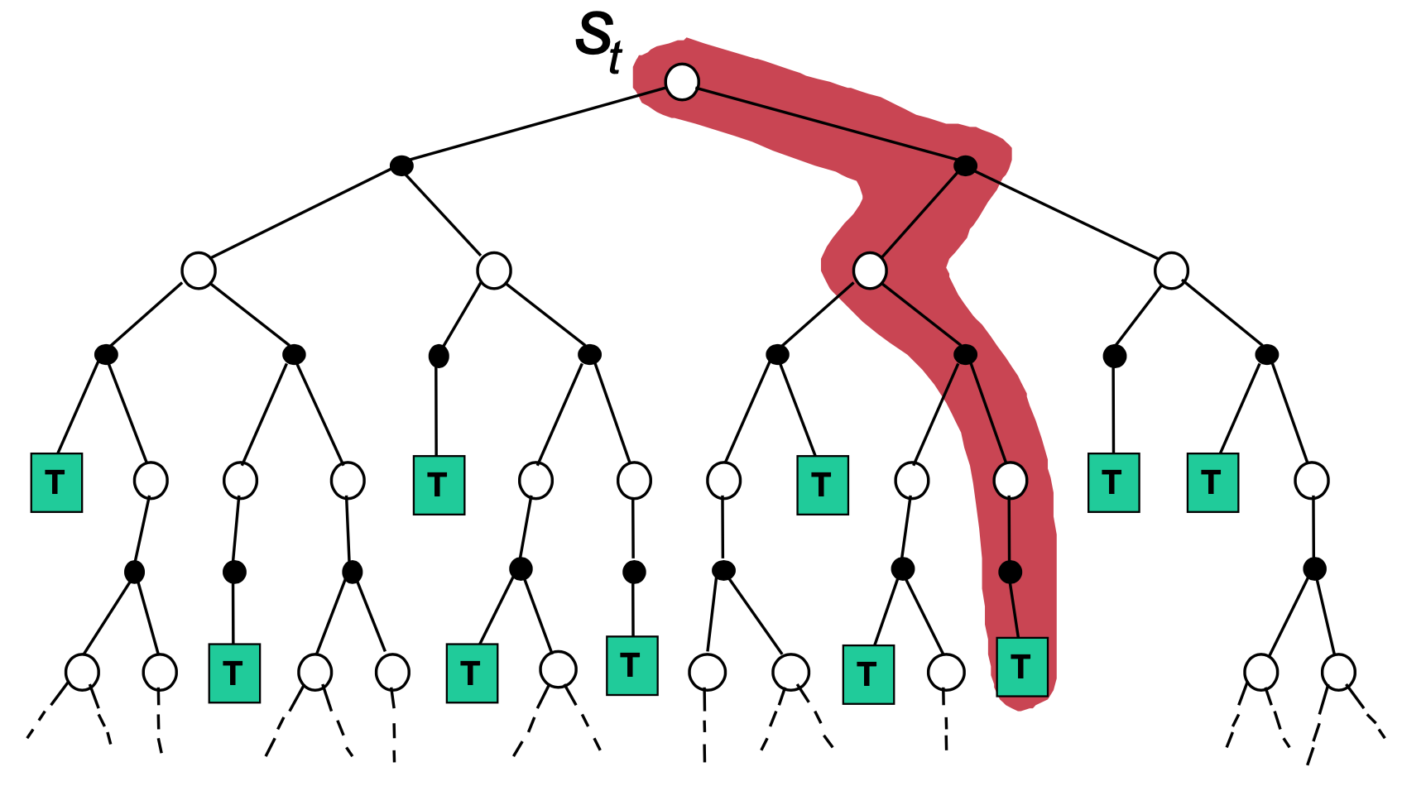
Bootstrapping and Sampling
bootstrapping: update estimates of state values based on estimates of values of successor states
sampling: experience of sample sequences (no need for complete knowledge of environment)
Dynamic Programming
Temporal Difference (TD) Learning
Monte Carlo (MC)
from Sutton
bootstrapping
no sampling → model-based (transition probabilities needed)
bootstrapping
sampling → model-free
no bootstrapping
sampling → model-free

Slide 11
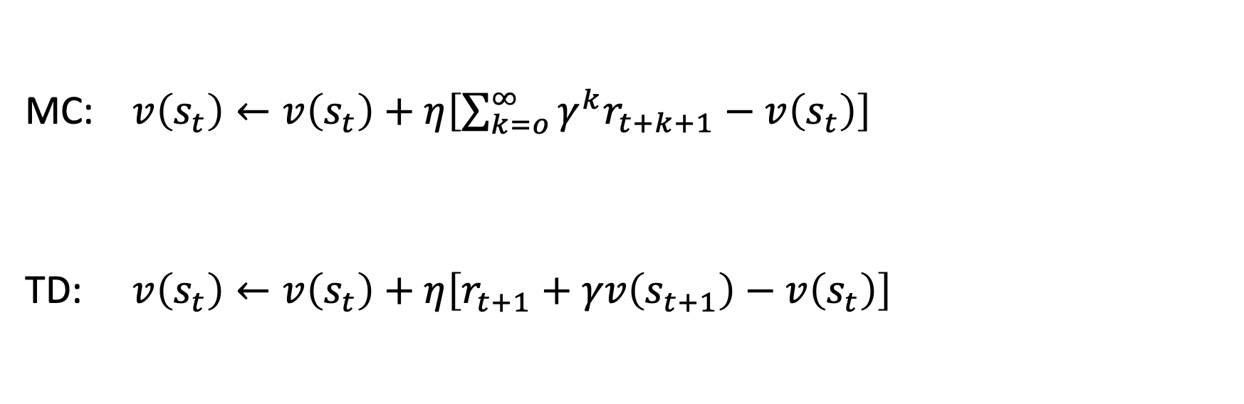
Sampling Update Rule
MC: $v\left(s_{t}\right)←v\left(s_{t}\right)+η\left[\sum_{k=o}^{∞}{γ^{k}r_{t+k+1}}−v\left(s_{t}\right)\right]$
TD: $v\left(s_{t}\right)←v\left(s_{t}\right)+η\left[r_{t+1}+γv\left(s_{t+1}\right)−v\left(s_{t}\right)\right]$
bootstrapping

Slide 12
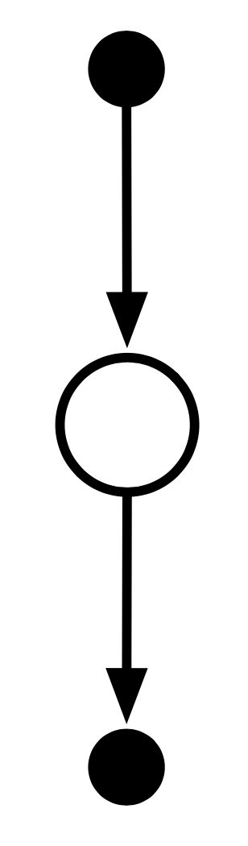
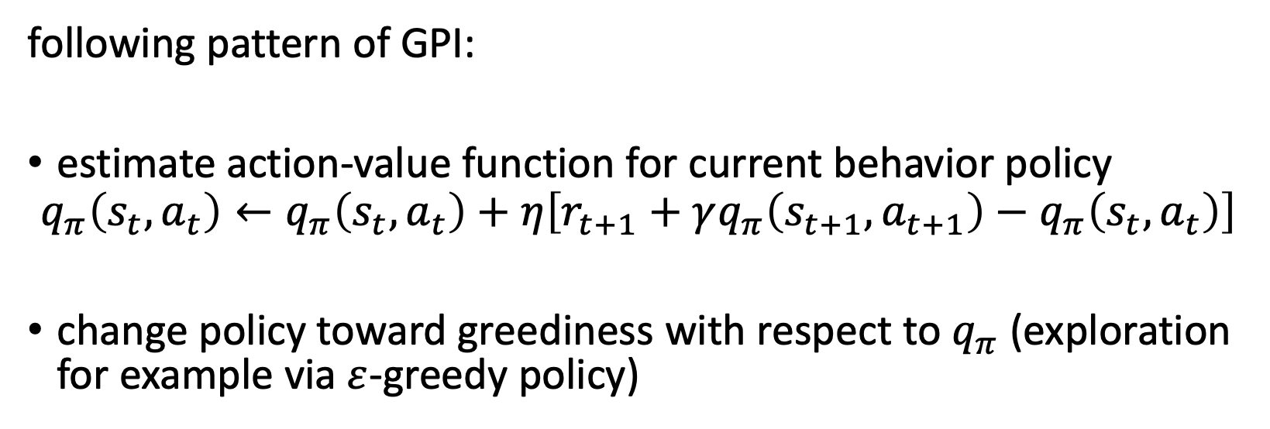
On-Policy TD Control: SARSA
S A R S A
from Sutton
following pattern of GPI:
estimate action-value function for current behavior policy
$$q_{π}\left(s_{t},a_{t}\right)←q_{π}\left(s_{t},a_{t}\right)+η\left[r_{t+1}+γq_{π}\left(s_{t+1},a_{t+1}\right)−q_{π}\left(s_{t},a_{t}\right)\right]$$
change policy toward greediness with respect to $q_{π}$ (exploration for example via $ε$-greedy policy)

Slide 13
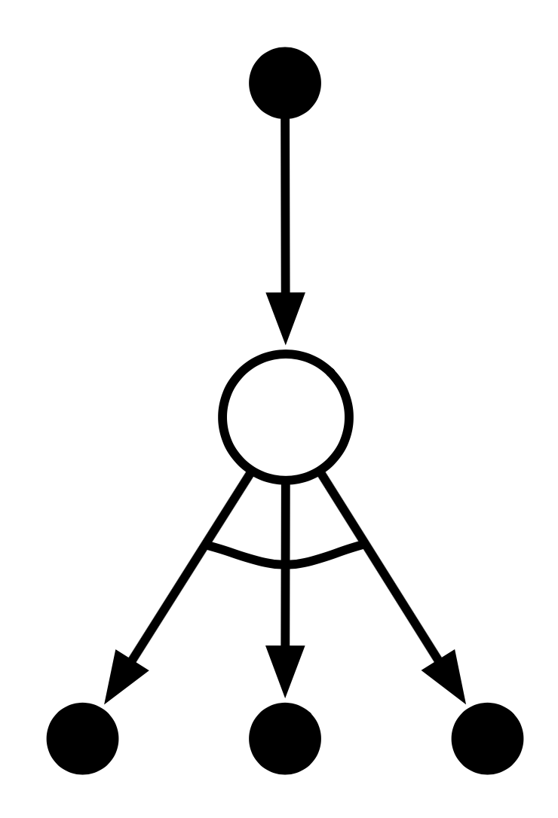
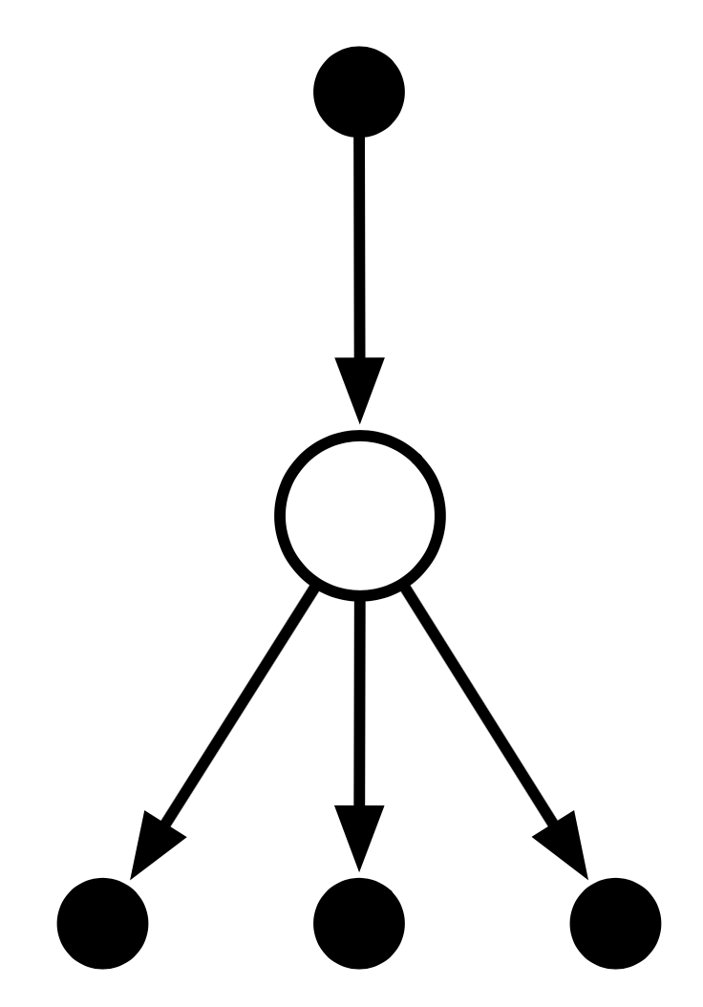
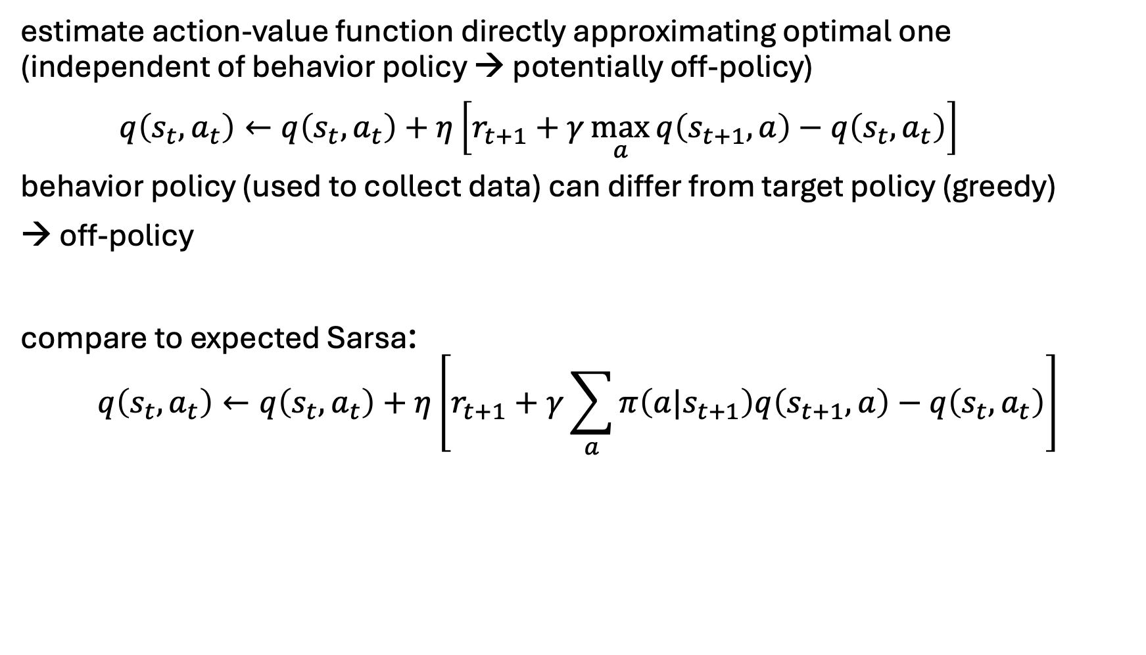
Off-Policy TD Control: Q-Learning
estimate action-value function directly approximating optimal one (independent of behavior policy → potentially off-policy)
$q\left(s_{t},a_{t}\right)←q\left(s_{t},a_{t}\right)+η\left[r_{t+1}+γ\max_{a}{q\left(s_{t+1},a\right)}−q\left(s_{t},a_{t}\right)\right]$
behavior policy (used to collect data) can differ from target policy (greedy)
→ off-policy
compare to expected Sarsa:
$$q\left(s_{t},a_{t}\right)←q\left(s_{t},a_{t}\right)+η\left[r_{t+1}+γ\sum_{a}{π\left(a|s_{t+1}\right)q\left(s_{t+1},a\right)}−q\left(s_{t},a_{t}\right)\right]$$

Slide 14
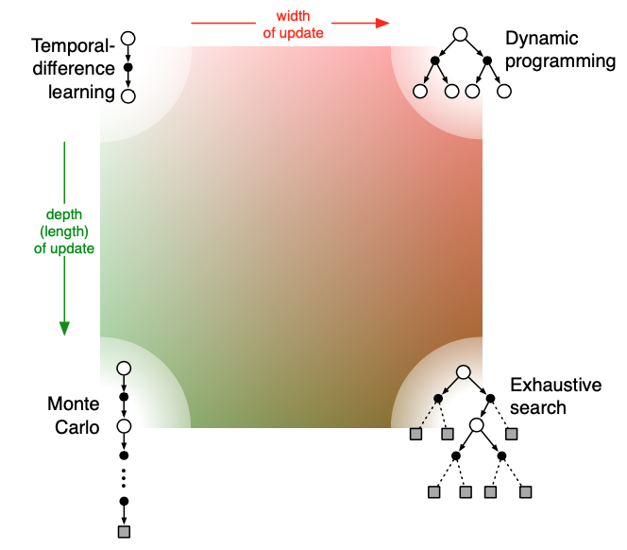
Summary: Update Characteristics
one-step TD
reduce depth of search by bootstrapping with value function predicting future outcome
n-step TD
MC
from Sutton
reduce breadth of search by sampling actions from policy

