Slide 1
Introduction
Reinforcement Learning

Slide 2
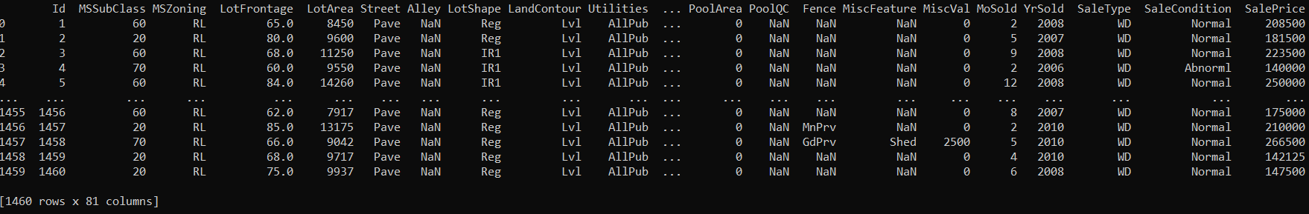
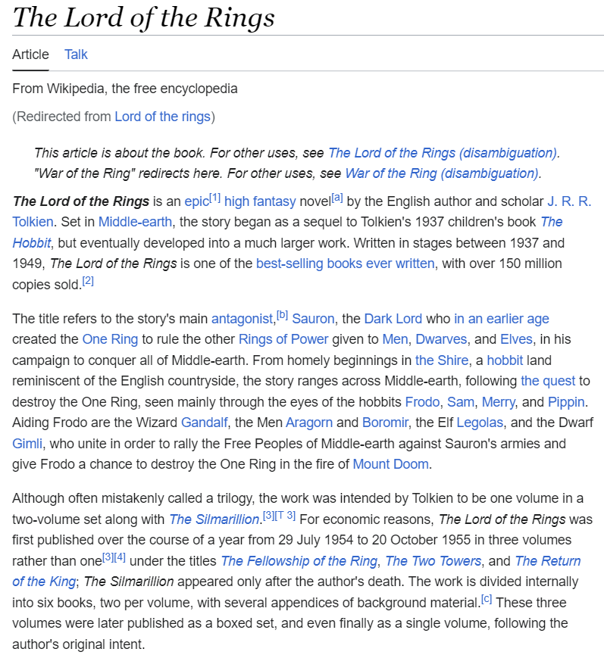
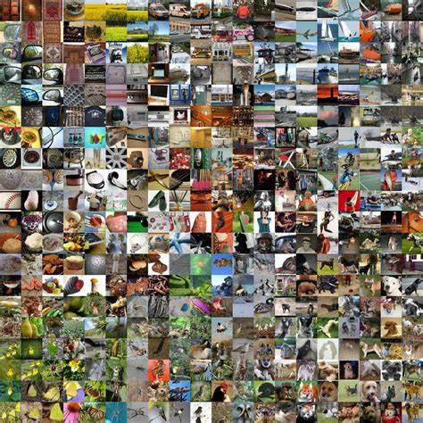
Main Areas of Artificial Intelligence (AI)
tabular data
language models
control
computer vision
all empowered by one key component: learning from data → Machine Learning (ML)

Slide 3
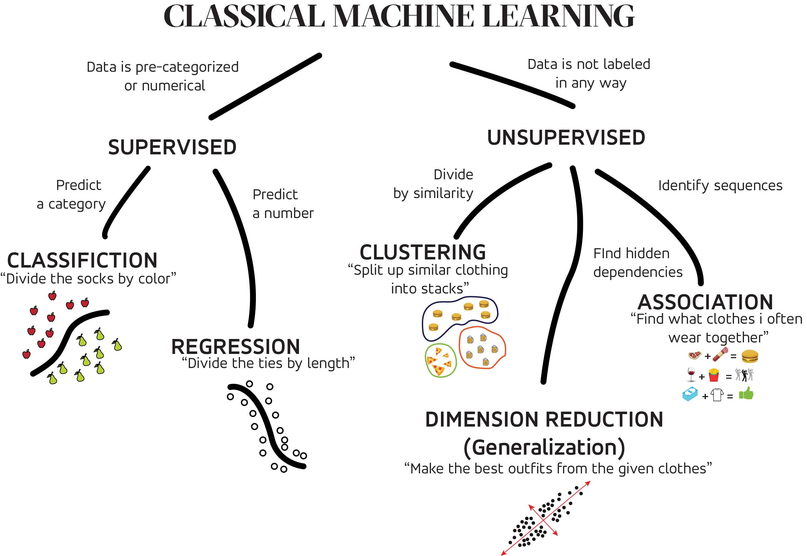
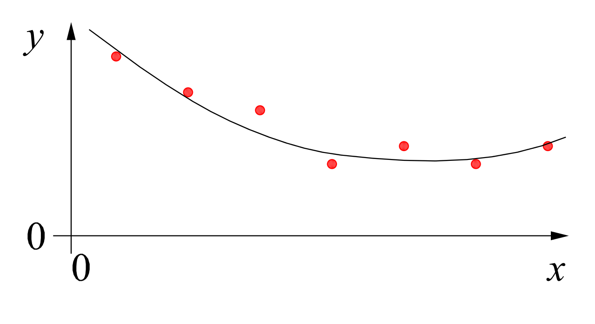
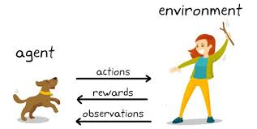
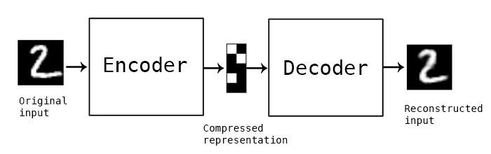
MACHINE LEARNING
no supervision, but goal-based interaction with environment
training target available (labeled or past data)
data not labeled in any way
SUPERVISED
REINFORCEMENT LEARNING
UNSUPERVISED
CLASSIFICATION
ASSOCIATION
CLUSTERING
LEARN STATE OR ACTION VALUES
LEARN POLICY DIRECTLY
REGRESSION
DIMENSIONALITY REDUCTION
SELF-SUPERVISED
learning by teacher
(high-dimensional curve fitting)
learning by observation
(pattern recognition)
learning by trial-and-error
(sequential decision making)

Slide 4
Course Schedule
Motivation: Control vs. Learning
Foundations: Tabular Methods
Function Approximation: Supervised Learning Overview
Deep Reinforcement Learning
Outlook: Advanced & Emerging Methods

Slide 5
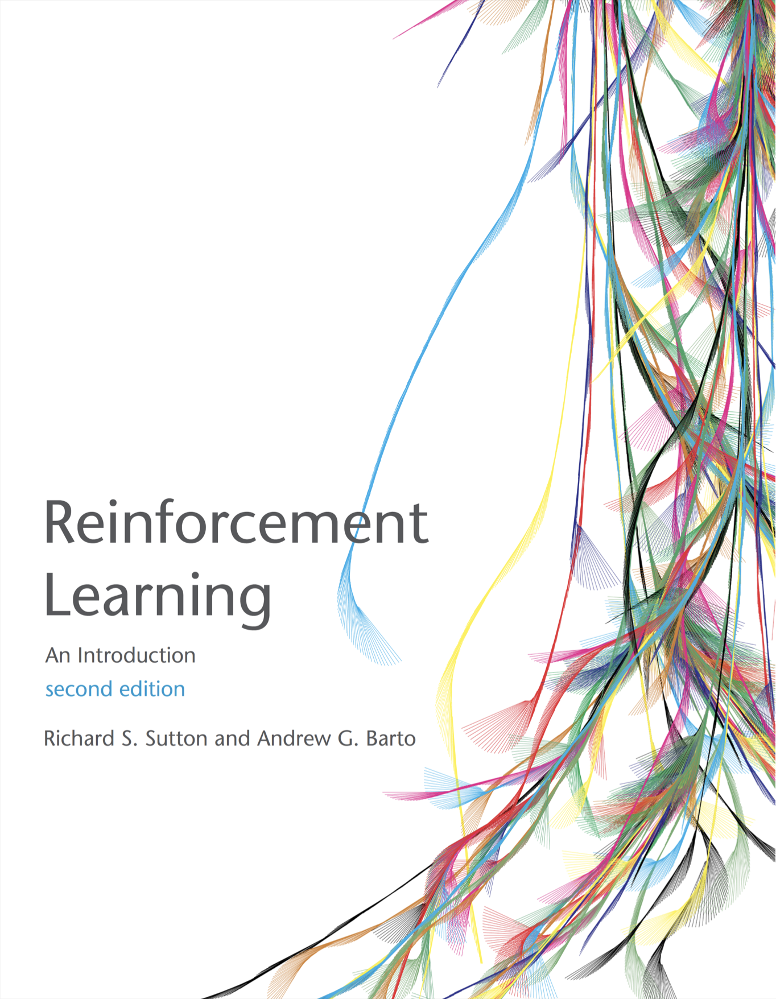
Literature
Reinforcement Learning:
An Introduction
classic textbook covering the foundations
Reinforcement Learning:
An Overview
includes Deep RL and some advanced topics
both freely available as pdf

Slide 6
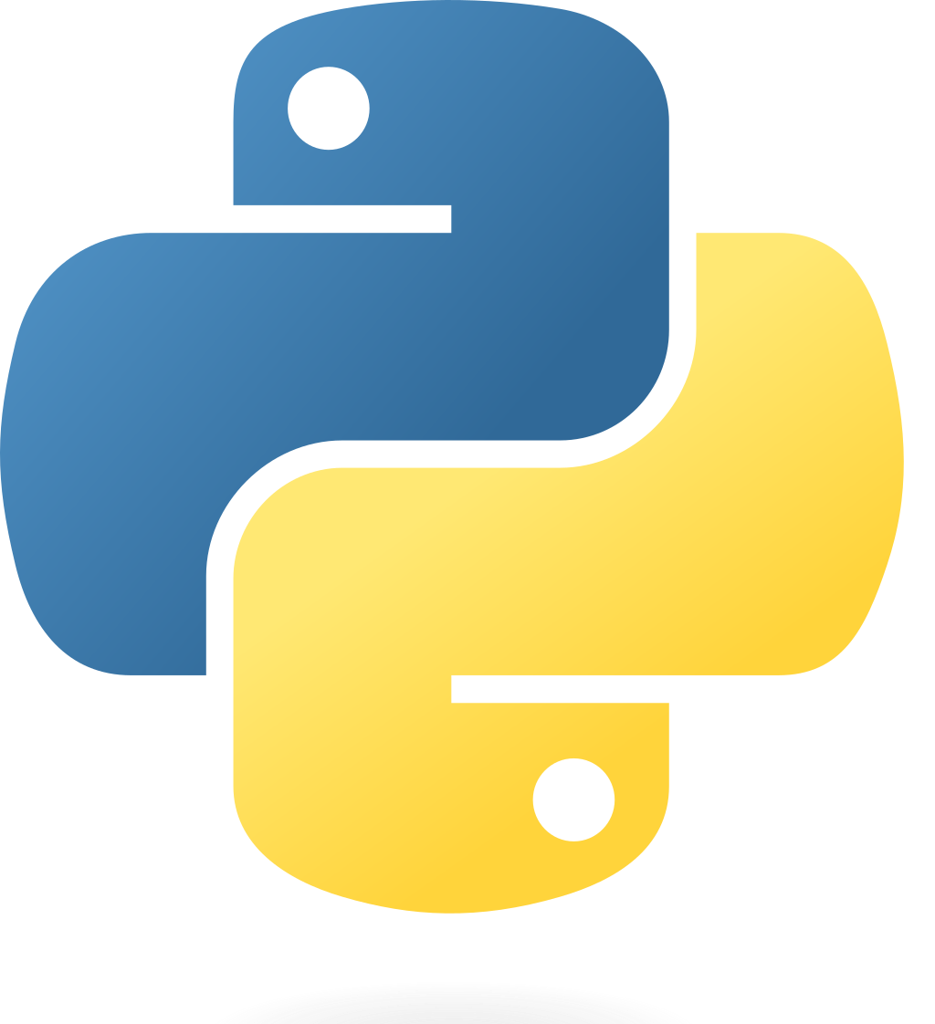

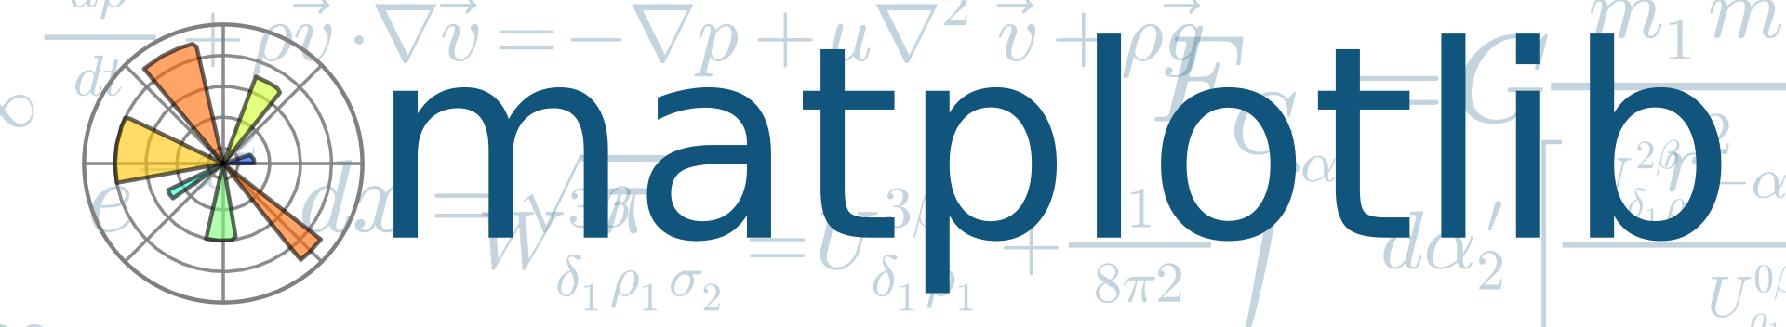



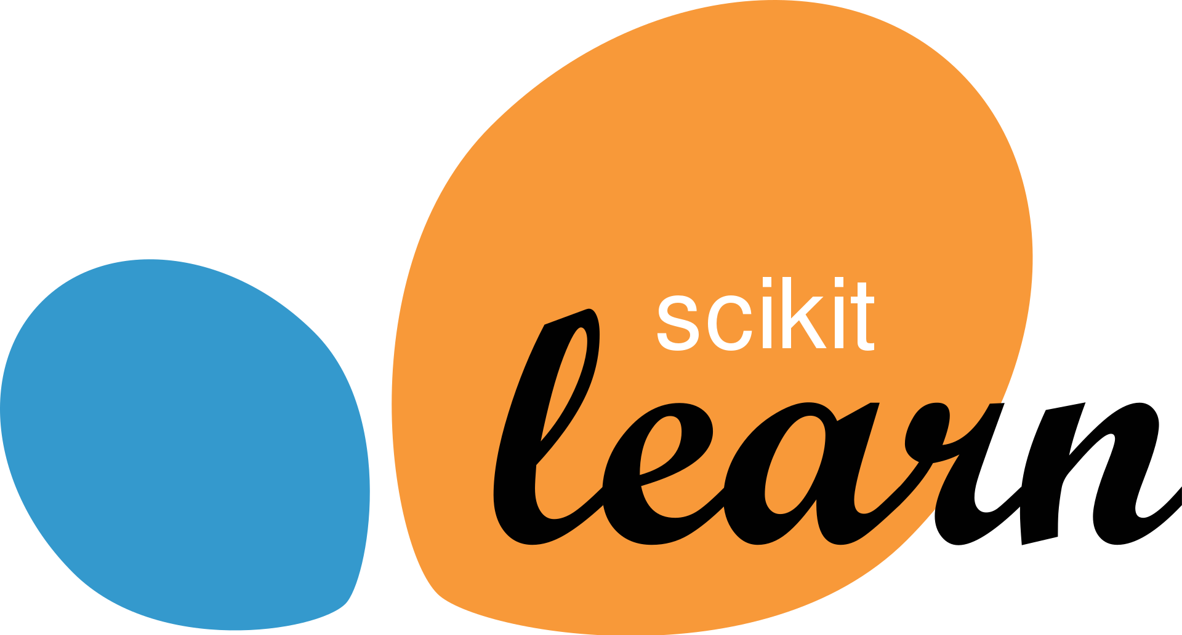
Used Programming Language: Python
good compromise between rapid prototyping and production
vast ecosystem
very popular for data processing and ML: scientific Python stack

Slide 7
Programming Environments
locally, best use
a virtual environment to flexibly install packages (e.g., venv)
an IDE of your choice (e.g., VS Code)
both plain Python files or Jupyter notebooks are fine
but cloud-based environments also fine (e.g., Google Colab)

