Slide 1
Motivation
Reinforcement Learning

Slide 2
Motivation
Control theory refresher
Model Predictive Control
Model-free vs. model-based control

Slide 3
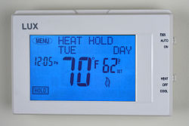
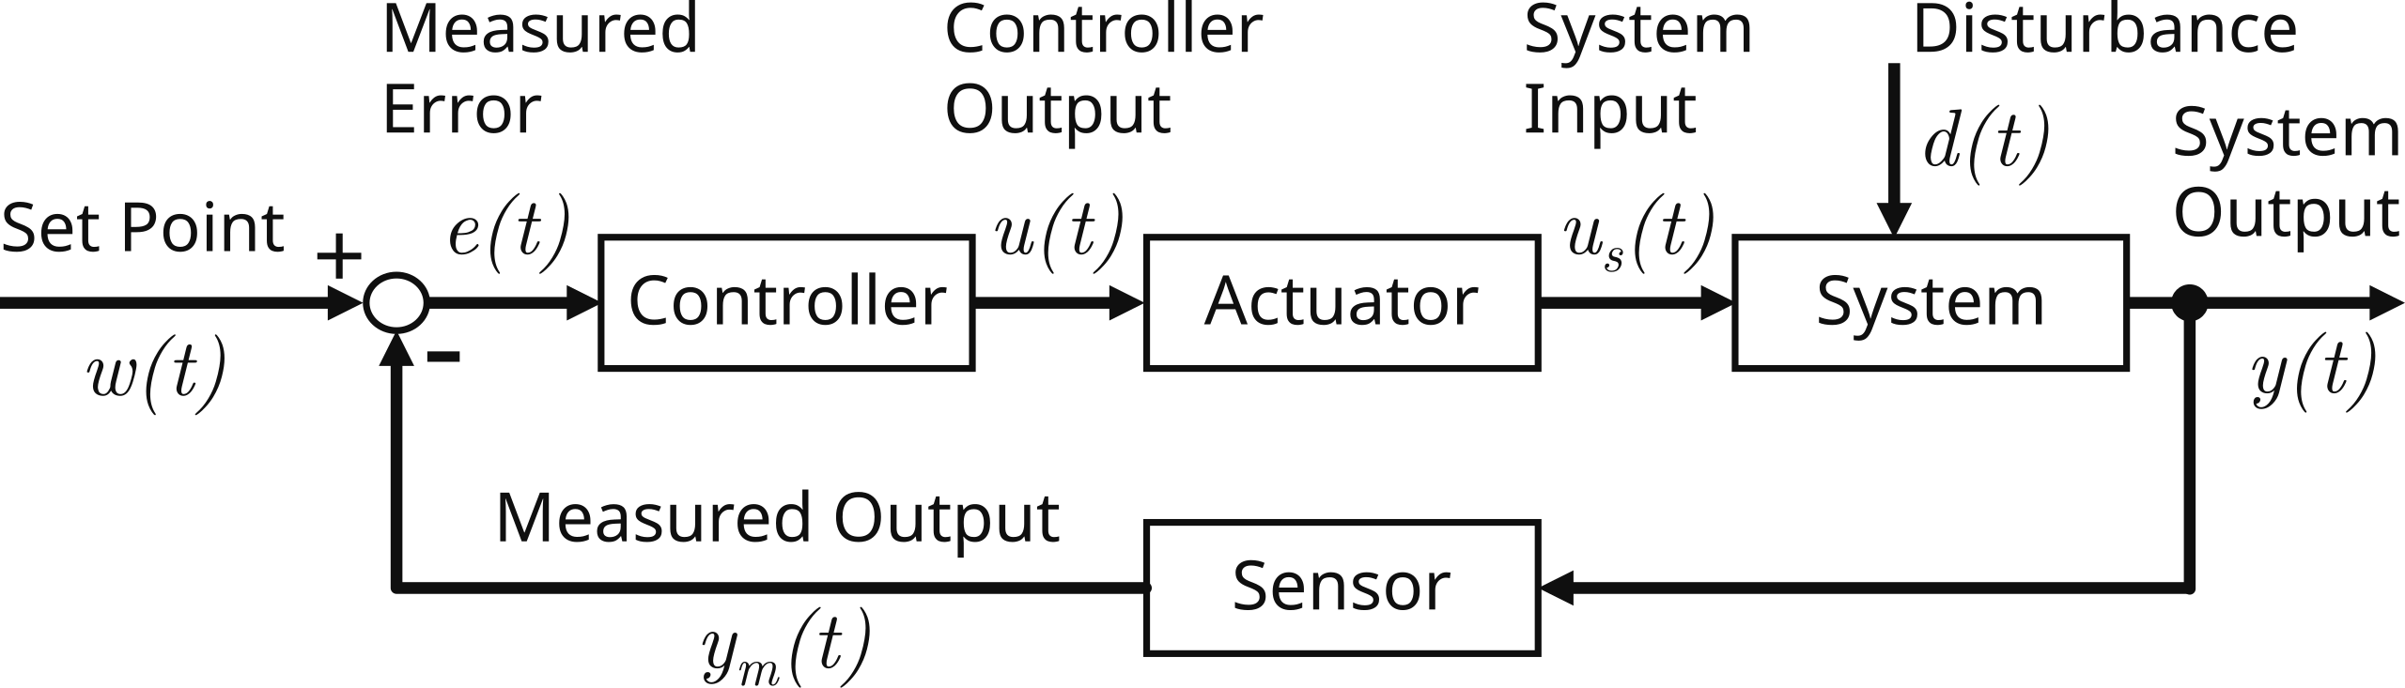
Closed-Loop Control
controller compares reference and output
error signal drives control action
maintains temperature near setpoint
Process
Process
Process

Slide 4
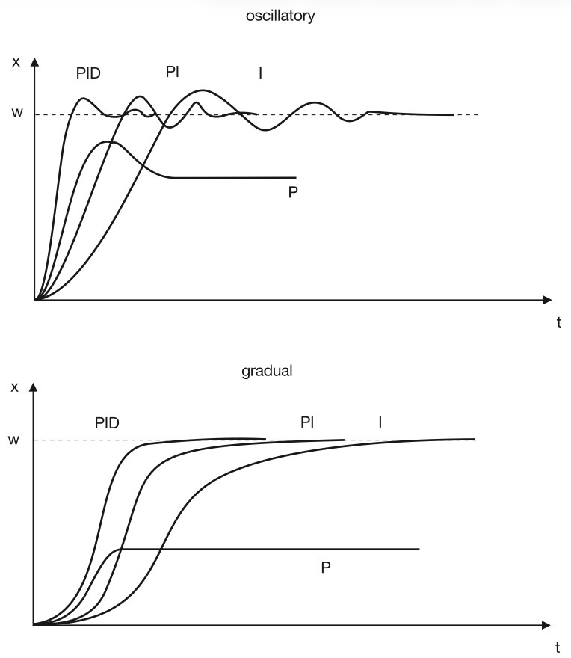
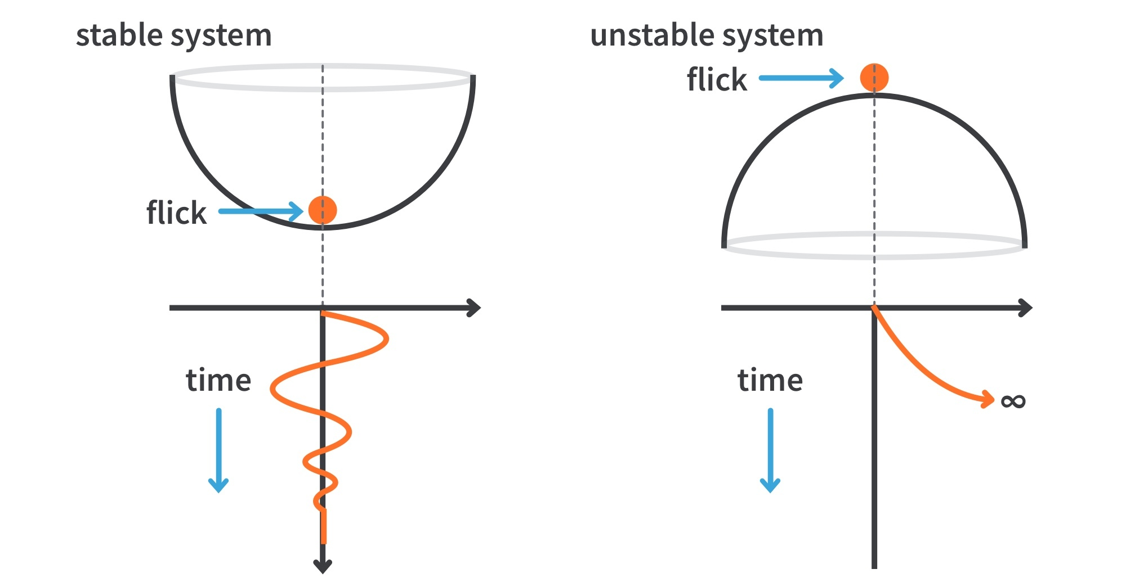
Control Objectives
stability (bounded output)
fast response: rise and settling time
low overshoot
small steady-state error
robustness (insensitivity to model uncertainty and disturbances)

Slide 5
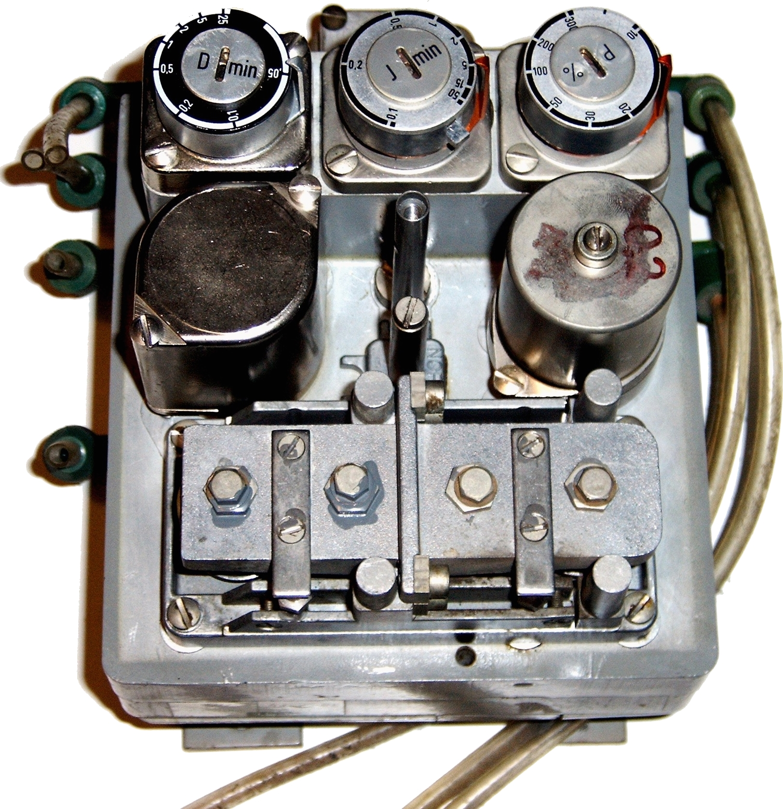
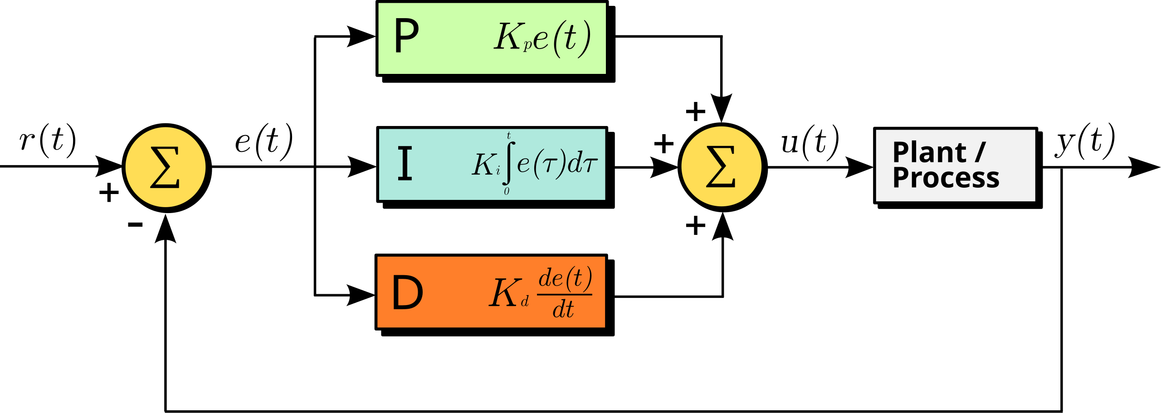
PID Controllers
example: pneumatic PID
most widely used industrial controller
purely reactive

Slide 6
Limits of Classic Control
mostly reactive, tuned for simple linear systems
poor handling of constraints and delays
struggles with high-dimensional, nonlinear, or unstructured environments
many modern applications (robotics, autonomous driving, games) involve:
large state/action spaces
partial observability
complex interactions
→ hard or impossible to design classic controllers manually

Slide 7
Model Predictive Control (MPC)
optimal control method
apply a model of the system to predict future developments (e.g., differential equation, but potentially also using ML)
adjust the manipulated variable to minimize the deviation of the controlled variable over several steps → optimization
execute only the first step, then repeat the process
requires model of the system

Slide 8
Model-Free vs Model-Based Control
model-based control (MPC): uses a system model to plan or optimize actions
model-free reinforcement learning (RL): learns control directly from interaction → no explicit system model needed
trade-off:
model-based: sample efficient, predictive, naturally handles constraints
model-free: flexible, works with unknown dynamics, maximizes long-term reward

Slide 9
When to Use What
rule of thumb:
PID: simple loops
MPC: constrained multivariable control
RL: complex systems without good models
many modern systems combine them:
PID for low-level control
MPC for high-level trajectory optimization
RL for strategy or policy learning
example: autonomous driving
PID: steering torque
MPC: trajectory tracking
RL: driving behavior

