Slide 1
Tabular Methods
Reinforcement Learning

Slide 2
Tabular Methods
Mathematical setup: Markov decision processes, rewards, policies, state-value & action-value functions, Bellman equations
Planning: policy evaluation & improvement, value iteration, policy iteration, dynamic programming
Model-free learning: Monte Carlo methods, temporal-difference learning, SARSA, Q-learning

Slide 3
Sequential Decision Making
reinforcement learning (RL):
formalization of sequential decision making (action policy) of software agent interacting with environment
corresponds to search for best (or rather good) action policy to reach a given goal (e.g., win a game)
using learning from examples (data) to guide the search
RL usually more difficult (e.g., non-differentiable as a whole) than supervised learning (which can be seen as “generalized optimization”, often of proxy metric)

Slide 4
Main Elements of RL
goal: find action policy maximizing reward from environment
action policy
exploration-exploitation trade-off
e.g., epsilon-greedy: random exploration at small fraction of the time
feedback from environment
goal-directed, no supervision
scalar reward signal, cumulative and delayed (credit assignment problem)

Slide 5
Optional Elements of RL
value functions for states or actions: improve efficiency of search in vast action policy space (alternative: direct policy search)
model of environment: (model-free) learning from trial-and-error or (model-based) planning
can be used in different ways:
simulate experience from model (for learning)
decision-time planning (e.g., heuristic search or model predictive control)

Slide 6
Mathematical Setup

Slide 7
Markov Decision Process (MDP)
idea: current state includes all information about past
transition probabilities between states describe dynamics of given MDP
action policy: mapping from states to probabilities for selection of different actions

Slide 8
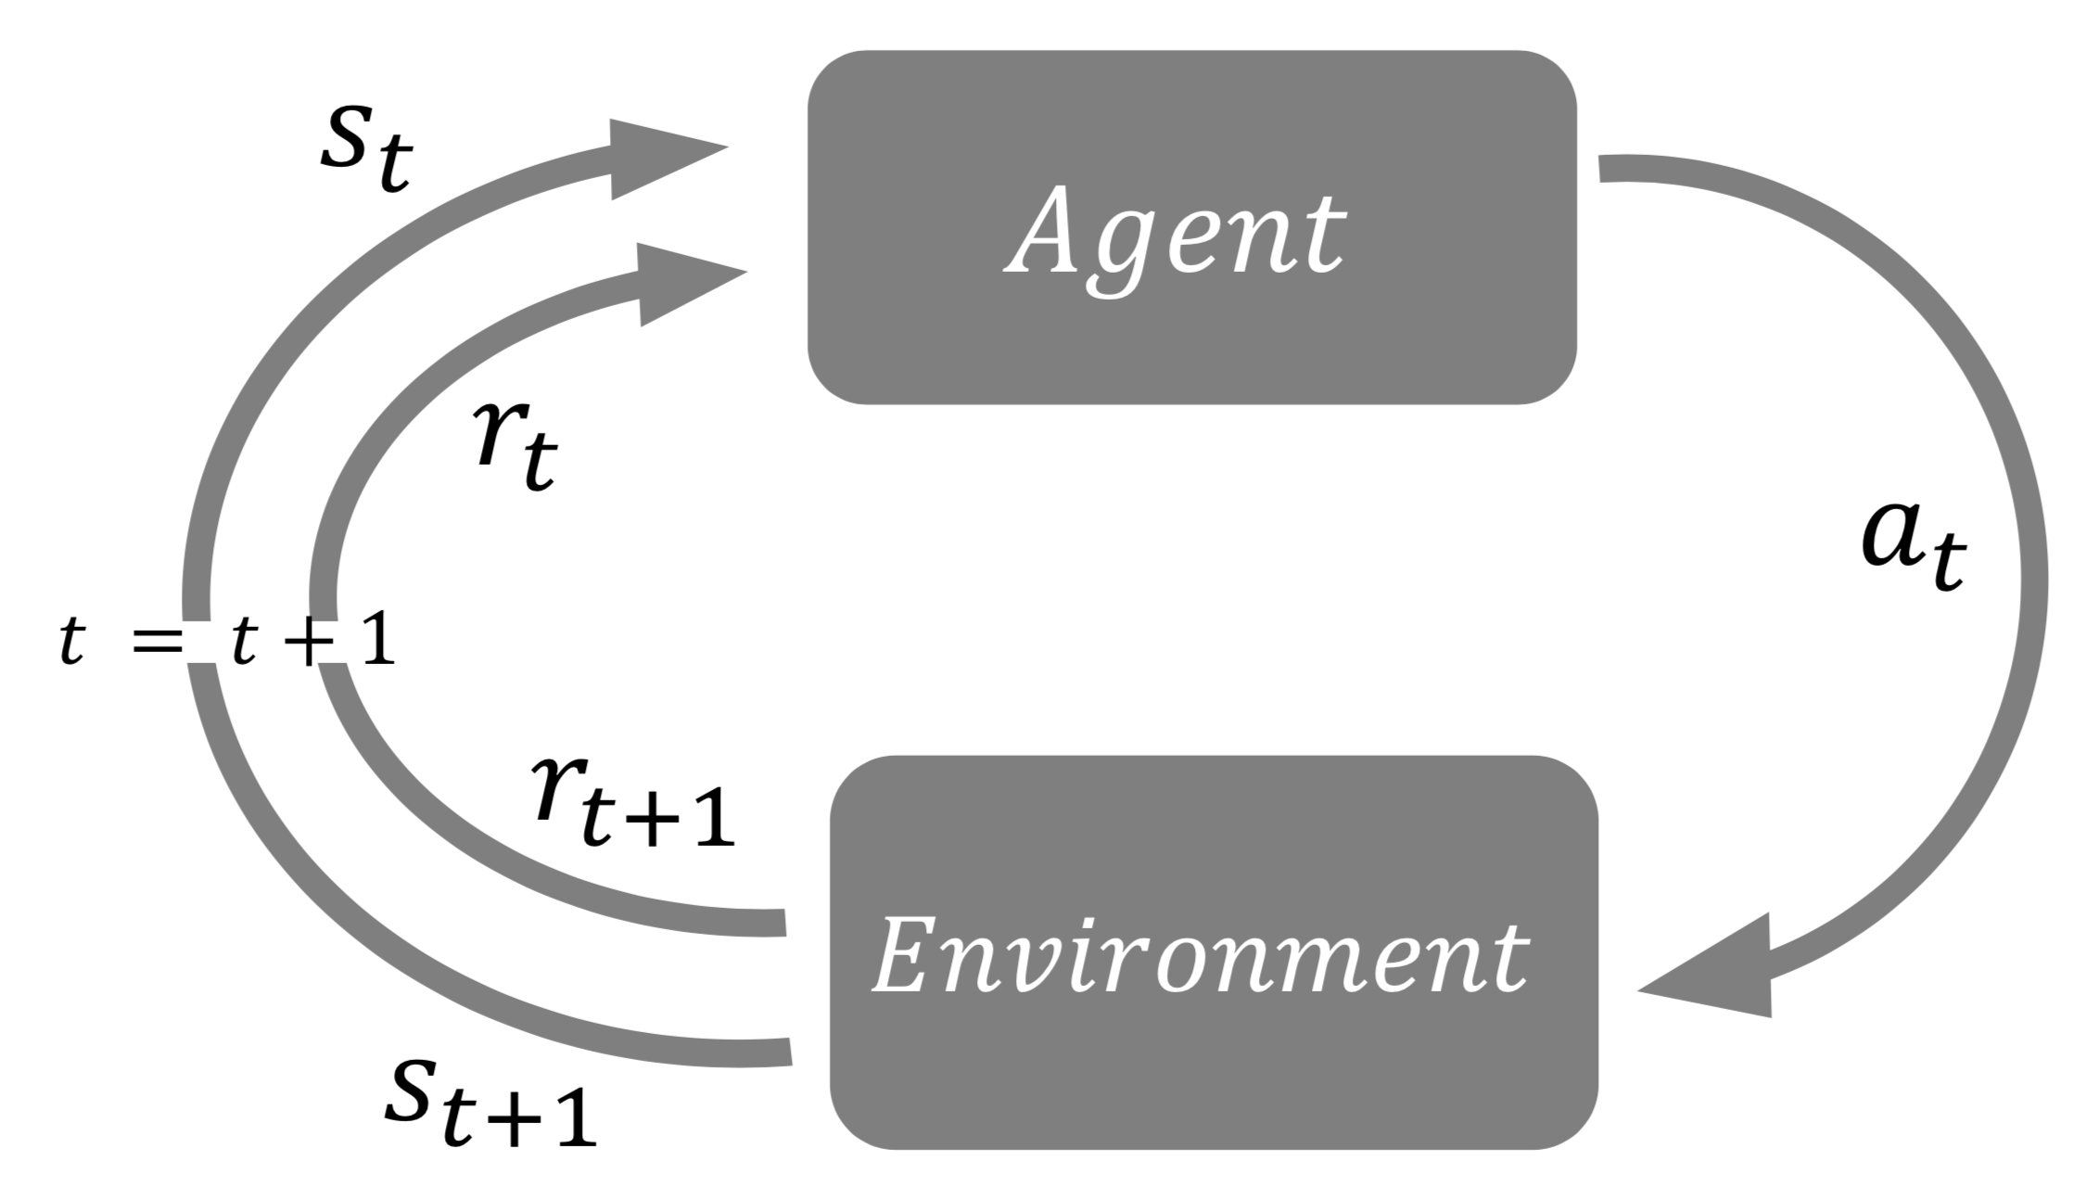
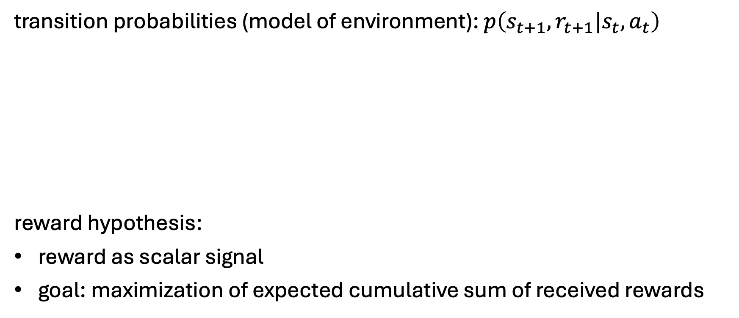
States, Actions, and Rewards
transition probabilities (model of environment): $p\left(s_{t+1},r_{t+1}|s_{t},a_{t}\right)$
reward hypothesis:
reward as scalar signal
goal: maximization of expected cumulative sum of received rewards

Slide 9
State and Action Values
state/action value: total amount of expected future reward starting from given state/action (usually with discounting of later steps)
→ indicating long-term desirability of states/actions
main motivation: improve efficiency of search in policy space
(for comparison: evolutionary methods search directly by evaluating entire policies)

Slide 10
State-Value Function
return
discount rate
(needed for all states)
$$v_{π}\left(s_{t}\right)=E_{π}\left[\sum_{k=o}^{∞}{γ^{k}r_{t+k+1}}|s_{t}\right]=E_{π}\left[r_{t+1}+γv_{π}\left(s_{t+1}\right)|s_{t}\right]$$
$$=\sum_{a_{t}}{π\left(a_{t}|s_{t}\right)\sum_{s_{t+1}^{′},r_{t+1}}{p\left(s_{t+1}^{′},r_{t+1}|s_{t},a_{t}\right)\left[r_{t+1}+γv_{π}\left(s_{t+1}^{′}\right)\right]}}$$
on-policy
policy: probabilitiy to take specific action being in a given state
transition probability (depending on environment) from state $s_{t}$ to state $s_{t+1}^{′}$for a given action
Bellman (expectation) equation: recursion
(sweep through entire state space)

Slide 11
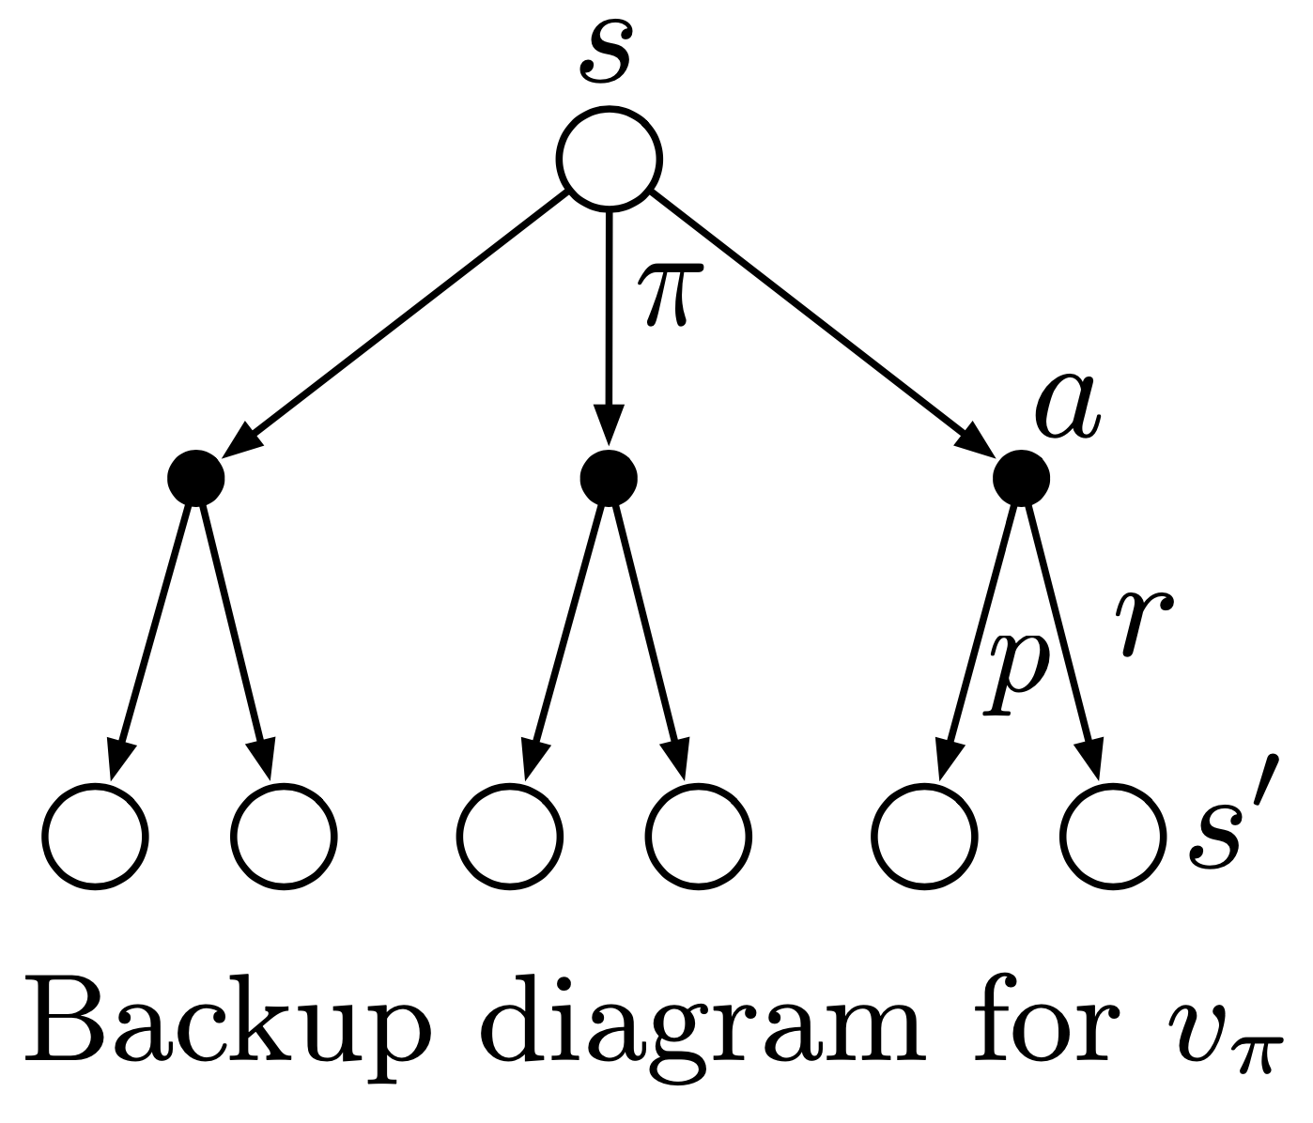
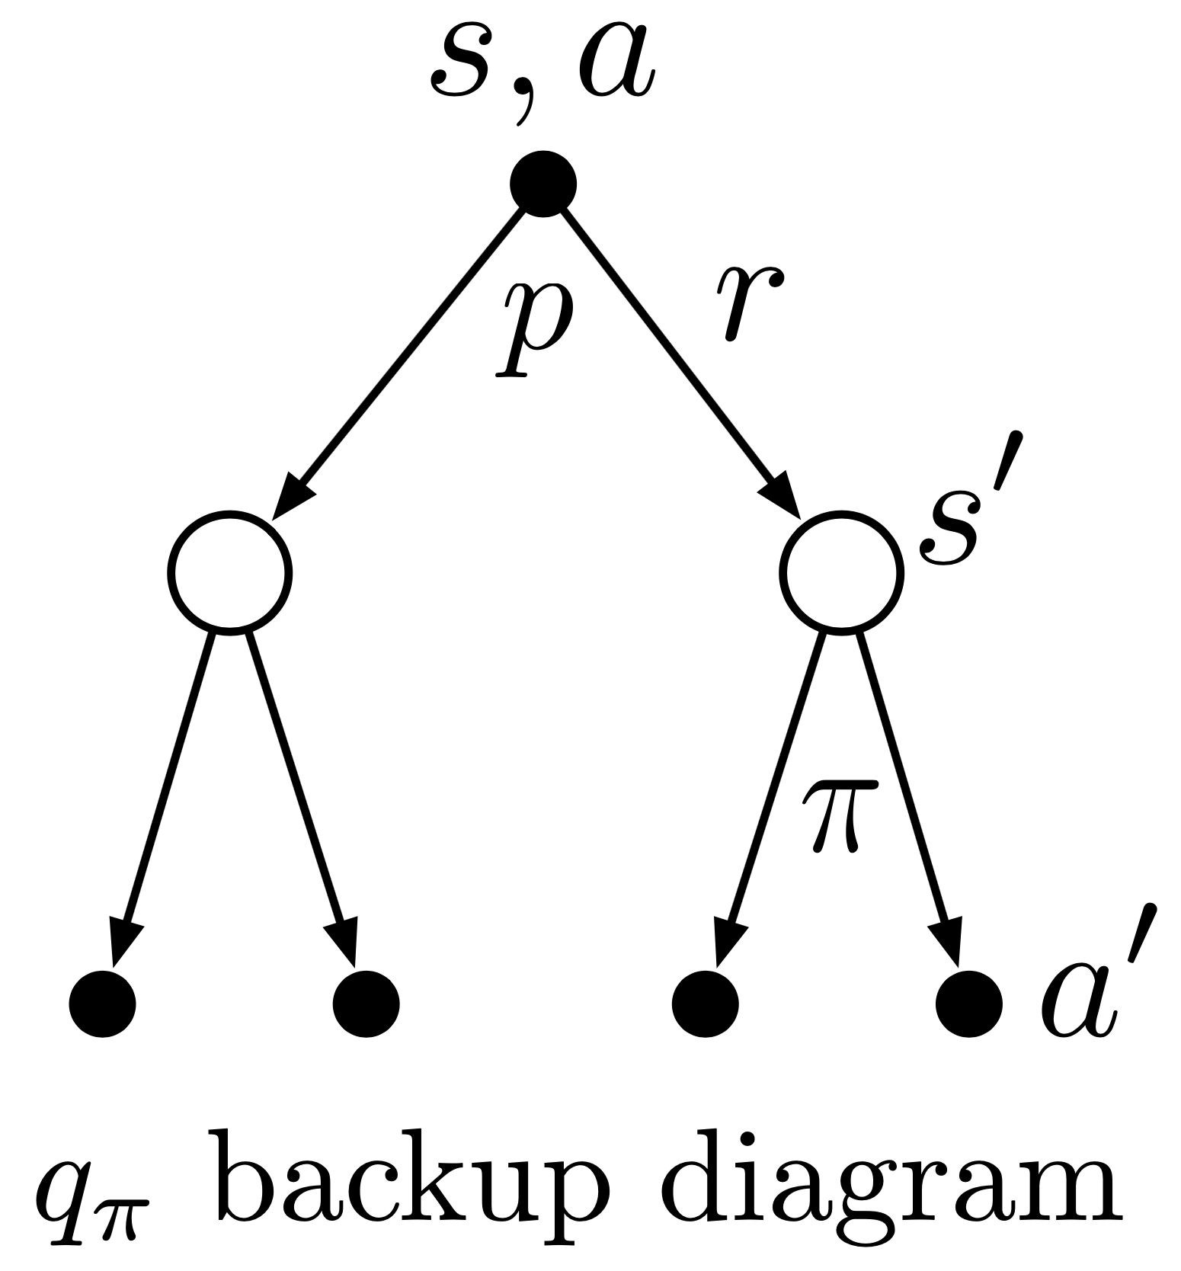
Action-Value Function
$$q_{π}\left(s_{t},a_{t}\right)=E_{π}\left[\sum_{k=o}^{∞}{γ^{k}r_{t+k+1}}|s_{t},a_{t}\right]=E_{π}\left[r_{t+1}+γq_{π}\left(s_{t+1},a_{t+1}\right)|s_{t},a_{t}\right]$$
$$=\sum_{s_{t+1}^{′},r_{t+1}}{p\left(s_{t+1}^{′},r_{t+1}|s_{t},a_{t}\right)\left[r_{t+1}+γ\sum_{a_{t+1}^{′}}{π\left(a_{t+1}^{′}|s_{t+1}^{′}\right) q_{π}\left(s_{t+1}^{′},a_{t+1}^{′}\right)}\right]}$$

Slide 12
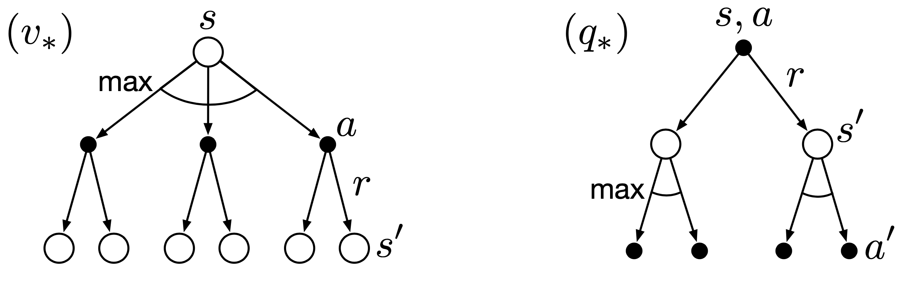
Bellman Optimality Equations
optimal solutions to Bellman equations (directly defining optimal policy):
rarely possible to find in practice (due to missing model of environment, invalid Markov property, limited computational resources)
→ approximate solutions

Slide 13
Planning

Slide 14
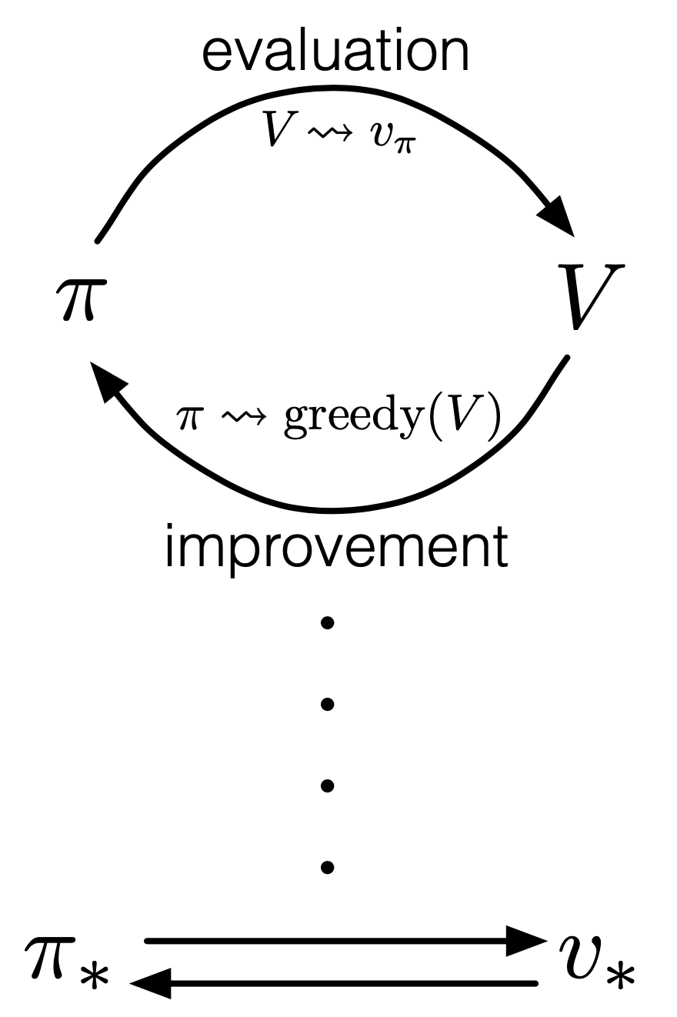
Dynamic Programming (DP)
generalized policy iteration (GPI):
iterative approaches to find approximations for optimal value functions
policy evaluation: calculate value function with current policy (Bellman equation as update rule)
policy improvement: adjusting policy to act greedy (pick actions with maximum values) with respect to value function of current policy
putting both components together:
policy iteration:
value iteration: truncated policy evaluation using Bellman optimality equation as update rule (stopped after one update of each state)
GPI also followed by MC and TD methods …

Slide 15
Limited Utility of DP
requires full model of environment
computationally expensive
expected update operation (based on values of all possible successor states and their probability)
for each state (in potentially huge state space)
(asynchronous DP at least avoids systematic sweeps over entire state space)
→ need for more efficient methods achieving the same effect as DP, without (perfect) model of environment

Slide 16
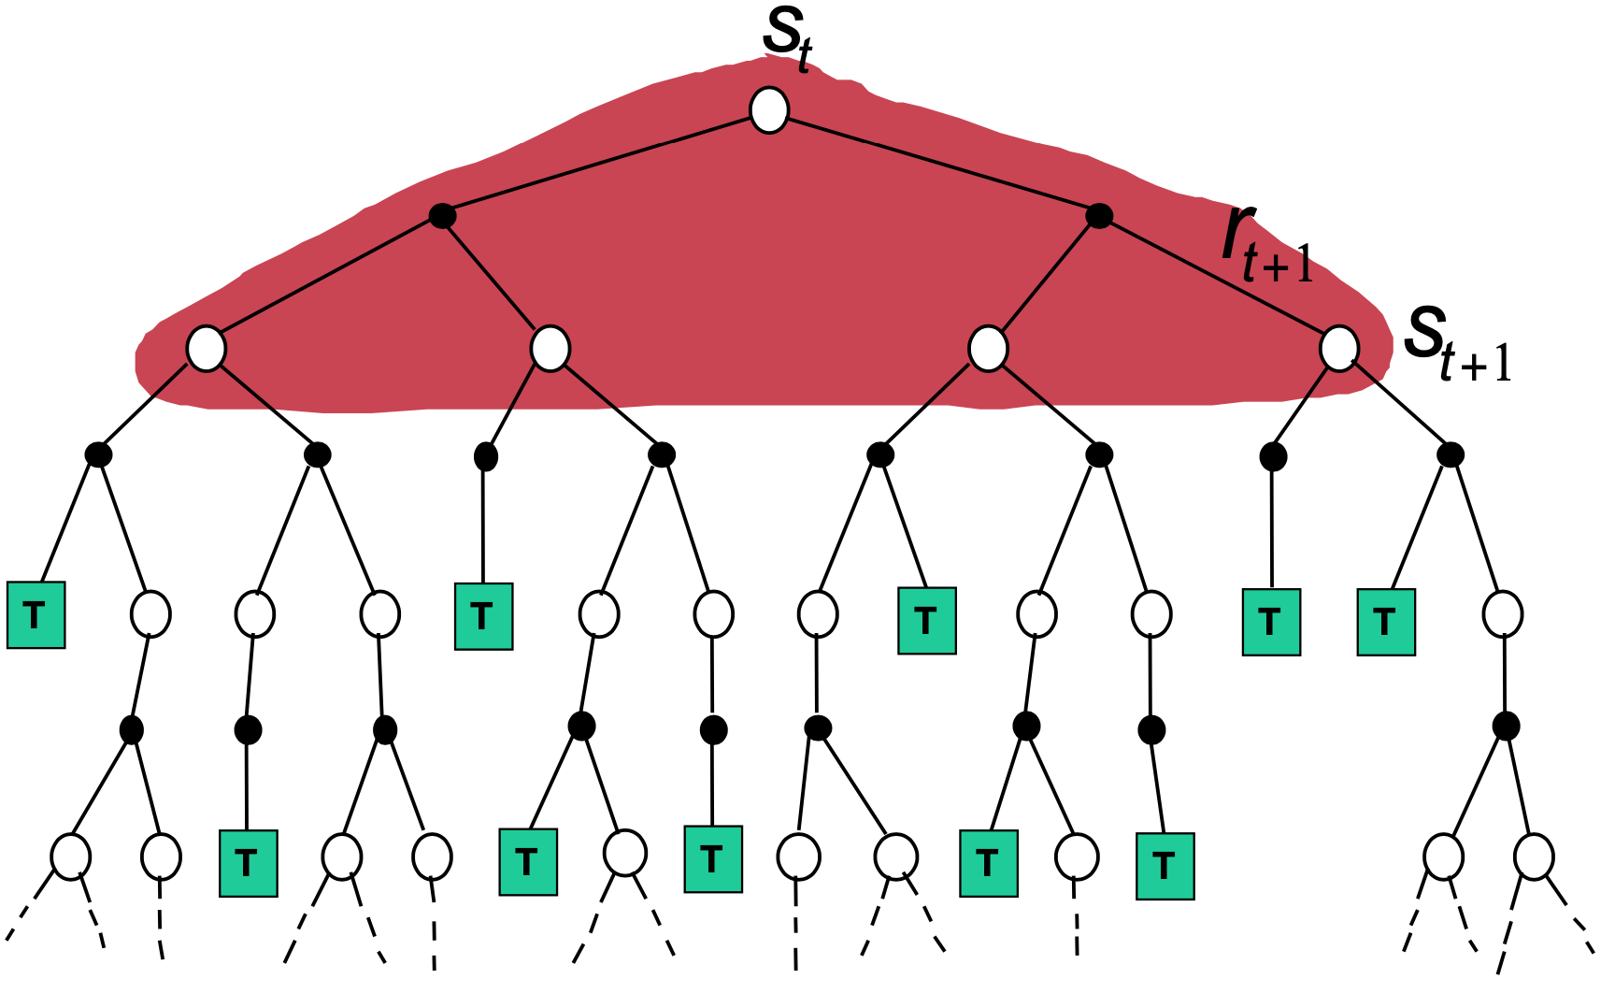
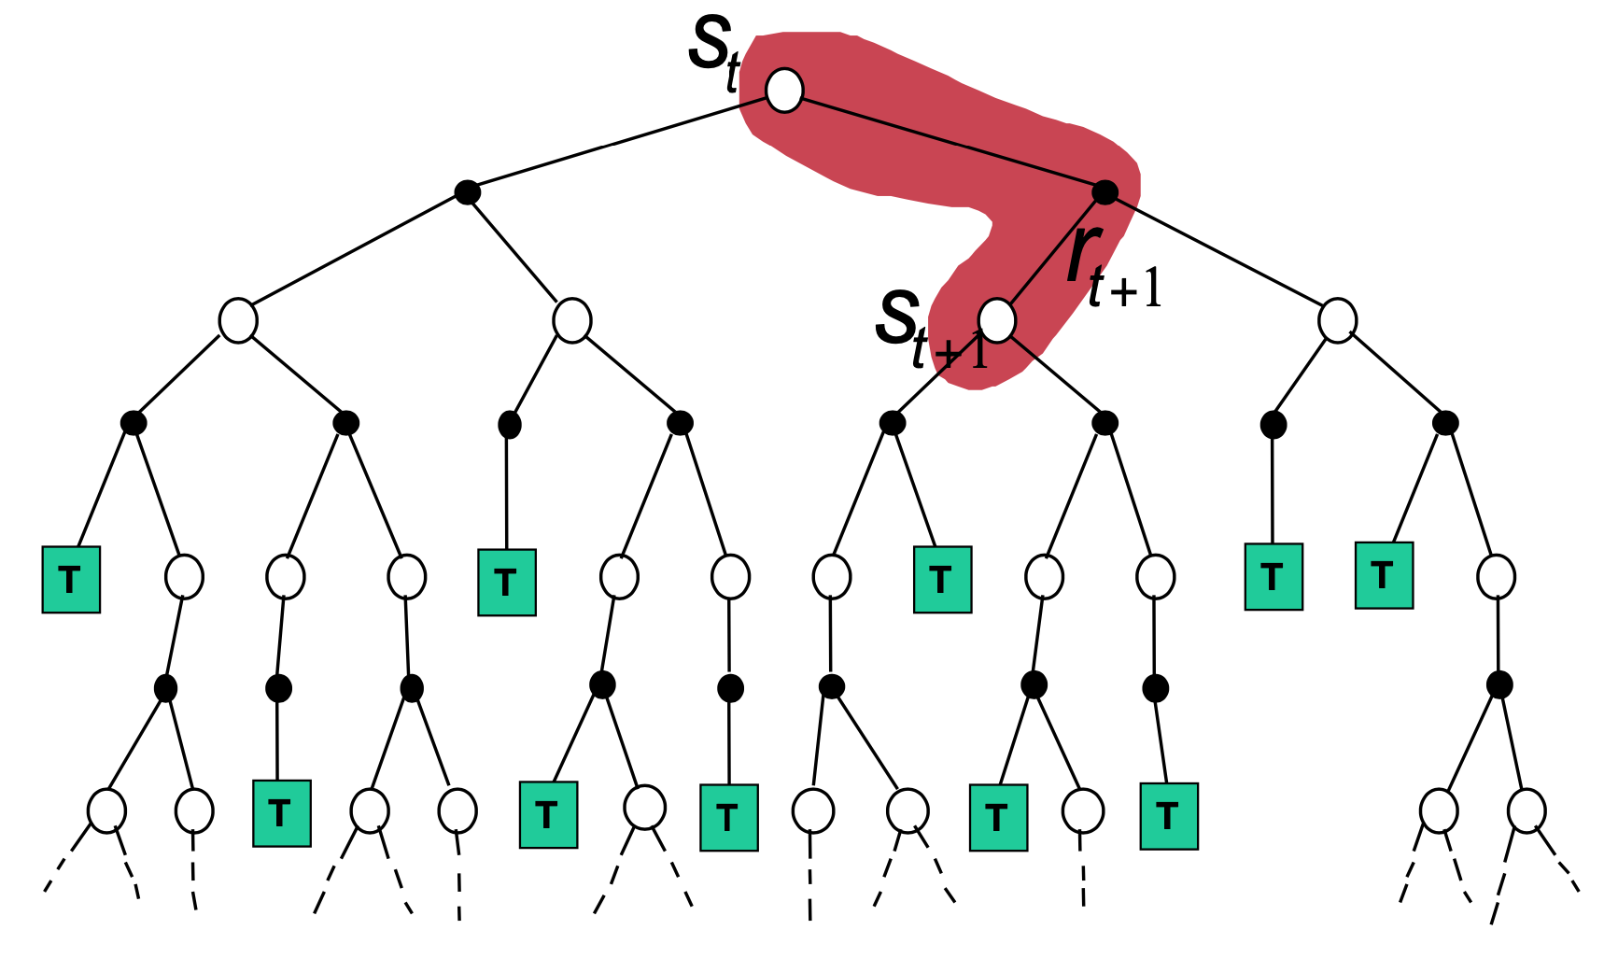
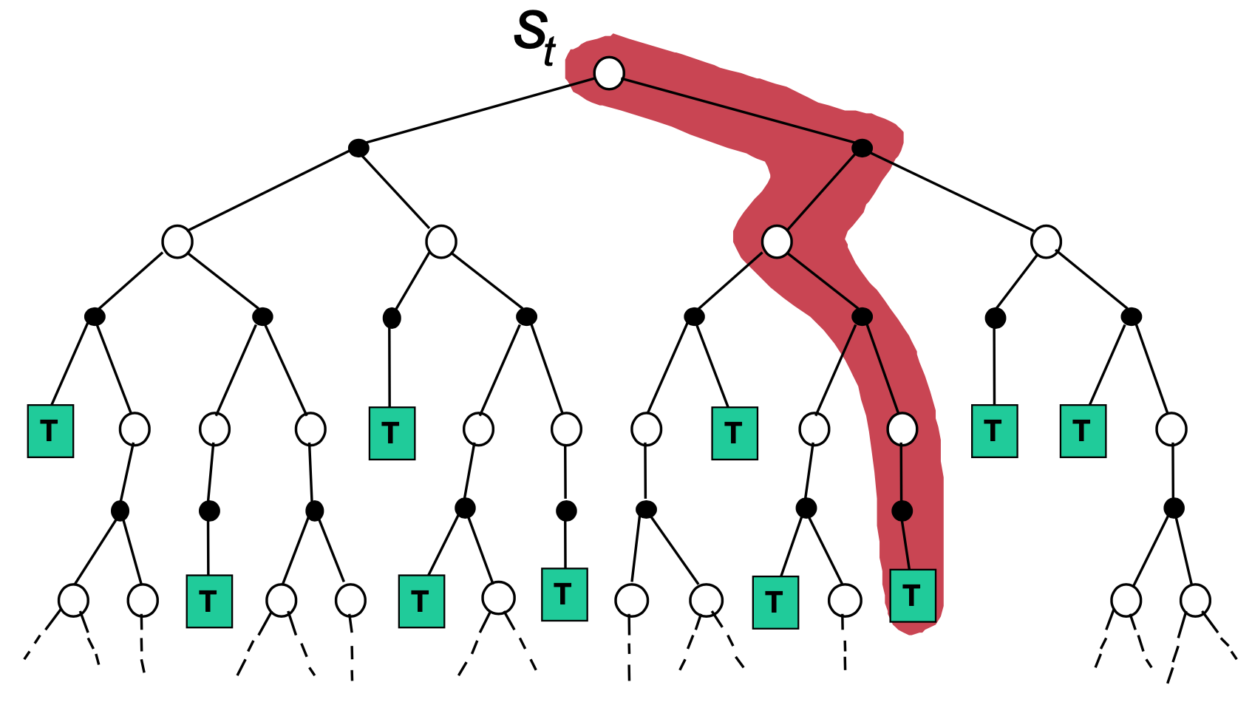
Bootstrapping and Sampling
bootstrapping: update estimates of state values based on estimates of values of successor states
sampling: experience of sample sequences (no need for complete knowledge of environment)
Dynamic Programming
Temporal Difference (TD) Learning
Monte Carlo (MC)
bootstrapping
no sampling → model-based (transition probabilities needed)
bootstrapping
sampling → model-free
no bootstrapping
sampling → model-free

Slide 17
Model-Free Learning

Slide 18
Sampling Update Rule
MC: $v\left(s_{t}\right)←v\left(s_{t}\right)+η\left[\sum_{k=o}^{∞}{γ^{k}r_{t+k+1}}−v\left(s_{t}\right)\right]$
TD: $v\left(s_{t}\right)←v\left(s_{t}\right)+η\left[r_{t+1}+γv\left(s_{t+1}\right)−v\left(s_{t}\right)\right]$
bootstrapping

Slide 19

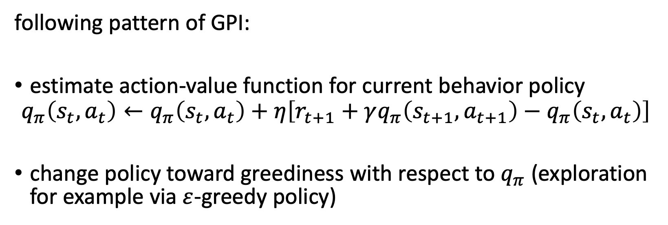
On-Policy TD Control: SARSA
S A R S A
following pattern of GPI:
estimate action-value function for current behavior policy
$$q_{π}\left(s_{t},a_{t}\right)←q_{π}\left(s_{t},a_{t}\right)+η\left[r_{t+1}+γq_{π}\left(s_{t+1},a_{t+1}\right)−q_{π}\left(s_{t},a_{t}\right)\right]$$
change policy toward greediness with respect to $q_{π}$ (exploration for example via $ε$-greedy policy)

Slide 20
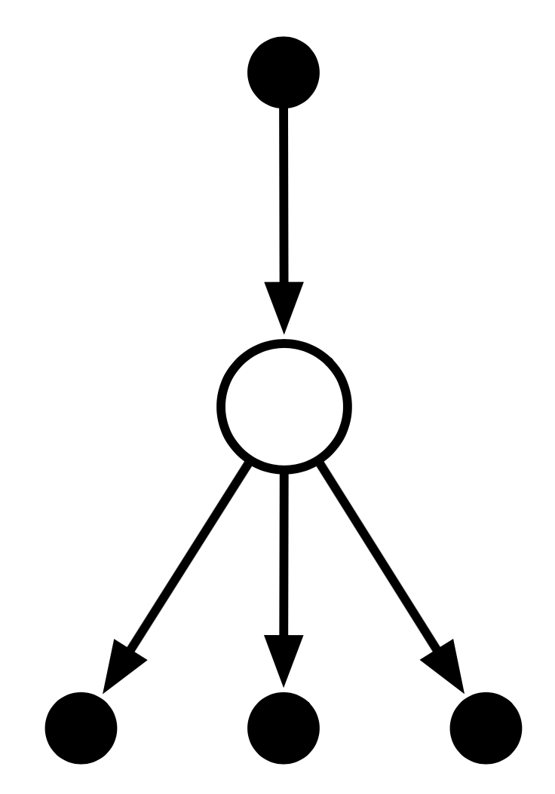
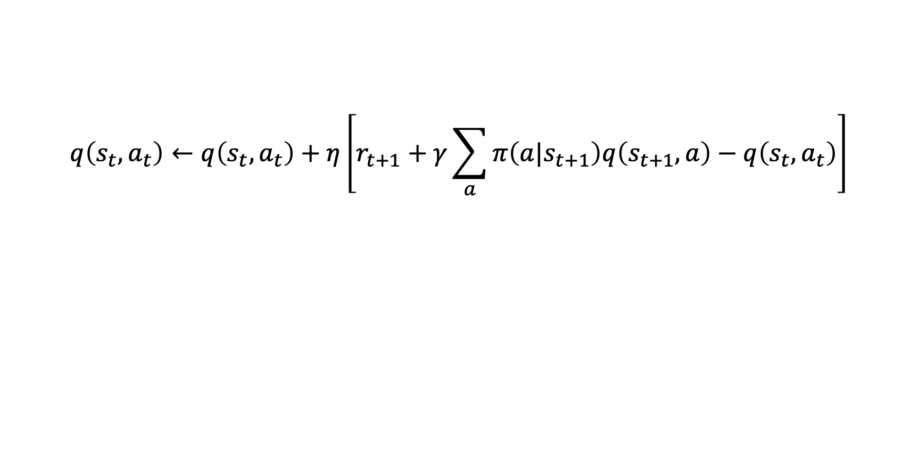
Expected SARSA
$$q\left(s_{t},a_{t}\right)←q\left(s_{t},a_{t}\right)+η\left[r_{t+1}+γ\sum_{a}{π\left(a|s_{t+1}\right)q\left(s_{t+1},a\right)}−q\left(s_{t},a_{t}\right)\right]$$

Slide 21
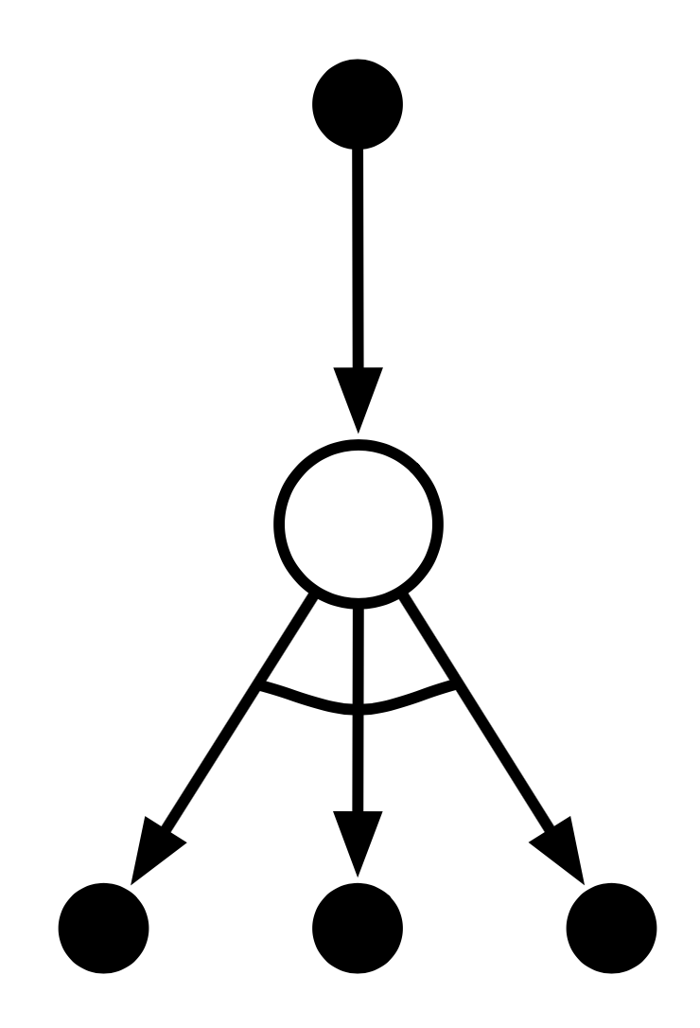
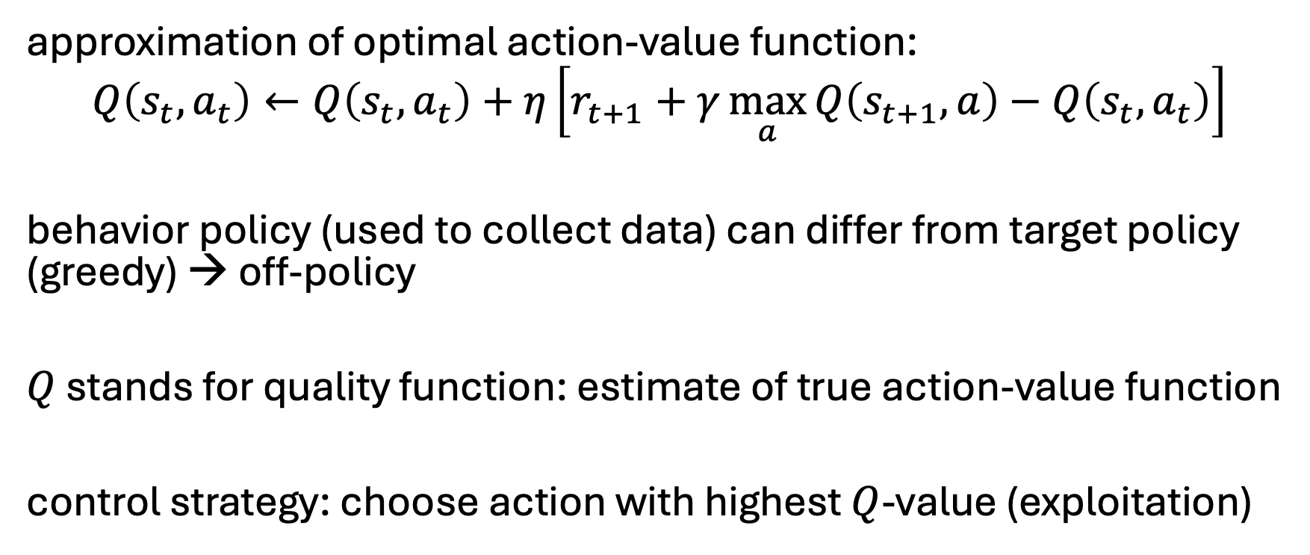
Off-Policy TD Control: Q-Learning
approximation of optimal action-value function:
$$Q\left(s_{t},a_{t}\right)←Q\left(s_{t},a_{t}\right)+η\left[r_{t+1}+γ\max_{a}{Q\left(s_{t+1},a\right)}−Q\left(s_{t},a_{t}\right)\right]$$
behavior policy (used to collect data) can differ from target policy (greedy) → off-policy
$Q$ stands for quality function: estimate of true action-value function
control strategy: choose action with highest $Q$-value (exploitation)

Slide 22
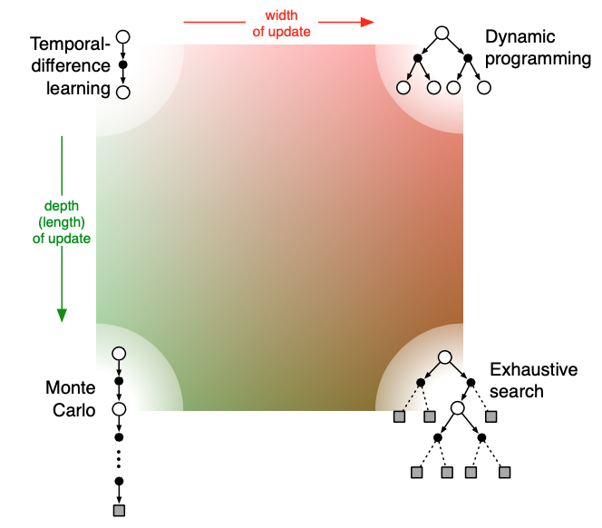
Update Characteristics
model of environment needed
one-step TD
Bootstrapping
reduce depth of search by bootstrapping with value function predicting future outcome
n-step TD
Sampling
MC
reduce breadth of search by sampling actions from policy
very inefficient

Slide 23
Limitation of Tabular Methods
tabular methods (calculating values for each state/action) simply memorize observed data
problem with tabular solution methods in practice: large state/action spaces (kind of curse of dimensionality)
→ need for generalization: supervised learning to the rescue
non-linear function approximation over state/action space
nowadays often deep learning methods → deep RL

Slide 24
Practice Project
Gymnasium Blackjack

