Slide 1
Toward a Tabular Foundation Model
October 2024

Slide 2
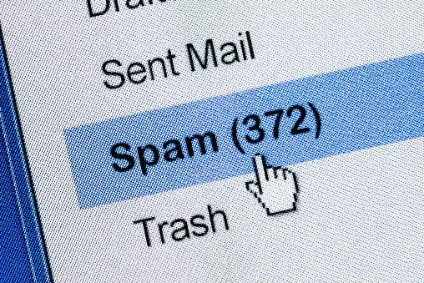
Classic Supervised Learning
other examples:
energy consumption prediction
predictive maintenance
input-output mapping
specific models for each task and data set
feature engineering
Example: Spam Filtering
Classify emails as spam or no spam
use information like occurrence of specific words or email length as features
features x1 and x2 spam, no spam
use accordingly labeled emails as training set

Slide 3
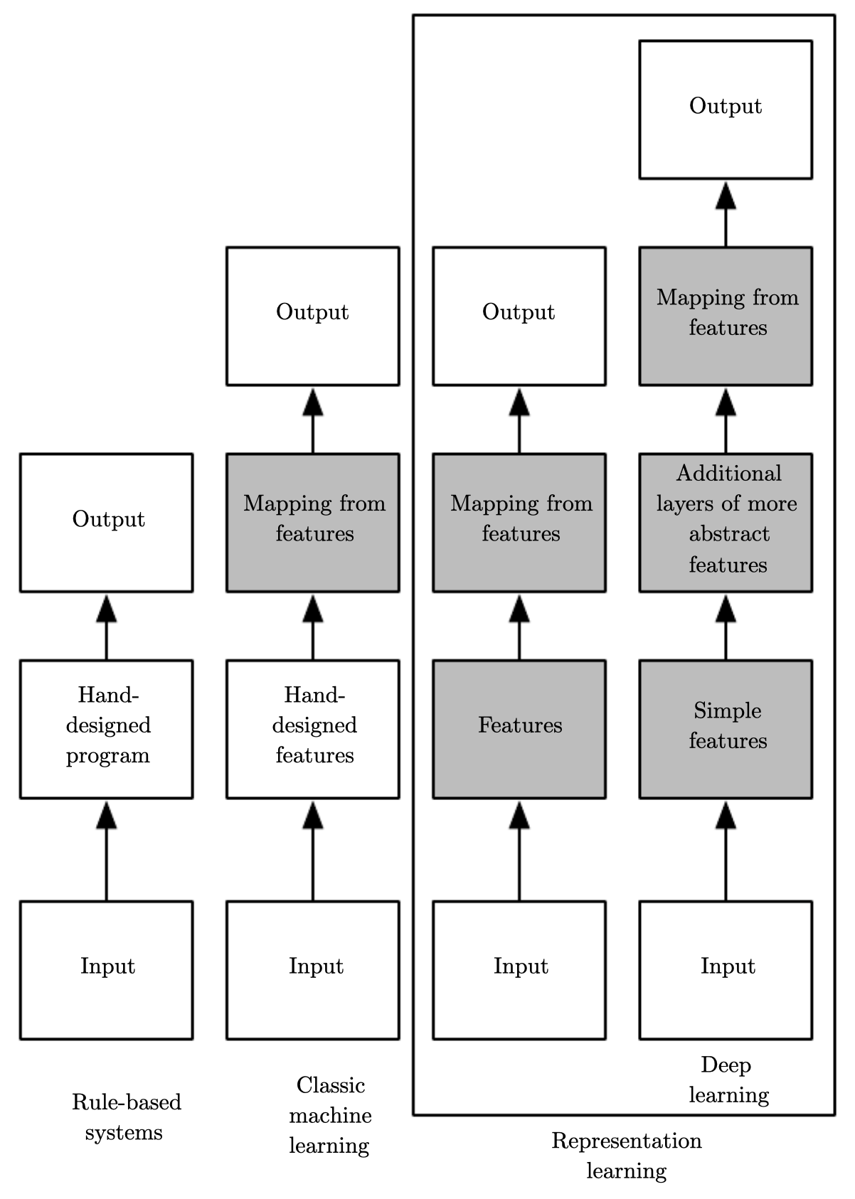
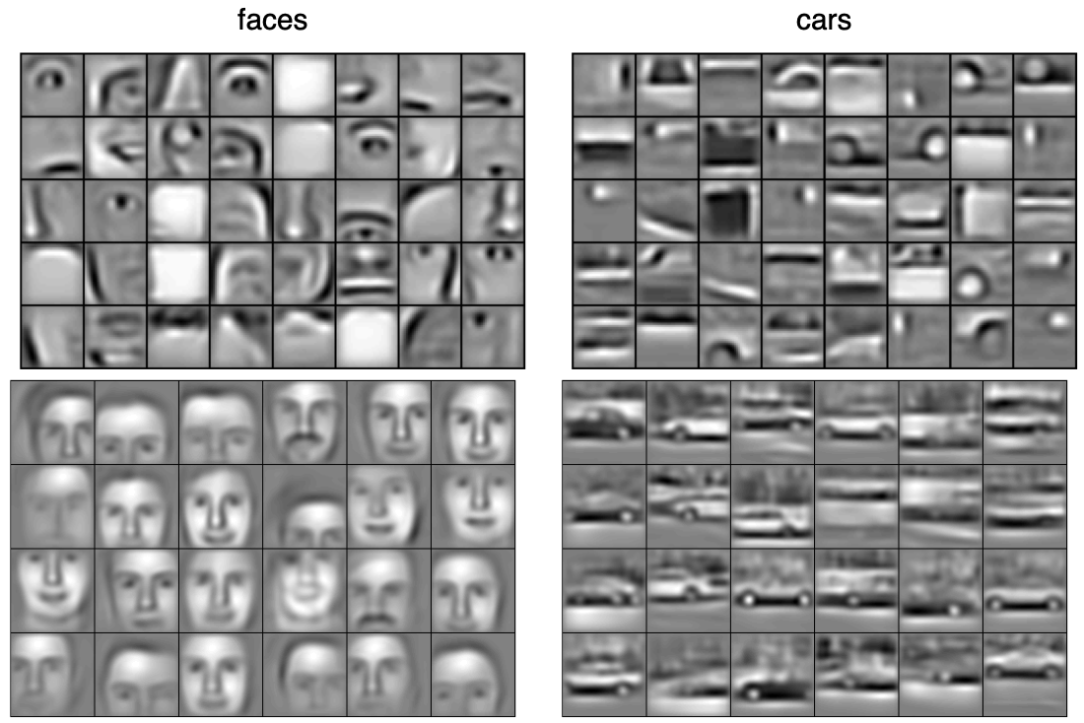
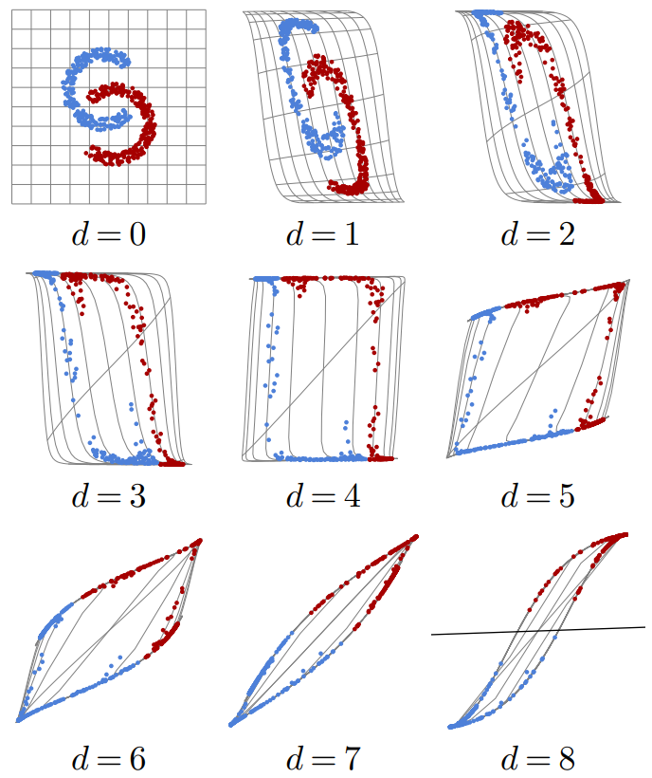
Ladder of Generalization
classic ML: feature engineering
deep learning: feature learning
(hierarchy of concepts learned from raw data in deep graph with many layers)
source
source
source

Slide 4
Transfer Learning
idea:
generic pre-training of foundation models on huge data sets
subsequent finetuning for specific tasks on small(er) data sets
(usually done by means of deep learning methods, thanks to its compositional nature)
very successful for:
computer vision (e.g., object classification)
language models (e.g., BERT, GPT)

Slide 5
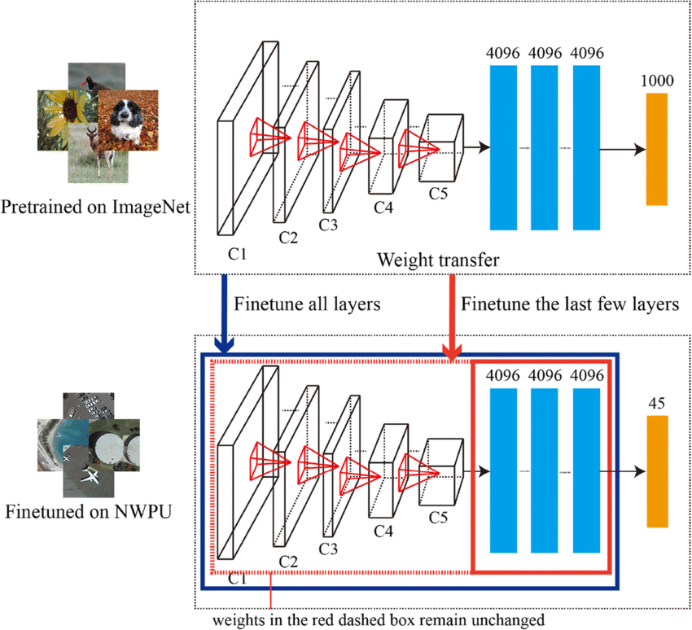
CNN Finetuning
other examples:
visual defect detection
support chip design
source

Slide 6
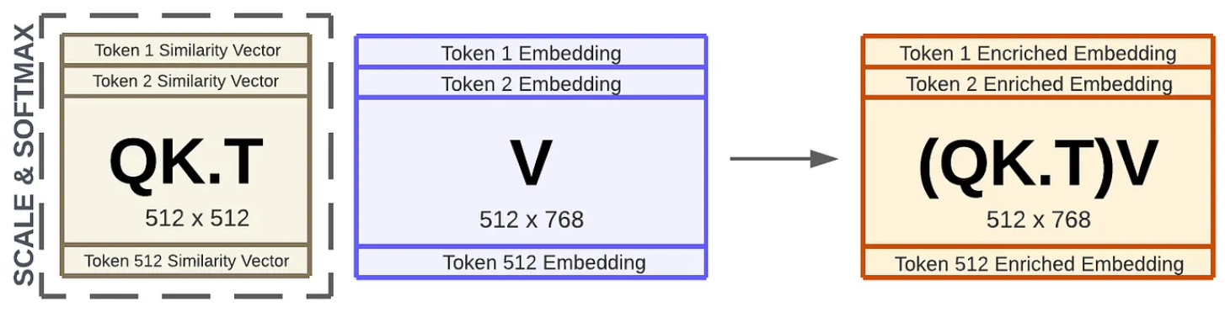
Language Models: Contextual Semantics
self-supervised learning: e.g., next/masked-word prediction
tokenization: split text into chunks (e.g., words)
semantics by means of vector embeddings: e.g., via bag-of-words (or end-to-end in transformer)
positional encoding & embeddings: order of sequence
contextual embeddings: (self-)attention (weighted averages: influence from other tokens)
source

Slide 7
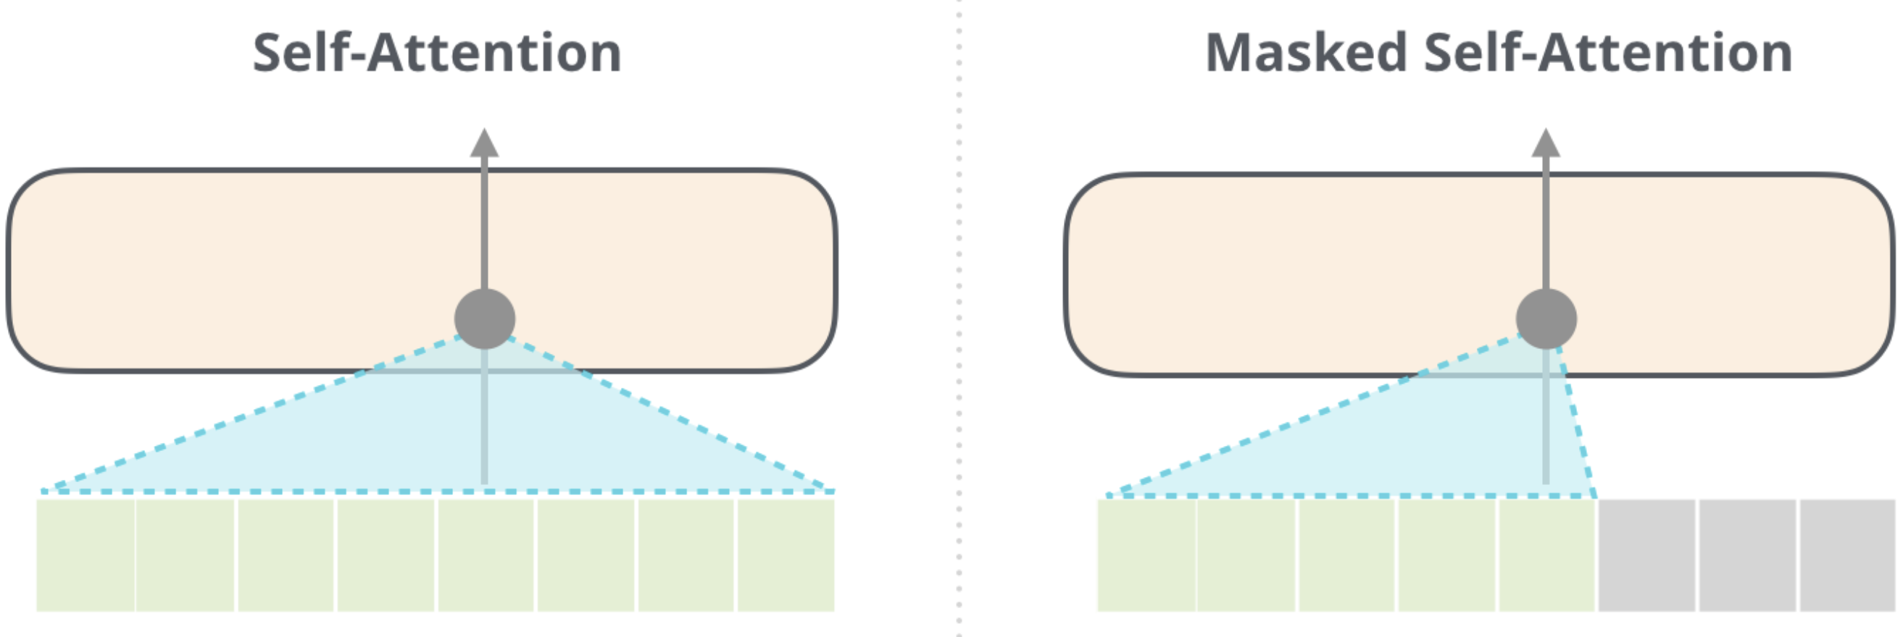
Encoder vs Decoder LLMs
example use case: small language models on edge devices
encoder-only LLMs
prime example: BERT
self-supervised pre-training: masked-word prediction
finetuning on downstream tasks (e.g., sequence classification)
can’t generate text
can’t be prompted
decoder-only LLMs
prime example: GPT
self-supervised pre-training: next-word prediction
instruction tuning (e.g., RL from human feedback)
generate text: chat bots
prompt engineering (zero-/few-shot)
aka causal
source

Slide 8
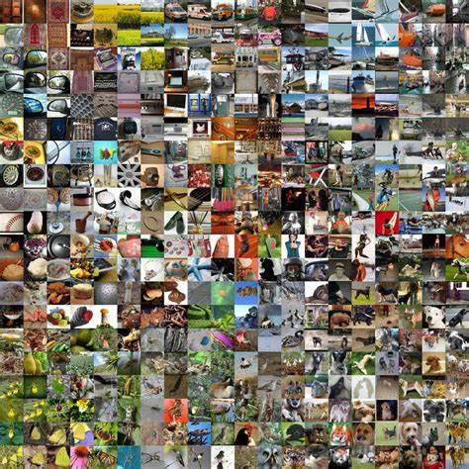
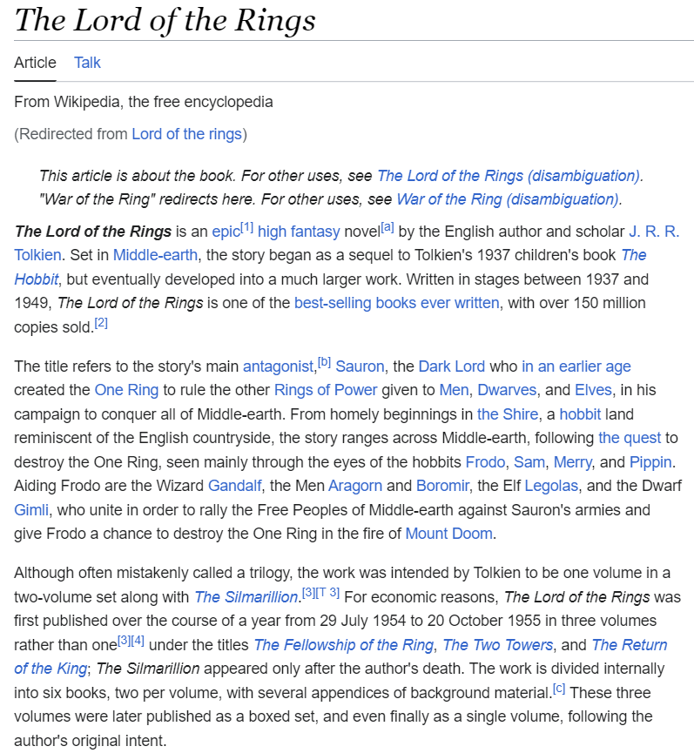
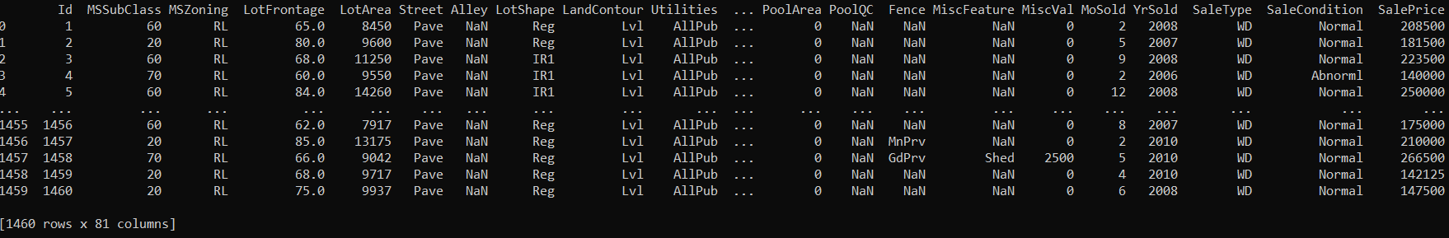
Structured/Tabular vs Unstructured Data
unstructured data: homogenous
→ deep learning rules
→ allows transfer learning (foundation models in CV and NLP)
structured data: heterogenous
→ feature engineering needed
deep learning loses its advantage over shallow methods
→ e.g., gradient boosting still used a lot
ImageNet

Slide 9
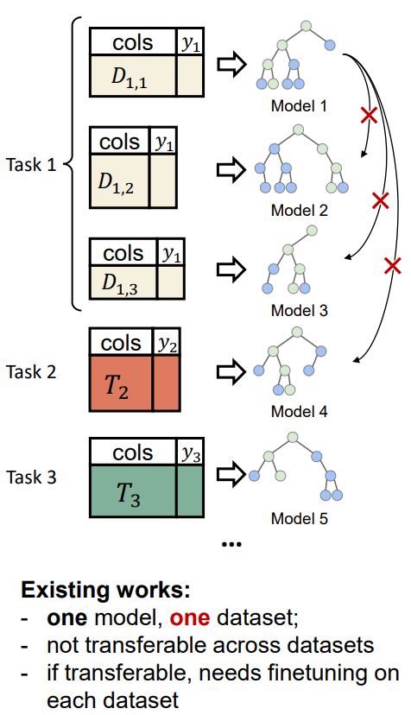
Idea of Tabular Foundation Models
pre-training across data sets and even different tasks
finetuning on small data sets
benefit from world knowledge in LLMs, for example in terms of data imputation
source

Slide 10
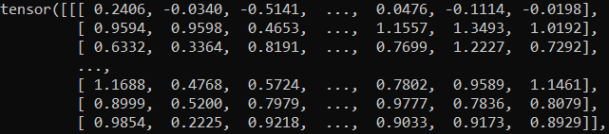
Overcome the Data Integration Challenge
generate vector embeddings for each entry (column name & row value)
convert to prompts for LLM calls
extract embeddings
(average of last hidden state)

Slide 11
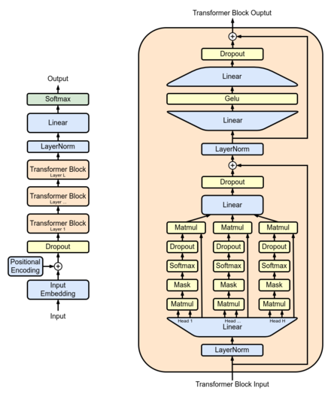
Transformer for Numerical Data
adaptions to GPT architecture:
replace language model head and loss function to reflect tabular prediction setup
drop positional encoding
(permutation invariance)
x
x
x
x
drop causal masking
(permutation invariance)
input previously generated column embeddings directly
from wikipedia

Slide 12
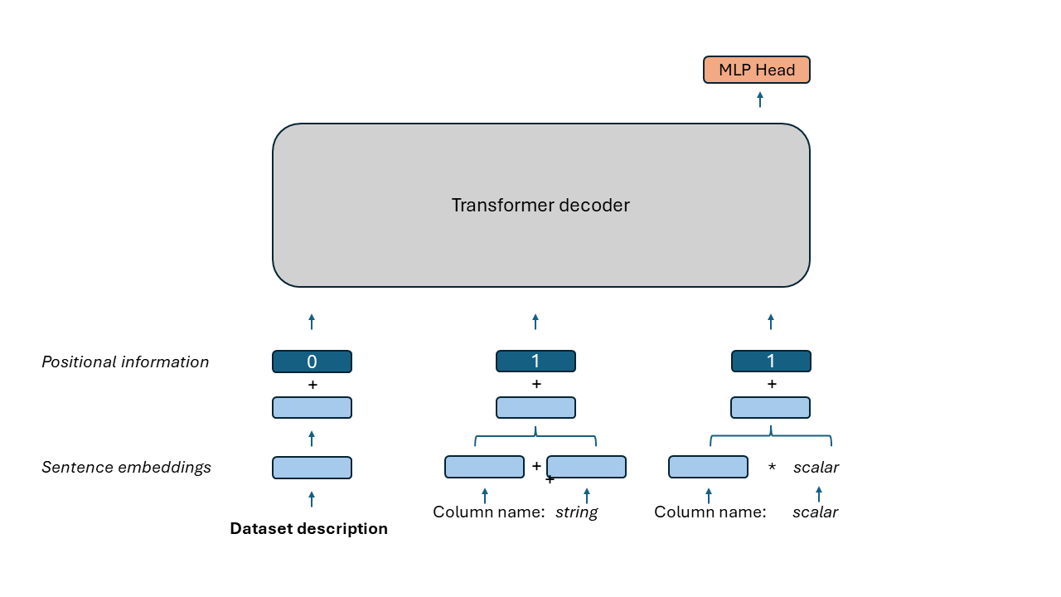
Concept Model
transformer encoder

Slide 13
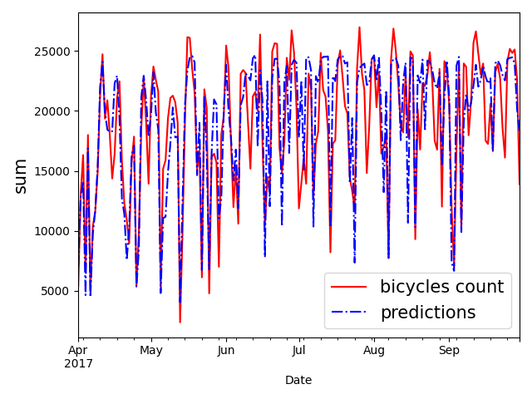
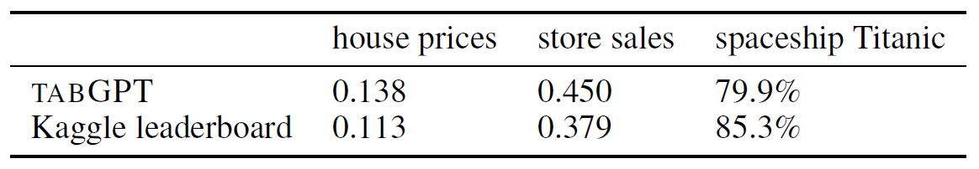
Early Results and Outlook
feasibility checks: method works
prediction accuracy of individual models competitive to prevalent methods
can be trained across data sets and tasks without significantly losing accuracy
pre-train and finetune approach can be applied
next step: proper pre-training of a foundation model
→ need to add many data sets and tasks (self-supervised with rotating target column)

