Slide 1

PROJECT TEAM
Online Casino
Victor Ehrenmüller-Jensen
UI-Designer & Frontend
Sebastian Schwingenschuh
Frontend & Websockets
Felix Zannantoni
Game Logic & Websockets
DEVELOPMENT & DESIGN PROJECT
Julian Einzinger
DB-Expert & General Admin

Slide 2
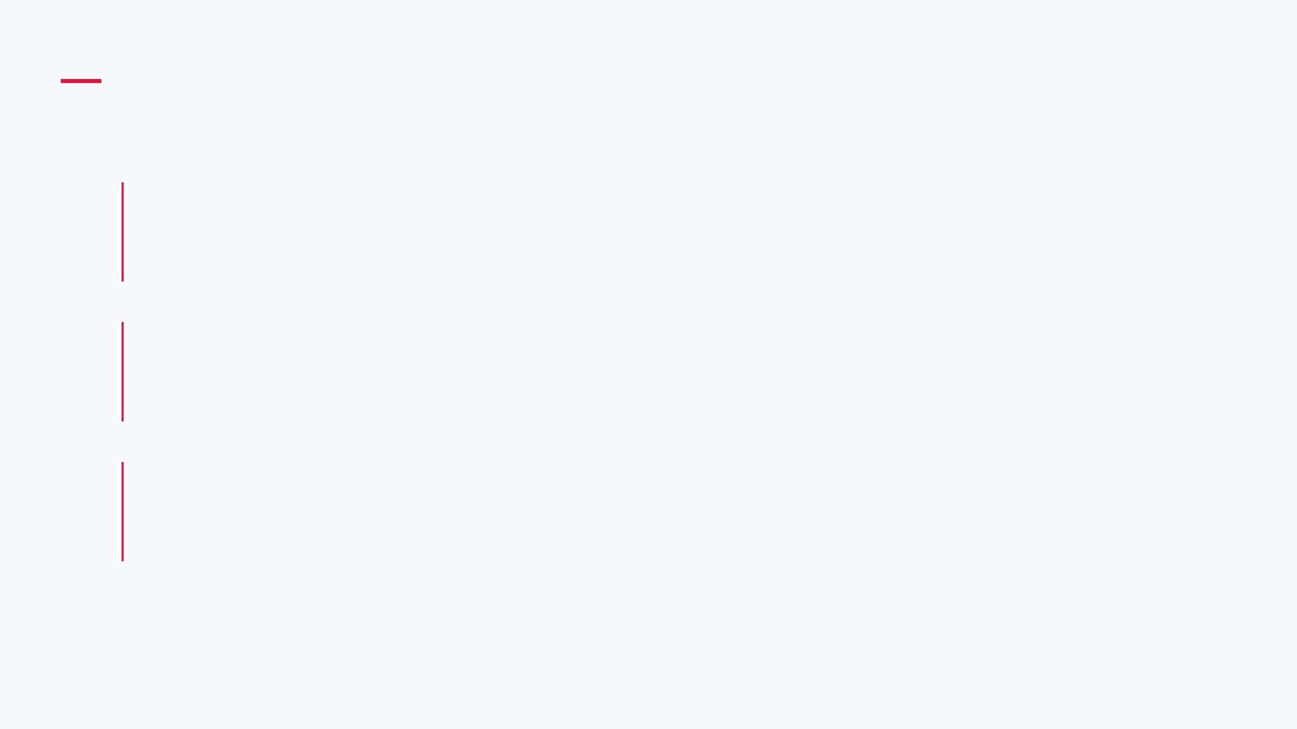
FEATURE SET I: UI & EXPERIENCE
Player Dashboard
Comprehensive overview of statistics, history, and active sessions.
Interactive Menu
IMAGE PLACEHOLDER
Fluid game selection interface with dynamic categories and search.
[ Main User Interface Screenshot ]
600 x 400 px
Real-time Updates
Instant balance and state synchronization across all components.

Slide 3

FEATURE SET II: GAME MECHANICS
Fair Play Algorithms
Secure betting logic ensuring mathematical fairness and transparency.
IMAGE PLACEHOLDER
Diverse Game Modes
Support for Slots, Blackjack, and Roulette with distinct rule sets.
[ Gameplay Visualization ]
600 x 400 px
Seamless Transitions
Smooth handling of game states from betting to result calculation.

Slide 4
FEATURE SET III: BACKEND & SECURITY
User Authentication
Secure login system with encrypted credential storage and session management.
Data Encryption
IMAGE PLACEHOLDER
End-to-end encryption for all financial transactions and sensitive user data.
[ System Architecture Diagram ]
600 x 400 px
Websocket Sync
Low-latency bidirectional communication for real-time game state updates.

Slide 5
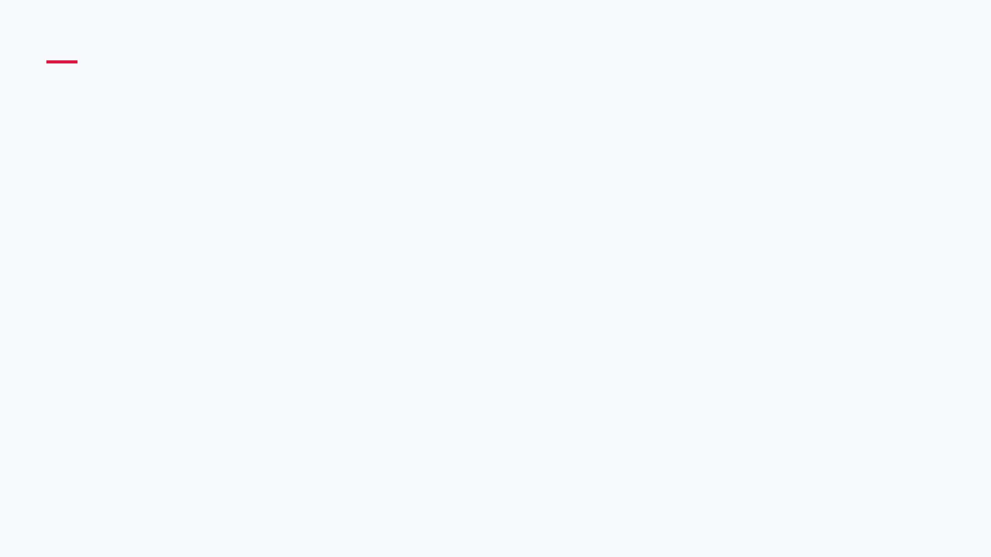
CODE SNIPPET I: FRONTEND
REACTIVE UI
Implementation of dynamic components that respond to state changes instantly.
// WebSocket connection & state update
const socket = new WebSocket('ws://casino.api');
socket.onmessage = (event) => {
WEBSOCKETS
const data = JSON.parse(event.data);
Real-time communication layer for low-latency game updates.
// Trigger reactive UI update
updateGameState(data);
};
function updateGameState(state) {
renderBalance(state.balance);
renderTable(state.activeGame);
}

Slide 6
CODE SNIPPET II: GAME LOGIC
Secure Randomness
JAVA / BACKEND
Implementation of cryptographically strong random number generation to ensure absolute fairness in game outcomes.
// Core algorithms for game outcomes
// Example: Random number generation
public class
GameEngine {
public int
generateResult() {
return
SecureRandom
Server-Side Validation
.getInstanceStrong()
.nextInt(37);
All game logic is executed and validated on the server to prevent client-side manipulation.
}
}

Slide 7
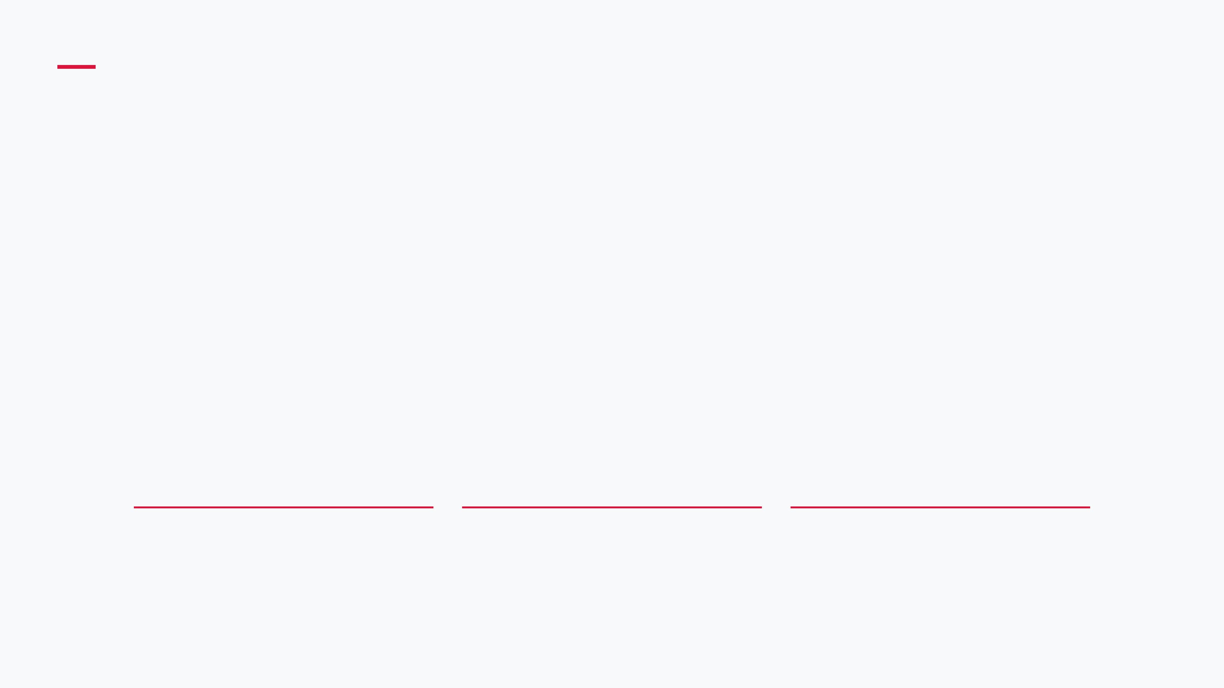
CODE SNIPPET III: DATABASE & TRANSACTIONS
SQL / POSTGRESQL
-- Secure balance update and history logging
BEGIN
;
UPDATE
player_balance
SET
balance = balance - 10
WHERE
player_id =
1
AND
balance >=
10
;
INSERT INTO
bet_history (player_id, amount, timestamp)
VALUES
(
1
,
10
,
NOW
());
COMMIT
;
Atomic Transactions
Integrity Checks
Audit Trail
Ensures that balance updates and history entries either both succeed or both fail.
Conditional updates prevent negative balances at the database level.
Automatic timestamping for every transaction to maintain a reliable betting history.

Slide 8
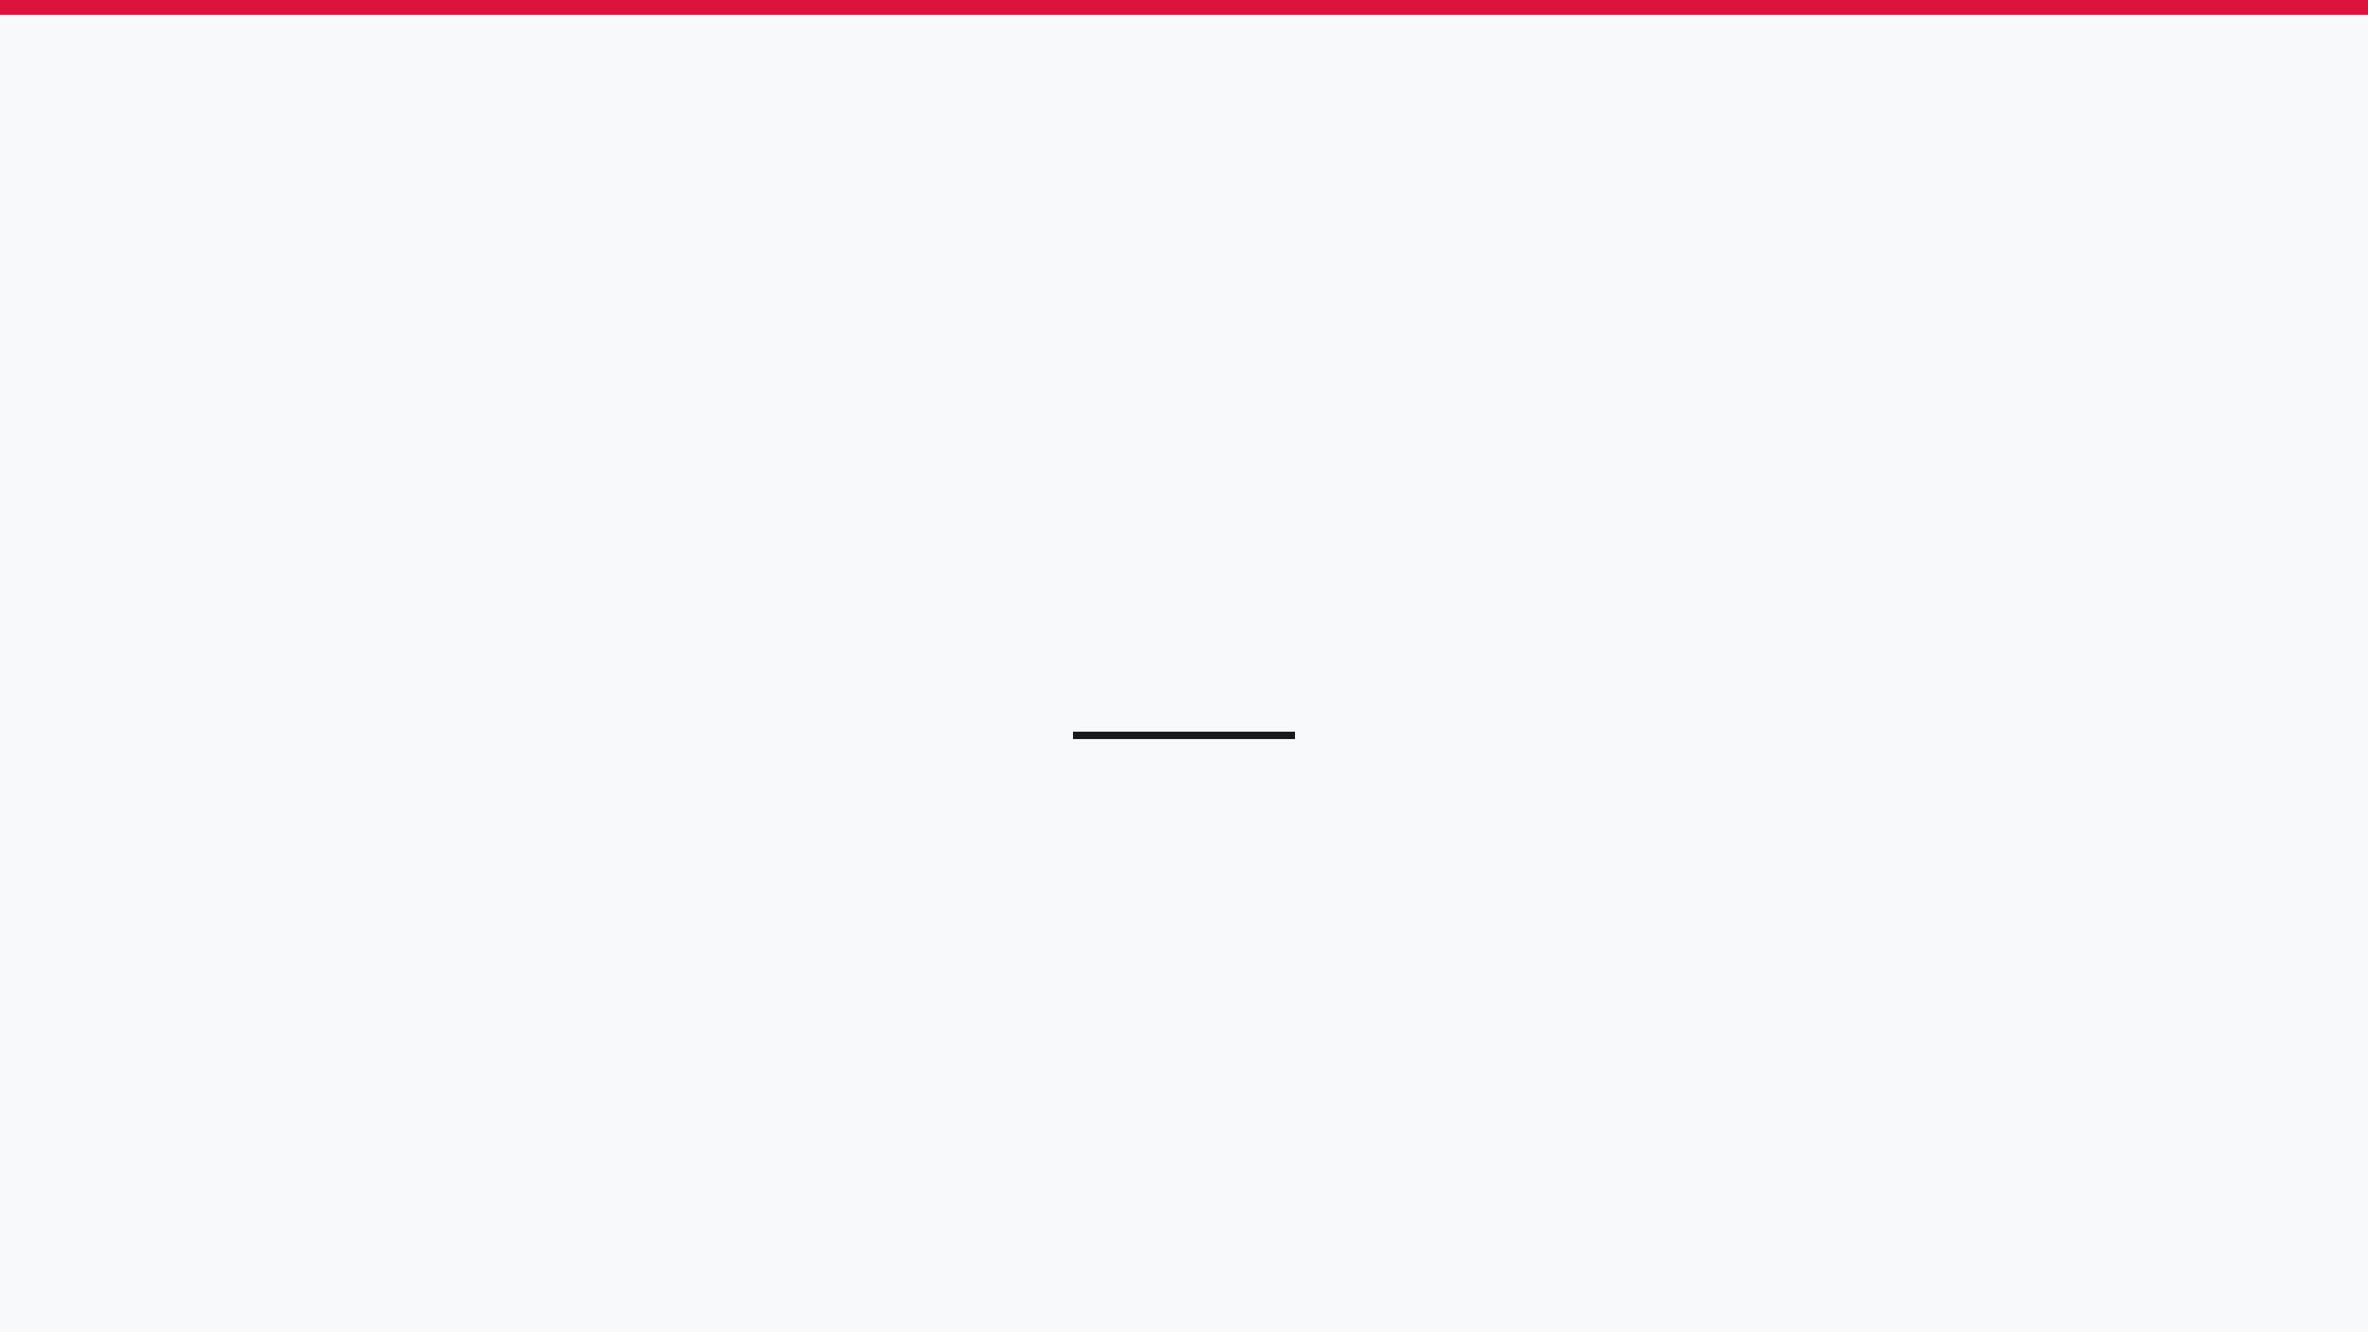
SYSTEM SHOWCASE
LIVE DEMO
Application Walkthrough
Real-time Features
Interactive Q&A
Step-by-step tour of the user journey from registration to gameplay.
Demonstration of live websocket updates and instant balance synchronization.
Open discussion and technical deep-dive during the live session.

Slide 9

GET IN TOUCH
Danke für Ihre Aufmerksamkeit
PROJECT REPOSITORY
https://github.com/2526-3ahif-syp-wmc/OnlineCasino
WEBSITE
QUESTIONS & FEEDBACK
https://if230168.cloud.htl-leonding.ac.at

