Slide 1
CSEAM731 · REINFORCEMENT LEARNING · CIA-3
Dynamic Pricing with Reinforcement Learning
DQN · DDPG · PPO · SAC on one shared pricing MDP — a measured comparison
Based on Liu et al. (2019), “Dynamic Pricing on E-commerce Platform with Deep Reinforcement Learning: A Field Experiment” (arXiv:1912.02572)
Code, data pipeline, trained agents and interactive dashboard: github.com/Feliz7000/rl-dynamic-pricing-comparison
CSEAM731 · CIA-3 · Dynamic pricing with DQN · DDPG · PPO · SAC
1
Notes:
Open with the question, not the method: same pricing problem, four RL algorithms, which sets better prices and why. Everything in the project exists to answer that fairly and measurably.

Slide 2
AGENDA
What we will cover
1
The problem and the source paper
2
One shared MDP
Why dynamic pricing, what Alibaba field-tested on Tmall
State, action and reward every algorithm sees
3
The hard part: a demand model
4
Four algorithms
How to score a price nobody ever charged
DQN, DDPG, PPO, SAC — what each does differently
5
Fair-comparison protocol
6
Results and the live race
Baselines, budgets, seeds, held-out products
Measured DRCR, revenue vs. the seller, dashboard
7
Caveats and next steps
What the numbers do and do not show
CSEAM731 · CIA-3 · Dynamic pricing with DQN · DDPG · PPO · SAC
2
Notes:
Eight beats: problem, MDP, the counterfactual demand model, the four algorithms, the live race, results, training behaviour, caveats. About 12-15 minutes.

Slide 3
1 · THE PROBLEM
Prices should move with the market
STATIC PRICING
DYNAMIC PRICING
WHY REINFORCEMENT LEARNING
• One price, set once, held for weeks
• Blind to traffic swings, seasonality, competitor moves
• Leaves revenue on the table in both directions
• Re-price every period from what you observe now
• Needs a policy: state → price
• Rules of thumb scale badly across thousands of SKUs
• Sequential decisions with delayed, noisy feedback
• Learns the policy from outcomes, no hand-written rules
• Natural fit: state, action, reward
The question this project answers: given the exact same pricing problem — same information, same allowed moves, same reward — which of four RL algorithms sets better prices, and why?
CSEAM731 · CIA-3 · Dynamic pricing with DQN · DDPG · PPO · SAC
3
Notes:
Dynamic pricing = re-setting a price repeatedly as demand, traffic and competitors change. A human does it by rules of thumb and re-prices rarely; an RL agent does it by trial, reward and correction, every period.

Slide 4
1 · LIU ET AL. 2019
The source paper: a real field experiment on Tmall
• Pricing as an MDP. State = what you know about a product this period; action = the price; reward = how the market responds.
• Reward = DRCR, not revenue. Traffic swings for reasons unrelated to price, so they normalise revenue by traffic (RCR) and reward the change in it.
• Discrete vs continuous. DQN chooses among K price buckets; DDPG outputs an exact price. Few buckets are imprecise, many spread the data thin.
• Cold start. Low-traffic products lack data; their pipeline pre-trains on historical human prices.
• Deployed on Tmall.com from July 2018 — the numbers on the right are from live traffic, not simulation.
30-DAY FIELD TEST · DRCR, MANUAL = 1.00
DDPG
6.07
DQN
5.03
Manual
1.00
CSEAM731 · CIA-3 · Dynamic pricing with DQN · DDPG · PPO · SAC
4
Notes:
Alibaba's supply-chain team deployed RL pricing on Tmall.com from July 2018. Three ideas carry into our project: pricing as an MDP; DRCR as the reward instead of raw revenue; and the DQN vs DDPG field test. Scaled to manual = 1.00, DDPG scored 6.07 and DQN 5.03 over a 30-day phase.

Slide 5
1 · THE PROJECT
Our approach: fix the problem, swap only the learner
Algorithm | Family | Action space | Policy | Exploration | Chosen to test
DQN | Value-based | 11 discrete price buckets | Off-policy | ε-greedy schedule | The paper's baseline; the bucket trade-off
DDPG | Actor-critic, deterministic | Exact continuous price | Off-policy | External OU noise | The paper's winner; precision without buckets
PPO | Actor-critic, stochastic | Exact continuous price | On-policy | Built into the policy | Robustness to a noisy reward
SAC | Actor-critic, max-entropy | Exact continuous price | Off-policy | Entropy bonus, self-tuned | DDPG's benefit with stable, automatic exploration
What is held equal for all four: the environment and demand model, the 35-number state, the ±25 % action range, the DRCR reward, network size (2 × 128 ReLU), optimiser, the environment-step budget, the seeds, and the held-out products used for every reported number.
CSEAM731 · CIA-3 · Dynamic pricing with DQN · DDPG · PPO · SAC
5
Notes:
The report keeps the paper's states, action and reward fixed and swaps only the algorithm. This codebase turns that written comparison into a measured one: a real environment, four trained agents, held-out products, three seeds, and a dashboard where every number traces back to a checkpoint.

Slide 6
2 · THE SHARED MDP
One decision = one product for one month
STATE s(i,t) · 35 numbers
ACTION a(i,t) · a new price
REWARD r(i,t) · scaled DRCR
• Own attributes: entering price, score, freight
• Recent performance: 3-month rolling sales, revenue, traffic; last DRCR
• Pricing history: lag prices, % change
• Competitiveness: price / score / freight gaps vs 3 similar products, price rank
• Seasonality flags + category one-hot
• Within ±25 % of the entering price
• DQN: one of K = 11 buckets (−25 % … +25 %, middle = no change)
• DDPG / PPO / SAC: tanh output in [−1, 1] → exact price
• Guard: clipped to [0.5×, 1.5×] of the product's observed range
• RCR(t) = revenue(t) / category traffic(t)
• DRCR(t) = RCR(t) − RCR(t−1)
• reward = 100 × DRCR
• A difference signal: even a good policy hovers near zero
• Traffic proxy = units sold across the category that month
Time structure. 15 months per product: months 1–3 warm up the rolling features and RCR history; the agent prices months 4–15 (12 decisions). Features that describe recent performance are shifted one month so this month's outcome can never leak into the state.
CSEAM731 · CIA-3 · Dynamic pricing with DQN · DDPG · PPO · SAC
6
Notes:
State: 35 numbers in five groups, all known before the price is set. Action: a new price within plus or minus 25 percent of the entering price. Reward: 100 times DRCR. Each product has 15 months: 3 warm-up, 12 decisions.

Slide 7
3 · COUNTERFACTUAL DEMAND
The hard part: history only shows one price per month
Logged data
THE FIX: A DEMAND-RESPONSE MODEL
month | price charged | units sold | … at $85? | … at $110?
2017-06 | $92.40 | 38 | ? | ?
2017-07 | $94.10 | 35 | ? | ?
2017-08 | $90.80 | 41 | ? | ?
• Fit units-sold = f(price, context) on the full history
• Ask it for any candidate price at the real month's context (competitors, traffic, season)
• It becomes the environment's transition and reward function
• Agents and the seller's own prices are scored through the same model → fair, in-simulator comparison
• Validated on each product's last 2 months: R² = 0.94 in log-units
Pure replay cannot answer the question marks. If the agent picks $110, the row for $94.10 tells us nothing about it.
CSEAM731 · CIA-3 · Dynamic pricing with DQN · DDPG · PPO · SAC
7
Notes:
The dataset records what sold at the one price the seller charged. An RL agent proposes prices nobody charged, so something must predict what would have sold. That something is the demand model, and it is the environment's physics. Every policy, including the seller's own path, is scored through the same model.

Slide 8
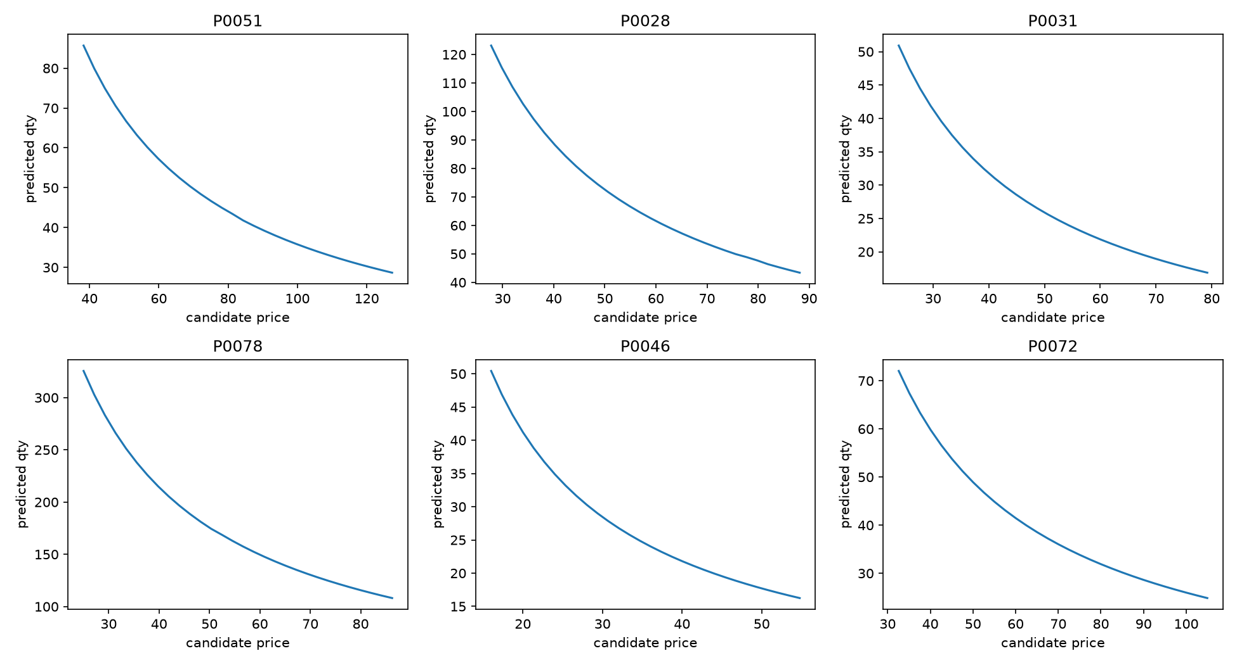
3 · COUNTERFACTUAL DEMAND
The demand model: elasticity first, corrections second
LAYER 1 · FIXED-EFFECTS ELASTICITY BASELINE
• log(1+qty) = αᵢ + β·log(price) + controls
• Every regressor demeaned within product → β comes from each product's own price moves
• Fitted β = -0.89: +10 % price ≈ −9 % units
LAYER 2 · CAPPED GRADIENT-BOOSTED RESIDUAL
• HistGradientBoosting, depth 3, ≤ 250 trees, early-stopped, L2 = 1.0
• Learns competitor gaps, seasonality, category effects the line misses
• Output clipped to ±3σ of its in-sample spread → can bend, never flip
Guard rails: prices clipped to [0.5×, 1.5×] of the product's history; competitor gaps recomputed at the candidate price; time-based holdout, never a random row split.
CSEAM731 · CIA-3 · Dynamic pricing with DQN · DDPG · PPO · SAC
8
Notes:
Layer one is a fixed-effects log-log elasticity regression, demeaned within product. A pooled fit gave a positive price coefficient because products priced high for unrelated reasons also sold well; demeaning removed that confound. Layer two is a shallow gradient-boosted residual, capped at three standard deviations so it can bend the curve but never flip it. Guard rails stop agents from exploiting the model off-distribution.

Slide 9
3 · DATA
The data: a retail pricing panel, real schema, synthetic fallback
Column group | Fields | Feeds
Identity / time | product_id, product_category_name, month_year | grouping, warm-up, seasonality
Own product | unit_price, qty, total_price, freight_price, product_score, lag_price, customers | state, demand-model target
Competitors | comp_1..3, ps1..3, fp1..3 | competitiveness gaps, price rank
Calendar | weekday, weekend, holiday, month, year | seasonality features
SYNTHETIC PANEL USED TODAY
• 10 categories × 8 products × 15 months = 1,200 rows, 80 products
• units = base × (price / ref)^(−elasticity) × season × noise, category elasticity 1.0–2.5
• Prices follow a mean-reverting random walk (~3 % / month)
• Same columns as Kaggle → drop the real CSV into data/raw/, refit, rerun
• Product split: 60 train / 20 held-out, by product, stratified by category
Leakage discipline. A feature may only use what is known before the month's price is set: rolling sales, revenue, traffic and DRCR are shifted one month; the row's own price, units and revenue are never inputs, only fitting targets. Competitor prices are this month's, treated as observable and exogenous.
CSEAM731 · CIA-3 · Dynamic pricing with DQN · DDPG · PPO · SAC
9
Notes:
Target dataset is Kaggle's Retail Price Optimization, derived from Olist: one row per product-month with price, units, freight, score, three competitor prices, lag price. The sandbox had no internet, so results today use a schema-identical synthetic panel generated from an explicit elasticity law. Swapping in the real CSV needs no code changes.

Slide 10
3 · THE ENVIRONMENT (PRICINGENV)
One episode, step by step
RESET
OBSERVE
ACT
DECODE
GUARD
PREDICT
REWARD
ROLL ON
pick a product;
months 1–3 warm up
›
state s_t
(35 numbers)
›
bucket or
value in [−1, 1]
›
entering price
× (1 ± 25 %)
›
clip to [0.5×, 1.5×]
of history
›
demand model →
units at that price
›
RCR = p·q / traffic
r = 100·ΔRCR
›
lag prices, gaps,
rolling sales → next month
 | Training episodes | Evaluation episodes
Products | random draw from the 60 training products | each of the 20 held-out products, once
Horizon | 20 steps | until real months run out (12 decisions)
Past month 15 | bootstrapped: competitors ±3 %, traffic ±5 % noise from the last real row | never — episode ends
Exploration | on (ε-greedy / OU noise / sampled policy) | off — deterministic actions
CSEAM731 · CIA-3 · Dynamic pricing with DQN · DDPG · PPO · SAC
10
Notes:
A standard Gymnasium environment. Reset picks a product and loads three warm-up months. Each step: observe, act, decode to a price, guard, ask the demand model, compute RCR and the reward, roll the agent's own history forward, load the next real month. Training episodes may bootstrap past month 15; evaluation never does.

Slide 11
4 · VALUE-BASED, DISCRETE
DQN — score every price move, pick the best
HOW IT WORKS
WHAT TO SAY ABOUT IT
• Q(s, · | θ): 35 numbers in → 11 values out, one per bucket
• target y = r + γ · maxₐ′ Q(s′, a′ | θ⁻)
• loss = Huber( Q(s, a | θ) − y )
• Experience replay: 50,000 transitions, random batches of 64 → decorrelated updates
• Target network θ⁻: frozen copy refreshed every 100 updates → the target stops chasing itself
• Simplest and most stable; the paper's own baseline
• Structural limit: 11 buckets → finest move is 5 %
• The paper measured the cost of that imprecision (5.03 vs 6.07)
• In this run its ε schedule did not finish: at 15k steps it still acted randomly 43 % of the time
EXPLORATION
HYPERPARAMETERS
• ε-greedy: random bucket with prob. ε, else argmax
• ε: 1.0 → 0.05 linearly over 25,000 steps
• Evaluation: ε = 0
• γ = 0.99, Adam lr 1e-3
• batch 64, buffer 50k, 500 warm-up steps
• K = 11 buckets over ±25 %
IMPLEMENTATION CHECK
• Learned CartPole-v1 (eval return > 100) in 4,000 steps before touching the pricing env
CSEAM731 · CIA-3 · Dynamic pricing with DQN · DDPG · PPO · SAC
11
Notes:
DQN never outputs a price directly; it scores the 11 moves and picks the best. Two stabilisers: replay buffer and a target network. Mention the scheduling handicap honestly before someone asks why it is below the baseline.

Slide 12
4 · DETERMINISTIC ACTOR-CRITIC
DDPG — an actor outputs the exact price, a critic scores it
HOW IT WORKS
WHAT TO SAY ABOUT IT
• critic: y = r + γ · Q′(s′, μ′(s′)); loss = MSE(Q(s,a) − y)
• actor: loss = − mean Q(s, μ(s)) (gradient flows through the critic)
• targets: θ′ ← 0.005·θ + 0.995·θ′ after every update
• Actor ends in tanh → [−1, 1] → ±25 % of the entering price
• Target copies of both actor and critic keep the bootstrapped target stable
• Removes the bucket trade-off entirely — an exact price
• The paper's field winner (6.07 vs 5.03) is the empirical case for it
• Cost: a delicate two-network loop, sensitive to hyperparameters and to the hand-scheduled noise
• Here: same training level as SAC, but 5× wider spread across seeds on held-out products
EXPLORATION
HYPERPARAMETERS
• Actor is deterministic → noise added from outside
• Ornstein–Uhlenbeck, θ = 0.15, σ 0.20 → 0.05 over 25k steps
• Reset at each episode end; off in evaluation
• γ = 0.99, actor lr 1e-4, critic lr 1e-3
• τ = 0.005, batch 64, buffer 50k
• 500 warm-up steps
IMPLEMENTATION CHECK
• Learned Pendulum-v1: +100 return between first and last 10 episodes of a 6,000-step run
CSEAM731 · CIA-3 · Dynamic pricing with DQN · DDPG · PPO · SAC
12
Notes:
Two networks: the actor maps state to one price, the critic scores state-price pairs, and the actor is nudged in whatever direction the critic says raises the score. The hand-scheduled noise is the weakness SAC was chosen to remove.

Slide 13
4 · ON-POLICY, CLIPPED UPDATES
PPO — improve a price distribution by a bounded step each batch
HOW IT WORKS
WHAT TO SAY ABOUT IT
• Collect 1,024 steps with the current policy; store log π(a|s) and V(s)
• GAE: δₜ = rₜ + γV(sₜ₊₁) − V(sₜ); Âₜ = Σ (γλ)ᵏ δₜ₊ₖ, λ = 0.95
• ratio rₜ = πθ(aₜ|sₜ) / πθₒₗₔ(aₜ|sₜ)
• loss = − mean min( rₜÂₜ , clip(rₜ, 0.8, 1.2)·Âₜ ) − 0.01·entropy
• 10 epochs over minibatches of 64, then discard the rollout — no replay buffer
• Chosen for robustness to a noisy reward: the clip bounds how far one lucky month can move the policy
• Price: sample efficiency — it cannot reuse old data
• Its running mean is still climbing at 15k steps while off-policy agents settled by 3k
• Runs continuous here (not the report's 'optionally discrete') so it compares directly with DDPG/SAC
EXPLORATION
HYPERPARAMETERS
• Built in: the policy is a Gaussian with a learned std
• Entropy bonus stops it collapsing early
• Evaluation uses the mean
• γ = 0.99, λ = 0.95, clip ε = 0.2
• lr 3e-4, rollout 1,024, 10 epochs, minibatch 64
• entropy 0.01, value coef 0.5, grad-norm 0.5
IMPLEMENTATION CHECK
• Pendulum-v1 needed ~100k steps (vs 6k for DDPG/SAC) — the value estimate takes 10–15 rollouts to calibrate
CSEAM731 · CIA-3 · Dynamic pricing with DQN · DDPG · PPO · SAC
13
Notes:
PPO learns a distribution over prices and improves it by a bounded amount after each fresh batch. Two implementation details: actor and critic have separate optimisers and separate gradient clipping; clipping them together silently crushes the policy gradient. Slower to learn, by design.

Slide 14
4 · MAXIMUM ENTROPY, TWIN CRITICS
SAC — reward randomness, and tune that reward automatically
HOW IT WORKS
WHAT TO SAY ABOUT IT
• objective: max Σₜ [ r(sₜ,aₜ) + α·H(π(·|sₜ)) ]
• critics: y = r + γ·[ min(Q₁′,Q₂′)(s′,a′) − α·log π(a′|s′) ], a′ ~ π(·|s′)
• actor: loss = mean[ α·log π(a|s) − min(Q₁,Q₂)(s,a) ] (reparameterised)
• temperature: loss = − mean[ logα · (log π(a|s) + H_target) ], H_target = −1
• tanh-squashed Gaussian policy with the log-prob correction; twin critics counter overestimation
• Chosen for the low-traffic problem: keeps exploring nearby prices while uncertain, no noise schedule to tune
• Tests whether DDPG's exact price can be had with better stability
• Result: best held-out DRCR and the tightest spread across seeds (5× tighter than DDPG)
• Update order: critics → actor → temperature → target critics; α detached everywhere but its own loss
EXPLORATION
HYPERPARAMETERS
• Intrinsic: sample from the policy during training
• α rises when entropy falls below target, and vice versa
• Evaluation: tanh(mean)
• γ = 0.99, all three lr 3e-4
• τ = 0.005, batch 64, buffer 50k
• 500 warm-up steps, target entropy −1
IMPLEMENTATION CHECK
• Learned Pendulum-v1 in 6,000 steps with finite critic loss and a finite, moving α throughout
CSEAM731 · CIA-3 · Dynamic pricing with DQN · DDPG · PPO · SAC
14
Notes:
SAC is DDPG's off-policy actor-critic with three upgrades: entropy in the objective, twin critics with the minimum, and a learned temperature. Nothing is scheduled by hand. It won on both mean and stability.

Slide 15
4 · COMPARISON
Four designs side by side
 | Type | Action space | On / off-policy | Exploration | Key strength | Key limitation | Test DRCR
DQN | Value-based | Discrete (11 buckets) | Off-policy | ε-greedy schedule | Simple, stable, sample-efficient with replay | Buckets cap price precision | 0.0313 ± 0.0236
DDPG | Actor-critic | Continuous | Off-policy | External OU noise | Exact price, no discretisation trade-off | Sensitive to hyperparameters and noise schedule | 0.0748 ± 0.0044
PPO | Actor-critic | Continuous | On-policy | Stochastic policy + entropy bonus | Clipped updates are robust to noisy rewards | Cannot reuse data → needs more steps | 0.0778 ± 0.0046
SAC | Actor-critic | Continuous | Off-policy | Entropy term, self-tuned α | Automatic exploration, twin critics, stable | Extra temperature parameter and two critics | 0.0822 ± 0.0009
CSEAM731 · CIA-3 · Dynamic pricing with DQN · DDPG · PPO · SAC
15
Notes:
The report's Section 6 table, now with the measured column. Read across: type, action space, on/off policy, how it explores, its strength, its limitation, and what it actually scored.

Slide 16
5 · PROTOCOL
Fair-comparison protocol and baselines
Reference | What it does | Why it is there
Static | keeps the entering price every month | 'do nothing' — the floor a useful agent must beat
Random | uniform random action each month | how much the environment gives away by chance
Historical | the seller's actual prices, through the same model | the human pricer; basis of 'uplift vs. seller'
HELD EQUAL FOR EVERY AGENT
• Environment, demand model, feature scaler, 60 / 20 product split
• Network size 2 × 128 ReLU in every actor, critic and Q network; Adam
• Budget in environment steps (15,000 per run) — fair across on- and off-policy
• Seeds 0, 1, 2 for every agent and baseline; mean ± std reported
• Evaluation: deterministic actions, 20 held-out products, real months only
• Smoke tests first: DQN on CartPole-v1, DDPG/PPO/SAC on Pendulum-v1 — caught a PPO gradient-clip bug and a wrong-sign pooled elasticity
Shared contract. Every agent implements the same four methods — select_action, observe, update, save/load — so training and evaluation loops are identical code. The comparison is of algorithm design, not of setup.
CSEAM731 · CIA-3 · Dynamic pricing with DQN · DDPG · PPO · SAC
16
Notes:
A DRCR number means nothing alone, so three references are scored through the identical environment. Everything that could bias the comparison is held equal. Each algorithm also had to learn a standard Gymnasium task with the same code before touching this environment; that separates a broken learner from a broken environment.

Slide 17
6 · RESULTS
Results: SAC leads, all three continuous agents beat the seller
Policy | Mean test DRCR | Std across seeds | Revenue vs. seller | Training-tail reward
SAC | 0.0822 | 0.0009 | +3.9 % | 2.32 ± 0.67
PPO | 0.0778 | 0.0046 | +3.0 % | 1.61 ± 0.84
DDPG | 0.0748 | 0.0044 | +3.0 % | 2.30 ± 0.67
Static (no change) | 0.0537 | 0.0000 | +0.1 % | —
Random | 0.0443 | 0.0026 | -0.9 % | —
DQN | 0.0313 | 0.0236 | -3.0 % | -0.95 ± 0.80
HOW TO READ IT
• Test DRCR: the reward the agents trained on, averaged per month — the report's metric
• Revenue vs. seller: total predicted revenue under the policy minus under the seller's own prices, same model, all 20 products
• Training-tail: on the 100× scale, training products, last 20 % of steps — not comparable to test DRCR
• Continuous > bucketed, reproducing the paper's DDPG > DQN. SAC's spread is 5× tighter than DDPG's.
3 seeds × 15,000 environment steps per run · 20 held-out products · results/comparison_summary.csv
CSEAM731 · CIA-3 · Dynamic pricing with DQN · DDPG · PPO · SAC
17
Notes:
Three seeds times 15,000 steps, evaluated on the 20 held-out products. Test DRCR is the trained reward; revenue vs seller is the intuitive version through the same demand model. The two agree on the ranking. DQN is below the do-nothing baseline on this budget.

Slide 18
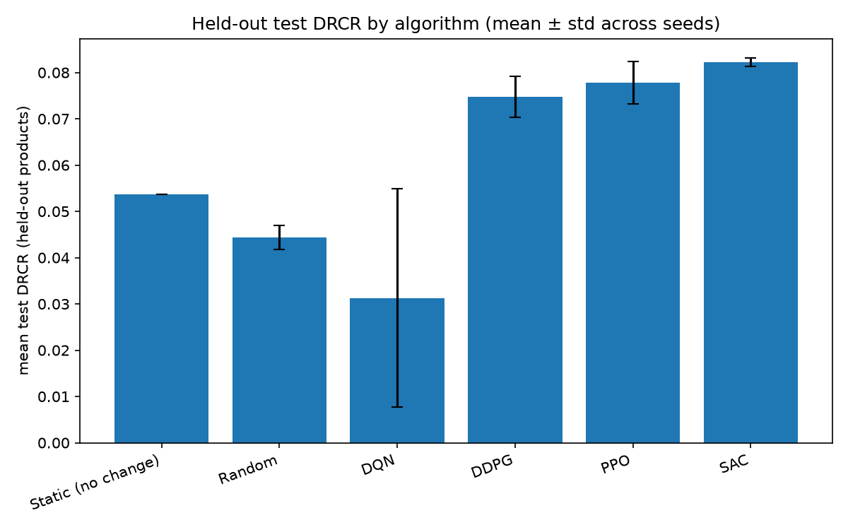
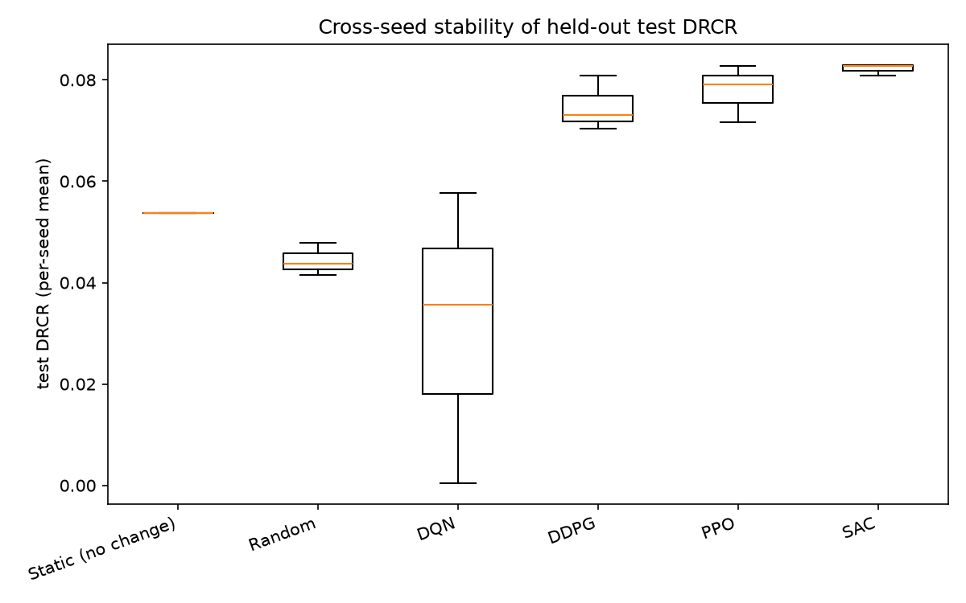
6 · RESULTS
Held-out DRCR and cross-seed stability
CSEAM731 · CIA-3 · Dynamic pricing with DQN · DDPG · PPO · SAC
18
Notes:
Left: mean test DRCR with error bars across seeds. Right: the per-seed spread. SAC's three seeds land within 0.002 of each other; DQN's range from 0.0005 to 0.058, which is the exploration-schedule problem showing up as variance.

Slide 19
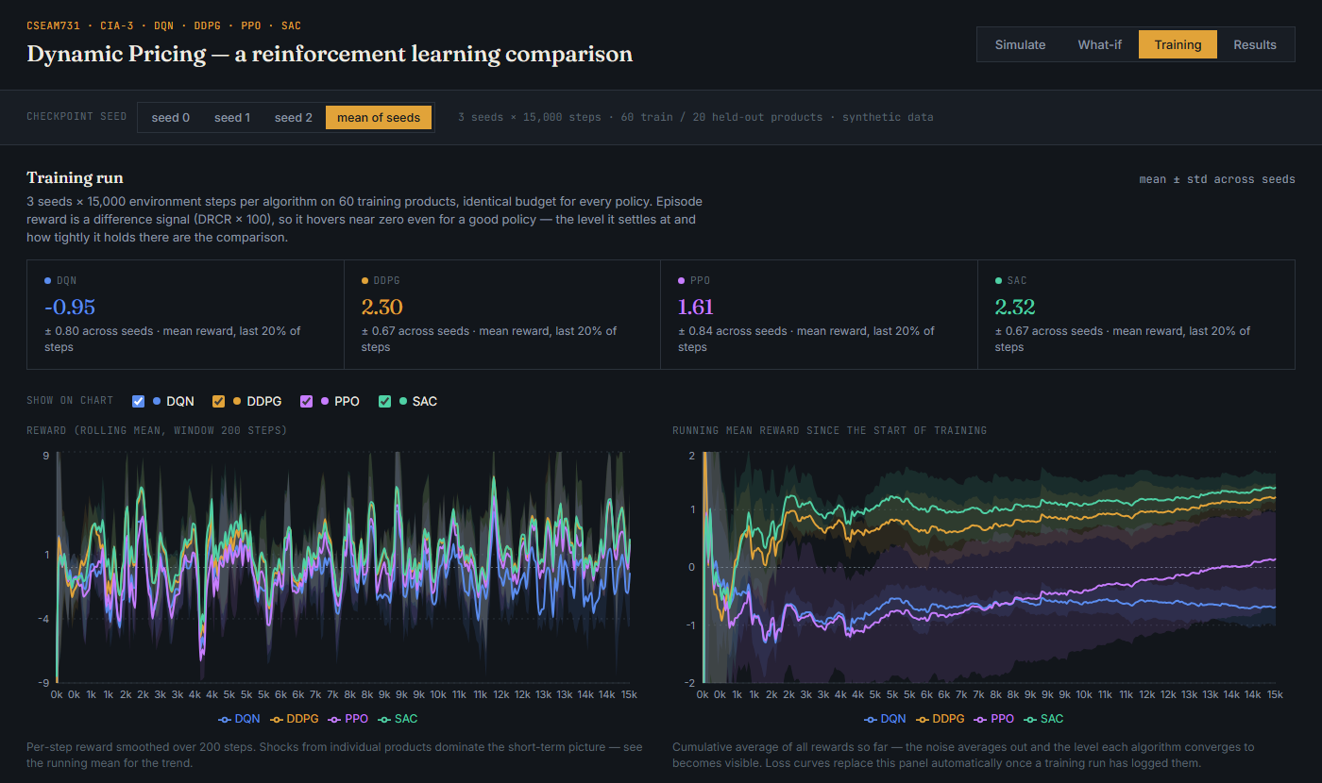
6 · TRAINING
Training behaviour: off-policy settles early, PPO is still climbing
CSEAM731 · CIA-3 · Dynamic pricing with DQN · DDPG · PPO · SAC
19
Notes:
Left panel: rolling reward, dominated by product-level shocks. Right: the running mean since step zero, where the noise averages out. SAC and DDPG converge on top by about 3,000 steps; PPO climbs steadily from minus one and has not plateaued at 15,000; DQN stays below zero.

Slide 20
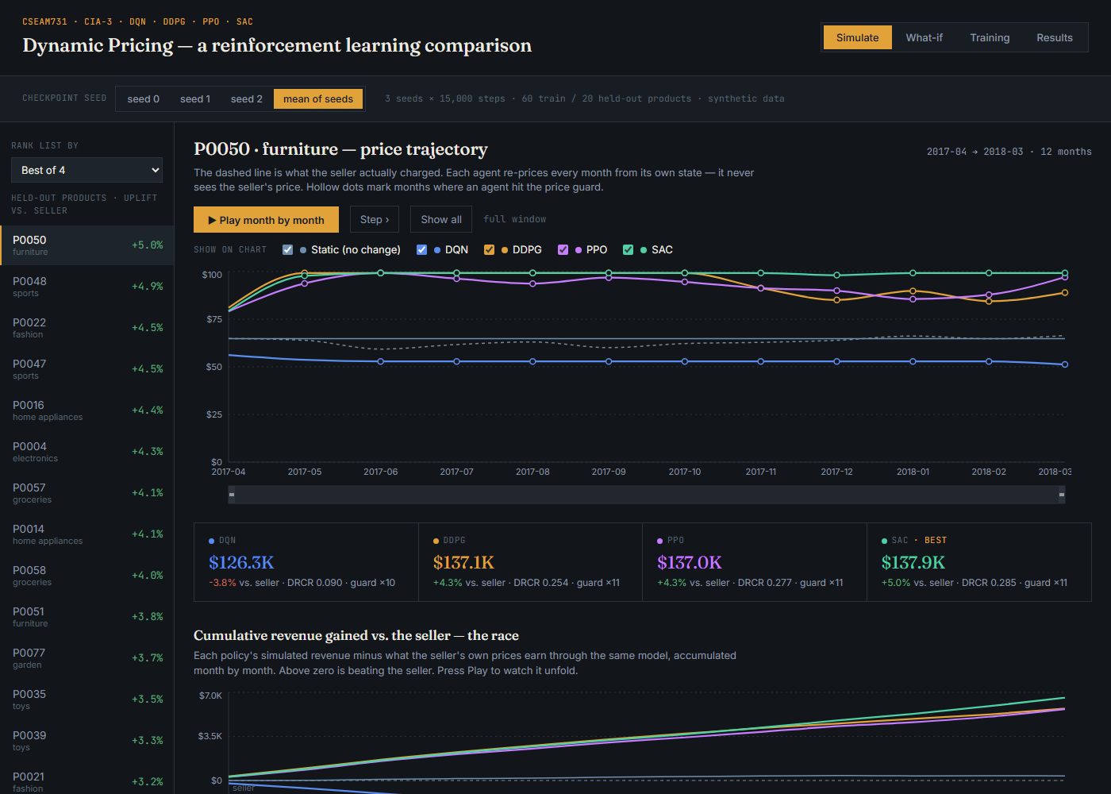
6 · DASHBOARD
Live demo: the month-by-month race
WHAT TO POINT AT
• Watchlist: 20 held-out products, ranked
• Dashed line = the seller's actual price
• Hollow dots = the price guard was hit
• ▶ Play steps month by month; stat cards are cumulative-to-date
• P0050: SAC +5.0 % vs. the seller
• Then the aggregate-uplift bars: the headline slide
CSEAM731 · CIA-3 · Dynamic pricing with DQN · DDPG · PPO · SAC
20
Notes:
Open docs/index.html, Simulate tab. Left: held-out products ranked by uplift vs the seller. Press Play: each month the four agents re-price; the dashed line is what the seller charged; hollow dots are guard hits; the scoreboard updates. Below, the race chart shows cumulative revenue gained vs the seller — above zero is beating the human.

Slide 21
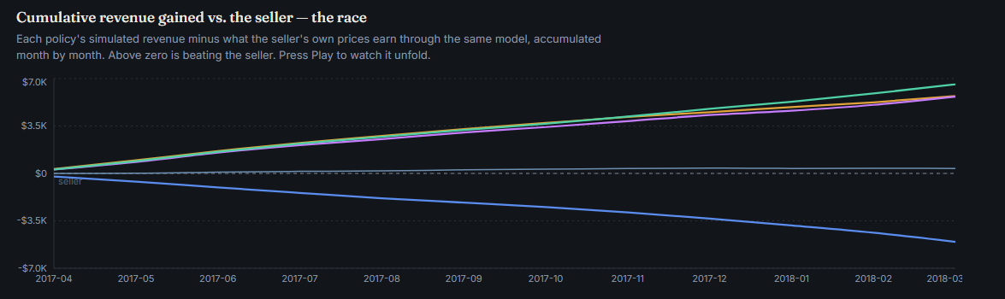
6 · DASHBOARD
Cumulative revenue gained vs. the seller (P0050, furniture)
CSEAM731 · CIA-3 · Dynamic pricing with DQN · DDPG · PPO · SAC
21
Notes:
Each line is a policy's simulated revenue minus what the seller's own prices earn through the same model, accumulated month by month. SAC, PPO and DDPG climb to roughly six to seven thousand above the seller over twelve months; DQN slips below.

Slide 22
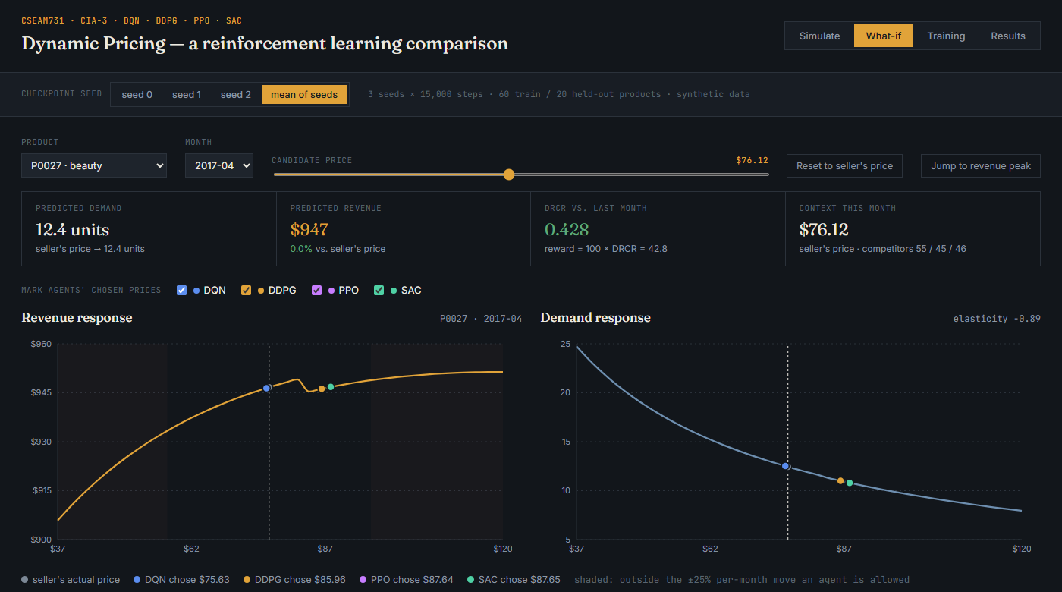
6 · DASHBOARD
Live demo: what the demand model believes
WHAT TO POINT AT
• Drag the slider: units fall, revenue rises, DRCR updates live
• Grey dot = seller's price; coloured dots = each agent's price that month
• Shaded = outside the ±25 % per-month move
• Elasticity -0.89: inelastic → revenue keeps rising with price
• This is why the continuous agents push up to the guard
• Streamlit app runs the same query live for any product
CSEAM731 · CIA-3 · Dynamic pricing with DQN · DDPG · PPO · SAC
22
Notes:
What-if tab. Pick a product and month, drag the price: units fall, revenue moves, DRCR updates. The markers show where the seller priced and where each agent priced that month. This is the single best way to explain the counterfactual model — and why the agents raise prices: for most products revenue keeps rising with price up to the guard.

Slide 23
7 · INTERPRETATION
What the ranking supports
CONTINUOUS > BUCKETED
SELF-TUNED EXPLORATION IS STEADIER
ON-POLICY COSTS SAMPLES
• DDPG, PPO and SAC all beat the seller by 3–4 %
• DQN's finest move is 5 % and it landed below the do-nothing baseline
• Reproduces the paper's DDPG > DQN
• SAC and DDPG reach the same training level (2.32 vs 2.30)
• SAC's held-out spread across seeds: ±0.0009 vs DDPG ±0.0044
• No noise schedule to get wrong
• PPO competitive at 0.0778 but still improving at 15k steps
• It cannot reuse data; off-policy agents settled by ~3k
• Exactly the trade-off the report predicts
What it does not show. That pushing prices to the guard would pay on Tmall. Inside this simulator demand is inelastic, so it is the right move; on a real market that depends on the true elasticity. The paper's 30-day field test is the evidence that RL pricing pays; this project is the evidence about which algorithm learns it best under a fair protocol.
CSEAM731 · CIA-3 · Dynamic pricing with DQN · DDPG · PPO · SAC
23
Notes:
Three claims the data supports, and one that it does not. Continuous beats bucketed; entropy-regularised exploration is more stable than a hand-scheduled noise process; PPO is competitive but slower. What it does not show: that raising prices to the guard would work on a real market — that depends on the true elasticity, and the paper's field test is the evidence for that, not this project.

Slide 24
7 · LIMITATIONS
Caveats we state before anyone asks
DQN is under-trained, not only bucket-limited
ε anneals over 25,000 steps; the run gave it 15,000, so the saved checkpoint still acted randomly 43 % of the time. Seed 2 scored 0.0005. A 50k-step run removes this confound; the bucket penalty stays.
The agents mostly raise prices and hit the guard
Fitted elasticity -0.89 is inelastic, so predicted revenue rises with price up to the 1.5× guard. Correct inside the simulator; not evidence about a real market.
The demand model under-estimates the generating elasticity
Synthetic categories were built with elasticity 1.0–2.5; monthly price moves are only ~3 %, so there is little within-product variation and ridge shrinks the slope.
The data is synthetic
Schema-identical to Kaggle's Retail Price Optimization with a known demand law, which is what lets the simulator be validated (R² 0.94). Real data changes every number, not the method.
20 products, 3 seeds
Enough to rank, not for tight confidence intervals; the per-seed dots show the honest spread.
CSEAM731 · CIA-3 · Dynamic pricing with DQN · DDPG · PPO · SAC
24
Notes:
Five honest limitations. Say them yourself; they are much cheaper to own than to be asked about.

Slide 25
7 · FUTURE WORK
Next steps
1
Re-run at the full budget
TOTAL_STEPS=50000 SEEDS="0 1 2 3 4" bash scripts/run_full_comparison.sh — lets DQN's ε schedule finish; 5 seeds for tighter intervals
2
Swap in the real Kaggle data
Drop the CSV into data/raw/, refit the demand model, rerun; the pipeline is schema-driven end to end
3
Per-category elasticity
Let β vary by category in the baseline; the synthetic generator already does, the fit does not yet
4
Log losses and re-plot
train.py now records each agent's update metrics; the next run lights up the critic/value-loss panel automatically
5
Offline RL for cold-start products
The paper pre-trains on human prices; conservative offline methods (CQL, IQL) are the modern version of that idea
CSEAM731 · CIA-3 · Dynamic pricing with DQN · DDPG · PPO · SAC
25
Notes:
Ordered by value per hour. The 50k run is one command and fixes the DQN confound. The real CSV needs no code changes. More seeds tighten the intervals. Per-category elasticity and a richer traffic proxy are modelling improvements; offline RL is the methodological step the paper's cold-start problem points at.

Slide 26
SUMMARY
Conclusion
Same states, same actions, same reward — only the learner changed. SAC set the best prices and did so most consistently.
• Continuous pricing beats bucketed pricing — DDPG, PPO and SAC all beat the seller's own prices by 3–4 %; DQN, with 5 % steps and an unfinished exploration schedule, did not.
• Entropy-regularised exploration is the stable one — SAC matched DDPG's level with a 5× tighter spread across seeds and nothing scheduled by hand.
• On-policy robustness costs samples — PPO was competitive and still climbing when the budget ran out.
• The comparison is honest and reproducible — a validated counterfactual demand model with guard rails, held-out products, identical budgets, smoke-tested learners, and a dashboard where every number traces to a checkpoint.
CSEAM731 · CIA-3 · Dynamic pricing with DQN · DDPG · PPO · SAC
26
Notes:
One shared problem, four learners, one fair protocol, one measured answer. SAC best and steadiest; continuous beats bucketed; PPO robust but slow; everything reproducible from one script and visible in the dashboard.

Slide 27
SOURCES
References
• Liu, J., Zhang, Y., Wang, X., Deng, Y., & Wu, X. (2019). Dynamic Pricing on E-commerce Platform with Deep Reinforcement Learning: A Field Experiment. arXiv:1912.02572.
• Mnih, V., et al. (2015). Human-level control through deep reinforcement learning. Nature, 518(7540), 529–533.
• Lillicrap, T. P., et al. (2015). Continuous control with deep reinforcement learning. arXiv:1509.02971.
• Schulman, J., Wolski, F., Dhariwal, P., Radford, A., & Klimov, O. (2017). Proximal Policy Optimization Algorithms. arXiv:1707.06347.
• Haarnoja, T., Zhou, A., Abbeel, P., & Levine, S. (2018). Soft Actor-Critic: Off-Policy Maximum Entropy Deep RL with a Stochastic Actor. arXiv:1801.01290.
• Sutton, R. S., & Barto, A. G. (2018). Reinforcement Learning: An Introduction (2nd ed.). MIT Press.
• Kaggle: Retail Price Optimization dataset (Olist-derived). Code and dashboard: github.com/Feliz7000/rl-dynamic-pricing-comparison
CSEAM731 · CIA-3 · Dynamic pricing with DQN · DDPG · PPO · SAC
27

Slide 28
Questions
Live dashboard: docs/index.html · Live models: streamlit run app/streamlit_app.py
github.com/Feliz7000/rl-dynamic-pricing-comparison
CSEAM731 · CIA-3 · Dynamic pricing with DQN · DDPG · PPO · SAC
28
Notes:
Likely questions: how can you score a price never charged (the demand model, same for every policy); why do agents raise prices (inelastic fitted demand); why is DQN below baseline (buckets plus the unfinished epsilon schedule); why is PPO behind SAC (sample efficiency, still climbing); how do you know the RL code is right (CartPole and Pendulum first).

