Slide 1
Agentic Quality Engineering
Systematic Quality Assurance for Multi-Agent Systems
Senior Director, AI Platform Engineering — Microsoft
MLDS 2026 · 27 March 2026

Slide 2
What is Agentic Quality Engineering?
The discipline of ensuring AI agents behave correctly, reliably, safely, and auditably — in production, at scale.
Correctness
Factually accurate, grounded outputs with citation provenance
Reliability
Consistent behavior across repeated executions and edge cases
Safety
Operates within guardrails, permission boundaries, and ethical limits
Efficiency
Token usage, latency, and cost within defined budgets
Auditability
Every decision forensically reconstructable after the fact
MLDS 2026 · Agentic Quality Engineering · 2/12

Slide 3
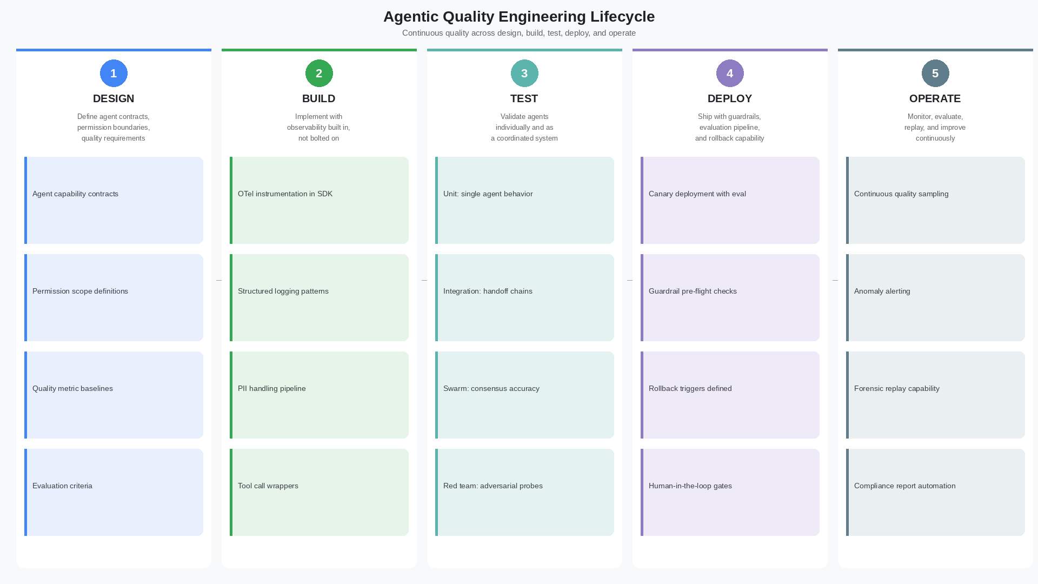
Quality Engineering Lifecycle
MLDS 2026 · Agentic Quality Engineering · 3/12

Slide 4
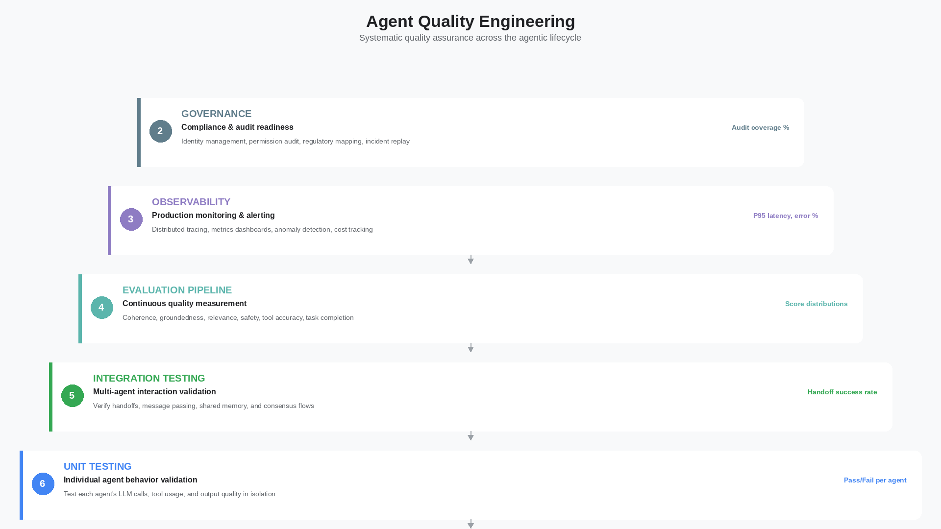
Agent Quality Pyramid
MLDS 2026 · Agentic Quality Engineering · 4/12

Slide 5
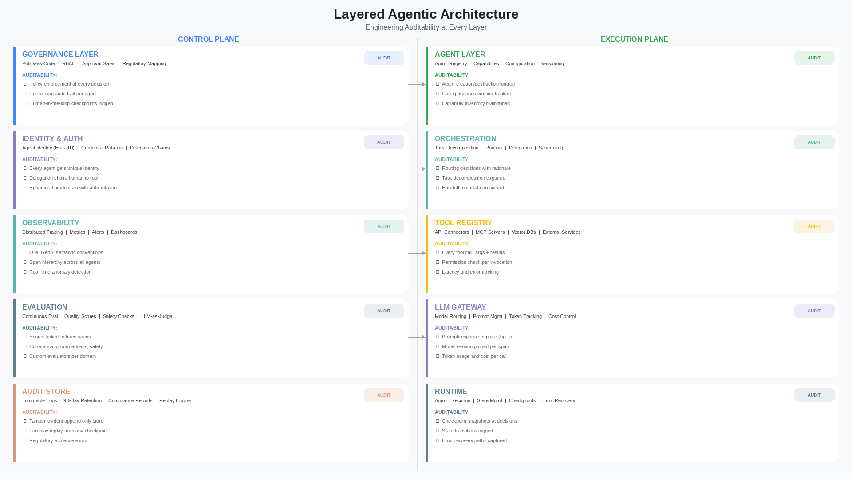
Layered Architecture — Auditability at Every Layer
MLDS 2026 · Agentic Quality Engineering · 5/12

Slide 6
Control Plane — Where Auditability Lives
The control plane governs policy, identity, routing, evaluation, and audit — separated from execution
Governance Layer
Policy-as-code enforced at every decision. Approval gates logged immutably.
Identity & Auth
Agent identity (Entra ID), delegation chains, credential rotation — all audited.
Observability Layer
OTel tracing, metrics, alerts. The nervous system of the audit trail.
Evaluation Layer
Continuous quality scores linked to trace spans. Safety + compliance signals.
Audit Store
Immutable, tamper-evident log. 90-day retention. Forensic replay engine.
MLDS 2026 · Agentic Quality Engineering · 6/12

Slide 7
Execution Plane — What Gets Audited
Agents, orchestration, tools, LLMs, and runtime — every layer generates audit spans
Agent Layer
Agent creation/destruction, config changes, capability inventory — version tracked.
Orchestration
Task decomposition rationale, routing decisions, handoff metadata — all logged.
Tool Registry
Every tool call captured: arguments, results, permissions checked, latency.
LLM Gateway
Prompt/response capture (opt-in), model version pinned, token + cost per call.
Runtime
Checkpoint snapshots, state transitions, error recovery paths — all recorded.
MLDS 2026 · Agentic Quality Engineering · 7/12

Slide 8
What is Engineering Auditability?
Engineering Auditability is the practice of building forensic reconstruction capability into the architecture itself — not adding it after deployment.
At the Control Plane:
Policy enforcement, identity management, evaluation scores, compliance evidence
At the Execution Plane:
Agent actions, tool calls, LLM interactions, state transitions, error recovery
Across Both Planes:
Distributed tracing (OTel), immutable audit store, forensic replay engine
MLDS 2026 · Agentic Quality Engineering · 8/12

Slide 9
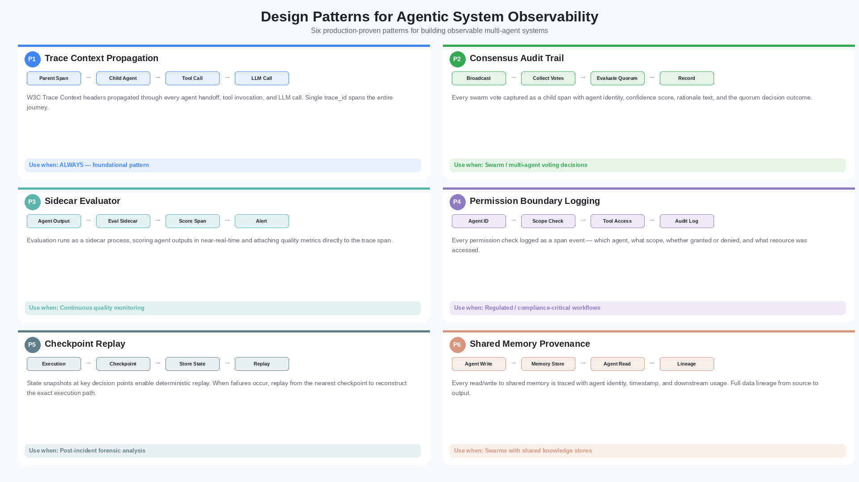
Design Patterns for Observability
MLDS 2026 · Agentic Quality Engineering · 9/12

Slide 10
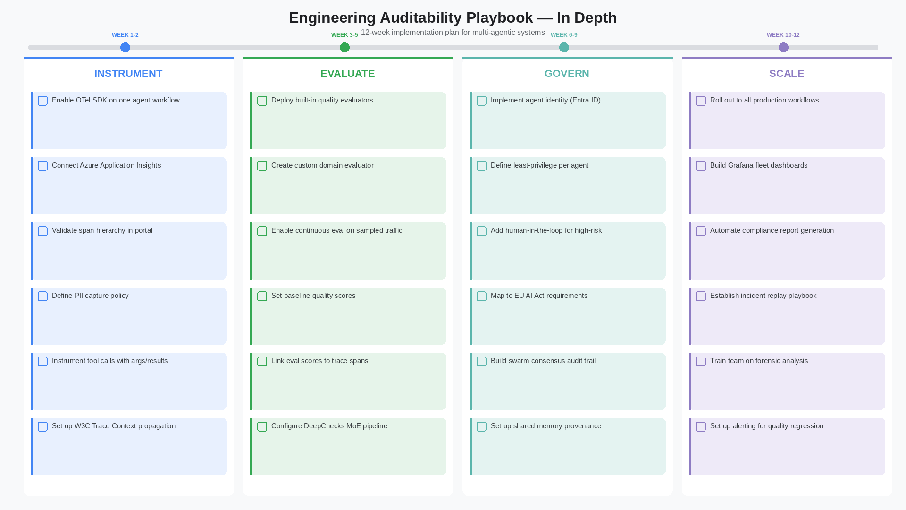
Implementation Playbook — 12 Weeks
MLDS 2026 · Agentic Quality Engineering · 10/12

Slide 11
Key Takeaways
01
Quality engineering is a lifecycle — design, build, test, deploy, operate
02
Separate control plane (govern) from execution plane (run)
03
Engineering auditability means building forensic capability into the architecture
04
Every layer generates audit spans — agent, orchestration, tool, LLM, runtime
05
6 design patterns make observability a first-class concern, not an afterthought
MLDS 2026 · Agentic Quality Engineering · 11/12

Slide 12
Agentic quality is not a testing phase —
it is an architectural commitment.
Thank You — MLDS 2026

