Slide 1
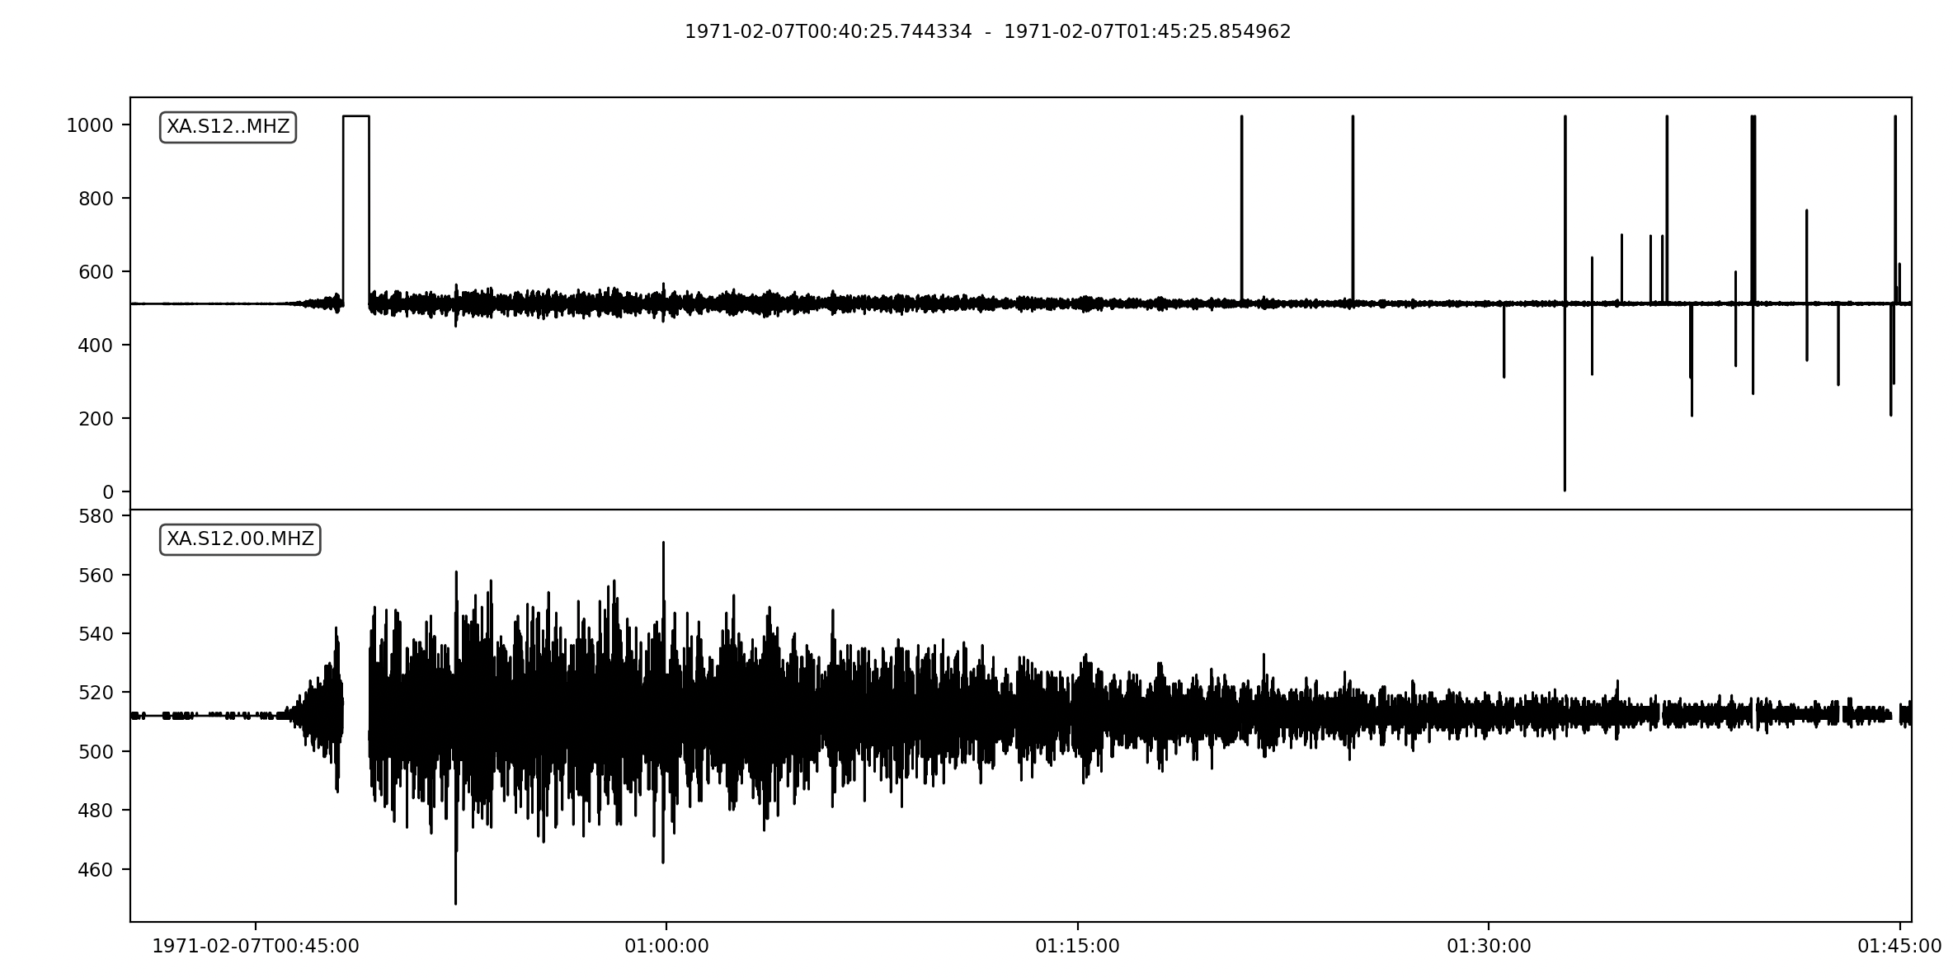
Data Cleaning
Apollo 14 – Lunar Module impact
S12 MHZ
Digital Units
All data on tape
S12 MHZ
Digital Units
Damaged data excluded and trace despiked

Slide 3
Data Cleaning
Apollo 14 – Lunar Module impact
S12 MHZ
Digital Units
All data on tape
S12 MHZ
Digital Units
Damaged data excluded and trace despiked

Slide 4
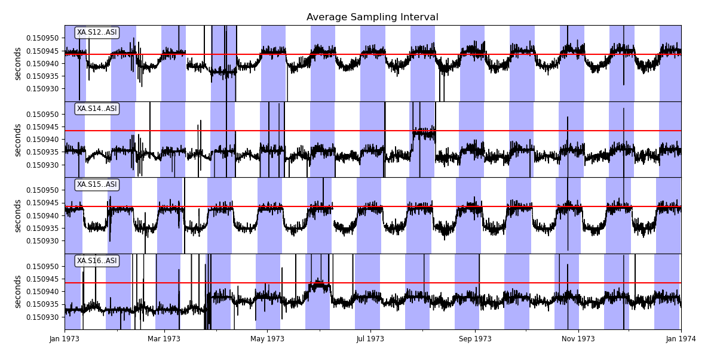
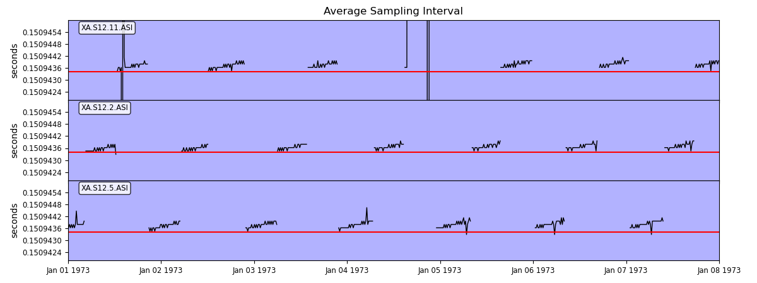
a)
b)

