Slide 1

Design Thinking
By Jarazet Altamirano

Slide 2
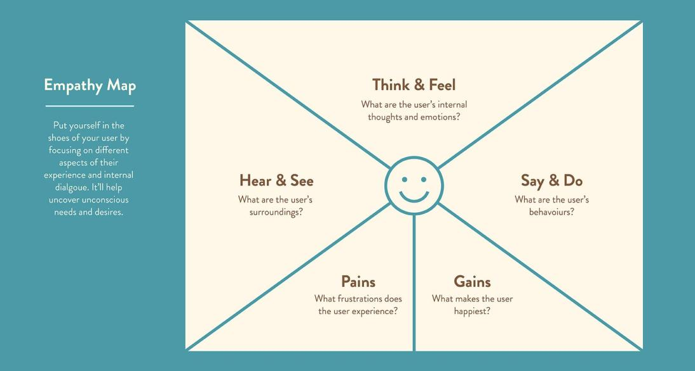
Notes:
https://www.toptal.com/designers/product-design/design-problem-statement

Slide 3
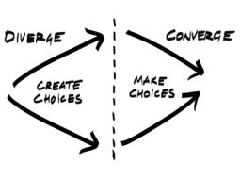
Challenge Definition / “CD” Canvas
1. Understand
Gap between the current state & the desired state: Pains
Expand
3. Define
How might we convert the needs into opportunities?
4. Reframe
Zoom out of the challenge: Ask What if?
Connecting
Dots
___________
2 . Explore
Explicit & implicit wants: 5 Whys
Designed by Jarazet Altamirano based on the steps of the Design Thinking Methodology License: CC BY-SA 3.0

