Slide 1
CS 4843 Cloud Computing Spark
Palden Lama, PhD
Department of Computer Science
University of Texas at San Antonio

Slide 2
Limitations of traditional big data solutions (MapReduce, Dyrad, etc.)
Data re-use requires writing and reading from distributed file system, which has a lot of overhead (disk I/O, replication, serialization)
Not suitable for iterative machine learning (e.g K-means clustering, logistic regression, etc.) and graph algorithms (e.g PageRank, shortest path, etc.)
Not suitable for interactive data mining (where a user would like to load data into RAM across a cluster and query it repeatedly.)
Not suitable for stream processing (real-time data processing)
Notes:
Interactive data mining - user runs multiple adhoc queries on the same subset of the data

Slide 3
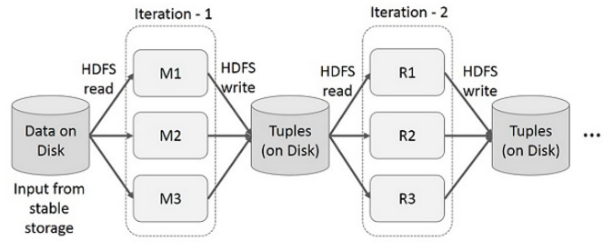
Iterative Operations with MapReduce

Slide 4
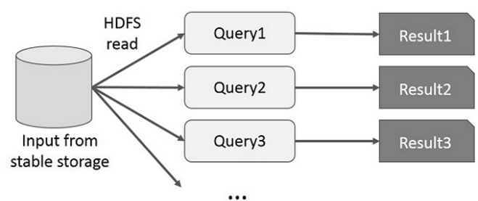
Interactive Operations with MapReduce

Slide 5
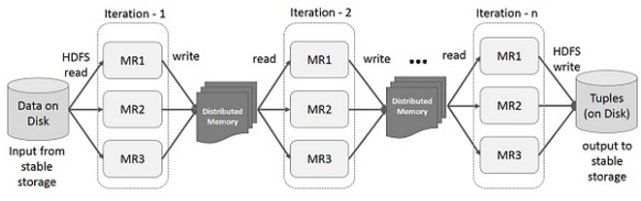
Iterative Operations with Spark

Slide 6
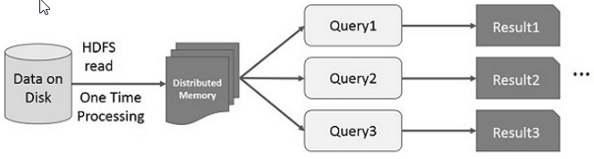
Interactive Operations with Spark

Slide 7
What is Spark?
Fast and Expressive Cluster Computing Engine Compatible with Apache Hadoop, Mesos, and Standalone.
Up to 10× faster on disk, 100× in memory
2-5× less code
Efficient
Usable
Generalized execution model
In-memory storage
(RDD)
Rich APIs in Java, Scala, Python
Interactive shell
Courtesy: DataBricks
Notes:
generalized execution model to support a wide variety of applications
In-memory -> good for interactive data mining, and iterative algorithms

Slide 8
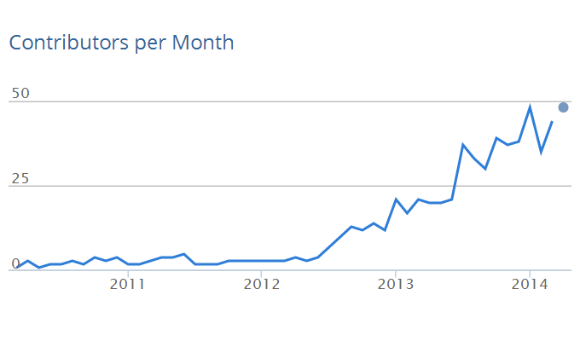
Originally developed in 2009 in UC Berkeley’s AMPLab, and open sourced in 2010.
50 organizations
200+ contributers
Courtesy: DataBricks

Slide 9
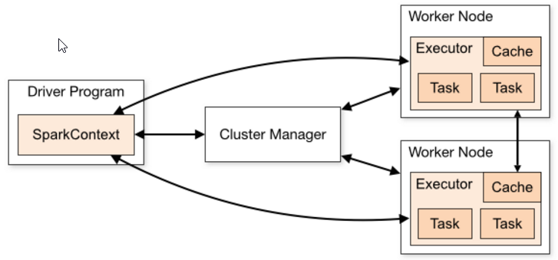
Spark Cluster Architecture
Driver Program:
Runs on the master node, schedules job execution & negotiates resources with the cluster manager.
It is the entry point of the Spark Shell.
It runs the main() function of a Spark application and creates a SparkContext.
Executor:
Worker process running on behalf of a Spark application.
Runs tasks (as threads) for computation.
Keeps data in memory (cache) or disk storage
Each Spark application runs its own Driver Program and an independent set of Executors.

Slide 10
Job Scheduling
Scheduling across applications:
The cluster managers that Spark runs on provides this facility.
For example: Standalone cluster manager performs FIFO scheduling across applications
Scheduling within application:
Driver program is responsible for scheduling jobs within an application.
Spark includes a fair scheduler to schedule resources within each SparkContext.

Slide 11
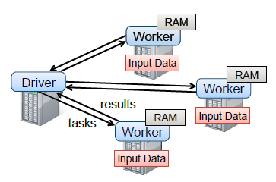
Spark cluster in action

Slide 12
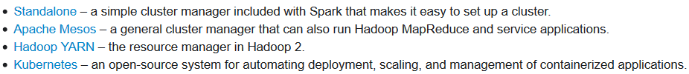
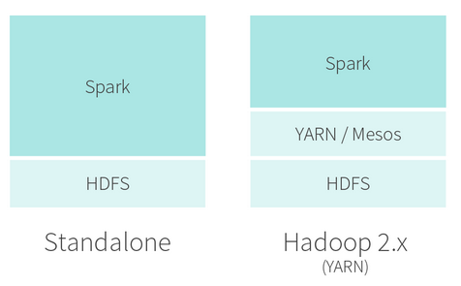
Spark Deployment
Cluster Managers supported by Spark
Spark is 100% compatible with Hadoop’s Distributed File System (HDFS)

Slide 13
Key Concept behind Spark : RDD (Resilient Distributed Datasets)
A fault-tolerant abstraction for in-memory cluster computing
RDD represents a read-only partitioned collection of records that are distributed across multiple machines, and can be operated in parallel.
Enables efficient data re-use (RDD can persist in distributed memory)
Fault-tolerant

Slide 14
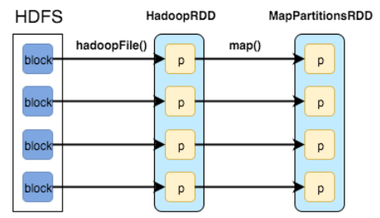
RDD Concept in Spark
(data in disk)
(data in memory)
(data in memory)
Compare this with Mapreduce
4 parallel tasks
4 parallel tasks

Slide 15
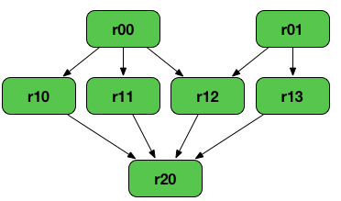
RDD lineage – Logical Execution Plan
RDD Lineage (aka RDD operator graph or RDD dependency graph) is a graph of all the parent RDDs of a RDD. It is built as a result of applying transformations to the RDD and creates a logical execution plan.
RDD lineage of r20
Lost partition(s) of r20
Lost partition(s) of r20 and r12
Fault tolerant without replicating data across machines

Slide 16
RDD Efficiency
Fault tolerant without replicating data across machines
Logging transformations (operations) used to build a dataset. Keeps track of lineage rather than replicating actual data.
If a partition of RDD is lost, there is enough information about how it was derived from parent RDDs or from data in storage to recompute that partition.
Amount of transformations to be logged is kept small due to the fact that RDD only allows coarse grained transformation (that apply the same operation to many data items e.g map, filter, join, etc.).

Slide 17
RDD Features
RDD Persistence
Programmers can use persist() method on the RDD to save it in memory for future use
Spark keeps persistent RDDs in memory by default, but it can spill them to disk if there is not enough RAM.
Users can set a persistence priority on each RDD to specify which in-memory data should spill to disk first.
RDD Partitioning
By default, a partition is created for each HDFS block, which by default is 64MB.
Users can override the default partitioning, and specify the number of partitions for an RDD.
The number of partitions determine the parallelism (number of concurrent tasks) of a Spark job.

Slide 18
RDD Operations
Transformations - are lazy operations on a RDD that create one or more new RDDs
map : applies a user-provided function to each dataset element
filter: applies a criteria to select dataset elements
join: combines multiple datasets based on common key
Many others…
Actions - return a value to the driver program after running a computation on the dataset
count
collect
reduce
saveAsTextFile
Many others…
https://spark.apache.org/docs/latest/rdd-programming-guide.html

Slide 19
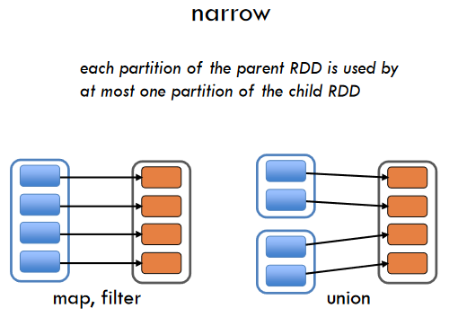
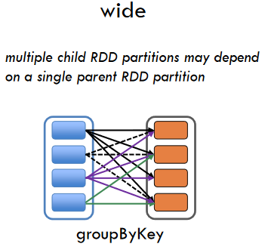
RDD Operations
Types of Transformations : narrow vs. wide
Data is not shuffled.
Data needs to be shuffled across partitions.
-> network intensive

Slide 20
Spark Job and Stages
Job - is a top-level work item (computation) submitted to DAGScheduler to compute the result of an action. A single Spark application may trigger multiple jobs.
DAGScheduler - is the scheduling layer of Apache Spark (part of driver program) that transforms a logical execution plan (i.e. RDD lineage) to a physical execution plan. It splits a job into a number of stages that form a Directed Acyclic Graph, keeps track of which RDDs and stage outputs are materialized, and finds a minimal schedule to run jobs.
Stage - A stage is a set of parallel tasks (one task per RDD partition) that compute partial results of a function executed as part of a Spark job.

Slide 21
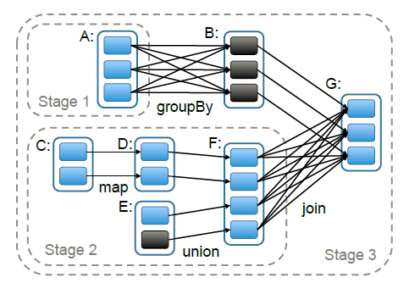
A Spark Job running in stages
To run an action on RDD G, the DAGScheduler builds stages of the job.
stages are separated at wide dependencies (transformations)
narrow transformations are pipelined inside each stage.
Which transformations in the Figure are wide and which ones are narrow ?
A DAG of stages belonging to a particular job. Partitions are shaded rectangles,
in black if they are already in memory.

Slide 22
Spark Programming in Python
Import some Spark classes into your program
Initialize Spark
Build a SparkConf object that contains information about your application.
Create a SparkContext object, which tells Spark how to access a cluster
from pyspark import SparkContext, SparkConf
conf = SparkConf().setAppName(“myappname”)
sc = SparkContext(conf=conf)
Or
sc = SparkContext(appName=“myappname”)
Notes:
The appName parameter is a name for your application to show on the cluster UI

Slide 23
Spark Programming in Python
SparkConf example
conf = SparkConf()
conf.setAppName(“my application name”)
conf.set(‘spark.executor.memory’, ‘2g’)
conf.set(‘spark.executor.cores’, 4)
sc = SparkContext(conf=conf)
Notes:
The appName parameter is a name for your application to show on the cluster UI

Slide 24
Spark Shell/Programming in Python working with RDD
Create RDD using Parallelized Collections
data = [1, 2, 3, 4, 5, 6]
distData = sc.parallelize(data)
OR,
distData = sc.parallelize(data, 2)
distData.getNumPartitions()
sc.defaultParallelism
distData.count()
distData.sum()
https://spark.apache.org/docs/1.6.1/programming-guide.html
Notes:
calling SparkContext’s parallelize method on an existing collection

Slide 25
Spark Shell/Programming in Python working with RDD
The RDD (distData) can be operated in parallel
distData.reduce(lambda a, b: a + b)
from operator import add
distData.reduce(add)
Action | Meaning
reduce(func) | Aggregate the elements of the dataset using a function func (which takes two arguments and returns one). The function should be commutative and associative so that it can be computed correctly in parallel.
Notes:
The function is called with the first two elements from the list,
then with the result of that call and the third element, and so on, until all of the list elements have been handled

Slide 26
Spark Shell/Programming in Python working with RDD
The RDD (distData) can be operated in parallel
data = [1, 2, 3, 4, 5, 6]
distData = sc.parallelize(data, 2)
distData.reduce(lambda a, b: a + b)
1,2,3
reduce -> 6
The function is called with the first two elements from the list, then with the result of that call and the third element, and so on, until all of the list elements have been handled
reduce -> 21
4,5,6
reduce -> 15
distData
Tasks running on worker nodes
Final result in driver program
Notes:
The function is called with the first two elements from the list,
then with the result of that call and the third element, and so on, until all of the list elements have been handled

Slide 27
Spark Shell/Programming in Python working with RDD
Create RDD using External Dataset
distFile = sc.textFile(“file:///home/hduser/data.txt”)
distFile = sc.textFile(“file:///home/hduser/*.txt”)
distFile = sc.textFile(“hdfs://<namenode_ip>:54310/inputpath”)
Textfile is read as a collection of lines
URI for the file (either a local path on the machine, or a hdfs://, s3n://, etc
Notes:
create distributed datasets from any storage source supported by Hadoop, including your local file system, HDFS, Cassandra, HBase, Amazon S3,
any other Hadoop InputFormat.

Slide 28
Spark Shell/Programming in Python working with RDD
Create RDD using External Dataset
The textFile method also takes an optional second argument for controlling the number of slices of the file
By default, Spark creates one slice for each block of the file (blocks being 64MB by default in HDFS)
Note that you cannot have fewer slices than blocks.
Notes:
create distributed datasets from any storage source supported by Hadoop, including your local file system, HDFS, Cassandra, HBase, Amazon S3,
any other Hadoop InputFormat.

Slide 29
Passing Functions to Spark
Lambda expressions
Using separate function definition
lines = sc.textFile(“file:///home/hduser/data.txt")
lineLengths = lines.map(lambda s: len(s))
totalLength = lineLengths.reduce(lambda a, b: a + b)
Lambdas do not support multi-statement functions or statements that do not return a value
def myFunc(s):
words = s.split(" ")
return len(words)
lines.map(myFunc)

Slide 30
Lazy Transformation and Persistence
Lazy Transformation: Spark does not start applying RDD transformations until the first action is called.
Persistence: By default, RDDs do not persist in memory. They are created and transformed everytime an action is called. Use persist() or cache() method to save the RDD in memory.
lines = sc.textFile(“file:///home/hduser/data.txt")
lineLengths = lines.map(lambda s: len(s))
totalLength = lineLengths.reduce(lambda a, b: a + b)
lineLengths.persist()

Slide 31
Working with Key-Value Pairs
A few special Spark operations are only available on RDDs of key-value pairs.
Example: distributed “shuffle” operations, such as grouping or aggregating the elements by a key.
lines = sc.textFile(“file:///home/hduser/data.txt")
pairs = lines.map(lambda s: (s, 1))
counts = pairs.reduceByKey(lambda a, b: a + b)
counts.collect()
counts how many times each line of text occurs in a file
reduceByKey(func, [numTasks]) | When called on a dataset of (K, V) pairs, returns a dataset of (K, V) pairs where the values for each key are aggregated using the given reduce function func, which must be of type (V,V) => V. Like in groupByKey, the number of reduce tasks is configurable through an optional second argument.

Slide 32
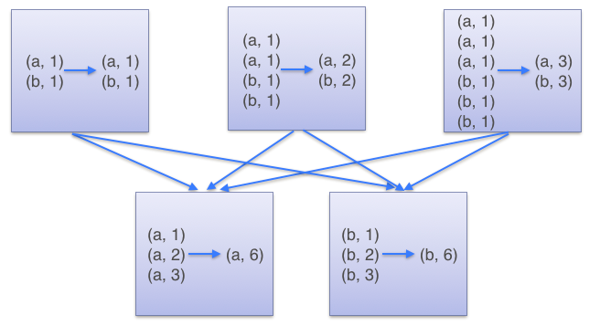
reduceByKey Transformation Example
X = sc.parallelize([(‘a’,1),(‘b’,1),(‘a’,1)…… ], 3)
Y = X.reduceByKey(lambda a, b: a + b)
Combiner based on the reduce function/lambda is automatically executed
RDD X
To determine which machine/partition to shuffle a pair to, Spark calls a partitioning function on the key of the pair.
RDD Y

Slide 33
groupByKey Transformation Example
Y = X.groupByKey()
(a,1)
(b,1)
(a,1)
(a,1)
(b,1)
(b,1)
(a,1)
(a,1)
(a,1)
(b,1)
(b,1)
(b,1)
RDD X
(a,[1,1,1,1,1,1])
(b,[1,1,1,1,1,1])
RDD Y
Y.mapValues(list).collect()

Slide 34
Some Key-Value Operations
pets = sc.parallelize( [(“cat”, 1), (“dog”, 1), (“cat”, 2)])
pets.reduceByKey(lambda x, y: x + y)
pets.groupByKey()
pets.sortByKey()
# => {(cat, 3), (dog, 1)}
# => {(cat, [1, 2]), (dog, [1])}
# => {(cat, 1), (cat, 2), (dog, 1)}

Slide 35
Other Key-Value Operations
visits = sc.parallelize([ (“index.html”, “1.2.3.4”), (“about.html”, “3.4.5.6”), (“index.html”, “1.3.3.1”) ])
pageNames = sc.parallelize([ (“index.html”, “Home”), (“about.html”, “About”), (“contact.html”, “Contact”) ])
visits.join(pageNames) # (“index.html”, (“1.2.3.4”, “Home”)) # (“index.html”, (“1.3.3.1”, “Home”)) # (“about.html”, (“3.4.5.6”, “About”))
visits.cogroup(pageNames) # (“index.html”, ([“1.2.3.4”, “1.3.3.1”], [“Home”])) # (“about.html”, ([“3.4.5.6”], [“About”]))

Slide 36
Other Key-Value Operations
rdd = sc.parallelize([("a", 1), ("b", 1), ("a", 1)])
rdd.groupByKey().mapValues(len).collect()
[('a', 2), ('b', 1)]
rdd.groupByKey().mapValues(list).collect()
[('a', [1, 1]), ('b', [1])]

Slide 37
Basic Transformations Summary
A SparkContext represents the connection to a Spark cluster,
nums = sc.parallelize([1, 2, 3])
# Pass each element through a function
squares = nums.map(lambda x: x*x)
# Keep elements passing a predicate
even = squares.filter(lambda x: x % 2 == 0)
# Map each element to zero or more others
nums.flatMap(lambda x: range(x))
# => {0, 0, 1, 0, 1, 2}
Range object (sequence of numbers 0, 1, …, x-1)
Notes:
All lazy

Slide 38
Basic Actions Summary
nums = sc.parallelize([1, 2, 3])
# Retrieve RDD contents as a local collection
nums.collect() # => [1, 2, 3]
# Return first K elements
nums.take(2) # => [1, 2]
# Count number of elements
nums.count() # => 3
# Merge elements with an associative function
nums.reduce(lambda x, y: x + y) # => 6
# Write elements to a text file
nums.saveAsTextFile(“file:///file.txt”)
Notes:
Launch computations

Slide 39
Setting the Level of Parallelism
All the pair RDD operations take an optional second parameter for number of tasks
words.reduceByKey(lambda x, y: x + y, 5)
words.groupByKey(5)
visits.join(pageViews, 5)

Slide 40
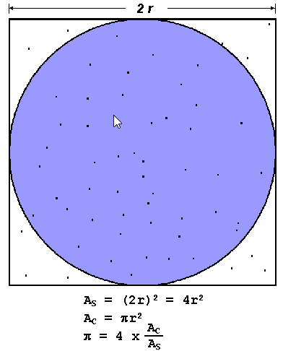
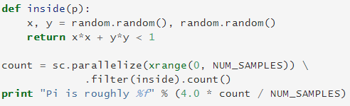
Example: Pi Estimation
sc = SparkContext(appName=“myappname”)

Slide 41
Example: Wordcount
RDD lines
(Deer, 1)
(Bear, 1)
(River, 1)
(Bear, 1)
reduceByKey
(Bear, 2)
(Deer, 2)
Deer Bear River
Bear
flatMap,
map
Deer Car River
Car
(Deer, 1)
(Car, 1)
(River, 1)
(Car, 1)
(Car, 2)
(River, 2)
lines = sc.textFile("hdfs://<namenode_ip>:54310/inputpath") counts = lines.flatMap(lambda line: line.split(" ")) \ .map(lambda word: (word, 1)) \ .reduceByKey(lambda a, b: a + b) counts.saveAsTextFile("hdfs://...")
Notes:
Flatmap: Similar to map, but each input item can be mapped to 0 or more output items (so func should return a Seq rather than a single item).

Slide 42
Example: Sort Numeric Data
lines = sc.textFile(“file:///user/hduser/myfile”)
sortedCount = lines.flatMap(lambda x: x.split(“ ”)) \
.map(lambda x: (int(x),1)) \
.sortByKey()
output = sortedCount.collect()
for (num, unitcount) in output:
print (num)

Slide 43
Examples:
Assume that Gutenberg project’s ebooks are stoed in the following HDFS location : /user/hduser/gutenberg. The Namenode IP address is 129.115.30.77 and port number is 54310. Using the Spark Shell,
count the total number of lines in the ebooks.
count the total number of words in the ebooks.
c) count how many times does the word “world” appears in the ebooks.
lines = sc.textFile("hdfs://129.115.30.77:54310/user/hduser/gutenberg")
lines.count()
import re
nonblanks = lines.filter(lambda line: not re.match(r"^\s*$",line))
words = nonblanks.flatMap(lambda line: line.split(" "))
words.count()
words.filter(lambda word: re.search(r"\bworld\b",word)).count()
map vs flatMap
re.match vs re.search
https://docs.python.org/2/howto/regex.html#regex-howto

Slide 44

Example: Log Mining (finding cause of error from web service log)
Using Spark, the operator can load just the error messages from the logs into RAM across a set of nodes and query them interactively.
RDD definition
At this point, no work has been performed on the cluster.
Notes:
Filter tranformation

Slide 45
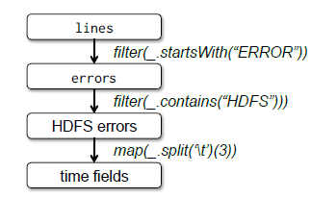
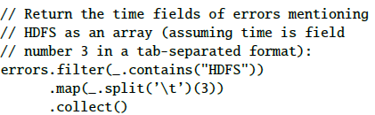
Example: Log Mining (cont’d)
RDD action: collect
Lineage graph
Spark will store the partitions of errors in memory
The Spark scheduler will pipeline the transformations and send a set of tasks to compute them to the nodes holding the cached partitions of errors.
Notes:
When first action is encountered, spark applies transformations..
If a partition of errors is lost, spark rebuilds it by applying filter on only the corresponding partition of lines

Slide 46
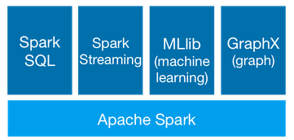
Spark Ecosystem

Slide 47
References
http://spark.apache.org
http://spark.apache.org/docs/1.6.1/quick-start.html
http://spark.apache.org/docs/1.6.1/programming-guide.html

