Slide 1
DESIGN AND IMPLEMENTATION OF AN E-COMMERCE WEBSITE

Slide 2
METHODOLOGY
We used the Waterfall model.
We actually drew a plan using trello and ticked the completion of each module of the project after completion.
We ensured that all we were thought in class got implemented in the project.
We also did our own research thereby implementing other methods to accomplish our purpose

Slide 3
IMPLEMENTATION
We were able to achieve this project with the use of
Express Node.Js
MongoDB
Html/CSS3
Bootstrap(minimal)
"also with the help of npm dependencies featured in the next slide"

Slide 4
DEPENDENCIES
Dependency is a state in which one object uses a function of another object.
bcrypt
bcryptjs
body-parser
connect-flash
express
express-handlebars
express-session
method
method-override
mongoose
multer
override
passport
passport-local
uuid

Slide 5
MIDDLEWARE
Middleware is the software layer that lies between the operating system and the applications on each side of a distributed computer network.
Middleware functions are functions that have access to the request object ( req ), the response object ( res ), and the next function in the application's request-response cycle. The next function is a function in the Express router which, when invoked, executes the middleware succeeding the current middleware.

Slide 6
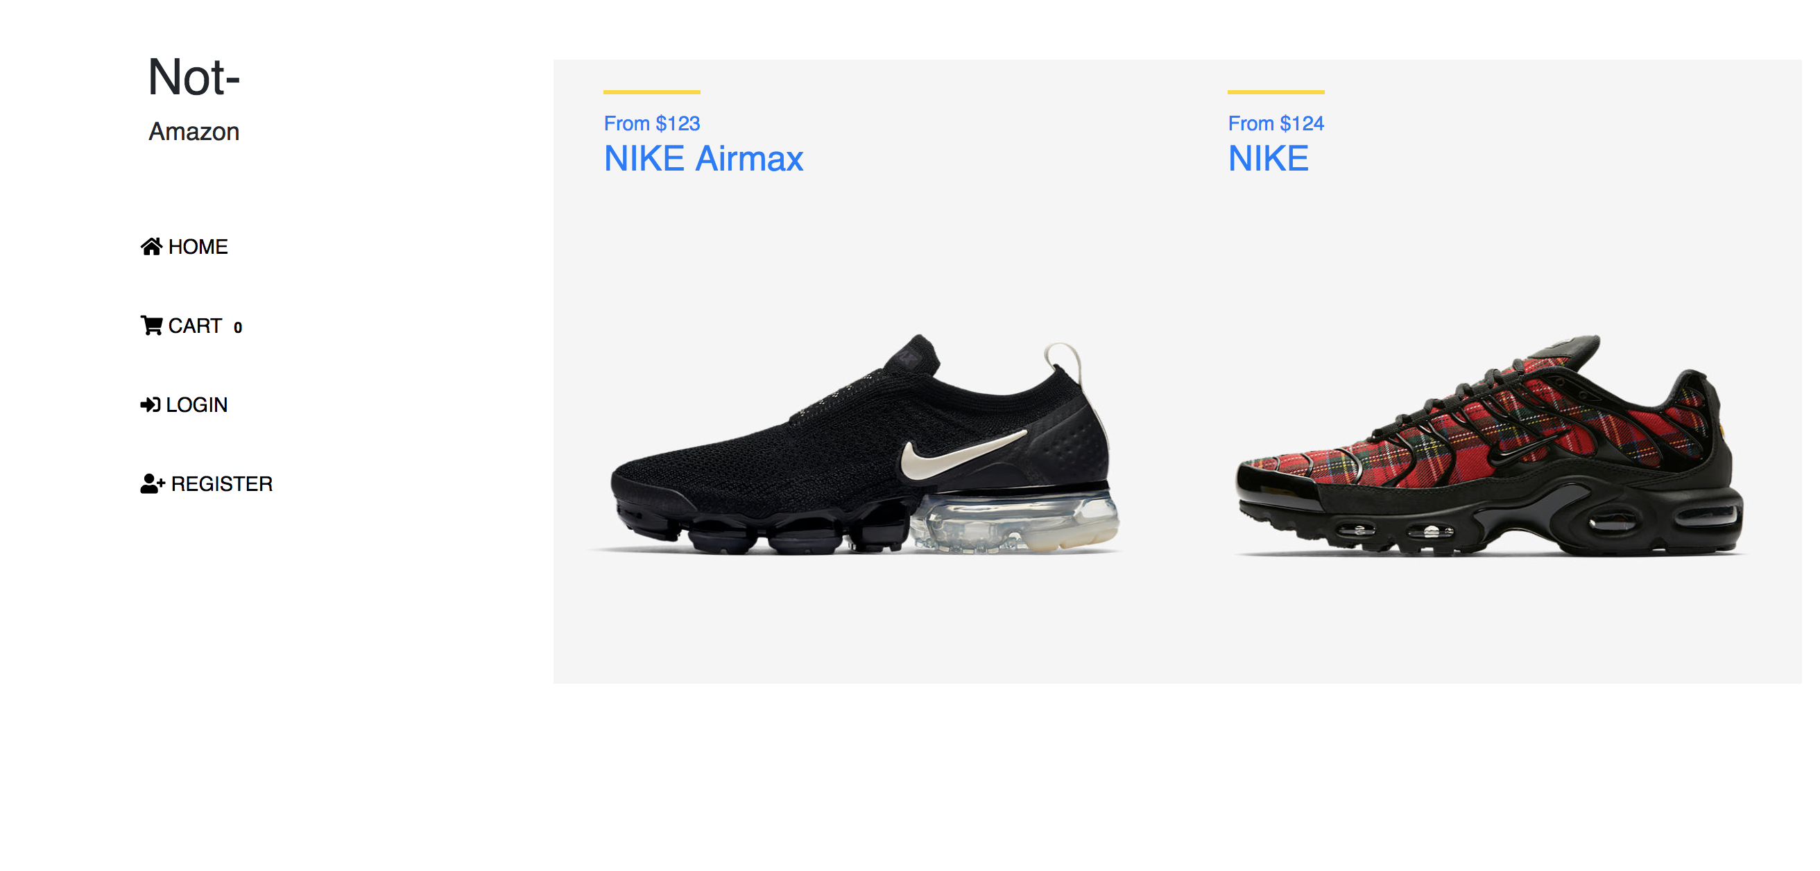
HOME PAGE

Slide 7
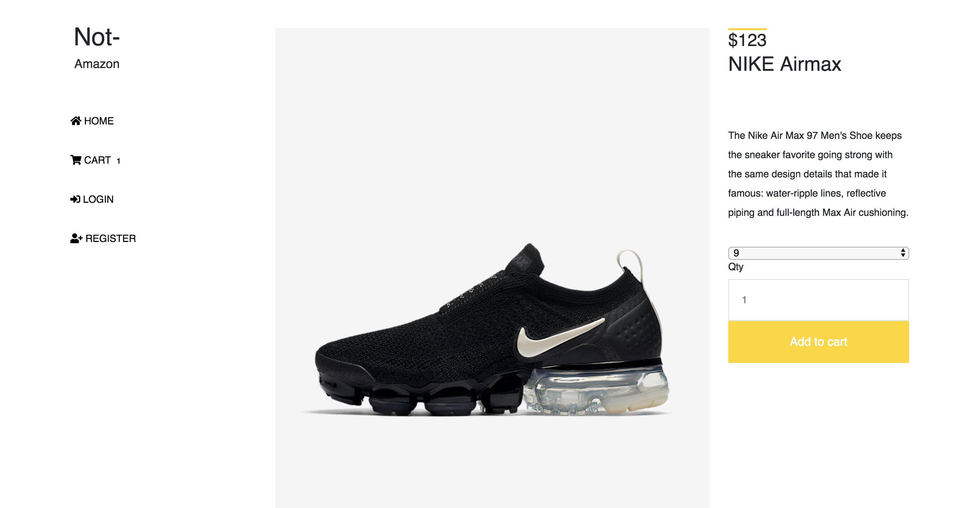
VIEW PAGE

Slide 8
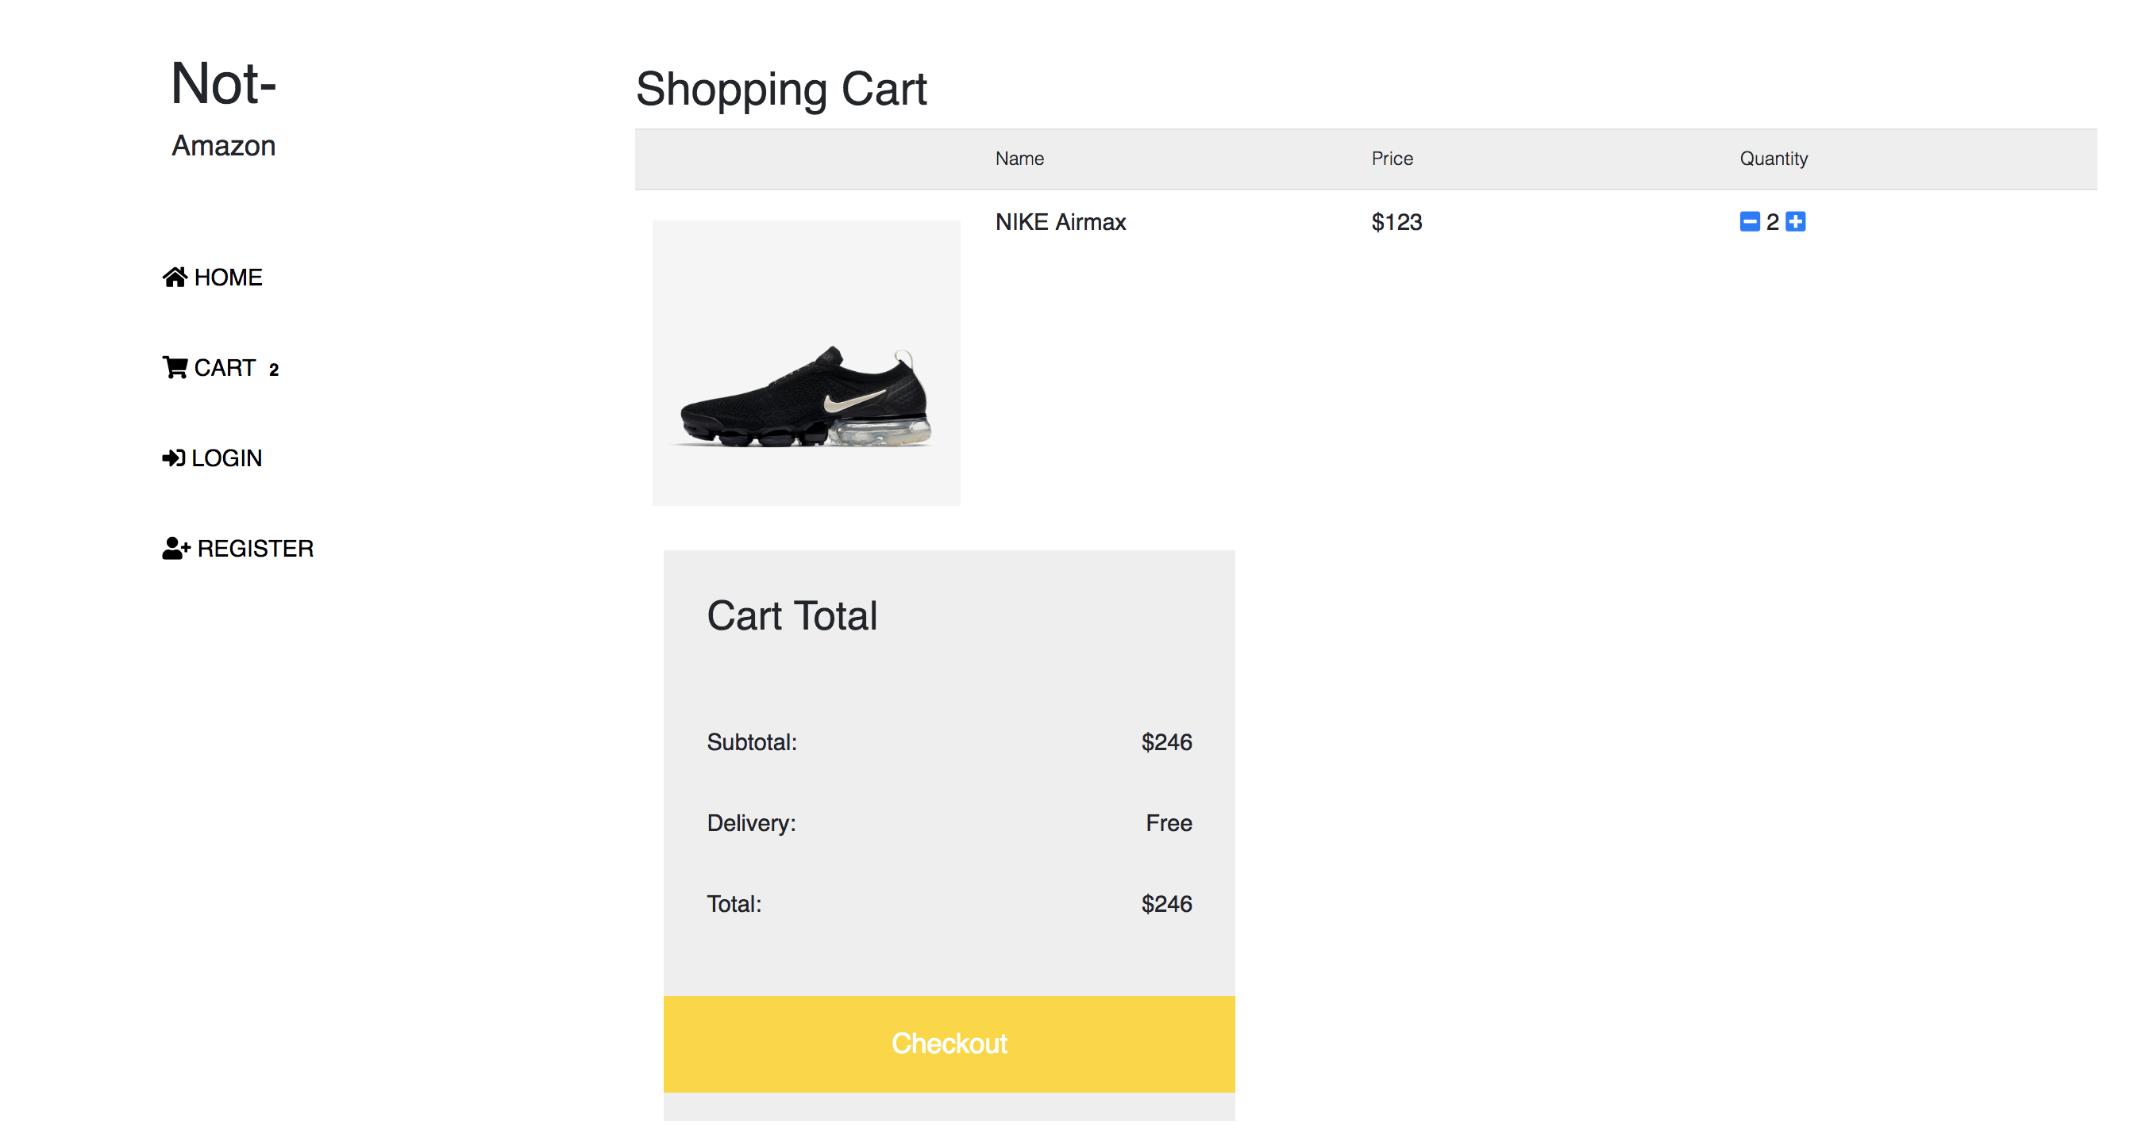
SHOPPING CART

Slide 9
THANKS FOR YOUR TIME

