Slide 1
Customer Churn Analysis ABC Communication Ltd
AnalystLab Africa | Data Analytics Internship | Week1
Prepared by: Ofentse Lebethe

Slide 2
Business Problem
ABC Communication Ltd is losing customers to churn
Overall churn rate: 26.5% roughly 1 in 4 customers
Goal: identify why customers leave and recommend retention strategies

Slide 3
Dataset Overview
7,043 customer records, 21 columns
No missing values or duplicate rows
Found and fixed a data quality issue: Total Charges had 11 blank entries (new customers with tenure = 0)
Overall churn rate: 26.5%

Slide 4
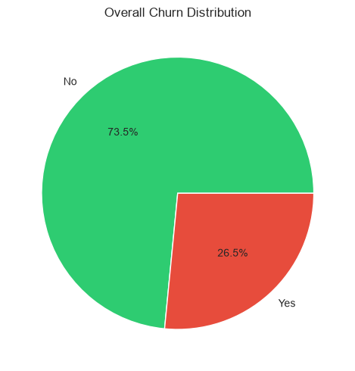
Customer Base Overview 26.5% of customers have churned

Slide 5
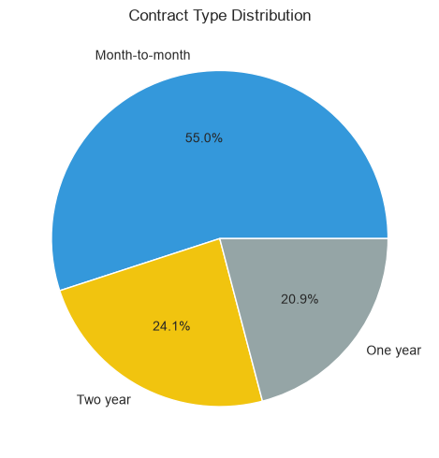
Contract Type Distribution
55% of customers are on flexible month-to-month contracts

Slide 6
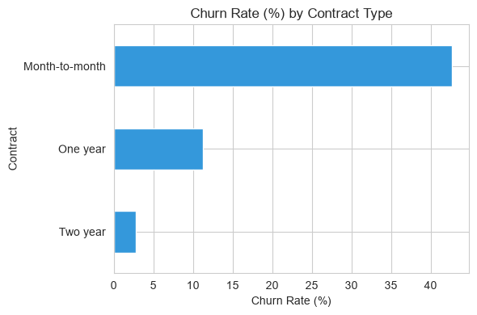
Churn by Contract Type
Month-to-month customers churn 15x more than two-year contract customers

Slide 7
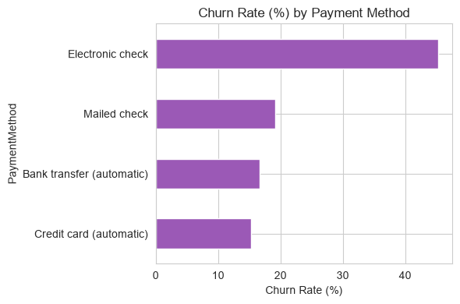
Churn by Payment Method
Electronic check users churn far more than customers using automatic payment

Slide 8
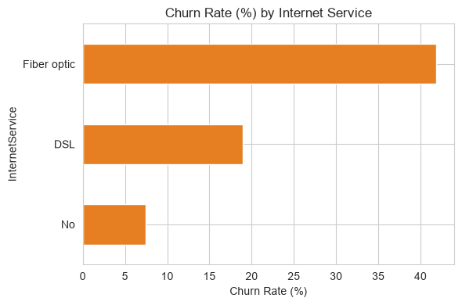
Churn by Internet Service
Fiber optic customers churn more than DSL, despite the premium product

Slide 9
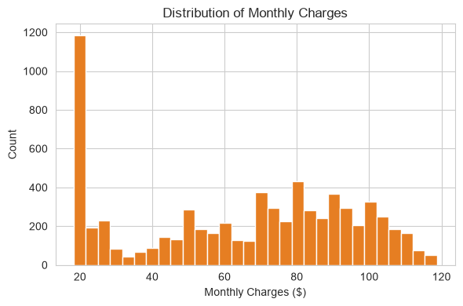
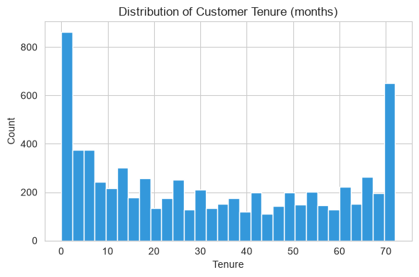
Tenure & Charges Patterns
New customers (0-5 months) and long-term customers (70+ months) are the two largest groups, the first few months are the critical retention window.

Slide 10
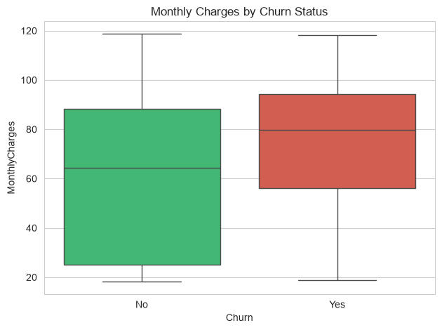
Monthly Charges by Churn Status
Customers who churn tend to pay higher monthly charges than those who stay

Slide 11
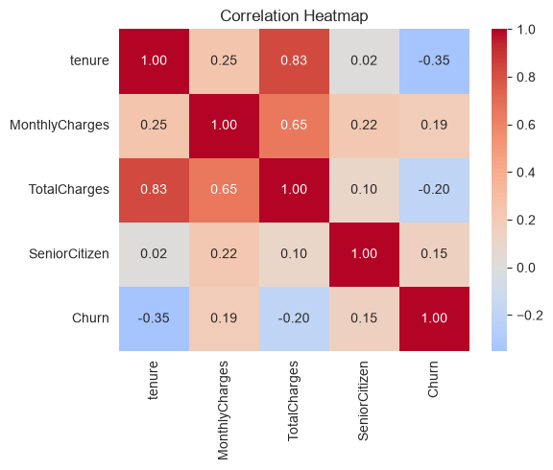
What Drives Churn? Correlation Analysis
Tenure has the strongest link to churn, longer staying customers are far less likely to leave

Slide 12
Key Insights & Recommendations
Month-to-month contracts and electronic check payments are the biggest churn drivers
Fiber optic customers churn more despite being the premium product
Churn is concentrated in the first few months of tenure
Recommendation: incentivize longer contracts and automatic payments
Recommendation: investigate fiber optic pricing and service quality
Recommendation: build an early-tenure retention programme

Slide 13
Thank You
Questions?
Ofentse | Data Analytics Intern, AnalystLab Africa

