Slide 1
PFE DEFENSE / JUNE 2026
Evidence-Based
DEX
APK
SBOM Recovery
from compiled Android APKs
MATCH
Static evidence fusion, CycloneDX output, confidence-aware CVE mapping, and guarded AI assistance.
CVE
SBOM
927 / 1837
84 / 84
6772 / 6772
normal source-validated emitted versions confirmed
controlled expected Maven versions
source-known v2 lane, not APK-only accuracy
Notes:
Open with the problem, not the score. Say: this project starts from a compiled APK, where dependency metadata is absent. The tool recovers evidence, emits CycloneDX, maps vulnerabilities, and keeps uncertainty visible. Mention the three headline numbers only after stating that the v2 lane is source-known and not APK-only accuracy.

Slide 2
THE PROBLEM
02
Compilation removes the dependency metadata SBOM tools expect
SOURCE PROJECT
COMPILED APK
Dependencies are explicit
Evidence is indirect
build.gradle
compile + R8
DEX bytecode
classes mixed and optimized
coordinates + versions
version catalog
R8 transforms
rename, shrink, inline
shared dependency policy
metadata lost
Native files
hash evidence only
lock / tree
resolved transitives
No Maven version
must be inferred
Normal source-based SBOM
Reverse-SBOM problem
The MVP must reconstruct identity and version from what survives compilation.
APK-to-SBOM MVP | emitted confirmation is not full recall | v2 is a source-known upper bound
Notes:
Explain why normal SBOM tools are not enough: they consume source metadata. In an APK, Maven coordinates and exact versions are usually absent and R8 can transform the remaining bytecode. The research problem is evidence reconstruction, not manifest parsing.

Slide 3
RESEARCH POSITIONING
03
The literature converges on hybrid evidence, but not perfect version recovery
GEN 1
GEN 2
GEN 3
GAP
Signatures
Structure
Learned models
Exact
versions
under R8
packages
graphs
token models
class hashes
opcodes
R8 resilience
profiles
fuzzy similarity
risk classification
+ standard
SBOM output
LibScout LibRadar
LibPecker SAD ATVHunter
LibAttention ObfDetector
Project response
multi-scale evidence + separate identity/version confidence + CycloneDX + transparent limits
APK-to-SBOM MVP | emitted confirmation is not full recall | v2 is a source-known upper bound
Notes:
Do not present the papers as a list. Present the progression: signatures, structure, then learned models. The unresolved gap is exact version recovery under optimization together with standard SBOM and vulnerability output. Our design combines proven signals and reports uncertainty.

Slide 4
PROJECT OBJECTIVE
04
The objective is a useful security artifact, not forced certainty
INPUT
EVIDENCE ENGINE
CycloneDX
Confidence
APK
Identity
Version
standard SBOM
identity + version
static evidence
class / method
88/100
evidence
opcode / graph
74/100
Ambiguity
OSV
literal / unique
52/100
near versions
CVE evidence
DEX manifest
resources native
confidence + ambiguity policy
Policy: strong evidence produces strong claims; weak evidence stays uncertain or report-only.
APK-to-SBOM MVP | emitted confirmation is not full recall | v2 is a source-known upper bound
Notes:
The output is not only a list of library names. It is a CycloneDX SBOM with identity confidence, version confidence, ambiguous alternatives, and confidence-aware OSV results. Ambiguity is preserved because a false exact version can create a false confirmed CVE.

Slide 5
ARCHITECTURE DECISIONS
05
Architecture choices were driven by evidence, scope, and interoperability
DECISION
CHOSEN DESIGN
WHY
NOT CHOSEN
Analysis
Hybrid static pipeline
Works from the APK alone; combines name and structural evidence; reproducible for evaluation.
Package/hash-only or dynamic-first
Versions
Local Maven reference DB
SBOM and CVE claims require coordinate + version; JAR/AAR profiles are repeatable.
Library-name-only detection
SBOM
CycloneDX + PURL
Standard security artifact with Maven identity, evidence properties, and scanner compatibility.
Custom JSON as final output
Vulnerabilities
OSV first
Queries Maven package/version directly and fits PURL-based component evidence.
NVD/CPE-only mapping
Obfuscation
Confidence-affecting policy
R8 can remove or transform evidence, so the system lowers confidence instead of claiming immunity.
“Obfuscation-proof” claims
Architecture rationale: docs/architecture/DECISIONS_LOG.md | docs/architecture/MVP_ARCHITECTURE.md
APK-to-SBOM MVP | emitted confirmation is not full recall | v2 is a source-known upper bound
Notes:
Explain the choices as engineering decisions, not decoration. Static hybrid analysis was chosen because the input is an APK and package/hash-only evidence is fragile. Maven references were chosen because exact versions are required for SBOM and CVE work. CycloneDX and PURL provide interoperability. OSV aligns with Maven package/version queries. R8 is treated as confidence-affecting because perfect resilience is not supported by the evidence.

Slide 6
SYSTEM ARCHITECTURE
06
MVP architecture: APK evidence and Maven references converge at the matcher
1
2
3
4
5
6
Compiled APK
APK extraction
DEX analysis
Hybrid matcher
Confidence gate
Security outputs
DEX · manifest · resources · native
inventory · metadata · forensic risk
packages · classes · methods · opcodes · graph
candidate shortlist · multi-signal scoring
identity · version · ambiguity
CycloneDX · OSV · JSON/HTML report
REFERENCE PROFILE PIPELINE
candidate profiles feed the matcher
Maven JAR/AAR
D8 normalization
Feature extraction
SQLite reference DB
coordinate + version + POM
JAR/AAR bytecode converted to DEX
same representation as APK evidence
versioned profiles + PURLs
WHY THIS SHAPE
Static and reproducible
Same feature space
Confidence before CVE
Every decision can be traced to evidence and replayed.
APK and Maven artifacts are compared using equivalent DEX features.
Weak version evidence cannot become a confirmed vulnerability.
Implementation map: src/apk_sbom/apk_extractor.py -> dex_analyzer.py -> matcher.py -> sbom.py / vulnerability.py / report.py
APK-to-SBOM MVP | emitted confirmation is not full recall | v2 is a source-known upper bound
Notes:
This is the actual MVP architecture. The main APK lane extracts and analyzes evidence, the separate Maven lane builds comparable versioned profiles, and both meet at the hybrid matcher. A confidence gate sits before CycloneDX and OSV so uncertain version evidence cannot become a strong vulnerability claim. The separation also makes the system reproducible: reference construction can evolve without hiding matcher behavior.

Slide 7
COMPONENT 1 | APK EXTRACTOR
07
APK extraction evolved from file listing into a forensic boundary detector
01
ZIP inventory
02
Metadata
03
Native evidence
04
Forensics
List classes.dex and basic APK entries.
Decode manifest, SDK levels, package and version.
Hash every .so file by ABI without inventing identity.
Flag hidden DEX, opaque assets, and protector hints.
CURRENT OUTPUT
WHY THIS CHOICE
APK SHA-256 and exact binary identity
The extractor must establish what evidence is actually present before matching begins.
standard and nonstandard DEX paths
manifest package, version, SDK, permissions
No decompiler dependency
Uses the APK ZIP surface and Androguard only where binary XML/DEX parsing is needed.
resources/assets counts
Boundary honesty
Native and hidden-code cases become explicit limitations instead of false Maven claims.
native files, ABI, size, SHA-256
extraction-risk indicators
Multidex first-class
All standard classes*.dex files are carried into later analysis.
Implementation: src/apk_sbom/apk_extractor.py -> inspect_apk(), build_forensic_summary(), apk_indicators()
APK-to-SBOM MVP | emitted confirmation is not full recall | v2 is a source-known upper bound
Notes:
Evolution: the extractor began as a ZIP/DEX inventory, then added manifest decoding, native hashing, and finally forensic indicators for nonstandard DEX and protector-like packaging. We chose this because later confidence is only credible if the pipeline first knows which evidence is present or hidden. Code: src/apk_sbom/apk_extractor.py.

Slide 8
COMPONENT 2 | DEX ANALYZER
08
DEX analysis grew from coarse counts into reusable multi-scale evidence
01
Coarse
02
Identity
03
Structure
04
R8 research
Packages, class counts, method counts, opcode histogram.
Class descriptors, methods, fields, API references.
Class dependencies, graph shape, literals and context.
Basic-block, call-chain, neighbor, field-operation features.
FEATURE LAYERS
DESIGN RULE
package class method opcode CDG literal
Extract broadly.
Score narrowly.
CORE SCORING
GUARDED
API references opcode tri-grams POM coherence
Promising features remain available for experiments without silently changing production decisions.
INERT / REPORT
basic blocks call chains class neighbors field operations
Implementation: src/apk_sbom/dex_analyzer.py -> analyze_dex_bytes(), analyze_apk_dex()
APK-to-SBOM MVP | emitted confirmation is not full recall | v2 is a source-known upper bound
Notes:
The DEX analyzer started with packages and opcode counts. It then added class/method identity, graph and literal evidence, and later the Phase 3 multi-scale features. The key choice is to extract broadly but keep new features inert until control matrices justify scoring. Code: src/apk_sbom/dex_analyzer.py. Evidence: docs/evaluation/R8_MULTISCALE_FEATURE_DIAGNOSTICS.md.

Slide 9
COMPONENT 3 | REFERENCE DB
09
The reference database became a reproducible Maven-to-DEX feature factory
01
Seed list
02
Maven fetch
03
DEX normalization
04
Guarded growth
Hand-selected coordinates and versions.
Download JAR/AAR plus POM metadata and hashes.
Convert JAR/classes.jar through D8 for comparable bytecode.
Store rich SQLite features; promote versions only after controls.
Maven
D8
Features
SQLite
JAR / AAR
POM
DEX
normalization
classes methods
opcodes graph
coordinate + version
searchable evidence
10,517
15.8 GB
106 / 106
Guarded
coordinate-version components in the final large v2 DB
feature database artifact
source-tree cases rerun in the bounded lane
reference additions must pass current controls
Code: maven_downloader.py -> reference_converter.py -> reference_features.py | DB: data/reference_db/reference_features_demo_final_large_v2.sqlite
APK-to-SBOM MVP | emitted confirmation is not full recall | v2 is a source-known upper bound
Notes:
The reference lane evolved from a small manual list into a reproducible factory: fetch Maven artifacts and POMs, normalize JAR/AAR bytecode through D8, extract the same features as the APK, and store them in SQLite. We guard reference growth because adding the correct version can still regress another APK when adjacent versions are similar.

Slide 10
COMPONENT 4 | MATCHER
10
Candidate generation and matching evolved toward guarded multi-signal decisions
01
Package shortlist
02
Weighted fusion
03
Version policy
04
Evidence gates
Fast recall, but fragile under renaming and artifact overlap.
Class, method, opcode, graph, literal evidence.
Unique evidence, artifact families, ambiguity and near ties.
Unsafe global signals stay disabled or report-only.
CANDIDATE FLOW
CURRENT DECISION LOGIC
APK feature set
Identity
package, class, method, opcode and graph agreement
reference package prefilter
Version
score gap plus version-distinctive literals/context
same-coordinate versions
Family
Okio/OkHttp/Lifecycle target overlap rules
artifact-family rules
Guardrail
API-ref and opcode tri-gram weights remain 0.0 globally
ranked candidates
shortlist before deep scoring
WHY
One global improvement is not enough: a target fix is rejected when controlled, clean, partial, or boundary controls regress.
Implementation: src/apk_sbom/matcher.py | Decision evidence: docs/thesis/EXPERIMENT_DECISION_LEDGER.md
APK-to-SBOM MVP | emitted confirmation is not full recall | v2 is a source-known upper bound
Notes:
The matcher evolved from package-driven candidate generation into weighted multi-signal fusion, then added artifact-family and version-ambiguity policies. The strongest project lesson is the evidence gate: a change that fixes one target but regresses controls is not promoted. Code: src/apk_sbom/matcher.py.

Slide 11
COMPONENT 5 | VERSION DECISION
11
Confidence evolved from one score into separate claims and explicit ambiguity
01
Single score
02
Identity split
03
Version split
04
Ambiguity
Easy to display, but mixes presence and exact version.
First decide whether the library is present.
Then measure exact-version support and score gap.
Export near-tie versions and gate CVE confirmation.
IDENTITY
VERSION
AMBIGUITY
CVE
present?
exact?
alternatives?
confirmed
overlap strength
rank and score gap
feature-equivalent tie
only when
identity + version
are strong
structural agreement
unique evidence
near tie <= 0.006
family coherence
near-version competition
structured version set
POLICY
A detected library can be real while its exact version remains uncertain; the output must preserve that distinction.
Implementation: matcher.py -> build_version_decisions(), classify_identity_candidate(), classify_version_candidate()
APK-to-SBOM MVP | emitted confirmation is not full recall | v2 is a source-known upper bound
Notes:
The original single-score view was too easy to overinterpret. The current model separates identity from exact version, records score-gap and distinctive evidence, and exports ambiguous alternatives. This is why uncertain versions cannot create confirmed vulnerabilities.

Slide 12
COMPONENT 6 | SBOM GENERATOR
12
SBOM output evolved from internal JSON into evidence-rich CycloneDX 1.5
01
Internal JSON
02
CycloneDX
03
PURL + evidence
04
Boundary files
Useful for debugging, not interoperable.
Standard components, hashes, dependencies and metadata.
Maven identity, confidence properties, ambiguity.
Native .so entries remain hash-only file components.
sbom.cdx.json
WHY CYCLONEDX
"type": "library"
Standard
Can be consumed by other SBOM and security workflows.
"purl": "pkg:maven/...@version"
Traceable
Every component carries PURL, confidence, and evidence.
"identity-confidence": "0.871"
"version-confidence": "0.843"
Native files and uncertainty are represented without false package claims.
Honest
"ambiguous-versions": [...]
Implementation: src/apk_sbom/sbom.py -> build_cyclonedx_bom() | Spec version: CycloneDX 1.5
APK-to-SBOM MVP | emitted confirmation is not full recall | v2 is a source-known upper bound
Notes:
The SBOM lane moved from internal result JSON to CycloneDX 1.5, then added Maven PURLs, evidence properties, separate identity/version confidence, ambiguity, and native hash-only file components. We chose CycloneDX because it connects directly to vulnerability and scanner workflows.

Slide 13
COMPONENT 7 | CVE / OSV
13
Vulnerability lookup became package-aware and confidence-aware
01
NVD idea
02
OSV first
03
Enrichment
04
Claim gate
CPE mapping is awkward for Maven coordinates.
Batch Maven package + version queries.
Deduplicate CVE/GHSA aliases and retain strongest severity.
Confirmed vs potential depends on identity/version/source proof.
Maven PURL
OSV batch
Normalize
Classify
pkg:maven/group/artifact@version
query package + version
aliases + severity + duplicates
confirmed / potential / none
CONFIRMED
Strong identity + exact/high version confidence + source confirmation when available.
POTENTIAL
OSV matched, but version ambiguity or source mismatch blocks a confirmed claim.
Implementation: src/apk_sbom/vulnerability.py -> query_osv_for_libraries(), deduplicate_vulnerabilities(), classify_vulnerability_finding()
APK-to-SBOM MVP | emitted confirmation is not full recall | v2 is a source-known upper bound
Notes:
We considered NVD-first mapping, but Maven coordinates align much better with OSV. The current lane batches queries, enriches and deduplicates aliases, extracts severity, and then classifies findings using the component confidence and source validation. Code: src/apk_sbom/vulnerability.py.

Slide 14
COMPONENT 8 | REPORTS
14
Reporting evolved into the transparency layer of the system
01
Raw outputs
02
Human formats
03
Uncertainty
04
Research layers
matches.json and sbom.cdx.json.
JSON, Markdown, and HTML from one evidence model.
Identity/version confidence, ambiguity, R8 and extraction risk.
Source validation, Phase 5, router, and AI remain labeled report-only.
matches.json
sbom.cdx.json
osv-vulnerabilities.json
ranked candidates and signal breakdown
standard component and evidence output
normalized advisory evidence
report.json
report.md
report.html
complete machine-readable package
thesis and review friendly
demo and analyst friendly
WHY
The report is where experimental evidence can be useful without silently changing selected versions, SBOM components, or CVE labels.
Implementation: src/apk_sbom/report.py -> generate_final_report(), build_json_report(), build_markdown_report(), build_html_report()
APK-to-SBOM MVP | emitted confirmation is not full recall | v2 is a source-known upper bound
Notes:
Reporting is not cosmetic. It is the transparency layer that keeps default matcher authority separate from experiment-only and AI assistance. All formats are generated from the same evidence, so uncertainty and provenance stay consistent. Code: src/apk_sbom/report.py.

Slide 15
DATASET DESIGN
15
A layered dataset is necessary because different APKs support different claims
L1 CONTROLLED
Exact dependencies by construction | precision, recall, F1, version correctness
L2 SOURCE-VALIDATED REAL
APK + source tag + resolved dependency tree | emitted-version confirmation
L3 / L4 SOURCE-LINKED OR SMOKE
Qualitative robustness, runtime, parse success, report coverage
L5 LIMITATION
Native, hidden DEX, protected or framework boundaries
RULE
Never use a smoke or limitation APK to claim precision, recall, or exact-version accuracy.
Design source: docs/evaluation/DATASET_DESIGN.md
APK-to-SBOM MVP | emitted confirmation is not full recall | v2 is a source-known upper bound
Notes:
The layered design prevents claim inflation. Controlled and source-validated APKs support quantitative correctness claims. Smoke APKs support robustness claims. Limitation APKs show whether the tool warns honestly. Evidence: docs/evaluation/DATASET_DESIGN.md.

Slide 16
DATASET COLLECTION
16
Every real APK proof bundle connects binary, source, dependency tree, and report
1
2
3
4
5
Acquire APK
Pin source
Resolve tree
Run MVP
Validate
F-Droid / GitHub release
record SHA-256
matching tag or commit
verify versionName/code
exact Gradle module +
runtime configuration
report + CycloneDX +
OSV artifacts
coordinate/version comparison
classify clean or partial
RESCUE LESSON
Old Android projects often require validation-only copies, exact module/flavor probing, and legacy Gradle/JDK lanes.
Workflow: scripts/advance_real_apk_batch_proofs.py | Rescue profiles: configs/real_apk_blocker_rescue_profiles.json
Proof outputs: data/results/source-validation/ | Classification: data/results/evaluation/apk-type-evaluation.json
APK-to-SBOM MVP | emitted confirmation is not full recall | v2 is a source-known upper bound
Notes:
A real APK is not counted because a source link exists. The proof bundle must identify the exact binary, matching source, resolved runtime dependency tree, generated report, and source-validation output. For difficult builds we used validation-only copies and exact module/configuration probing.

Slide 17
APK CLASSIFICATION
17
Evaluation keeps hard APK families visible instead of collapsing them into one score
Controlled
72 APKs
84 expected versions
known ground truth
Clean real
5 APKs
47 emitted versions
strong source proof
Partial real
97 APKs
1790 emitted versions
realistic hard cases
Blocked
0 APKs
none remaining
proof gates completed
Limitations
4 cases
outside exact metric
native / hidden / protected
Scientific rule: preserve the denominator, classify exclusions, and expose every remaining gap.
APK-to-SBOM MVP | emitted confirmation is not full recall | v2 is a source-known upper bound
Notes:
Explain the five layers. Controlled cases test mechanics. Clean real APKs provide strong exact evidence. Partial real APKs are the difficult, realistic population. Blocked is now zero. Limitation cases remain visible but are excluded from exact Maven-version metrics.

Slide 18
DATASET COMPOSITION
18
The current thesis set combines exact controls, real proof, and explicit boundaries
72
102
5 / 97
4
controlled fixtures
source-validated real APKs
clean / partial real APKs
limitation or boundary cases
COVERAGE DIMENSIONS
Build
clear rename shrink optimize repackage inline stress
Packaging
single DEX multidex multi-library native-heavy
Ecosystem
AndroidX Kotlin Compose networking security legacy
Boundaries
native .so hidden DEX protected/obfuscated samples
Canonical truth: data/results/evaluation/thesis-evaluation-tables.json | docs/evaluation/THESIS_EVALUATION_TABLES.md
APK-to-SBOM MVP | emitted confirmation is not full recall | v2 is a source-known upper bound
Notes:
The current generated truth is 72 controlled fixtures, 102 source-validated real APKs split into 5 clean and 97 partial, plus 4 boundary cases. These counts come from data/results/evaluation/thesis-evaluation-tables.json, not the older planning targets.

Slide 19
EVALUATION METHODOLOGY
19
The methodology measures only what each ground-truth layer can support
Controlled
Expected coordinate + version
TP / FP / FN / version mismatch
Precision, recall, F1, exact version
Source-validated
Resolved runtime dependency tree
Confirmed / mismatch / missing or nuance
Emitted Maven version confirmation
Smoke / limitation
No complete dependency truth
Parse success, runtime, warnings, outputs
Qualitative behavior only
REQUIRED PHRASE
The real-APK metric is emitted Maven version confirmation rate, not full dependency recall.
Generation: scripts/build_apk_type_evaluation.py -> scripts/build_thesis_evaluation_tables.py
APK-to-SBOM MVP | emitted confirmation is not full recall | v2 is a source-known upper bound
Notes:
Be precise about the metric. Controlled fixtures can support full precision/recall/F1 because dependencies are known by construction. Real APKs use the resolved source tree to confirm the versions the tool emitted. That is not full dependency recall.

Slide 20
RESULTS
20
The normal real-APK result and the v2 upper-bound answer different questions
NORMAL APK / SOURCE-VALIDATED METRIC
SOURCE-KNOWN V2 LANE
50.5%
6772 / 6772
927 of 1837 emitted Maven versions confirmed
exact emitted rows
Controlled
84/84
Cases
106
Clean real
47/47
Wrong emitted
0
Partial real
880/1790
Missing emitted
0
Source gaps
5238
Measures correctness of what the APK-only tool emitted.
Do not combine these lanes: v2 proves bounded recognition, not unconstrained APK-only accuracy.
APK-to-SBOM MVP | emitted confirmation is not full recall | v2 is a source-known upper bound
Notes:
State the normal metric first: 927 of 1837 emitted Maven versions confirmed across 102 source-validated real APKs. Then separate the v2 lane: 6772 exact emitted rows across 106 source-tree cases under exact source-version slices. It is an upper-bound recognition test, not APK-only production accuracy.

Slide 21
UPPER-BOUND EXPERIMENT
21
The source-known v2 lane isolates recognition from candidate-selection difficulty
WHAT IS CONSTRAINED
106 / 106
6772 / 6772
Each APK is matched only against coordinate-version rows observed in its resolved source tree.
source-tree cases completed
emitted rows exact
0
5238
removes global version-selection noise
wrong-version emitted rows
source-gap rows remain
tests bytecode recognition in the correct slice
keeps non-emitted source rows as a separate denominator
INTERPRETATION
This proves bounded recognition when the correct source versions are available; it does not prove unconstrained APK-only accuracy.
Evidence: docs/evaluation/DEMO_FINAL_V2_PACKAGE.md | data/results/evaluation/real-apk-demo-final-large-v2-source-version-dashboard.json
APK-to-SBOM MVP | emitted confirmation is not full recall | v2 is a source-known upper bound
Notes:
This is the slide where wording matters most. The v2 lane uses exact source coordinate-version slices, so it answers whether the matcher recognizes correct bytecode when candidate selection is bounded. It does not measure unconstrained APK-only production accuracy.

Slide 22
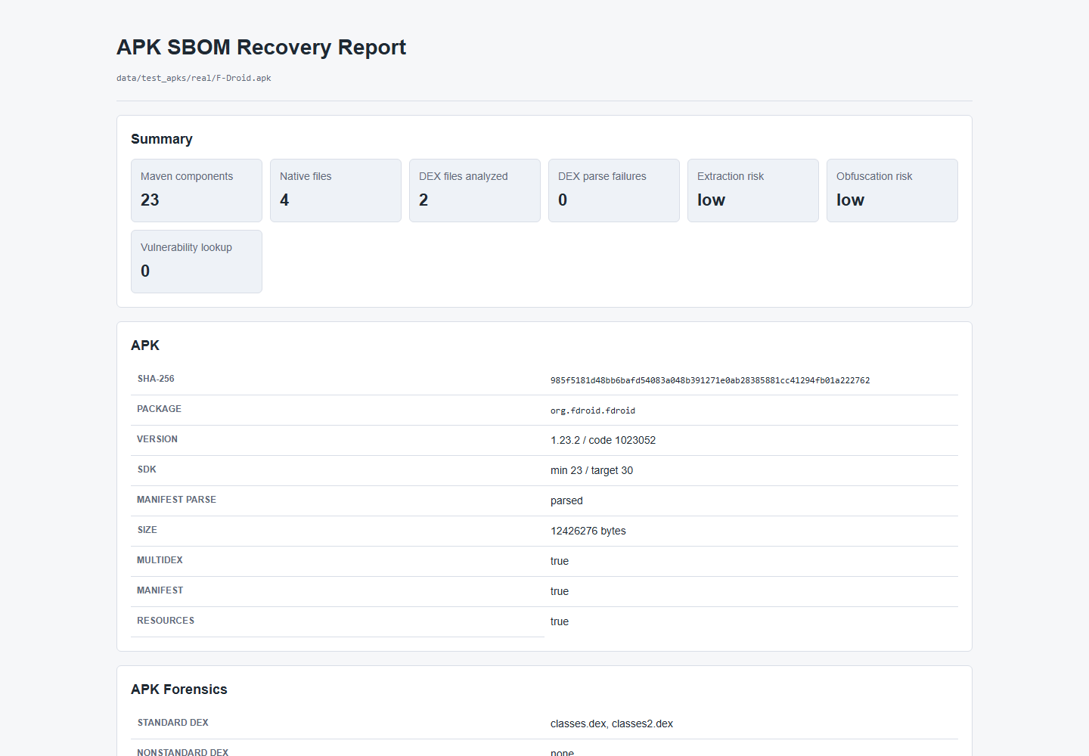
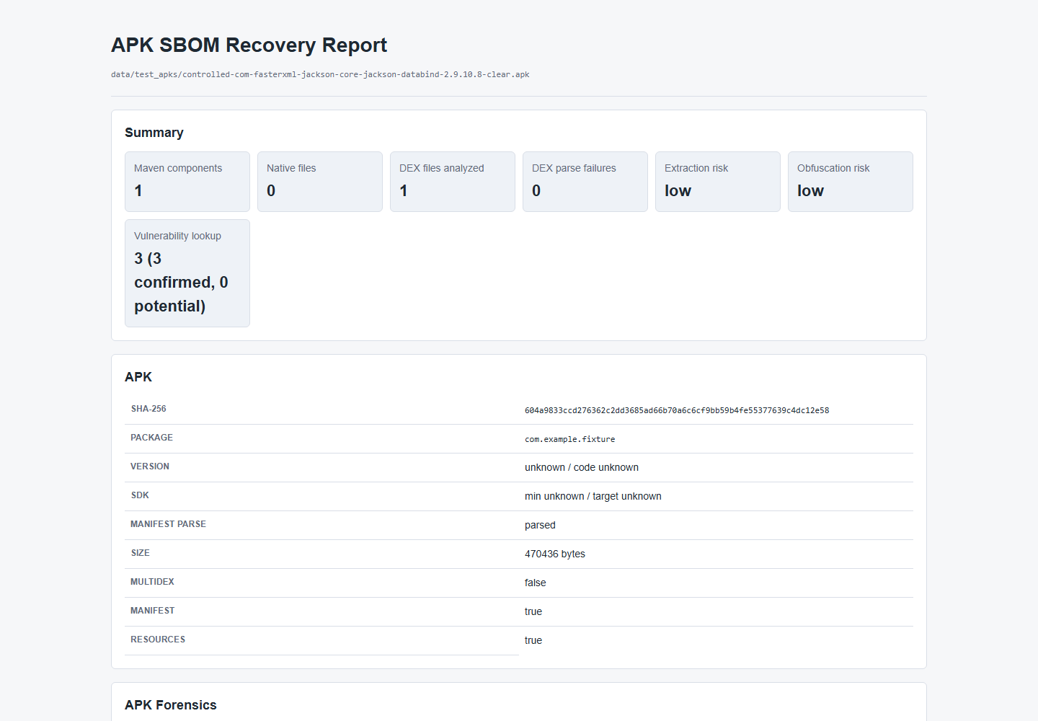
CVE RESULTS
22
Generated report screenshots prove both the clean and vulnerable demo lanes
CLEAN REAL APK
CONTROLLED POSITIVE CVE
23 Maven components | OSV 0
Jackson Databind 2.9.10.8 | 3 HIGH
CVE-2020-36518
CVE-2022-42003
CVE-2022-42004
Artifacts: report.html + sbom.cdx.json + osv-vulnerabilities.json + source-validation.json
APK-to-SBOM MVP | emitted confirmation is not full recall | v2 is a source-known upper bound
Notes:
These are screenshots of the generated project reports, not mockups. The clean F-Droid report shows 23 Maven components and zero returned vulnerabilities. The controlled Jackson Databind 2.9.10.8 report shows three confirmed HIGH advisories: CVE-2020-36518, CVE-2022-42003, and CVE-2022-42004.

Slide 23
CONCRETE DEMO INTERPRETATION
23
One run separates correct versions from scoring, recall, and reference-DB gaps
CORRECT
SCORING MISS
MATCHER RECALL
REFERENCE GAP
emitted + source-confirmed
candidate version mismatch
reference exists, not emitted
exact version absent from DB
okhttp 4.12.0
okio selected 2.8.0
activity-compose
collection-ktx
coroutines-android 1.7.3
source version 3.7.0
source 1.10.1
source 1.4.4
activity 1.10.1
status version-mismatch
exact version is in DB
missing-reference-candidate
The selected Maven version matches the source dependency tree.
Kept outside the confirmed SBOM instead of becoming a false exact claim.
The next action is threshold or feature-recall work, not DB growth.
The coordinate/version must be added or safely aliased before matching can succeed.
Transparency totals: 442 missing-reference rows | 2,281 matcher-recall rows | 5,238 source-gap rows
APK-to-SBOM MVP | emitted confirmation is not full recall | v2 is a source-known upper bound
Notes:
Use concrete examples. F-Droid confirms versions such as okhttp 4.12.0, coroutines-android 1.7.3, and activity 1.10.1. The okio 2.8.0 candidate disagreed with source 3.7.0 and was not promoted as confirmed. activity-compose 1.10.1 is a matcher-recall case because the reference exists. collection-ktx 1.4.4 is a missing-reference case because the exact version is absent.

Slide 24
FAILED EXPERIMENTS
24
Negative experiments protected the production tool from attractive regressions
API-reference weight
No metric change
Keep disabled
Opcode tri-grams
Regressed OpenTracks + Conversations
Keep disabled
Global multi-scale blend
10 target gains; 6 controlled + 121 real blockers
Reject globally
Coroutines 1.6.4 reference
20/20 targets fixed; 3 controls regressed
Experiment only
APK-only reranker
0 safe fixes across 582 wrong-version rows
Reject
Candidate expansion
134 refs selected wrong old Activity version
Do not promote
Raw opcode Transformer
0.110 macro-F1 < 0.128 baseline
Research only
LESSON
Promotion requires target improvement and a clean current-control matrix; novelty alone is not enough.
APK-to-SBOM MVP | emitted confirmation is not full recall | v2 is a source-known upper bound
Notes:
This slide is a strength, not an apology. The project records experiments that looked promising but failed controls. The production matcher stays conservative because target improvements were not allowed to hide regressions. Evidence: docs/thesis/EXPERIMENT_DECISION_LEDGER.md.

Slide 25
AI PROBLEM FORMULATION
25
AI predicts evidence roles and risk states, not final Maven versions
TRAINING UNIT
SIX LABELS
One matcher / transparency evidence row
confirmed_exact
suggest_report_only
Rows
20,523 training eligible
suppress_uncertain
risk_only
Cases
149 grouped case IDs
Coordinates
1,370 Maven coordinates
mismatch_or_extra
boundary_do_not_suggest
Split
104 train / 15 validation / 30 test cases
Features
scores, overlap counts, context flags
Grouped splitting by APK case reduces row-level leakage.
AUTHORITY
The task is report-only identity/risk triage. Selected versions, SBOM components, and CVE labels remain deterministic.
APK-to-SBOM MVP | emitted confirmation is not full recall | v2 is a source-known upper bound
Notes:
The AI task is deliberately not exact-version selection. Each row is classified into one of six evidence roles. Splits are grouped by APK case to reduce leakage. The labels and features come from existing matcher, transparency, Phase 5, and boundary artifacts.

Slide 26
CLASSICAL ML
26
RandomForest was selected for explainable, structured, report-only assistance
0.708
0.690
0.383
13,736
test macro-F1
test accuracy
majority baseline accuracy
report-only suggestions
WHY RANDOM FOREST
TOP FEATURES
fits the structured numeric evidence already produced
identity confidence
0.231
class weighting handles imbalanced labels
boundary flag
0.217
feature importance supports defense explanations
best score
0.206
fast local training and deterministic grouped split
source rank
0.086
dependency score
0.068
Implementation: src/apk_sbom/ai_r8_assistant.py | Metrics: data/results/experiments/ai-r8-assistant/metrics.json
APK-to-SBOM MVP | emitted confirmation is not full recall | v2 is a source-known upper bound
Notes:
RandomForest was chosen because the evidence is structured and numeric, the model trains quickly, class weights handle imbalance, and feature importance is explainable. The result is 0.708 macro-F1, but suggestions remain report-only.

Slide 27
DEEP LEARNING
27
The DL lane separates a strong structured-token result from a weak raw-opcode result
MVP-SAFE STRUCTURED TOKENS
RAW DEX OPCODE TOKENS
0.882
0.110
test macro-F1 | 0.907 accuracy
below 0.128 opcode-count baseline
20,523 rows; 1,704-token vocabulary
1,680 method sequences from 14 APKs
1-layer TransformerEncoder, d_model 64, 4 heads
case-heldout split across seven profile labels
removes source version, raw coordinate, source rank, and diagnostic shortcuts
raw sequence alone does not generalize
candidate for report-only risk triage
needs more APKs, context, and APK-level aggregation
DECISION
Keep the structured model as report-only evidence; keep the raw-opcode model as an honest negative result.
APK-to-SBOM MVP | emitted confirmation is not full recall | v2 is a source-known upper bound
Notes:
The structured-token Transformer is strong even after obvious source shortcuts are removed. The raw-opcode Transformer is much weaker and does not beat a simple baseline under a case-heldout split. This is why the DL story includes both a useful prototype and a negative result.

Slide 28
AI INTEGRATION GATE
28
AI assists hard R8 triage, while the deterministic matcher keeps authority
RandomForest
0.708
integrated report-only
MVP-safe Transformer
0.882
risk-triage candidate
Structured Transformer
0.977
research status only
Raw opcode Transformer
0.110
below 0.128 baseline
READY
report wording, prioritization, R8 risk triage
BLOCKED
selected versions, SBOM components, CVE labels
31,589 local evidence rows | strict APK promotion candidates: 0
APK-to-SBOM MVP | emitted confirmation is not full recall | v2 is a source-known upper bound
Notes:
Present AI as a guarded research contribution. The RandomForest is integrated only for report suggestions. The source-free MVP-safe Transformer reaches 0.882 macro-F1 and is a report-only risk-triage candidate. The raw-opcode model underperforms its baseline, so it remains an honest negative result. AI cannot select final versions or change SBOM/CVE output.

Slide 29
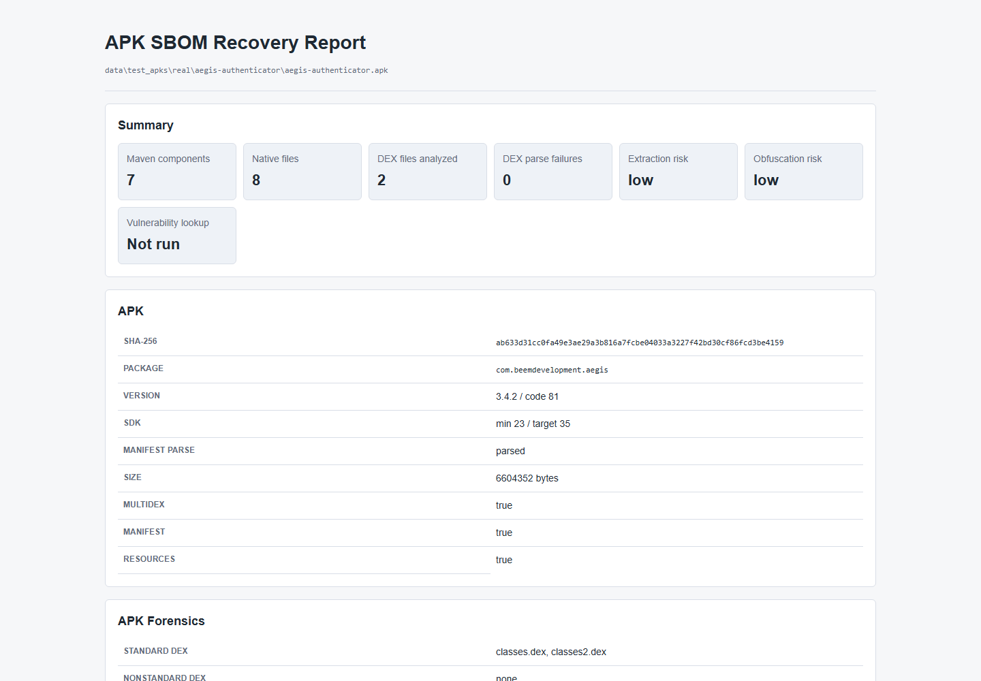
LIVE DEMO EVIDENCE
29
The reproducible demo command returns a 10/10 verdict and keeps AI report-only
PowerShell | project .venv
.\.venv\Scripts\python.exe scripts\run_final_ai_defense_demo.py --refresh
{
"checks_passed": 10,
"checks_total": 10,
"ready": true,
"matcher_authority_ready": false
}
Model reruns
RandomForest 0.708 | MVP-safe Transformer 0.882
Raw opcode Transformer 0.110 < 0.128 baseline
Aegis hard APK | 7 emitted components
GUARDRAIL
AI changes report wording and triage only; selected versions, SBOM components, and CVE labels remain deterministic.
Present from saved reports; do not rebuild the 15.8 GB DB during the defense.
APK-to-SBOM MVP | emitted confirmation is not full recall | v2 is a source-known upper bound
Notes:
This exact command was rerun through the project virtual environment and returned 10 of 10 checks with ready true. The RandomForest, five-epoch MVP-safe Transformer, and raw-opcode Transformer scripts were also rerun; the five-epoch structured model reproduced 0.882165 macro-F1. During the defense, show the saved metrics and reports instead of spending several minutes retraining. Avoid rebuilding the large DB or querying OSV live.

Slide 30
LIMITATIONS AND FUTURE WORK
30
The next research steps follow directly from the remaining evidence gaps
CURRENT LIMIT
NEXT ENGINEERING
NEXT RESEARCH
adjacent AndroidX/Kotlin versions
stronger candidate recall and pruning
larger independent R8 corpora
reference coverage gaps
version-unique literal/context evidence
class/package-aware opcode aggregation
R8 inlining and removed evidence
broader guarded reference growth
scoped hybrid structural rerankers
native and hidden-code boundaries
faster batch and DB workflows
strict APK-only promotion controls
PROMOTION BAR
A future method becomes authoritative only after nonzero APK-only candidates survive representative exact and boundary controls.
APK-to-SBOM MVP | emitted confirmation is not full recall | v2 is a source-known upper bound
Notes:
Future work is evidence-driven. The first priority is version-distinctive and candidate-recall evidence, then broader independent R8 data and stricter APK-only promotion controls. Native and hidden-code recovery remain separate research problems.

Slide 31
CONCLUSION
A credible reverse-SBOM tool
must be useful, measurable, and honest about uncertainty.
01
End-to-end MVP
02
Transparent evaluation
03
Guarded innovation
APK -> evidence -> CycloneDX -> CVE
clean, partial, boundary, and gap exports
hybrid matcher research + report-only AI
NEXT
stronger version-specific evidence, broader independent R8 corpora, and stricter APK-only promotion controls
Questions
Demo command: python scripts/run_final_ai_defense_demo.py --refresh
Notes:
Close with three contributions: an end-to-end APK-to-SBOM pipeline, a transparent evaluation that keeps hard cases visible, and guarded matcher/AI research that does not overrule deterministic evidence. The next work is stronger version-specific evidence and larger independent R8 corpora. Then invite questions.

Slide 32
BACKUP 1 | PROJECT STRUCTURE
32
The pfe-final repository connects source code, datasets, Docker, databases, and evidence outputs
pfe-final/
IMPLEMENTATION FLOW
├─ src/apk_sbom/
production pipeline modules
APK input
data/test_apks or mounted user APK
├─ scripts/
evaluation, training, demo, DB workflows
├─ datasets/
dataset manifests and ground truth
Extract + analyze
apk_extractor.py + dex_analyzer.py
├─ data/test_apks/
controlled and real APK inputs
Match
matcher.py queries reference_features*.sqlite
├─ data/reference_db/
SQLite Maven feature databases
├─ data/results/
SBOM, reports, metrics, screenshots
Emit
sbom.py + vulnerability.py + report.py
├─ tests/
unit and regression controls
├─ docs/
architecture, evaluation, thesis evidence
Validate
source-validation JSON + evaluation scripts
├─ Dockerfile
toolchain image definition
Preserve evidence
data/results/... HTML, JSON, CycloneDX, metrics
└─ docker-compose.yml
bind-mounted reproducible workspace
Core modules: apk_extractor.py dex_analyzer.py reference_features.py matcher.py sbom.py vulnerability.py report.py
APK-to-SBOM MVP | emitted confirmation is not full recall | v2 is a source-known upper bound
Notes:
Use this slide when asked how the repository is organized. It shows the complete path from APK inputs and Maven reference databases through production modules, evaluation scripts, tests, Docker, and generated evidence under data/results.

Slide 33
BACKUP 2
33
Exact matcher signals, default weights, and guarded signals
Class
0.45
DISABLED GLOBALLY
Method
0.25
API-reference weight 0.00
Opcode tri-gram weight 0.00
Package
0.15
Opcode
0.15
Implemented for diagnostics, but current controls do not justify global scoring.
Unique version
0.12
TIE THRESHOLDS
Dependency
0.10
feature-equivalent <= 0.001
near tie <= 0.006
near-tie score floor 0.35
Literal
0.08
Source: src/apk_sbom/matcher.py constants and score_reference_component()
APK-to-SBOM MVP | emitted confirmation is not full recall | v2 is a source-known upper bound
Notes:
Weights are evidence contributions, not probabilities, and some policies can adjust the final decision. The most important defense point is that optional API-reference and opcode tri-gram weights remain zero globally.

Slide 34
BACKUP 3 | DOCKER IMPLEMENTATION
34
Docker packages the complete Android analysis toolchain while data and outputs stay reproducible
10,517
15.8 GB
/app
.:/app
/app/src
reference coordinate-version rows
final v2 SQLite database
container working directory
Compose bind mount
PYTHONPATH
DOCKERFILE TOOLCHAIN
REPRODUCIBLE ARTIFACT FLOW
Python 3.12 + project requirements
Host inputs
data/test_apks + datasets
JDK 11 + default JDK
Host reference
data/reference_db/*.sqlite
Android SDK, build-tools 36 + legacy 29, D8
Gradle 9.5 plus compatibility versions
Container execution
docker compose run --rm apk-sbom ...
Syft, Grype, Trivy, CycloneDX CLI, cdxgen
Host outputs
data/results/... report.html, JSON, SBOM
Source copied to /app; default command checks toolchain
Regression proof
tests + source-validation + metrics
Files: Dockerfile | docker-compose.yml | .dockerignore | data/reference_db/ | data/results/
APK-to-SBOM MVP | emitted confirmation is not full recall | v2 is a source-known upper bound
Notes:
The Docker image contains the Android and SBOM toolchain, while Compose bind-mounts the repository at /app so APK inputs, the 15.8 GB reference DB, and generated results remain visible and reusable on the host. The .dockerignore excludes large result, DB, source, and APK directories from the image build context; they are supplied through the bind mount.

Slide 35
BACKUP 4
35
Detailed APK-family classification
Clear
names and code preserved
exact/high expected
R8 rename
identifiers rewritten
structure should survive
R8 shrink
unused code removed
lower evidence volume
R8 optimize
calls and methods rewritten
version evidence stressed
Repackage
namespace flattened
package signal weakened
Multidex
several classes*.dex
all DEX files analyzed
Native-heavy
many .so files
hash-only native components
Hidden/protected
nonstandard DEX or opaque payload
risk warning, no false Maven claim
Source: docs/evaluation/APK_TYPE_EVALUATION.md | data/results/evaluation/apk-type-evaluation.json
APK-to-SBOM MVP | emitted confirmation is not full recall | v2 is a source-known upper bound
Notes:
Use this slide when asked how APK types change expected behavior. The classifier is part of the evaluation interpretation, not an excuse to hide failures.

Slide 36
BACKUP 5
36
Source-gap taxonomy separates explanation from actionable matcher work
Exact in DB and emitted
898
recognized output subset
Exact version in DB
5,874
reference exists; not all rows emit
Artifact-family alias
1,504
public/target coordinate overlap
Metadata-only
734
BOM or source metadata without bytecode
Source boundary
277
native/framework/build-only boundary
Matcher-recall gap
2,281
reference exists; matcher did not emit
Missing coordinate/version
442
reference growth candidate
Missing coordinate
72
coordinate absent entirely
ACTIONABLE
2,281 matcher-recall rows and 442 missing-reference rows require different engineering responses.
APK-to-SBOM MVP | emitted confirmation is not full recall | v2 is a source-known upper bound
Notes:
This taxonomy prevents the 5,238 source-gap rows from being mislabeled as one kind of failure. Some are aliases or metadata-only; 2,281 are matcher recall and 442 are missing-reference candidates.

Slide 37
BACKUP 6
37
Failed-experiment regression matrix
Global Phase 4 blend
+10 target opportunities
6 controlled, 121 real, 10 clean blockers
Reject global
Phase 5 scoped trigger
4 target improvements
0 triggered regression/conflict
Experiment only
Coroutines 1.6.4
20/20 targets fixed
1 clean + 2 boundary regressions
Reject shared DB
API ref weight 0.05
No measured benefit
No metric change
Disabled
Opcode tri-gram 0.02
No confirmed improvement
OpenTracks + Conversations regress
Disabled
APK-only reranker
0 changes
0 fixes; source alternative visible 7.6%
Reject
Candidate expansion
134 same-coordinate refs
selected 1.2.0-alpha01 vs source 1.8.1
Reject
APK-to-SBOM MVP | emitted confirmation is not full recall | v2 is a source-known upper bound
Notes:
The scoped Phase 5 trigger is the interesting middle ground: it retained four improvements without triggered regressions, but it stays experiment-only because the profiles are narrow and learned from a small candidate set.

Slide 38
BACKUP 7
38
RandomForest confusion and ablation evidence
TEST PER-CLASS F1
ABLATION MACRO-F1
confirmed_exact
1.000
all features
0.708
suggest_report_only
1.000
no overlap counts
0.710
suppress_uncertain
0.912
no context flags
0.564
boundary_do_not_suggest
0.803
scores only
0.558
risk_only
0.352
overlap counts only
0.176
mismatch_or_extra
0.179
context flags only
0.162
Metrics: data/results/experiments/ai-r8-assistant/metrics.json
APK-to-SBOM MVP | emitted confirmation is not full recall | v2 is a source-known upper bound
Notes:
The model is excellent on exact and report-only labels but weaker on broad risk and mismatch categories. The ablation shows that no single feature family explains the result; the full structured evidence is useful, but the model remains diagnostic.

Slide 39
BACKUP 8
39
Transformer corpus, split, and per-class results
20,523
1,704
1,680
14
MVP-safe structured rows
structured-token vocabulary
raw method opcode sequences
APKs in raw-opcode corpus
MVP-SAFE TEST F1
RAW OPCODE CASE-HELDOUT
confirmed exact
1.000
Train 665 | Validation 175 | Test 840
suggest report-only
0.974
7 labels | 120 test sequences per label
suppress uncertain
0.909
risk only
0.880
Transformer macro-F1 0.110
research-only
mismatch / extra
0.766
Opcode-count baseline 0.128
boundary
0.764
Metrics: metrics-mvp-safe.json | ai-r8-raw-opcode-prototype/metrics.json
APK-to-SBOM MVP | emitted confirmation is not full recall | v2 is a source-known upper bound
Notes:
The structured model performs well across all six report labels. The raw opcode corpus uses a stricter case-heldout setup but is still too small: only two APK cases per label, one held out for test. This supports the next-data requirement.

