Slide 1
GRADUATION DEFENSE
Evidence-Based
SBOM Recovery
from Compiled Android APKs
APK
Evidence
SBOM
CVE report
Trustworthy component attribution, CycloneDX output, and vulnerability interpretation
Fendi Mohamed
Computer Systems Engineering
Notes:
This defense presents one coherent project from two angles. The Master thesis frames trustworthy SBOM recovery as an evidence problem. The Engineering thesis implements and evaluates a working APK-to-SBOM pipeline.

Slide 2
INTRODUCTION
02
The problem starts after the source code is gone
Main points
Visual plan
Source projects contain dependency files, lockfiles, and resolved Gradle trees.
Evidence view
A compiled APK contains DEX bytecode, resources, manifest data, native files, and signatures.
Two-column comparison between source project and compiled APK.
Bounded claim
Maven coordinates and exact versions are usually not directly visible.
R8 can rename, shrink, inline, and reorganize evidence.
Establish why the task is difficult.
APK-to-SBOM MVP | emitted confirmation is not full recall | v2 is a source-known upper bound
Notes:
Normal SBOM generation works best when source metadata exists. This work starts in the harder audit scenario where only the APK is available.

Slide 3
INTRODUCTION
03
A valid SBOM is not automatically a trustworthy SBOM
Main points
Visual plan
SBOM formats define representation.
Trust depends on the evidence behind each component claim.
APK
Evidence
Match
SBOM
Report
A recovered component can be clear at identity level and uncertain at version level.
Vulnerability interpretation must inherit that uncertainty.
State the main Master thesis insight.
APK-to-SBOM MVP | emitted confirmation is not full recall | v2 is a source-known upper bound
Notes:
The Master thesis separates the syntax of an SBOM from the trustworthiness of the claims inside it. This distinction drives the whole defense.

Slide 4
INTRODUCTION
04
The project answers one practical question
Main points
Visual plan
Can a compiled Android APK be transformed into a useful SBOM without pretending that weak evidence is certain?
Question centered with two small columns: useful output and unsafe output.
Useful means standard output, traceable evidence, confidence labels, and honest limitations.
Unsafe means forced exact versions, hidden denominator gaps, and unqualified CVE claims.
Define the central question.
APK-to-SBOM MVP | emitted confirmation is not full recall | v2 is a source-known upper bound
Notes:
The goal is not perfect reverse engineering. The goal is a usable security artifact that remains honest about what the APK evidence can and cannot prove.

Slide 5
INTRODUCTION
05
The defense combines two complementary theses
Main points
Visual plan
Master thesis: evidence model, state of the art, trust taxonomy, research agenda.
Three-source synthesis diagram feeding one defense narrative.
Engineering thesis: system design, implementation, CLI, evaluation, demo.
Existing deck: final architecture, headline metrics, demo proof, and guardrail wording.
Explain the role of each thesis document.
APK-to-SBOM MVP | emitted confirmation is not full recall | v2 is a source-known upper bound
Notes:
The Master thesis explains why trust boundaries matter. The Engineering thesis shows how those boundaries were implemented in a working prototype.

Slide 6
INTRODUCTION
06
Roadmap
01
02
03
04
Introduction
Background
State of the Art
Contribution
05
06
07
Implementation
Demonstration
Conclusion
APK-to-SBOM MVP | emitted confirmation is not full recall | v2 is a source-known upper bound
Notes:
The presentation moves from problem context to literature, then to the proposed contribution, implementation, demonstration, and future work. Section 2. Background

Slide 7
BACKGROUND
07
Software supply chains depend on many hidden components
Main points
Visual plan
Modern applications assemble direct and transitive dependencies.
Libraries may come from Maven, Android artifacts, native binaries, generated code, and frameworks.
APK
Evidence
Match
SBOM
Report
Security teams need inventory to manage exposure and vulnerability response.
Introduce supply-chain context.
APK-to-SBOM MVP | emitted confirmation is not full recall | v2 is a source-known upper bound
Notes:
The SBOM need comes from the complexity of modern dependency reuse. Android applications are especially difficult because many components are merged before distribution.

Slide 8
BACKGROUND
08
An SBOM is a structured component inventory
Main points
Visual plan
SBOM means Software Bill of Materials.
Minimal example SBOM row: group, artifact, version, PURL.
It records components, versions, identifiers, and relationships.
Standards such as CycloneDX and SPDX define exchange formats.
Package URL helps identify ecosystem package coordinates.
Define SBOM simply.
APK-to-SBOM MVP | emitted confirmation is not full recall | v2 is a source-known upper bound
Notes:
The project uses CycloneDX and PURL because the output should be interoperable, not a custom detector report only.

Slide 9
BACKGROUND
09
Build-time SBOMs and reconstructed SBOMs are different
Main points
Visual plan
Build-time SBOM: produced from source, dependency resolution, and build metadata.
Reconstructed SBOM: inferred from the delivered artifact.
APK
Evidence
Match
SBOM
Report
The reconstructed case must preserve uncertainty and provenance.
Establish key conceptual distinction.
APK-to-SBOM MVP | emitted confirmation is not full recall | v2 is a source-known upper bound
Notes:
A build-time SBOM has access to authoritative metadata. A reconstructed APK SBOM must infer from residue and should never claim more authority than the evidence supports.

Slide 10
BACKGROUND
10
Android builds transform the evidence before analysis
Main points
Visual plan
Source code and Gradle dependencies are resolved.
Java and Kotlin code becomes JVM bytecode.
APK
Evidence
Match
SBOM
Report
D8 converts bytecode into DEX.
R8 may shrink, optimize, obfuscate, and inline code.
The result is a signed APK.
Explain the Android build path.
APK-to-SBOM MVP | emitted confirmation is not full recall | v2 is a source-known upper bound
Notes:
This slide explains why dependency boundaries are not preserved in the final artifact. The analyzer sees the result of the build, not the developer's dependency graph.

Slide 11
BACKGROUND
11
The APK exposes several evidence regions
Main points
Visual plan
AndroidManifest.xml for package and component metadata.
APK container diagram with five labeled regions.
classes.dex and classes2.dex for executable bytecode.
resources.arsc, res, and assets for packaging evidence.
lib ABI directories for native shared libraries.
META-INF and signing blocks for package integrity evidence.
Show what can be inspected statically.
APK-to-SBOM MVP | emitted confirmation is not full recall | v2 is a source-known upper bound
Notes:
Each region has value, but none is a complete dependency inventory. DEX is the main Maven evidence region, while native files require separate treatment.

Slide 12
BACKGROUND
12
DEX evidence supports several signal families
Main points
Visual plan
Package and class descriptors.
Evidence view
Methods and fields.
Evidence family table with strengths and risks.
Opcode counts and instruction patterns.
Bounded claim
String literals and constants.
API references and method invocations.
Class dependency and call relations.
Prepare the matcher discussion.
APK-to-SBOM MVP | emitted confirmation is not full recall | v2 is a source-known upper bound
Notes:
The implementation extracts multiple DEX features because each one fails differently under transformations.

Slide 13
BACKGROUND
13
R8 weakens names, coverage, and structure
Main points
Visual plan
Renaming weakens textual identity.
Evidence view
Shrinking removes unused code.
Transformation impact matrix: signal versus R8 effect.
Bounded claim
Inlining changes method boundaries.
Class merging changes graph structure.
Constant propagation can remove literals.
Explain the main transformation threat.
APK-to-SBOM MVP | emitted confirmation is not full recall | v2 is a source-known upper bound
Notes:
R8 is not only renaming. It can remove or rewrite the exact features used to distinguish adjacent library versions.

Slide 14
BACKGROUND
14
Identity and exact version are separate decisions
Main points
Visual plan
Identity asks whether a component family or coordinate is present.
Version asks which exact release is supported.
APK
Evidence
Match
SBOM
Report
Security authority asks whether vulnerability interpretation is justified.
A strong identity match can still have weak version authority.
Establish a central trust boundary.
APK-to-SBOM MVP | emitted confirmation is not full recall | v2 is a source-known upper bound
Notes:
This distinction prevents a plausible library match from becoming an unsupported exact version and then a misleading CVE finding.

Slide 15
BACKGROUND
15
Static analysis is reproducible but bounded
Main points
Visual plan
Static analysis inspects the delivered APK without running it.
Scope boundary diagram with static evidence inside and dynamic or hidden code outside.
It is suitable for repeatable batch processing.
It cannot fully analyze encrypted payloads, downloaded code, or runtime-only behavior.
Boundary cases should be reported, not hidden.
Explain scope.
APK-to-SBOM MVP | emitted confirmation is not full recall | v2 is a source-known upper bound
Notes:
The project is intentionally static. It reports native and hidden-code boundaries instead of inventing Maven identities for unsupported regions. Section 3. State of the Art

Slide 16
STATE OF THE ART
16
The Master thesis reviews component recovery as evidence attribution
Main points
Visual plan
The review does not build a simple leaderboard.
Evidence view
Four-part taxonomy: techniques, evidence, threats, evaluation.
Tools use different datasets, transformations, and correctness units.
Bounded claim
The Master thesis classifies techniques, evidence sources, transformation threats, and evaluation practices.
Transition to state of the art.
APK-to-SBOM MVP | emitted confirmation is not full recall | v2 is a source-known upper bound
Notes:
The Master thesis focuses on what each approach can justify as evidence, not only on reported percentages.

Slide 17
STATE OF THE ART
17
Early tools relied on profiles, packages, and signatures
Main points
Visual plan
LibScout uses reference profiles and method descriptor hierarchy.
Timeline segment with LibScout, LibRadar, LibD.
LibRadar uses API frequencies and package clustering.
LibD uses dependency relations and opcode hashing.
These methods helped scale detection but remained sensitive to structure and references.
Cover first generation methods.
APK-to-SBOM MVP | emitted confirmation is not full recall | v2 is a source-known upper bound
Notes:
The first generation made library detection practical but did not fully solve exact version attribution in transformed APKs.

Slide 18
STATE OF THE ART
18
Structural methods reduced dependence on package names
Main points
Visual plan
ORLIS uses coarse filtering and class-level CFG evidence.
Simple graph-to-library matching diagram.
LibPecker uses class dependency relations and adaptive similarity.
LibID formulates matching as a constrained class-correspondence problem.
Structural evidence improves identity but still depends on references and transformations.
Cover graph and correspondence approaches.
APK-to-SBOM MVP | emitted confirmation is not full recall | v2 is a source-known upper bound
Notes:
Structural methods are important because package names are fragile. They also show that stronger evidence often costs more computation.

Slide 19
STATE OF THE ART
19
Version-level methods make the security problem visible
Main points
Visual plan
ATVHUNTER links version detection with vulnerability identification.
Evidence view
LibScan refines class correspondence using method and call-chain opcode similarity.
Table: tool, version evidence, security relevance.
Bounded claim
SAD uses class structural similarity for version-level detection.
Exact version recovery is harder than library presence.
Show why exact versions matter.
APK-to-SBOM MVP | emitted confirmation is not full recall | v2 is a source-known upper bound
Notes:
Version-level tools are closest to SBOM and CVE use cases because vulnerability databases depend on exact affected versions.

Slide 20
STATE OF THE ART
20
Optimization-aware research shows why R8 must be treated separately
Main points
Visual plan
LibHunter studies compiler optimization effects.
927 / 1837
84 / 84
Optimization and inlining can remove or merge the units used by detectors.
source-validated emitted versions
controlled expected versions
Renaming is easier than shrinking and inlining.
6772 / 6772
source-known v2 emitted rows
Realistic evaluation must separate transformation types.
Focus on R8 and optimization.
APK-to-SBOM MVP | emitted confirmation is not full recall | v2 is a source-known upper bound
Notes:
The lesson is that obfuscation cannot be treated as one checkbox. Different transformations harm different evidence families.

Slide 21
STATE OF THE ART
21
Learned representations are promising but not version authority
Main points
Visual plan
LibAttention uses learned representations for library presence under R8.
Model output boundary: report assistance allowed, SBOM mutation blocked.
Transformers can capture patterns that manual features may miss.
Presence classification is not the same as exact Maven version recovery.
Learned models need guardrails before they affect SBOM or CVE output.
Include AI literature fairly.
APK-to-SBOM MVP | emitted confirmation is not full recall | v2 is a source-known upper bound
Notes:
AI can help triage hard cases, but the thesis keeps it separate from authoritative component and version decisions.

Slide 22
STATE OF THE ART
22
SBOM-oriented systems expose the output gap
Main points
Visual plan
Most Android TPL tools output tool-specific matches.
Operational SBOM use requires standard identifiers, provenance, confidence, and vulnerability boundaries.
APK
Evidence
Match
SBOM
Report
UniBOM shows the value of unified SBOM analysis.
Android-specific APK-to-CycloneDX recovery remains a gap.
Explain why detector output is not enough.
APK-to-SBOM MVP | emitted confirmation is not full recall | v2 is a source-known upper bound
Notes:
The project is positioned at the intersection of component detection, SBOM generation, and vulnerability interpretation.

Slide 23
STATE OF THE ART
23
Realistic benchmarks lower the expected ceiling
Main points
Visual plan
Systematic assessments show no tool dominates all conditions.
Evidence view
TPL-Benchmark reports a much lower realistic library-level ceiling than older isolated papers suggest.
Small comparison chart labeled original reports versus common benchmark reality.
Bounded claim
Dataset choice, ground truth, and metric unit change the meaning of a score.
A single polished number can mislead.
Introduce benchmark humility.
APK-to-SBOM MVP | emitted confirmation is not full recall | v2 is a source-known upper bound
Notes:
The defense should not claim that this MVP beats every tool. It should claim that it reports evidence and limitations more responsibly.

Slide 24
STATE OF THE ART
24
The main research gap is trustworthy authority
Main points
Visual plan
Exact-version evidence degrades faster than identity evidence.
Five-gap list with small warning markers.
Reference coverage and matcher recall are often mixed.
Standard SBOM output is rarely integrated with Android binary attribution.
Vulnerability claims often inherit hidden version uncertainty.
Negative experiments and abstentions are often invisible.
Summarize gaps from Master thesis.
APK-to-SBOM MVP | emitted confirmation is not full recall | v2 is a source-known upper bound
Notes:
The gap is not only algorithmic accuracy. It is also how outputs become auditable security claims.

Slide 25
STATE OF THE ART
25
The state of the art shaped the MVP design
Main points
Visual plan
Adopt reference profiles from versioned detection.
Evidence view
Adapt graph, opcode, literal, and dependency evidence.
State-of-the-art lesson, MVP adaptation, remaining limitation table.
Reject package-only boundaries.
Bounded claim
Reject generic newest-version tie breaking.
Use AI only as report-only assistance.
Emit standard CycloneDX with confidence properties.
Connect literature to implementation.
APK-to-SBOM MVP | emitted confirmation is not full recall | v2 is a source-known upper bound
Notes:
This slide prevents the project from looking ad hoc. Each main feature has a research basis and a bounded implementation decision.

Slide 26
STATE OF THE ART
26
The review leads to an evidence-first principle
Main points
Visual plan
Do not ask only whether a version was emitted.
Four-question checklist.
Ask what evidence supports it.
Ask what could invalidate it.
Ask how it may safely be used downstream.
Close the state-of-the-art section.
APK-to-SBOM MVP | emitted confirmation is not full recall | v2 is a source-known upper bound
Notes:
This principle becomes the design rule for the contribution and implementation sections. Section 4. Contribution

Slide 27
CONTRIBUTION
27
The contribution is an evidence-gated APK-to-SBOM workflow
Main points
Visual plan
A research-backed model for APK-derived SBOM trust.
A static Android APK analysis pipeline.
APK
Evidence
Match
SBOM
Report
Versioned Maven reference profiles normalized to DEX.
Hybrid matching with confidence and ambiguity.
CycloneDX output and confidence-aware vulnerability lookup.
State contribution plainly.
APK-to-SBOM MVP | emitted confirmation is not full recall | v2 is a source-known upper bound
Notes:
The contribution is both conceptual and practical. The system implements the evidence boundaries argued by the Master thesis.

Slide 28
CONTRIBUTION
28
Each recovered component is treated as a claim
Main points
Visual plan
Subject APK.
Claim record schema shown as a simple form.
Candidate component and artifact family.
Identity and version status.
Supporting and opposing evidence.
Provenance and validation context.
Permitted security interpretation.
Explain the evidence model.
APK-to-SBOM MVP | emitted confirmation is not full recall | v2 is a source-known upper bound
Notes:
The project does not treat a match row as a final fact. It treats it as a claim with evidence and limits.

Slide 29
CONTRIBUTION
29
The system separates authoritative and report-only paths
Main points
Visual plan
Authoritative path: extraction, reference DB, matcher, SBOM, OSV, report.
Report-only path: R8 diagnostics, AI assistance, hybrid router, version-band experiments.
APK
Evidence
Match
SBOM
Report
Report-only outputs can explain risk.
They cannot change selected versions, SBOM components, CVE labels, or metrics.
Explain authority design.
APK-to-SBOM MVP | emitted confirmation is not full recall | v2 is a source-known upper bound
Notes:
This separation allows experimentation without silently changing the official output.

Slide 30
CONTRIBUTION
30
Confidence is not one score
Main points
Visual plan
Identity confidence measures component presence support.
927 / 1837
84 / 84
Version confidence measures exact release support.
source-validated emitted versions
controlled expected versions
Ambiguous versions are preserved when evidence is close.
6772 / 6772
source-known v2 emitted rows
Abstention is allowed when evidence is insufficient.
Explain identity and version confidence.
APK-to-SBOM MVP | emitted confirmation is not full recall | v2 is a source-known upper bound
Notes:
A confident family match and an uncertain exact version can coexist. The output should expose that situation.

Slide 31
CONTRIBUTION
31
The matcher uses complementary evidence
Main points
Visual plan
Package coverage.
Evidence view
Class coverage.
Method coverage.
Feature weight table with nonzero and disabled features.
Opcode similarity.
Bounded claim
Dependency similarity.
Literal overlap.
Version-unique evidence.
Optional API and opcode tri-gram diagnostics.
Show signal fusion.
APK-to-SBOM MVP | emitted confirmation is not full recall | v2 is a source-known upper bound
Notes:
The matcher is intentionally hybrid. Optional signals exist, but they stay disabled when they do not improve controls safely.

Slide 32
CONTRIBUTION
32
CycloneDX output carries evidence boundaries forward
Main points
Visual plan
Accepted Maven decisions become CycloneDX components.
Small CycloneDX component example.
Components use Package URLs.
Native files become hash-based file components.
Confidence, match type, ambiguity, and evidence summaries remain attached.
Tie detection to SBOM standard.
APK-to-SBOM MVP | emitted confirmation is not full recall | v2 is a source-known upper bound
Notes:
The SBOM is not only a list. It carries enough context for a downstream analyst to understand how strong a recovered claim is.

Slide 33
CONTRIBUTION
33
Vulnerability findings inherit component confidence
Main points
Visual plan
OSV lookup uses selected Maven coordinate and version.
Vulnerability authority ladder: confirmed, potential, report-only.
Findings are classified by evidence strength.
Source-confirmed findings are stronger than potential or report-only findings.
A weak version must not become a fake confirmed CVE.
Explain CVE policy.
APK-to-SBOM MVP | emitted confirmation is not full recall | v2 is a source-known upper bound
Notes:
This is the security impact of confidence. A vulnerability database can only answer the version it is given.

Slide 34
CONTRIBUTION
34
The contribution includes honest evaluation categories
Main points
Visual plan
Controlled fixtures.
Evaluation layer pyramid.
Clean source-validated real APKs.
Partial source-validated real APKs.
No-Maven-signal controls.
Source-known upper-bound lane.
Limitation and boundary cases.
Report-only experiments.
Bridge to implementation and evaluation.
APK-to-SBOM MVP | emitted confirmation is not full recall | v2 is a source-known upper bound
Notes:
The evaluation design is part of the contribution because it prevents clean cases, hard cases, and boundary cases from being mixed into one misleading score. Section 5. Implementation

Slide 35
IMPLEMENTATION
35
The Engineering thesis implements the full pipeline
Main points
Visual plan
Input: compiled Android APK.
Core: extractor, DEX analyzer, reference database, matcher, SBOM generator, vulnerability layer, report generator.
APK
Evidence
Match
SBOM
Report
Output: JSON, Markdown, HTML, CycloneDX, and OSV artifacts.
Open implementation section.
APK-to-SBOM MVP | emitted confirmation is not full recall | v2 is a source-known upper bound
Notes:
This section focuses on the engineering thesis solution and how the concepts became an end-to-end tool.

Slide 36
IMPLEMENTATION
36
APK inspection records what is actually present
Main points
Visual plan
ZIP entry inventory.
Evidence view
Manifest metadata.
APK evidence inventory table.
DEX file discovery.
Bounded claim
Native file inventory and hashes.
Resource and asset observations.
Forensic indicators for nonstandard or hidden code.
Explain extraction.
APK-to-SBOM MVP | emitted confirmation is not full recall | v2 is a source-known upper bound
Notes:
The extractor provides the foundation. If code is missing, hidden, or native, the system should record the boundary instead of assuming absence.

Slide 37
IMPLEMENTATION
37
DEX analysis builds comparable evidence
Main points
Visual plan
Parse all relevant classes.dex files.
DEX to feature profile diagram.
Extract class, method, field, opcode, literal, and API evidence.
Build class dependency relations.
Aggregate multi-DEX evidence without losing parse errors.
Explain feature extraction.
APK-to-SBOM MVP | emitted confirmation is not full recall | v2 is a source-known upper bound
Notes:
DEX analysis turns APK bytecode into the same style of features that will later be extracted from Maven references.

Slide 38
IMPLEMENTATION
38
Maven references are normalized before comparison
Main points
Visual plan
Download versioned JAR and AAR artifacts.
Extract AAR bytecode when needed.
APK
Evidence
Match
SBOM
Report
Convert bytecode to DEX with D8.
Extract the same feature families.
Store coordinate, version, and evidence in SQLite.
Explain reference construction.
APK-to-SBOM MVP | emitted confirmation is not full recall | v2 is a source-known upper bound
Notes:
Comparing APK DEX to source or JVM bytecode directly would introduce representation mismatch. The reference database uses a DEX-oriented representation.

Slide 39
IMPLEMENTATION
39
Candidate generation keeps matching scalable
Main points
Visual plan
Large reference databases create candidate pressure.
927 / 1837
84 / 84
The system first shortlists plausible coordinates and versions.
source-validated emitted versions
controlled expected versions
Detailed scoring is reserved for candidates with enough evidence.
6772 / 6772
source-known v2 emitted rows
Shortlist changes need regression controls before promotion.
Explain coarse matching.
APK-to-SBOM MVP | emitted confirmation is not full recall | v2 is a source-known upper bound
Notes:
The matcher must balance recall and cost. A too-strict shortlist can lose real components, while a too-broad shortlist creates false near-ties.

Slide 40
IMPLEMENTATION
40
Weighted scoring ranks evidence but does not prove probability
Main points
Visual plan
Package coverage: 0.15.
Evidence view
Class coverage: 0.45.
Method coverage: 0.25.
Clean weight table with disabled rows shaded lightly.
Opcode similarity: 0.15.
Bounded claim
Dependency similarity: 0.10.
Literal overlap: 0.08.
Version-unique evidence: 0.12.
API references and opcode tri-grams: disabled by default.
Explain matcher formula in accessible form.
APK-to-SBOM MVP | emitted confirmation is not full recall | v2 is a source-known upper bound
Notes:
The score ranks candidates. It is not a calibrated probability. Confidence also depends on alternatives, gaps, coverage, and transformations.

Slide 41
IMPLEMENTATION
41
Version decisions preserve alternatives
Main points
Visual plan
Candidates are grouped by coordinate.
Version ranking example with top candidate and near-tie candidates.
The top version is compared with nearby alternatives.
Score gap and version-unique evidence drive exactness.
Near-ties become ambiguous version sets.
Explain exact versus ambiguous decisions.
APK-to-SBOM MVP | emitted confirmation is not full recall | v2 is a source-known upper bound
Notes:
The system can select a best candidate while still exposing that nearby versions remain plausible.

Slide 42
IMPLEMENTATION
42
SBOM generation converts accepted decisions into CycloneDX
Main points
Visual plan
Maven components include group, artifact, version, and PURL.
Evidence properties record confidence and match status.
APK
Evidence
Match
SBOM
Report
Native files are represented as file components with hashes.
Uncertain Maven candidates are excluded by default unless explicitly requested.
Explain SBOM module.
APK-to-SBOM MVP | emitted confirmation is not full recall | v2 is a source-known upper bound
Notes:
The default SBOM is conservative. Diagnostic consumers can include uncertain rows, but that changes the meaning of the SBOM.

Slide 43
IMPLEMENTATION
43
Vulnerability lookup is confidence-aware
Main points
Visual plan
OSV queries use accepted package versions.
OSV, GHSA, and CVE identifiers are normalized.
APK
Evidence
Match
SBOM
Report
Source validation can relabel findings.
Findings can be source-confirmed, source-version-mismatch, source-missing, potential, or report-only.
Explain OSV and classification.
APK-to-SBOM MVP | emitted confirmation is not full recall | v2 is a source-known upper bound
Notes:
The vulnerability layer does not repair uncertain component evidence. It reports vulnerability results within the authority of the detected version.

Slide 44
IMPLEMENTATION
44
Reports make the evidence inspectable
Main points
Visual plan
matches.json for ranked candidates.
Evidence view
sbom.cdx.json for standard SBOM output.
Output artifact bundle.
Bounded claim
osv-vulnerabilities.json for vulnerability responses.
report.json for combined machine-readable evidence.
report.md and report.html for human review.
Explain report outputs.
APK-to-SBOM MVP | emitted confirmation is not full recall | v2 is a source-known upper bound
Notes:
The reports are important because defense and audit users need to see why a decision was made, not only the final component list.

Slide 45
IMPLEMENTATION
45
The CLI supports stage-level diagnosis
Main points
Visual plan
inspect-apk checks archive, manifest, DEX, native, and forensic evidence.
Evidence view
analyze-dex checks bytecode features.
Command table.
match-apk checks ranked candidates.
Bounded claim
generate-sbom writes CycloneDX.
scan-sbom-osv enriches vulnerabilities.
generate-report creates the complete package.
validate-source-deps supports evaluation.
Explain commands.
APK-to-SBOM MVP | emitted confirmation is not full recall | v2 is a source-known upper bound
Notes:
The CLI is modular so failures can be localized. This also supports reproducibility and demo preparation.

Slide 46
IMPLEMENTATION
46
Docker makes the runtime reproducible
Main points
Visual plan
Python 3.12 runtime.
Docker runtime box with inputs and outputs.
APK analysis libraries and DEX tooling.
SQLite reference database.
Project commands run through docker compose.
Cached artifacts support defense demos without long rebuilds.
Cover environment.
APK-to-SBOM MVP | emitted confirmation is not full recall | v2 is a source-known upper bound
Notes:
The thesis includes reproducibility instructions because APK analysis depends on tool versions, D8 availability, and reference data.

Slide 47
IMPLEMENTATION
47
Evaluation layers prevent overclaiming
Main points
Visual plan
Controlled fixtures test mechanics with known ground truth.
Evidence view
Clean real APKs test exact emitted rows in easier source-validated cases.
Evaluation layer table.
Bounded claim
Partial real APKs expose hard families.
No-Maven-signal controls measure emission boundaries.
Limitation cases test native and hidden-code scope.
Present evaluation setup.
APK-to-SBOM MVP | emitted confirmation is not full recall | v2 is a source-known upper bound
Notes:
The denominator matters. The evaluation is designed to show where the tool works, where it is partial, and where it should abstain.

Slide 48
IMPLEMENTATION
48
Controlled fixtures validate mechanics
Main points
Visual plan
72 controlled APK fixtures.
Evidence view
84 expected Maven coordinate and version pairs.
Controlled category table.
Bounded claim
84 of 84 exact confirmations.
Categories include clear, R8 rename, R8 shrink, R8 optimize, shrink and optimize, repackaging, inline-like stress, multidex, and multi-library cases.
Present controlled result.
APK-to-SBOM MVP | emitted confirmation is not full recall | v2 is a source-known upper bound
Notes:
This result shows the system can recover exact versions when references and controlled ground truth are available. It is not a claim of perfect real-world coverage.

Slide 49
IMPLEMENTATION
49
Real APK results are split into clean and partial evidence
NORMAL APK / SOURCE-VALIDATED METRIC
SOURCE-KNOWN V2 LANE
50.5%
6772 / 6772
927 of 1837 emitted Maven versions confirmed
exact emitted rows
Controlled
84/84
Cases
106
Clean real
47/47
Wrong emitted
0
Partial real
880/1790
Missing emitted
0
Source gaps
5238
Measures correctness of what the APK-only tool emitted.
Do not combine these lanes. v2 proves bounded recognition, not unconstrained APK-only accuracy.
APK-to-SBOM MVP | emitted confirmation is not full recall | v2 is a source-known upper bound
Notes:
This is the key normal metric. The wording must be precise: emitted Maven version confirmation rate, not total dependency recall.

Slide 50
IMPLEMENTATION
50
Full source denominator reveals the remaining coverage gap
Main points
Visual plan
Resolved source dependency rows: 12082.
Evidence view
Exact source rows emitted by the ordinary lane: 927.
Coverage-first table.
Bounded claim
Full source denominator exact emission: 7.7 percent.
Shared DB exact-version coverage: 1231 of 12082, or 10.2 percent.
Reference coverage and matcher recall remain major limitations.
Explain why 50.5 percent is not the full story.
APK-to-SBOM MVP | emitted confirmation is not full recall | v2 is a source-known upper bound
Notes:
The full source denominator is stricter. It shows that useful emitted rows exist, but many dependencies are not emitted exactly end to end.

Slide 51
IMPLEMENTATION
51
The source-known v2 lane is an upper bound
NORMAL APK / SOURCE-VALIDATED METRIC
SOURCE-KNOWN V2 LANE
50.5%
6772 / 6772
927 of 1837 emitted Maven versions confirmed
exact emitted rows
Controlled
84/84
Cases
106
Clean real
47/47
Wrong emitted
0
Partial real
880/1790
Missing emitted
0
Source gaps
5238
Measures correctness of what the APK-only tool emitted.
Do not combine these lanes. v2 proves bounded recognition, not unconstrained APK-only accuracy.
APK-to-SBOM MVP | emitted confirmation is not full recall | v2 is a source-known upper bound
Notes:
The v2 lane proves recognition capacity when the correct source versions constrain the candidate space. It must not be presented as unconstrained APK-only accuracy.

Slide 52
IMPLEMENTATION
52
Remaining source gaps are classified instead of hidden
Main points
Visual plan
Source dependency rows: 12082.
Stacked bar of source-gap categories.
Source-gap rows: 5238.
Explained or boundary rows: 2515.
Actionable source-gap rows: 2723.
Missing-reference candidates: 442.
Matcher-recall candidates: 2281.
Matcher report-only suggestions: 1425.
Show transparency after v2.
APK-to-SBOM MVP | emitted confirmation is not full recall | v2 is a source-known upper bound
Notes:
The remaining denominator is visible. Some rows are not valid runtime bytecode targets, some need references, and many need matcher recall improvements.

Slide 53
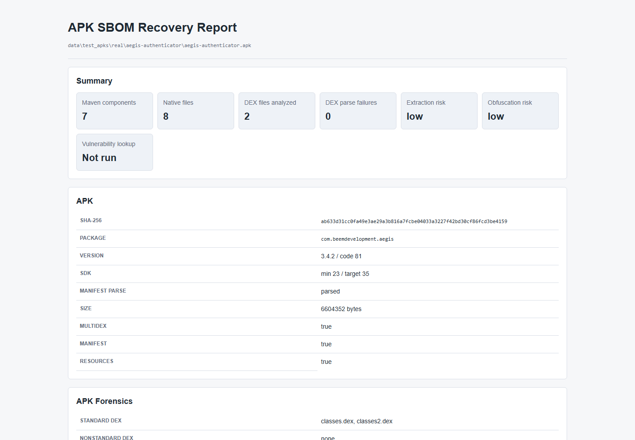
IMPLEMENTATION
53
AI and R8 assistance has its own evidence lane
Dataset evidence
Largest local dataset: 31589 rows.
Training-eligible rows: 20523.
Heldout or report-only rows: 11066.
Unique cases: 150.
Unique coordinates: 1370.
Report-only AI assistance is visible, but the deterministic matcher remains the SBOM authority.
APK-to-SBOM MVP | emitted confirmation is not full recall | v2 is a source-known upper bound
Notes:
This slide restores the old deck's AI proof lane. It shows that the ML and DL work is evaluated as its own evidence class and cannot silently change official SBOM or CVE output. Section 6. Demonstration

Slide 54
DEMONSTRATION
54
Classical ML supports report-only triage
Classical ML result
Authority boundary
Model
RandomForestClassifier
Allowed: report wording, prioritization, diagnostics.
Rows
20523
Blocked: selected versions, SBOM components, CVE labels, source-validation metrics.
Test macro-F1
0.708
Interpretation: useful triage, not exact Maven version proof.
Test accuracy
0.690
Decision
report-only assistance
The ML result is included because it is useful, and bounded because model output is not direct APK evidence.
APK-to-SBOM MVP | emitted confirmation is not full recall | v2 is a source-known upper bound
Notes:
The RandomForest is useful as an assistant because it can triage report rows. It is not allowed to confirm exact Maven versions.

Slide 55
DEMONSTRATION
55
Deep learning results are strong only in the guarded lane
Deep learning result
Macro-F1 comparison
Structured-token Transformer
0.977 macro-F1
Structured token
0.977
MVP-safe Transformer
0.882 macro-F1
MVP safe
0.882
Raw-opcode Transformer
0.110 macro-F1
Raw opcode
0.110
Raw-opcode baseline
0.128 macro-F1
Raw baseline
0.128
Verdict
raw-opcode DL research-only
Structured evidence helps report-only triage. Raw opcode sequences did not beat the baseline.
APK-to-SBOM MVP | emitted confirmation is not full recall | v2 is a source-known upper bound
Notes:
The old presentation separated ML and DL because the conclusions are different. Structured project-evidence tokens are useful for triage, while raw opcode sequences did not beat the baseline.

Slide 56
DEMONSTRATION
56
The demo follows one deterministic APK-to-report path
Input APK
Reference DB
generate-report
Output dir
Report bundle
matches.json
sbom.cdx.json
osv-vulnerabilities.json
report.json
report.md
report.html
Optional hybrid AI sections appear only when requested and do not alter the official output.
APK-to-SBOM MVP | emitted confirmation is not full recall | v2 is a source-known upper bound
Notes:
The demo should show an end-to-end path without live dependence on long rebuilds or unstable network services unless explicitly refreshed.

Slide 57
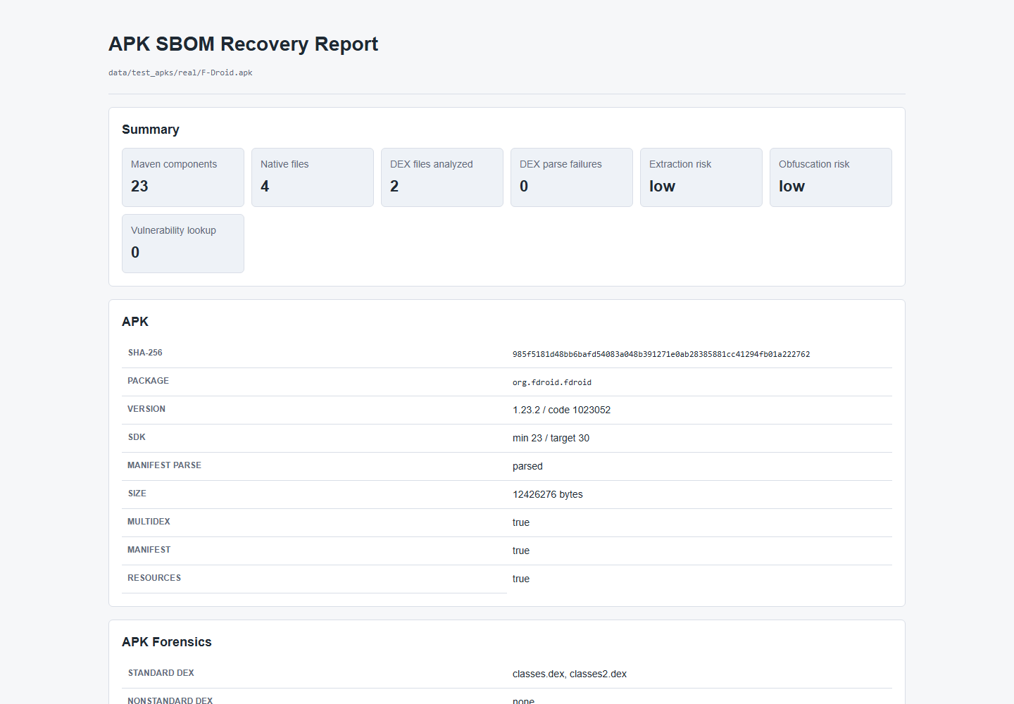
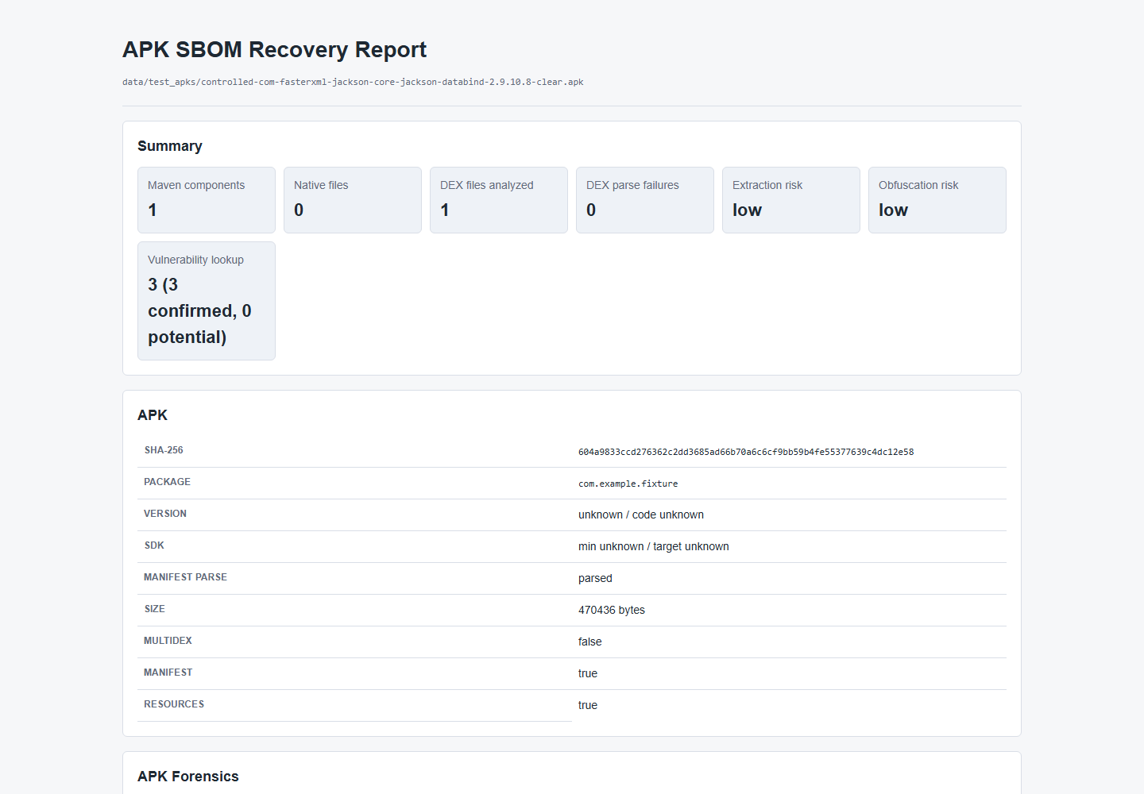
DEMONSTRATION
57
Clean and vulnerable screenshots prove both CVE lanes
CLEAN REAL APK
CONTROLLED POSITIVE CVE
23 Maven components | OSV 0
Jackson Databind 2.9.10.8 | 3 HIGH
CVE-2020-36518
CVE-2022-42003
CVE-2022-42004
APK-to-SBOM MVP | emitted confirmation is not full recall | v2 is a source-known upper bound
Notes:
These are generated report screenshots from the old deck, not mockups. The clean lane proves a negative vulnerability result, and the Jackson lane proves a positive vulnerability result.

Slide 58
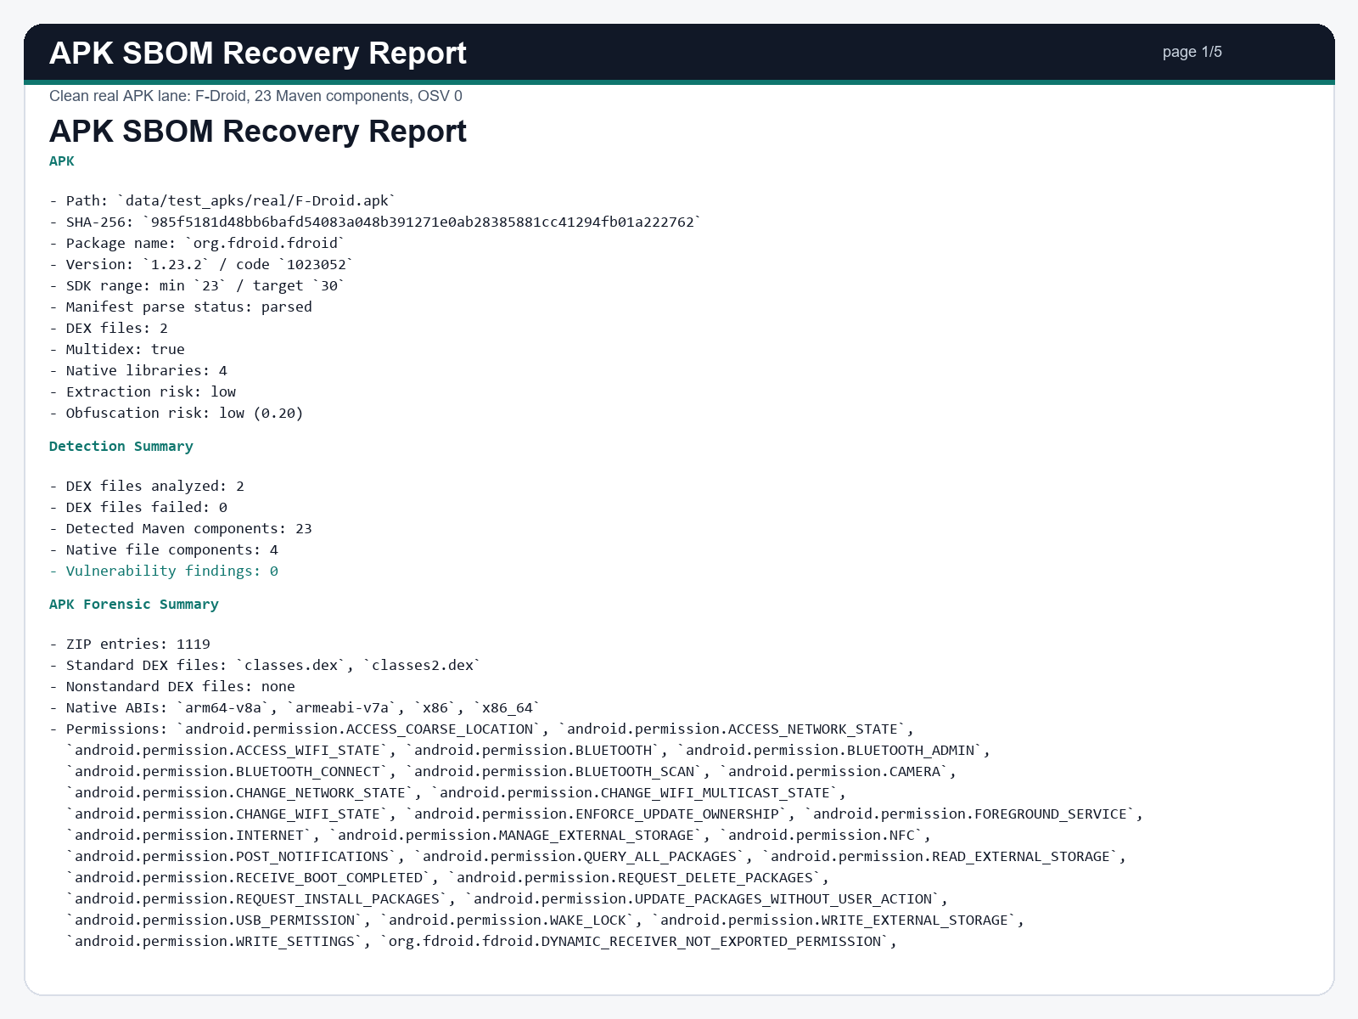
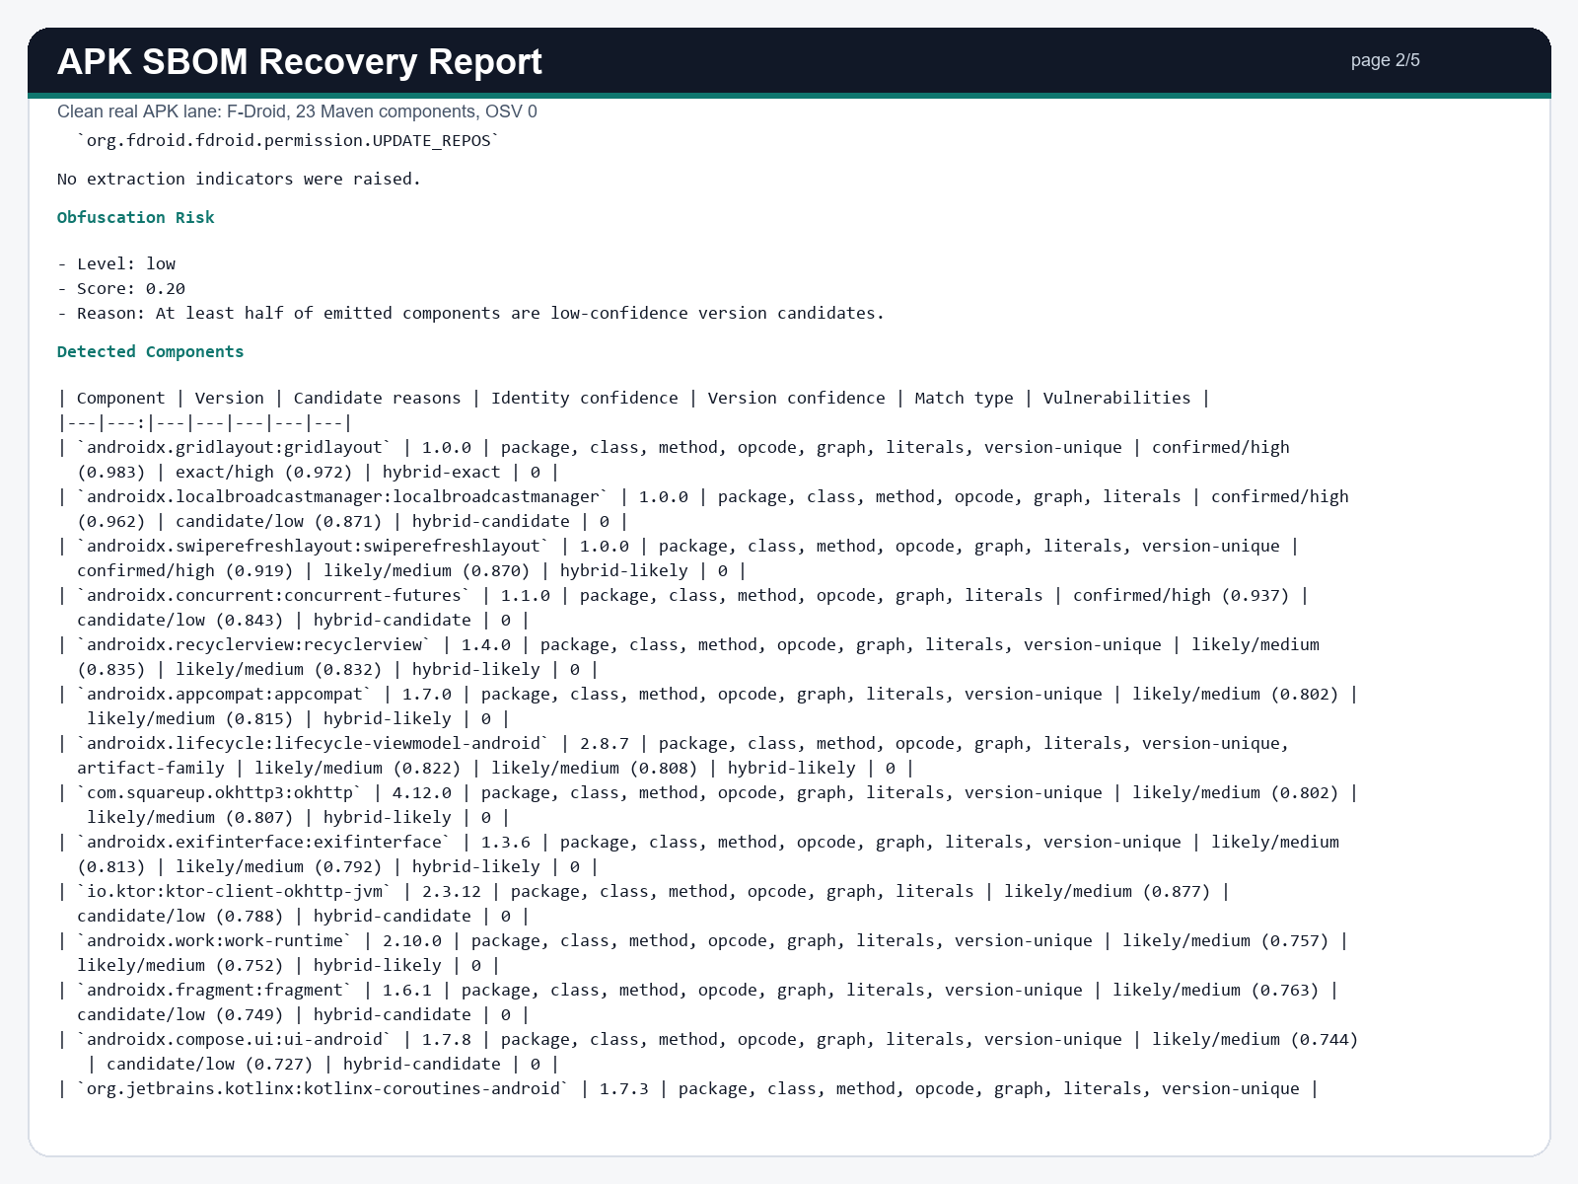
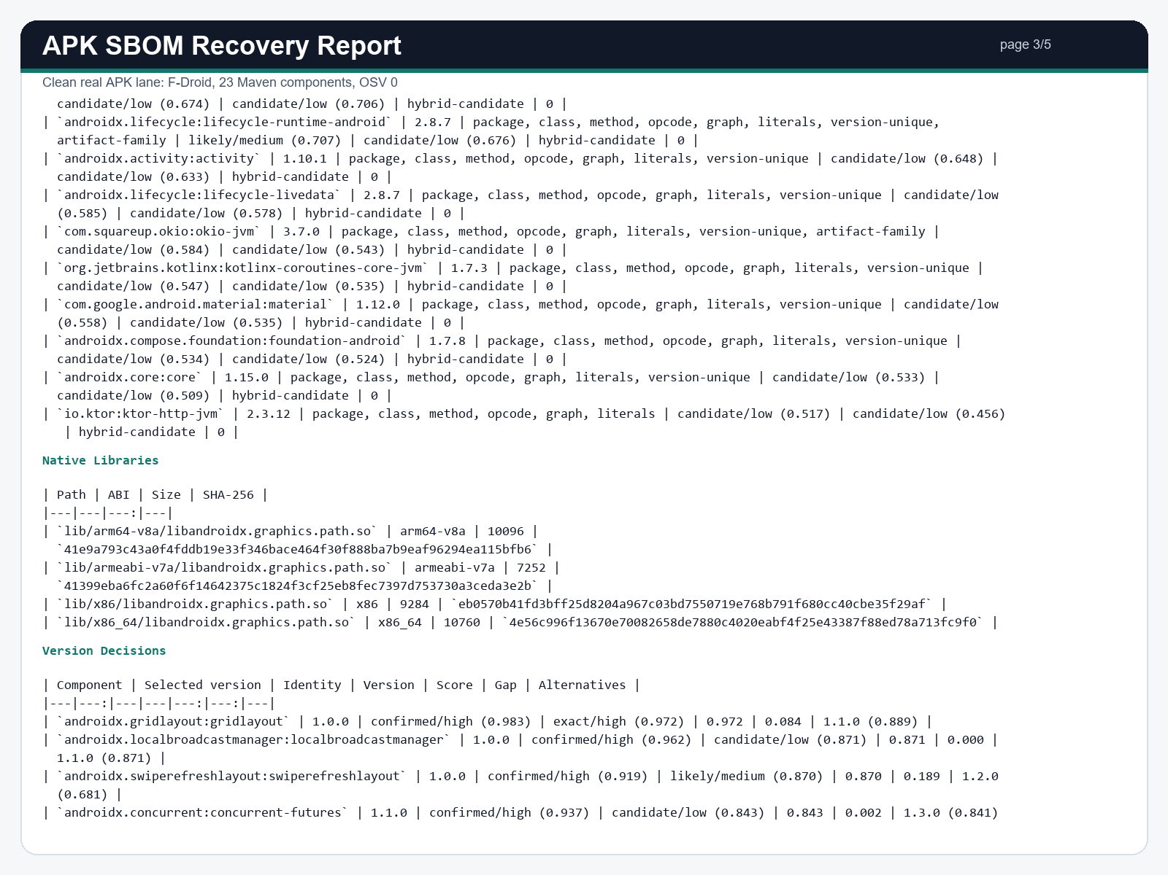
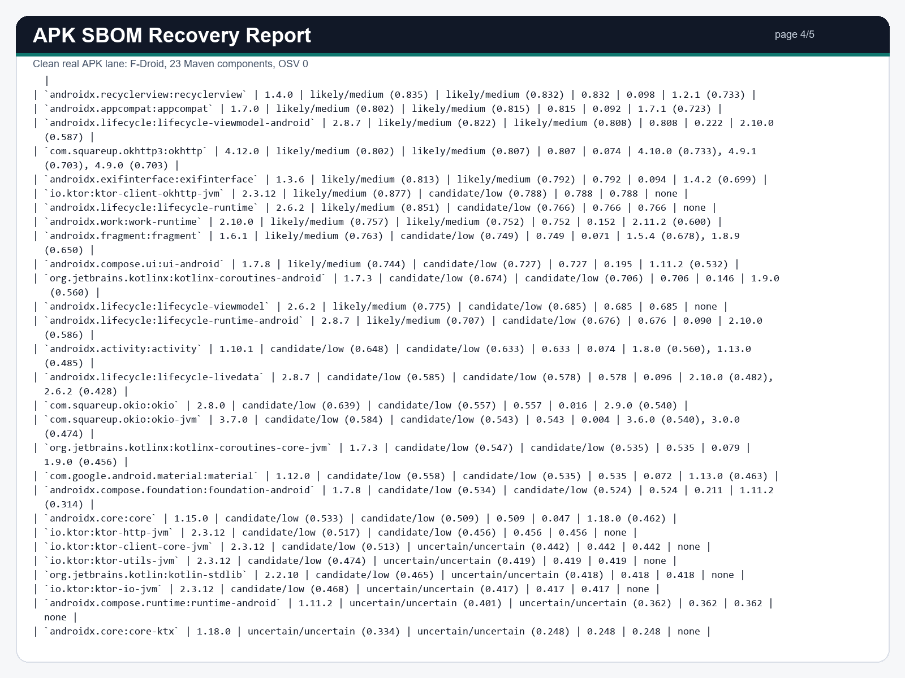
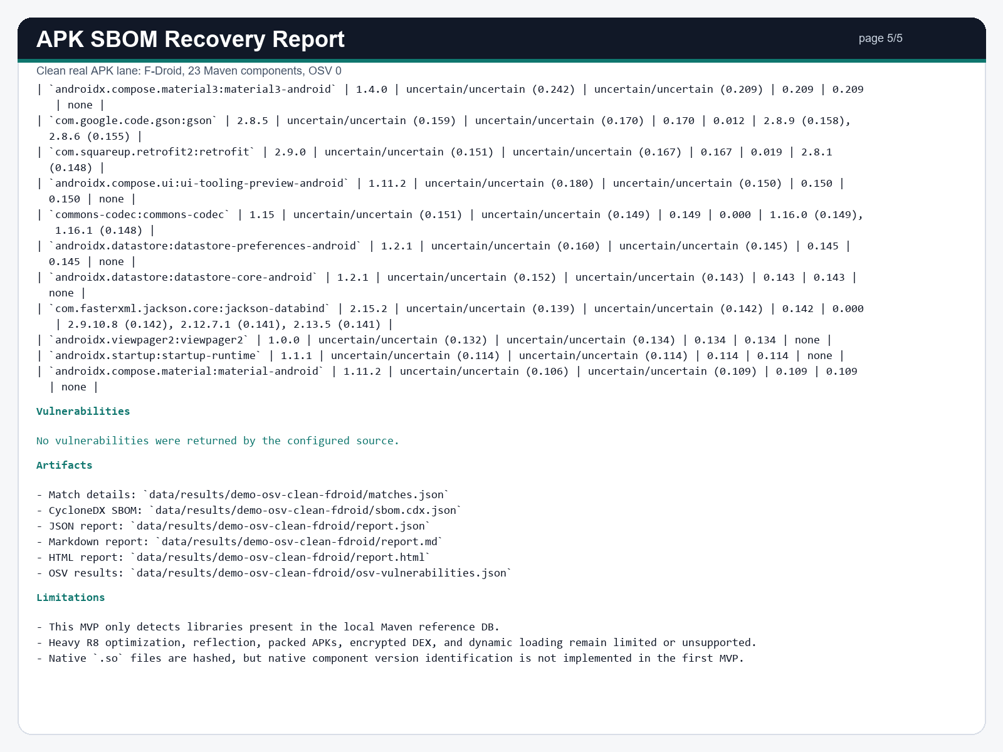
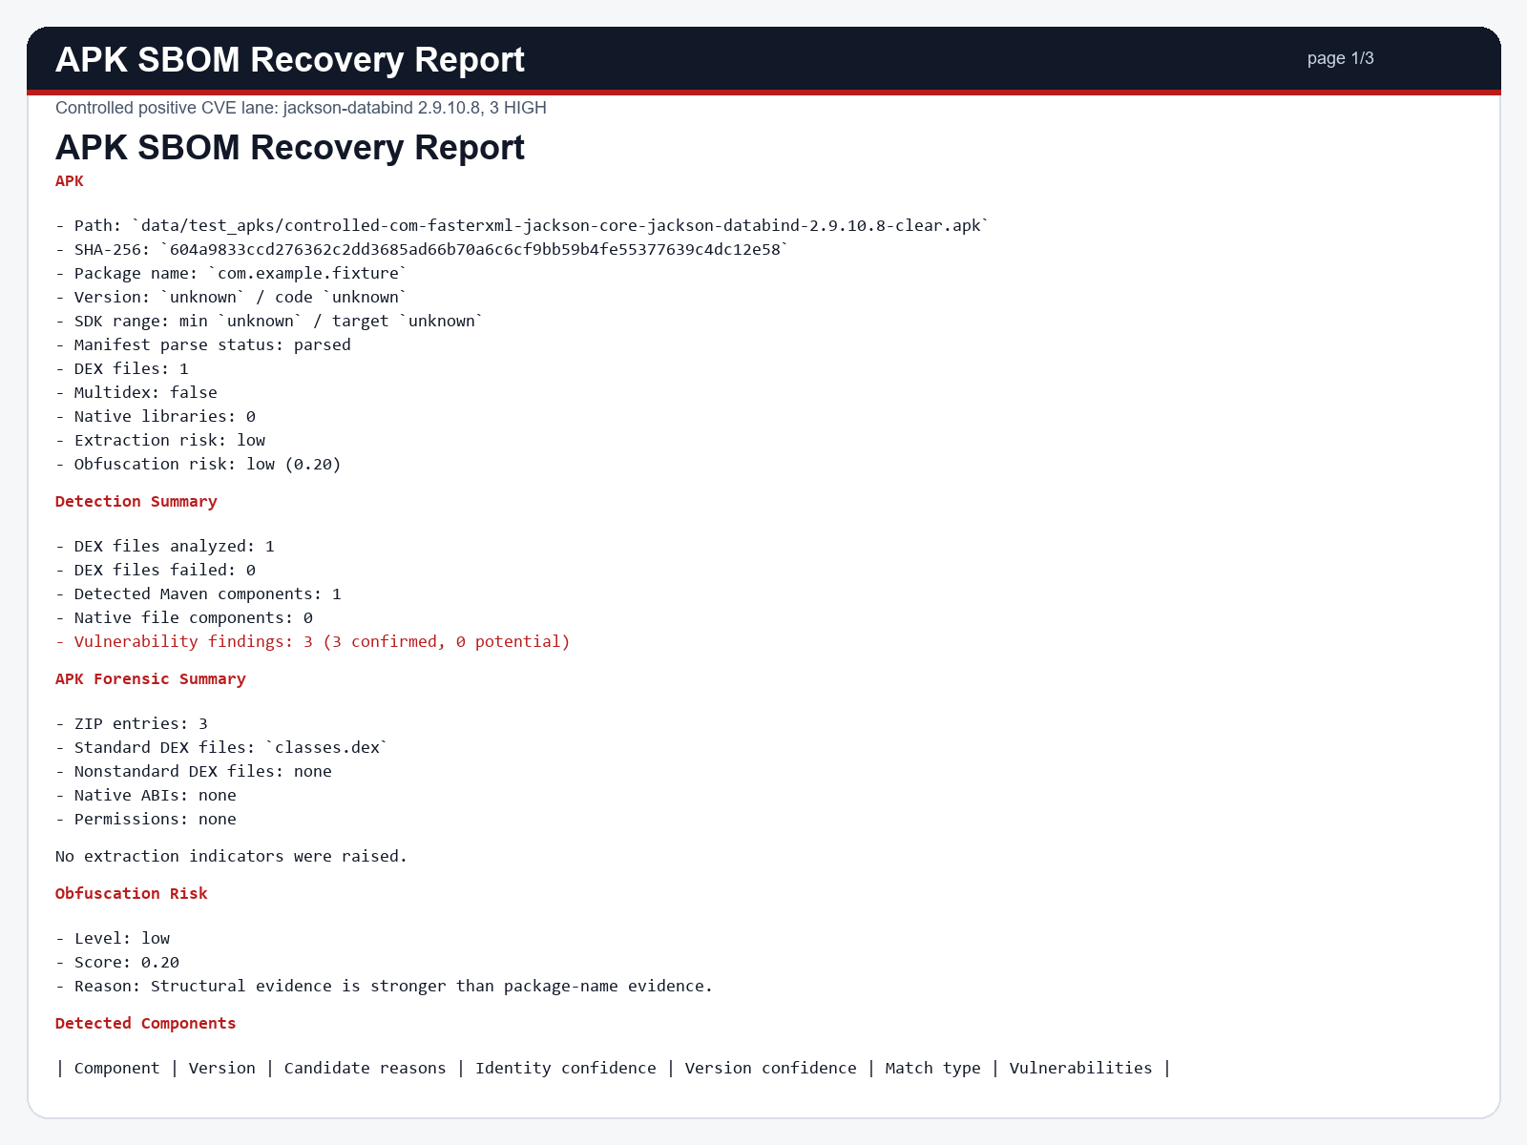
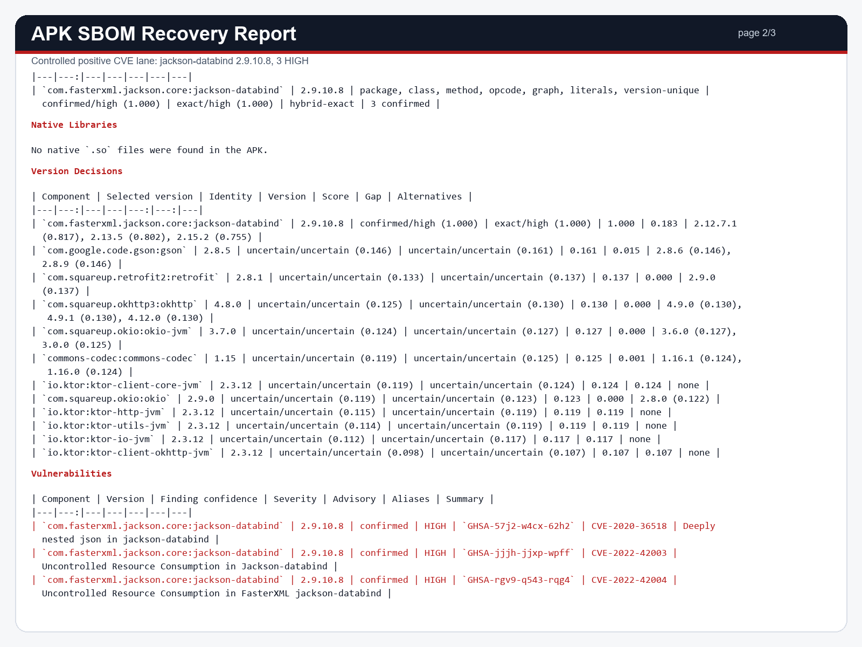
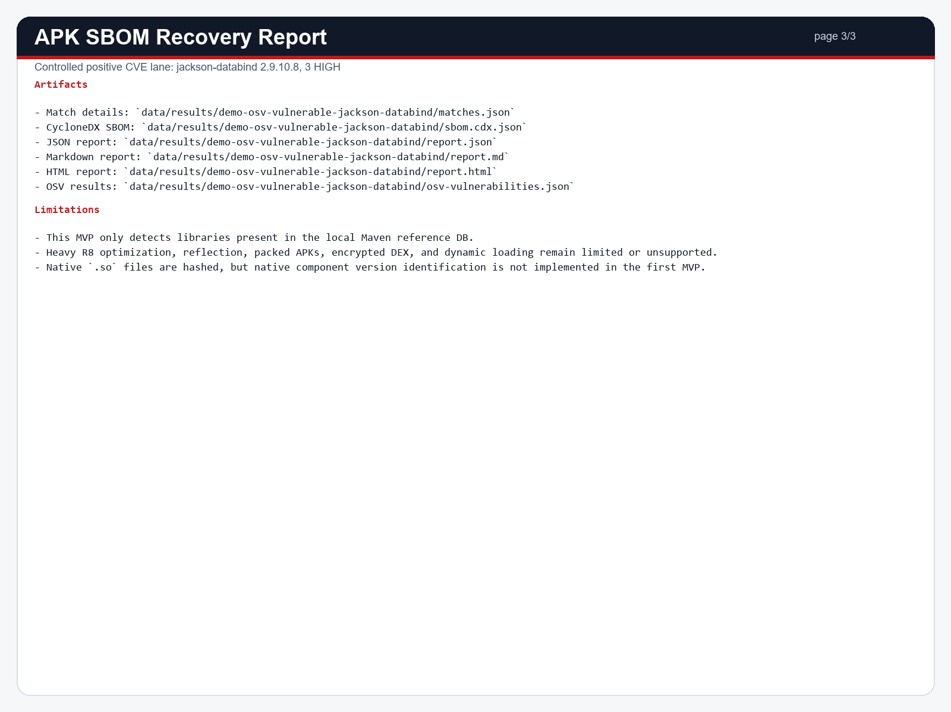
DEMONSTRATION
58
Full report pages and AI screenshots show output integrity
The screenshots prove implemented output surfaces. They do not claim perfect APK coverage.
APK-to-SBOM MVP | emitted confirmation is not full recall | v2 is a source-known upper bound
Notes:
This slide keeps the large screenshot set from the old presentation. It shows that the generated report surfaces clean, vulnerable, and AI-assisted proof while preserving the official output boundary. Section 7. Conclusion

Slide 59
CONCLUSION
59
The main result is bounded, auditable recovery
84 / 84
927 / 1837
6772 / 6772
controlled expected versions
source-validated emitted Maven versions
source-known v2 emitted rows
Synthesis
The Master thesis defines trustworthy APK-derived SBOM claims.
The Engineering thesis implements an evidence-gated APK-to-SBOM pipeline.
Controlled fixtures confirm 84 of 84 expected versions.
Real APKs show 927 of 1837 confirmed emitted Maven versions.
The v2 lane confirms 6772 of 6772 source-version constrained emitted rows as an upper bound.
Auditable partial knowledge is safer than unsupported exact-version certainty.
APK-to-SBOM MVP | emitted confirmation is not full recall | v2 is a source-known upper bound
Notes:
The conclusion should connect research and implementation. The project favors auditable partial knowledge over unsupported certainty.

Slide 60
CONCLUSION
60
Limitations and future work define the next research agenda
01
02
03
Improve reference coverage without unsafe promotion.
Improve matcher recall for source-gap rows.
Calibrate identity, version, ambiguity, and abstention classes.
04
05
06
Extend native and dynamically loaded code attribution.
Build public benchmarks with exact denominators and transformation labels.
Evaluate human understanding of confidence and report-only evidence.
APK-to-SBOM MVP | emitted confirmation is not full recall | v2 is a source-known upper bound
Notes:
The project ends with a clear agenda. The next step is not to remove uncertainty from the report, but to calibrate it and expand the evidence domains safely.

