Slide 1
Hack for the Sea 2016
Eric W. Brown (Python) & Ashwini Kumar (Java)
Lobsta Listen: A passive undersea data collection device

Slide 2
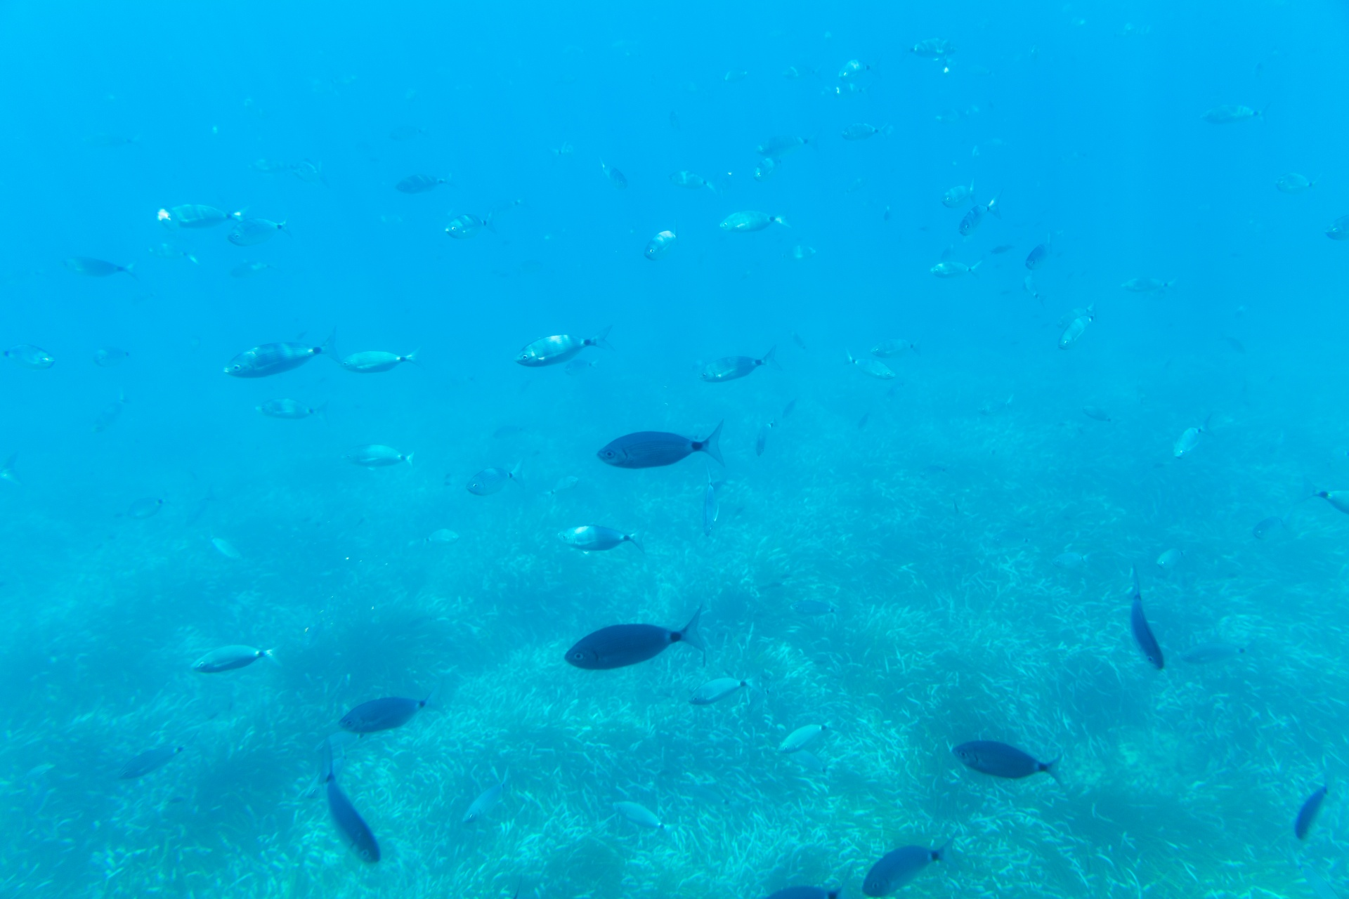
Motivation
Fish populations matter
But we don’t have much data

Slide 3
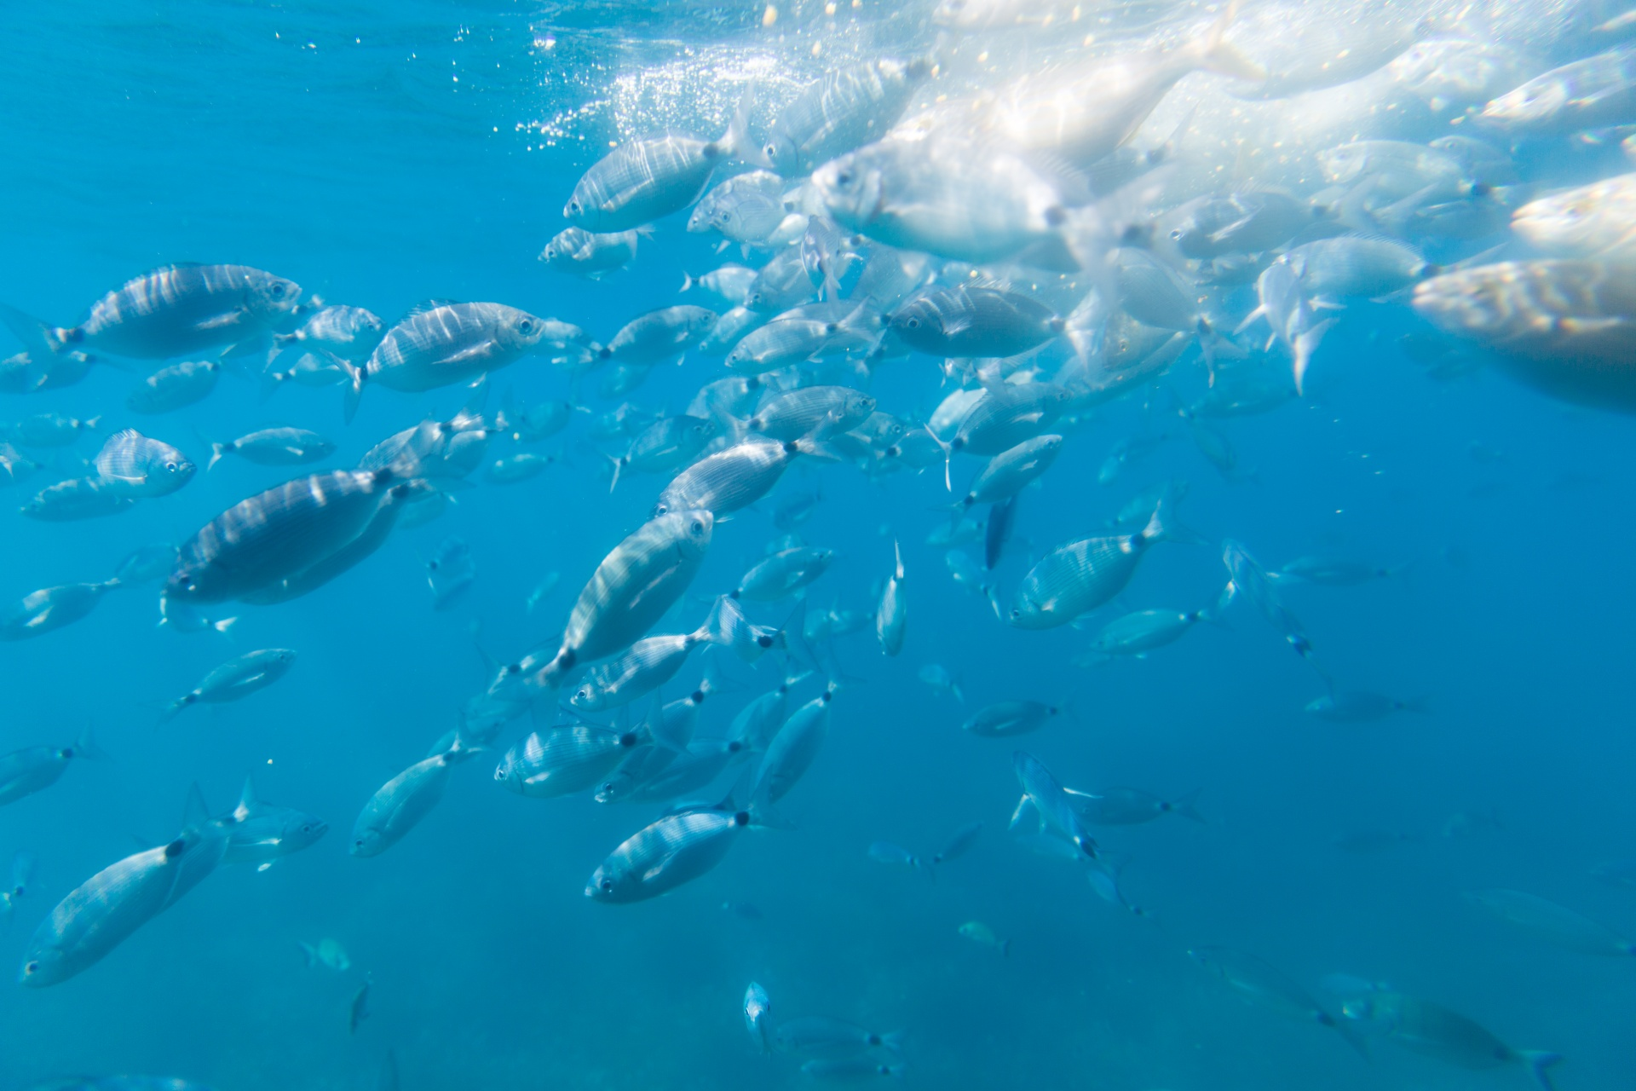
Fish Make Noise
Sometimes lots of noise
Audio recorded underwater is useful
This recording is traditionally expensive

Slide 4
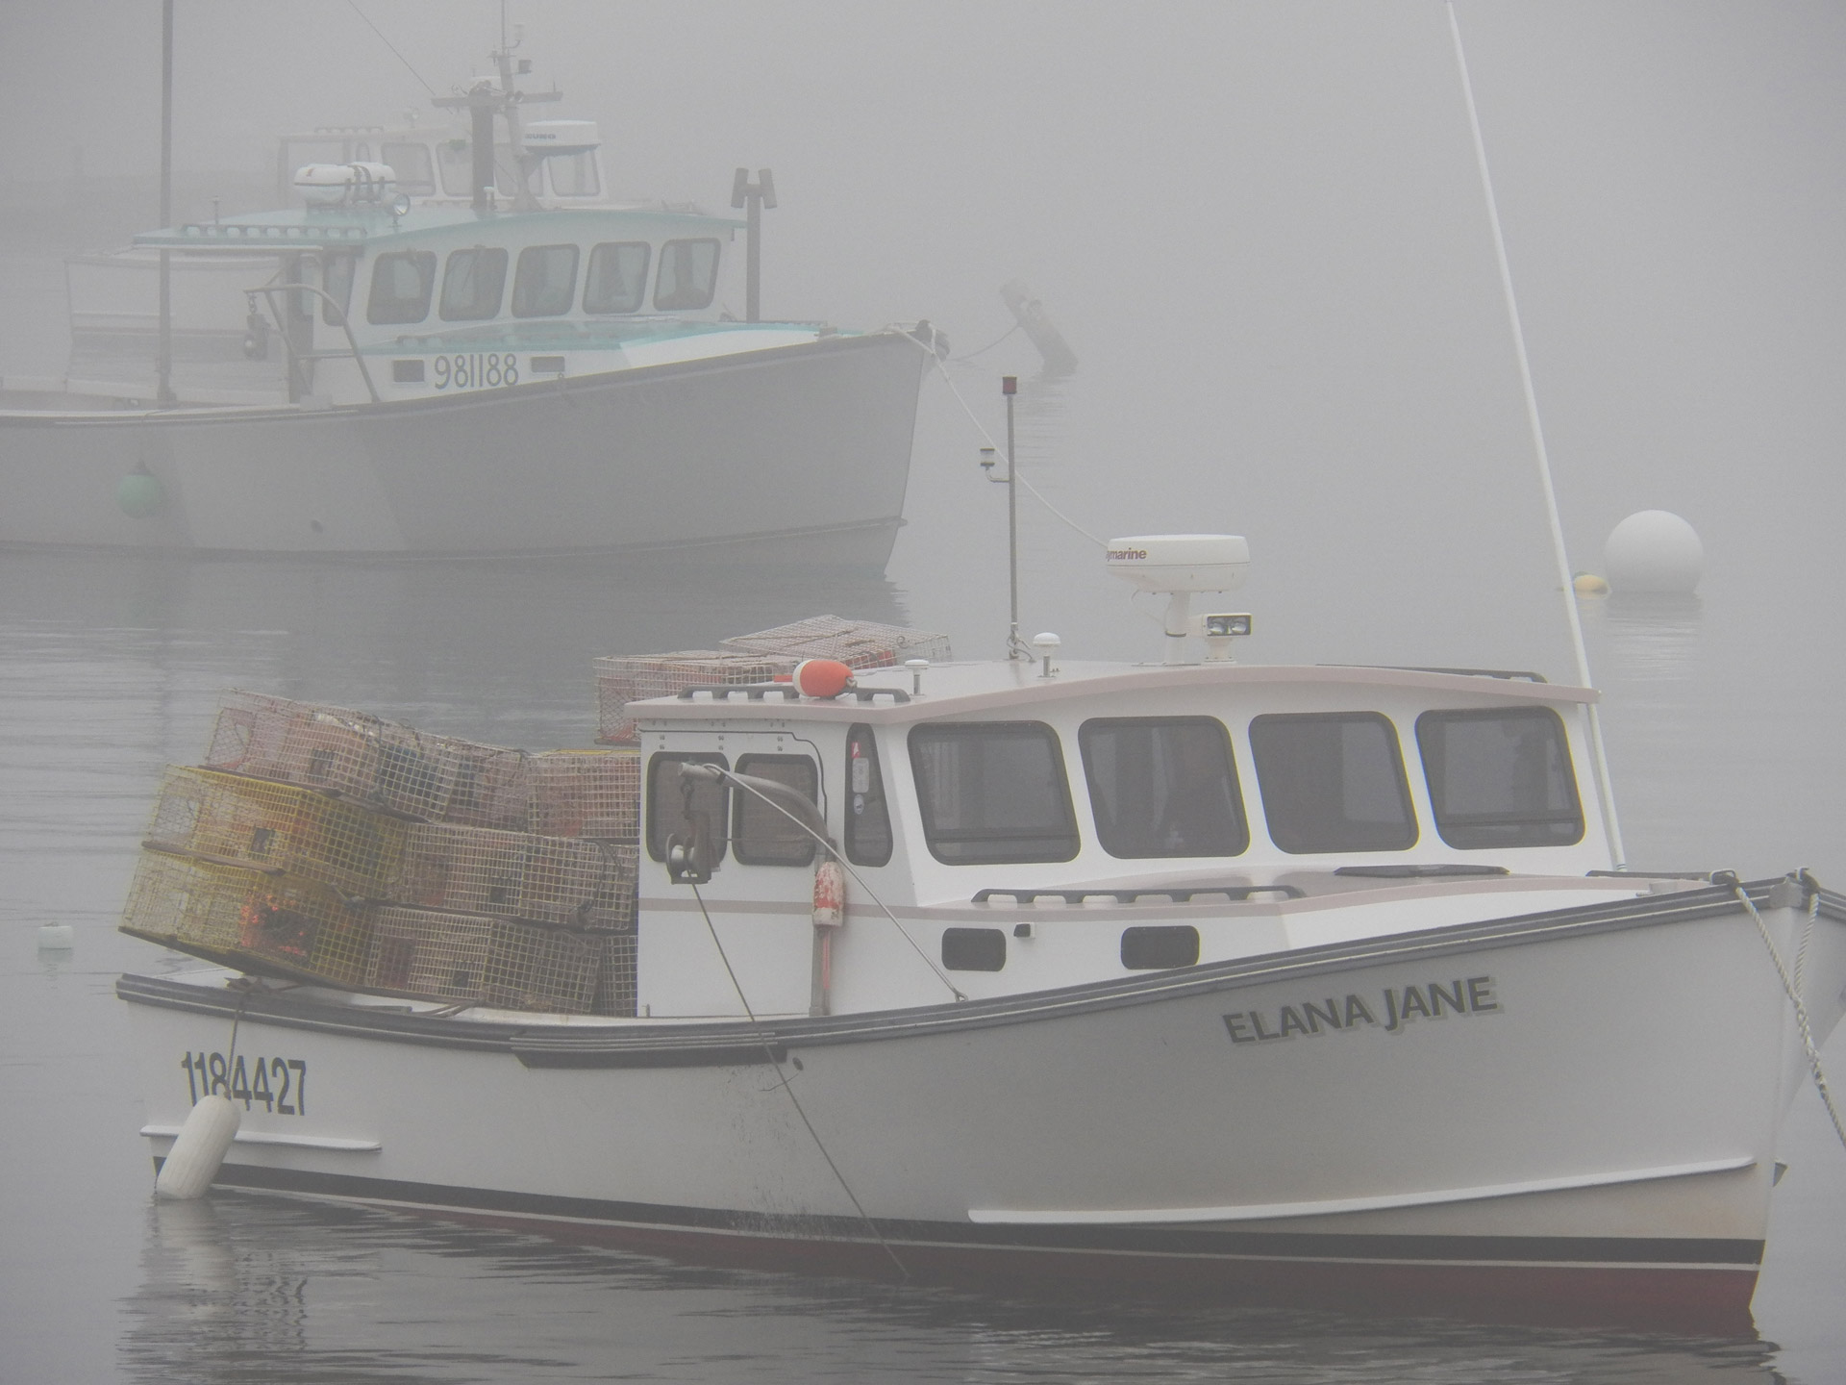
Possible Solution
Make a small, independent, waterproof recording device
Find a way to put it in place

Slide 5
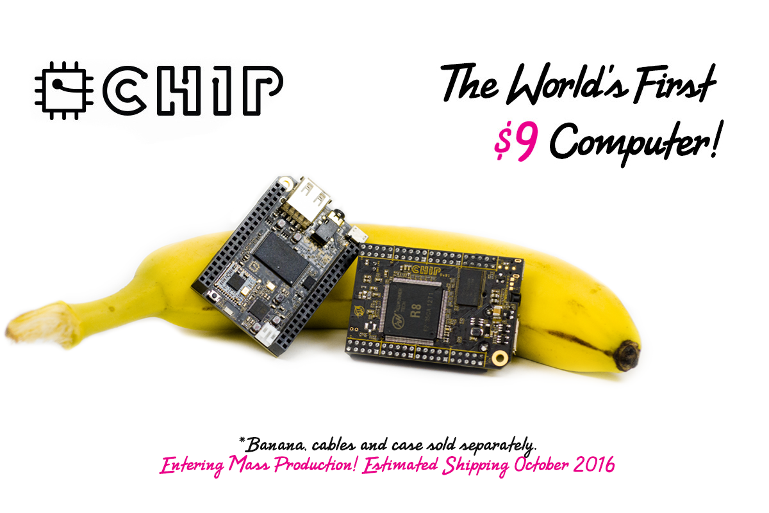
Inexpensive Computing
Starting with a C.H.I.P. we can use off-the-shelf components for hydrophone, GPS, pressure sensor, & battery

Slide 6
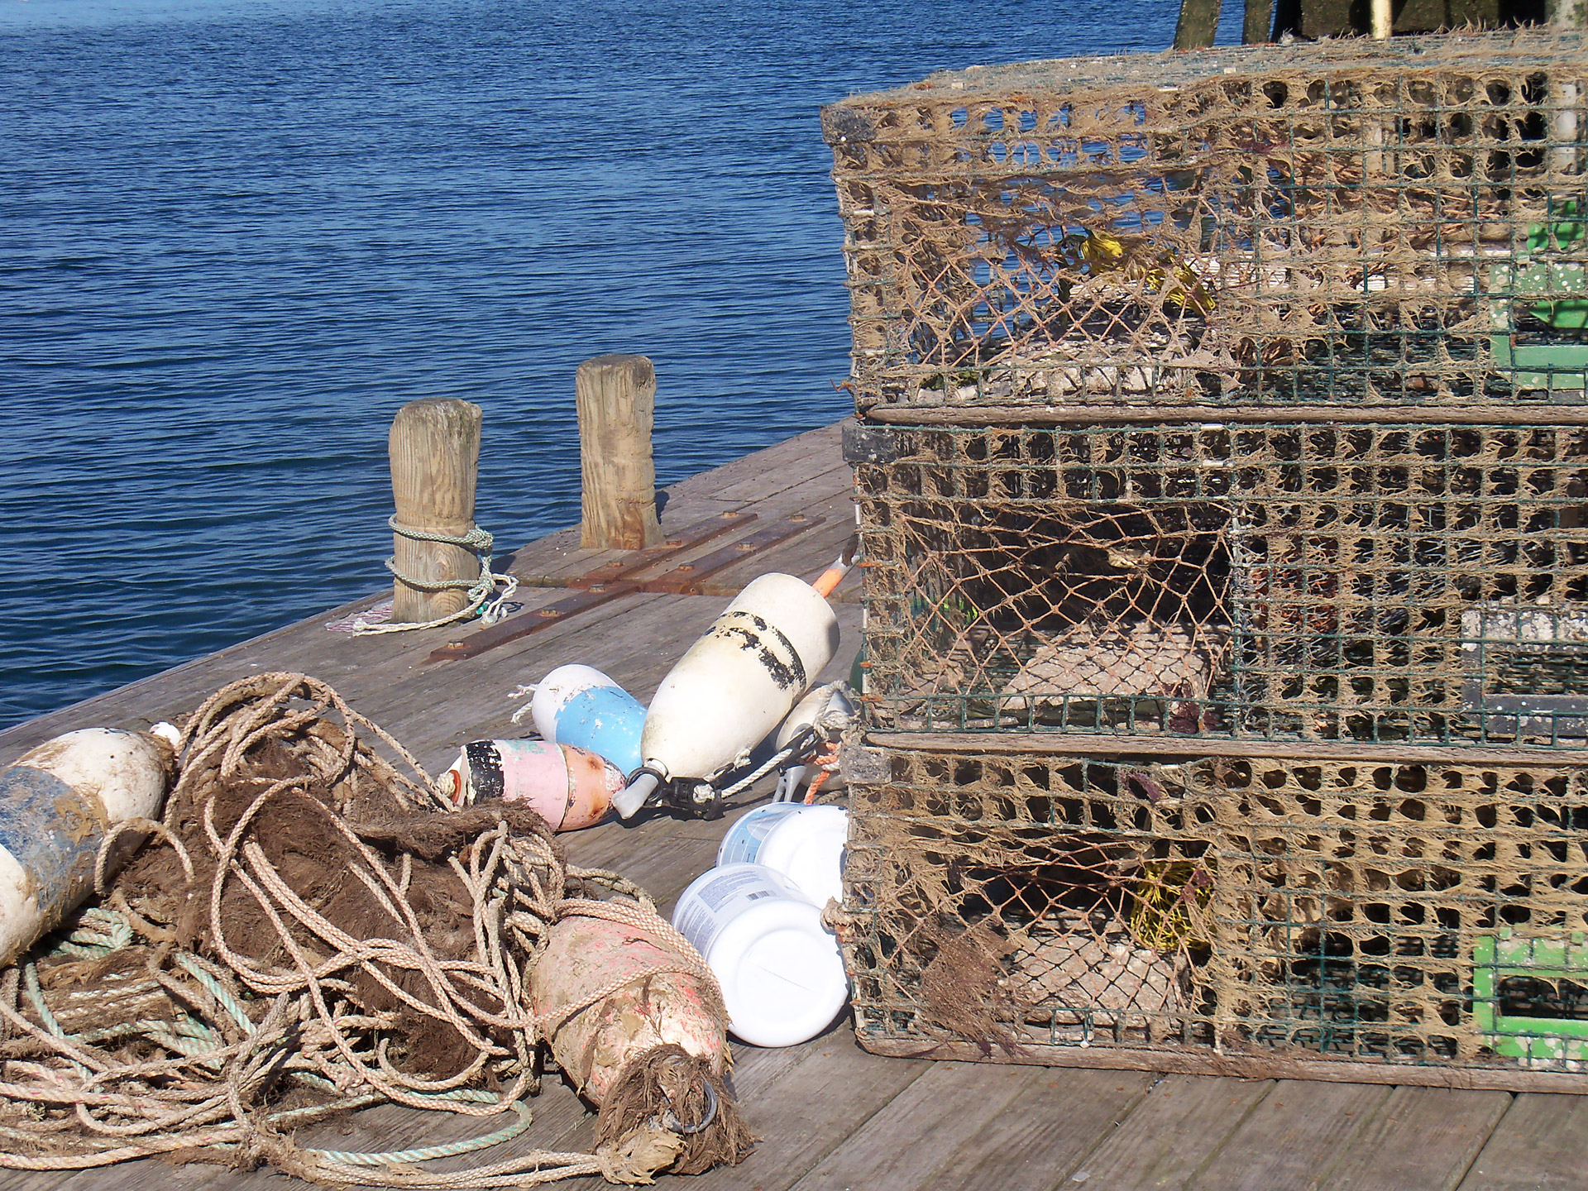
Placement
Lobstermen place traps on the sea bed daily
Our listening device can hitchhike on the traps

Slide 7


Software
We took two approaches on software
We did them in parallel
One is in Python
One is in Java
Both exploit Linux resources

Slide 8
Python Approach
Fully functional
Uses Twisted; event driven
Uses built-in arecord
Encodes audio using FLAC lossless compression
< 200 LOC (including comments)
Available on GitHub: https://github.com/Feneric/LobstaListen

Slide 9
Java Approach
Uses JavaX sound library
Highly configurable
Easy to extend with signal processing
Maven build system / easy dependency adding
Facility for unit testing / code coverage

Slide 10
Left to Do
Everything is off-the-shelf except the watertight casing
The pressure sensor will have its own interface, the code presently has a dummy call
The specific hydrophone will require some tuning

Slide 11
Credits
Eric W. Brown can be found at:
  https://www.shelltown.net/~eric/
  Feneric on GitHub
  @Feneric on Twitter
Ashwini Kumar can be found at:
Thanks to Iotopia Solutions, Gloucester Innovation, MRH.io, Flying Car, Maritime Gloucester, & North Shore T.E.C.H.
Some photos in this presentation came from PublicDomainPictures.net

