Slide 1
NEARBY PLACES
ON LOCATION-BASED PRUNING FOR
POINT-OF-INTEREST RECOMMENDATION
Jordan Silva Rodrygo L. T. Santos
Nivio Ziviani
jordan@dcc.ufmg.br rodrygo@dcc.ufmg.br
nivio@dcc.ufmg.br

Slide 2
POI Recommendation
What is it for?
Point-of-interest (POI) recommendation
helps users discover new interesting locations.

Slide 3




POI Recommendation
Location-based Social Networks

Slide 4

POI Recommendation
Intelligent Personal Assistant

Slide 5

POI Recommendation
Smart Cities

Slide 6

POI Recommendation
Traditional evaluation framework
01.
02.
03.
04.
.
.
.
10.
=

Slide 7
POI Recommender Methods
State-of-the-art POI recommenders perform expensive computations
k-Nearest Neighbors
User-based Collaborative Filtering (UserKNN) [Ricci et al. 2010]
Item-based Collaborative Filtering (ItemKNN) [Sarwar et al. 2011]
Matrix Factorization
Bayesian Personalized Ranking from Implicit Feedback (BPRMF) [Rendle et al. 2009]
State-of-the-Art POI Recommendation
Rank-GeoFM [Li et al. 2015]

Slide 8
Rank-GeoFM
State-of-the-art POI recommenders perform expensive computations
RankGeoFM is a ranking-based MF model that learns users’ preference rankings for POIs and includes the geographical influence of neighboring POIs.

Slide 9
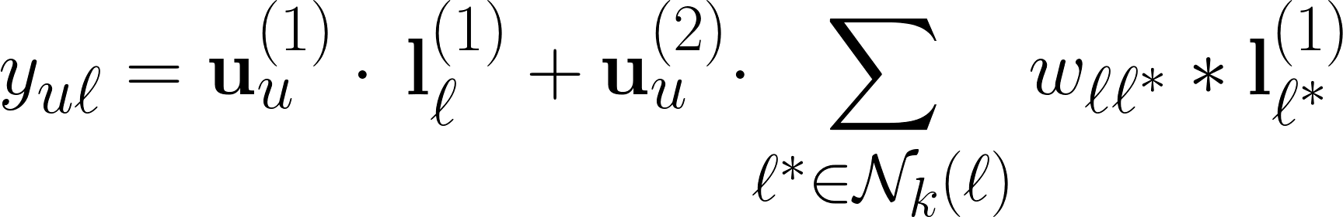
Rank-GeoFM
State-of-the-art POI recommenders perform expensive computations
user preference score
geographical influence score
latent factor to model the interaction between users and POIs
neighboring POIs of ℓ
distance-based weight
assigned to POI ℓ *

Slide 10
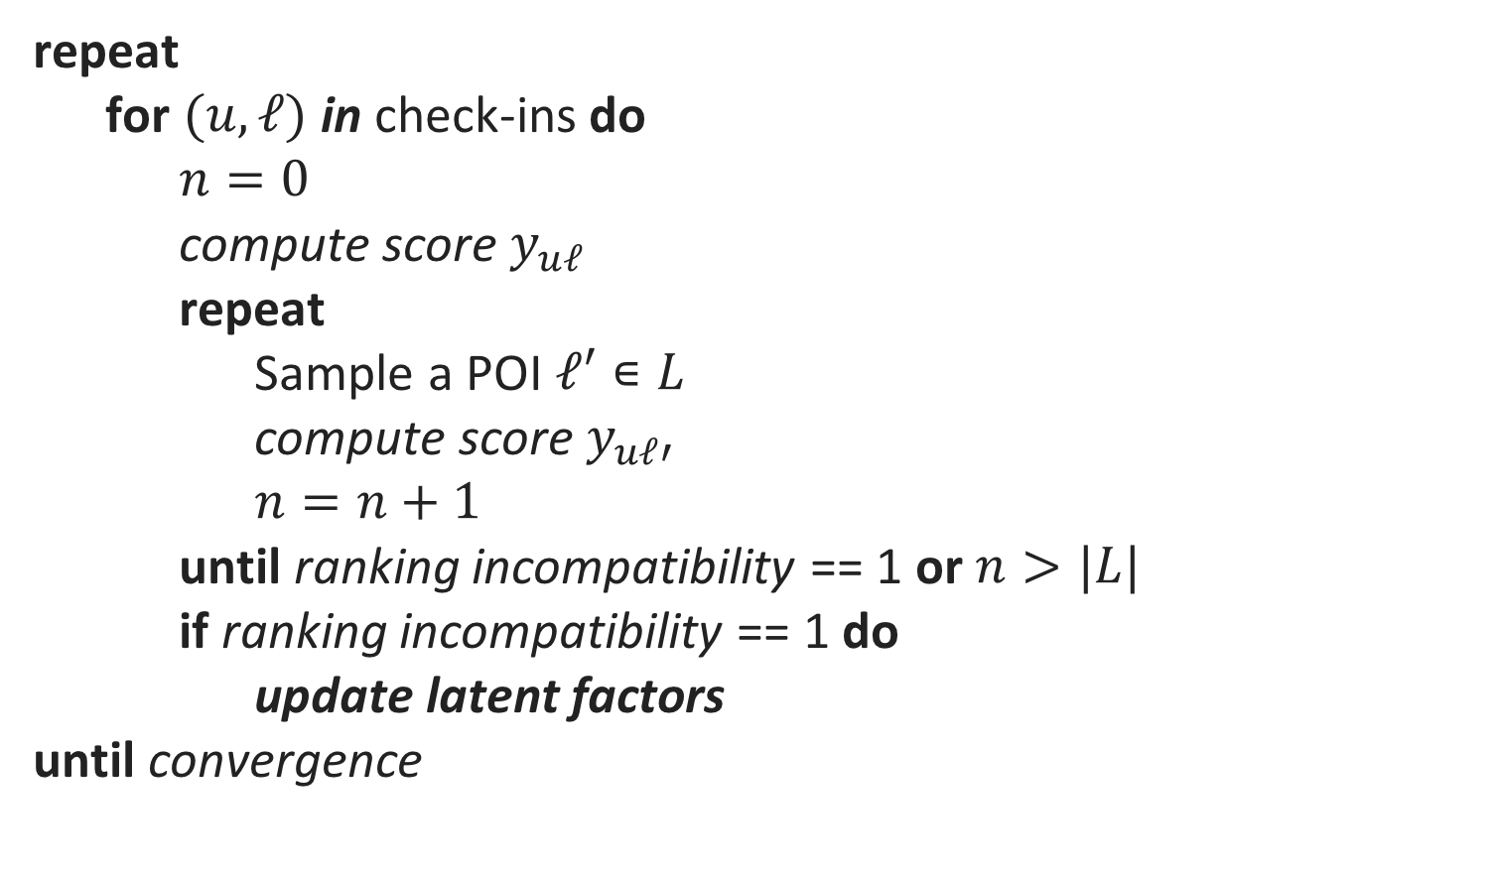
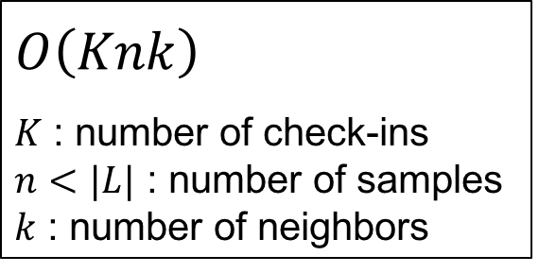
Rank-GeoFM
State-of-the-art POI recommenders perform expensive computations
repeat
for $(u,ℓ)$ in check-ins do
$n=0$
compute score $y_{uℓ}$
repeat
Sample a POI $ℓ′∊L$
compute score $y_{uℓ′}$
$n=n+1$
until ranking incompatibility == 1 or $n>|L|$
if ranking incompatibility == 1 do
update latent factors
until convergence
Iterate over all check-ins
Sampling POI until finding
a ranking incompatibility
$$O\left(Knk\right)$$
$K$ : number of check-ins
$n<|L|$ : number of samples
$k$ : number of neighbors
Update latent factors
if find a ranking incompatibility
Notes:
We are looking for false positives, i.e., non-relevant POIs that are inadvertently promoted by the current model
When n is small, took short time to make a mistake, the gradient will have a large magnitude
K = number of positive check-ins, n = mid loop, k = number of neighbors (cost of computing y)

Slide 11
Problems
State-of-the-art POI recommenders perform expensive computations
Expensive learning:
Must sample incompatible pairs among out-of-range POIs
Expensive prediction:
Must score all available POIs

Slide 12
Users’ Check-ins
In practice, users tend to visit nearby places
“Everything is related to everything else, but near things are more related than distant things”
Tobler's First Law of Geography

Slide 13
Users’ Check-ins
In practice, users tend to visit nearby places
Liao et al. "Who Wants to Join Me?: Companion Recommendation in Location Based Social Networks."
ACM ICTIR 2016.
Ye et al. "Exploiting geographical influence for collaborative point-of-interest recommendation."
ACM SIGIR 2011.
Yuan et al. "Time-aware point-of-interest recommendation."
ACM SIGIR 2013.

Slide 14
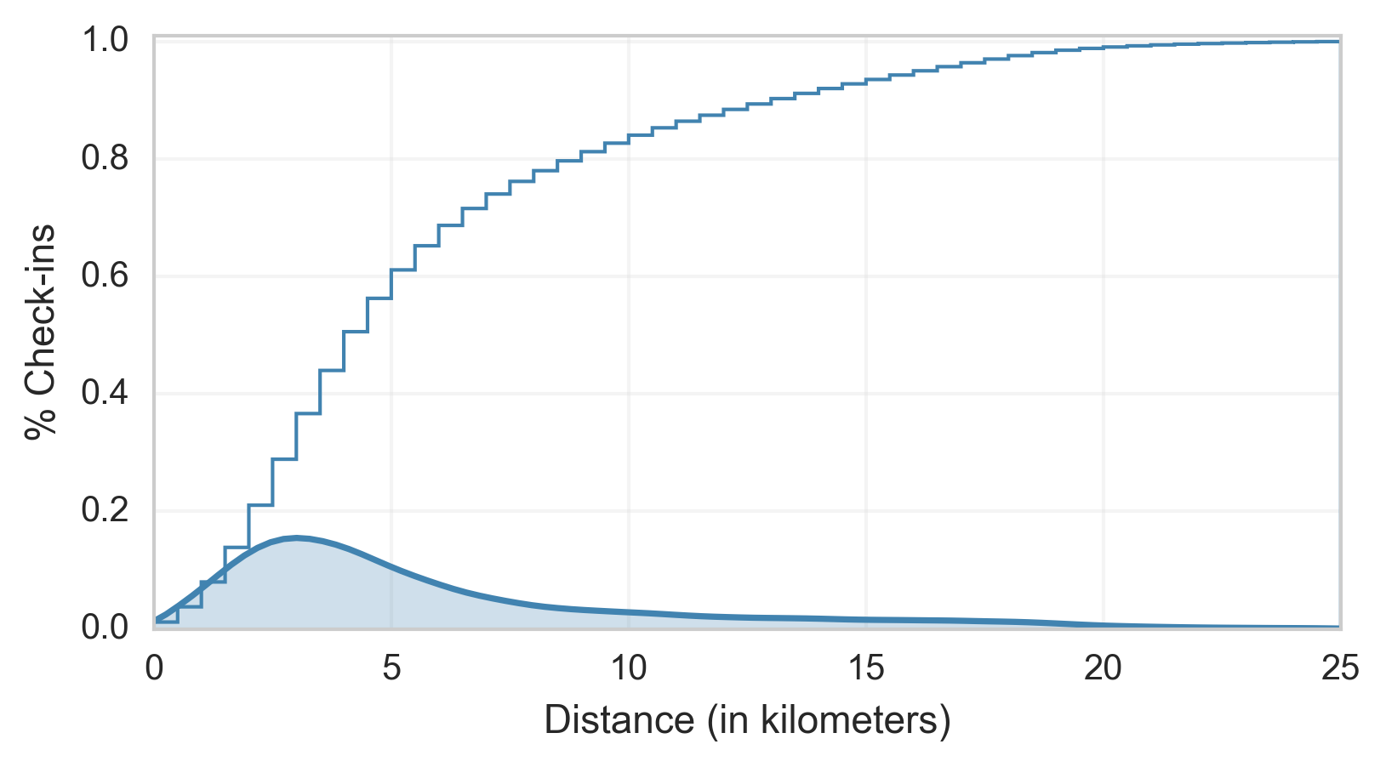
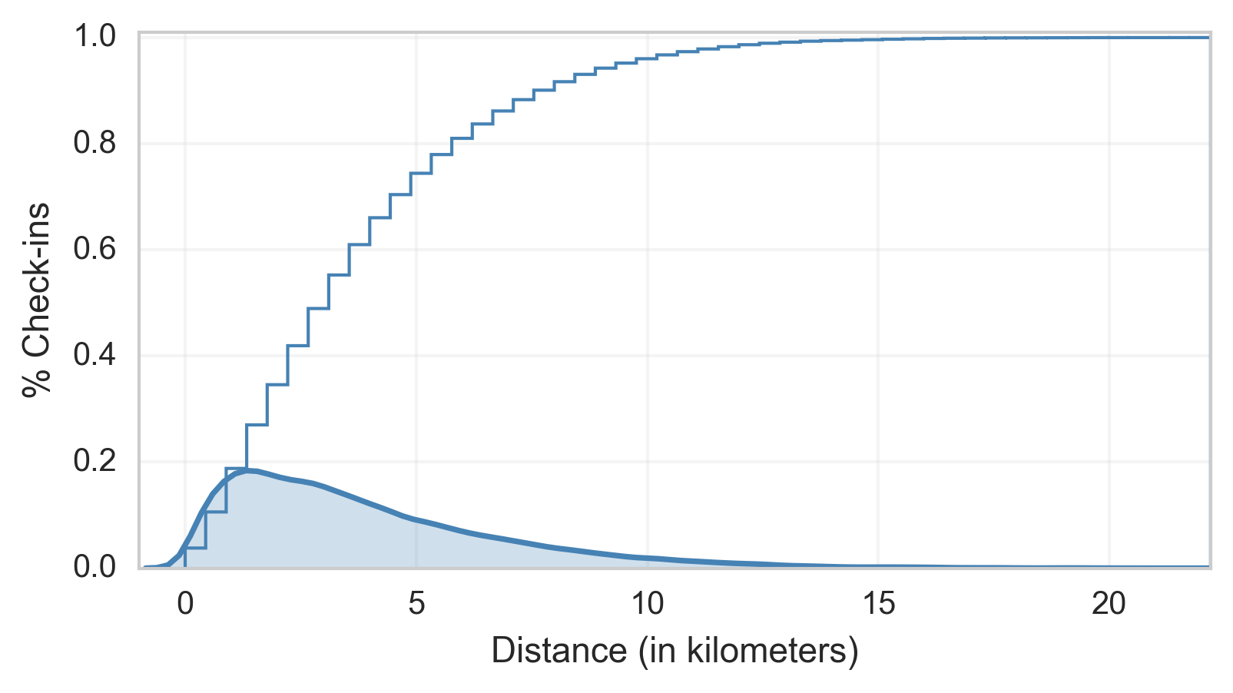
Users’ Check-ins
In practice, users tend to visit nearby places
New York
Belo Horizonte
60% check-ins
up to 5km
80% check-ins
up to 10km
96% check-ins
up to 10km
71% check-ins
up to 5km

Slide 15
Nearby POIs
In practice, users tend to visit nearby places
What if we restrict recommenders to work with data in the user's vicinity?

Slide 16
Nearby POI recommendation task
Exploring a new neighborhood
01.
02.
03.
04.
.
.
.
10.
01.
02.
03.
04.
=

Slide 17
Nearby POIs
In practice, users tend to visit nearby places
Akin to static pruning in search engines
Precompute scores at indexing time
Halt query processing at a given cutoff
In our setting, location is used for pruning

Slide 18
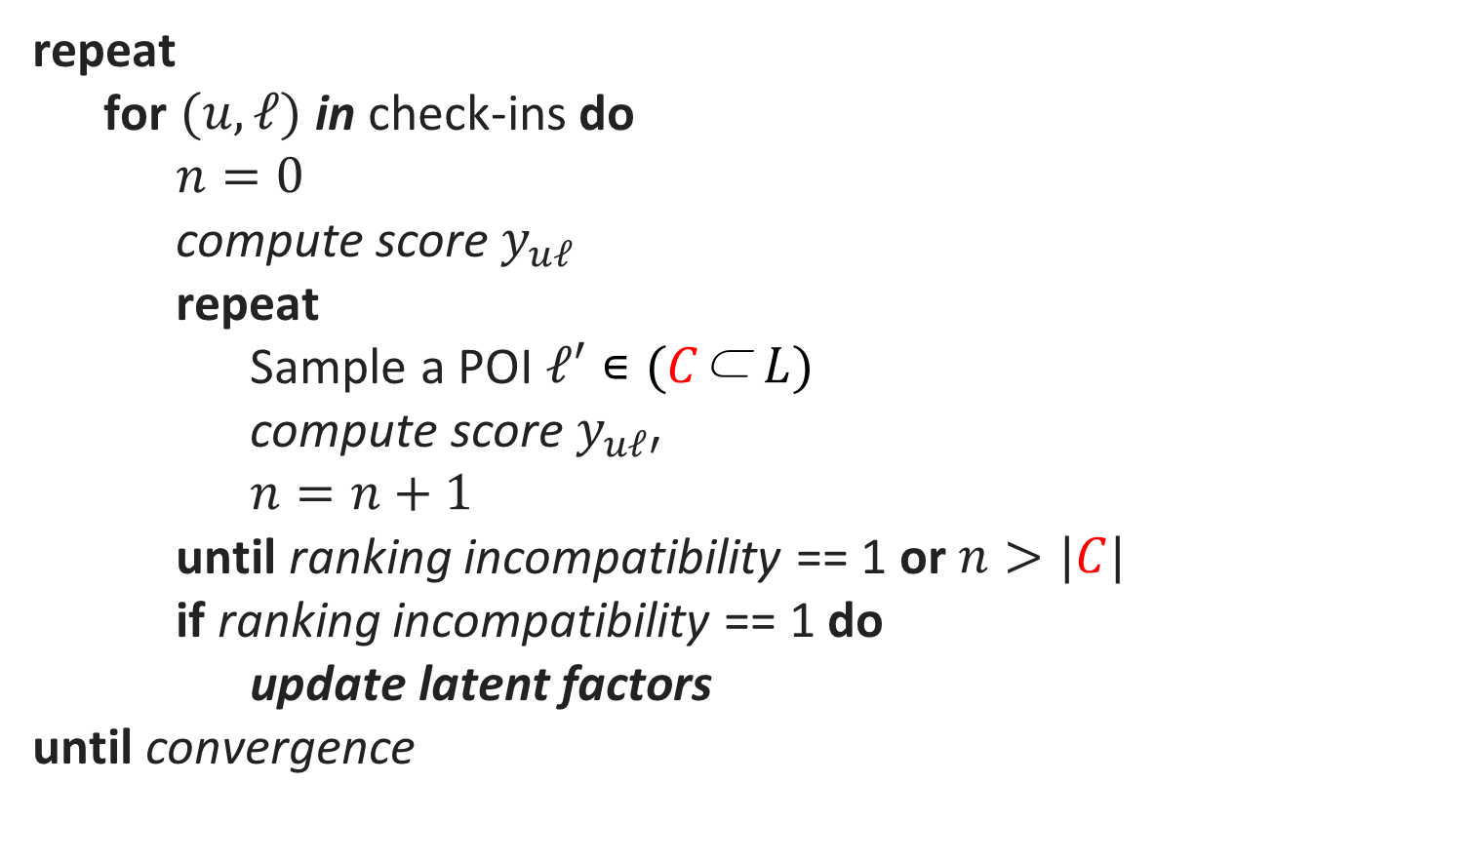
Rank-GeoFM
State-of-the-art POI recommenders perform expensive computations
repeat
for $(u,ℓ)$ in check-ins do
$n=0$
compute score $y_{uℓ}$
repeat
Sample a POI $ℓ′∊(C\text{⊂} L)$
compute score $y_{uℓ′}$
$n=n+1$
until ranking incompatibility == 1 or $n>|C|$
if ranking incompatibility == 1 do
update latent factors
until convergence
Sampling POI in the set of candidates until finding
a ranking incompatibility

Slide 19
Nearby POIs
In practice, users tend to visit nearby places
How would location-based pruning impact POI recommendation effectiveness and efficiency?

Slide 20
Nearby POI recommendation task
Traditional vs Nearby POI recommendation task
Traditional POI recommendation
Nearby POI recommendation
It explores the whole city | It explores only a restricted area
All POIs in the city are possible candidates | Only nearby POIs are candidates
Higher cost, potential noise increase | Lower cost, potential signal decrease
Geography is a key signal | Geography is assumed by construction

Slide 21
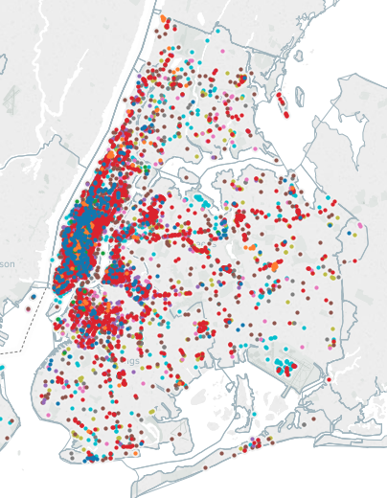
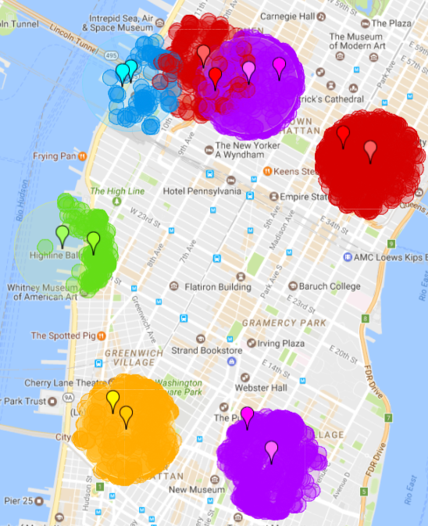
Nearby POI recommendation task
Traditional vs Nearby POI recommendation task
Traditional POI recommendation
Nearby POI recommendation

Slide 22
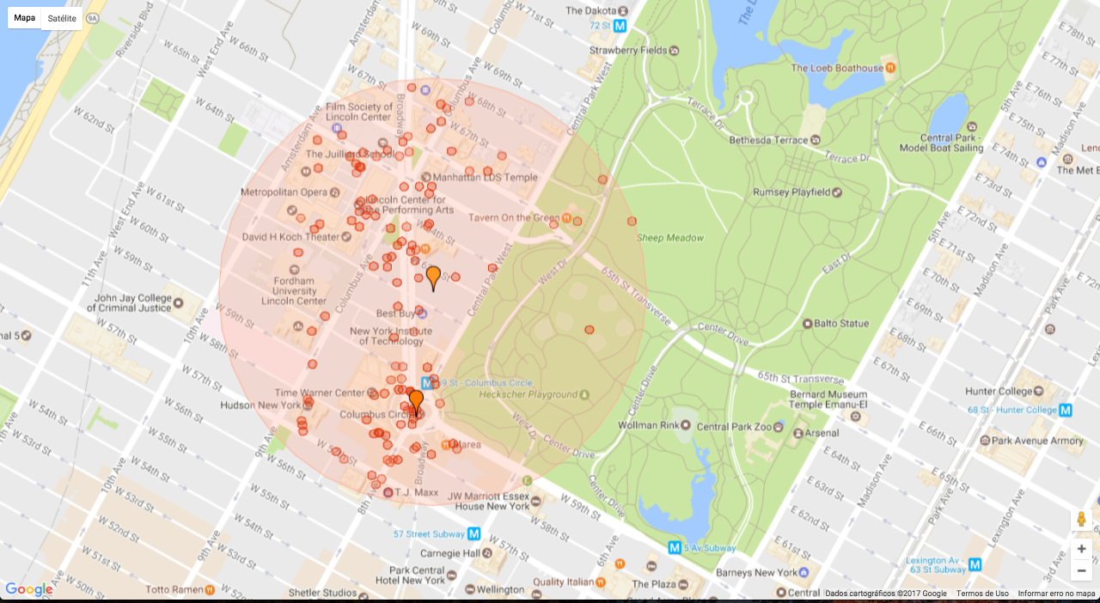
Nearby POI recommendation task
500m
500m
User
Relevant POI

Slide 23
Evaluation Methodology
Dataset Characterization
The New York City
Check-ins from July 2015 to July 2016
# Users 7,703
# Venues 8,575
# Check-ins 110,000 unique check-ins
Sparsity 99.971%
Notes:
Number of users = 7869 | Number of POIs = 9471
- \# User: 7,703
- \# Venue: 8,575
- \# Candidates: 8,812
- \# Training: 30,000 (240,000 time window / 100,000 uniques)
- \# Validation: 5,000 (40,000 time window)
- \# Test: 5,000 (40,000 time window)
- \# Check-ins: 110,000

Slide 24
Evaluation Methodology
Dataset Characterization
New York City Collection
1
3
3
4
4
4
5
5
5
5
6
6
6
7
1
7
July 2015 to June 2016
2
3
4
5
6
7
8
9
10
11
12
1
2
8
9
10
11
12
2
30k
5k
5k
T
V
T
only new POIs

Slide 25
Effectiveness (pruned training)
A performance comparison of different algorithms for the Nearby POI Recommendation task in the New York City collection.
Mean Reciprocal Rank
 | 500 m | 1 km | Traditional
Rank-GeoFM | 0.1066 | 0.0440 | 0.0182
Nearby Rank-GeoFM | 0.1063 | 0.0432 | 0.0171
Pruning the training by Nearby POIs does not affect the accuracy of the Rank-GeoFM
The small reduction in the accuracy of the Nearby Rank-GeoFM may be due to the random initialization of the latent factors.

Slide 26
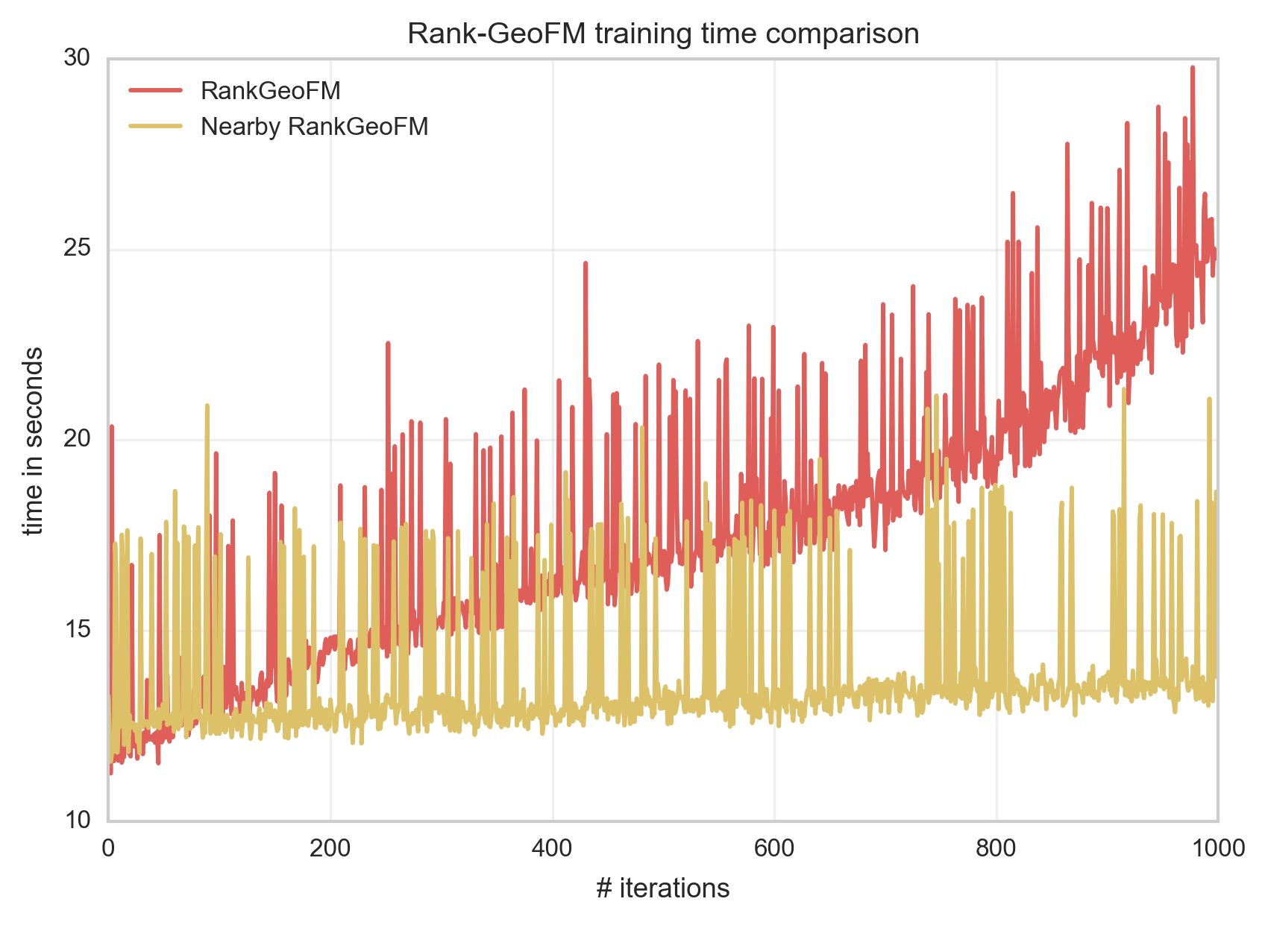
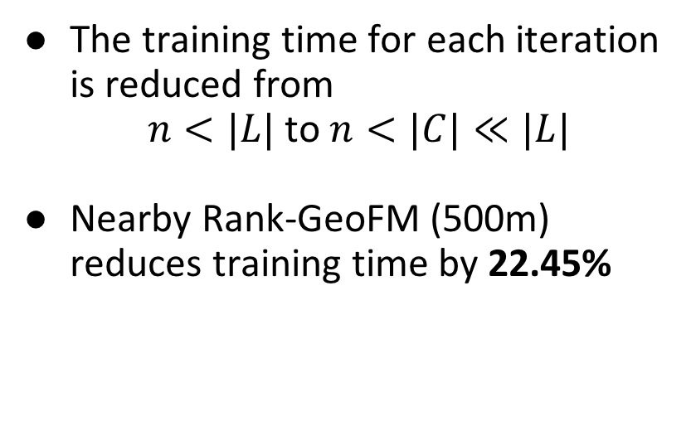
Efficiency (pruned training)
A performance comparison of different algorithms for the Nearby POI Recommendation task in the New York City collection.
4h 53m 25s
The training time for each iteration is reduced from
$n<|L|$ to $n<|C|≪|L|$
Nearby Rank-GeoFM (500m) reduces training time by 22.45%
3h 47m 31s

Slide 27
Effectiveness (pruned test)
A performance comparison of different algorithms for the Nearby POI Recommendation task in the New York City collection.
 |  | Mean Reciprocal Rank
 | # | traditional | 1 km | 500 m
Most Popular | 1 | 0.0845 | 0.1202 | 0.2365
BPRMF | 2 | 0.0825 | 0.1126 | 0.2228
WRMF | 3 | 0.0254 | 0.0604▼ 1 | 0.1341
Rank-GeoFM | 4 | 0.0182 | 0.0440▼ 2 | 0.1066
UserCF | 5 | 0.0169 | 0.0559 | 0.1259
WBPRMF | 6 | 0.0157 | 0.0652▲ 3 | 0.1552
ItemCF | 7 | 0.0025 | 0.0323 | 0.0889
Rank-GeoFM demoted 2 positions when geography is built-in via pruning

Slide 28
Conclusion
We proposed to build geography into POI recommendation
Location-based static pruning
Improved efficiency of Rank-GeoFM
Faster learning for Rank-GeoFM
Faster prediction for Rank-GeoFM
Unchanged accuracy
Decoupled geography from other effects
Rank-GeoFM penalized viz other methods

Slide 29
Future directions
Deeper breakdown analyses
Sparsity levels (user and item)
Neighborhood density / diversity / popularity
Further analyses
Pruning radius
Role of other contexts
Improved recommenders
Adaptive pruning (optimal radius per user / location)

Slide 30
NEARBY PLACES
ON LOCATION-BASED PRUNING FOR
POINT-OF-INTEREST RECOMMENDATION
Jordan Silva Rodrygo L. T. Santos
Nivio Ziviani
jordan@dcc.ufmg.br rodrygo@dcc.ufmg.br
nivio@dcc.ufmg.br

