Slide 1
Bayesian Decision Theory
Bayes Decision Rule
Loss function
Decision surface
Application in multivariate Gaussian distribution

Slide 2
Bayes Rule
My cat walks in, and I observe he is wet. Without looking outside, what is my guess about the weather?
Cat is wet
10%
got under neighbor’s sprinkler
0.95x0.1=0.095
Didn’t rain
95% (because it was sunny half an hour ago)
90%
Cat not wet
0.95x0.9=0.855
5%
Cat is wet
90%
0.05x0.9=0.045
Rained
10%
Cat not wet
0.05x0.1=0.005

Slide 3
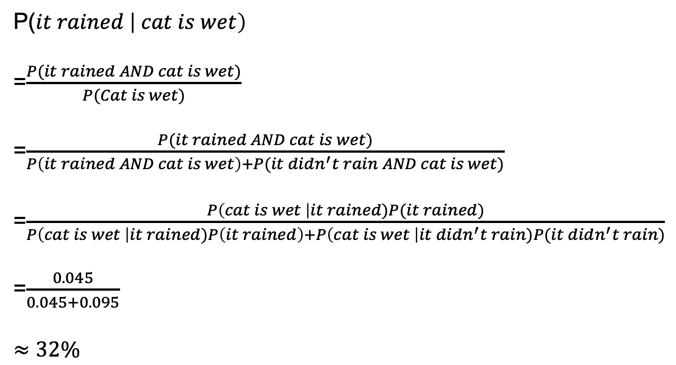
Bayes Rule
Rained
Didn’t rain
P($it rained \left| cat is wet\right)$
=$\frac{P(it rained AND cat is wet)}{P(Cat is wet)}$
=$\frac{P(it rained AND cat is wet)}{P\left(it rained AND cat is wet\right)+P(it didn^{′}t rain AND cat is wet)}$
=$\frac{P\left(cat is wet \right|it rained)P(it rained)}{P\left(cat is wet \right|it rained)P\left(it rained\right)+P\left(cat is wet \right|it didn^{′}t rain)P(it didn^{′}t rain)}$
=$\frac{0.045}{0.045+0.095}$
$$≈32\%$$
Not wet
Wet
However, if I change my prior knowledge about the weather,
P(it rained)=0.5, then P(it rained | cat is wet) = 90%

Slide 4
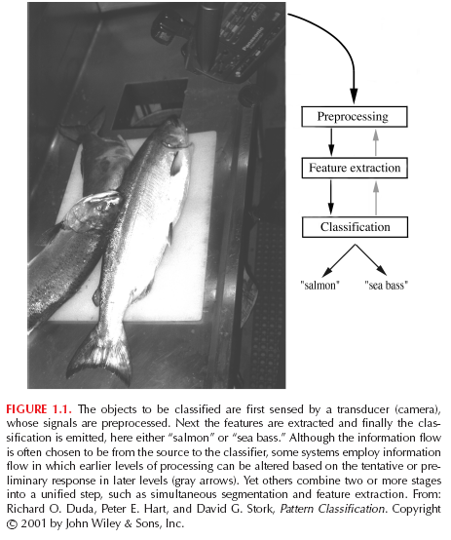
Classification task
The general scheme.
An example.

Slide 5
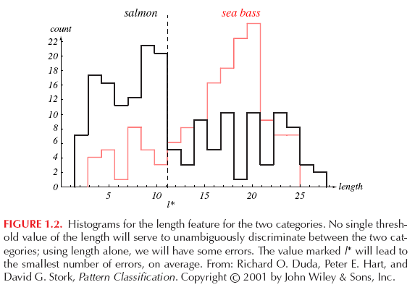
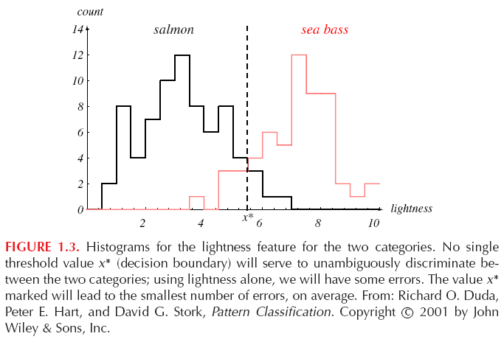
Classification task
In most cases, a single feature is not enough to generate a good classifier.

Slide 6
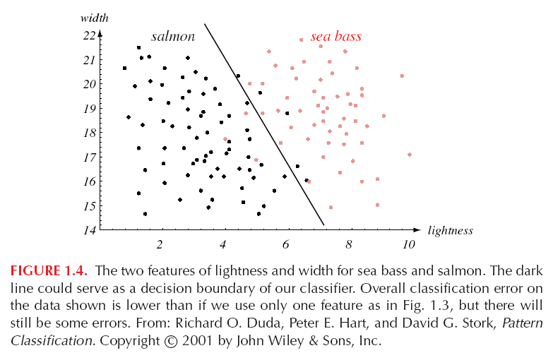
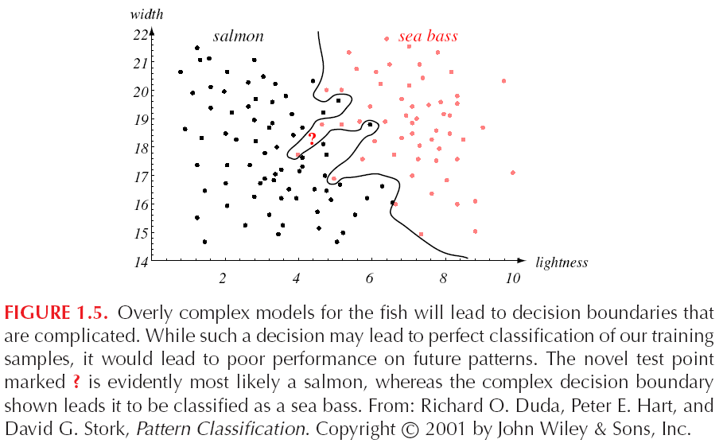
Classification task
Two extremes: overly rigid and overly flexible classifiers.

Slide 7
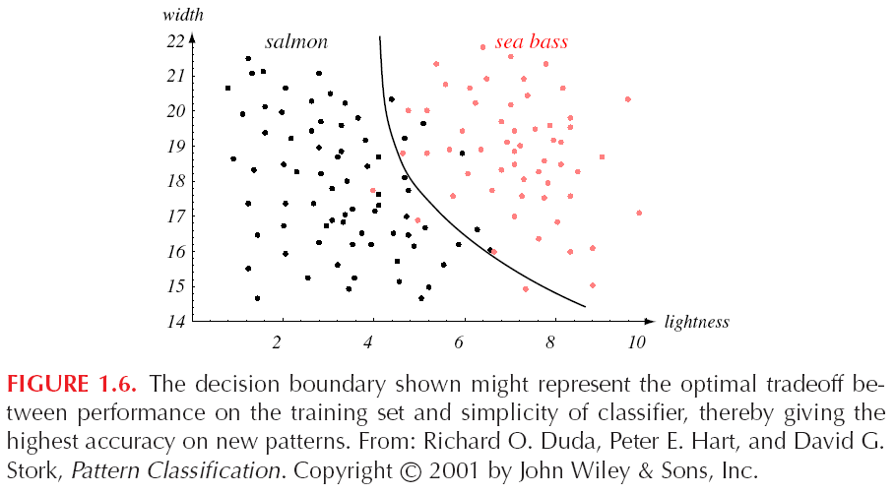
Classification task
Goal: an optimal trade-off between model simplicity and training set performance.

Slide 8
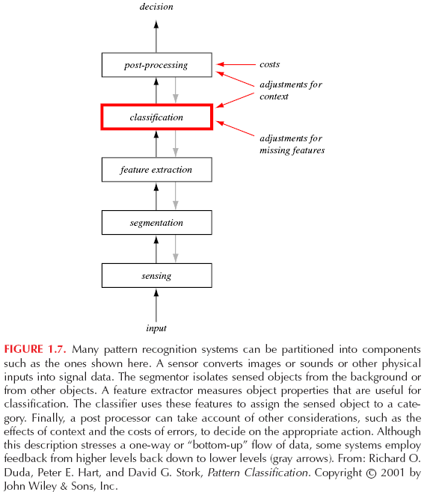
Classification task
An example of the overall scheme involving classification:

Slide 9
Bayes Decision
It is the decision making when all underlying probability distributions are known.
It is optimal given the distributions are known.
For two classes ω₁ and ω₂ ,
Prior probabilities for an unknown new observation:
P(ω₁) : the new observation belongs to class 1
P(ω₂) : the new observation belongs to class 2
P(ω₁ ) + P(ω₂ ) = 1
It reflects our prior knowledge. It is our decision rule when no feature on the new object is available:
Classify as class 1 if P(ω₁ ) > P(ω₂ )

Slide 10

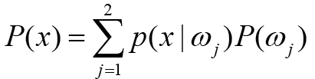
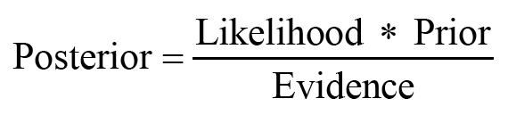
Bayes Decision
We observe features on each object.
P(x| ω₁) & P(x| ω₂) : class-specific density
The Bayes rule:

Slide 11
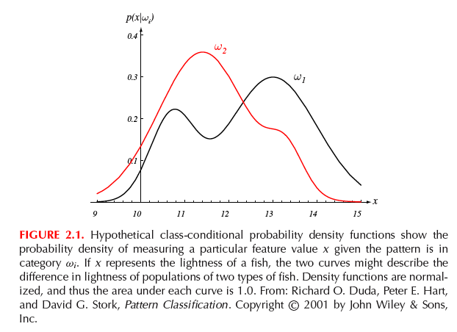
Bayes Decision
Likelihood of observing x given class label.

Slide 12
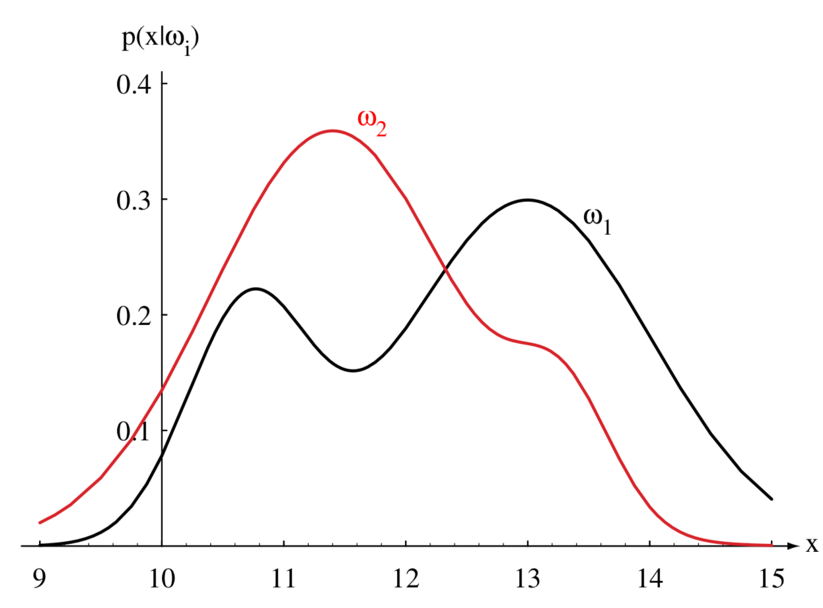
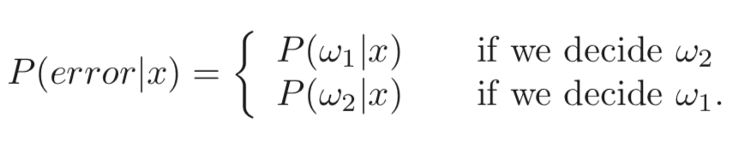
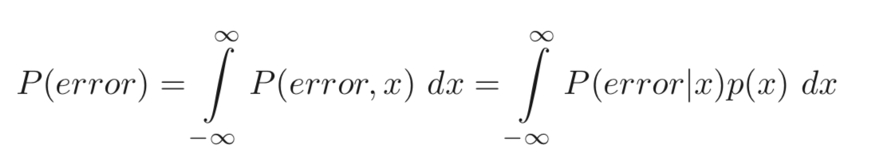
Bayes Decision
This is minimized by deciding ω₁ if P(ω₁|x) > P(ω₂|x) and ω₂ otherwise
At every x, we ensure that P(error | x) is as small as possible, then P(error) is minimized. Thus,
Bayes’ decision rule for minimizing the probability of error:

Slide 13
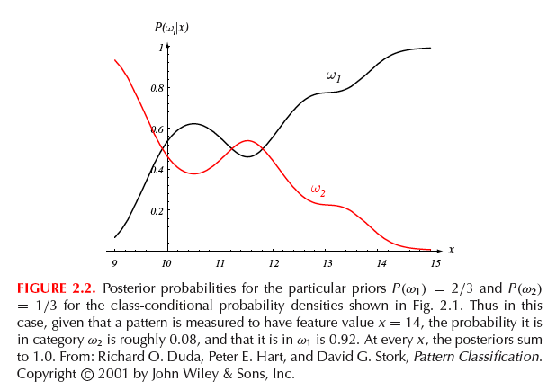

Bayes Decision
Posterior probabilities:

Slide 14




Loss function
Loss function:
probability statement --> decision
some classification mistakes can be more costly than others.
The set of c classes:
The set of possible actions:
: deciding that an observation belongs to a certain class
Loss when taking action i given the observation belongs to hidden class j:

Slide 15


Loss function
The expected loss:
Given an observation with covariant vector x, the conditional risk is:
At every x, a decision is made: α(x), by minimizing the expected loss.
Our final goal is to minimize the total risk over all x.

Slide 16
Loss function
The zero-one loss:
All errors are equally costly.
The conditional risk is:
The risk corresponding to this loss function is the average probability error.

Slide 17




Loss function
Let denote the loss for deciding class i when the true class is j
In minimizing the risk, we decide class one if
Rearrange it, we have

Slide 18
Loss function
Example:

Slide 19
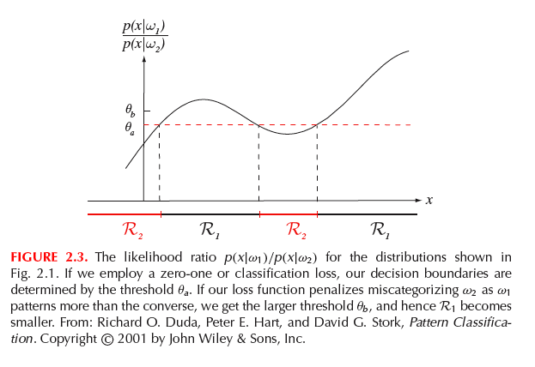
Loss function
Likelihood ratio.
If miss-classifying ω₂ is penalized more:
Zero-one loss function

Slide 20
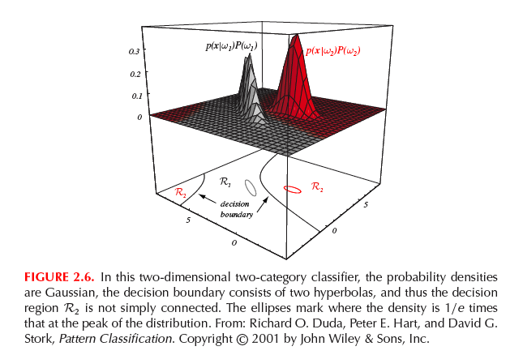
Decision surface
The discriminant functions help partition the feature space into c decision regions (not necessarily contiguous). Our interest is to estimate the boundaries between the regions.

Slide 21
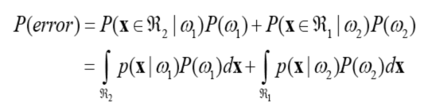
Optimality
Consider a two-class case.
Two ways to make a mistake in the classification:
Misclassifying an observation from class 2 to class 1;
Misclassifying an observation from class 1 to class 2.
The feature space is partitioned into two regions by any classifier: R₁ and R₂

Slide 22
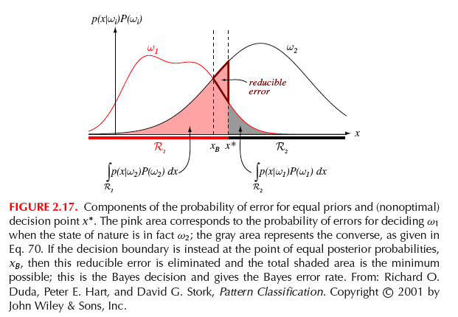
Optimality

Slide 23
Optimality
In the multi-class case, there are numerous ways to make mistakes. It is easier to calculate the probability of correct classification.
Bayes classifier maximizes P(correct). Any other partitioning will yield higher probability of error.
The result is not dependent on the form of the underlying distributions.

Slide 24
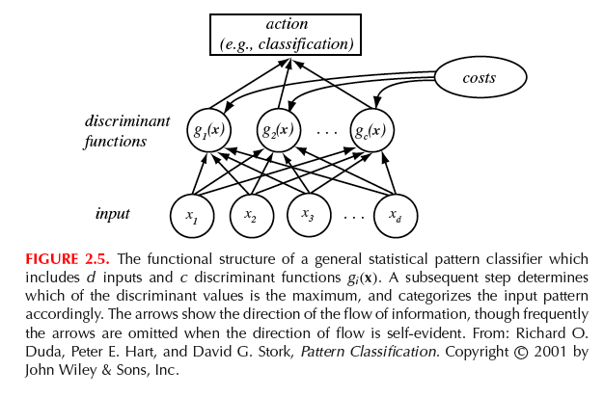
Discriminant function
Features -> discriminant functions g_{i}(x), i=1,…,c
Assign class i if g_{i}(x) > g_{j}(x) ∀j ≠ i
Decision surface defined by
g_{i}(x) = g_{j}(x)

Slide 25
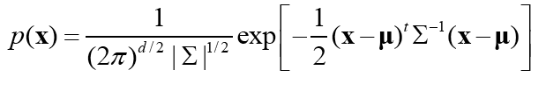
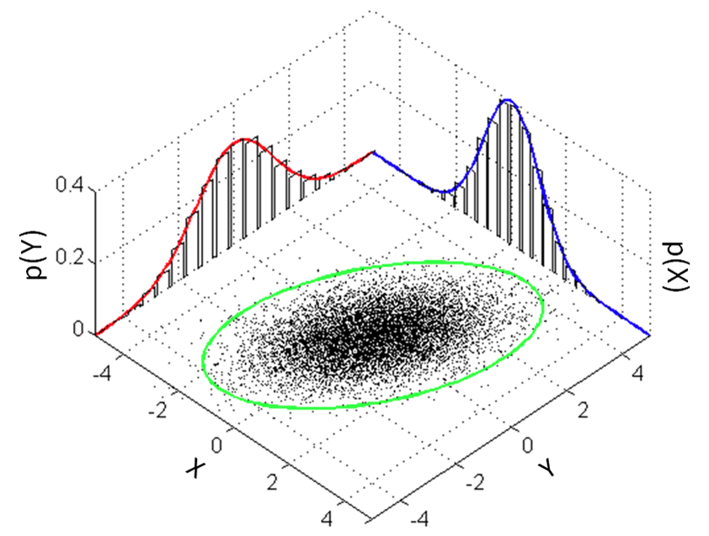
Normal density

Slide 26



Normal density
To make a minimum error rate classification (zero-one loss), we use discriminant functions:
This is the log of the numerator in the Bayes formula. Log is used because we are only comparing the g_{i}’s, and log is monotone.
When normal density is assumed:
We have:

Slide 27


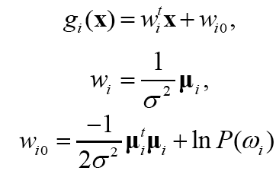
Discriminant function for normal density
Σ_{i} = σ²I
Linear discriminant function:
Note: blue boxes – irrelevant terms.

Slide 28


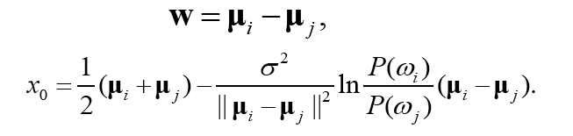
Discriminant function for normal density
The decision surface is where
With equal prior, x₀ is the middle point between the two means.
The decision surface is a hyperplane,perpendicular to the line between the means.

Slide 29
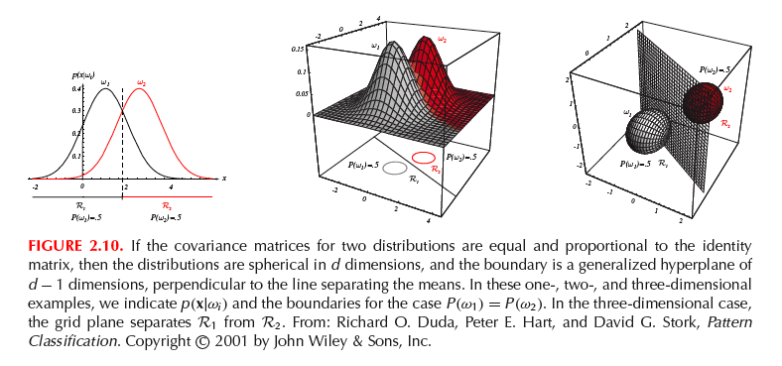
Discriminant function for normal density
“Linear machine”: dicision surfaces are hyperplanes.

Slide 30
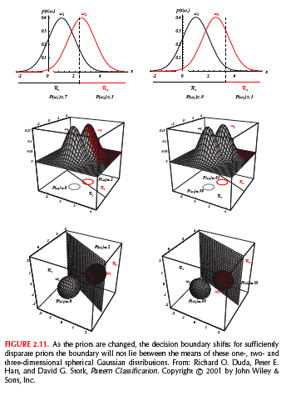
Discriminant function for normal density
With unequal prior probabilities, the decision boundary shifts to the less likely mean.

Slide 31




Discriminant function for normal density
(2) Σ_{i} = Σ

Slide 32


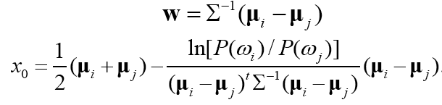
Discriminant function for normal density
Set:
The decision boundary is:

Slide 33
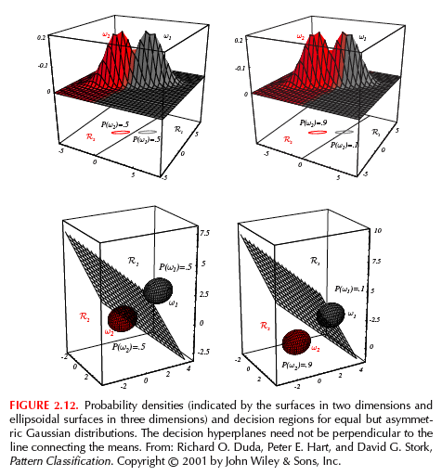
Discriminant function for normal density
The hyperplane is generally not perpendicular to the line between the means.

Slide 34
Discriminant function for normal density
(3) Σ_{i} is arbitrary
Decision boundary is hyperquadrics (hyperplanes, pairs of hyperplanes, hyperspheres, hyperellipsoids, hyperparaboloids, hyperhyperboloids)

Slide 35
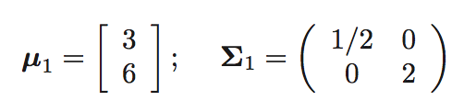
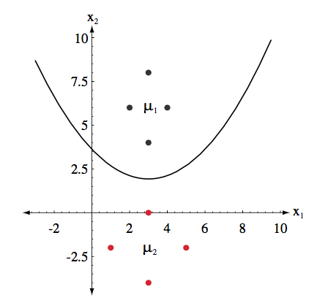
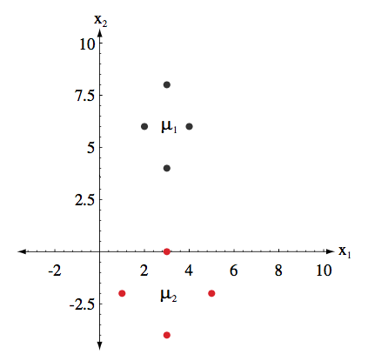
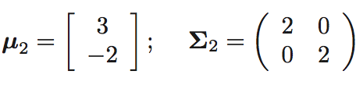
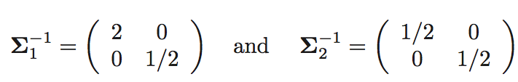


Discriminant function for normal density
Decision boundary:

Slide 36
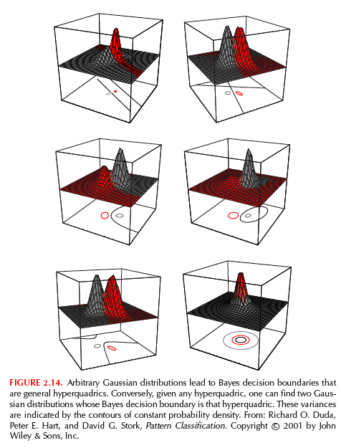
Discriminant function for normal density

Slide 37
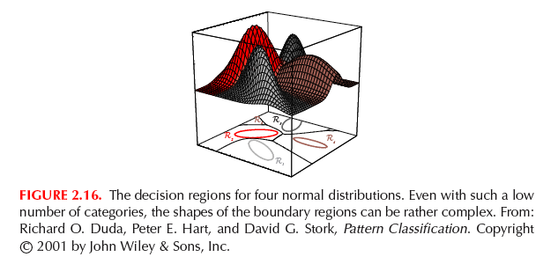
Discriminant function for normal density
Extention to multi-class.

