Slide 1
Transport Layer Protocols Optimization for Satellite Networks(T4SAT) Side Meeting
IETF 125 ShenZhen

Slide 2























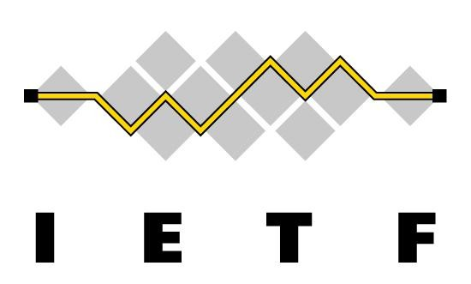










Note Well
This is a reminder of IETF policies in effect on various topics such as patents or code of conduct. It is only meant to point you in the right direction. Exceptions may apply. The IETF's patent policy and the definition of an IETF "contribution" and "participation" are set forth in BCP 79; please read it carefully.
As a reminder:
By participating in the IETF, you agree to follow IETF processes and policies.
If you are aware that any IETF contribution is covered by patents or patent applications that are owned or controlled by you or your sponsor, you must disclose that fact, or not participate in the discussion.
As a participant in or attendee to any IETF activity you acknowledge that written, audio, video, and photographic records of meetings may be made public.
Personal information that you provide to IETF will be handled in accordance with the IETF Privacy Statement.
As a participant or attendee, you agree to work respectfully with other participants; please contact the ombudsteam (https://www.ietf.org/contact/ombudsteam/) if you have questions or concerns about this.
Definitive information is in the documents listed below and other IETF BCPs. For advice, please talk to WG chairs or ADs:
BCP 9 (Internet Standards Process)
BCP 25 (Working Group processes)
BCP 25 (Anti-Harassment Procedures)
BCP 54 (Code of Conduct)
BCP 78 (Copyright)
BCP 79 (Patents, Participation)
https://www.ietf.org/privacy-policy/ (Privacy Policy)

Slide 3
Motivation
LEO/MEO networks (e.g., Starlink, OneWeb) are rapidly developing in recent years, providing new ways for Internet accessing.
LEO/MEO networks have the characteristic of high dynamic, which cause packet disorder or loss, unlike terrestrial networks.
This directly impacts user experience if the transport layer don’t handle it well.
IETF has related work to satellite network, TVR, DTN, TIPTOP.
However, systematic optimization of core transport layer for LEO/MEO specifics is not deeply discussed or explored.
This meeting is about promoting broader thinking of if the transport layer protocols need to be optimized for LEO/MEO networks.

Slide 4
Recap. of the Sidemeeting in IETF-122/123
Requirements:
Tianji Jiang, China Mobile, Satellite Transmission Requirements Challenges
Tianji Jiang, China Mobile, Transport Optimization in Satellite Networks: - 3GPP Use cases, Challenges & Considerations
Jie Liu, Geely, Thoughts on LEO scenarios and requirements
Problem Analysis and Solutions:
Feng Qian, TikTok, LEO Satellite vs. Cellular Networks: Exploring the Potential for Synergistic Integration
Jianping Pan, UVIC Canada, Handover behaviors of LEO satellite networks and impacts on the transport-layer protocols of the Internet
Liz lzhikevich, UCLA & Netflix, Manipulating Congestion Control To Improve Video Streaming Over Starlink
Quan Xiong, ZTE, Technical Considerations for T4SAT

Slide 5
Agenda
 | Topic | Time(mins) | Presenter | Company
0 | Welcome & Review | 5 | Feng Yang Yanbiao, Li | China Mobile CNIC CAS
1 | Maintaining Stable Connections in Highly Dynamic LEO Satellite Networks | 15 | Xian Yu | CNIC CAS
2 | High Performance Transport Protocol Optimization | 15 | Daniel Huang | ZTE
3 | Transport Layer OAM Protocol Consideration | 15 | Feng Yang | China Mobile
4 | Open Discussion | 10 | All

Slide 6
Questions List
Questions to Have in Mind You don’t have to answer these questions, but please think about them for the discussion at the end of the meeting. (not limited to these questions)
Is the problem to optimize transport layer protocols for LEO/MEO well understood?
Is there a need to optimize transport layer protocols for LEO/MEO?
For the LEO/MEO based problem space, transportation layer OAM be necessary?
The relationship between what we are discussing now (i.e., LEO/MEO based transport) and those exiting IETF WGs (TVR, DTN, CCWG, TIPTOP)? – adjacency relationship
Further actions?

