Slide 1


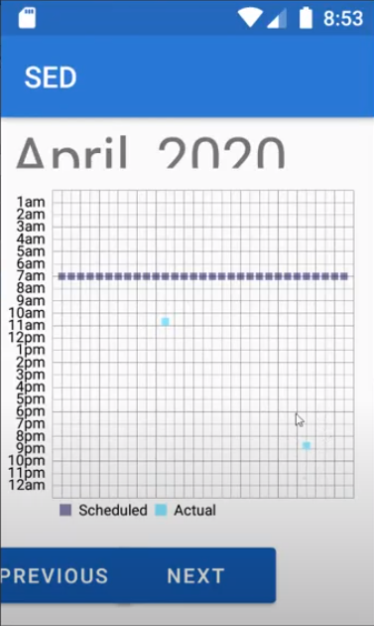
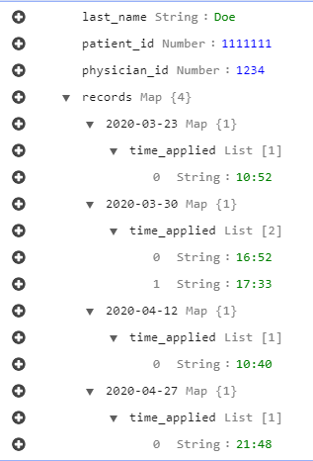
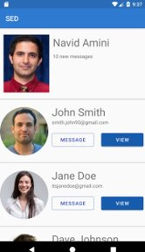
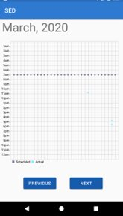
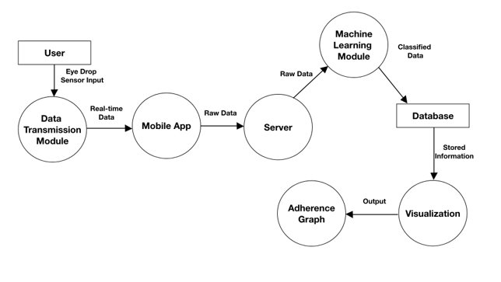
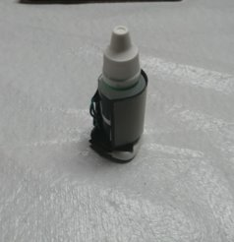
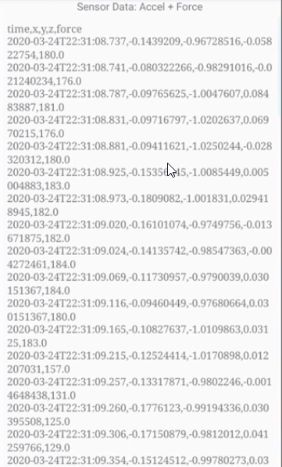
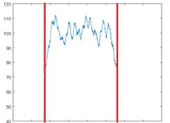




Smart Eye Drops
Team Members: Feng You, Marco Aguilar, Ivan Yu, Aaron Alvarez, Ana Cortes, Jonathan Nunez
Faculty Advisor: Dr. Navid Amini, Kevin Delao
Vodafone Liaison: Haley Kirk
Department of Computer Science
College of Engineering, Computer Science, and Technology
California State University, Los Angeles
BACKGROUND
Glaucoma is the second leading cause of irreversible blindness worldwide. More than 3 million Americans are living with glaucoma, 2.7 million are +40 years old. Nonadherence rate is the main cause for glaucoma patients to end up with permanent and irreversible eye damage. The current ability to measure adherence and compliance to eye medication are poor.
Currently the adherence rate and compliance to eye medication is very poor. There was an Australian study done on 17,000 people with glaucoma. Among the 17,000 people, 44% patients stopped taking treatment within the first six month. The number increases to 52% within the first year. We hope to build a device that will aid in increasing the adherence rate of eye medication for glaucoma and similar diseases.
RESULTS
We were able to build a completed product that works end-to-end. Our machine learning algorithm is working and make accurate predictions of 6 classifications. The follow is a image of our android application. The light blue dots indicate that a successful application of the eye drop has been detected. The image on the right show our database entry of successful eye drop applications.
OBJECTIVE
We want to build a eye drop application monitor by utilizing machine learning to detect when an eye drop has been applied. We want our device to be as unobtrusive as possible and easy to use. We hope that this will enable physicians to alter and adjust patients regimen. We hope that our product will enable patients who require eye medication to comply with their medication and increase their adherence rate.
APPLICATION ARCHITECTURE
DATA COLLECTION
TECHNOLOGIES USED
CONCLUSION
Connected multiple sensors to collect data from eye drop.
Built an android application with user interface.
Applied machine learning algorithm to classify data collected from eye drop monitor.
Have a working end-to-end prototype of our eye drop monitor.
Notes:
Have students check that the logo is the appropriate one to use.

