Slide 1
Learning optimal classification trees using a binary linear program formulation
Sicco Verwer and Yingqian Zhang
Delft University of Technology
s.e.verwer@tudelft.nl
Eindhoven University of Technology
yqzhang@tue.nl

Slide 2
Modifying machine learning
Data
Algorithm
Output
3 points where machine learning
can be modified

Slide 3
Our approach
Do not modify the input or output, but the algorithm itself
Of course, this is very costly to modify for every problem
Therefore we develop a declarative method to build machine learning models
The algorithm can be changed by declaring a few constraints or a different objective

Slide 4
Decision trees
f₁ < c₁ ?
yes no
f₂ < c₂ ?
f₃ < c₃ ?
f₄ < c₄ ?
f₅ < c₅ ?
f₆ < c₆ ?
f₇ < c₇ ?
p₁
p₂
p₃
p₄
p₅
p₆
p₇
p₈

Slide 5
Decision tree learning
Learning optimal DT is NP-hard
Traditionally a greedy procedure
Pick the split that optimizes a heuristic (GINI, ...)
Iterate
Prune using another heuristic (MDL, ...)
Works good if what you want to optimize coincides with the heuristic, e.g., accuracy

Slide 6
Contribution
Our work: a declarative method to build (optimal) decision trees
Find a decision tree of depth at most K that
optimizes an objective function
maximize accuracy
minimize error
under constraints, for example
such that there is no discrimination
such that there are 0 false positives/negative

Slide 7
Contribution
Our work: a declarative method to build (optimal) decision trees
Find a decision tree of depth at most K that
optimizes an objective function
maximize accuracy
minimize error
under constraints, for example
such that there is no discrimination
such that there are 0 false positives/negative
We provide a new efficient formulation using binary programming, and use CPLEX solver to find optimal trees

Slide 8
Problem
Optimization problem:
Finding an optimal classification/regression tree of depth at most k for a given dataset of n rows (samples) and m features/attributes
3 parts:
encoding internal nodes – paths to leaves
encoding leaves – what to predict for each row
encoding the objective

Slide 9
Problem
Optimization problem:
Finding an optimal classification/regression tree of depth at most k for a given dataset of n rows (samples) and m features/attributes
3 parts:
encoding internal nodes – paths to leaves
encoding leaves – what to predict for each row
encoding the objective

Slide 10
OCT (Bertsimas & Dunn)
If a node reaches leaf i
all decisions on right branches A_{R} of the path A to i are satisfied
all decisions on left branches A_{L} of the path A to i are satisfied
left branching: z_{it} = 1 → a_{m}^{T} x_{i} ≤ b_{m}
right branching: z_{it} = 1 → a_{m}^{T} x_{i} ≥ b_{m}
b_{m} continuous
a_{m}^{T} and z_{it} boolean decision variables

Slide 11
OCT:
f₁ < c₁ ?
yes no
f₂ < c₂ ?
f₃ < c₃ ?
f₄ < c₄ ?
f₅ < c₅ ?
f₆ < c₆ ?
f₇ < c₇ ?
p₁
p₂
p₃
p₄
p₅
p₆
p₇
p₈
requires num_rows * num_leafs * depth constraints

Slide 12
Our approach:
f₁ < c₁ ?
yes no
f₂ < c₂ ?
f₃ < c₃ ?
f₄ < c₄ ?
f₅ < c₅ ?
f₆ < c₆ ?
f₇ < c₇ ?
p₁
p₂
p₃
p₄
p₅
p₆
p₇
p₈
if a node is true, then all of its right children are false

Slide 13
Our approach:
f₁ < c₁ ?
yes no
f₂ < c₂ ?
f₃ < c₃ ?
f₄ < c₄ ?
f₅ < c₅ ?
f₆ < c₆ ?
f₇ < c₇ ?
p₁
p₂
p₃
p₄
p₅
p₆
p₇
p₈
if a node is false, then all of its left children are false

Slide 14
Our approach:
f₁ < c₁ ?
yes no
f₂ < c₂ ?
f₃ < c₃ ?
f₄ < c₄ ?
f₅ < c₅ ?
f₆ < c₆ ?
f₇ < c₇ ?
p₁
p₂
p₃
p₄
p₅
p₆
p₇
p₈

Slide 15
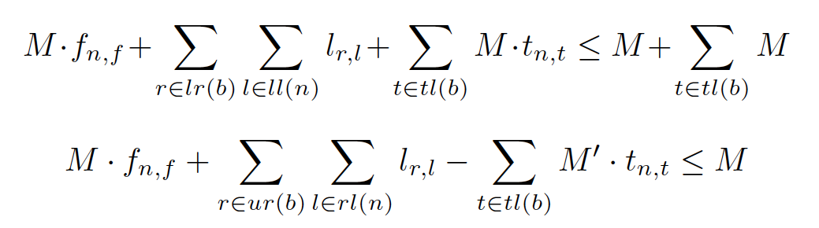
BinOCT
If a decision is true
all leafs under the right branch are false
If a decision is false
all leafs under the left branch are false
left branching: f_{n,f} = 1 → Σ l_{r,l} ≤ M - M Σ
right branching: f_{n,f} = 1 → Σ l_{r,l} ≤ M Σ t_{n,t}
b_{m} continuous
a_{m}^{T} and z_{it} boolean decision variables

Slide 16
An example
value | class
0 | +
1 | +
2 | +
3 | -
4 | -
5 | +
6 | -
7 | +
8 | +

Slide 17
An example
value | class
0 | +
1 | +
2 | +
3 | -
4 | -
5 | +
6 | -
7 | +
8 | +
4 possible thresholds

Slide 18
An example
value | class
0 | +
1 | +
2 | +
3 | -
4 | -
5 | +
6 | -
7 | +
8 | +
4 possible thresholds
In every node, a threshold is
chosen using binary values

Slide 19
Decision nodes
t_{n,1} | t_{n,2} | l_{0,1} | l_{1,1} | l_{2,1} | l_{3,1} | l_{4,1} | l_{5,1} | l_{6,1} | l_{7,1} | l_{8,1}
1 | 1 | 1 | 1 | 1 | 0 | 0 | 0 | 0 | 0 | 0
1 | 0 | 1 | 1 | 1 | 1 | 1 | 0 | 0 | 0 | 0
0 | 1 | 1 | 1 | 1 | 1 | 1 | 1 | 0 | 0 | 0
0 | 0 | 1 | 1 | 1 | 1 | 1 | 1 | 1 | 0 | 0
t_{n,i} = threshold value for node n, l_{j,1} = row j reaches left leaf

Slide 20
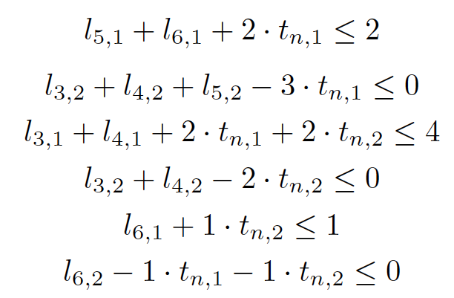

Decision nodes
t_{n,1} | t_{n,2} | l_{0,1} | l_{1,1} | l_{2,1} | l_{3,1} | l_{4,1} | l_{5,1} | l_{6,1} | l_{7,1} | l_{8,1}
1 | 1 | 1 | 1 | 1 | 0 | 0 | 0 | 0 | 0 | 0
1 | 0 | 1 | 1 | 1 | 1 | 1 | 0 | 0 | 0 | 0
0 | 1 | 1 | 1 | 1 | 1 | 1 | 1 | 0 | 0 | 0
0 | 0 | 1 | 1 | 1 | 1 | 1 | 1 | 1 | 0 | 0
l variables are forced to 0 by t variable assignments
several rows are combined into single constraints

Slide 21
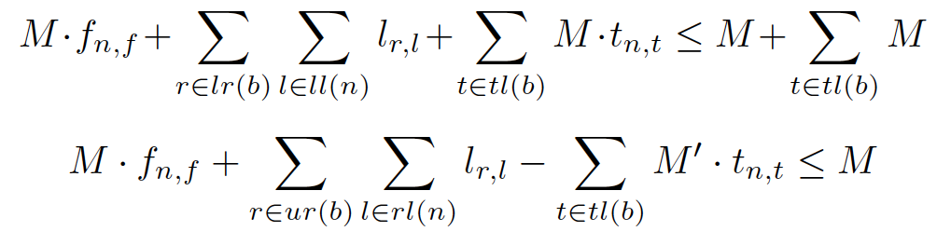
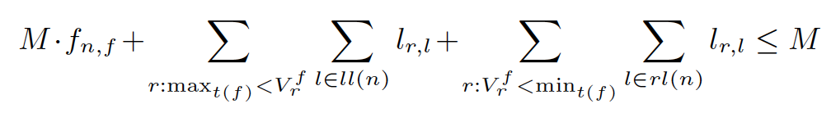
Node formulation using big-M

Slide 22
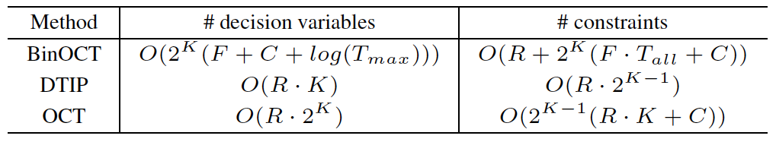
Encoding size
K = tree depth
F = number of features
C = number of classes
T_{max} = maximum number of decision thresholds
T_{all} = total number of possible decision thresholds

Slide 23
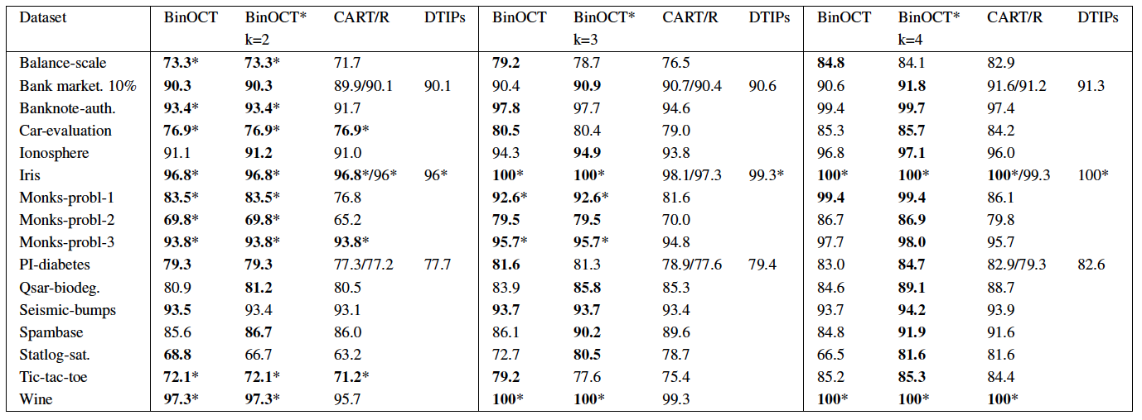
Training results
5-fold cross-validation, 50% train, 25% test

Slide 24
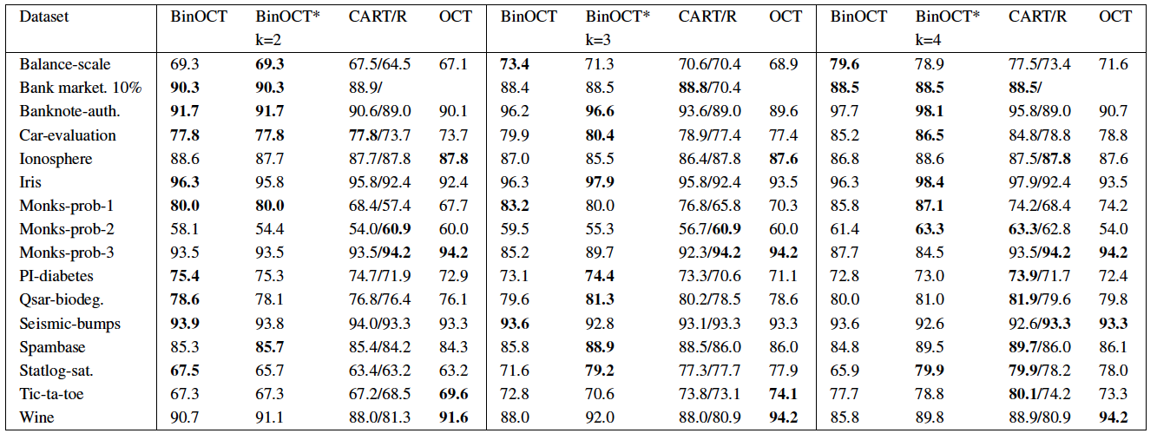
Testing results
5-fold cross-validation, 50% train, 25% test
validation set not used

Slide 25
Conclusions and future work
…

