Slide 1
Valuation and Risk Models
FRM Part I 培训讲义
讲师：王天宇

Slide 2
Topic Weightings in FRM Part I
Session NO. | Content | Weights
Study Session 1 | Foundations of Risk Management | 20
Study Session 2 | Quantitative Analysis | 20
Study Session 3 | Financial Markets and Products | 30
Study Session 4 | Valuation and Risk Models | 30

Slide 3
Valuation 估值
  Option Valuation 期权估值
  Fixed Income Valuation 固定收益证券估值
Risk Models 风险模型
  Market Risk Measurement and Management 市场风险度量和管理
  Credit Risk Measurement and Management 信用风险度量和管理
  Operational Risk Measurement and Management 操作风险度量和管理
  Stress Testing 压力测试

Slide 4
53%
55%
Option Valuation

Slide 5
Binomial Trees 二叉树法
The Black-Scholes-Merton Model BSM模型法
The Greek Letters 希腊字母

Slide 6
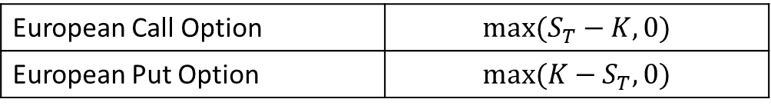
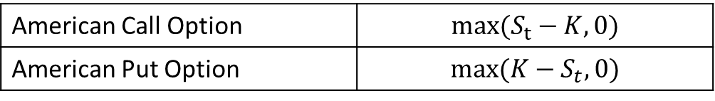
Binomial Trees
Payoffs of European Options at Expiring Time T 欧式期权在到期日（T）的收益
Payoffs of American Options at Exercise Time t 美式期权在行权日（t）的收益

Slide 7
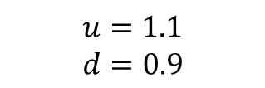
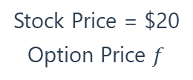
Binomial Trees
Example
  The stock price of ABC company is $20 presently. The stock will go up to 22 or down to 18 three months later. What is the European call price of this stock three months from now? Suppose the strike price is K = $21, continuously compounded risk-free rate is 4%.
Stock Price = $22
Option Price = $1
Stock Price = $20
Option Price $f$
$$u=1.1$$
$$d=0.9$$
Stock Price = $18
Option Price = $0

Slide 8
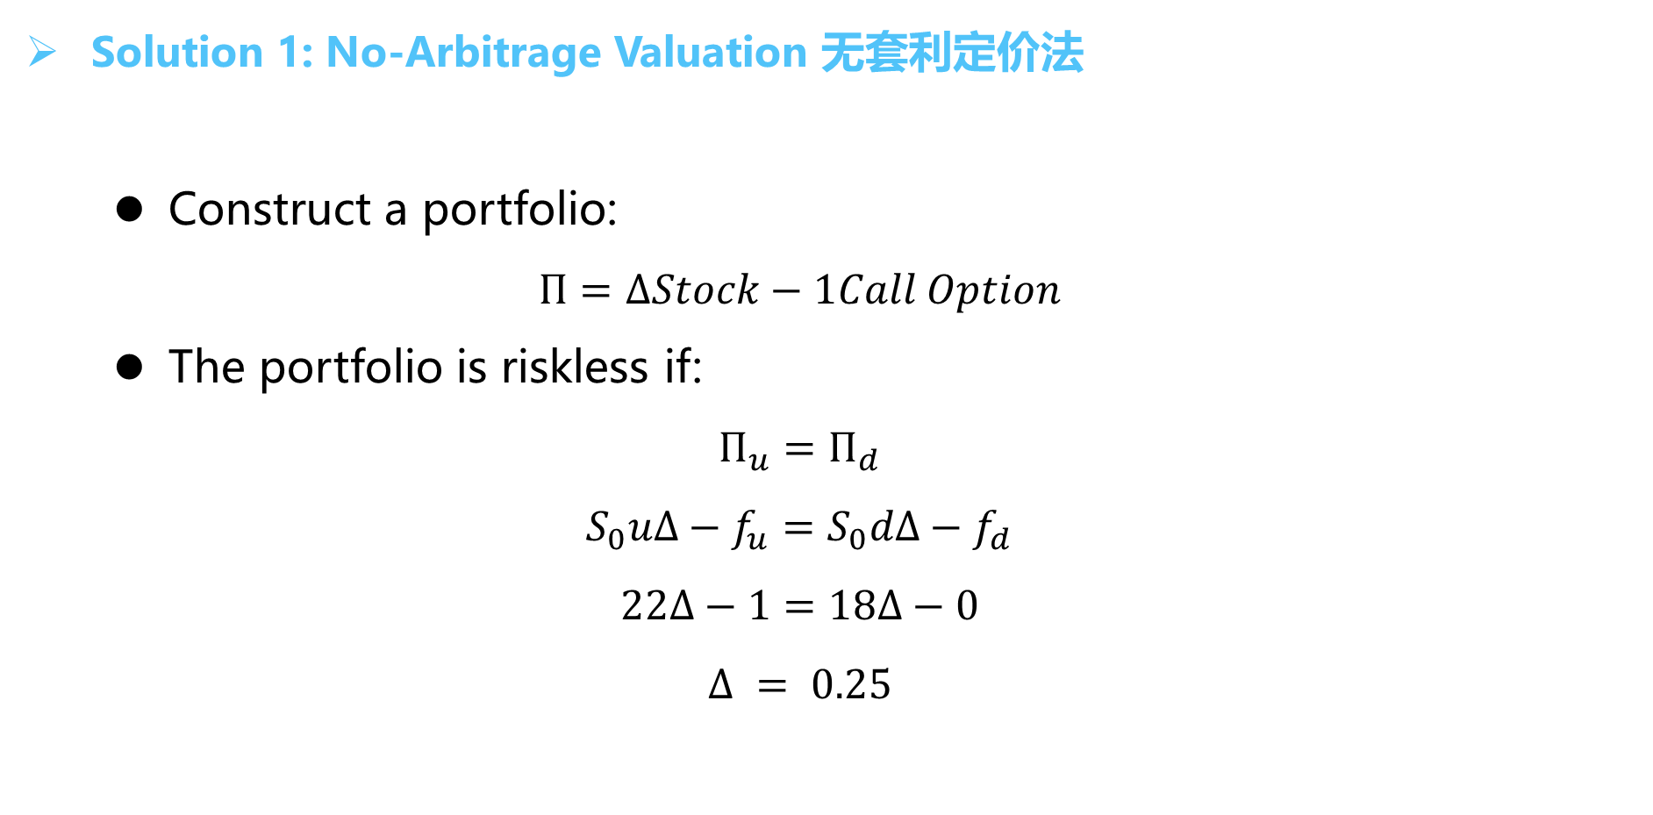
Binomial Trees
Solution 1: No-Arbitrage Valuation 无套利定价法
  Construct a portfolio:
  $$Π=ΔStock−1Call Option$$
  The portfolio is riskless if:
  $$Π_{u}=Π_{d}$$
  $$S_{0}uΔ−f_{u}=S_{0}dΔ−f_{d}$$
  $$22Δ−1=18Δ−0$$
  $$Δ = 0.25$$

Slide 9
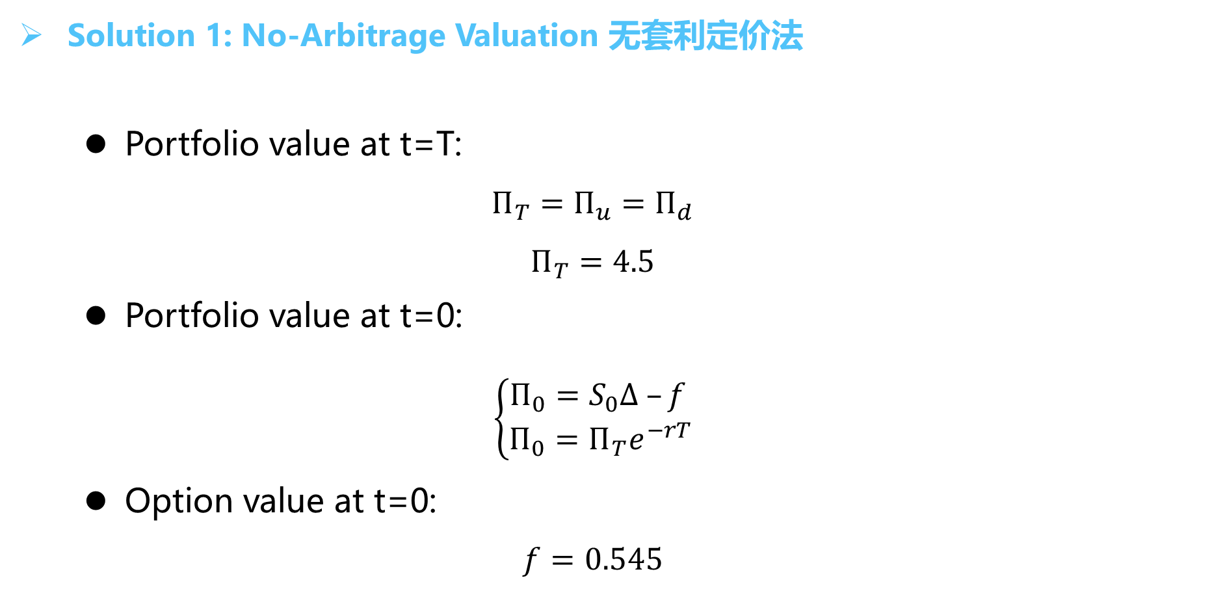
Binomial Trees
Solution 1: No-Arbitrage Valuation 无套利定价法
  Portfolio value at t=T:
  $$Π_{T}=Π_{u}=Π_{d}$$
  $$Π_{T}=4.5$$
  Portfolio value at t=0:
  $$\left\{\begin{aligned}Π_{0}=S_{0}Δ –f \\ Π_{0}=Π_{T}e^{−rT}\end{aligned}\right.$$
  Option value at t=0:
  $$f=0.545$$

Slide 10
Binomial Trees
Solution 2: Risk-Neutral Valuation 风险中性定价法
  Risk-neutral investors:
  They do not increase the expected return they require from an investment to compensate for increased risk.
  Features of a risk-neutral world:
  The expected return on a stock (or any other investment) is the risk-free rate.
  The discount rate used for the expected payoff on an option (or any other instrument) is risk-free rate.

Slide 11
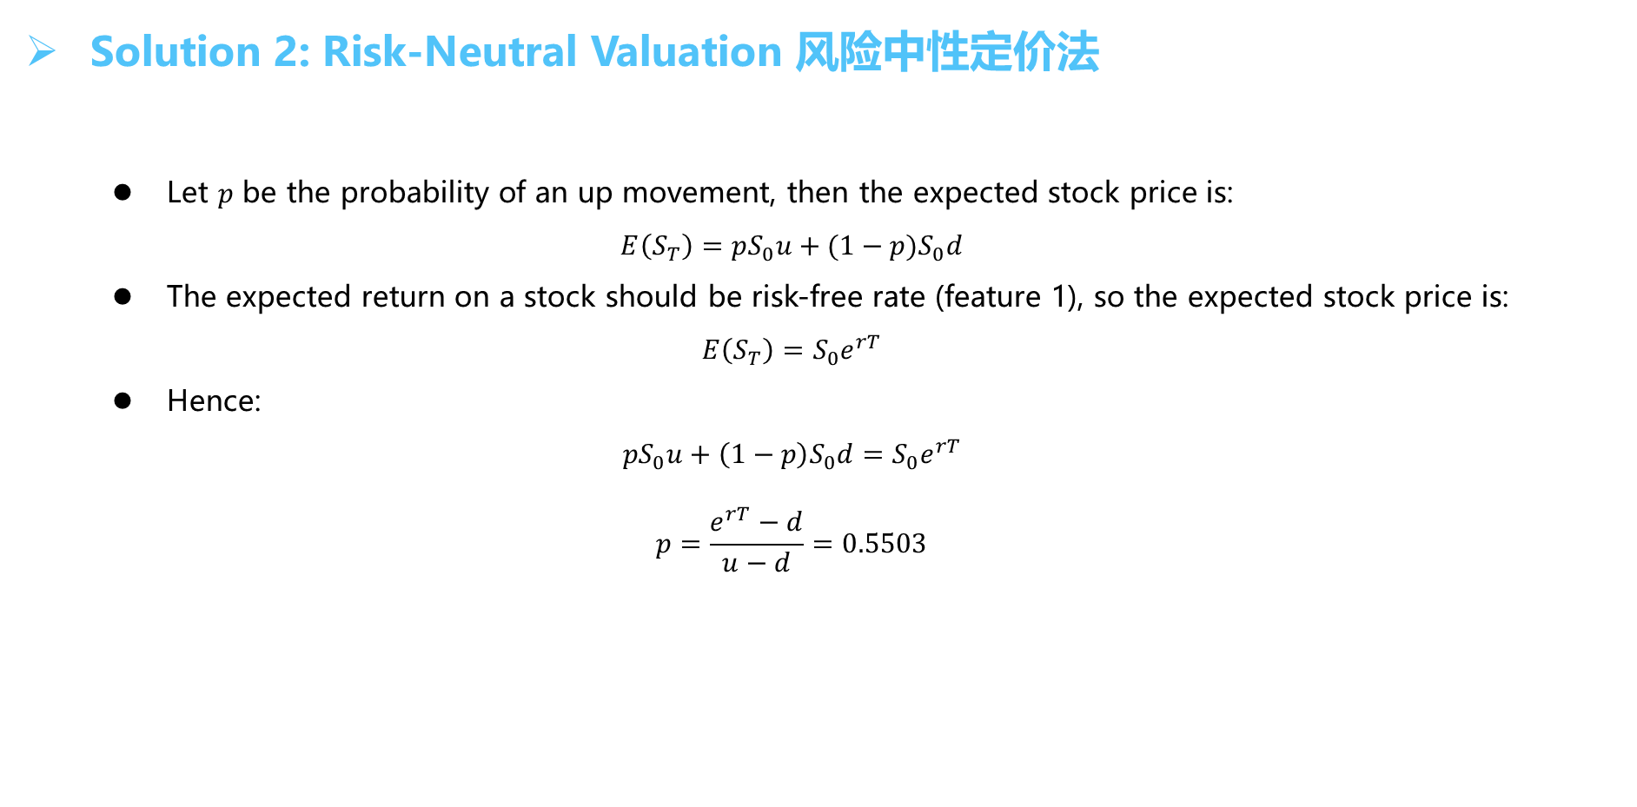
Binomial Trees
Solution 2: Risk-Neutral Valuation 风险中性定价法
  Let $p$ be the probability of an up movement, then the expected stock price is:
  $$E\left(S_{T}\right)=pS_{0}u+(1−p)S_{0}d$$
  The expected return on a stock should be risk-free rate (feature 1), so the expected stock price is:
  $$E\left(S_{T}\right)=S_{0}e^{rT}$$
  Hence:
  $$pS_{0}u+\left(1−p\right)S_{0}d=S_{0}e^{rT}$$
  $$p=\frac{e^{rT}−d}{u−d}=0.5503$$

Slide 12

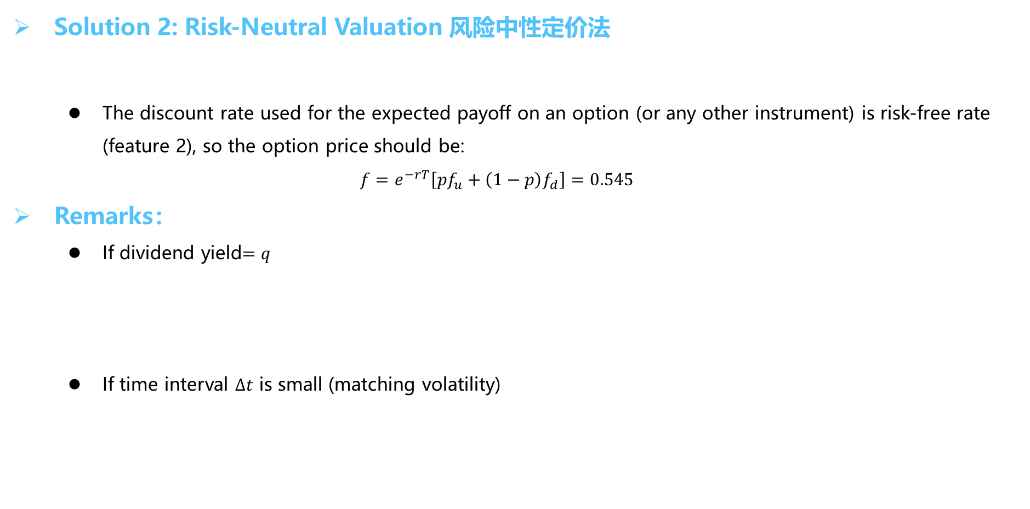

Binomial Trees
Solution 2: Risk-Neutral Valuation 风险中性定价法
  The discount rate used for the expected payoff on an option (or any other instrument) is risk-free rate (feature 2), so the option price should be:
  $$f=e^{−rT}\left[pf_{u}+\left(1−p\right)f_{d}\right]=0.545$$
Remarks：
  If dividend yield$=q$
  If time interval $∆t$ is small (matching volatility)
$$p=\frac{e^{\left(r−q\right)Δt}−d}{u−d}$$
$$u=e^{σ\sqrt{Δt}};d=e^{−σ\sqrt{Δt}}$$

Slide 13

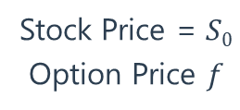

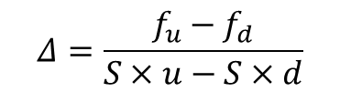
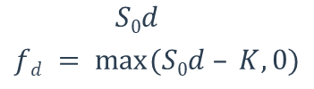

Binomial Trees
Summary
  No-Arbitrage Valuation
$$S0u$$
$$fu = max⁡(S0u – K, 0)$$
Stock Price = $S0$
Option Price $f$
$$S0d$$
$$fd = max⁡(S0d – K, 0)$$
$$Δ=\frac{f_{u}−f_{d}}{S×u−S×d}$$
$$S_{0}uΔ−f_{u}=S_{0}dΔ−f_{d}$$
$f$= $S_{0}Δ –Π_{T}e^{−rT}$

Slide 14


Binomial Trees
Summary
  Risk-Neutral Valuation
p
$$S0u$$
$$fu = max⁡(S0u – K, 0)$$
Stock Price = $S0$
Option Price $f$
1-p
$$S0d$$
$$fd = max⁡(S0d – K, 0)$$
$$S_{0}=\left[S_{0}×u×p+S_{0}×d×\left(1−p\right)\right]e^{−rΔt}⇒p=\frac{e^{rΔt}−d}{u−d} or p=\frac{e^{\left(r−q\right)Δt}−d}{u−d}$$
$$u=e^{σ\sqrt{Δt}};d=e^{−σ\sqrt{Δt}}$$
$$f=\left[pf_{u}+\left(1−p\right)f_{d}\right]e^{−rΔt}$$

Slide 15
Binomial Trees
Exercise 1
A stock currently trades at $10. At the end of three months, the stock will either be $11 or $9. The continuously compounded risk-free rate of interest is 3.5% per year. The value of a 3-month European call option with a strike price of $10 is closest to:
  $0.11
  $0.54
  $0.65
  $1.01
Correct Answer : B

Slide 16
Binomial Trees
Exercise 2
A trader has an American put option with strike price of $50. The underlying asset is stock with a spot price of $40. Using an one-step binomial tree to evaluate the option. Suppose the stock price will go up or down by $8 in 6 month, the risk-free rate is 6.2, what is the value of this American put?
  USD 8.19
  USD 8.45
  USD 10.00
  USD 10.32
Correct Answer : C

Slide 17
Binomial Trees
Example
Asset | Strike | Time | Volatility | Riskless | Div. Yield
$810 | $800 | 0.5 | 20% | 5% | 2%
u | d | p
1.1052 | 0.9048 | 0.5126
$989.34
$895.19
$810
$810
Option Value = 53.40
$732.92
$663.17

Slide 18
Binomial Trees
Example
189.34
100.66
53.4
10
5.06
0

Slide 19
Binomial Trees
Summary
S₀uu
f_{uu}
S₀u
f_{u}
S₀
f
S₀ud
f_{ud}
S₀d
f_{d}
S₀dd
f_{dd}

Slide 20
Binomial Trees
American Options
判断是否提前执行
S₀uu
f_{uu}
S₀u
f_{u}
S₀
f
S₀ud
f_{ud}
S₀d
f_{d}
S₀dd
f_{dd}
判断是否提前执行
At earlier nodes, the value of the option is
$$MAX [intrinsic value if option were exercised, discounted value of two subsequent nodes]$$

Slide 21
Binomial Trees
Example : American Put Option with price jump of +/- 20%
Asset | Strike | Time | Riskless | Div. Yield
$50 | $52 | 2 | 5% | 0%
u | d | p
1.2 | 0.8 | 0.6282
$72
$60
$50
$48
Option Value = 5.09
$40
$32

Slide 22
Binomial Trees
Example : American Put Option with price jump of +/- 20%
0
1.4147/0
5.09/2
4
9.4634/12
20

Slide 23
Binomial Trees
Increasing the Number of Time Periods
  If we shorten the length of the intervals in a binomial model, there are more intervals over the same time period, more branches to consider, and more possible ending values.
  If we continue to shrink the length of intervals in the model until they are what mathematicians call “arbitrarily small”, we approach continuous time as the limiting case of the binomial model.
  The model for option valuation in the next topic (the Black-Scholes-Merton model) is a continuous time model. The binomial model “converges” to this continuous time model as we make the time periods arbitrarily small.

Slide 24
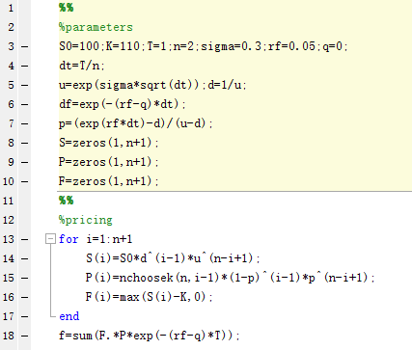
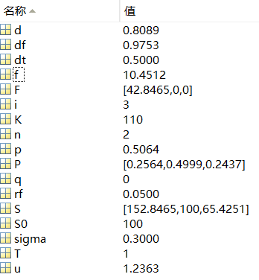
Binomial Trees
Using Binominal Trees to price an option

Slide 25
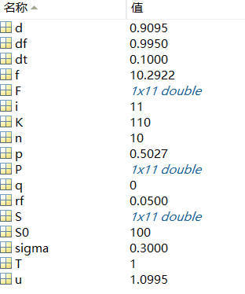
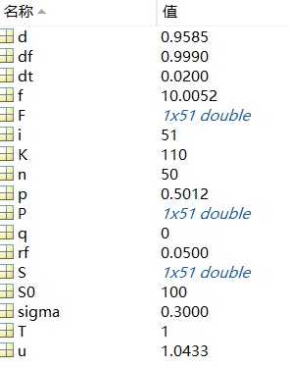
Binomial Trees
Using Binominal Trees to price an option
n=10
n=50

Slide 26
Black-Scholes-Merton Model
Example
FTSE Index
Date | Closing Price | ln(S(t)/S(t-1))
2009/7/22 | 4493.73
2009/7/23 | 4559.8 | 0.014596
2009/7/24 | 4576.61 | 0.003680
2009/7/27 | 4586.13 | 0.002078
2009/7/28 | 4528.84 | -0.012571
2013/7/15 | 6586.11 | 0.006271
2013/7/16 | 6556.35 | -0.004529
2013/7/17 | 6571.93 | 0.002374
2013/7/18 | 6634.36 | 0.009455
2013/7/19 | 6630.67 | -0.000556
miu= | 0.039%
sigma= | 1.084%

Slide 27
Black-Scholes-Merton Model
Assumptions
  The price of the underlying asset follows a lognormal distribution.
  The price of the underlying asset is continuous, jump is not considered.
  The (continuous) risk-free rate is known and constant.
  The volatility of the underlying asset is known and constant.
  The markets are frictionless.
  There are no cash flows on the underlying asset.
  The options valued are European options.

Slide 28

Black-Scholes-Merton Model
Lognormal Assumption
  Stock return：
  Ito’s process:
  Ito’s Lemma:
  As the stock price follows a Geometric Brownian Motion, if we define G = lnS, using Ito’s lemma, we have:
$$dS=μSdt+σSdz$$

Slide 29

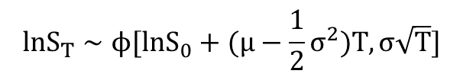
Black-Scholes-Merton Model
Lognormal Assumption
  It means：
  A variable has a lognormal distribution if the natural logarithm of the variable is normally distributed. While the equation above shows that lnST is normally distributed. The stock price is lognormally distributed.
$lnS_{T}−lnS_{0}∼ϕ$[$(μ−\frac{1}{2}σ^{2})T,σ\sqrt{T}]$
$$lnS_{T}∼ϕ[lnS_{0}+(μ−\frac{1}{2}σ^{2})T,σ\sqrt{T}]$$

Slide 30
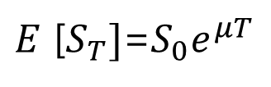


Black-Scholes-Merton Model
Expected Return and Volatility
  If $S_{T}$equals the stock price at future time $T$, the expected value of $S_{T}$ is given as:
  The variance of $S_{T}$ is given by:
$E$ [$S_{T}]$=$S_{0}e^{μT}$
$$VAR\left[S_{T}\right]=S_{0}^{2}e^{2μT}(e^{σ^{2}T}−1)$$

Slide 31


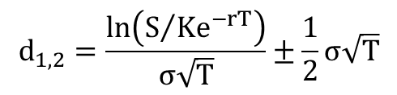

Black-Scholes-Merton Model
Risk-Neutral Assumption
  The price of a European call option is given by:
  The price of a European put option is given by:
  Where:
$$c=e^{−r(T−t)}E\left[max\left(S_{T}−K,0\right)\right]$$
$$c=SN\left(d_{1}\right)−Ke^{−rT}N\left(d_{2}\right)$$
$$p=Ke^{−rT}N\left(−d_{2}\right)−SN\left(−d_{1}\right)$$
N(d₁): delta of call
N(d₂): prob. of call exercise
1-N(d₂): prob. of put exercise
$$d_{1,2}=\frac{ln\left(S/{Ke^{−rT}}\right)}{σ\sqrt{T}}±\frac{1}{2}σ\sqrt{T}$$

Slide 32
Black-Scholes-Merton Model
Example
  Stock price is $10, Strike is $9.
  Volatility is 20%.
  Term is six months.
  Riskless rate is 5%.

Slide 33
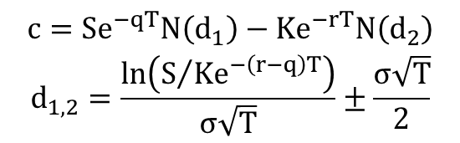
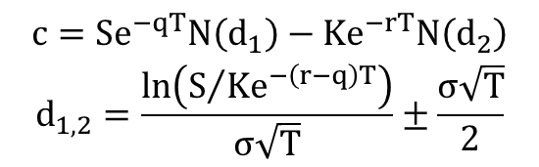
Black-Scholes-Merton Model
Effect of Dividend on BSM Model
  Call Option Put Option
Black’s Approximation
  Using the procedure for European options on 𝑇 and 𝑡 and then taking the larger of the two as the price of American options.
$$\begin{matrix}c=Se^{−qT}N\left(d_{1}\right)−Ke^{−rT}N\left(d_{2}\right) \\ d_{1,2}=\frac{ln\left(S/{Ke^{−\left(r−q\right)T}}\right)}{σ\sqrt{T}}±\frac{σ\sqrt{T}}{2}\end{matrix}$$
$$\begin{matrix}c=Se^{−qT}N\left(d_{1}\right)−Ke^{−rT}N\left(d_{2}\right) \\ d_{1,2}=\frac{ln\left(S/{Ke^{−\left(r−q\right)T}}\right)}{σ\sqrt{T}}±\frac{σ\sqrt{T}}{2}\end{matrix}$$

Slide 34
Black-Scholes-Merton Model
Exercise 1
Each of the following is an assumption of the basic BSM OPM except:
  Asset price follows a geometric Brownian motion (GBM) which is a continuous process without jumps.
  The continuously compounded rate of return on the stock is normally distributed, such that the distribution of the future stock prices is lognormal.
  The expected rate of return on the stock and volatility are constant.
  The expected real-world rate of return on the stock is known and the value of the option is an increasing function of this rate of return.
Correct Answer : D

Slide 35
Black-Scholes-Merton Model
Exercise 2
In the Black-Scholes expression for a European call option the term used to compute option probability of exercise is:
  d₁
  d₂
  N(d₁)
  N(d₂)
Correct Answer : D

Slide 36
Black-Scholes-Merton Model
Exercise 3
The current price of a stock is $25. A put option with a $20 strike price that expires in six months is available. N(d1) = 0.9737 and N(d2) = 0.9651. If the underlying stock exhibits an annual standard deviation of 25%, and the current continuously compounded risk-free rate is 4.25%, the Black-Scholes-Merton value of the put is closest to:
  $0.01
  $0.03
  $0.33
  $0.36
Correct Answer : B

Slide 37
Black-Scholes-Merton Model
Warrants
  Warrants are attachments to a bond issue that give the holder the right to purchase shares of a security at a stated price.
  Warrants can be valued as a separate call option on the firm’s shares.
  One distinction is necessary though. With call options, the shares are already outstanding, and the exercise of a call option triggers the trading of shares among investors at the strike price of the call options. But, when investor exercises warrants, the investor purchases shares directly from the firm. The distinction is that the value of all outstanding shares can be affected by the exercise of warrants.
  The primary complication is circularity: the warrant depends on the stock price, but the stock price is a function of (diluted by) the issuance of warrants. This is also called an iterative.

Slide 38
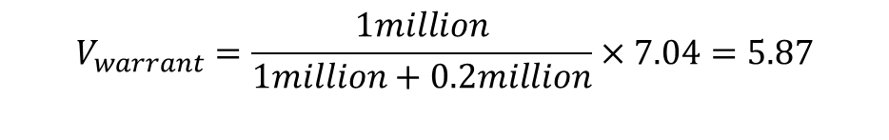
Black-Scholes-Merton Model
Example
  A company with 1 million shares worth $40 each is considering issuing 200,000 warrants each giving the holder the right to buy one share with a strike price of $60 in 5 years. The interest rate is 3% per annum, and the volatility is 30% per annum. The company pays no dividends.
  Since it is a call option, we first find the value of a 5-year European call option on the stock to be $7.04. Then we find the value of each warrant as:
  So, the total cost of the warrant issued is 5.87 * 200,000 = 1.17 million .
  Since the company’s equity adjusts the total cost of the options as soon as the decision to issue the warrants becomes generally known, the stock price is expected to decline by $1.17 to $38.83.
$$V_{warrant}=\frac{1million}{1million+0.2million}×7.04=5.87$$

Slide 39
The Greek Letters
Factors that Affect Option Prices
  S0 = current stock price
  X = strike price of the option
  T = time to expiration of the option
  r = short-term risk-free interest rate over T
  D = present value of the dividend of the underlying stock
  σ = expected volatility of stock prices over T

Slide 40
The Greek Letters
Naked and Covered Option Positions
  If you sell a call option without owning the underlying asset, you hold a naked position (i.e. , you have no hedge whatsoever).
  If you sell a call option while owning shares, you have a covered position.
Stop-Loss Trading Strategy
  The strategy is to hold a naked position when the option is out-of-the-money and a covered position when the option is in-the-money. Although “superficially attractive”, the strategy becomes too expensive if the stock price crosses the strike price level many times.

Slide 41
The Greek Letters
Example
  Consider a financial institution that has sold for $300,000 a European call option on 100,000 shares of a non-dividend-paying stock. Assumptions are:
  • Stock price (𝑆_0) is $49
  • Strike (K) is $50
  • Volatility (σ) is 20%
  • Term (t) is 0.3846 (20 weeks)
  • Riskless rate is 5%
  The Black–Scholes–Merton value of an option to buy one share is $2.40. Therefore, the price of the option is about $240,000. The financial institution has therefore sold a product for $60,000 more than its theoretical value. But it is faced with the problem of hedging the risks.

Slide 42
The Greek Letters
Example
  Naked position:
    The institution does nothing other than selling its stock option. This strategy works well if the stock price is below $50 at the end of the 20 weeks. The option then costs the financial institution nothing and it makes a profit of $300,000.
    However, if the call is exercised then the institution has to buy 100,000 shares at the market price prevailing in 20 weeks to cover the call. For example, if after 20 weeks the stock price is $60, the option costs the financial institution $1,000,000 (stock price minus strike price times the no. of shares). This is considerably greater than the $300,000 charged for the option.
  Covered position:
    This involves buying 100,000 shares as soon as the option has been sold. If the option is exercised, this strategy works well. However, if the stock price drops it could lead to a significant loss. For example, if the stock price drops to $40, the financial institution loses $900,000 (fall in the price of stock times the no. of shares) on its stock position. This is considerably greater than the $300,000 charged for the option.

Slide 43
The Greek Letters
Delta
  The delta of an option, Δ, is the ratio of the change in price of the call/put option to the change in the price of the underlying assets.
  Delta is the slope of the option pricing function at the current stock price.

Slide 44
The Greek Letters
Delta
Delta
1
  Call option Δ range from 0 to 1.
  Put option Δ range from -1 to 0.
0.5
Call Options
0
K
Long Call | Δ > 0
Short Call | Δ < 0
Long Put | Δ < 0
Short Put | Δ > 0
-0.5
Put Options
-1
Delta of Call and Put Option

Slide 45
The Greek Letters
Delta
Delta
1.0
0.9
0.8
0.7
0.6
0.5
0.4
0.3
0.2
90-day
0.1
60-
30-
10-day
0.0
90
100
110
Spot Price
  When t→T, delta is unstable.
  For a call option at the money, Δ ≈ 0.5.

Slide 46
The Greek Letters
Delta
  According to the BSM Model
or
  Where:
    ∂c = change in the call option price;
    ∂p = change in the put option price;
    ∂S = change in the stock price.

Slide 47
The Greek Letters
Delta
  Forward Delta 1 or e^{-qT}
  Futures Delta e^{rT} or e^{(r – q)T}
    T=0
    T=1
  Portfolio Delta: summation of the product of each option position and its delta.

Slide 48
The Greek Letters
Delta Hedge
  A position with a delta of zero is called a delta neutral position.
Example
  A call delta equals to 0.6 means that the price of a call option on a stock will change by approximately $0.60 for a $1.00 change in the value of the stock.
  If an investor is short 1,000 call options, he will need to be long 600(0.6×1,000) shares of the underlying. When the value of the underlying asset increases by $1.00, the underlying position increases by $600, while the value of his option position decreases by $600. When the value of the underlying asset decreases by $1.00, there is an offsetting increase in value in the option position.

Slide 49
The Greek Letters
Dynamic Aspects of Delta Hedge
  Because delta changes, a position is delta neutral only instantaneously (for a very short period of time). To maintain a delta neutral position, the trader must re-balance the portfolio.
  Continuously maintaining a delta-neutral position can be very costly in terms of transaction costs.
  If gamma is higher (such as the case when the options are at-the-money), rebalancing more frequently is required. On the other hand, when gamma is lower (such is the case when options are deeply in the money or deeply out of the money), rebalancing is required less frequently.

Slide 50
The Greek Letters
Summary
  Delta is:
    Slope of a call option
    N(d1)
    CDF of a normal distribution
    dc/ds
    Hedge ratio

Slide 51
The Greek Letters
Gamma
  The Gamma of options on an underlying asset is the rate of change of the option’s delta with respect to the price of the underlying asset. That is to measure the stability of delta.
  Gamma is used to correct the hedging error associated with delta-neutral positions by providing added protection against large movements in the underlying asset's price.
10
Current Value of Option
5
Delta + Gamma
Actual
Delta
0
110
90
100
Current Price of Underlying Asset

Slide 52
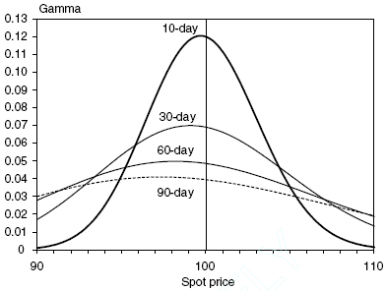
The Greek Letters
Gamma
  When gamma is large, delta will be changing rapidly.
  Gamma is largest when an option is at-the-money.
  Gamma is the same for call and put options.
  Delta Neutral Positions
    Hedge against small changes in stock price.
  Gamma Neutral Positions
    Hedge against larger changes in stock price.
Long Call | Short Call | Long Put | Short Put
γ > 0 | γ < 0 | γ > 0 | γ < 0

Slide 53
The Greek Letters
Example: Creating a Gamma Neutral Position
  Suppose an existing short option position is delta-neutral but has a gamma of -6,000. Here, gamma is negative because we are short the options. Also, assume that there exists a traded option with a delta of 0.6 and a gamma of 1.25. Create a gamma-neutral position.
    Buy 6,000/1.25 = 4,800 options
    Sold 4,800×0.6 = 2,880 shares of the underlying position
  You can also create a gamma needed position, e.g., gamma of -1,000.
 | Delta 0 | Gamma -6000
Buy 4800 options (6000/1.25 = 4800) | 4800 × 0.6 = 2880 | 0
Sell 2880 stocks | 0 | 0

Slide 54
The Greek Letters
Implication of Vega
  Vega is the rate of change of the value of the option with respect to the volatility of the underlying asset.
  Most sensitive to changes in volatility when they are at the money.
  Vega of a call is equal to the Vega of a put.

Slide 55
The Greek Letters
Theta
  Theta is the rate of change of the value of the option with respect to the passage of time with all else remaining the same.
  Theta is sometimes referred to as the time decay. As time to maturity decreases with all else remaining the same, the option tends to become less valuable, so theta is usually negative for an option.
  For long position, theta<0, means option lose value as time goes by.
  Short-term at the money option has a greatest negative theta.

Slide 56
The Greek Letters
Rho
  Rho is the sensitivity to the interest rates.
  The equity options are not as sensitive to changes in the risk-free rate as they are to changes in the other variables.
  In the money calls and puts are more sensitive to changes in rates than out-of-the-money options.

Slide 57
The Greek Letters
Relationship between Delta, Theta, and Gamma
  Stock option prices are affected by delta, theta, and gamma as indicated in the following relationship:
  where:
    r = the risk-neutral risk-free rate of interest
    π = the price of the option
    θ = the option theta
    S = the price of the underlying stock
    Δ = the option delta
    σ2 = the variance of the underlying stock
    Г = the option gamma

Slide 58
The Greek Letters
Portfolio insurance
  The combination of (1) an underlying instrument and (2) either cash or a derivative that generates floor value for the portfolio in the event that market values decline, while still allowing for upside potential in the event that market values rise.
  The simplest way to create portfolio insurance is buy put options on an underlying portfolio. In this case, any loss on the portfolio may be offset with gains on the long put options.
  An alternative to buying the puts, a synthetic put position can be created with index futures contracts. This is accomplished by selling index futures contracts in an amount equivalent to the proportion of the portfolio dictated by the delta of the required put option.
  The main reasons traders may prefer synthetically creating the portfolio insurance position with index futures include substantially lower trading costs and relatively higher levels of liquidity.

Slide 59
The Greek Letters
Exercise 1
The dividend yield of an asset is 10% per annum, what is the delta of a long forward contract on the asset with 6 months to maturity?
  0.95
  1.00
  1.05
  Cannot determine without additional information
Correct Answer : A

Slide 60
The Greek Letters
Exercise 2
A portfolio of stock A and options on stock A is currently delta neutral, but has a positive gamma, which of the following actions will make the portfolio both delta and gamma neutral?
  Buy call options on stock A and sell stock A
  Sell call options on stock A and sell stock A
  Buy put options on stock A and buy stock A
  Sell put options on stock A and sell stock A
Correct Answer : D

Slide 61
The Greek Letters
Exercise 3
Which of the following IBM options has the highest gamma with the current market price of IBM common stock at USD 68?
  Call option expiring in 10 days with strike USD 70
  Call option expiring in 10 days with strike USD 50
  Put option expiring in 10 days with strike USD 50
  Put option expiring in two months with strike USD 70
Correct Answer : A

Slide 62
The Greek Letters
Exercise 4
Suppose an existing short option position is delta-neutral, but has a gamma of -600. Also assume that there exists a traded option with a delta of 0.75 and a gamma of 1.50. In order to maintain the position gamma-neutral and delta-neutral, which of the following is the appropriate strategy to implement?
  Buy 400 options and sell 300 shares of the underlying asset
  Buy 300 options and sell 400 shares of the underlying asset
  Sell 400 options and buy 300 shares of the underlying asset
  Sell 300 options and buy 400 shares of the underlying asset
Correct Answer : A
 | Delta 0 | Gamma -600
Buy 400 options | 400×0.75 = 300 | 0
Sell 300 stocks | 0 | 0

Slide 63
The Greek Letters
Exercise 5
Steve, a market risk manager at Marcat Securities, is analyzing the risk of its S&P 500 index options trading desk. His risk report shows the desk is net long gamma and short vega. Which of the following portfolios of options shows exposures consistent with this report?
  The desk has substantial long-expiry long call positions and substantial short-expiry short put positions.
  The desk has substantial long-expiry long put positions and substantial long-expiry short call positions.
  The desk has substantial long-expiry long call positions and substantial short-expiry short call positions.
  The desk has substantial short-expiry long call positions and substantial long-expiry short call positions.
Correct Answer : D
Notes:
Consider a forward contract on a non-dividend-paying stock whose value is given as:
S0-Ke^-rt
The futures price for a contract on a non-dividend-paying stock is given by: S0e^rt.

Slide 64
53%
55%
Fixed Income Valuation

Slide 65
Reviews 回顾
Spot, Forward and Par Rates 即期，远期和平价利率
Valuation 估值
Returns, Spreads and Yields 收益，利差和收益率
Bond Replication 债券复制
One-Factor Risk Metrics and Hedges 单因素风险度量和对冲
Multi-Factor Risk Metrics and Hedges 多因素风险度量和对冲

Slide 66
Reviews
Bonds Basics
  A bond is an instrument of indebtedness of the bond issuer to the holders. It is a debt security, under which the issuer owes the holders a debt and, depending on the terms of the bond, is obliged to pay them interest (the coupon) and/or to repay the principal at a later date, termed the maturity date.
  Characteristics of bonds
    Coupon rate
    Face value
    Maturity
    Yield to maturity (YTM)
Notes:
Relationship between coupon rate, YTM, and bond prices
Coupon effect: fairly priced bonds of the same maturity but different coupons have different yields to maturity.
If a firm issues a bond at par, it means that the market rate for the bond is precisely that of the coupon rate. Immediately after this bond is issued and before the market has time to adjust, the bond will trade at par.
After the bond begins trading in the market, the same cannot be said, the price of the bond will reflect market conditions.
the relationship among a bond’s coupon rate, the yield required by the market, and the bond’s price relative to par value
Coupon rate = market yield, bond trade at par value
Coupon rate > market yield, bond trade at premium
Coupon rate < market yield, bond trade at discount

Slide 67
Reviews
Treasury Bills, Treasury Notes and Treasury Bonds
  A short-term debt obligation backed by the U.S. government with a maturity of less than one year.
  A US Treasury bill is a discount instrument: the discount rate is expressed as a percentage of the face value. Consequently, the discount rate is not a true yield.
  A marketable, fixed-interest U.S. government debt security with a maturity of more than 10 years. Treasury bonds make interest payments semi-annually.
Notes:
T-bills：一二两段都是T-bills。Paid no interest. Par value=$1000, purchase price=$950
T-notes: 1-10年。
T-notes 和T-bonds唯一区别是maturity。Paid fixed int rate twice a year.

Slide 68
Reviews
Treasury STRIPS
  Separate Trading Registered Interest and Principal Securities
$5
$5
$5+$100
3-year bond
$5
C-STRIPS 1
$5
C-STRIPS 2
$5
C-STRIPS 3
$100
P-STRIPS

Slide 69
Reviews
Advantage of STRIPS (Why investors like them) | Disadvantages of STRIPS
They can be combined or re-constructed into any required sequence of cash flows. | Can be illiquid.
More interest-rate sensitive than coupon bearing bonds (all other things being equal). | Short term (long-term) C-STRIPS often trade rich (cheap).
Notes:
定制的东西肯定没有标准的好卖
PO与IO在偿付来源上的区别决定了投资PO与投资IO有截然不同的投资风险。PO以证券化贷款的本金受偿，而证券化贷款本金额是确定的，只是支付的时间可能产生偏差。因此，投资者的投资本金不会受到损失，风险只在于收益率的大小。但对于IO而言，如果证券化贷款的早偿（不论由利率变化或其它原因所致）速度足够快，则有可能发生的情形是，支持资产所产生的利息总额可能还不及投资者所支付的IO购买价格，也即投资者连投资本金都不能收回，更不用说投资资金的利息损失了。
PO 和IO的价格对利率变化非常敏感的特性使得其常被用作利率套期交易工具。例如，PO可用作固定利率负债的套期保值工具，因为当市场利率的下降时，PO的价值上升，正好可弥补固定利率负债因利率下降而产生的负增值损失。对于IO而言，当市场利率处于临界点利率之下时，IO可用作固定利率资产的套期保值工具；反之，则可用于固定利率负债的套期保值。因为在此两种情形下，IO价值随市场利率变动而变动的方向刚好与套期保值对象的变动方向相反。

Slide 70
Spot, Forward and Par Rates
Discount Factor
  The discount factor, d(t), for a term of (t) years, gives the present value of one unit of currency ($1) to be received at the end of that term.
  Example: If d(0.5) = 0.97557, the present value of $1 to be received in six months is 97.557 cents. Assume A pays $105 in six months. Given the same discount factor, $105 to be received in six months is worth 0.97557×$105 = $102.43.

Slide 71
Spot, Forward and Par Rates
Spot Rate
  A t-period spot rate, or zero rate, denoted as z(t), is the yield to maturity on a zero-coupon bond that matures in t-years.
  The spot rate curve is the graph of the relationship between spot rates and maturity.
  The spot rate curve can be derived from either a series of STRIPS prices, or the comparable discount factor.

Slide 72
Spot, Forward and Par Rates
STRIPS Prices and Discount Factors
Maturity | STRIPS Price | Discount Factor | Spot Rate
0.5 | 99.2556 | 0.992556 | 1.50%
1.0 | 97.8842 | 0.978842 | 2.15%
1.5 | 96.2990 | 0.962990 | 2.53%
2.0 | 94.3299 | 0.943299 | 2.94%
2.5 | 92.1205 | 0.921205 | 3.31%
3.0 | 89.7961 | 0.897961 | 3.62%

Slide 73
Spot, Forward and Par Rates
Forward Rate
  Forward rates are interest rates corresponding to a future period implied by the spot curve.
  All forward rates are computed using spot rates, and all spot rates can be computed using the appropriate forward rates.

Slide 74
Spot, Forward and Par Rates
Spot Rates and Forward Rates
Maturity (Years) | Spot Rate | 6-Month Forward Rate
0.5 | 1.50% | 1.50%
1.0 | 2.15% | 2.80%
1.5 | 2.53% | 3.29%
2.0 | 2.94% | 4.17%
2.5 | 3.31% | 4.80%
3.0 | 3.62% | 5.18%

Slide 75
Spot, Forward and Par Rates
Par Rate
  The T-year, semiannual par rate is the rate, C(T), such that a fixed-rate asset with par value of $100 that makes regular semi-annual coupon payments of C(T)/2×$100 discounts to a present value equal to the par value of $100.
Fixed rate (pay) = ?
Float rate (receive) = Libor

Slide 76
Spot, Forward and Par Rates
Term Structure
  The relationship between spot rates and maturity/term is called the term structure of spot rate.
  Flattening: longer-term rates fall by more than shorter-term rates, or shorter-term rates rise by more than longer-term rates.
  Steepening: longer-term rates increase by more than shorter-term rates, or shorter-term rates fall by more than longer-term rates.

Slide 77
Spot, Forward and Par Rates
Exercise 1
The following discount function contains semi-annual discount factors out to two years: d(0.5) = 0.9970, d(1.0) = 0.9911, d(1.5) = 0.9809, d(2.0) = 0.9706. What is the implied eighteen-month (1.5 year) spot rate (aka, 1.5 year zero rate)?
  0.600%
  1.176%
  1.290%
  1.505%
Correct Answer : C

Slide 78
Spot, Forward and Par Rates
Exercise 2
The price of a six-month zero-coupon bond is $99.90 and the price of a one-year zero-coupon bond is $98.56. What is the implied six-month forward rate, under semi-annual compounding?
  1.30%
  2.95%
  2.73%
  3.08%
Correct Answer : C

Slide 79
Valuation
Pricing Bond using Discount Factors, Spot Rates, or Forward Rates
  Assume a 1-year treasury bond that pays a 6% semi-annual coupon.
  Calculate the Bond Price using Discount Factors.
    Price = ($3×0.992556) + ($103×0.980296) = $103.95
Maturity | Spot Rate (%) | Discount Factor | 6 Month Forward Rate (%)
0.50 | 1.50 | 0.992556 | 1.50
1.00 | 2.00 | 0.980296 | 2.50
1.50 | 2.25 | 0.966995 | 2.75
2.00 | 2.50 | 0.951524 | 3.25
2.50 | 2.75 | 0.933997 | 3.75
Notes:
The price of premium bonds will gradually fall until they trade at par value at maturity.
The price of discount bonds will gradually rise to par values as maturity gets closer. This converging effect is known as pull to par.

Slide 80
Valuation
  Calculate the Bond Price using Spot Rates.
  Calculate the Bond Price using Forward Rates.

Slide 81
Valuation
Example
  Given the interest rates as below, which of the following is closest to the price of a 4-year bond that has a par value of $1,000 and makes 10% coupon payments annually?
    Current 1-year spot rate = 5.5%
    1-year forward rate one year from today = 7.63%
    1-year forward rate two years from today = 12.18%
    1-year forward rate three years from today = 15.50%

Slide 82
Valuation
Example
  The table below shows selected T-bond prices for semiannual coupon, $100 face value bonds. Calculate discount factors for these given bond prices.
Bond | Coupon | Maturity | Price
1 | 4.25% | 11/15/06 | 101-16
2 | 7.25% | 5/15/07 | 105-31+
3 | 2.00% | 11/15/07 | 101-07
4 | 12.00% | 5/15/08 | 120-30
5 | 5.75% | 11/15/08 | 110-13+

Slide 83
Valuation

Slide 84
Valuation
Price of an Annuity and a Perpetuity
  Annuity
    An annuity with semiannual payments is a security that makes a payment c/2 every six months for T years but never makes a final “principal” payment (i.e., FV=0). The price of an annuity, A(T), is given by:
  Example
    Suppose a fixed-income instrument offers annual payments in the amount of $100 for 10 years. The YTM of the security is 10%. Compute the price of this security.

Slide 85
Valuation
  Perpetuity
    A perpetuity bond is a bond that pays coupons forever. The price of a perpetuity is simply the coupon divided by the yield.
    Price of a perpetuity = c/y
  Example
    Suppose a fixed-income instrument offers annual payments in the amount of $100 into perpetuity. The YTM of the security is 10%. Compute the price of this security.

Slide 86
Valuation
Exercise 1
The price of a three-year zero-coupon government bond is 85.16. The price of a similar four-year bond is 79.81. What is the one-year implied forward rate from year 3 to year 4?
  5.4%
  5.5%
  5.8%
  6.7%
Correct Answer : D

Slide 87
Valuation
Exercise 2
A $1,000 par bond carries a coupon rate of 10%, pays coupons semiannually, and has 13 years remaining to maturity. Market rates are currently 9.25%. The price of the bond is closest to:
  $586.60
  $1,036.03
  $1,055.41
  $1,056.05
Correct Answer : D

Slide 88
Returns, Spreads and Yields
Gross and Net Realized Returns
  Gross Realized Returns
  For example, a bond is purchased for $105.856 and settled (sold) for $105.
Gross Realized Return
Par | $100
Coupon | 4.50%
6/1/2010 Price | $105.856
11/30/2010 Coupon | $2.250
Price | $105.000
Gross Realized Return | 1.317%

Slide 89
Returns, Spreads and Yields
  Net Realized Return: net realized return incorporates funding cost
  We continue the example, but this time we finance the purchase (we borrow the initial price). The borrowing rate happens to be 0.20% per annum, such that the loan payoff equals $105.856×(1 + 0.20%/2) = $105.962.

Slide 90
Returns, Spreads and Yields
Net Realized Return
Par | $100
Coupon | 4.5%
6/1/2010 Price | -$105.856
Borrow | $105.856
Borrow rate | 0.20%
11/30/2010 Coupon | $2.250
Price | $105
Pay Loan | -$105.962
Net Realized Return | 1.217%

Slide 91
Returns, Spreads and Yields
Yield to Maturity
  Yield to maturity is an internal rate of return found by equating the present value of the cash flows to the current price of the security.
  Example: Suppose a bond pays $50 every six months for five years and a final payment of $1,000 at maturity in five years. If the price is $900, calculate the realized return on the security. Assume all cash flows are reinvested at the YTM.
  Answer: The semiannual rate is the y that solves the following equation:

Slide 92
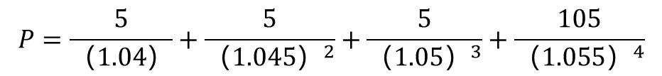
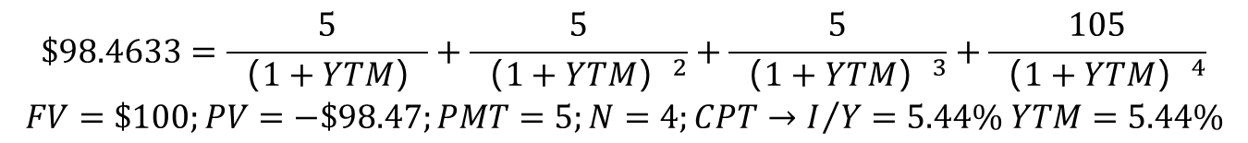
Returns, Spreads and Yields
Example:
A bond with a $100 par value pays a 5% coupon annually for 4 years. The spot rates corresponding to the payment dates are as follows: year 1: 4.0%; year 2: 4.5%; year 3: 5.0%; year 4: 5.5%; Assume the price of the bond is $98.4633. Calculate the price of the bond using spot rates and determine in the YTM for the bond.
Answer: The formula for the price of the bond using the spot rates is as follows.
  Compute the YTM:
$$P=\frac{5}{（1.04）}+\frac{5}{（1.045）^{2}}+\frac{5}{（1.05）^{3}}+\frac{105}{（1.055）^{4}}$$
$$\begin{matrix}\$98.4633=\frac{5}{（1+YTM）}+\frac{5}{（1+YTM）^{2}}+\frac{5}{（1+YTM）^{3}}+\frac{105}{（1+YTM）^{4}} \\ FV=\$100;PV=−\$98.47;PMT=5;N=4;CPT→I/Y=5.44\% YTM=5.44\%\end{matrix}$$

Slide 93
Returns, Spreads and Yields
Relationship between Spot Rates and YTM
  YTM is a kind of average of all the spot rates that enter into the bond pricing equation.
  When there is a flat term structure of spot rates, the yield must equal those spot rates.
  When the term structure of spot rates is upward-sloping, the yield of the two-year bond will be below the two-year spot rate (use two-year bond as example).
  When the term structure of spot rates is downward-sloping, the yield of the two-year bond will be above the two-year spot rate.
$$P=\frac{CF_{1}}{\left(1+YTM\right)}+\frac{CF_{2}}{{\left(1+YTM\right)}^{2}}+…+\frac{CF_{n}}{{\left(1+YTM\right)}^{n}}=\frac{CF_{1}}{\left(1+z_{1}\right)}+\frac{CF_{2}}{{\left(1+z_{2}\right)}^{2}}+…+\frac{CF_{n}}{{\left(1+z_{n}\right)}^{n}}$$

Slide 94
Returns, Spreads and Yields
Interest Rate
Interest Rate
9
9
8
Forward Curve
8
7
Spot Curve
7
Yield Curve
6
6
Yield Curve
5
5
Spot Curve
Forward Curve
4
4
3
3
0
1
2
3
4
5
6
7
8
9
10
0
1
2
3
4
5
6
7
8
9
10
Maturity(Year)
Maturity(Year)
Upward-Sloping Term Structure
Downward-Sloping Term Structure

Slide 95
Returns, Spreads and Yields
Reinvestment Risk and Interest Rate Risk
  The yield to maturity can be viewed as the realized return on the bond assuming all cash flows are reinvested at the YTM and the bond is held to maturity.
  Future interest rates can be less than the yield to maturity at the time bond is purchased, known as reinvestment risk.
  If the bond is not held to maturity, the investor faces the risk that he may have to sell for less than the purchase price, resulting a return that is less than the yield to maturity, known as interest rate risk.

Slide 96
Returns, Spreads and Yields
The Spread of a Bond
  The market price of any security can be thought of as its value computed using some term structure of interest rates plus a premium or discount.
$$P=\frac{c}{1+f\left(1\right)+s}+\frac{c}{\left[1+f\left(1\right)+s\right]\left[1+f\left(2\right)+s\right]}+…+\frac{c+F}{\left[1+f\left(1\right)+s\right]\left[1+f\left(2\right)+s\right]…\left[1+f\left(T\right)+s\right]}$$
$$P=\frac{c}{1+f\left(1\right)+s\left(1\right)}+\frac{c}{\left[1+f\left(1\right)+s\left(1\right)\right]\left[1+f\left(2\right)+s\left(2\right)\right]}+…+\frac{c+F}{\left[1+f\left(1\right)+s\left(1\right)\right]\left[1+f\left(2\right)+s\left(2\right)\right]…\left[1+f\left(T\right)+s\left(T\right)\right]}$$

Slide 97
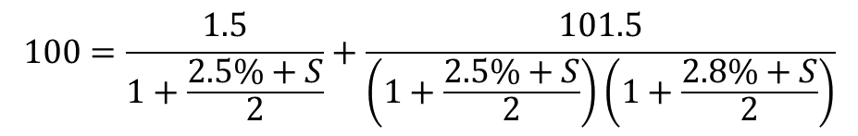
Returns, Spreads and Yields
Example
  A Treasury bond has one year to maturity. The forward curve of this bond is as follows: f(0.5) = 2.5%, f(1) = 2.8%, coupon rate is 3%, paid semi-annually. Compute the spread of a similar corporate bond if its current price is 100.
$$100=\frac{1.5}{1+\frac{2.5\%+S}{2}}+\frac{101.5}{\left(1+\frac{2.5\%+S}{2}\right)\left(1+\frac{2.8\%+S}{2}\right)}$$

Slide 98
Returns, Spreads and Yields
Decomposition of P&L
  The bond’s profit and loss consists of both:
    Price appreciation (or depreciation); a.k.a., capital gain or loss.
    Cash-carry: explicit cash flows such as coupon payments and financing costs.
  The total profit and loss can be decomposed into three components:
    Carry-roll-down: the price change due to the passage of time where rates move as expected but with no change in the spread.
    Rate change: the price effect of rates changing from the intermediate term structure to the term structure that actually prevails at time t+1.
    The price appreciation due to a spread change is the price effect due to the bond’s individual spread changing from s(t) to s(t+1).

Slide 99
Returns, Spreads and Yields
Example
 | Start period | 2010 1-1 | 2011 1-1 | 2012 1-1 | Price | P&L
Pricing date: 2010-1-1; annual coupon=$1
Initial forwards | Term structure | 2% | 3% | 4% | 93.0229
 | spreads | 0.5% | 0.5% | 0.5%
Pricing date: 2011-1-1; annual coupon=$1
Carry-roll- down | Term structure |  | 3% | 4% | 94.3485 | +1.3256
 | Spreads |  | 0.5% | 0.5%
Rate change | Term structure |  | 2% | 3% | 96.1800 | +1.8315
 | Spreads |  | 0.5% | 0.5%
Spread change | Term structure |  | 2% | 3% | 95.2577 | -0.9223
 | Spreads |  | 1% | 1%

Slide 100
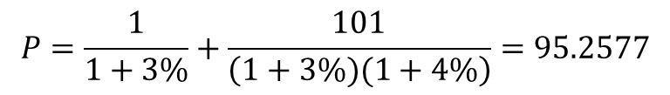
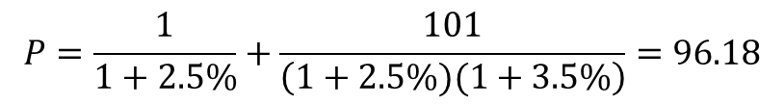
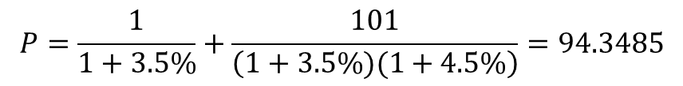
Returns, Spreads and Yields
Price on 2010-1-1:
Price after carry-roll-down:
Price after rate change:
Price after spread change:
$$P=\frac{1}{1+2.5\%}+\frac{1}{\left(1+2.5\%)(1+3.5\%\right)}+\frac{101}{\left(1+2.5\%)(1+3.5\%)(1+4.5\%\right)}=93.0229$$
$$P=\frac{1}{1+3.5\%}+\frac{101}{\left(1+3.5\%)(1+4.5\%\right)}=94.3485$$
$$P=\frac{1}{1+2.5\%}+\frac{101}{\left(1+2.5\%)(1+3.5\%\right)}=96.18$$
$$P=\frac{1}{1+3\%}+\frac{101}{\left(1+3\%)(1+4\%\right)}=95.2577$$

Slide 101
Returns, Spreads and Yields
Exercise 1
According to the pure expectations hypothesis, which of the following statements is correct concerning the expectations of market participants in an upward-sloping yield curve environment?
  Interest rates will increase and the yield curve will flatten.
  Interest rates will increase and the yield curve will steepen.
  Interest rates will decrease and the yield curve will flatten.
  Interest rates will decrease and the yield curve will steepen.
Correct Answer : A

Slide 102
Returns, Spreads and Yields
Exercise 2
A bond portfolio manager invests $20 million in a bond issued at par that matures in 30 years, and which promises to pay an annual interest rate of 9%. The interest is paid once per year, and the payments are reinvested at an annual interest rate of 8%. The first payment is one year from today. What is the annual yield on this investment?
  8.185%
  8.285%
  8.385%
  8.415%
Correct Answer : C
Notes:
N=29,I/Y=8,PV=1.8,PMT=1.8,CPT FV=-203.91
N=30,PV=20,PMT=0,FV=-(203.91+20),CPT I/Y=8.385

Slide 103
Returns, Spreads and Yields
Exercise 3
Reinvestment risk would not occur if:
  Interest rates remained constant over the time period the bond is held.
  The bonds were callable.
  Bonds are issued at par.
  Only zero-coupon bonds are purchased.
  I only
  I and II
  III only
  I and IV
Correct Answer : D

Slide 104
Bond Replication
Replication
  Law of one price: absent confounding factors (e.g., liquidity, financing, taxes, credit risk), identical sets of cash flows should sell for the same price.
  Example: The following table gives the prices of two out of three US Treasury notes for settlement on August 30, 2008. All three notes will mature exactly one year later on August 30, 2009. Assume annual coupon payments and that all three bonds have the same coupon payment date. Assuming the “law of one price”, what should be the price of the 4 1/2 US Treasury Note?
Coupon | Price
2 7/8 | $98.40
4 1/2 | ?
6 1/4 | $101.30

Slide 105
Bond Replication
On August 30, 2009, prices of bonds are:
  Bond 1: 100+2.875
  Bond 3: 100+6.25
  Bond 2: 100+4.5
Through replication, we have:
  102.875 w₁ + 106.25 (1-w₁) = 104.5
  w₁ = 0.5185 (weight of bond 1)
And so:
  0.5185 B₁ + (1-0.5185) B₃ = B₂
  0.5185*98.4 + (1-0.5185)*101.3 = 99.80 = B₂

Slide 106
Bond Replication
  If investors are able to exploit a mispricing due to the law of one price, it is an arbitrage opportunity.
  When mispricing happens, arbitrage may not occur because of three reasons:
    Transaction Costs
    Bid-Ask Spread
    Bonds have idiosyncratic differences that are recognized by the market and priced accordingly.

Slide 107
Bond Replication
Example: Three bond yields and prices are shown below.
  The 2-year spot rate is 8.167%. Is there an arbitrage opportunity using these three bonds? If so, describe the trades necessary to exploit the arbitrage opportunity?
Answer:
  0.08 B₁ + 1.08 B₂ = B₃
  0.08*96.154 + 1.08*85.734 = 100.285 (not 100)
  Bond 3 is undervalued, so we buy Bond 3. Bond 1 and Bond 2 are overvalued, and we sell them together.
 | Maturity | YTM | Coupon | Price (% of par)
1 | 1 year | 4% | 0% | 96.154
2 | 2 years | 8% | 0% | 85.734
3 | 2 years | 8% | 8% | 100
$100
0.08 Bond 1
$100
1.08 Bond 2
$8
$8+$100
1 Bond 3

Slide 108
Bond Replication
  Replicating Portfolio
Time = 0 |  | 1 year |  | 2 years
-1,000,000.000 | (cost of 2-year, 8% coupon bonds) | +80,000 | (coupon) | +1,080,000 | (coupon)
+76,923.20 | (proceeds 1-year, 0% coupon bonds) | -80,000 | (maturity)
+925,927.20 | (proceed 2-year, 0% coupon bonds) |  |  | -1,080,000
+2,850.40 | Net | 0 |  | 0 | (maturity)

Slide 109
One-Factor Risk Metrics and Hedges
Introduction
  Price changes are based on interest rate factors, which are random variables that impacts interest rates in some ways.
  This is a one-factor approach which assumes that a change in one rate (e.g., 10-year rate) will impact all other rates along the curve in a similar fashion.
Bond Price
10-year, 6% coupon bond
150
100
50
0
6
10
20
30
Yield

Slide 110
One-Factor Risk Metrics and Hedges
Macaulay Duration
  The weighted-average time to receipt of cash flows.
  For a zero coupon bond, the Macaulay duration equals to its maturity.
  For a plain bond, the Macaulay duration is less than or equal to its maturity.
  For consol, the Macaulay duration is 1+1/y.

Slide 111
One-Factor Risk Metrics and Hedges
Example
Period | Coupon | Principal | Discount Factor | PV of CF | Weight | Time*Weight
0.5 | 5.00 |  | 0.942 | 4.71 | 0.050 | 0.025
1.0 | 5.00 |  | 0.887 | 4.44 | 0.047 | 0.047
1.5 | 5.00 |  | 0.835 | 4.18 | 0.044 | 0.066
2.0 | 5.00 |  | 0.787 | 3.94 | 0.042 | 0.084
2.5 | 5.00 |  | 0.741 | 3.71 | 0.039 | 0.098
3.0 | 5.00 | 100.00 | 0.698 | 73.29 | 0.778 | 2.333
 |  |  |  | 94.25 |  | 2.653
 |  |  |  |  |  | Duration

Slide 112


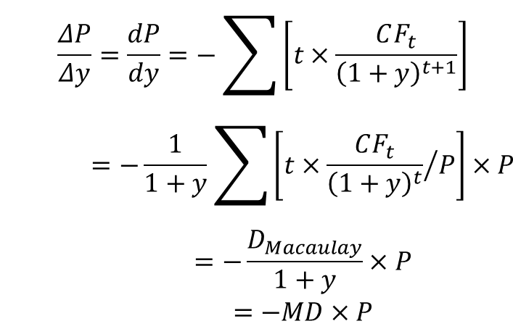
One-Factor Risk Metrics and Hedges
Modified Duration
  Expresses the measurable change in the value of a security in response to a change in interest rates.
Dollar Duration: DD = Modified Duration × Bond Value
$$P=f(y)=\sum{\frac{CF_{t}}{{\left(1+y\right)}^{t}}}$$
$$\begin{matrix}\frac{ΔP}{Δy}=\frac{dP}{dy}=−\sum{\left[t×\frac{CF_{t}}{{\left(1+y\right)}^{t+1}}\right]} \\ =−\frac{1}{1+y}\sum{\left[t×{\frac{CF_{t}}{{\left(1+y\right)}^{t}}}/P\right]}×P \\ =−\frac{D_{Macaulay}}{1+y}×P \\ =−MD×P\end{matrix}$$
$$\begin{matrix}MD=−\frac{ΔP}{Δy}×\frac{1}{P} \\ =\frac{D_{Macaulay}}{1+y}\end{matrix}$$

Slide 113
One-Factor Risk Metrics and Hedges
DV01
  The DV01 is the absolute value of the price change of a bond from one basis point change in yield.
  DV01 Hedge: Sensitivity measures like DV01 are commonly used to compute hedge ratios.
$$DV01=|price at YTM_{0}−price at YTM_{1}|$$
  DV01 = Modified Duration×Bond Value×0.0001

Slide 114
One-Factor Risk Metrics and Hedges
Example
  Suppose a 30-year semiannual coupon bond has a DV01 of 0.17195624, and a 15-year semiannual coupon bond will be used as the hedging instrument. The 15-year bond has a DV01 of 0.10458173. Compute the hedge ratio.
  For every $1 par value of the 30-year bond, short $1.644 of par of the 15-year bond.
$$HR=\frac{DV01\left(per \$100 of initial position\right)}{DV01\left(per \$100 of hedging instrument\right)}=\frac{0.17195624}{0.10458173}=1.644$$

Slide 115
One-Factor Risk Metrics and Hedges
Convexity
  A measure of the non-linear relationship between price and yield duration of a bond to changes in interest rates, the second derivative of the price of the bond with respect to interest rates (duration is the first derivative).
  Convexity is always positive for regular coupon-paying bonds.
Bond Price
Underestimate of price increases when the yield falls.
Overestimate of price decreases when the yield rises.
Bond Yield
Convex Price-Yield Curve for a given Coupon Rate and Maturity

Slide 116

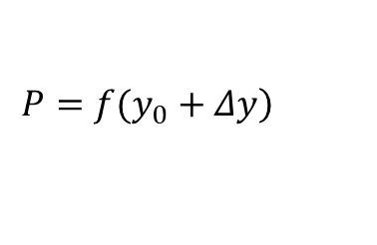
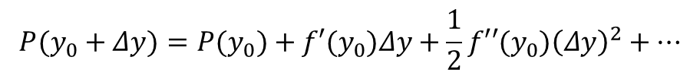
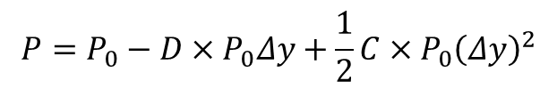
One-Factor Risk Metrics and Hedges
Price Approximation
  The actual, exact price
  The duration estimate
  The duration and convexity estimate
$$P(y_{0}+Δy)=P(y_{0})+f′(y_{0})Δy+\frac{1}{2}f′′(y_{0}){\left(Δy\right)}^{2}+…$$
dollar duration
dollar convexity
$$\left.P=f(y_{0}+Δy\right)$$
$$P=P_{0}−D×P_{0}Δy$$
$$P=P_{0}−D×P_{0}Δy+\frac{1}{2}C×P_{0}{\left(Δy\right)}^{2}$$

Slide 117
One-Factor Risk Metrics and Hedges
Example
  Consider a 10-year zero-coupon Treasury bond trading at a yield of 6%, semiannually compounding.
  The present value of the bond: P = 100/(1+6%/2)²⁰ = 55.37
  Calculation of Durations, for a zero-coupon bond:
    Macaulay duration = 10 years
    Modified duration: MD = 10/(1+6%/2) = 9.71
    Dollar duration: DD = D*×P = 9.71×55.37 = $537.55
    DV01 = DD/10,000 = $0.053755
  We can use the duration to calculate the bond price approximately when the yield changes, for example, yield goes to 7% from 6% now.
  The exact price of bond is P = 100/(1+7%/2)²⁰ = $50.257.
Notes:
The difference is 49.992-50.257=-0.265, as percentage of -0.53%
Question: can we get a more accurate approximation?

Slide 118

One-Factor Risk Metrics and Hedges
  Using duration to approximate:
  C = (T+1)T/(1+y’)² = 21×20/(1+6%/2)² = 395.89 semesters², that is 98.97 years². So the more accurate approximation is:
  The difference is 50.266 - 50.257 = 0.009, or the percentage of 0.02%.
$$P_{1}=P_{0}+f′\left(y_{0}\right)Δy=55.368−537.55×1\%=\$49.992$$
$$\begin{matrix}P_{1}=P_{0}+f′\left(y_{0}\right)Δy+\frac{1}{2}f′′\left(y_{0}\right){\left(Δy\right)}^{2} \\ =55.368−5.375+0.5×\left[98.97×55.37\right]{\left(1\%\right)}^{2} \\ =55.368−5.375+0.274=\$50.266\end{matrix}$$

Slide 119
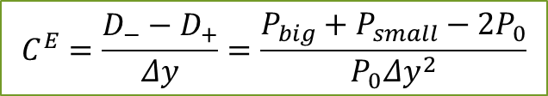
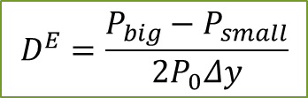
One-Factor Risk Metrics and Hedges
Effective Duration and Effective Convexity
  In a vanilla bond (without embedded options) we can typically use modified and effective interchangeably. When the bond contains embedded options, we prefer effective duration:
  Where:
  P₀ = initial observed bond price
  Δy = change in required yield, in decimal form
  Effective convexity: an approximate measure of convexity
$$D^{E}=\frac{P_{big}−P_{small}}{2P_{0}Δy}$$
$$C^{E}=\frac{D_{−}−D_{+}}{Δy}=\frac{P_{big}+P_{small}−2P_{0}}{P_{0}Δy^{2}}$$

Slide 120
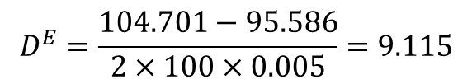
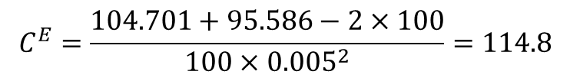
One-Factor Risk Metrics and Hedges
Example
  Suppose there is a 15-year, option-free non-callable bond with an annual coupon of 7% trading at par. Compute the bond’s duration for a 50 basis point increase and decrease in yield, and compute the convexity of this bond.
  Answer:
    If interest rates rise by 50 basis points:
    N=15; PMT=7.00; FV=100; I/Y=7.5%; CPT→PV=-95.586
    If interest rates fall by 50 basis points:
    N=15; PMT=7.00; FV=100; I/Y=6.5%; CPT→PV=-104.701
$$D^{E}=\frac{104.701−95.586}{2×100×0.005}=9.115$$
$$C^{E}=\frac{104.701+95.586−2×100}{100×{0.005}^{2}}=114.8$$

Slide 121
One-Factor Risk Metrics and Hedges
Negative Convexity
  With callable bond, the upside price appreciation in response to decreasing yield is limited (sometimes called price compression). Consider the case of a bond that is currently callable at 102.
Price
Option-Free Bond
Call Option Value
102
Callable Bond
Negative Convexity
Positive Convexity
y’
Yield
Notes:
If a bond that exhibits negative convexity is used to hedge a bond with positive convexity or vice versa, it is unstable when rates move away from y’.
This negative convexity could also characterize a mortgage-backed security.

Slide 122
One-Factor Risk Metrics and Hedges
  With puttable bond, the downside price appreciation in response to increasing yield is limited. It gives the holder the right to sell the bond back to the issuer at a set price.
Price
Puttable Bond
More Convexity
97
Option-Free Bond
Put Option Value
y’
Yield

Slide 123
One-Factor Risk Metrics and Hedges
Portfolio Duration and Convexity
  In regard to both modified (effective) duration and convexity, portfolio duration and convexity equal the weighted sum of individual, respectively, durations and convexities where each component’s weight is its value as a percentage of portfolio value.

Slide 124
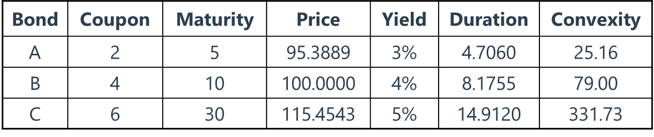


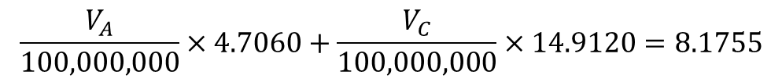
One-Factor Risk Metrics and Hedges
Bullet versus Barbell Portfolio
  A manager purchase $100 million B at a cost of $100,000,000. The payments are semi-annual. Using A and C to construct a portfolio with the same cost and duration.
  Barbell benefits more from interest rate volatility.
$$V_{A}+V_{C}=100,000,000$$
$$C_{portfolio}=129.4$$
$$\frac{V_{A}}{100,000,000}×4.7060+\frac{V_{C}}{100,000,000}×14.9120=8.1755$$

Slide 125
One-Factor Risk Metrics and Hedges
Exercise 1
A zero-coupon bond with a maturity of 10 years has an annual effective yield of 10%. What is the closest value for its modified duration?
  9
  10
  99
  100
Correct Answer : A

Slide 126
One-Factor Risk Metrics and Hedges
Exercise 2
The modified duration is 10.46 of a bond with a current price of $716.38. What is the bond’s DV01?
  $0.40
  $0.75
  $1.25
  Need more information (yield, maturity)
Correct Answer : B

Slide 127
One-Factor Risk Metrics and Hedges
Exercise 3
A market maker sells $100 million face value of call options on underlying bonds when the interest rate is 4%. The price of the call option is $3 million and their (modified) duration is 80 years. At the same 4% rate, as the underlying bonds pay a 4% coupon, the price of the underlying happens to equal $100 par with a duration of 7 years.
Short $12.9 million of underlying bond
Short $24 million of underlying bond
Long $24 million of underlying bond
Long $34.3 million of underlying bond
Correct Answer : D
  DV01_{option} + DV01_{bond} = 0
  -3m*80*0.0001 + n*100*7*0.0001 = 0 n = 342,857

Slide 128
Multi-Factor Risk Metrics and Hedges
Major Weakness of Single-Factor Approaches
  A single-factor approach to measuring and hedging risk in fixed income markets is quite limiting because it assumes that within the term structure of interest rate, all rate are driven by a single factor.
  The problem with this is that it is observed that for different maturities we observe shifts that do not always move by the same relative or absolute magnitude; indeed we can observe that 10-year rates go down at the same time as 3-year rates go down. This is what is known as curve risk.
y
Nonparallel
Parallel
T

Slide 129
Multi-Factor Risk Metrics and Hedges
Key Rate Exposures
  Key-Rate Shifts
  Partial ’01
  Forward-Bucket ’01s
Key Rate Shifts
  The key rate shift technique is an approach to nonparallel shifts in the yield curve, which is allows for changes in all rates to be determined by changes from selected key rates. A few rates along the term-structure are picked which are representative of the curve.
  Shifts in the key-rates are decline linearly.
  The rate of a given maturity is affected solely by its closest key-rate.
Notes:
Typically, liquid instruments are picked, which generally implies maturities of 2-year, 5-year, 10-year and 30-year rates as these are among the most heavily traded instruments.
For example, a shift in the 10-year rate is determined by the changes in the 5-year and 30-year rates. That is, if the 5-year and 1-year rates were to stay constant, a change in the 1-year rate would not change the 10-year rate.

Slide 130
Multi-Factor Risk Metrics and Hedges
1
0.8
0.6
Basis points
0.4
0.2
0
0
5
10
15
20
25
30
35
Term

Slide 131


Multi-Factor Risk Metrics and Hedges
Key Rate ‘01s and Key Rate Duration
  Key Rate 01s: which is the key rate equivalent of DV01.
  Key Rate Duration: which is the key rate equivalent of durations.
  The ways of calculation for key rate is similar to the DV01 and durations.
$${\text{DV}\text{01}}_{\text{key}}\text{= −0.0001}×Δ\text{P}\text{/}Δ\text{y}$$
$$D_{key}=−\frac{1}{P}⋅\frac{∂P}{∂y_{k}}$$

Slide 132
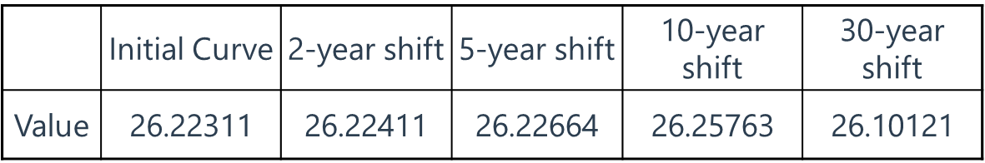
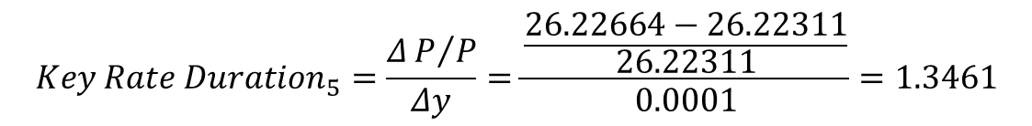
Multi-Factor Risk Metrics and Hedges
Example:
The initial curve is the basis for our calculations, and the 2, 5, 10 and 30-year is the present value after applying a one basis point shift. Calculate 5-year key rate 01 and key rate duration.
$$K\text{ey} Rate {01}_{5}=26.22664−26.22311=0.003530=\frac{ΔP/Δy}{10000}=\frac{DD}{10000}$$
$$Key Rate Duration_{5}=\frac{ΔP/P}{Δy}=\frac{\frac{26.22664−26.22311}{26.22311}}{0.0001}=1.3461$$

Slide 133
Multi-Factor Risk Metrics and Hedges
Partial ’01s and PV01
  Interest rate risk is measured in terms of swap curves not only by swaps traders, but also by asset managers that run portfolios that combine bonds and swaps. When swaps are taken as the benchmark for interest rates, risk along the curve is usually measured with Partial ’01s or Partial PV01s.
  Swap market participants fit a par swap rate curve every day, if not more frequently, from a set of traded or observable par swap rates and shorter-term money market and futures rates.
  The partial ’01s with respect to a particular fitted rate is defined as the change in the value of the portfolio after a one-basis-point decline in that fitted rate and a refitting of the curve. All other fitted rates are unchanged.
Notes:
For example, if a curve fitting algorithm fits the three-month London Interbank Offered Rate and par rates at 2-, 5-, 10-, and 30-year maturities, then the two-year partial ’01 would be the change in the value of a portfolio for a one-basis point decline in the two-year par rate and a refitting of the curve, where the three-month LIBOR and the par 5-, 10- and 30-year rates are kept the same.

Slide 134
Multi-Factor Risk Metrics and Hedges
PV01
  The PV01 of a security is defined as the change in the value of the security if the rates of all fitting securities decline by one basis point.
  PV01 is conceptually equivalent to DV01, where the underlying curve fitting methodology defines rates at all terms given the changes in the rates of the fitting securities.
Forward-Bucket ’01s
  Forward-bucket ’01s are computed by shifting the forward rate (one basis point) over each of several defined regions of the term structure, one region at a time. For the illustration of this section, the term structure is divided into five buckets: 0-2 years, 2-5 years, 5-10 years, 10-15 years, and 20-30 years. The best choice of buckets depends on the application at hand.

Slide 135
Multi-Factor Risk Metrics and Hedges
Exercise 1
The main problem associated with using single-factor approaches to hedge interest rate risk is:
  No method can hedge interest rate risk.
  Single-factor model assume mean-reversion between one short-term and one long-term rate.
  Single-factor models assume effects across the entire curve dictated by one rate.
  Single-factor models assume risk-free securities have credit exposure.
Correct Answer : C

Slide 136
Multi-Factor Risk Metrics and Hedges
Exercise 2
Using key rates of 2-year, 5-year, 7-year, and 20-year exposures assumes all of the following except that the:
  2-year rate will affect the 5-year rate
  7-year rate will affect the 20-year rate
  5-year rate will affect the 7-year rate
  2-year rate will affect the 20-year rate
Correct Answer : D

Slide 137
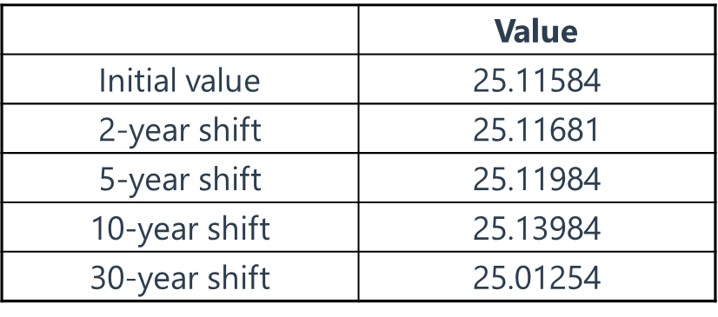
Multi-Factor Risk Metrics and Hedges
Exercise 3
The following table provides the initial price of a C-STRIP and its present value after application of a one basis shift in four key rates.
  What is the key rate ’01 for a 30-year shift?
    A. -0.058 B. 0.024 C. 0.103 D. 0.158
  What is the key-rate duration for a 30-year shift?
    -4.57 B. 15.80 C. 38.60 D. 41.13
Correct Answer
C
D
Notes:
答案：C
Key rate’01 with respect to the 30-year shift is calculated as follows:
−1/10,000 (25.01254−25.11584)/(0.01%)=0.103
This implies that the C-strip decreases in price by 0.103 per 100 face amount for a positive one basis point 30-year shift.
答案：D
Key rate duration for the 30-year shift is calculated as follows:
−1/25.11584 (25.01254−25.11584)/(0.01%)=41.13

Slide 138
Multi-Factor Risk Metrics and Hedges
Exercise 4
Assume you own a security with a 2-year key rate exposure of $4.78, and you would like to hedge your position with a security that has a corresponding 2-year key rate exposure of 0.67 per $100 of face value. What amount of face value would be used to hedge the 2-year exposure?
  $478
  $239
  $713
  $670
Correct Answer : C

Slide 139
53%
55%
Market Risk Measurement and Management

Slide 140
Measures of Financial Risk 金融风险的度量
Putting VaR to Work 让VaR生效
Quantifying Volatility in VaR Models 量化VaR模型中的波动性

Slide 141


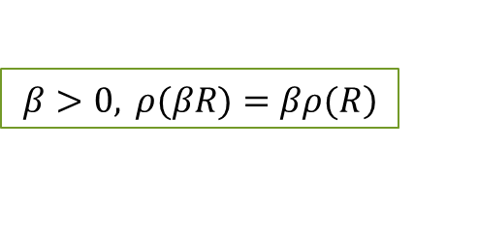
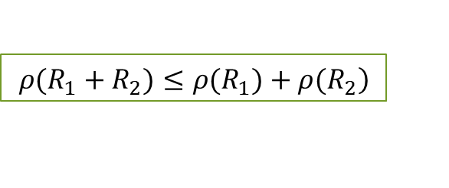
Measures of Financial Risk
Coherent Risk Measure
  Monotonicity
    A random cash flow or future value R₁ that is always greater than R₂ should have a lower risk.
  Subadditivity
    The portfolio’s risk should not be greater than the sum of its parts.
  Positive Homogeneity
    The risk of a position is proportional to its scale or size.
  Translation Invariance
    Like adding cash, for constant c,
$$R_{1}≥R_{2}\text{, }then ρ\text{(}R_{1}\text{)}≤ρ\text{(}R_{2}\text{)}$$
$$\left.ρ(R_{1}+R_{2})≤ρ(R_{1})+ρ(R_{2}\right)$$
$$\left.β>0, ρ(βR)=βρ(R\right)$$
$$ρ(R+c)=ρ(R)−c$$

Slide 142
Measures of Financial Risk
Mean-Variance Framework
  In the mean-variance framework, we model financial risk in terms of the mean and variance (or standard deviation) of P/L (or returns). As a related convenience, we assume the daily P/L or returns obey a normal distribution.
  If our distribution is skewed or has heavier tails – as is typically the case with financial returns – then the normality assumption is inappropriate and the mean-variance framework can produce misleading estimates of risk. The use of the standard deviation as a risk measurement is not appropriate for non-normal distributions.
Notes:
How much can we lose on our trading portfolio by tomorrow's close?
JP摩根公司在2004年置信水平为95%的日VaR值为1500万美元
其含义指该公司可以以95%的把握保证，2004年某一特定时点上的金融资产在未来24小时内，由于市场价格变动带来的损失不会超过1500万美元；
或者说，只有5%的可能损失超过1500万美元；
我们有95%的信心，我们所有交易活动带来的日风险估计值约为1500万美元。
VaR的来源与用途：
J.P Morgan用来计算市场风险的产物
基于统计分析基础上的风险度量技术
组合风险概括为一个数字，表示潜在亏损
逐步扩展到信用和操作风险管理领域

Slide 143
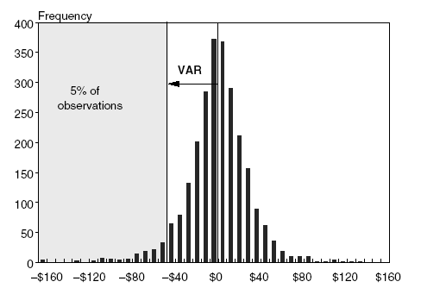
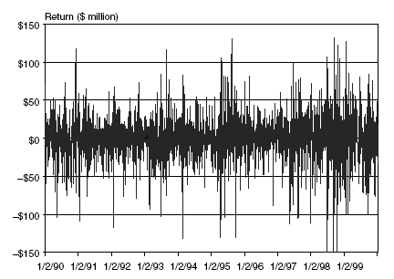
Measures of Financial Risk
Value at Risk
  VaR is the maximum loss over a target horizon and for a given confidence level.
VaR

Slide 144
Measures of Financial Risk
  Choice of VaR Parameters
    Time horizon: should depend on how quickly portfolio can be unwound. Regulators in effect use 1-day for bank market risk and 1-year for credit/operational risk.
    Confidence level: depends on objectives. Regulators use 99% for market risk and 99.9% for credit/operational risk.
    Data Window
Notes:
历史数据越多，精确度越高。置信区间越大，var越大，精确程度越低。置信区间越小，var越小，精确程度越高。

Slide 145
Measures of Financial Risk
  Advantages of VaR
    Used for risk control and performance assessment.
    Easy to understand.
    Advanced method.
    Single instrument or portfolio.
  Disadvantages of VaR
    Did not contain worst conditions, did not describe tail loss.
    Not sub-additive.
    Illiquid Assets

Slide 146




Measures of Financial Risk
Explain Why VaR is not a Coherent Risk Measure
  Suppose a trader invests three bonds A,B and C which are with the same characteristics and independent payoffs. Each bond has a face value of $100,000 and a default probability of 0.5%. Then the sum of the VaR of the three bonds ($0) is less than the portfolio VaR ($100,000). (99% confidence level)
Times of default | Loss | Probability
0 | 0
1 | 100,000
2 | 200,000
3 | 300,000
$${\left(99.5\%\right)}^{3}=0.9851$$
$$C_{3}^{1}(0.5\%){\left(99.5\%\right)}^{2}=0.0149$$
$$C_{3}^{2}{\left(0.5\%\right)}^{2}(99.5\%)=0.0001$$
$${\left(0.5\%\right)}^{3}=0$$
Notes:
Suppose a trader invests three bonds A,B and C which are with the same chracteristics and independent payoffs. Each bond has a face value of $100,000 and a default probability of 0.5%. Then the sum of the VaR of the three bonds ($0) is less than the portfolio VaR ($100,000). (99% confidence level).
Over the next period, we can either have no default, with a return of zero, or default with a loss of $100,000. The payoffs are thus −$100,000 with probability of 0.5% and +$0 with probability of 99.5%. Since the probability of getting $0 is greater than 99%, the VAR at the 99% confidence level is $0.
Now, consider a portfolio invested in three bonds (A,B,C) with the same characteristics and independent payoffs. The VAR numbers add up to VAR₁+ VAR₂+ VAR₃ = $0. To compute the portfolio VAR, we tabulate the payoffs and probabilities:
Here, the probability of zero or one default is 0.9851 + 0.0148 = 99.99%. The portfolio VAR is therefore $100,000, which is the lowest number, such that the probability exceeds 99%. Thus, the portfolio VAR is greater than the sum of individual VARs.
In this example, VAR is not subadditive. This is an undesirable property because it creates disincentives to aggregate the portfolio, since it appears to have higher risk.

Slide 147

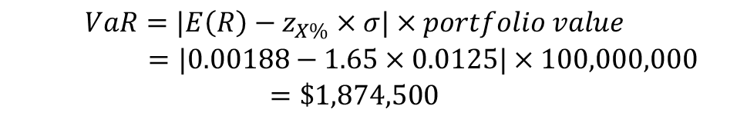
Measures of Financial Risk
  If an expected return is other than zero:
  Example: Calculating VaR given an expected return for a $100,000,000 portfolio, the expected 1-week portfolio return and standard deviation are 0.00188 and 0.0125, respectively. Calculate the 1-week VaR at 5% significance level.
$$VaR\left(X\%\right)=|E\left(R\right)−z_{X\%}×σ|$$
$$\begin{matrix}VaR=|E\left(R\right)−z_{X\%}×σ|×portfolio value \\ =|0.00188−1.65×0.0125|×100,000,000 \\ =\$1,874,500\end{matrix}$$

Slide 148

Measures of Financial Risk
Square Root Rule
  If fluctuations in a stochastic process from one period to the next are independent (i.e., there are no serial correlations or other dependencies), volatility increases with the square root of the unit of time.
    With trends → positive correlation → VaR increase
    With mean reversion → negative correlation → VaR decrease
$$VaR{\left(X\%\right)}_{t−days}=VaR{\left(X\%\right)}_{1−days}×\sqrt{\left.t(1+ρ\right)}$$
Notes:
Square root of time scaling assumes independent price moves (random walk) and constant volatility.

Slide 149
Measures of Financial Risk
Conditional VaR
  Also called expected shortfall, tail conditional expectation, conditional loss, expected tail loss. It is the average of the worst 100×(1-α)% of losses.
  Example: Given the following 30 ordered percentage returns of an asset, calculate the VaR and expected shortfall at a 90% confidence level: -16, -14, -10, -7, -7, -5, -4, -4, -3, -1, -1, 0, 0, 0, 1, 2, 2, 4, 6, 7, 8, 9, 11, 12, 12, 14, 18, 21, 23.
5%
5%
VaR
VaR

Slide 150
Measures of Financial Risk
Spectral Risk Measures
  Measures the weighted averages of the return quantiles from the loss distributions.
  ES is a special case of the risk spectrum measure where the weighting function is set for tail losses that all have an equal weight, and all other quantiles have a weight of zero.
  The VaR is a special case where only a single quantile is measured, and the weighting function is set to one, and all other quantiles have a weight of zero.

Slide 151
Measures of Financial Risk
Exercise 1
ρ(X + Y) ≤ ρ(X) + ρ(Y) is the mathematical equation for which property of a coherent risk measure?
  Monotonicity
  Subadditivity
  Positive homogeneity
  Translation invariance
Correct Answer : B

Slide 152
Measures of Financial Risk
Exercise 2
Consider a portfolio with a one-day VaR of $1 million. Assume that the market is trending with an autocorrelation of 0.1. Under this scenario, what would you expect the two-day VaR to be?
  $2 million
  $1.414 million
  $1.483 million
  $1.449 million
Correct Answer : C

Slide 153
Putting VaR to Work
Linear and Non-Linear Derivatives
  A linear derivative is when the relationship between the derivative and the underlying pricing factor(s) is linear. It does not need to be one-for-one but the “transmission parameter” delta needs to be constant for all levels of the underlying factor. A non-linear derivative has a delta that is not constant.
  All assets are locally linear. For tiny (infinitesimal) changes in the underling, the delta is approximately constant. So, we consider delta to be an approximation; i.e., the relationship is “locally linear.”
Notes:
A futures contract on S&P 500 index is approximately linear. A stock option is non-linear.
For example, an equity option is the classic example of a non-linear derivative: the option is convex in the value of the underlying. But maybe a better perspective is that its delta is not constant. The option delta is the slope of the tangent line.

Slide 154

Putting VaR to Work
VaR of Linear Derivatives – Delta-Normal Approximation
  Delta-Normal Approach: the linear approximation is assumed and the underlying factor is assumed to follow a normal distribution. Although the delta-normal method analytically tractable, it is only an approximation. It is not good for derivatives with extreme nonlinearities (MBS, Fixed-income securities with embedded option).
$$VaR_{Linear Derivative}=Δ×VaR_{Underlying Risk Factor}$$
$$\begin{matrix}VaR\left(dP\right)=|−D^{∗}P|× VaR\left(dy\right) \\ VaR\left(df\right)=|Δ|× VaR\left(dS\right)\end{matrix}$$
Notes:
Notes about this classic FRM-type question: First, see how it is satisfied to apply the linear approximation using only option delta. Second, we do realize this is an estimate: the accurate relationship is non-linear such that we are omitting the curvature (option gamma)
We use delta-normal, for example, when relying on both option delta and bond duration to estimate underlying price changes-based respectively on asset price and yield changes (the risk factors.)
In the case of an option, the underlying factor is the stock price and we’d assume the stock price is normally distributed.
In the case of a bond, we’d assume the yield is normally distributed.

Slide 155

Putting VaR to Work
  Example: The Big Pharma Inc’s stock is trading at USD 23 and the stock has a daily volatility of 1.5%. Using the delta-normal method, what is the VaR at the 95% confidence level of a long position in an at-the-money put on this stock with a delta of -0.5 over a 1-day holding period?
VaR of Nonlinear Derivatives – Delta-Gamma Approximation
$$VaR=|delta|×1.645×σ×S_{0}=0.5×1.645×0.015×23=0.28$$
$$\begin{matrix}VaR\left(dP\right)=|−D×P|×VaR\left(dy\right)−\frac{1}{2}\left(C×P\right)×VaR{\left(dy\right)}^{2} \\ VaR\left(df\right)=|Δ|×VaR\left(dS\right)−\frac{1}{2}Γ×VaR{\left(dS\right)}^{2}\end{matrix}$$
Notes:
Notes about this classic FRM-type question: First, see how it is satisfied to apply the linear approximation using only option delta. Second, we do realize this is an estimate: the accurate relationship is non-linear such that we are omitting the curvature (option gamma)
We use delta-normal, for example, when relying on both option delta and bond duration to estimate underlying price changes-based respectively on asset price and yield changes (the risk factors.)
In the case of an option, the underlying factor is the stock price and we’d assume the stock price is normally distributed.
In the case of a bond, we’d assume the yield is normally distributed.

Slide 156
Putting VaR to Work
VaR of Nonlinear Derivatives - Full Revaluation Method
  Full re-pricing of the portfolio under the assumption that the underlying risk factor(s) are shocked to experience a loss. i.e., what is the worst expected change in the risk factor, given some confidence and time horizon. Then, full revaluation prices the portfolio under changed risk factors.
  Full revaluation is accurate but computationally burdensome.
    Historical Simulation
    Bootstrap Simulation
    Monte Carlo Simulation
    Scenario Analysis
Notes:
Repricing a portfolio of complex derivatives of MBSs, swaptions, exotic option can require many computations.

Slide 157
Putting VaR to Work
  Structural Monte Carlo
  Scenario Analysis (Stress Testing)
 | Advantage | Disadvantage
Structural Monte Carlo | Able to generate correlated scenarios based on a statistical distribution. By design, models multiple risk factors. | Generated scenarios may not be relevant going forward.
 | Advantage | Disadvantage
Stress Testing | Can illuminate riskiness of portfolio to risk factors. By design, models multiple risk factors. Can specifically focus on the tails (extreme losses); Complements VaR. | May generate unwarranted red flags. Highly subjective.
Notes:
refers to any method that randomly generates trials, involves developing a model for future stock price returns and running multiple hypothetical trials through the model.

Slide 158
Putting VaR to Work
  Structural Monte Carlo vs. Scenario Analysis (Stress Testing)
    The problem with the SMC approach is that the covariance matrix is meant to be “typical”. But severe stress events wreak havoc on the correlation matrix. That’s correlation breakdown.
    Diversification benefits diminish under stress events, which is the worst time for them - breakdown in historic correlation matrices occur when the investor needs the diversification benefit the most.
    Scenarios can attempt to incorporate correlation breakdowns. One approach is to stress test (simulate) the correlation matrix.
Notes:
Compare this to VAR, which asks, what is the worst expected loss with 95% or 99% confidence? The probability of a “worst loss” is certain (100%); the issue is its location
As an extension to VAR

Slide 159
Putting VaR to Work
Worst Case Scenario Measure
  The worst case scenario (WCS) assumes that an unfavorable event will occur with certainty. The focus is on the distribution of worst possible outcomes given an unfavorable event. It extends VaR analysis.
E(R)
E(R)
Unfavorable Event
Normal Event
σ
σ

Slide 160
Putting VaR to Work
Exercise 1
If you use delta-normal VaR for a portfolio of options, which of the following statements is always correct?
  It necessarily understates VaR because it uses a linear approximation.
  It can sometimes overstate VaR.
  It performs most poorly for a portfolio of deep in-the-money options.
  It performs most poorly for a portfolio of deep out-of-the-money options.
Correct Answer : B

Slide 161
Putting VaR to Work
Exercise 2
A portfolio manager bought 1,000 call options on a non-dividend-paying stock, with a strike price of USD 100, for USD 6 each. The current stock price is USD 104 with a daily stock return volatility of 1.89%, and the delta of the option is 0.6. Using the delta-normal approach to calculate VaR, what is an approximation of the 1-day 95% VaR of this position?
  USD 112
  USD 1,946
  USD 3,243
  USD 5,406
Correct Answer : B
Notes:
VaR(Option)=Δ*VaR(S)
=0.6*(104*1.89%*1.65)
=1.946

Slide 162
Quantifying Volatility in VaR Models
Actual Asset Return Distribution
  The common deviations from normality that are problematic in modeling risk result from asset returns that are fat-tailed, skewed, or unstable.
    Fat-tailed (a.k.a., heavy tailed): a fat-tailed distribution is characterized by having more probability weight (observations) in its tails relative to the normal distribution.
    Skew: a skewed distribution refers to the observation that declines in asset prices are more severe than increases. This is in contrast to the symmetry that is built into the normal distribution.
    Time-varying (unstable): the parameters (e.g., mean, volatility) vary over time due to variability in market conditions.
Notes:
The second possible explanation for “fat tails” is that the volatility is time-varying.
Conditional parameter (e.g., conditional volatility): a parameter such as variance that depends on (is conditional on) circumstances or prior information. A conditional parameter, by definition, changes over time.

Slide 163
Quantifying Volatility in VaR Models
Potential Reasons for the Existence of Fat Tails
  The phenomenon of “fat tails” is most likely the result of the volatility and/or the mean of the distribution changing over time.
    If the mean and standard deviation are the same for asset returns for any given day, the distribution of returns is referred to as an unconditional distribution of asset returns.
    However, different market or economic conditions may cause the mean and variance of the return distribution to change over time. In such cases, the return distribution is referred to as a conditional distribution.
  The second possible explanation for “fat tails” is that the volatility is time-varying.
Notes:
Conditional parameter (e.g., conditional volatility): a parameter such as variance that depends on (is conditional on) circumstances or prior information. A conditional parameter, by definition, changes over time.
An unconditional distribution is the same regardless of market or economic conditions; for this reason, it is likely to be unrealistic.

Slide 164

Quantifying Volatility in VaR Models
  A regime-switching volatility model assumes different market regimes exist with high or low volatility. The conditional distributions of returns are always normal with a constant mean but either have a high or low volatility.
  The regime-switching model captures conditional normality and may resolve the fat-tail problem and other deviations from normality.
Notes:
A typical distribution is a regime-switching volatility model: the regime (state) switches from low to high volatility, but is never in between.
a risk manager may assume (and measure) an unconditional volatility but the distribution is actually regime switching. In this case, the distribution is conditional (i.e., it depends on conditions) and might be normal but regime switching; e.g., volatility is 10% during a low-volatility regime and 20% during a high-volatility regime but during both regimes, the distribution may be normal. However, the risk manager may incorrectly assume a single 15% unconditional volatility. But in this case, the unconditional volatility is likely to exhibit fat tails because it does not account for the regime switching.

Slide 165
Quantifying Volatility in VaR Models
Historical-Based Approach and Implied Volatility-Based Approach
  Historical-based approach typically fall into three sub-categories
    Parametric model typically assumes asset returns are normally or lognormally distributed with time-varying volatility.
    Nonparametric approach is less restrictive in that there are no underlying assumptions of the asset returns distribution. The most common nonparametric approach models volatility using the historical simulation method.
    Hybrid approach combines techniques of both parametric and nonparametric methods to estimate volatility using historical data. An example of a popular hybrid approach is Filtered Historical Simulation (FHS). Filtered historical simulation “updates” the volatility by fitting a model such as GARCH to the time-series.
Notes:
A value at risk (VaR) method for estimating risk is typically either a historical-based approach or an implied-volatility-based approach.
The advantage of implied volatility is the forward-looking predictive nature of the model. The implied volatility model reacts immediately to changing market conditions.
Risk varies over time. Models often assume a normal (Gaussian) distribution (“normality”) with constant volatility from period to period. But actual returns are non-normal and volatility varies over time (volatility is “time-varying” or “non-constant”). Therefore, it is hard to use parametric approaches to random returns; in technical terms, it is hard to find robust “distributional assumptions for stochastic asset returns”

Slide 166
Quantifying Volatility in VaR Models
  The implied volatility-based approach uses derivative pricing models such as the Black-Scholes-Merton option pricing model to estimate an implied volatility based on current market data rather than historical data.
    The advantage of implied volatility is the forward-looking predictive nature of the model. The implied volatility model reacts immediately to changing market conditions.
    The disadvantages of implied volatility is that implied volatility is model dependent. (1) Options on the same underlying asset may trade different implied volatilities. (2) The model assumes constant volatility, but volatility tends to change over time. (3) Limited availability because it requires traded price.
Notes:
A value at risk (VaR) method for estimating risk is typically either a historical-based approach or an implied-volatility-based approach.
The advantage of implied volatility is the forward-looking predictive nature of the model. The implied volatility model reacts immediately to changing market conditions.

Slide 167
Quantifying Volatility in VaR Models
Historical Simulation
  No parameter estimates are required, the only thing we need to determine up front is the lookback window. Once the window length is determined, we order returns in descending order, and go directly to the tail of this ordered vector.
  The model is not subject to estimation error related to correlations and the problem of higher correlations in downward markets.
Multivariate Density Estimation
  Multivariate density estimation (MDE) allows for weights to vary based on how relevant the data is to the current market environment, regardless of the timing of the most relevant data.
  MDE is very flexible in introducing dependence on economic variables (called state variables or conditioning variables).
Notes:
The key feature of multivariate density estimation is that the weights (assigned to historical square returns) are not a constant function of time. Rather, the current state—as parameterized by a state vector—is compared to the historical state: the more similar the states (current versus historical period), the greater the assigned weight.

Slide 168

Quantifying Volatility in VaR Models
Hybrid Approach
  The hybrid approach uses historical simulation to estimate the percentiles of the return and weights that decline exponentially (similar to EWMA). The following three steps are required to implement the hybrid approach.
    Step 1: Assign weights for historical realized returns to the most recent K returns using an exponential smoothing process as follows:
    Step 2: Order the returns.
    Step 3: Determine the VaR for the portfolio by starting with the lowest return and accumulating the weights until x percentage is reached.
$$\frac{1−λ}{1−λ^{k}},\frac{1−λ}{1−λ^{k}}⋅λ,...,\frac{1−λ}{1−λ^{k}}⋅λ^{k−1}$$
Notes:
Hybrid approach does not require distribution assumptions because it uses a historical simulation approach with an exponential weighting scheme.

Slide 169

Quantifying Volatility in VaR Models
Example: calculating 5% VaR using hybrid approach. The most recent observations is K = 100, and λ = 0.96.

Slide 170
Quantifying Volatility in VaR Models
Advantages of Nonparametric Methods
  Do not require assumptions of the entire returns distribution to estimate VaR.
  Fat tails, skewness, and other deviations from some assumed distribution are no longer a concern in the estimation process.
  Multivariate density estimation (MDE) allows for weights to vary based on how relevant the data is to the current market environment, regardless of the timing of the most relevant data.
  MDE is very flexible in introducing dependence on economic variables (called state variables or conditioning variables).

Slide 171
Quantifying Volatility in VaR Models
Disadvantages of Nonparametric Methods
  Data is used less efficiently. Large sample sizes are required.
  Separating the full sample of data into different market regimes reduces the amount of usable data for historical simulations.
  MDE may lead to data snooping or over-fitting in identifying required assumptions regarding the weighting scheme identification of relevant conditioning variables and the number of observations used to estimate volatility.
  MDE requires a large amount of data that is directly related to the number of conditioning variables used in the model.

Slide 172



Quantifying Volatility in VaR Models
Estimating Volatility
  The historical standard deviation approach assumes all m returns in the window are equally weighted.
  Each day, the forecast is updated by adding the most recent day and dropping the furthest day. In a simple moving average, all weights on past returns are equal and set to (1/M). Note raw returns are used instead of returns around the mean (i.e., the expected mean is assumed zero). This is common in short time intervals, where it makes little difference on the volatility estimate.
$$u_{i}=\frac{S_{i}−S_{i−1}}{S_{i−1}}$$
$$\overline{u}=\frac{1}{m}\sum_{i=1}^{m}{u_{n−i}}$$
$$σ_{n}^{2}=\frac{1}{m}\sum_{i=1}^{m}{u_{{}_{n−i}}^{2}}$$
Notes:
The figure of EWMA model: λ is called decay factor.
ARCH
Autoregressive: Recursive. A parameter (today’s variance) is a function of itself (yesterday’s variance).

Slide 173
Quantifying Volatility in VaR Models
  Example: assume the previous four daily returns for a stock are 6%, 5%, 4%, and 3%. What is a current volatility estimate, applying the moving average, given that our short trailing window is only four days? (4.64%)
  In the example above, notice that volatility is trending down, but MA does not reflect in any way this trend. The moving average (MA) series is simple but has two drawbacks:
    Ignores the order of the observations. Older observations may no longer be relevant, but they receive the same weight.
    Has a so-called ghosting feature: data points are dropped arbitrarily due to length of the window.

Slide 174


Quantifying Volatility in VaR Models
  The exponential smoothing methods place a higher weight on more recent data, and the weights decline exponentially to zero as returns become older.
  Persistence: In GARCH (1,1), the sum of the alpha (α) and beta (β) parameters. High persistence implies slow decay toward to the long-run average variance.
  GARCH (1, 1) is unstable if the persistence > 1. A persistence of 1.0 implies no mean reversion. A persistence of less than 1.0 implies “reversion to the mean”, where a lower persistence implies greater reversion to the mean.
  EWMA is a special case of GARCH.
$$\begin{matrix}EWMA \\ σ_{n}^{2}=λσ_{n−1}^{2}+\left(1−λ\right)u_{n−1}^{2}\end{matrix}$$
$$\begin{matrix}GARCH \\ σ_{n}^{2}=γV_{L}+αu_{n−1}^{2}+βσ_{n−1}^{2}\end{matrix}$$
Notes:
Autoregressive (AR): tomorrow’s variance (or volatility) is a regressed function of today’s variance—it regresses on itself
Conditional (C): tomorrow’s variance depends—is conditional on—the most recent variance. An unconditional variance would not depend on today’s variance
Heteroskedastic (H): variances are not constant they flux over time
The generic GARCH (p, q) model regresses on (p) squared returns and (q) variances.
Modern methods place more weight on recent information.
The figure of EWMA model: λ is called decay factor.
ARCH
Autoregressive: Recursive. A parameter (today’s variance) is a function of itself (yesterday’s variance).
GARCH estimates improve upon these weaknesses in two ways:
1. More recent observations are assigned greater weights. This overcomes ghosting because a volatility shock will immediately impact the estimate but its influence will fade gradually as time passes
2. A term is added to incorporate reversion to the mean

Slide 175

Quantifying Volatility in VaR Models
Example
  Consider the GARCH(1,1) equation below:
  The omega is 0.2 but don’t mistake omega for the long-run variance. Omega is the product of gamma and the long-run variance. So, if alpha + beta = 0.9, then gamma must be 0.1. Given that omega is 0.2, we know that the long-run variance must be 2.
$$σ_{n}^{2}=0.2+0.2μ_{n−1}^{2}+0.7σ_{n−1}^{2}$$

Slide 176
Quantifying Volatility in VaR Models
Exercise
The lowest six returns for a portfolio are shown in the following table.
What will the 5% VaR be under the hybrid approach? Assume each observation is a random event with 50% to the left and 50% to the right of each observation.
-3.10%
-3.04%
-2.96%
-2.90%
Correct Answer : C
Six Lowest Returns with Hybrid Weightings
 | Six Lowest Returns | Hybrid Weight | Hybrid Cumulative Weight
1 | -4.10% | 0.0125 | 0.0125
2 | -3.80% | 0.0118 | 0.0243
3 | -3.50% | 0.0077 | 0.0320
4 | -3.20% | 0.0098 | 0.0418
5 | -3.10% | 0.0062 | 0.0481
6 | -2.90% | 0.0027 | 0.0508

Slide 177
53%
55%
Credit Risk Measurement and Management

Slide 178
External and Internal Ratings 外部评级与内部评级
Capital Structure in Banks 银行的资本结构
Country Risk 国家风险

Slide 179
External and Internal Ratings
Rating Scales
  Rating scales can be short-term or long-term and they can apply to specific obligations or instruments (i.e., issue-specific credit ratings) or to an issuer’s general creditworthiness (i.e., issuer credit ratings).
  The bond universe is broadly divided into investment grade and non-investment grade bonds. In rating long-term debt, each agency uses a system of letter grades that locate an issuer or issue on a spectrum of credit quality from the very highest (triple-A) to the very lowest (D).
    Investment grade = rated Baa3 or BBB- and above
    Speculative or non-investment grade = issues rated Ba1 or BB+ and below

Slide 180
External and Internal Ratings
Investment Grade Ratings
Interpretation | S&P | Moody | Interpretation
Highest rating. Extremely strong capacity to meet obligations. | AAA | Aaa | Highest quality, with minimal credit risk.
Capacity to meet its financial obligation is very strong. | AA+ | Aa1 | High quality and subject to very low credit risk.
 | AA | Aa2
 | AA- | Aa3
Capacity to meet obligation still strong but susceptible to adverse changes in economic conditions. | A+ | A1 | Considered upper-medium grade and subject to low credit risk.
 | A | A2
 | A- | A3
Exhibits adequate protection parameters. | BBB+ | Baa1 | Subject to moderate credit risk.
 | BBB | Baa2
 | BBB- | Baa3

Slide 181
External and Internal Ratings
Speculative Grade Ratings
Interpretation | S&P | Moody | Interpretation
Less vulnerable to non-payment than other speculative issues but faces major ongoing uncertainties. | BB+ | Ba1 | Judged to have speculative elements and are subject to substantial credit risk.
 | BB | Ba2
 | BB- | Ba3
More vulnerable to non-payment than “BB” but has current capacity to meet financial obligation. | B+ | B1 | Considered speculative and are subject to high credit risk.
 | B | B2
 | B- | B3
Vulnerable to non-payment. | CCC+ | Caa1 | In poor standing.
 | CCC | Caa2
 | CCC- | Caa3
Highly vulnerable to non-payment. | CC/C | Ca | Highly speculative, likely to default.
In payment default. | D | C | Lowest rated bonds – typically in default, with little prospect for recovery.
Note: Moody’s adds numerical modifiers (1, 2, and 3) to each generic rating classification from Aa through Caa, where ‘1’ indicates an obligation that ranks at the higher end of category and ‘3’ indicates the lower end of the category.

Slide 182
External and Internal Ratings
Rating Process
  Analyze from bondholders’ perspectives. Rating agencies have a longer time horizon.
  The rating process is divided into a business review (i.e., qualitative component) and a quantitative analysis. Recently, the “outlook concept” has emerged. The outlook concept refers to a positive or negative trend.
  Corporate issuers typically pay rating agencies. Many believe this is a conflict.

Slide 183

External and Internal Ratings
Link between Ratings and Default
  Agencies publish cumulative default rates categorized by rating (i.e., the cumulative default rate per rating category) and transition matrices. Transition matrices plot the frequency of rating migrations over time; e.g., how many time did obligors rate “AA” migrate to “A”?
    Lower rated obligors tend to default more frequently.
    Better (worse) ratings are associated with lower (higher) default rates.
Notes:
The migrations across states are independent from one period to the next, no carry-over effect.

Slide 184

External and Internal Ratings
Example
  Given the following one-year transition matrix, what is the probability that a B rated firm will default over a two-year period?
  B-D: 3%
  B-A-D: 2%*0
  B-B-D: 93%*3%
  B-C-D: 2%*23%

Slide 185
External and Internal Ratings
Impact of Time Horizon, Economic Cycle, Industry, and Geography on External Ratings
  Use of through-the-cycle approach implies more stability but less (temporal) accuracy.
  Longer time horizons imply higher cumulative default probability, but even more so for speculative ratings.
  During a recession, probability of default increases and so does rating migration volatility.
  Financial firms tend to exhibit less rating consensus (i.e., variability among agencies).
  Non-U.S. methods may be biased due to lack of methodological seasoning.
Notes:
However, the cumulative probability of default increases more rapidly for non-investment grade obligors.

Slide 186
External and Internal Ratings
Ratings Change Impact Bond Prices
  Downgrades have a negative impact on bond prices; upgrades have a positive impact.
  But the relationship is statistically stronger for upgrades than downgrades.
External and Internal Ratings Approaches
  External rating agency scales have become commonplace.
  Internal Rating System: A bank can try to mimic the external agencies. Typically, a template assigns weights to credit risk factors (a scorecard) in order to produce a weighted score.
  Pro-cyclicality: tendency of internal ratings models to reinforce credit and business cycles.
Notes:
Supply and demand (policy asset allocation) policy: Some portfolios by policy may only hold investment grade bonds. For these, if a holding is downgraded to speculative (junk), the position must be sold. Therefore, a bond that is downgraded from investment-grade to speculative will experience less demand. A decrease in demand (or increase in supply) will lower the price.

Slide 187


External and Internal Ratings
Through-the-Cycle and At-the-Point Approach
  At-the-Point-in-Time: assesses credit quality over the near term; i.e., a few months or one year.
  Through-the-Cycle: rating agencies try to incorporate business cycles. Ratings are therefore typically considered “through-the-cycle”. Through-the-cycle ratings try to “filter out” cycle fluctuations. Because they incorporate an average, when economic conditions vary from the average, through-the-cycle may over- and under-estimate credit quality.

Slide 188
External and Internal Ratings
Exercise 1
Which of the following is not a true statement about internal credit ratings?
  The “at-the-point-in-time” approach makes heavy use of econometric modeling that relates current financial variables to estimated default risk.
  The “through-the-cycle” approach is forward-looking and attempts to incorporate future economic scenarios into current default risk estimates.
  “At-the-point-in-time” credit scores volatility is much higher than “through-the-cycle” score volatility.
  A sound internal system uses at-the-point-in-time scoring for small-to-medium-sized companies and private firms and through-the-cycle scoring for large firms.
Correct Answer : D

Slide 189

External and Internal Ratings
Exercise 2
The following table from Fitch Ratings shows the number of rated issuers migrating between two ratings categories during one year.
  Based on this information, what is the probability that an issue with a rating of A at the beginning will be downgraded by the end of the year?
  13.46% B. 13.44% C. 9.62% D. 3.85%
Correct Answer : C

Slide 190
Capital Structure in Banks
Credit Risk
  Credit risk is the risk that arises from any nonpayment or rescheduling of any promised payments (i.e., default-related events) or from (unexpected) credit migrations (i.e., events that are related to changes in the credit quality of a borrower) of a loan and that gives rise to an economic loss to the bank.
Steps to Derive Economic Capital for Credit Risk
  Expected Losses (EL)
  Unexpected Losses (UL-Standalone)
  Unexpected Loss Contribution (ULC)
  Economic Capital

Slide 191
Capital Structure in Banks
Expected Losses
  A bank can expect to lose, on average, a certain amount of money over a predetermined period of time when extending credits to its customers.
  A prudent bank should set aside a certain amount of money (often called loan loss reserves) to cover these losses that occur during the normal course of their credit business.
Three Components
  PD - Probability of Default
  EA - Exposure Amount
  LR - Loss Rate, the fraction of the exposure amount that is lost in the event of default, meaning the amount that is not recovered after the sale of the collateral.

Slide 192
Capital Structure in Banks
1 - PD_{H}
EA_{H}
EA₀
PD_{H}
EA_{H} (1 - LR_{H})
Where PD_{H} = Probability of default up to time H (horizon)
EA_{H} = Exposure amount at time H
LR_{H} = Loss rate experienced at time H

Slide 193


Capital Structure in Banks
Unexpected Loss
  By definition, EL does not itself constitute risk. If losses always equaled their expected levels, there would be no uncertainty, and there would be no economic rationale to hold capital against credit risk. Risk arises from the variation in loss levels—which for credit risk is due to unexpected losses (UL).
  Unexpected loss is the standard deviation of credit losses.
  ULs cannot be anticipated and hence cannot be adequately priced for in a loan’s interest rate. They require a cushion of economic capital.
  where
$$UL=EA×\sqrt{PD×σ_{LR}^{2}+LR^{2}×σ_{PD}^{2}}$$
$$\begin{matrix} σ_{LR}=Standard \text{deviation} \text{of} \text{the} \text{loss} \text{rate} \text{LR} \\ σ_{PD}=Standard \text{deviation} \text{of} \text{the} \text{default} \text{probability} \text{PD} \\ σ_{PD}^{2}=PD×\left(1−PD\right)\end{matrix}$$
Notes:
Standard deviation of actual credit losses around the expected loss average
For an individual loan, PD is independent of the EA and the LR, in most situations, EA and the LR can be viewed as being independent.
Since the expected exposure amount EA can vary, but is (typically) not
subject to changes in the credit characteristics itself, UL is dependent on the
default probability PD, the loss rate LR, and their corresponding variances,
σ2

Slide 194

Capital Structure in Banks
Example
  Suppose XYZ bank has booked a loan with the following characteristics: total commitment of $2,000,000, of which $1,200,000 is currently outstanding. The bank has assessed an internal credit rating equivalent to a 1% default probability over the next year. Draw down upon default is assumed to be 75%. The bank has additionally estimated a 40% loss given default. The standard deviation of EDF and LGD is 5% and 30%, respectively. Calculate the unexpected loss for XYZ bank.
$$AE = 1,200,000 + 800,000×75\% = 1,800,000$$
$$\begin{matrix} \\ UL=AE×\sqrt{PD×σ_{LR}^{2}+LR^{2}×σ_{PD}^{2}} \\ \end{matrix}$$
$$=AE×\sqrt{1\%×30\%^{2}+40\%^{2}×5\%^{2}}=64,900$$
Notes:
EL = 7200
UL = 64900

Slide 195
Capital Structure in Banks
Portfolio Credit Risk
  The expected loss of a portfolio of credits is straightforward to calculate because EL is linear and additive.
  When measuring unexpected loss at the portfolio level, we need to consider the effects of diversification because – as always in portfolio theory – only the contribution of an asset to the overall portfolio risk matters in a portfolio context.

Slide 196
Capital Structure in Banks
Unexpected Loss Contribution
Total contribution to the portfolio’s UL
Notes:
Marginal contribution of loan I the overall portfolio unexpected loss.

Slide 197
Capital Structure in Banks
Economic Capital
  As defined previously, the amount of economic capital needed is the distance between the expected outcome and the unexpected (negative) outcome at a certain confidence level.
  Unexpected loss is translated into economic capital for credit risk in three steps:
    First, the standalone unexpected loss is calculated.
    Then, the contribution of the standalone UL to the UL of the bank portfolio is determined.
    Finally, this unexpected loss contribution (ULC) is translated into economic capital by determining the distance between EL and the confidence level to which the portfolio is intended to be backed by economic capital.

Slide 198

Capital Structure in Banks

Slide 199
Capital Structure in Banks
Challenges to Quantifying Credit Risk
  This approach assumes that credits are illiquid assets. Since the credit risk of bank loans becomes more and more liquid and is traded in the capital markets, a value approach would be more suitable.
  This would require modeling the multi-period nature of credits and, hence, the expected and unexpected changes in the credit quality of the borrowers (and their correlations). Therefore, almost all of the internal credit risk models used in practice use only a one-year estimation horizon.
  Although this approach considers correlations at a practicable level within the same risk type, it assumes, when measuring, that all other risk components (such as market and operational risk) are separated and are measured and managed in different departments within the bank.

Slide 200
Country Risk
As companies and investors globalize, they are exposed to the political and economic turmoil that often characterize these markets.
As firms shift from local markets to foreign ones, we face three questions:
  Whether investments in different countries are exposed to different amounts of risk?
  Whether this risk is diversifiable in global portfolios?
  Whether we should be demanding higher returns in some countries?

Slide 201
Country Risk
Sources of country risk
  Life Cycle
  Political Risk
  Legal Risk
  Economic Structure

Slide 202
Country Risk
Life cycle
  A country that is still in the early stages of economic growth will generally have more risk exposure than a mature country.
  A global recession generally takes a far greater toll of small, emerging markets than it does in mature markets.
  In an emerging market, a recession or recovery can easily translate into double-digit growth, in positive or negative terms.

Slide 203
Country Risk
Political Risk
  Investors and companies that value government stability (and fixed policies) sometimes choose authoritarian countries, because a strong government can essentially lock in policies for the long term and push through changes that a democracy may never be able to do.
  The chaos of democracy does create more continuous risk (policies that change as governments shift), dictatorships create more discontinuous risk.
  The more stable policies an authoritarian system offers can be accompanied by other costs (political corruption and ineffective legal systems) that overwhelm the benefits of policy stability.

Slide 204
Country Risk
  It is difficult to draw a strong conclusion about which system is more conducive to higher economic growth.
  If those who enforce the rules are capricious, inefficient or corrupt in their judgments, there is a cost imposed on all who operate under the system.
  Countries that are in the midst of physical conflicts will expose investors/businesses to the risks of these conflicts.
  If your profits can be expropriated by the business (with arbitrary and specific taxes imposed just upon you) or your business can be nationalized (with you receiving well below the fair value as compensation), you will be less likely to invest.

Slide 205
Country Risk
Legal Risk
  Investors and businesses are dependent upon legal systems that respect their property rights and enforce those rights in a timely manner.
Economic Structure
  Some countries are dependent upon a specific commodity, product or service for their economic success.
  That dependence can create additional risk for investors and businesses, since a drop in the commodity’s price or demand for the product/service can create severe economic pain.

Slide 206
Country Risk
Risk Services
  Political Risk Services
    Political, financial and economic
Risk Services’ limitations
  Measurement models/methods: Many of the entities that develop the methodology and convert them into scores are not business entities and consider risks that may have little relevance for businesses.
  No standardization: The scores are not standardized and each service uses it own protocol.
  More rankings than scores: The country risk scores are more useful for ranking the countries than for measuring relative risk.

Slide 207
Country Risk
Foreign Currency Defaults
  A large proportion of sovereign defaults have occurred with foreign currency defaults, as the borrowing country finds its short of the foreign currency to meet its obligations.
  Facts about sovereign default risk
    Countries have been more likely to default on bank debt owed than on sovereign bonds issued.
    Latin American countries have accounted for much of sovereign defaulted debt in the last 50 years.
    Lacking significant domestic savings and possessing the allure of natural resources
    Borrowed heavily
    Military conflicts

Slide 208
Country Risk
Local Currency Defaults
  Reasons for default in the local currency
    Gold Standard: In the decades prior to 1971, when some countries followed the gold standard, currency had to be backed up with gold reserves. As a consequence, the extent of these reserves put a limit on how much currency could be printed.
    Shared Currency: The crisis in Greece has brought home one of the costs of a shared currency.
    Countries feel reluctant to print more currency to pay debt obligations as this will devalue the currency and cause inflation to increase.

Slide 209
Country Risk
Consequences of Default
  Reputation loss: A default government will make it more difficult to raise financing in future rounds.
  Capital Market turmoil: Investors withdraw from equity and bond markets, making it more difficult for private enterprises in the defaulting country to raise funds for projects.
  Real Output: sovereign defaults are followed by economic recessions, as consumers hold back on spending and firms are reluctant to commit resources to long-term investments.
  Political Instability: Default can also strike a blow to the national psyche, which in turn can put the leadership class at risk.

Slide 210
Country Risk
Factors determining sovereign default risk
  Degree of indebtedness.
  Pensions/Social Service Commitments: countries that have larger commitments on these counts should have higher default risk
  Revenues/Inflows to government: access to a larger tax base should increase potential tax revenues, which, in turn, can be used to meet debt obligations.
  Stability of revenues: countries with more stable revenue streams / diversified economies should therefore face less default risk. Income tax based systems generate more volatile revenues than sales tax.
  Political risk.
  Implicit backing from other entities: the danger is that the backing is implicit and not explicit.

Slide 211
Country Risk
Bond Rating Agencies’ Biggest advantages
  They have been assessing default risk in corporations for a hundred years and presumably can transfer some of their skills to assessing sovereign risk.
  Bond investors who are familiar with the ratings measures, from investing in corporate bonds, find it easy to extend their use to assessing sovereign bonds.
Critiques
  They do not change quickly enough to alert investors to imminent danger.

Slide 212
Country Risk
Rating Process
  A sovereign rating is focused on the credit worthiness of the sovereign to private creditors and not to official creditors.
  Notch-up approach: the foreign currency rating is viewed as the primary measure of sovereign credit risk and the local currency rating is notched up, based upon domestic debt market factors.
  Notch-down approach: it is the local currency rating that is the anchor, with the foreign currency rating notched down.

Slide 213
Country Risk
Sovereign bonds with investment grade ratings have defaulted far less frequently than sovereign bonds with speculative ratings. But ratings agencies have been criticized for:
  Ratings are upward biased.
  Herd behavior.
  Rating agencies take too long to change ratings, and that these changes happen too late to protect investors from a crisis.
  Vicious Cycle: Once a market is in crisis, there is the perception that ratings agencies sometimes over react and lower ratings too much.
  When a ratings agency changes the rating for a sovereign multiple times in a short time period, it is admitting to failure in its initial rating assessment.

Slide 214
Country Risk
Why do ratings agencies sometimes fail?
  Information problems: The data that the agencies use to rate sovereigns generally come from the governments.
  Limited resources: The agencies cannot afford to hire too many analysts.
  Revenue Bias.
  Other incentive problems: Some of the analysts who work for S&P and Moody’s may seek work with the governments that they rate, it is uncommon and thus should not pose a problem with conflict of interest.

Slide 215
Country Risk
The interest rate on the bond can be compared to a rate on a riskless investment in that currency to get a market measure of the default spread for that country.
Advantages to using the default spreads
  The market differentiation for risk is more granular than the ratings agencies;
  The market-based spreads are more dynamic than ratings, with changes occurring in real time.
Weaknesses
  More volatile than ratings.
  Can be affected by variables that have nothing to do with default.

Slide 216
Country Risk
Physical settlement: The buyer of the CDS can deliver the “defaulted” bond to the seller and get par value for the bond.
Cash settlement: The seller of the CDS can pay the buyer the difference between par value of the defaulted bond and the market price, which will reflects the expected recovery from the issuer.
The first is that the protection against failure is triggered by a credit event
If the seller defaults, the insurance guarantee will fail.
Corporate CDS represent the bulk of the market, followed by bank CDS and then sovereign CDS.
The narrowness of the market does make it vulnerable, since the failure of one or more of the big players can throw the market into tumult.

Slide 217
Country Risk
The prices that investors set for credit default swaps should provide us with updated measures of default risk in the reference entity.
CDS spreads are more timely and dynamic than sovereign ratings and that they reflect fundamental changes.
It is not clear that the CDS market is quicker or better at assessing default risks than the government bond market.
Limitations with using CDS prices as predictors of country default risk
  The exposure to counterparty and liquidity risk can cause changes in CDS prices.
  The narrowness of the CDS market can make individual CDS susceptible to illiquidity problems.

Slide 218
53%
55%
Operational Risk Measurement and Management

Slide 219
Operational Risk
Operational Risk
  The risk of direct and indirect loss resulting from inadequate or failed internal processes, people, and systems or from external events.
Seven Categories of Operational Risk
  Internal Fraud
  External Fraud
  Employment Practices and Workplace Safety
  Clients, Products, and Business Practices
  Damage to Physical Assets
  Business Disruption and System Failures
  Execution, Delivery, and Process Management
Notes:
High-frequency, low-severity (HFLS) events are operational losses that occur frequently but that result in small losses.
Low-frequency, high-severity (LFHS) events are rare but impose potentially catastrophic costs on the firm.

Slide 220
Operational Risk
Determination of Regulatory Capital
  Basic Indicator Approach
  Standardized Approach
  Advanced Measurement Approach - AMA

Slide 221
Operational Risk
Basic Indicator Approach
  In the Basic Indicator Approach (BIA), operational risk capital is set equal to 15% of annual gross income over the previous three years. Gross income is defined as net interest income plus noninterest income.

Slide 222
Operational Risk
Standardized Approach
Business Lines | Beta Factor
Corporate Finance | 18%
Trading and Sales | 18%
Payment and Settlement | 18%
Commercial Banking | 15%
Agency Services | 15%
Retail Banking | 12%
Asset Management | 12%
Retail Brokerage | 12%
Notes:
corporate finance 18%
trading and sales 18%
retail banking 12%
commercial banking 15%
settlement and payment activities 18%
angency and custody services 15%
asset management 12%
retail brokerage 12%

Slide 223
Operational Risk
Advanced Measurement Approach - AMA
  The operational risk regulatory capital requirement is calculated by the bank internally using qualitative and quantitative criteria.
  The Basel Committee has listed conditions that a bank must satisfy in order to use the standardized approach or the AMA approach. It expects large internationally active banks to move toward adopting the AMA approach through time.
  The capital charge for AMA is calculated as the bank’s operational value at risk with a one-year horizon and a 99.9% confidence level.

Slide 224
Operational Risk
Implementation of AMA
  Internal Data
    High-Frequency low-severity losses (HFLSLs) and Low-Frequency high-severity losses (LFHSLs)
    Must be supplemented with external data and scenario analysis.
  External Data
    data consortia and data vendors
    A scale adjustment should ne made to external data.
  Scenario Analysis
    The aim is to generate scenarios covering the full range of possible LFHSLs.
  Business Environment and Internal Control Factor

Slide 225
Operational Risk
Data Issues
  Loss frequency distribution: bank’s own data as far as possible.
  In regard to the loss severity data, regulators encourage banks to use their own data in conjunction with external data. There are two sources of external data: data obtained through sharing arrangements between banks; and publicly available data collected by third-party vendors.
  Relevant historical data is difficult to obtain, so regulators encourage banks to use scenario analysis, in addition to internal and external loss data. This involves managerial judgment to generate scenarios where large losses occur.

Slide 226
Operational Risk
Get a Loss Distribution from the Loss Frequency distribution and the Loss Severity Distribution
  The loss frequency distribution is the distribution of the number of losses observed during the time horizon (typically one year). For loss frequency, a common probability distribution is the Poisson Distribution.
  The loss severity distribution is the distribution of the size of a loss, given that a loss occurs. It is typically assumed that loss severity and loss frequency are independent. For the loss severity distribution, a lognormal probability distribution is often uses.

Slide 227
Operational Risk
Loss Severity and Loss Frequency
  The frequency and severity distributions must be combined.
  Monte Carlo simulation can be used for this purpose.
    We sample from the frequency distribution in order to determine the number of loss events (=n).
    We sample n times from the loss severity distribution to determine the loss experienced for each loss events (L₁, L₂, … L_{n}).
    We determine the total loss experienced (L₁ + L₂ + … L_{n}).

Slide 228
Operational Risk
Power Law to Measure Operational Risk
  The power law stats that for a wide range of variables
  Prob(v > x) = Kx^{-a}
  where v is the value of the variable, x is the relatively large value of v, and K and a are constants.
  The power law holds well for large losses experience by banks.
  This makes the calculation of VaR with high degrees of confidence (e.g., 99%) possible.
  Internal or external loss data is used to estimate the power law parameters.

Slide 229
Operational Risk
Operational Risk Management
  Risk control and self-assessment (RCSA) involves asking business unit managers to identify their operational risks. Sometimes questionnaires designed by senior managers are used.
  Key Risk Indicators (KRIs) are key tools in the management of operational risk. The most important indicators are prospective. They provide an early-warning system to track the level of operational risk in the organization. Examples of key risk indicators are staff turnover and number of failed transactions.

Slide 230
Operational Risk
Risks of Moral Hazard and Adverse Selection when using Insurance to Mitigate Operational Risks
  Moral hazard is the risk that the existence of the insurance contract will cause the bank to behave differently than it otherwise would. This changed behavior increases the risks to the insurance company. Insurance companies typically deal with moral hazard in several ways:
    Deductible: bank is responsible for bearing the first portion of the loss.
    Coinsurance provision: insurance company pays a predetermined percentage (< 100%) of losses in excess of the deductible.
    Policy limit: limit on the total liability of insurer.
  Adverse selection is when an insurance company cannot distinguish between good and bad risks; consequently, it offers the same price to everyone and inadvertently attracts more of the bad risks.
Notes:
For example, banks without good internal controls are more likely to enter into rogue trader insurance contracts; banks without good internal controls are more likely to buy insurance policies to protect themselves against external fraud. For example, banks without good internal controls are more likely to enter into rogue trader insurance contracts; banks without good internal controls are more likely to buy insurance policies to protect themselves against external fraud.

Slide 231
Operational Risk
Exercise 1
Which one of the following cases or events can be considered as resulting from operational risk?
  A bank reports losses on a diversified portfolio of stocks during the stock market decline.
  The bank becomes embroiled in a high-profile lawsuit with a customer that accuses it of improper selling practices.
  The bank reports the loss of $1.5 billion due to rises in interest rates.
  A U.S. investor makes a loss as the yen depreciates relative to the dollar.
Correct Answer : B

Slide 232
Operational Risk
Exercise 2
According to current Basel Committee proposals, banks using the advanced measurement approach must calculate the operational risk capital charge at a:
  99 percentile confidence level and a 1-year time horizon.
  99 percentile confidence level and a 5-year time horizon.
  99.9 percentile confidence level and a 1-year time horizon.
  99.9 percentile confidence level and a 5-year time horizon.
Correct Answer : C

Slide 233
53%
55%
Stress Testing

Slide 234
Properties of Stress Testing 压力测试的特性
Governance over Stress Testing 压力测试的管理
Stress Testing and Other Risk-Management Tools 压力测试以及其他风险管理工具

Slide 235
Stress Testing
Stress Testing
  Generically, simple stress testing consists of three steps:
    Create a set of extreme market scenarios (i.e., stressed scenarios) — often based on actual past events.
    For each scenario, determine the price changes to individual instruments in the portfolio; sum the changes in order to determine change in portfolio value.
    Summarize the results: show estimated level of mark-to-market gains/losses for each stressed scenario; show where losses would be concentrated.
  The goal of stress testing is to identify unusual scenarios that would not be covered by standard VaR models.

Slide 236
Stress Testing
Rationale for the Use of Stress Testing
  Provides forward-looking assessments of risk;
  Overcoming limitations of models and historical data;
  Complements Value at Risk (VaR);
  Supports internal and external communication;
  Feeds into capital and liquidity planning procedures;
  Informs setting of a banks’ risk tolerance;
  Facilitates development of risk mitigation or contingency plans across a range of stressed conditions.

Slide 237
Stress Testing
Benefits and Drawbacks of Stress Testing
  Advantage
    Complements (does not replace) value at risk. A tool to be used in addition to VaR;
    Simple and intuitive;
    Directly examines the tails (i.e., as opposed to measures of central tendency).
  Disadvantage
    Highly subjective;
    Could generate false alarms: implausible scenarios;
    Could miss plausible scenarios;
    Difficult to interpret: can produce lots of unfiltered information.

Slide 238
Stress Testing
Unidimensional and Multidimensional Scenario Analysis
  Unidimensional scenarios focus ”stressing” on key one variable at time. The key weakness of a unidimensional analysis is that scenarios cannot, by definition, account for correlation.
  Multidimensional is more realistic and attempts to stress multiple variables and their relationships.
Prospective Scenarios and Historical Scenarios
  Prospective scenarios try to analyze the implications of hypothetical one-off surprises; e.g., a major bank failure, a geopolitical crisis.
  Historical scenarios look to actual past events to identify scenarios that fall outside the VaR window.

Slide 239
Stress Testing
Event-Driven Scenarios and Portfolio-Driven Scenarios
  Event-Driven
    Scenario formulated from plausible events that generate movements in risk factors.
  Portfolio-Driven Scenarios
    First, risk vulnerabilities in the current portfolio are identified. Second, translated into adverse movements in risk factors.
Sensitivity Analysis and Stress Testing Model Parameters
  Sensitivity analysis is a form of stress testing that examines how model output variation relates to model input variation.
  Stress testing model parameters deals with just the variation in the model's inputs.
Notes:
The one-month period in October 1987 (S&P 500 index fell by > 21%)
Exchange rate crisis (1992) and U.S. dollar interest rates changes (spring of 1994)
The 1995 Mexican crisis
The East Asian crisis (summer of 1997)
The Russian devaluation of August 1998 and the Brazilian devaluation of 1999

Slide 240
Stress Testing
Common One-Variable Sensitivity Tests
  Derivatives Policy Group (DPG) unidimensional scenarios
  Parallel yield-curve shifting by +/- 100 bps
  Yield curve twisting by +/- 25 bps
  Each of four combinations or yield-curve shifts and twists
  Implied volatilities changing by +/- 20%
  Equity index values changing by +/- 10%
  Currencies moving by +/- 6% (major) or 20% (other)
  Swap spreads changing by 20 bps

Slide 241
Stress Testing
Standard Portfolio Analysis of Risk System
  SPAN is a scenario-based method for measuring portfolio risk.
  Calculates worst possible loss portfolio might incur over a specified time period (one trading day).
How the results of a stress test can be used to improve our risk analysis and risk management systems?
  Set aside economic capital to absorb worst-case losses;
  Purchase protection or insurance;
  Modify the portfolio;
  Restructure the business or product mix to enhance diversification;
  Develop a corrective or contingency plan should a scenario occur;
  Prepare alternative funding sources in anticipation of liquidity crunches.
Notes:
The SPAN® system is used to recommend margin requirements on futures and options exchanges. This system focuses on overall portfolio risk. The SPAN system estimates the effect on portfolio values of a large set of alternative scenarios. The margin then takes into account the largest loss that the portfolio might suffer.

Slide 242
Stress Testing
Major Weaknesses and Recommendations for Stress Testing and Integration in Risk Governances
  Weaknesses: lack of involvement of board and senior management; lack of overall organizational view; lack of fully developed stress testing; lack of adequate response to crisis.
  Recommendations: Stress testing should form an essential ingredient of overall governance of risk management plan, encompass multiple techniques and perspectives, involve a sound infrastructure and regular assessment, produce written policies and recommendations, and generate comprehensive firm and market-wide scenario testing.

Slide 243
Stress Testing
Stress Testing Methodologies
  Weaknesses: inadequate infrastructure, inadequate risk assessment approaches, inadequate recognition of correlation, and inadequate firm- wide perspectives.
  Recommendations: development of a comprehensive stress testing approach, identification and control of risk concentrations, multiple measurements of stress impact.
Stress Testing Scenarios
  Weaknesses: Lack of depth and breadth; Lack of adequate techniques; Lack of forward-looking scenarios.
  Recommendations: A variety of events; Futuristic outlook; Synergy effect; Time horizon; Reverse stress testing.

Slide 244
Stress Testing
Stress Testing of Specific Risks
  Complex Structured Products
    Should consider underlying assets, their exposure to systematic market factors, relevant contractual agreements, and impact of leverage.
  Basis Risk
    The effectiveness of risk mitigation techniques should be systematically challenged.
  Wrong-Way Risk
    Banks should stress test for highly leveraged counterparties, including potential for wrong-way risk.

Slide 245
Stress Testing
  Pipeline Risk
    Many of the risks associated with pipeline and warehoused exposures emerge when a bank is unable to access the securitization market due to either bank specific or market stresses.
  Contingent Risk
    Had stress tests adequately captured contractual and reputational risk associated with off-balance sheet exposures, concentrations in such exposures may have been avoided.
  Funding Risk
Notes:
Warehousing and pipeline risk refers to the event where originating banks are unable to off-load assets due to unexpected changes in market conditions. Involuntary holding of these assets expose the bank to losses due to declining values of these assets.
Another weakness of the models was that they did not adequately capture contingent risks that arose either from legally binding credit and liquidity lines or from reputational concerns related, for example, to off-balance sheet vehicles.

Slide 246
Governance over Stress Testing
I. Governance Structure
  Stress testing: exercises used to conduct a forward-looking assessment of the potential impact of various adverse events and circumstances on a banking institution.
  Risk appetite: the level and type of risk an institution is able and willing to assume in its exposures and business activities, given its business objectives and obligations to stakeholders.

Slide 247
Governance over Stress Testing
I. Governance Structure
  The BOD should:
    Have ultimate oversight responsibility for the entire organization.
    Define the culture of the organization.
    Be responsible for the institution’s stress-testing activities.
    Not rely on just one stress-test in making key decisions.
    Take action based on its review of stress-test results.

Slide 248
Governance over Stress Testing
I. Governance Structure
  Board members should:
    Be knowledgeable about stress-testing activities
    Evaluate information about stress-testing
    Ensure the stress-testing is in line with the institution’s risk appetite
    Use the results of the stress-tests with skepticism

Slide 249
Governance over Stress Testing
I. Governance Structure
  Senior Management should:
    Ensure that stress-tests are implemented in a satisfactory manner
    Establish adequate policies and procedures and ensure compliance
    Allocate appropriate resources and assign competent staff
    Take prompt remedial actions when necessary
    Report to the board on stress-test developments and results
    Ensure that stress-tests are appropriately coordinated

Slide 250
Governance over Stress Testing
I. Governance Structure
  Stress-testing should be used to:
    Inform the board about alignment of the institution’s risk profile with the risk appetite.
    Provide a forward-looking assessment of the potential impact of adverse outcomes.

Slide 251
Governance over Stress Testing
II. Policies, Procedures And Documentation
  Have written policies that govern the implementation of stress-tests
    In a clear manner;
    Approved and reassessed by the board;
    Effective and complete documentation;
    Up to date;
  Ensure that its stress-tests are documented appropriately.
  Ensure that documentation of the third-party approach is available.

Slide 252
Governance over Stress Testing
III. Validation And Independent Review
  Ensure the integrity of stress-testing processes and results.
  Conducted on an ongoing basis.
  The model used in a baseline situation may require a different specification to estimate stress outcomes.
  Limitations to which stress tests can be validated.
  Ensure that the benchmarks fit the institution’s risks.
  Expert-based judgement should be applied to ensure that test results are intuitive and logical.
  The lack of full validation should be communicated to users of stress-test results.
  Remediation plan to explain how the tests will be enhanced.

Slide 253
Governance over Stress Testing
IV. Internal Audit
  Procedures:
    Provide independent evaluation of the stress-testing activities.
    Ensure that stress-tests are conducted in a sound manner and remain current.
    Assess the staff involved in stress-tests.
    Check that all material changes to stress-tests are documented.
    Evaluate the validation and review conducted for stress-tests.
    Ensure stress-testing deficiencies are identified, tracked, and remediated.

Slide 254
Governance over Stress Testing
V. Other Key Aspects Of Stress-testing Governance
  1. Stress-testing Coverage
    Be applied at various levels in the institution.
    Capture the interplay among different exposures.
    Be conducted over various relevant time horizons.
  2. Stress-testing Types and Approaches
    Be relevant to the strategy set by the board.
    Consider the impact of both firm-specific and systemic stress events.
    Consider the incremental and cumulative effects of stress conditions.
    Take care in aggregating results across the firm and business lines.
    Reverse stress tests.

Slide 255
Governance over Stress Testing
V. Other Key Aspects Of Stress-testing Governance
  3. Capital and Liquidity Stress Testing
    Consider the situation in which multiple risks manifest themselves at the same time.
    Stress testing can aid contingency planning.

Slide 256
Stress Testing and Other Risk-Management Tools
I. Enterprise-wide Stress Testing
  An important use of stress testing has been to acquire enterprise-wide views of risk.
  A stress test may be viewed as translation of a scenario into a loss estimate stress tests usually focus on a few scenarios, whereas VaR measures commonly utilize a very large number of scenarios.

Slide 257
Stress Testing and Other Risk-Management Tools
II. Use Of VaR Models In Stress Tests
  Loss=PD×LGD×EAD
  Associate probability with a given hypothetical or historical stress scenario:
    Purpose: assess where the losses based on stress tests lie in the loss distribution used in the VaR/EC estimation.
    Match the stressed loss to a point on the loss distribution => coming up with the probability of that scenario.

Slide 258
Stress Testing and Other Risk-Management Tools
III. Stressed Calibration Of Value At Risk Measures
  Supervisory approaches: the new market risk rule requires banks to use stressed inputs (incorporation of stress into the risk measurement).
  Six risk factors to simulate the exposures:
    Three month LIBOR
    The yield on BAA-rated bonds
    The spread between yields on BAA- and AAA-rated bonds (BAA–AAA)
    The return on the S&P 500 index (SPX)
    The change in the volatility option index
    Contract interest rates on commitments for fixed-rate first mortgages

Slide 259
Stress Testing and Other Risk-Management Tools
III. Stressed Calibration Of Value At Risk Measures
  Advantages of stressed risk metrics:
    after taking into account stressed environments, capital should be adequate when the next stress occurs.
  Disadvantages:
    given that the inputs are always stressed, the risk metric will no longer be responsive to the current market conditions.

Slide 260
Stress Testing and Other Risk-Management Tools
Exercises
Which of the following statements about stress testing are true?
  Stress testing can complement VaR estimation in helping risk managers identify crucial vulnerabilities in a portfolio.
  Stress testing allows users to include scenarios that did not occur in the lookback horizon of the VaR data but are nonetheless possible.
  A drawback of stress testing is that it is highly subjective.
  The inclusion of a large number of scenarios helps management better understand the risk exposure of a portfolio.
  I and II only
  III and IV only
  I, II and III only
  All of the above
Correct Answer : C

Slide 261
It's easier to give up, but you won't get anything in the end. It's harder to keep going, but you would get something in the end.
放弃当然很容易，但你最终什么也得不到。继续当然很难，但你总会得到一些东西。

