Slide 1
Valuation and Risk Models
FRM Part I 培训讲义——强化班
讲师：王天宇
Notes:
同学们大家好，今天我们要讲的是FRM一级考试里的第四部分内容，也就是Valuation and Risk models，估值与风险模型。

Slide 2
Topic Weightings in FRM Part I
Session NO. | Content | Weights
Study Session 1 | Foundations of Risk Management | 20
Study Session 2 | Quantitative Analysis | 20
Study Session 3 | Financial Markets and Products | 30
Study Session 4 | Valuation and Risk Models | 30
Notes:
这部分内容在FRM一级考试里占了30%的比重。

Slide 3
Fixed-Income
  Valuation
  Risk Metrics
Options
  Valuation
  Greek Letters
3.Risk Measurement and Management
  Market Risk
  Credit Risk
  Operational Risk
  Stress Testing

Slide 4
53%
55%
Fixed Income: Valuation
Notes:
首先我们来讲Option Valuation

Slide 5
Compounding Interest
Spot and Forward Rate
Spread and Yield
Relationship between Rates
5. Discount Factor
6. Basic Valuation Approach
7. Bond Replication
8. Decomposition of P&L
Notes:
这部分我们主要介绍两种方法，二叉树法和BSM模型法，最后说一下希腊字母。

Slide 6
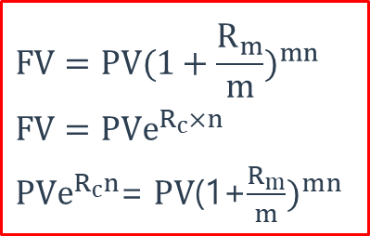
Compounding Interest
Compounding Interest
  Suppose we have an account where the simple interest is added in each year and then that money also earns interest.
  Assuming
    R_{c} is the rate of interest with continuous compounding.
    R_{m} is the rate of interest with discrete compounding (m per annum)
    n is the number of years.
$$FV=PV(1+\frac{R_{m}}{m})^{mn}$$
$$FV=PVe^{R_{c}×n}$$
$PVe^{R_{c}n}$= $PV$(1+$\frac{R_{m}}{m})^{mn}$

Slide 7
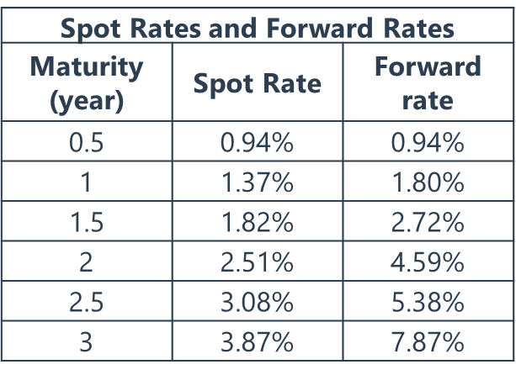

Spot, Forward and Par Rates
Spot Rate: A spot rate is the rate on a spot loan, an agreement in which a lender gives money to the borrower at the time of the agreement to be repaid at some single, specified time in the future.
Forward Rate: Interest rates corresponding to a future period implied by spot curve.
Par Rate: The T-year, semiannual par rate is the rate, C(T), such that a fixed-rate asset with par value of $100 that makes regular semi-annual coupon payments of C(T)/2×$100 discounts to a present value equal to the par value of $100.
$$(1+z_{1})^{T_{1}}(1+F_{1,2})^{\left(T_{2}−T_{1}\right)}=(1+Z_{2})^{T_{2}}$$
$$e^{Z_{1}T_{1}}×e^{F_{1,2}(T_{2}−T_{1})}=e^{Z_{2}T_{2}}$$
$$⇒F_{1,2}=\frac{Z_{2}T_{2}−Z_{1}T_{1}}{T_{2}−T_{1}}$$

Slide 8

Spread and Yield
Spread
  Important measures of relative value. Assume we define the term structure as a set of forward rates, then we can find a spread, s, that equates the discounted cash flows to the price of the bond.
YTM
  Single rate, when used to discount a bond’s cash flow, produces the bond’s market price.
  It can be viewed as the realized return on the bond assuming all cash flows are reinvested at the YTM and the bond is held to maturity.
$$P=\frac{c_{1}}{(1+y)}+\frac{c_{2}}{(1+y)^{2}}+⋯+\frac{c_{T}}{(1+y)^{T}}$$
$$P=\frac{c_{1}}{\left(1+Z_{1}\right)}+\frac{c_{2}}{(1+Z_{2})^{2}}+⋯+\frac{c_{T}}{(1+Z_{T})^{T}}$$

Slide 9
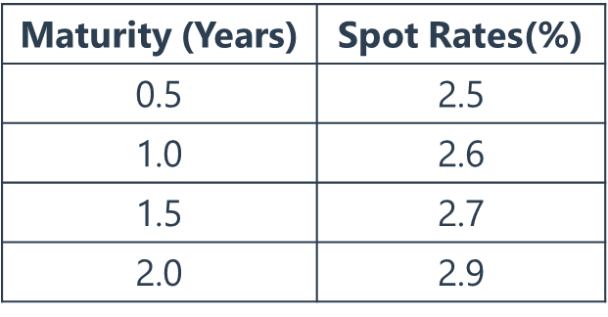
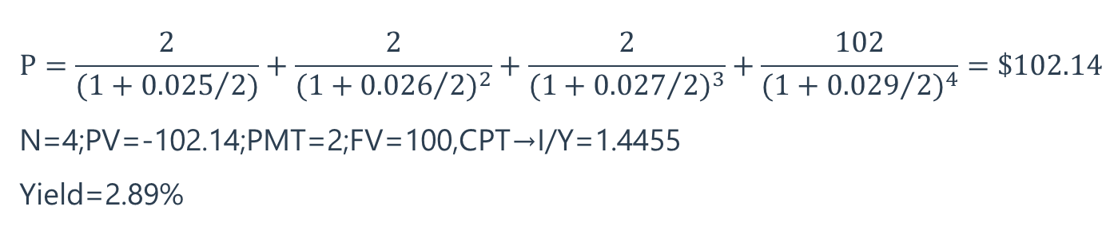
Spread and Yield
Example
  Consider a bond with $100 face value, 2-year maturity and 4% semiannual coupon. Given annualized spot rate as follow:
$$P=\frac{2}{(1+{0.025}/{2)}}+\frac{2}{(1+{0.026}/{2)^{2}}}+\frac{2}{(1+{0.027}/{2)^{3}}}+\frac{102}{(1+{0.029}/{2)^{4}}}=\$102.14$$
N=4;PV=-102.14;PMT=2;FV=100,CPT→I/Y=1.4455
Yield=2.89%

Slide 10
Relationship between Rates
Relationship between spot rates and YTM
  There are several spot rates and a single yield (YTM). YTM is a summary of all the spot rates that enter into the bond pricing equation.
    A flat term structure of sport rates: the yield must equal the one-year spot rate level as well.
    A term structure where spot rates are upward sloping over a two-year period: the two-year bond yield is below the two-year spot rate.
    A term structure where spot rates are downward sloping over a two-year period: the two-year yield is above the two-year spot rate.
Relationship between spot rates and forward rates
  Spot rates are an average of forward rates.
  If spot rates are increasing with term while forward rates are greater than spot rates

Slide 11

Discount Factor
Discount Factor
  For a term of t years, gives the present value of one unit of currency to be received at the end of that term.
  Example: consider a 7.875% bond due in 6 months with a market price of 101.40. We can extract the d(0.5) and the implied spot rate:
STRIPS Prices and Discount Factors
Maturity | STRIPS Price | Discount Factor | Spot Rate
0.5 | 99.5322 | 0.995322 | 0.94%
1 | 98.6439 | 0.986439 | 1.37%
1.5 | 97.3189 | 0.973189 | 1.82%
2 | 95.1336 | 0.951336 | 2.51%
2.5 | 92.6433 | 0.926433 | 3.08%
3 | 89.1374 | 0.891374 | 3.87%
$$d\left(t\right)=\frac{1}{(1+\frac{z(t)}{2})^{2t}}$$
$101.4=(100+100×7.875\%/2$)d(0.5) $Z_{0.5}=2\left[(1/d(0.5))−1\right]$

Slide 12
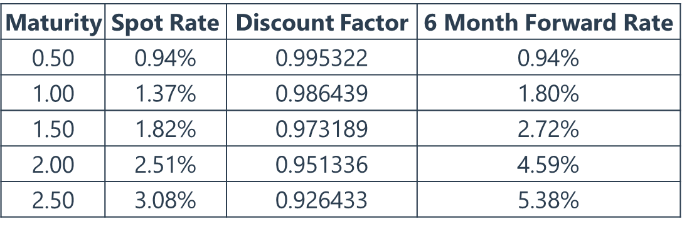
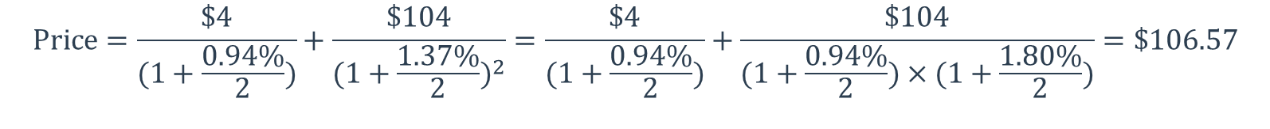
Basic Valuation Approach
Characteristics of Bonds
Pricing Bond using Discount Factors, Spot Rates, or Forward Rates
  Given a 1-year treasury bond that pays a 8% semi-annual coupon
  Price = ($4×0.995322) + ($104×0.986439) = $106.57
  Coupon Rate
  Face Value
  Interest Rate
  Maturity
$$Price=\frac{\$4}{(1+\frac{0.94\%}{2})}+\frac{\$104}{(1+\frac{1.37\%}{2})^{2}}=\frac{\$4}{(1+\frac{0.94\%}{2})}+\frac{\$104}{(1+\frac{0.94\%}{2})×(1+\frac{1.80\%}{2})}=\$106.57$$

Slide 13

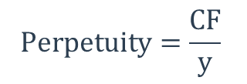
Basic Valuation Approach
Price of an Annuity and a Perpetuity
  Annuity
    An annuity with semiannual payments is a security that makes a payment c/2 every six months for T years but never makes a final “principal” payment (i.e., FV=0). The price of an annuity, A(T), is given by:
  Perpetuity
    A perpetuity bond is a bond that pays coupons forever. The price of a perpetuity is simply the coupon divided by the yield.
$$A=\frac{CF}{y}\left(1−{\left(\frac{1}{1+\frac{y}{2}}\right)}^{2T}\right)$$
$$Perpetuity=\frac{CF}{y}$$

Slide 14
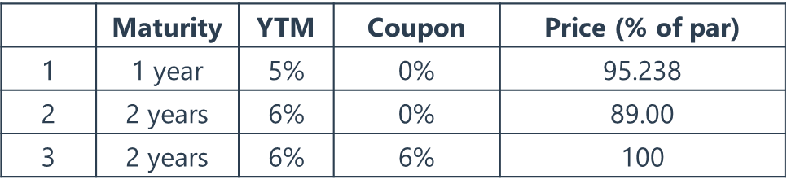
Bond Replication
Replication Approach
  Law of One Price: Absent confounding factors (e.g., liquidity, financing, taxes, credit risk), identical sets of cash flows should sell for same price.
  Example: three bond yields and prices are shown below.
  The 2-year spot rate is 6.03%. Is there an arbitrage opportunity using these three bonds? If so, describe the trades necessary to exploit the arbitrage opportunity?

Slide 15
Bond Replication
Replication Approach (cont’d)
Time = 0 |  | 1 year |  | 2 years
-1,000,000.00 | (cost of 2-year, 6% coupon bonds) | +60,000 | (coupon) | +1,060,000 | (coupon)
+57,142.86 | (proceeds 1-year, 0% coupon bonds) | -60,000 | (maturity)
+943,396.20 | (proceed 2-year, 0% coupon bonds) |  |  | -1,060,000
+539.06 | Net | 0 |  | 0 | (maturity)

Slide 16
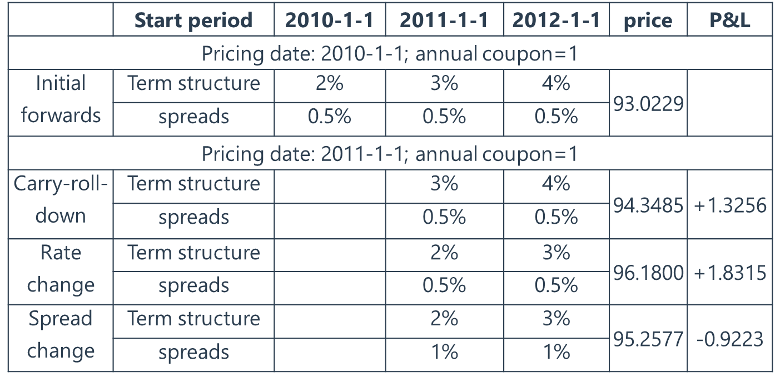
Decomposition of P&L

Slide 17
Exercise 1
The following discount function contains semi-annual discount factors out to two years: d(0.5) = 0.9970, d(1.0) = 0.9911, d(1.5) = 0.9809, d(2.0) = 0.9706. What is the implied 1.5 year zero rate?
  0.600%
  1.176%
  1.290%
  1.505%
Answer: C

Slide 18
Exercise 2
The price of a six-month zero-coupon bond is $99.90 and the price of a one-year zero-coupon bond is $98.56. What is the implied six-month forward rate, under semi-annual compounding?
  1.30%
  2.95%
  2.73%
  3.08%
Answer: C

Slide 19
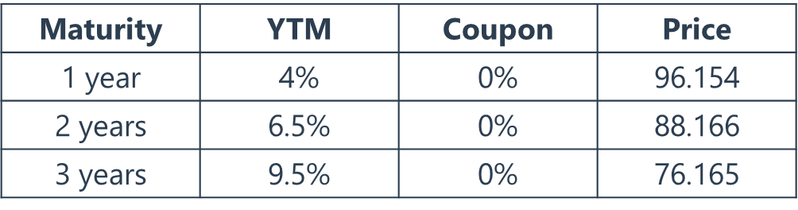
Exercise 3
Given the following information:
  1-year forward rate one year from today = 9.7%
  1-year forward rate two years from today = 11.3%
  2-year forward rate one year from today = 12.27%
  Which of the following statements about the forward rates, based on the bond prices, is true?
  A. The 1-year forward rate one year from today is too low.
  B. The 2-year forward rate one year from today is too high.
  C. The 1-year forward rate two years from today is too low.
  D. There’s no opportunities for arbitrage.
Answer: C

Slide 20
Exercise 4
A 3-year bond with a current price of $105.91 pays a semi-annual coupon with a coupon rate of 5%. What is the bond’s YTM?
  1.97%
  2.25%
  2.93%
  3.56%
Answer: C

Slide 21
Exercise 5
There are two U.S. Treasury bond. The first has a price of 99.98, matures in six months, and pays a semi-annual coupon at a rate of 3%. The second has a price of 101.11, matures in one year, and pays a semi-annual coupon at a rate of 4%. What are, respectively, the six-month and one-year discount factor?
  d(0.5) = 0.9790, d(1.0) = 0.9830
  d(0.5) = 0.9850, d(1.0) = 0.9720
  d(0.5) = 1.0020, d(1.0) = 0.9830
  d(0.5) = 0.9650, d(1.0) = 1.0340
Answer: B

Slide 22
Exercise 6
Three different U.S. Treasury notes pay semi-annual coupons and mature in exactly one year; i.e., each pays the next coupon in six months and matures six months subsequently. The price of Bond A with a coupon rate of 2.0% per annum is $99.02 and the price of Bond C with a coupon rate of 7.0% per annum is $103.91. If Bond B has a coupon rate of 4.0% per annum, what is the price of Bond B?
  $99.12
  $100.56
  $100.98
  $101.12
Answer: C

Slide 23
53%
55%
Fixed Income:
Risk Metrics
Notes:
首先我们来讲Option Valuation

Slide 24
One-Factor Risk Metrics
Multi-Factor Risk Metrics
Notes:
这部分我们主要介绍两种方法，二叉树法和BSM模型法，最后说一下希腊字母。

Slide 25
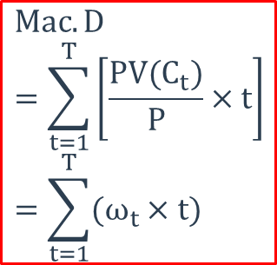
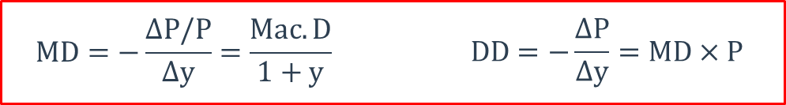
One-Factor Risk Metrics
Duration
  Macaulay Duration
    For a zero coupon bond, the Macaulay duration equals to its maturity.
    For a plain bond, the Macaulay duration is less than or equal to its maturity.
  Modified Duration and Dollar Duration
    All else being equal, duration increase for longer maturities, lower coupons, and lower the yields.

Slide 26


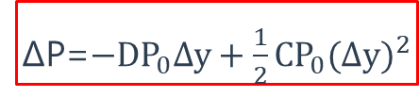

One-Factor Risk Metrics
Duration (cont’d)
  DV01
  Effective Duration
Convexity
  Non-linear relationship
  All else being equal, convexity increase for longer maturities, lower coupons, and lower the yields.
  Effective Convexity
$$DV01=MD×P×0.0001$$
$$D^{E}=\frac{P_{−}−P_{+}}{2P_{0}∆y}$$
$$C^{E}=\frac{{DD}_{−}−{DD}_{+}}{P_{0}∆y}=\frac{P_{−}+P_{+}−2P_{0}}{P_{0}Δy^{2}}$$
ΔP=$−DP_{0}∆y+\frac{1}{2}CP_{0}(∆y)^{2}$

Slide 27
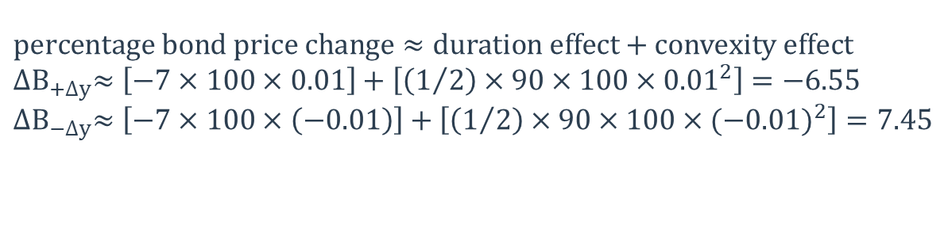
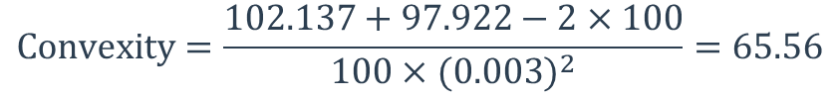
One-Factor Risk Metrics
Convexity (cont’d)
  Example: Suppose there is a 10-year option-free noncallable bond with an annual coupon of 7% trading at par. If interest rates rise by 30 bps, estimated price is 97.922. If interest rates fall by 30 bps, estimated price is 102.137. Calculate the convexity of this bond.
  Example: Estimate the effect of a 100 bps increase and decrease on a 10-year, 5%, option-free bond currently trading at par, using the duration/convexity approach with a duration of 7 and a convexity of 90.
$$Convexity=\frac{102.137+97.922−2×100}{100×(0.003)^{2}}=65.56$$
$$percentage bond price change≈duration effect+convexity effect$$
$${∆B}_{+∆y}≈\left[−7×100×0.01\right]+\left[\left(1/2\right)×90×100×{0.01}^{2}\right]=−6.55$$
$${∆B}_{−∆y}≈\left[−7×100×\left(−0.01\right)\right]+\left[\left(1/2\right)×90×100×{(−0.01)}^{2}\right]=7.45$$

Slide 28
One-Factor Risk Metrics
Negative Convexity
  Most mortgage bonds are negatively convex, and callable bonds usually exhibit negative convexity at lower yields.
  For example, with a callable bond, as interest rate fall, the incentive for the issuer to call the bond at par increases; therefore, its price will not rise as quickly as the price of a non-callable bond. This is why the shape of callable bond’s curve of price with respect to yield is concave or negatively convex.
Portfolio Duration and Convexity
  In regard to both modified (effective) duration and convexity, portfolio duration and convexity equal the weighted sum of individual, respectively, durations and convexities where each component’s weight is its value as a percentage of portfolio value.

Slide 29
Multi-Factor Risk Metrics
Key Rate Shifts
  An approach take nonparallel shifts into account.
  Allowing that changes in all rates can be determined by changes from selected key rates.
  A few rates along the term-structure are picked which are representative of the curve.
  Shifts in the key-rates are decline linearly.
  The rate of a given maturity is affected solely by its closest key-rate.
Key Rate Duration
  Which is the key rate equivalent of durations.
Key Rate 01s
  Which is the key rate equivalent of DV01.

Slide 30
Exercise 1
MTGE4. MTGE7. MTGE10 are mortgage-backed securities (MBS) that pay 4%. 7%. and 10% coupons, respectively prevailing mortgage rates are 10% Assuming these securities have the same maturity and coupon frequency, which of the following is correct?
  In most cases, convexity is sufficient to approximate MBS price changes resulting from yield changes for purpose of estimating VaR.
  In most cases, duration is sufficient to approximate MBS price changes resulting from yield changes for purpose of estimating VaR.
  The Optionality embedded in a MBS makes the implementation of the duration-convexity method less appropriate the purpose of estimating VaR.
  As rates fall, MTGE10 price change approximations using the duration-convexity method are likely to be better than MTGE4 price change approximations.
Answer: C

Slide 31
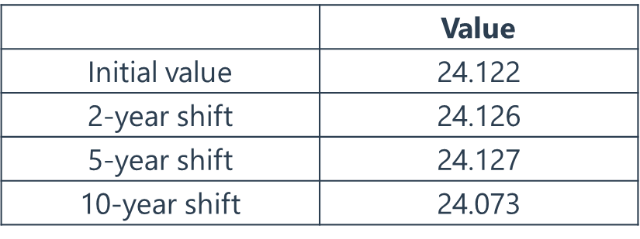
Exercise 2
The following table provides the initial price of a C-STRIP and its present value after application of a one basis shift in three key rates.
  What is the key rate ’01 for a 10-year shift?
    A. 0.014 B. 0.016 C. 0.303 D. 0.049
  What is the key-rate duration for a 10-year shift?
    A. 20.31 B. 23.450 C. 19.60 D. 36.14
Correct Answer

Slide 32
Exercise 3
An underlying exposure has a 5-year key-rate ’01 of +$23,970. If this key rate exposure can be hedged by trading five-year bond that itself has a 5-year key rate ’01 of $0.048 per 100 face amount, what is the hedge trade?
  Buy $499.375 in face amount
  But $49.94 million in face amount
  Sell $499.375 in face amount
  Sell $49.94 million in face amount
Answer: D

Slide 33
53%
55%
Options：
Valuation
Notes:
首先我们来讲Option Valuation

Slide 34
Binomial Trees
Black-Scholes-Merton Model
Notes:
这部分我们主要介绍两种方法，二叉树法和BSM模型法，最后说一下希腊字母。

Slide 35
Binomial Trees
Binomial Trees
  Assumption
    The stock price follows geometric Brownian motion
    Risk neutral;
    u=1/d;
  One-Step Binomial Model
S₀u
f_{u} = max(S₀u – K, 0)
p
Stock Price = S₀
Option Price f
1 – p
S₀d
f_{d} = max(S₀d – K, 0)
$p=\frac{e^{rΔt}−d }{ u−d}$ or $p=\frac{e^{\left(r−q\right)Δt}−d}{u−d} f=\left[pf_{u}+\left(1−p\right)f_{d}\right]e^{−rΔt} u=e^{σ\sqrt{Δt}};d=e^{−σ\sqrt{Δt}}$

Slide 36

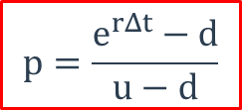
Binomial Trees
Binomial Trees (cont’d)
  Two-Step Binomial Model
S₀uu
f_{uu}
S₀u
f_{u}
S₀
f
S₀ud
f_{ud}
S₀d
f_{d}
S₀dd
f_{dd}
$$p=\frac{e^{rΔt}−d}{u−d}$$
$$f=e^{−2rΔt}\left[p^{2}f_{uu}+2p(1−p)f_{ud}+{\left(1−p\right)}^{2}f_{dd}\right]$$

Slide 37
Binomial Trees
Binomial Trees (cont’d)
  Example: 2-step European Call, Up and Down Informed by Volatility
Asset | Strike | Time | Volatility | Riskless | Div. Yield
$810 | $800 | 0.5 | 20% | 5% | 2%
u | d | p
1.1052 | 0.9048 | 0.5126
$989.34
$895.19
$810
$810
Option Value = 53.40
$732.92
$663.17

Slide 38
Binomial Trees
Binomial Trees (cont’d)
  American Options
判断是否提前执行
S₀u
f_{u}
S₀uu
f_{uu}
S₀
f
Make sure that the option value at each node is no less than the intrinsic value.
S₀ud
f_{ud}
S₀d
f_{d}
S₀dd
f_{dd}
判断是否提前执行

Slide 39
Binomial Trees
Binomial Trees (cont’d)
  Example: American Put Option with Price Jump of +/-20%
Asset | Strike | Time | Riskless | Div. Yield
$50 | $52 | 2 | 5% | 0%
u | d | p
1.2 | 0.8 | 0.6282
$72
$60
$50
$48
Option Value = 5.09
$40
$32

Slide 40
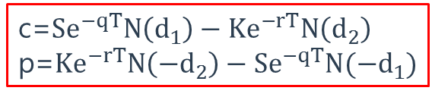
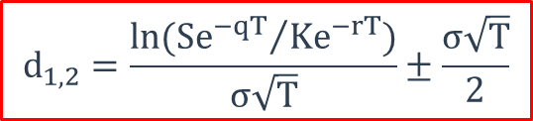
Black-Scholes-Merton Model
Black-Scholes-Merton Model
  Assumptions
    The stock price follows a lognormal distribution and is continuous. Jump is not considered.
    The risk-free rate and volatility of the stock is known and constant.
    There are no transaction costs or taxes.
    There are no cash flows on the stock.
    European options
  Valuation
  The early exercise of American options
c=$Se^{−qT}N\left(d_{1}\right)−Ke^{−rT}N\left(d_{2}\right)$
p=$Ke^{−rT}N\left(−d_{2}\right)−Se^{−qT}N(−d_{1})$
$$d_{1,2}=\frac{ln({Se^{−qT}}/{Ke^{−rT}})}{σ\sqrt{T}}±\frac{σ\sqrt{T}}{2}$$
$$American call: D_{n}>X\left(1−e^{−r\left(T−t_{n}\right)}\right) American put: D_{n}<X\left(1−e^{−r\left(T−t_{n}\right)}\right)$$

Slide 41

Black-Scholes-Merton Model
Warrants and employee stock options are different from regular call options in that exercise leads to the company issuing more shares and then selling them to the option holder for the strike price.
As the strike price is less than the market price, this dilutes the interest of the existing shareholders.
Suppose the company has N shares worth S₀ each and the number of new options contemplated! is M, with each option giving the holder the right to buy one share for K. The value of each option is the value of
Regular call options on the company’s stock. Therefore the total cost of the options is M times this.
$$\frac{N}{N+M}$$

Slide 42
53%
55%
Options：
Greek Letters
Notes:
首先我们来讲Option Valuation

Slide 43
Greek Letters
Impact of Underlying Asset Price – Delta
  The delta of an option, Δ, is defined as the ratio of change in option price to change in underlying asset price.
  Call option Δ range from 0 to 1
  Put option Δ range from -1 to 0
  When t→T, delta is unstable
Delta
1
Long Call | Δ > 0
Short Call | Δ < 0
Long Put | Δ < 0
Short Put | Δ > 0
0.5
Call Options
0
K
-0.5
Put Options
-1
Call and Put Option Delta

Slide 44
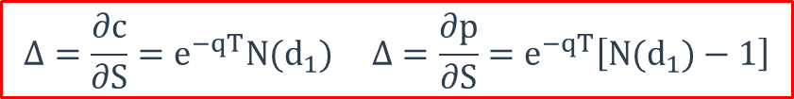
Greek Letters
Impact of Underlying Asset Price – Delta (cont’d)
  According to the BSM Model, option delta is as follow
  Portfolio Delta: summation of product of each position and its delta.
Delta Hedge
  A position with a delta of zero is called a delta neutral position.
  To maintain a delta neutral position, trader must re-balance the portfolio. If gamma is higher (such as the case when options are at-the-money), rebalancing more frequently is required. On the other hand, when gamma is lower (such is the case when options are deeply in the money/deeply out of the money), rebalancing is required less frequently.
  Hedge against small changes in asset price.
$$Δ=\frac{∂c}{∂S}=e^{−qT}N(d_{1}) Δ=\frac{∂p}{∂S}=e^{−qT}\left[N(d_{1})−1\right]$$

Slide 45
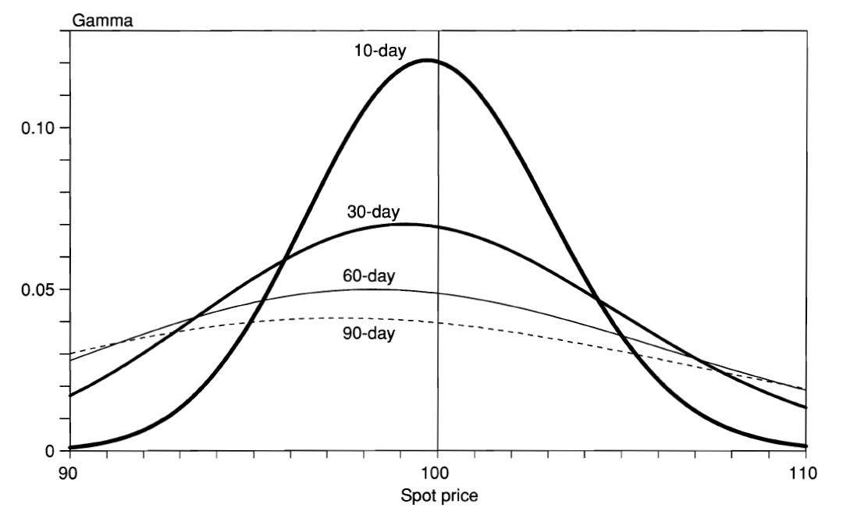
Greek Letters
Impact of Underlying Asset Price – Gamma
  Rate of delta change with respect to price change of underlying asset.
  Providing added protection against large movements.
  If gamma is large, delta is very sensitive to the price change of the underlying asset.
  Largest when is at-the-money.
  Same for call and put options.
Gamma Hedge
  Hedge against larger changes
Long Call | Short Call | Long Put | Short Put
γ > 0 | γ < 0 | γ > 0 | γ < 0

Slide 46
Greek Letters
Delta and Gamma Hedge
  Example: Suppose that a portfolio is delta neutral and has a gamma of -3,000. The delta and gamma of a particular traded call option are 0.62 and 1.50, respectively. Create a gamma-neutral position.
    Buy 3,000/1.5 = 2,000 options
    Sold 2,000 ×0.62 = 1,240 shares of the underlying position
  You can also create a gamma needed position, e.g., gamma of -6,000.
Impact of Volatility – Vega
  Rate of change of the value of the option with respect to the volatility of the underlying asset.
  Largest when is at-the-money.
  Same for call and put options.

Slide 47
Greek Letters
Impact of Maturity – Theta
  Rate of change of the value of option with respect to the passage of time.
  Time decay. As time to maturity decreases, option tends to become less valuable, so theta is usually negative for an long position, means option lose value as time goes by.
  Short-term at the money option has a greatest negative theta.
Impact of Interest Rate – Rho
  Sensitivity to the interest rate
  In the money calls and puts are more sensitive to changes in rates than out-of-the-money options.

Slide 48
Exercise 1
Vega is the sensitivity of an option’s price to changes in volatility. Increases in an underlying instrument’s volatility will usual increase the value of options since increases in volatility produce a greater probability that an option will find its way into the money. Of the four options listed below, which investment has the potential to produce a negative Vega measure?
  Shout Option
  Call Option
  Put Option
  Barrier Option
Answer: D

Slide 49
Exercise 2
A cash-or-nothing call (also known as a digital call) pays a fixed amount to the buyer if the asset finishes above the strike price. Assume that at the end of a 1-year investment horizon, the stock is equal to $50, the fixed payment amount is equal to $45, and N(d₁) and N(d₂) from the Black-Scholes-Merton model are equal to 0.9767 and 0.9732, respectively. The value of this cash-or-nothing call when the risk-free rate equals 3% is closest to:
  $5
  $42
  $44
  $47
Answer: B

Slide 50
Exercise 3
A stock is currently trading at USD 45, and its annual price volatility is 30%. The risk-tree rate is 1.5% per year. A risk manager is developing a 1-step binomial tree for a 2-year horizon. What is the risk-neutral probability that the stock will move down?
  30%
  43%
  57%
  70%
Answer: C

Slide 51
Exercise 4
GF Corporation is a non-dividend-paying stock that is currently priced at $48. An analyst has determined that the annual standard deviation of returns on GF stock is 8% and that the annual risk-free interest rate on a continuously compounded basis is 6%. Calculate the value of a 12-month American call option on GF stock with a strike price of $50 using a two-period binomial model.
  $1.25
  $2.01
  $2
  $2.21
Answer: B

Slide 52
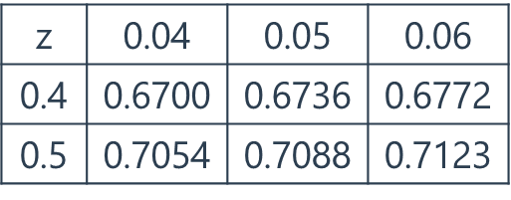
Exercise 5
Stock XYZ trades for $50 and has 1-year call and put options written on it with an exercise price of $50. The annual standard deviation estimate is 10%, and the continuously compounded risk-free rate is 5%. The value of both the call and put using the BSM option pricing model are closest to:
Call Put
  $4.12 $1.11
  $3.4 $0.96
  $3.4 $1.11
  $4.12 $0.96
Answer: B

Slide 53
Exercise 6
An investor holds an American call option on a dividend paying stock with the following characteristics
  Current stock price ,S=USD 50
  Strike price, K=USD 50
  Time to expiration ,T=2 months
  A divided, D, of USD 1 per share has just been announced ,with an ex-dividend date, t, of one month from now, Assuming the risk-free rate, r, is 1.5% and the option stays at-the-money, is it optimal to exercise the option right before the ex-dividend date?
  Yes, because S < K*e ^{(-r(T-t))} + D
  Yes, because D > K*(1-e^{(-r(T-t))})
  No, because the call option is at-the-money ,and early exercise is only optimal when it is deep in-the-money
  No, because unlike an American put option, it is never optimal to exercise an American call option early.

Slide 54
Exercise 7-8
Which of the following is true regarding options’ Greeks?
  Theta tends to be large and positive when buying at-the-money options.
  Gamma is greatest for in-the-money options with long maturities.
  Vega is greatest for at-the-money options with long maturities.
  Delta of deep in-the-money put options tends towards +1
Answer: C
How can a trader produce a short Vega, long gamma position?
  Buy short-maturity options, sell long-maturity options.
  Buy long-maturity options, sell short-maturity options.
  Buy and sell options of long maturity.
  Buy and sell options of short maturity.
Answer: A

Slide 55
Exercise 9
A delta-neutral position exhibits a gamma of -5000. An existing option with a delta equal to 0.6 exhibits a gamma of 1.5. Which of the following will generate a gamma-neutral position for the existing portfolio?
  Buy 3,333 of the available options.
  Sell 3,333 of the available options.
  Buy 3,014 of the available options.
  Sell 3,014 of the available options.
Answer: A

Slide 56
53%
55%
Risk Measurement and
Management
Notes:
首先我们来讲Option Valuation

Slide 57
Market Risk
Credit Risk
Operational Risk
Stress Testing

Slide 58




Measures of Financial Risk
Coherent Risk Measure
  Monotonicity
    A random cash flow or future value R₁ that is always greater than R₂ should have a lower risk.
  Subadditivity
    The portfolio’s risk should not be greater than the sum of its parts.
  Positive Homogeneity
    The risk of a position is proportional to its scale or size.
  Translation Invariance
    Like adding cash
$$R_{1}≥R_{2},then ρ(R_{1})≤ρ(R_{2})$$
$$ρ\left(R_{1}+R_{2}\right)≤ρ\left(R_{1}\right)+ρ(R_{2})$$
$$β>0,ρ\left(βR\right)=βρ(R)$$
$$for constant c,ρ\left(R+c\right)=ρ\left(R\right)−c$$

Slide 59
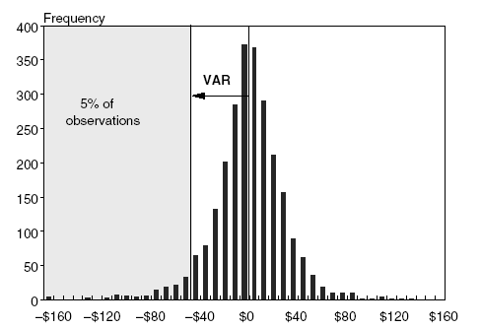
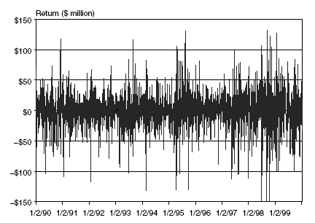
Measures of Financial Risk
Mean-Variance Framework
Value at Risk
  VaR is the maximum loss over a target horizon and for a given confidence level.
  Disadvantages of VaR
    Did not contain worst conditions, did not describe tail loss.
    Not sub-additive.

Slide 60


Measures of Financial Risk
Value at Risk (cont’d)
  If an expected return other than zero:
  Example: Given that for a $1,000,000 portfolio, the expected 1-year portfolio return and standard deviation are 0.00124 and 0.0321. Calculate the 1-year VaR at 1% significance level.
  Square Root Rule
    If there are no serial correlations or other dependencies, volatility increases with the square root of the unit of time.
    With trends→positive correlation→VaR increase
    With mean reversion→negative correlation→VaR decrease
$$VaR\left(X\%\right)=|μ−z_{X\%}×σ|$$
$$VaR{\left(X\%\right)}_{J−days}=VaR{\left(X\%\right)}_{1−days}×\sqrt{J}$$

Slide 61
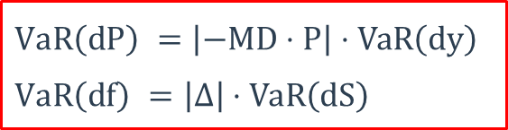
Measures of Financial Risk
Value at Risk (cont’d)
  Delta-Normal Approach
    Linear approximation
    Underlying factor is assumed to follow a normal distribution
    Not good for derivatives with extreme nonlinearities (MBS, Fixed-income securities with embedded option).
    Example: The Big Pharma Inc’s stock is trading at USD 23 and the stock has a daily volatility of 1.5%. Using the delta-normal method, what is the VaR at the 95% confidence level of a long position in an at-the-money put on this stock with a delta of -0.5 over a 1-day holding period?
$$VaR\left(dP\right) =\left|−MD⋅P\right|⋅VaR\left(dy\right)$$
$$VaR\left(df\right) =\left|Δ\right|⋅VaR\left(dS\right)$$

Slide 62
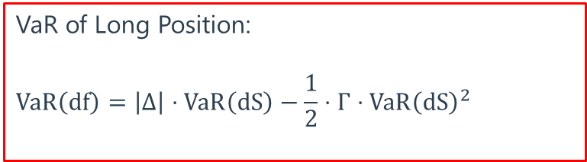
Measures of Financial Risk
Value at Risk (cont’d)
  Delta-Gamma Approach
    Nonlinear approximation
  Full Revaluation Method
    Full re-pricing under the assumption that the underlying risk factor(s) are shocked to experience a loss. i.e., what is the worst expected change in the risk factor, given some confidence and time horizon. Then, full revaluation prices the portfolio under changed risk factors.
    Accurate but computationally burdensome.
VaR of Long Position:
$$VaR\left(df\right)=\left|Δ\right|⋅VaR\left(dS\right)−\frac{1}{2}⋅Γ⋅VaR{\left(dS\right)}^{2}$$

Slide 63
Measures of Financial Risk
Expected Shortfall/Conditional VaR
  Average of the worst 100×(1-α)% of losses.
  Example: Given the following 30 ordered percentage returns of an asset, calculate the VaR and expected shortfall at a 90% confidence level: -16, -14, -10, -7, -7, -5, -4, -4, -3, -1, -1, 0, 0, 0, 1, 2, 2, 4, 6, 7, 8, 9, 11, 12, 12, 14, 18, 21, 23.
Spectral Risk Measures
5%
5%
VaR
VaR

Slide 64
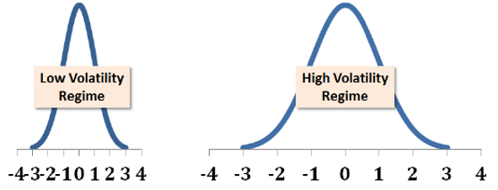
Quantifying Volatility in VaR Models
Potential Reasons for the Existence of Fat Tails
  When an assets returns are normally distributed, they are then defined by constant mean and volatility parameters. One of the possible explanation for fat tails is that the volatility is time-varying.
  Different market or economic conditions may cause the mean and variance of the return distribution to change over time. In such cases, the return distribution is referred to as a conditional distribution.
  A regime-switching volatility model assumes different market regimes exist with high or low volatility. The model captures conditional normality and may resolve the fat-tail problem.

Slide 65
Quantifying Volatility in VaR Models
Various Approaches for Estimating VaR
  Historical-Based Approach: use historical time series data
    Parametric Approach
      Imposes a specific distribution assumption on asset returns
    Nonparametric Approach
      No specific distribution assumptions.
      Historical simulation is the simplest and most prominent representative
    Hybrid Approach
      Combined approach. For example, Filtered historical simulation updates the volatility by fitting a model such as GARCH to the time-series.
  Implied Volatility Based Approach: uses derivative pricing models and current derivative prices in order to impute an implied volatility without having to resort to historical data. The use of implied volatility obtained from BSM option pricing model is the most prominent example.

Slide 66
Quantifying Volatility in VaR Models
Parametric Approach
  Historical Standard Deviation
  EWMA
  GARCH
Parametric Volatility
Historical Returns
Yes
No
Implied Volatility
Equally
Historical Standard Deviation
How do we weight the data
EWMA
GARCH
More Weight to more Recent

Slide 67

Quantifying Volatility in VaR Models
Parametric Approach (cont’d)
  Historical Standard Deviation Approach
    Assuming equally weighted
    Each day, the forecast is updated by adding the most recent day and dropping the furthest day.
    Raw returns are used instead of returns around the mean (i.e., the expected mean is assumed zero).
  Exponential Smoothing Method
    Exponential smoothing places exponentially declining weights on historical data, placing more weight on more recent information and less weight on past information.
    Two models, EWMA and GARCH employ exponential smoothing.
$$σ_{\text{n}}^{2}\text{=}\left(\frac{1}{\text{M}}\right)\sum_{i=1}^{M}{u_{n−i}^{2}}$$

Slide 68


Quantifying Volatility in VaR Models
Parametric Approach (cont’d)
  EWMA
  GARCH
    In GARCH (1,1), the sum of the alpha (α) and beta (β) parameters is called persistence.
    GARCH (1, 1) is unstable if the persistence > 1. A persistence of 1.0 implies no mean reversion. A persistence of less than 1.0 implies “reversion to the mean,” where a lower persistence implies greater reversion to the mean.
    EWMA is a special case of GARCH.
$$σ_{n}^{2}=λσ_{n−1}^{2}+\left(1−λ\right)u_{n−1}^{2}$$
$$\begin{matrix}σ_{n}^{2}=ω+αu_{n−1}^{2}+βσ_{n−1}^{2} \\ {\text{V}}_{L}=\frac{ω}{1−α−β}\end{matrix}$$

Slide 69
Quantifying Volatility in VaR Models
Nonparametric Methods
  Historical Simulation
    No parameter estimates are required
    Once the window length is determined, we order returns in descending order, and go directly to the tail of this ordered vector.
    The model is not subject to estimation error related to correlations and the problem of higher correlations in downward markets.
  Multivariate Density Estimation
    The weights are not a constant function of time.
    Allows for weights to vary based on how relevant the data is to the current market environment.
    The current state – as parameterized by a state vector – is compared to the historical state: the more similar the states (current versus historical period), the greater the assigned weight.

Slide 70
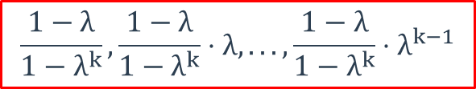
Quantifying Volatility in VaR Models
Hybrid Approach
  It combines historical simulation (by estimating the percentiles of returns directly) and EWMA (by using exponentially declining weights on past data). The following three steps are required to implement the hybrid approach.
    Denote by u_{t-1,1} the realized return from t - 1 to t. To each of the most recent K returns u_{t-1,1}, u_{t-2,t-1},… u_{t-k,t-k-1} assign a weight:
    Order the returns in ascending order.
    In order to obtain the x percent VaR of the portfolio, start from the lowest return and keep accumulating the weights until x percent is reached.
$$\frac{1−λ}{1−λ^{k}},\frac{1−λ}{1−λ^{k}}⋅λ,...,\frac{1−λ}{1−λ^{k}}⋅λ^{k−1}$$

Slide 71
Quantifying Volatility in VaR Models
Hybrid Approach
  Example: calculating 5% VaR using hybrid approach. The most recent observations is K = 100, and λ = 0.98.
Order | Return | Periods Ago | hybrid weight | hybrid cumulative weight
1 | -3.30% | 3 | 0.0221 | 0.0221
2 | -2.90% | 2 | 0.0226 | 0.0447
3 | -2.70% | 65 | 0.0063 | 0.0510
4 | -2.50% | 45 | 0.0095 | 0.0605
5 | -2.40% | 5 | 0.0213 | 0.0818
6 | -2.30% | 30 | 0.0128 | 0.0946

Slide 72
Foreign Exchange Risk
Foreign Exchange Risk
  The risk that an investor will have to close out a long or short position in a foreign currency at a loss due to an adverse movement in exchange rates. Also known as "currency risk" or "exchange-rate risk".
  A positive net exposure position means that we are net long in a currency; A negative net exposure position means that we are net short in a currency.
  On-Balance-Sheet Hedging is achieved when a financial institution has a matched maturity and currency foreign asset-liability book. Rather than matching foreign assets with foreign liabilities, we may choose to remain un-hedged on the balance sheet, and hedge off-balance-sheet by taking a position in the forward market.

Slide 73
Foreign Exchange Risk
The effect of an appreciation/depreciation of a currency relative to a foreign currency.
  The appreciation of a country's currency means that the country’s goods are more expensive for foreign buyers and that foreign goods are cheaper for foreign sellers. Thus, when a country's currency appreciates, domestic manufacturers find it harder to sell their goods abroad and foreign manufacturers find it easier to sell their goods to domestic purchasers. Otherwise, the reverse.

Slide 74
Foreign Exchange Risk
The effect of an appreciation/depreciation of a currency relative to a foreign currency
  Example: On May 15，2015, the exchange rate of the U.S. dollar for the British pound was 1.5528. It is now June 15, 2015,the exchange rate is 1.5602. A U.S.-made Buick Enclave costs $55,000 over the entire period. Has the U.S. dollar appreciated or depredated in value relative to the pound? What is the British citizen's £ gain or loss on the purchase of the car if he waits to buy on June 15?
  The U.S. dollar has depreciated in value relative to the pound.
  On May 15: The British citizen needs $55,000/1.5528 = £35,420.
  On June 15: The British citizen needs $55,000/1.5602 = £35,252.
  The gain from waiting is £35,420 - £35,252 = £168.

Slide 75
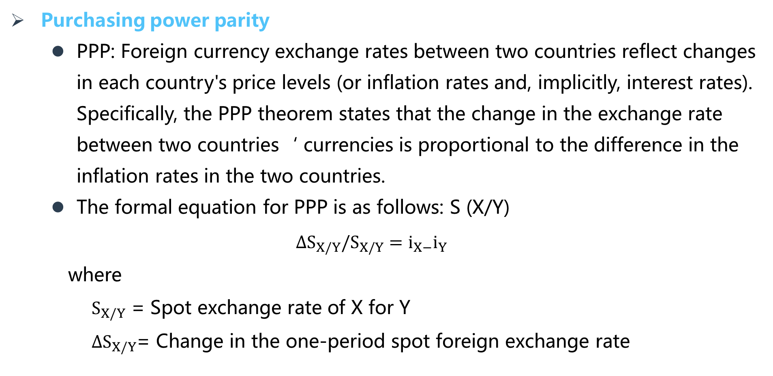
Foreign Exchange Risk
Purchasing power parity
  PPP: Foreign currency exchange rates between two countries reflect changes in each country's price levels (or inflation rates and, implicitly, interest rates). Specifically, the PPP theorem states that the change in the exchange rate between two countries‘ currencies is proportional to the difference in the inflation rates in the two countries.
  The formal equation for PPP is as follows: S (X/Y)
  $$∆S_{X/Y}/S_{X/Y}=i_{X−}i_{Y}$$
      where
      $S_{X/Y}$ = Spot exchange rate of X for Y
      $∆S_{X/Y}$= Change in the one-period spot foreign exchange rate

Slide 76

Foreign Exchange Risk
Purchasing power parity
  Example: Suppose that the current spot exchange rate of U.S. dollars for Russian rubles, $S_{{RUB}/{USD}}$, is 0.17 (i.e., 0.17 dollar, or 17 cents, can be received for 1 ruble). The price of Russian-produced good increases by 10 percent (i.e., inflation in Russia, $i_{R}$, is 10 percent), and the U.S. price index increases by 4 percent (i.e., inflation in the United States, $i_{US}$, is 4 percent). According to PPP, the 10 percent rise in the price of Russian goods relative to the 4 percent rise in the price of U.S. goods results in a depreciation of the Russian ruble (by 6 percent). Specifically, the exchange rate of Russian rubles to U.S. dollars should fall, so that:
  $i_{US}−i_{R}=ΔS_{{RUB}/{USD}}/S_{{RUB}/{USD}}$ $0.04−0.1=ΔS_{{RUB}/{USD}}/0.17$
  $$ΔS_{{RUB}/{USD}}=−0.0102$$
  Thus, 0.1598 of $1 can be received for 1 ruble.

Slide 77
Exercise 1
Your colleague reports a 95.0% one-day value-at-risk (VaR) of $1.4 million for a equities portfolio. If we assume 250 trading days in a year, each of the following is a valid conclusion except which of the following is false (cannot be concluded from the statement)?
  If the VaR is accurate, we expect a daily loss in excess of $1.4 million to occur on about 12 or 13 days (12.5) during year
  If the return distribution is normal, then we can assume the VaR is sub-additive
  This is a parametric VaR and therefore cannot characterize a heavy-tailed distribution
  If the returns are i.i.d. normal, we can scale to a 10-day VaR with $1.4*SQRT(10) = $4.3 million 95% 10-day VaR
Answer: C

Slide 78
Exercise 2
A bond with a face value of $10.0 million has a one-year probability of default (PD) of 1.0% and an expected recovery rate of 35.0%. What is the bond's one-year 99.0% expected shortfall (ES; aka, CVaR)?
  $3.25 million
  $6.5 million
  $9.1 million
  Not enough information: need the tail distribution
Answer: B

Slide 79
Exercise 3
An investor has a short position in put option (i.e., has written a put) on an underlying asset with value of $100,000. The delta of the put option is -0.40. The 95.0% value at risk (VaR) of the underlying asset is 12.0%. Which of the following statements is correct when second-order terms (quadratic VaR) are considered?
  VaR of the short option position is slightly less than $4,800
  VaR of the short option position is slightly more than $4,800
  VaR of the short option position is slightly less than $12,000
  VaR of the short option position is slightly more than $12,000
Answer: B

Slide 80
Exercise 4
A stock with a current price of $200.00 has an annual volatility of 30.0%. An at-the-money (ATM) call option has a delta, N(d₁), of 0.6180 and gamma of 0.00950. If we assume 250 trading days, what is the one-day 95.0% confident delta-gamma value at risk (VaR) of a long position in the call option?
  $1.99
  $3.67
  $3.85
  $14.72
Answer: B

Slide 81
Exercise 5
Which of the following best summarizes the key difference(s) between these two approaches to VaR estimation: exponentially weighted moving average (EWMA; aka, RiskMetrics) versus the hybrid approach?
  Hybrid approach does not utilize exponentially declining weights
  Hybrid is parametric and EWMA is non-parametric
  Hybrid estimates the VaR as a quantile (percentile) of ordered (but weighted) historical returns, but EWMA does not sort returns
  There is no difference: EWMA is the hybrid approach
Answer: C

Slide 82
Exercise 6
A risk manager is considering switching from using historical volatility to using implied volatility in VaR calculations. Which of the following statements about implied volatility are correct?
  Implied volatility estimates are model dependent and a mis-specified model can result in erroneous forecasts.
  Implied volatility estimates require that historical returns are indicative of future returns.
  Implied volatility estimates tend to underestimate future volatility as a result of mean reversion
  Implied volatility estimates are generally accurate even if there is only one trade in the option used to calculate an estimate.
Answer: A

Slide 83
Expected and Unexpected Loss
Credit Risk
  Credit risk is the risk that arises from any nonpayment or rescheduling of any promised payments (i.e., default-related events) or from (unexpected) credit migrations (i.e., events that are related to changes in the credit quality of a borrower) of a loan and that gives rise to an economic loss to the bank.
Three Drivers
  Probability of Default: Probability that a borrower will default before the end of a predetermined period of time or at any time before the maturity of the loan.
  The exposure amount of the loan at the time of default.
  The loss rate, that is, the fraction of the exposure amount that is lost in the event of default, meaning the amount that is not recovered after the sale of the collateral.

Slide 84

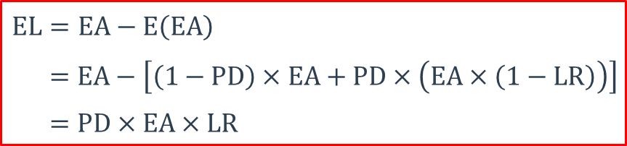
Expected and Unexpected Loss
Expected Losses
  A bank can expect to lose, on average, a certain amount of money over a predetermined period of time when extending credits to its customers.
  A prudent bank should set aside a certain amount of money (often called loan loss reserves) to cover these losses that occur during the normal course of their credit business.
$$EL=EA−E\left(EA\right)$$
$=EA−\left[\left(1−PD\right)×EA+PD×\left(EA×\left(1−LR\right)\right)\right]$
$=PD×EA×LR$
$$\text{adjusted} \text{exposure}=OS+α×COM$$

Slide 85
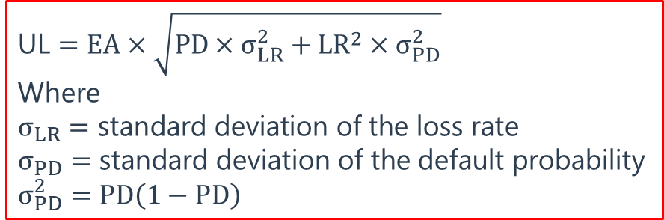
Expected and Unexpected Loss
Unexpected Loss
  By definition, EL does not itself constitute risk. If losses always equaled their expected levels, there would be no uncertainty, and there would be no economic rationale to hold capital against credit risk. Risk arises from the variation in loss levels – which for credit risk is due to unexpected losses (UL).
  Unexpected loss is the standard deviation of credit losses.
  ULs cannot be anticipated and hence cannot be adequately priced for in a loan’s interest rate. They require a cushion of economic capital.
$$\text{UL}=EA×\sqrt{PD×σ_{LR}^{2}+LR^{2}×σ_{PD}^{2}}$$
Where
$$σ_{LR}=\text{standard} \text{deviation} \text{of} \text{the} \text{loss} \text{rate}$$
$$σ_{PD}=\text{standard} \text{deviation} \text{of} \text{the} \text{default} \text{probability}$$
$$σ_{PD}^{2}=PD\left(1−PD\right)$$

Slide 86
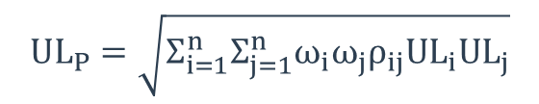
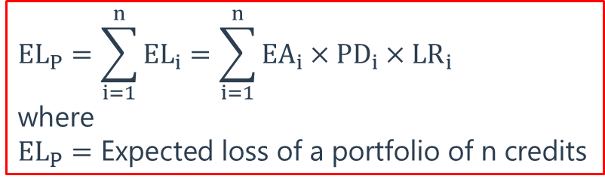
Expected and Unexpected Loss
Portfolio Credit Risk
  The expected loss of a portfolio of credits is straightforward to calculate because EL is linear and additive.
  When measuring unexpected loss at the portfolio level, we need to consider the effects of diversification because – as always in portfolio theory – only the contribution of an asset to the overall portfolio risk matters in a portfolio context.
$${EL}_{P}=\sum_{i=1}^{n}{{EL}_{i}}=\sum_{i=1}^{n}{EA_{i}×PD_{i}×LR_{i}}$$
where
$${EL}_{P}=\text{Expected} \text{loss} \text{of} \text{a} \text{portfolio} \text{of} \text{n} \text{credits}$$
$$UL_{P}=\sqrt{Σ_{i=1}^{n}Σ_{j=1}^{n}ω_{i}ω_{j}ρ_{ij}UL_{i}UL_{j}}$$

Slide 87
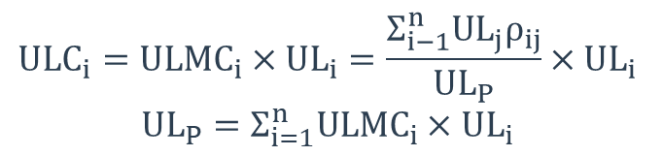

Expected and Unexpected Loss
Portfolio Credit Risk (cont’d)
  Unexpected Loss Contribution
  Total Contribution to the Portfolio’s UL
$$ULMC_{i}=\frac{∂UL_{P}}{∂UL_{i}}=\frac{∂{\left(UL_{P}^{2}\right)}^{\frac{1}{2}}}{∂UL_{i}}=\frac{1}{2}{\left(UL_{P}^{2}\right)}^{−\frac{1}{2}}×\frac{∂\left(UL_{P}^{2}\right)}{∂UL_{i}}=\frac{\left(Σ_{j=1}^{n}UL_{j}ρ_{ij}\right)}{UL_{P}}$$
$$ULC_{i}=ULMC_{i}×UL_{i}=\frac{Σ_{i−1}^{n}UL_{j}ρ_{ij}}{UL_{P}}×UL_{i}$$
$$UL_{P}=Σ_{i=1}^{n}ULMC_{i}×UL_{i}$$

Slide 88
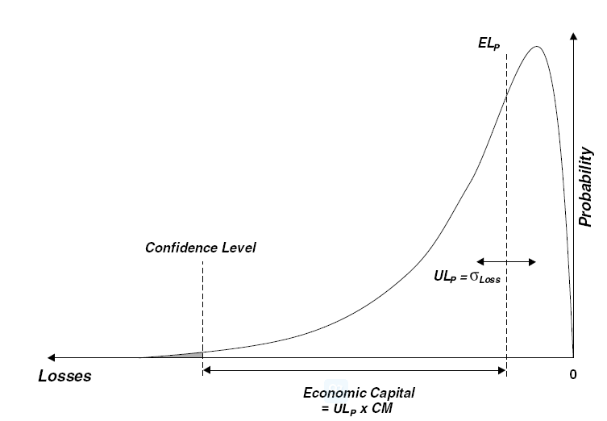
Expected and Unexpected Loss
Economic Capital
$$\text{Eco}nomic{ \text{Capital}}_{P}=UL_{P}×CM Economic{ \text{Capital}}_{i}=ULC_{i}×CM$$

Slide 89
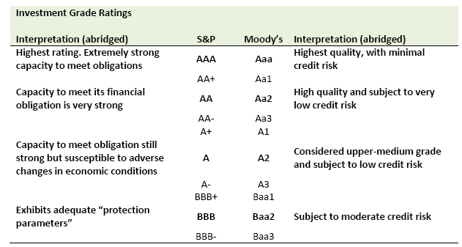
External and Internal Ratings

Slide 90
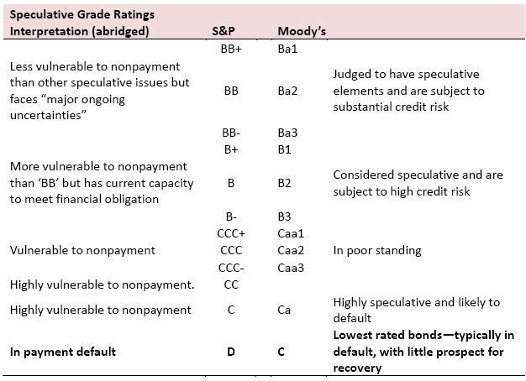
External and Internal Ratings

Slide 91
External and Internal Ratings
The rating process will differ according to the type of instrument being rated. The rating process for industrial bonds (following the example of S&P) focuses on the following areas:
  Business Risk
  Competitive Positioning
  Financial Risk
  Financial Policies
  Capitalization
  Financial Flexibility
Internationally, the sovereign rating will be the ceiling for the rating of an issuer within that country. For sovereigns, there are additional factors to consider such as:
  Political stability
  Social and economic coherence.
  Integration into global economic system.
  Industry Characteristics
  Management
  Financial Characteristics
  Profitability
  Cash flow protection

Slide 92
External and Internal Ratings
Rating and Default
  Ratings communicate an opinion about the creditworthiness of an issuer or an obligation. They should indicate the likelihood and severity of default. Characteristics of ratings performance for corporate bonds:
    Ratings and corporate default rates are inversely related. This inverse relationship holds for all time periods following the ratings, such as one year, five years, ten years, etc.
    Yield spreads over treasury bonds correlate highly with ratings (i.e., the greater the spread, the lower the credit rating).
    Default rates for investment grade issues (Baa or better) are substantially lower than default rates for speculative grade issues (Ba or worse).

Slide 93
External and Internal Ratings
Rating and Default (cont’d)
  Agencies publish cumulative default rates categorized by rating (i.e., the cumulative default rate per rating category) and transition matrices. Transition matrices plot the frequency of rating migrations over time;
Rating From | Rating To
 | A | B | C | D
A | 97% | 3% | 0% | 0%
B | 2% | 93% | 2% | 3%
C | 1% | 12% | 64% | 23%
D | 0% | 0% | 0% | 100%
Time 0
Time 1
Time 2
A
A
B
B
B
C
C
D
D

Slide 94
External and Internal Ratings
At-the-Point Approach and Through-the-Cycle
  At-the-Point-in-Time: assesses credit quality over the near term; i.e., a few months or one year.
  Through-the-Cycle: rating agencies try to incorporate business cycles. Ratings are therefore typically considered “through-the-cycle”. Through-the-cycle ratings try to “filter out” cycle fluctuations. Because they incorporate an average, when economic conditions vary from the average, through-the-cycle may over- and under-estimate credit quality.
Impact of Rating Changes on Corporate Security Price
  If ratings bring information about the credit quality of firms, a change in rating should lead to changes in the prices of corporate securities such as bonds issued by firm.
    An upgrade is likely to have a positive impact on bond prices while a downgrade is likely to have a negative impact on bond price.
    The result is statistically stronger for downgrades.

Slide 95
Country Risk
Sources of Country Risk
  Economic growth life cycle
  Political risk
  Legal system in a country
  Disproportionate dependence on a particular product or service
Composite Measures of Country Risk
  Political Risk Services (PRS)
  Euromoney
  The Economist
  The World Bank

Slide 96
Country Risk
Sovereign Default
  Foreign Currency Defaults
    Many governments have been dependent on debt borrowed from other countries, usually denominated in a foreign currency. A large proportion of sovereign defaults have occurred with this type of sovereign borrowing, as the borrowing country finds it’s short of the foreign currency to meet its obligations, without the option of being able to print money in that currency.
  Local Currency Defaults
    Countries should be able to print more of the local currency to meet their obligations and should never default. There are three reasons why local currency default occurs. Gold Standard; Shared Currency; The Alternative of Printing more Currency to Pay Debt Obligations has Costs.
    Some countries may choose to default in local currency debt because they have foreign currency debt funding local currency assets.

Slide 97
Country Risk
Sovereign Default (cont’d)
  Factors Determining Sovereign Default Risk
    Degree of Indebtedness
    Pensions/Social Service Commitments
    Revenues/Inflows to Government
    Stability of Revenues
    Political Risk
    Implicit Backing from other Entities
  Problems with Sovereign Default Measurement by Rating Agencies
    Ratings are upward biased
    There is herd behavior
    Too little, too late
    Vicious Cycle
    Ratings Failures

Slide 98
Country Risk
Sovereign Default (cont’d)
  Using Sovereign Default Spread as a Predictor of Defaults
    Sovereign Default Spread
      When a government issues bonds, denominated in a foreign currency, the interest rate on the bond can be compared to a rate on a riskless investment in that currency.
    Advantage
      Market differentiation for risk is more granular than the ratings agencies
      Market-based spreads are more dynamic than ratings
    Disadvantages
      Tend to be more volatile than ratings
      Can be affected by variables that have nothing to do with default. Liquidity and investor demand can cause shifts in spreads that have little or nothing to do with default risk.

Slide 99
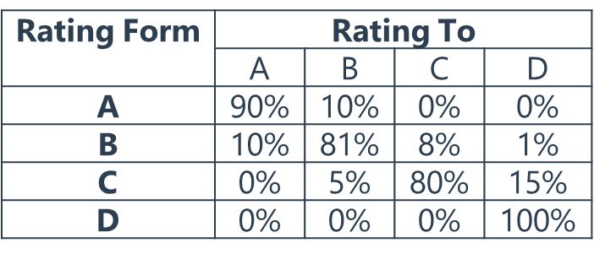
Exercise 1
A bank uses a 4-grade scale for its internal credit model. The 1-year rating transition probabilities for this model are given. If a newly issued bond is rated “A” by this model, what is the probability that it will be rated “B” or lower two years from now?
  9%
  10%
  18%
  19%
Answer: C

Slide 100
Exercise 2
GF Bank has contractually agreed to a $50,000,000 credit facility with ABC Corp., of which $32,000,000 is currently outstanding. ABC has very little collateral, so GF Bank estimates a one-year probability of default of 3%. The collateral is unique to its industry with limited resale opportunities, so GF Bank assigns an 90% loss rate. The expected loss (EL) for GF Bank is closest to:
  $78,000
  $96,000
  $788,000
  $864,000
Answer: D

Slide 101
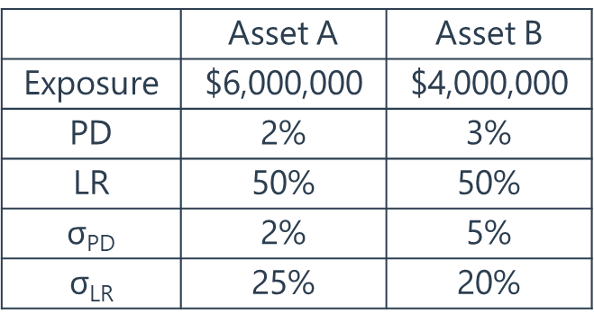
Exercise 3
GF Bank has two assets outstanding. The features of the loans are summarized in the following table. Assuming a correlation of 0.3 between the assets, what is the value of the unexpected loss of the portfolio (ULP)?
  Less than $500,000
  Between $500,000 and $2,000,000
  Between $2,000,000 and $3,000,000
  Greater than $3,000,000
Answer: A

Slide 102
Exercise 4
A bank has extended two loans to customers in the same industry. Both loans are have an exposure amount (EA) of $50.0 million, default probability (PD) of 2.0%, loss rate (LR) of 50.0%, and standard deviation of loss rate of 60.0% such that each loan has an expected loss of $500,000 and an unexpected loss of $5.5 million. In this way, the bank's credit portfolio consists of these two credit assets; and the default correlation between the two loans is 0.28. Which is nearest to the risk contribution of each asset to the portfolio's unexpected loss?
  $3.33 million
  $4.40 million
  $5.37 million
  $5.50 million
Answer: B

Slide 103
Operational Risk
Operational Risk
  The risk of loss resulting from inadequate or failed internal processes, people, and systems or from external events.
Basel’s Seven Categories of Operational Risk
  Internal Fraud
  External Fraud
  Employment Practices and Workplace Safety
  Clients, Products, and Business Practices
  Damage to Physical Assets
  Business Disruption and System Failures
  Execution, Delivery, and Process Management

Slide 104
Loss Distribution Approach
Loss Frequency Distribution
  Models number of losses
  Common probability distribution: Poisson Distribution
Loss Severity Distribution
  Models size of a loss
  Common probability distribution: Lognormal Distribution
Loss Distribution
  Assume that loss severity and loss frequency are independent
  The frequency and severity distributions must be combined; Monte Carlo simulation can be used for this purpose.
    Sample from frequency distribution to determine number of losses
    Sample n times from the loss severity distribution to determine the loss experienced for each loss events
    Determine the total loss experienced

Slide 105
Loss Distribution Approach
Data Issues
  Loss frequency distribution: bank’s own data as far as possible.
  In regard to the loss severity data, regulators encourage banks to use their own data in conjunction with external data. There are two sources of external data: data obtained through sharing arrangements between banks; and publicly available data collected by third-party vendors.
  Relevant historical data is difficult to obtain, so regulators encourage banks to use scenario analysis, in addition to internal and external loss data. This involves managerial judgment to generate scenarios where large losses occur.

Slide 106
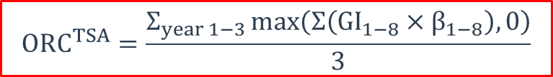
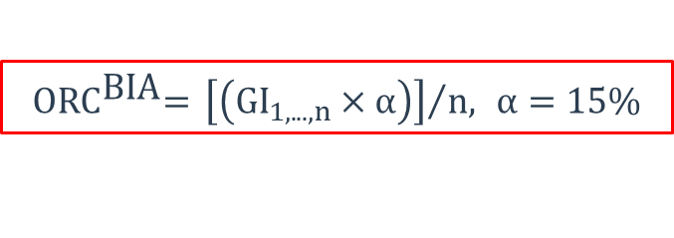
Regulatory Capital Requirement
Basic Indicator Approach: through a simple calculation of the average gross revenue for the past 3 years, multiplied by 15%.
Standardized Approach: The total capital charge is calculated as the three-year average of the simple summation of the regulatory capital charges across each of the business lines in each year.
$${\text{ORC}}^{\text{BIA}}\text{= }{\left[\left(GI_{1,...,n}×α\right)\right]}/{n, }α=15\%$$
$$ORC^{TSA}=\frac{Σ_{year 1−3}\max\left(Σ\left(GI_{1−8}×β_{1−8}\right),0\right)}{3}$$
Corporate Finance | 18% | Angency and custody services | 15%
Trading and sales | 18% | Asset management | 12%
Settlement and payment activities | 18% | Retail brokerage | 12%
Commercial banking | 15% | Retail banking | 12%

Slide 107

Regulatory Capital Requirement
Advanced Measurement Approach (AMA)
  Allows a bank to design its own model for calculating operational risk capital. Three main requirements:
    Must hold capital for a 1-year horizon at 99.9% confidence level.
    All four elements of the framework must be included in the model: internal loss data, external loss data, scenario analysis, and business environment internal control factors.
    There must be an appropriate method for allocating the capital to the businesses to incent good behavior.
$${\text{ORC}}^{AMA}\text{= }\text{UL}\text{(1−}\text{year}\text{, 99.9\% }\text{confidence}\text{)}$$

Slide 108
Risk Control Self-Assessment
RCSA
  Involves asking business unit managers to identify their operational risks. Sometimes questionnaires designed by senior managers are used.
  First identify and assess inherent risks by making no inferences about controls embedded in the process: controls are assumed to be absent.
  Once these inherent risks are understood, controls will be added in the RCSA framework. The effectiveness of these controls are then assessed. The residual risk is also calculated, which is the risk that is left after inherent risks are controlled.
  Risk metrics such as key risk indicators (KRIs) would contribute to the risk identification process. These indicators/factors are mostly quantitative and are used as a proxy for the quality of the control environment of a business. Examples of key risk indicators are staff turnover and number of failed transactions.

Slide 109
Exercise 1
Which of the following statements concerning the measurement of operational risk is correct?
  Economic capital should be sufficient to cover both expected and worst-case operational risk losses.
  Loss severity and loss frequency tend to be modeled with lognormal distributions.
  Operational loss data available from data vendors tend to be biased towards small losses.
  The standardized approach used by banks in calculating operational risk capital allows for different beta factors to be assigned to different business lines.
Answer: D

Slide 110
Exercise 2
In the Basel II Standardized Approach for operational risk, the beta factor serves as a proxy for the industry-wide relationship between the operational risk loss experience for a given business line and the aggregate level of gross income for that business line. Which of the following lines has the highest beta factor?
  Corporate finance
  Retail banking
  Commercial banking
  Asset management.
Answer: A

Slide 111
Governance over Stress Testing
Key Elements of Effective Governance over Stress Testing
  Governance Structure
  Internal Audit
Governance Structure
  Board of Directors
    The board should evaluate and discuss information received from senior management about stress testing to ensure that the stress testing activities are in line with the institution’s risk appetite.
    Need to review with a critical eye, challenging key assumption.
    The board should be able to take action based on its review of stress test results including changing capital levels, altering strategies or withdrawing from certain activities. Stress-testing activities can serve as a useful “early-warning” mechanism for the board.
  Policies, Procedures and Documentation
  Validation and Independent Review

Slide 112
Governance over Stress Testing
Governance Structure (cont’d)
  Senior Management
    Duties: Establishing policies and procedures and ensuring their compliance. Allocating resources and assigning skilled staff. Overseeing stress-test development and implementation. Evaluating stress-test results. Reviewing findings related to the functioning of stress test processes and taking necessary remedial action.
    Responsible for reporting to the board.
    Ensure there is appropriate buy-in at different levels of the institution.
    Benchmarking or other comparative analysis should be used to evaluate the stress-testing results.

Slide 113
Governance over Stress Testing
Governance Structure (cont’d)
  Senior Management (cont’d)
    Should use stress testing to supplement other information it develops and provides to the board, such as other risk metrics or measures of capital and liquidity adequacy.
    Should ensure that staff involved in stress testing operate under the proper incentives.
    Should ensure that there is a regular assessment of stress testing activities across the institution by an independent, unbiased party.
    Ensures that stress-testing activities are updated in light of new risks, better understanding of the institution’s exposures and activities, new stress-testing techniques, updated data sources and changes in its operating structure and its internal and external environment.

Slide 114
Governance over Stress Testing
Internal Audit
  Provides independent evaluation of the ongoing performance, integrity and reliability of stress-testing activities. It is not expected that internal audit will have knowledge of all stress-test details, or will have to independently assess each stress test used.
  Serves the valuable task of assessing the full suite of stress-testing activities across the institution on a regular basis to evaluate whether, as a whole, such activities are functioning as intended, in adherence with policies and procedures and serving the institution properly.

Slide 115
Governance over Stress Testing
Policies, Procedures and Documentation
  Stress Testing Policies should:
    Describe the overall purpose of stress-testing activities.
    Indicate stress-testing roles and responsibilities.
    Outline the process for choosing stressful conditions for tests.
    Include information about validation and independent review.
    Provide transparency to third parties for their understanding of an institution’s stress testing activities.
    Be reviewed and updated as necessary to ensure that stress testing practices remain appropriate and keep up to date with changes.
  An institution should ensure that its stress tests are documented properly, including a description of the types of stress tests and methodologies used, test results, key assumptions, limitations and uncertainties, and suggested actions.

Slide 116
Governance over Stress Testing
Validation and Independent Review
  Ensuring that there is appropriate independence and effective challenge in the validation and review process;
  Including validation and independent review of the qualitative or judgmental aspects of a stress test – such aspects can be an integral component of a stress test and should be reviewed, even if they cannot be tested in a quantitative/statistical sense;
  Ensuring that stress tests are subject to development standards, including a clear statement of purpose, proper theory and design, sound methodologies and processing components, and developmental testing (including testing of assumptions);
  Acknowledging limitations in stress-testing methodologies, even if they represent best practices;

Slide 117
Governance over Stress Testing
Validation and Independent Review (cont’d)
  Recognizing any data limitations or weaknesses in data quality;
  Ensuring that stress tests are implemented in a rigorous manner that is appropriate for the stated use, and accounting for any changes to the developed stress test that occur during implementation;
  Monitoring performance on an ongoing basis and assessing any degradation in performance (where possible);
  Expressing stress-test uncertainty and inaccuracy, including in the form of confidence bands around estimates and/or factors not observable or not fully incorporated;
  Ensuring that vendor or other third-party models are sufficiently validated, including their implementation, to ensure they function as intended and are appropriate for the institution’s use.

Slide 118
Stress Testing and Other Risk Management Tools
Relationship between Stress Testing and Other Risk Measure
  In practice, stress tests usually focus on a few scenarios, whereas VaR measures commonly utilize a very large number of scenarios.
  In practice, the loss estimates are often defined differently between stress tests and economic capital/VaR method:
    Measurement units (accounting vs. market): Stress test losses measure accounting-based implications.
    Time horizon: Enterprise-wide stress tests often examine a long period such as losses over 9 quarters in the Dodd–Frank stress tests in the US.
    Role of Probabilities: usually assign ordinal rank assignments
    Approach: rather than unconditional scenarios typically generated in VaR-type metrics. Especially in the case of regulatory stress tests, the scenario-generation process looks at the present period as the starting point and generates two or three hypothetical scenarios from that point.

Slide 119
Principles for Sound Stress Testing
Stress Testing Principles for Banks
  Stress testing should form an integral part of the overall governance and risk management culture of the bank.
  Should operate a stress testing program that promotes risk identification and control; provides a complementary risk perspective to other risk management tools; improves capital and liquidity management; and enhances internal and external communication.
  Should take account of views from across the organization and should cover a range of perspectives and techniques.
  Should have written policies and procedures governing the stress testing program.
  Should have a suitably robust infrastructure in place, which is sufficiently flexible to accommodate different and possibly changing stress tests at an appropriate level of granularity.
  Should regularly maintain and update its stress testing framework.

Slide 120
Principles for Sound Stress Testing
Stress Testing and Scenario Selection
  Stress tests should cover a range of risks and business areas, including at the firm-wide level.
  Stress testing programs should cover a range of scenarios, including forward-looking scenarios, and aim to take into account system-wide interactions and feedback effects.
  Stress tests should feature a range of severities, including events capable of generating the most damage whether through size of loss or through loss of reputation.
  Reverse stress tests start from a known stress test outcome (such as breaching regulatory capital ratios, illiquidity or insolvency) and then asking what events could lead to such an outcome for the bank.
  As part of an overall stress testing program, a bank should aim to take account of simultaneous pressures in funding and asset markets, and the impact of a reduction in market liquidity on exposure valuation.

Slide 121
Principles for Sound Stress Testing
Stress Testing and Scenario Selection (cont’d)
  A bank should enhance its stress testing practices by considering important interrelations between various factors.
  Effectiveness of risk mitigation techniques should be systematically challenged.
  The stress testing program should explicitly cover complex and bespoke products such as securitized exposures.
  The stress testing program should cover pipeline and warehousing risks. A bank should include such exposures in its stress tests regardless of their probability of being securitized.
  A bank should enhance its stress testing methodologies to capture the effect of reputational risk.
  A bank should enhance its stress testing approaches for highly leveraged counterparties and in assessing potential wrong-way risk related to risk mitigating techniques.

Slide 122
It's easier to give up, but you won't get anything in the end. It's harder to keep going, but you would get something in the end.
放弃当然很容易，但你最终什么也得不到。继续当然很难，但你总会得到一些东西。

