Slide 1
Financial Market and Product
FRM Part I 强化班 培训讲义
讲师：Xiao

Slide 2
Topic Weightings in FRM Part I
Session NO. | Content | Weights
Study Session 1 | Foundations of Risk Management | 20
Study Session 2 | Quantitative Analysis | 20
Study Session 3 | Financial Markets and Products | 30
Study Session 4 | Valuation and Risk Models | 30

Slide 3
Financial Institutions
  Banks
  Insurance Companies and Pension plan
  Mutual Funds and Hedge Funds
  Swaps
  Options Markets
  Properties of Stock Options
  Trading Strategies
  Exotic Options
  Commodity Forwards and futures
  EX,OTC,DPCs and SPVs
  Basic Principles of Central Clearing
  Foreign Exchange Risk
  Corporate Bonds
  MBS
Financial Products
  Introduction
  Mechanics of Futures Markets
  Hedging Strategies
  Interest Rate
  Forward and Future Prices
  Interest Rate Futures

Slide 4
Banks
Financial Institutions

Slide 5
The Risks Facing Banks
Credit Risk
  Credit risk is the risk that counterparties in a loan transactions and derivatives transactions will default.
  Greatest risk facing a bank and is usually the one for which the most regulatory capital is required.
Market Risk
  Market risk arises primarily from the bank’s trading operations.(trading book will decline in value)
Operational Risk
  The risk that losses are made because internal systems fail to work or because of external events.

Slide 6
Capital Management
Economic capital
  This is the capital that the bank, using its own models rather than those prescribed（规定的） by regulators,
  However, banks have no choice but to maintain their capital above the regulatory capital level.
Regulatory Capital
    the capital required to be held by banks as a requirement for meeting the central bank regulators objective of keeping the total capital of a bank adequately high, so that the chance of a bank failure is very low.
    Capital is required for three types of risk.(Basel)
    The time horizon used by regulators for considering losses from credit risks and operational risks is 1 year, whereas the time horizon for considering losses from market risks is usually much shorter.

Slide 7
Capital Management
Economic capital is typically (or at least often) less than regulatory capital.
  Still banks should maintain their capital levels adequately above the regulatory minimum so as to avoid having to raise capital at short notice when required.

Slide 8
Deposit Insurance
Moral hazard problem.
  As a measure of restoring confidence in banks, government regulators in many countries often insure depositors for losses up to a certain level under their guaranty programs.
  Moral hazard can be stated as the possibility that the existence of insurance changes the behavior of the insured party.
  Federal Deposit Insurance Corporation (FDIC) to protect depositors.

Slide 9
Investment Banking Financial Arrangement
Private Placement
  Securities are sold to small number of large institutional investors, such as life insurance companies/pension funds, and investment bank receives a fee.
Public Offering
  Securities are offered to the general public. A public offering may be on a best efforts or firm commitment basis.
  Best Efforts: the investment bank does as well as it can to place the securities with investors and is paid a fee that depends, to some extent, on its success.
  Firm Commitment: the investment bank agrees to buy the securities from the issuer at a particular price and then attempts to sell them in the market for a slightly higher price.it ends up owning them itself.

Slide 10
Potential Conflicts of Interest In Banking
While selling advisory services to investors, a bank may promote securities that its investment banking division is trying to sell.
The confidential information obtained about the company to which a bank lends may be misused.
The research side of the securities division might be enticed(诱使) to rate a company's share as a “buy”, so as to please the company's management and get more investment banking business.
Separating the commercial banking division from investment banking.
  For this, internal barriers known as Chinese walls can be set up. This prohibits the transfer of information from one part of the bank to another when this is not in the best interests of the bank's customers.

Slide 11
Banking Book and Trading Book
Trading Book
  Trading book includes all the assets and liabilities the bank has as a result of its trading operations; i.e., instruments the bank intends to trade.
  marked to market daily
    For example, if a bank buys an asset for $100 on one day and the price falls to $60 the next day, it records an immediate loss of $40.
  marking to model.
    A model has to be assumed by the bank

Slide 12
Banking Book and Trading Book
Banking Book
  Banking book includes loans made to corporations and individuals.
  These loans are not marked to market.
    When a borrower makes principal and interest payments of a loan on time, the loan is recorded in the bank's books at the principal amount owed plus accrued interest.
    If payments due from the borrower are more than 90 days past due, the loan is usually classified as a non-performing loan. In this case the bank does not then accrue interest on the loan when calculating its profit.
    When it becomes likely that principal of the loan will not be repaid, the loan is classified as a loan loss.——Reserve

Slide 13
Originate-to-Distribute Model
Characteristic
  Involves the bank originating but not keeping loans. Portfolios of loans are packaged into tranches which are then sold to investors.
  Also termed securitization.
Benefits
  By securitizing the loans it gets them off the balance sheet and frees up funds to enable it to make more loans.
  It also frees up capital that can be used to cover risks being take elsewhere in the bank.
  A bank can earn a further fee if it services the loan after it has been sold
Drawbacks
  Banks may relax their mortgage lending standards and the credit quality of the instruments being originated may decline sharply.

Slide 14
Identify the major risks faced by a bank.★
Distinguish between economic capital and regulatory capital.★★
Explain how deposit insurance gives rise to a moral hazard problem.★
Describe investment banking financing arrangements.★
Describe the potential conflicts and recommend solutions.★
Describe the distinctions between the banking book and the trading book of a bank.★
Explain the originate-to-distribute model.★★

Slide 15
Insurance Companies and Pension Plan
Financial Institutions

Slide 16
Various Categories of Insurance Companies
Various Categories of Insurance Companies
  Insurance companies may be classified under two main categories. They are life insurance or nonlife insurance (also known as property-casualty insurance) firms.
  A pension plan is also a form of insurance arranged by a company for its employees.
Main feature
  policy holders makes regular premium payments in exchange for the promise of receiving contingent payout(s) which triggered by well-defined (contractual——契约) events.

Slide 17
Mortality Table
Extract from US Mortality Tables (2013): Male
Extract from US Mortality Tables (2013): Female
Age | Prob. death within one year | Prob. Survival | Life expectancy (yrs)
30 | 0.001467 | 0.97519 | 47.82
31 | 0.001505 | 0.97376 | 46.89
32 | 0.001541 | 0.97230 | 45.96
33 | 0.001573 | 0.97080 | 45.03
Age | Prob. death within one year | Prob. Survival | Life expectancy (yrs)
30 | 0.000664 | 0.98635 | 52.01
31 | 0.000705 | 0.98569 | 51.04
32 | 0.000748 | 0.98500 | 50.08
33 | 0.000794 | 0.98426 | 49.11

Slide 18
Mortality Table
How Tables Are Used In Pricing Life Insurance
  Consider a female aged 30
  Probability of death during first year is 0.000664
  Probability of death during second year is
  (1-0.000664) × 0.000705
  Probability of death during third year is
  (1-0.000664) × (1-0.000705) ×0.000748
  Etc…
  Minimum premium is such that present value of inflows equals present value of outflows.

Slide 19
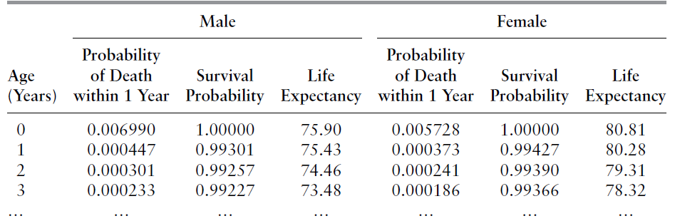
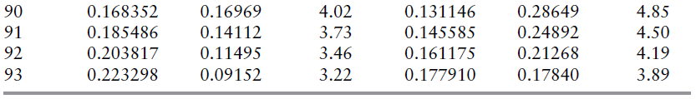
Mortality Table
Valuation of Life Insurance Contracts
  Mortality tables are the key to valuing life insurance contracts.

Slide 20
Mortality Table
Valuation of Life Insurance Contracts (cont’d)
  Example
  Assume interest rates for all maturities are 4% per annum (with semiannual compounding). Premiums are paid once a year at the beginning of the year. Given the above mortality tables, what is an insurance company’s break-even premium for $100,000 of life insurance for a man of average health aged 90?
    Scenario 1: Lasts 1 year. Payout occurs halfway through the year.
      Expected payout: 0.168352 × 100,000 = $16,835
      Premium: 16,835/1.02 = $16,505
    Scenario 2: Lasts 2 years. Payout in 1st year occurs halfway through the year. Payout in the 2nd year occurs at time 18 months.

Slide 21
Mortality Table
Valuation of Life Insurance Contracts (cont’d)
  Example (cont’d)
  Present value of expected payout in the first year: $16,505
  Probability that the policyholder dies during the second year is:
  (1 – 0.168352) × 0.185486 = 0.154259
  Present value of expected payout in the second year:
  0.154259 × 100,000/(1.02³) = $14,536
  Total present value of payouts is: $16,505 + $14,536 = $31,041
  Present value of the premium payments is:
  X + (1 – 0.168352)X/(1.02²) = 1.799354X
  The break-even annual premium is the value of X that solves:
  1.799354X = 31,041 → X = $17,251

Slide 22
Property-casualty insurance companies
Based on their concentration of activities in either property insurance and casualty insurance.
  Property insurance provide protection against loss of or damage to property from accidents, fire, theft, water damage, etc.
  Casualty insurance provides protection to individuals and companies against legal liability exposures (from, for example, injuries caused to third parties).

Slide 23
Risks Facing Insurance Companies
Risks facing insurance companies:
  The reserves held by the insurance companies to meet the payouts as required by the claims of policyholders may fall short of their estimation. This is the biggest risk faced by the insurance companies.
  Another risk faced by insurance companies is that they mostly invest in corporate bonds and when defaults on corporate bonds increase, it takes a toll on the profitability of the insurance company.
  They face liquidity risks associated with their investments. Illiquid bonds give higher yields but they cannot be readily converted into cash to meet high claims when they are not anticipated beforehand.
  Since insurance companies enter into transactions with banks and reinsurance companies, they are also exposed to credit risk.
  Finally, like banks, insurance companies are also exposed to operational risks and business risks.

Slide 24
Risks in Life Insurance
Mortality Risk
  The risk that wars, epidemics such as AIDS, or pandemics such as Spanish flu will lead to people living not as long as expected.
  This adversely affects the payouts on most types of life insurance contracts since the insured amount has to be paid earlier than expected.
Longevity Risk
  The risk that advances in medical sciences and lifestyle changes will lead to people living longer.
  Increases in longevity increases the profitability of most life insurance contracts since final payout is either delayed or less likely to happen.
  Hedging: If the exposure in the insurance company is unacceptable, they may decide to enter into reinsurance contracts for some of the risks.

Slide 25
Moral Hazard and Adverse Selection
By aligning the interest of the policyholders more closely with those of the insurance company, moral hazard can be handled better, as explained by using the following methods:
  Deductibles（免赔额）: The policyholder is responsible for bearing the first part of any loss.
  Co-insurance provision（共同保险条款）: The insurance company pays a predetermined percentage (less than 100%) of losses in excess of the deductible.
  Policy limit（保单限额）: An upper limit to the payout is set by the insurance company.

Slide 26
Moral Hazard and Adverse Selection
Two important risks facing insurance companies
  Adverse selection occurs when an insurance company cannot distinguish between good and bad risks and as a result it offers the same price to everyone, thereby attracting more of the bad risks.

Slide 27
Key Indicators
Loss Ratio
  Loss ratio is the ratio of payouts made to premiums earned in a year by an insurance company.
Expense Ratio
  Ratio of expenses to premiums earned in a year.
  The two major sources of expenses are loss adjustment expenses（理赔费用） and selling expenses（销售费用）.
Combined Ratio
  Sum of the loss ratio and the expense.
  Sometimes a small dividend is paid to policyholders. Ratios taking it into account is referred to as the combined ratio after dividends.
Operating Ratio
  Take investment income into account.

Slide 28
Example of Ratios for Property-Casualty Insurance
Loss Ratio | 75%
Expense ratio | 30%
Combined ratio | 105%
Dividends | 1%
Combined ratio after dividends | 106%
Investment income | (9%)
Operating ratio | 97%
送分！

Slide 29
Capital Requirement
The table below shows the summary of the balance sheet for a life insurance company. Life Insurance (Investments are mostly long-term corporate bonds)
  it takes on credit risk because the default rate on the bonds may be higher than expected.
Assets |  |  | Liabs and Net worth
Investments | 90 |  | Policy Reserves | 80
Other assets | 10 |  | Sub Long Term Debt | 10
 |  |  | Equity Capital | 10
Total | 100 |  |  | 100

Slide 30
Capital Requirement
Property-Casualty Insurance (Investments are mostly liquid shorter maturity bonds)
Hence the risks associated with their business is higher. So, in turn, the equity required is higher here than that for life insurance companies as seen in the table.
Assets |  |  | Liabs and Net worth
Investments | 90 |  | Policy Reserves | 45
Other assets | 10 |  | Unearned premiums | 15
 |  |  | Sub Long Term Debt | 10
 |  |  | Equity Capital | 30
Total | 100 |  |  | 100

Slide 31
DB Plans and DC Plans
Companies set up pension plans for their employees with regular contributions from both the employer and the employee while the employee is working. This serves as a source of income for the employees after they retire until the time of their death. There are two types of pension plans which are as described below:
Main types
  Defined benefit plan
  Defined contribution plan

Slide 32
DB Plans and DC Plans
Defined benefit plan
  The pension that the employee will receive on retirement is defined by the plan.
  Typically it is calculated by a formula that is based on the number of years of employment and the employee’s salary.
  Defined Contribution Plan
  In a defined contribution plan, the contributions to the plan are defined, and the employer and employee contributions are invested on behalf of the employee. When employees retire, the final value of the contributions invested so far can be converted to a lifetime annuity or received as a lump sum.

Slide 33
DB Plans and DC Plans
Differences between a DB and a DC plan
  In a defined benefit plan, all contributions are pooled and payments to retirees are made out of the pool. In a defined contribution plan, the funds are identified with individual employees. An account is set up for each employee and the pension is calculated only from the funds contributed to that account.
  Defined contribution plans involve very little risk for employers. If the performance of the plan’s investments is less than anticipated, the employee bears the cost. By contrast, defined benefit plans impose significant risks on employers because they are ultimately responsible for paying the promised benefits.

Slide 34
Describe the key features of insurance companies and identify the risks.★
Describe the use of mortality tables and calculate the premium payment and the expected payout for a policy holder. ★★★
Calculate and interpret ratios.★
Describe moral hazard and adverse selection risks and how to overcome. ★★
Distinguish between mortality risk and longevity risk and how to hedge. ★
Evaluate the capital requirements. ★
Compare the guaranty system and the regulatory requirements.
Describe a defined benefit plan and a defined contribution plan for a pension fund and explain the differences between them. ★★★

Slide 35
Mutual funds and Hedge funds
Financial Institutions

Slide 36
Mutual Funds and ETFs
Different Types of Mutual Funds——diversification opportunities
  Open-End Funds
  Shares in the fund can be bought from the fund or sold back to the fund at any time.
  They are valued once a day, at 4 p.m. When an investor issues instructions to buy or sell shares, the value calculated at the end of the day is applied for the transaction made before that time during that day.
  The value of each share is calculated in terms of net asset value(NAV) of the fund which is equal to total value of the portfolio divided by the number of shares outstanding. The total value of the portfolio in turn is calculated as the sum of market values of each asset in the portfolio.

Slide 37
NAV of an Open-end Mutual Fund
Net Asset Value (NAV)
  To obtain the value of each share for an open-end mutual fund, the mutual fund manager first calculates the market value of each asset in the portfolio so that the total value of the fund is determined.
  This total value is then divided by the number of shares outstanding to find out the value per share called the net asset value (NAV) of the fund.
  For example
  if the total value of the all the assets in the fund is calculated to be $100 million and if the number of outstanding shares is 2 million, then the NAV is $50 per share (=100/2).

Slide 38
Mutual Funds and ETFs
Different Types of Mutual Funds
  Closed-End Mutual Funds
  They have a fixed number of shares outstanding.
  Closed-end funds are like regular corporations and the shares of the fund are traded on a stock exchange which means they can be bought and sold during any time of the day.
  For closed-end funds, two NAVs can be calculated.
  One is the price at which the shares of the fund are trading.
  The other referred to as the fair market value is the market value of the fund’s portfolio divided by the number of shares outstanding. Usually a closed-end fund’s share price is less than its fair market value. Fees paid to fund managers are considered to be a reason for this.

Slide 39
Mutual Funds and ETFs
Exchange-Traded Funds（ETFs）
  They often track an index and so are an alternative to an index mutual fund for investors who are comfortable earning a return that is designed to mirror the index.
  An institutional investor deposits a block of securities with the ETF and obtains shares in the ETF (known as creation units) in return. Some or all of the shares in the ETF are then traded on a stock exchange. This gives ETFs characteristics of a closed-end fund rather than an open-end fund.
  Institutional investors can give up shares they hold in the ETF and receive the assets or they can deposit new assets and receive new shares. This ensures that there’s never any appreciable difference between the price at which shares in the ETF are trading and their fair market value. This is a key difference between ETFs and closed-end funds and makes ETFs more attractive to investors than closed-end funds.

Slide 40
Key Differences between HFs and MFs
Mutual funds vs Hedge Funds
  Mutual Funds which are called “unit trusts” （单位信托基金）in some countries, serve the needs of relatively small investors, while hedge funds seek to attract funds from wealthy individuals and large investors such as pension funds.
  Hedge funds are subject to much less regulation than mutual funds because they accept funds only from financially sophisticated individuals and organizations. This gives them a great deal of freedom to develop sophisticated, unconventional, and proprietary investment strategies. Hedge funds are sometimes referred to as alternative investments.
  Hedge funds are free to use a wider range of trading strategies than mutual funds and are usually more secretive about what they do.
  Mutual funds are required to explain their investment policies in a prospectus that is available to potential investors.

Slide 41
Return on HF and the Incentive Fee of HF
Return on a hedge fund investment （CFA）
  For an investor of hedge funds, the fees paid can be high. For example, consider an investment that is divided equally between two funds, A and B and both funds charge “2 plus 20;” i.e., the traditional arrangement of 2.0% of assets under management (AUM) plus 20.0% of realized profits. Recently, fee pressure has forced many firms to offer 1.5% and 15.0%; startup funds may offer even better terms.

Slide 42
Return on a HF Investment
Assume in the first year, Fund A earns 20% and Fund B earns –10% such that the investor’s average return on investment before fees is calculated as follows:
  Investor return before fees: 0.5 × 20% + 0.5 × (−10%) = 5%.
  Fees paid to the funds are:
  Fund A fees: 2% + 0.2 × (20 - 2)% = 5.6%.
  Fund B fees: only 2% since no profit is made.
  The average fee paid on the investment in the hedge funds is:
  (5.6 + 2)/2 =3.8%.
  The investor is left with a return of: 5 - 3.8 = 1.2%

Slide 43
Return on a HF Investment
Incentives of Hedge Fund Managers
  For example, consider there is a 0.40 probability of a 60% profit and a 0.60 probability of a 60% loss for a hedge fund that charges the industry standard fee of “2 plus 20%.”
  The expected return of the investment is calculated as:
  0.4 × 60% + 0.6 × (−60%) = –12%.
  Although the return is negative, the manager still earns a fee on it as calculated below.
  For a 60% profit the hedge fund’s fee is 2 + 0.2 × 58 = 13.6%.
  For the 60% loss, the hedge fund’s fee is 2%.
  The expected fee to the hedge fund is 0.4 × 13.6 + 0.6 × 2 = 6.64%

Slide 44
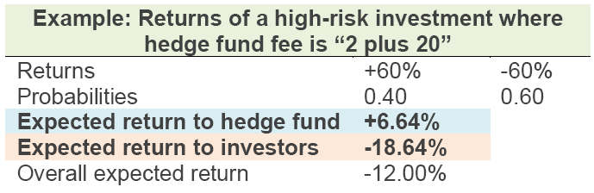
Return on a HF Investment
Incentives of Hedge Fund Managers
  The fee is therefore, 6.64% of the funds under administration. The expected management fee is 2% and the expected incentive fee is 4.64%.
  To the investors in the hedge fund, the expected return is negative as shown.
  0.4 × (60 - 0.2 × 58 - 2) + 0.6 × (−60 − 2) = −18.64 %
  The calculations are summarized in the table below.

Slide 45
Fee Structure
Fee Structure
  Hurdle Rate
  Minimum return necessary for the incentive fee to be applicable.
  High-Water Mark Clause
  Any previous losses must be recouped by new profits before an incentive fee applies.
  There may be a proportional adjustment clause stating that, if funds are withdrawn by investors, the amount of previous losses that has to be recouped is adjusted proportionally.
  Clawback Clause
  Allows investors to apply part or all of previous incentive fees to current losses. A portion of the incentive fees paid by the investor each year is then retained in a recovery account. This account is used to compensate investors for a percentage of any future losses
  However, these clauses are not always as useful to investors as they sound

Slide 46
Hedge Fund Strategies
Hedge Funds Strategies（名词解释）
  Long/Short Equity
    The hedge fund manager identifies a set of stocks that are considered to be undervalued by the market and a set that are considered to be overvalued. The manager takes a long position in the first set and a short position in the second set.
  Equity-Market-Neutral Fund
    Dollar-neutral fund: the dollar amount of the long position equals the dollar amount of the short position.
    Beta-neutral fund: the weighted average beta of the shares in the long portfolio equals the weighted average beta of the shares in the short portfolio so that the overall beta of the portfolio is zero.
  Dedicated Short
    Look exclusively for overvalued companies and sell them short.
    They are attempting to take advantage of the fact that brokers and analysts are reluctant to issue sell recommendations.

Slide 47
Hedge Fund Strategies
Distressed Securities
  Bonds with a credit rating of CCC are referred to as “distressed”. Typically, distressed bonds sell at a big discount to their par value and provide a yield that is over 10% more than the yield on Treasury bonds.
  Bankruptcy proceedings usually lead to a reorganization or liquidation of a company. Managers of funds are searching for debt that is undervalued by the market.
  Some funds are passive investors. They buy distressed debt when the price is below its fair value and wait. Other hedge funds adopt an active approach. They might purchase a sufficiently large position in outstanding debt claims so that they have the right to influence a reorganization proposal.

Slide 48
Hedge Fund Strategies
Merger Arbitrage
  Merger arbitrage involves trading after a merger or acquisition is announced in the hope that the announced deal will take place.
  Cash Deals
  Example: Suppose the shares of Company B were trading at $20 prior to the announcement. Immediately after the announcement its share price might jump to $28. Merger-arbitrage hedge funds buy the shares in company B for $28 and wait. If the acquisition goes through at $30, the fund makes a profit of $2 per share. If it goes through at a higher price, the profit is higher. However, if for any reason the deal does not go through, the hedge fund will take a loss.

Slide 49
Hedge Fund Strategies
Merger Arbitrage (cont’d)
  Share-for-Share Exchanges
  Example: Suppose that Company A announces that it is willing to exchange one of its shares for four of Company B’s shares. Assume that Company B’s shares were trading at 15% of the price of Company A’s shares prior to the announcement. After the announcement, Company B’s share price might rise to 22% of Company A’s share price. A merger-arbitrage hedge fund would buy a certain amount of Company B’s stock and at the same time short a quarter as much of Company A’s stock. This strategy generates a profit if the deal goes ahead at the announced share-for-share exchange ratio or one that is more favorable to Company B.

Slide 50
Hedge Fund Strategies
Convertible Arbitrage （这个相对来说重要一点）
  Convertible bonds are bonds that can be converted into the equity of the bond issuer at certain specified future times with the number of shares received in exchange for a bond possibly depending on the time of the conversion.
  The issuer usually has the right to call the bond in certain circumstances.
  Many convertible bonds trade at prices below their fair value. Hedge fund managers buy the bond and then hedge their risks by shorting the stock (delta hedging). Interest rate risk and credit risk can be hedged by shorting nonconvertible bonds that are issued by the company that issued the convertible bond.

Slide 51
Hedge Fund Strategies
Fixed Income Arbitrage
  Relative value strategy: hedge fund managers buy bonds that the zero-coupon yield curve indicates are undervalued by the market and sell bonds that it indicates are overvalued.
  Market-neutral strategies are similar to relative value strategies except that the hedge fund manager tries to ensure that the fund has no exposure to interest rate movements.
  Some fixed-income hedge fund managers follow directional strategies where they take a position based on a belief that a certain spread between interest rates, or interest rates themselves, will move in a certain direction.

Slide 52
Hedge Fund Strategies
Emerging Markets
  Emerging market hedge funds specialize in investments associated with developing countries.
  Some of these funds focus on equity investments. Usually they invest in securities trading on the local exchange, but sometimes they use American Depository Receipts (ADRs). They are backed by shares of a foreign company.
  Another type of investment is debt issued by an emerging market country. Eurobonds are bonds issued by the country and denominated in a hard currency such as the U.S. dollar or the euro. Local currency bonds are bonds denominated in the local currency.

Slide 53
Hedge Fund Strategies
Global Macro
  Global macro hedge fund managers carry out trades that reflect global macroeconomic trends.
  They look for situations where markets have, for whatever reason, moved away from equilibrium and placed large bets that they will move back into equilibrium.
Managed Futures
  Hedge fund managers that use managed futures strategies attempt to predict future movements in commodity prices.
  Some managers base their trading on technical analysis, which analyzes past price patterns to predict the future. Others use fundamental analysis, which involves calculating a fair value for the commodity from economic, political, and other relevant factors.

Slide 54
Differentiate among open-end mutual funds, closed-end mutual funds, and ETFs. ★ ★
Calculate the net asset value (NAV) ★ ★
Distinguish between active and passive management and define alpha. ★
Explain the key differences between hedge funds and mutual funds. ★ ★ ★
Calculate the return on a hedge fund investment and the incentive fee, the terms hurdle rate, high-water mark, and claw back. ★ ★ ★
Describe various hedge fund strategies, identify the risks faced by hedge funds. ★ ★
Describe hedge fund performance and explain the effect of measurement biases on performance measurement. ★ ★

Slide 55
Introduction
Financial Products

Slide 56
Board Categories of Traders
Hedgers
  Use derivatives markets to offset the risk（抵消风险） of prices moving unfavorably for their ongoing business activities.
Speculators
  Use derivatives to seek profits by betting on the future direction of market prices of the underlying asset. (赌徒）
Arbitrageurs
  Use derivatives to take offsetting positions in two or more instruments to lock in a profit.
Market maker
  A market maker is a firm facilitate the trading of a particular security to keep the financial market liquid by providing buy and sell quotations simultaneously.

Slide 57
Over-The-Counter Markets
A derivatives exchange is a central marketplace where participants can trade standardized contracts. The over-the-counter (OTC) market is an alternative to exchanges where trades take place between two counterparties directly or through a network of dealers linked by recorded phone conversations and computers.(customized contracts)
The key differences include the following:
Over-the-Counter | Exchange-Traded
Customized | Standardized
Trade with counterparty (Default Risk) | Backed by a clearing house
Not trade in a central location | Trade in a physical exchange
Unregulated | Regulated
Trading volume: large | Trading volume: small

Slide 58
Advantages and Disadvantages of OTC
Advantage of OTC
  Customization (a.k.a.,“tailored” exposure): The terms of a contract do not have to be those specified by an exchange.
  Market participants are free to negotiate any mutually attractive deal for any type of security.
  The OTC markets for derivatives are huge and thus may provide ample liquidity for trading in certain instruments.
Disadvantage of OTC
  Counterparty risk may be high when trades do not take place through a central counterparty (CCP).
  Since trades can be highly customized, for certain securities, active trading may not take place due to liquidity issues.

Slide 59
Over-The-Counter Markets
Forward | Futures
Trade over-the-counter (OTC) | Trade on an exchange
Not standardized | Standardized contracts
One specified delivery date | Range of delivery dates
Settled at contract’s end | Settled daily
Delivery or final cash settlement usually occurs | Contract usually closed out prior to maturity
Reduces basis risk due to tailored specifications but less liquid | High liquidity due to standardized specifications but more basis risk
Default risk is present | Guaranteed by clearinghouse
No margin deposit required | Margin required and adjusted

Slide 60
Options, Forward contract payoffs
Forward Payoff:
  If K is the delivery price and S_{t} is the spot price of the asset at maturity of the contract:
    Payoff for a long position in forward contract is S_{t} − K
    Payoff for a short position in forward contract is K − S_{t}
  Since the forward has no initial cost, its profit plot is identical to its payoff plot.

Slide 61
Options, Forward contract payoffs
Option Payoff:
  Payoff for a call option buyer (long) is Max (S_{t} − k, 0). The payoff to the call seller(short) is the negative of this value.
  Payoff for a put option buyer (long) is Max(k − S_{t}, 0). The payoff to the put seller(short) is the negative of this value.
  Since an option has an initial cost (the option premium), option charts plot the option profit as payoff minus the premium cost of the option.
      Profit=payoff-Premium cost of option

Slide 62
Options, Forward contract payoffs
Note the difference between an option payoff and an option profit:
  Premium: Initial cost (or initial investment or up-front cost)
  Payoff: Gain or loss on exercise (i.e., intrinsic value at exercise)
  Profit: Payoff of the option less its initial cost.
    To the long who buys the option:(Net)Profit=payoff-Premium
    To the short who sells (writes) the option:(Net)Profit=Premium-payoff

Slide 63
Options, Forward contract payoffs
Payoffs
  (a) long position, (b) short position.
  Delivery price = K
  Price of asset at contract maturity = S_{T}
Payoff
Payoff
0
0
K
S_{T}
K
S_{T}
Payoff = S_{T} – K
Payoff = K – S_{T}
(a)
(b)

Slide 64
Options, Forward contract payoffs
Payoffs of Options
Payoff
Payoff
S_{T}
S_{T}
K
K
Max(S_{T} – K, 0)
-Max(S_{T} – K, 0)
Payoff
Payoff
S_{T}
S_{T}
K
K
Max(K – S_{T}, 0)
-Max(K – S_{T}, 0)

Slide 65
Options, Forward contract payoffs
Profit of Call Option
Profit
Profit
+$1.50
$20.00
Premium
$21.50
Market
Price
Market
Price
0
0
Premium
$21.50
$20.00
-$1.50
Loss
Exercise Price
Loss
Exercise Price

Slide 66
Options, Forward contract payoffs
Profit of Put Option
Profit
Profit
+$0.70
$5.30
$6.00
Market
Price
Premium
Market
Price
0
0
Premium
$5.30
$6.00
-$0.70
Loss
Exercise Price
Loss
Exercise Price

Slide 67
Describe the OTC market and evaluate its advantages and disadvantages. ★★
Differentiate between options, forwards, and futures contracts. ★
Identify and calculate option and forward contract payoffs. ★
Calculate and compare the payoffs from hedging strategies involving forward contracts and options. ★
Calculate and compare the payoffs from speculative strategies involving futures and options. ★
Calculate an arbitrage payoff and describe how arbitrage opportunities are temporary. ★★
Describe some of the risks that can arise from the use of derivatives. ★
Differentiate among the broad categories of traders: hedgers, speculators, and arbitrageurs. ★

Slide 68
Mechanics of Futures Markets
Financial Products

Slide 69
Key Features of A Futures Contract
A futures contract is a standardized contract that trades on a futures exchange and is an agreement to buy or to sell an underlying asset at a delivery date at some pre-set futures price. The specifications of a futures contract include, but are not limited to:
Specifications of Futures Contract
  Asset:
    A Treasury bond futures contract(T bond≥15 years).
    A Treasury note futures contract(6.5 ≤ T note ≤ 10 years).
  Contract Size
    Treasury bond Futures has a face value of $100,000;
    S&P 500 Futures contract is index×$250 (multiplier of 250)
    Eurodollar futures contract has a face value of $1 million
  Delivery Arrangement：The exchange specifies delivery location.
  Delivery Month
  Price Quotes：For e.g., crude oil futures is quoted in dollars and cents.
  Price limits and position limits

Slide 70
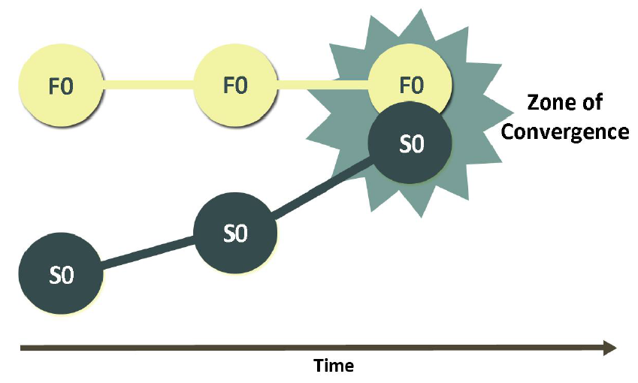
Convergence of Futures and Spot price
Convergence of Futures and Spot price
  At the futures contract approaches maturity, the spot price should converge with the futures price (at least to a so-called “zone of convergence”). Put another way, the basis (the difference between the spot and futures price) should converge toward zero as the futures contract approaches maturity.

Slide 71
Margin Requirement
Key terms are:
  Margin account: Broker requires deposit.
  Initial margin: Must be deposited when contract is initiated.
  Mark-to-market: At the end of each trading day, margin account is adjusted to reflect gains or losses.
  Maintenance margin: Investor can withdraw funds in the margin account in excess of the initial margin. A maintenance margin guarantees that the balance in the margin account never gets negative (the maintenance margin is lower than the initial margin).
  Margin call: When the balance in the margin account falls below the maintenance margin, the broker executes a margin call. The next day, the investor needs to “top up” the margin account back to the initial margin level.
  Variation margin: Extra funds deposited by the investor after receiving a margin call. There is only a variation margin if and when there is a margin call.
  Variation margin = Initial margin – Margin account balance

Slide 72
Margin Requirement
Example
Contract Specifications
Contract Size (ounces) |  | 100
Number of Contracts |  | 2
Initial Futures |  | $600
Margin | Per | Total
Initial margin | $2,000 | $4,000
Maintenance margin | $1,500 | $3,000

Slide 73
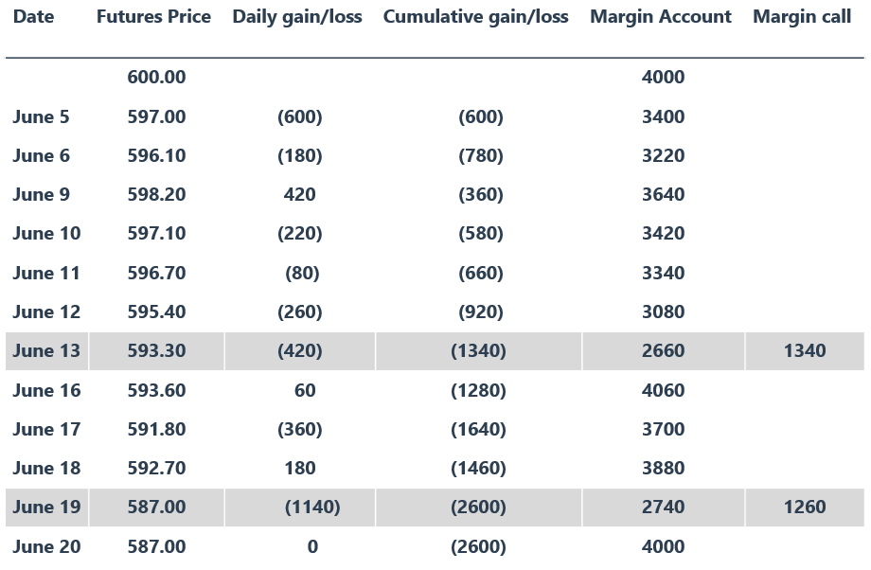
Margin Requirement
IMPORTANT CONCEPT: The maintenance margin is a trigger level—once triggered, the investor must “top up” to the initial margin level rather than just to the maintenance margin level.

Slide 74
Role of Clearinghouse in Futures
Role of Clearinghouse
  Acts as an intermediary in futures transactions
  Guarantees performance of parties
  Members must post funds with exchange. the broker or a clearing house member is required to maintain initial margin (“clearing margin”) with the clearinghouse.
  Main task to keep track of transactions, calculate net position of each member daily

Slide 75
Central Counterparties（CCPs）
Role of central counterparties in OTC markets
  Once an OTC derivative transaction has been agreed between two parties, the CCP assumes the credit risk of both sides of the trade and becomes the counterparty to both the parties.
    Members of the CCP, similarly to members of an exchange clearing house, have to provide both initial margin and daily variation margin.
    Like members of an exchange clearing house, they are also required to contribute to a guaranty fund.
    If an OTC market participant is not itself a member of a CCP, it can arrange to clear its trades through a CCP member by providing margin to the CCP. Its relationship with the CCP member is similar to the relationship between a broker and a futures exchange clearing house member.

Slide 76
Role of Collateralization
Collateralization (highlights) 其实不做单独考察，但是概念很重要！
  Similar to margining system for exchanges
  OTC contract between Company A & Company B
  Contract valuation once per day
  If contract value to Company A increases, Company B pays collateral equal to the increase (variation margin) and vice versa.
  Interest paid on outstanding balances

Slide 77
Differences Between A Normal and Inverted Futures Markets
Normal and Inverted Futures Market
  If the forward price is higher than the spot price (or the distant forward price is higher than the near forward price) the Futures curve is said to be normal, or in Contango.
    If the forward price is less than the spot price (or the distant forward price is less than the near forward price), the Futures curve is said to be inverted, or in Backwardation.
Futures Price
Spot Price
Spot Price
Time
Futures Price
Time

Slide 78
Different Market Quotes
Market Quotes
  Opening Price: prices at which contracts were trading immediately after the start of trading.
  Highest Price: during the Day and Lowest Price during the Day
  Settlement Price: Price at which the contract traded immediately before the end of a day’s trading session. It is the price used for calculating daily gains and losses and margin requirements.
  Trading Volume: number of contracts traded in a day.
  Open Interest: number of contracts outstanding, that is, the number of long positions or, equivalently, the number of short positions. If there is a large amount of trading by day traders the volume of trading in a day can be greater than either the beginning-of-day or end-of-day open interest.

Slide 79
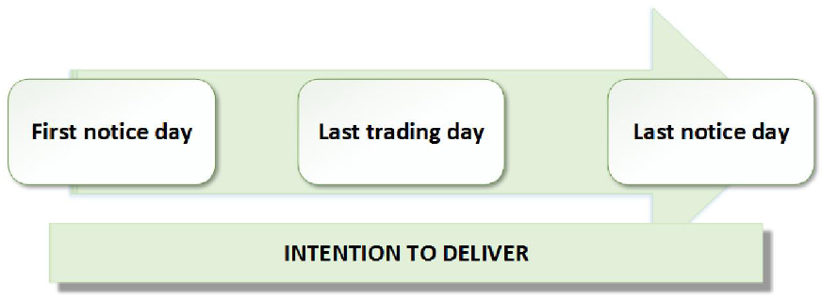
Delivery Process
Mechanics of the delivery process
  If the futures contract is not closed out before maturity, it is usually settled by delivering the asset underlying the contract. The most recent settlement price is used for delivery and this price is adjusted for grade, location of delivery, and so on.
  The whole delivery procedure from the issuance of the notice of intention to deliver to the delivery itself generally takes about two to three days, namely first notice day, last notice day and last trading day.
  Cash settlement
  S&P 500

Slide 80
Different Trading Order Types
Different trading order types(CFA)
  Market order (guarantees the transaction, but not the price): The market order is a simple (the simplest) request to execute the trade immediately at the best available price.
  Limit order (guarantees price, but not the transaction): A limit order specifies a particular price. The order can be executed only at this price or at one more favorable to the investor.
    For example : If the limit price is $30 for an investor wanting to buy, the order will be executed only at a price of $30 or less. There is no guarantee that the order will be executed at all, because the limit price may never be reached.

Slide 81
Different Trading Order Types
Stop-loss order (if an asset reaches a specified price, it, in effect, becomes a market order): The order is executed at the best available price once a bid or offer is made at that particular price or a less-favorable price.
  For example : Suppose a stop-loss order to sell at $30 is issued when the market price is $35. It becomes an order to sell if and when the price falls to $30. The purpose of a stop order is usually to close out a position if unfavorable price movements take place. It limits the loss that can be incurred.

Slide 82
Different Trading Order Types
Stop-limit order (combination of stop and limit: as soon as stop is breached, limit order applies): The order becomes a limit order as soon as a bid or offer is made at a price equal to or less favorable than the stop price. Two prices must be specified in a stop-limit order: the stop price and the limit price. If the stop price and the limit price are the same, the order is sometimes called a stop-and-limit order.
  For example: Suppose when the market price is $35, a stop-limit order to buy is issued with a stop price of $40 and a limit price of $41. As soon as there is a bid or offer at $40, the stop-limit becomes a limit order at $41.

Slide 83
Different Trading Order Types
Market-if-touched order (a.k.a., board order): A market-if-touched (MIT)-order is executed at the best available price after a trade occurs at a specified price or at a price more favorable than the specified price. In effect, an MIT becomes a market order once the specified price has been hit. It enables investors to take profits when favorable price movements occur.
Discretionary order (a.k.a., market-not-held order): A market order except that execution may be delayed at the broker's discretion in an attempt to get a better price
Fill-or-kill order: This order must be executed immediately on receipt or not at all.
Open order (a.k.a., good-till-cancelled order): It is in effect until executed or end of trading in the particular contract
Time-of-day order: Specifies a particular period of time during the day when the order can be executed.

Slide 84
Define and describe the key features of a futures contract.★★
Explain the convergence of futures and spot prices. ★★★
Explain the operation of a margin account and describe the rationale for margin requirements. ★★★
Describe the role of a clearinghouse in futures and over-the-counter market transactions. ★★
Describe the role of central counterparties (CCPs) and distinguish between bilateral and centralized clearing. ★
Describe the role of collateralization in the over-the-counter market and compare it to the margining system. ★★
Identify the differences between a normal and inverted futures market. ★★★
Explain the different market quotes, and describe trading volume and open interest. ★
Describe the mechanics of the delivery process and contrast it with cash settlement. ★
Evaluate the impact of different trading order types. ★★★
Compare and contrast forward and futures contracts. ★★★

Slide 85
Hedging strategies using futures
Financial Products

Slide 86
Short and Long Hedge
Short hedge
  A short forward or futures hedge is an agreement to sell in the future and is appropriate when the hedger already owns the asset.
Long Hedge
  A long forward or futures hedge is an agreement to buy in the future and is appropriate when the hedger does not currently own the asset but expects to purchase it in the future.(lock in a price)

Slide 87
Strip Hedge and Stack Hedge
Strip Hedge and Stack Hedge
  Strip Hedge: Hedge a stream of obligations by offsetting each individual obligation with a futures contract matching the maturity and quantity of the obligation.
  Stack Hedge: Hedge using futures with single maturity to offset changes in the present value of the future obligations.

Slide 88
Basis Risk
Define the basis
  Remember that the basis itself converges to zero over time, as the spot price converges toward the futures price. We can represent the basis as:
  Basis=Spot price _{hedged} _{Asset}-Futures price _{Futures contract}
  Financial commodities often express basis risk in the reverse:
  Future price – Spot Price.
  The direction of your subtraction is not critical: the basis is the difference in price.
  An increase in the basis is called a strengthening of the basis.
  A decrease in the basis is called a weakening of the basis.

Slide 89
Basis Risk
Long the basis refers to a set of positions that consists of a short futures position and a long cash position. Position that are long the basis benefit when the basis is strengthening.
Short the basis refers to a set of positions that consists of a long futures position and a short cash position. Positions that are short the basis benefit when the basis is weakening.

Slide 90
Basis Risk
Sources of basis risk
  Choice of the contract: It is the key factor affecting basis risk and has two components:
  The choice of the asset underlying the futures contract: If the asset being hedged does not exactly match an asset underlying a futures contract, it is necessary to carry out a careful analysis to determine which of the available futures contracts has futures prices that are most closely correlated with the price of the asset being hedged.
  The choice of the delivery month: In general, basis risk increases as the time difference between the hedge expiration and the delivery month increases. Therefore, it is good to choose a delivery month that is as close as possible to, but later than, the expiration of the hedge.

Slide 91
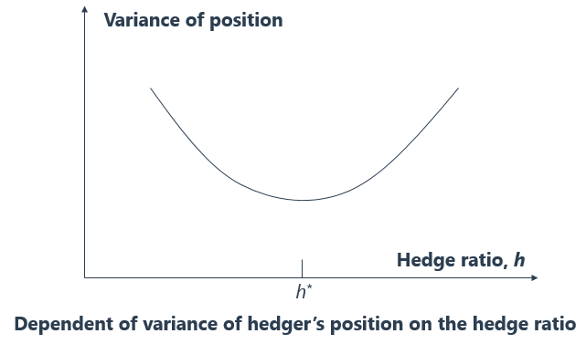


Minimum Variance Hedge Ratio(MVR)
Hedging with Futures Contract
  Minimum Variance Hedge Ratio
    The minimum variance hedge ratio depends on the relationship between changes in the spot price and changes in the futures price. By using it, we can form a hedged position with minimum variance.
$$h^{∗}=ρ_{S,F}\frac{σ_{S}}{σ_{F}}$$
where $σ_{S}$ is the standard deviation of the changes in the spot price(ΔS) of the asset we are
hedging, $σ_{F}$ is the standard deviation of the changes in the futures prices(ΔF), and $ρ_{S,F}$is the coefficient of correlation between the two price changes.

Slide 92
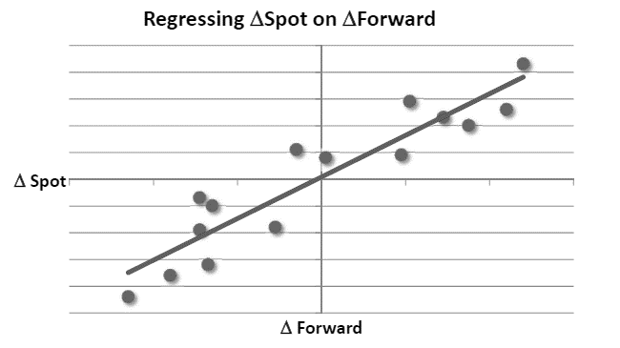
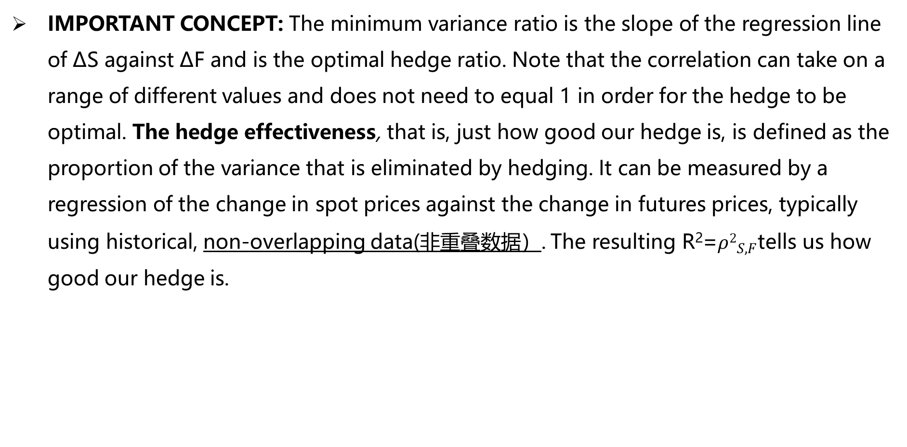
Minimum Variance Hedge Ratio(MVR)
IMPORTANT CONCEPT: The minimum variance ratio is the slope of the regression line of ΔS against ΔF and is the optimal hedge ratio. Note that the correlation can take on a range of different values and does not need to equal 1 in order for the hedge to be optimal. The hedge effectiveness, that is, just how good our hedge is, is defined as the proportion of the variance that is eliminated by hedging. It can be measured by a regression of the change in spot prices against the change in futures prices, typically using historical, non-overlapping data(非重叠数据）. The resulting R²=${ρ2}_{S,F}$tells us how good our hedge is.

Slide 93
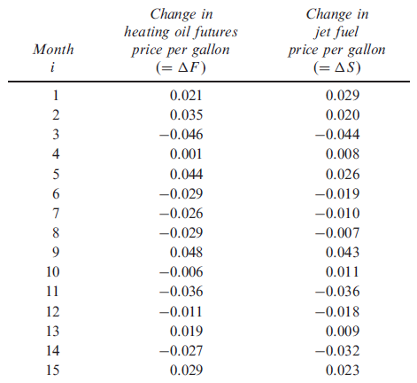

Hedging with Futures Contract
Hedging with Futures Contract
  Example: An airline expects to purchase 2 million gallons of jet fuel in 1 month and decides to use heating oil futures for hedging. Each heating oil contract traded by the CME Group is on 42,000 gallons of heating oil.
 | ΔF | ΔS
Std. | 0.031 | 0.026
Correlation | 0.928
$$HR=ρ_{S,F}\frac{σ_{S}}{σ_{F}}$$
=0.928$×\frac{0.026}{0.031}=0.778$
N=0.778$×\frac{2000000}{42000}=37.03$

Slide 94
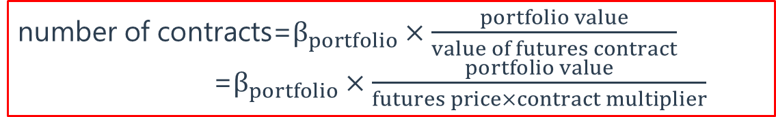

Hedging with Futures Contract
Hedging with Futures Contract (cont’d)
  Hedging with Stock Index Futures
  Hedging with Interest Rate Futures
    The number of contracts required to hedge against an uncertain change in the yield given by ∆y, is given by:
number of contracts=$β_{portfolio}×\frac{portfolio value}{value of futures contract}$
=$β_{portfolio}×\frac{portfolio value}{futures price×contract multiplier}$
$$number of contracts=(β^{∗}−β)×\frac{portfolio value}{value of futures contract}$$
$$N^{∗}=\frac{{PD}_{p}}{F_{c}D_{F}}$$

Slide 95
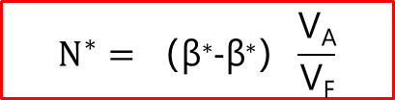

Hedging with Futures Contract
How to change a stock portfolio’s beta
  Given a portfolio beta (β), the current value of the portfolio (V_{A}), and the value of stocks underlying one futures contract (V_{F}), the number of stock index futures contracts (i.e., which minimizes the portfolio variance) to be hedged is given by:
  And now, by extension, when the goal is to shift portfolio beta from (β) to a target beta (β∗), the number of stock index futures contracts required is given by:
$$N^{∗}=β\frac{\text{V}\text{A}}{\text{V}\text{F}}$$
$$N^{∗}=（\text{β}\text{∗}−\text{β}\text{∗}）\frac{\text{V}\text{A}}{\text{V}\text{F}}$$

Slide 96

Hedging with Futures Contract
Hedging with Futures Contract (cont’d)
  Example 1
    You are a portfolio manager with a $20 million growth portfolio that has a beta of 1.4, relative to the S&P 500. The S&P 500 futures are trading at 1,150, and the multiplier is 250. You would like to hedge your exposure to market risk over the next few months. Identify whether a long or short hedge is appropriate, and determine the number of S&P 500 contracts you need to implement the hedge.
Short 1.4$×\frac{\$20,000,000}{1,150×250}≈97 contracts$

Slide 97
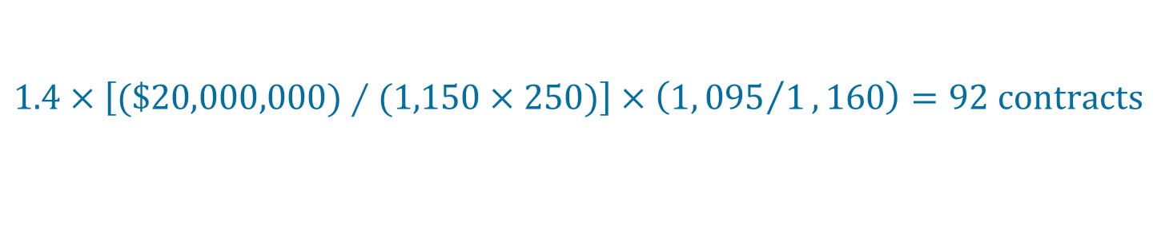
Hedging with Futures Contract
Hedging with Futures Contract (cont’d)
  Example 2
    Suppose that you would like to make a tailing the hedge adjustment to the number of contracts needed in the previous example. Assume that when evaluating the next daily settlement period you find that the S&P 500 spot price is 1,095 and the futures price is now 1,160. Determine the number of S&P 500 contracts needed after making a tailing the hedge adjustment.
$$1.4×\left[(\$20,000,000)∕(1,150×250)\right]×\left(1,{095}/1,160\right)=92 contracts$$

Slide 98
Hedging with Futures Contract
Hedging with Futures Contract (cont’d)
  Example 3
    Suppose we have a well-diversified $100 million equity portfolio. The portfolio beta relative to the S&P 500 is 1.2. The current value of the 3-month S&P 500 Index is 1,080. The portfolio manager wants to completely hedge the systematic risk of the portfolio over the next three months using S&P 500 Index futures. Demonstrate how to adjust the portfolio’s beta:
$number of contracts=(0−1.2)\frac{100,000,000}{1,080×250}$=-444.44

Slide 99
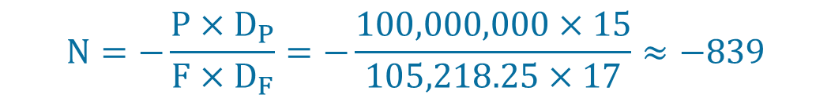
Hedging with Futures Contract
Hedging with Futures Contract (cont’d)
  Example 4
    There is a portfolio of $100 million with a 6-month hedging horizon. And the 6-month T-bond contract is quoted at 105-09, and the contract size is $100,000. The duration of the portfolio is 15, and the duration of the futures contract is 17. Outline the appropriate hedge for small changes in yield.
$$N=−\frac{P×D_{P}}{F×D_{F}}=−\frac{100,000,000×15}{105,218.25×17}≈−839$$

Slide 100
Stack and Roll Hedge
When the delivery date of the futures contract occurs prior to the expiration date of the hedge, or there is little liquidity but in the spot and prompt month, the hedger can roll forward the hedge, that is close out a futures contract and take the same position on a new futures contract with a later delivery date. This is also known as a stack and roll strategy.

Slide 101
Stack and Roll Hedge
Example:
  Consider a company that wishes to use a short hedge to reduce the risk associated with the price wo be received for an asset at Time T. If there are futures contracts 1,2,3…,n with progressively later delivery dates. The company can use the following strategy:
    Time t₁: Short future contract
    Time t₂: Close out futures contract 1
    Short futures contract 2
    Time t₃: Close out futures contract 2
    Short futures contract 3
    ……
    Time t_{n}: Close out futures contract n-1
    Short futures contract n
    Time T: Close out futures contract n.

Slide 102
Stack and Roll Hedge
Risks arising from a stack and roll strategy
  It exposes the hedger to basis risk on each new hedge.a.k.a., rollover basis risk.
  With insufficient liquidity this can cause major problems. This is largely due to unfortunate timing: in the short-run we have cash outflows due to the loss on the futures contract. However, since the firm employs the stack and roll strategy every month, it can readily expect to buy futures, and thus hedge its cost in the following months at a lower price.

Slide 103
Define and differentiate between short and long hedges and identify their appropriate uses. ★
Describe the arguments for and against hedging and the potential impact of hedging on firm profitability. ★
Define the basis and explain the various sources of basis risk, and explain how basis risks arise when hedging with futures. ★★★
Define cross hedging, and compute and interpret the minimum variance hedge ratio and hedge effectiveness. ★★★
Compute the optimal number of futures contracts needed to hedge an exposure, and explain and calculate the “tailing the hedge” adjustment. ★★★
Explain how to use stock index futures contracts to change a stock portfolio’s beta. ★★★
Explain how to use stock index futures contracts to lock in the benefit of a stock selection. ★★
Explain the term “rolling the hedge forward” or “stack and roll” and describe some of the risks that arise from this strategy. ★★★

Slide 104
Interest Rate
Financial Products

Slide 105
Treasury Rates,LIBOR,and Repo Rates
LIBOR (London Interbank Offered Rate)
  A LIBOR quote by a particular bank is the rate of interest at which the bank is prepared to make an unsecured large wholesale deposit with other banks.
  AA-rated bank
  LIBOR is risk free？

Slide 106
Treasury Rates,LIBOR,and Repo Rates
Repo rates
  Sometimes, trading activities are funded with a repo or repurchase agreement: a contract where a dealer (who owns securities) agrees to sell them to another company now and buy them back later at a slightly higher price.
  The other company is lending a collateralized (secured) loan.
  The difference between selling price (today) and the repurchased price (tomorrow or later) is the interest paid in obtaining a loan and this interest rate is called repo rate.
  If structured carefully, the loan involves very little credit risk.
  If the borrower does not honor the agreement, the lending company simply keeps the securities.
  The most common type of repo is an overnight repo.

Slide 107
Treasury Rates,LIBOR,and Repo Rates
Risk-Free Rate
  Traders argue that Treasury rates are too low to be used as risk-free rates because:
    Market demand : Financial institutions, to fulfill a variety of regulatory requirements must purchase Treasury bills/bonds. This increases demand for these Treasury instruments driving the price up and their yield down.
    Regulatory relief : The amount of (regulatory) capital required to support an investment in Treasury bills/bonds is substantially smaller than the capital required to support a similar investment in other instruments.
    Tax treatment : In the United States, Treasury instruments are given a favorable tax treatment because they are not taxed at the state level.

Slide 108
Value of An Investment
Compounding Frequencies
  Simple Interest
  Compounding Interest
    Suppose we have an account where the simple interest is added in each year and then that money also earns interest.
    Assuming
      R_{c} is the rate of interest with continuous compounding.
      R_{m} is the rate of interest with discrete compounding (m per annum)
      n is the number of years.
$FV=PV(1+\frac{R_{m}}{m})^{mn}$ FV=PV$×e^{R_{c}×n }$ PV$×e^{R_{c}n}=PV(1+\frac{R_{m}}{m})^{mn}$
我觉得这些公式不重要，会推导就行！

Slide 109
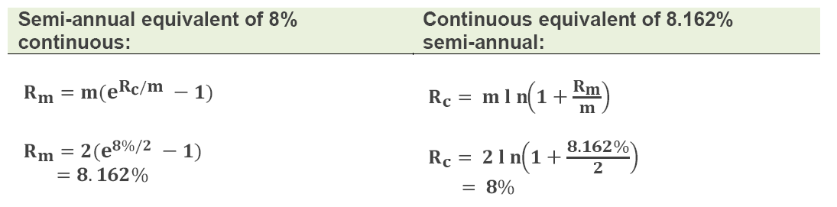
Value of An Investment
Convert interest rates based on different compounding frequencies.
  The present value is discretely discounted at (m) periods per year (e.g., m = 2 for semiannual compounding) over (n) years by using the formula on the left. The continuous equivalent is the right. When the future value is $1.00, the PV is the discount factor (DF).

Slide 110
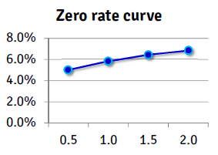
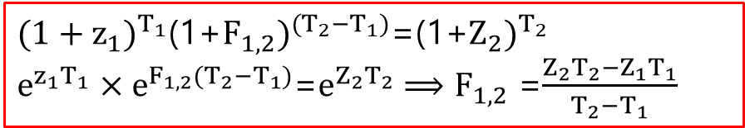
Theoretical Price of A Bond
Spot and Forward Rate
  Spot Rate
    A t-period spot rate, or zero rate, denoted as z(t), is the yield to maturity on a zero-coupon bond that matures in t-years.
  Forward rates
    Interest rates corresponding to a future period
    implied by the spot curve.
$(1+z_{1})^{T_{1}}$(1+$F_{1,2})^{(T_{2}−T_{1})}$=(1+$Z_{2})^{T_{2}}$
$e^{z_{1}T_{1}}×e^{F_{1,2}(T_{2}−T_{1})}$=$e^{Z_{2}T_{2}}$ $⟹F_{1,2}$ =$\frac{Z_{2}T_{2}−Z_{1}T_{1}}{T_{2}−T_{1}}$
基本每年都会考！

Slide 111
Theoretical Price of A Bond
How to determine the price of a bond?
  Example: Suppose that a 2-year Treasury bond with a principal of $100 provides coupons at the rate of 6% per annum semiannually. The Treasury zero rates are below, compute the bond price:
Treasury Zero Rates Maturity (Years) | Zero Rate (%) (continuously Compounded)
0.5 | 5.0
1 | 5.8
1.5 | 6.4
2.0 | 6.8
$$P=3e^{−0.05×0.5}+e^{−0.058×1}+3e^{−0.064×1.5}+103e^{−0.068×2.0}=98.39$$
标红肯定有原因滴！

Slide 112
Theoretical Price of A Bond
Bond Yield (yield to maturity, YTM) (BAII II)
  A bond’s yield (YTM) is the single rate that discounts the bond's cash flows to match its market price. Unlike the zero-rate curve (which it averages), it is effectively a flat line.
    Suppose $98.39 is the observed market price of the bond. We can us an iterative (‘‘trial and error’’) procedure to retrieve the single discount rate that, when applied to all cash flows, returns a bond price equal to this market price. The single rate that discounts (then sums) all cash flows to a price of $98.39 is found to be 6.76%.
    什么是trial and error? 如何使用？
    DerivaGem
这是一个Excel大师级插件!

Slide 113
Theoretical Price of A Bond
Par Yield
  The par yield for a bond is the coupon rate that causes the bond price to equal its principal or par value. The par yield discounts cash flows at the various zero rates, but finds the coupon rate that discounts the present value (model price) to its par value (i.e, $100.00 or $1,000.00)
一般不会让你算这个，要算你也会对不对？

Slide 114
Value of a FRA
Forward Rate Agreement (FRA)
  A forward rate agreement (FRA) is an agreement that a fixed interest rate will apply to either borrowing or lending a certain principal during a specified future time period.
  The value of a forward rate agreement (FRA) where a fixed rate,R_{K}, will be received on a principal (L) between times T₁ and T₂ ,if R_{F} is the forward rate for the period and R₂is the spot/zero rate for maturity T₂ is given by:
$$VFRA=L\left(RK−RF\right)\left(T2−T1\right)e^{−R2T2}$$

Slide 115
Value of a FRA
If LIBOR is 4.5% in 3 years, company ends up paying 4% to the counterparty who is the buyer receiving the payment at a future value of time t = 3.25 years of $125,000.
  100,000,000 × (4% − 4.5% ) × 0.25 = −$125,000
  Discounting this to the present value at year 3, we get
  -$125,000/(1+4.5%*0.25)=-123,609

Slide 116
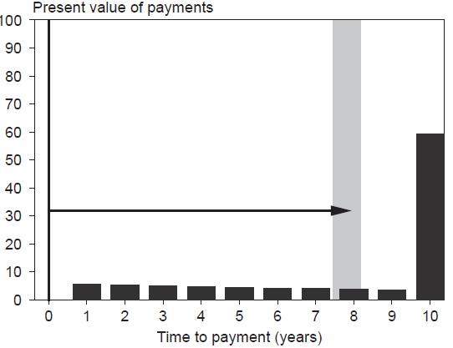

Duration,Modified Duration,and Dollar Duration
Interest Rate Risk
  Macaulay Duration
      Average period of cash flow returning weighted by discounted cash flow.
D=$\frac{\sum_{t=1}^{T}{[\frac{C_{t}}{(1+y)^{t}}×t]}}{\sum_{t=1}^{T}{\frac{C_{t}}{(1+y)^{t}}}}$=$\frac{\sum_{t=1}^{T}{[PV(C_{t})×t]}}{P}$=$\sum_{t=1}^{T}{[\frac{PV(C_{t})}{P}×t]}$=$\sum_{t=1}^{T}{(ω_{t}×t)}$
这个公式有什么好看的？
抛弃又舍不得……
    For a zero coupon bond, the Macaulay duration equals to its maturity.
    For a plain bond, Macaulay duration is less than or equal to its maturity.

Slide 117
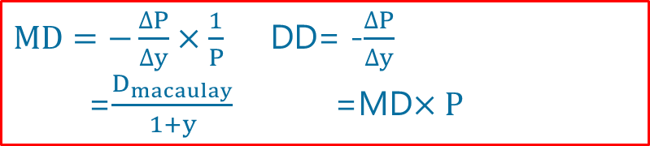
Duration,Modified Duration,and Dollar Duration
Interest Rate Risk (cont’d)
  Modified Duration
  All else being equal, duration increase for longer maturities, lower coupons, and lower yields.
  DV01
$MD=−\frac{∆P}{∆y}×\frac{1}{P}$ DD= -$\frac{∆P}{∆y}$
=$\frac{D_{macaulay}}{1+y}$ =MD$×P$
  DV01 = Modified Duration × Bond Value ×0.0001

Slide 118
Limitations of Duration and Convexity
Limitations of duration
  Parallel shift in the zero-coupon yield curve
  A small change in yield(i.e., unrealistic)
  Duration is a first-order linear approximation
久期和修正久期的推导是不要求掌握的，但我希望各位能够掌握……

Slide 119
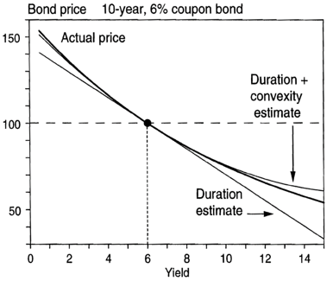

Limitations of Duration and Convexity
Convexity estimation
  Convexity
    A measure of the non-linear relationship between price and yield. Changes in duration of a bond to changes in interest rates, the second derivative of the price of the bond with respect to interest rates.
    All else being equal, convexity increase for longer maturities, lower coupons, and lower yields.
P$=P_{0}−DP_{0}∆y+\frac{1}{2}CP_{0}(∆y)^{2}$

Slide 120
Limitations of Duration and Convexity
Interest Rate Risk
  Portfolio Duration and Convexity: In regard to both modified duration and convexity, portfolio duration and convexity equal the weighted sum of individual, respectively, durations and convexities where each component’s weight is its value as a percentage of portfolio value.
  Example
Coupon | Maturity | YTM | Price (% or par) | Par (millions) | Weights | D | C
5.00% | 5 | 4.00% | 104.4912925 | 3 | 22.97% | 4.41 | 22.92
6.00% | 15 | 5.00% | 110.4651463 | 4 | 32.37% | 10.11 | 132.54
7.00% | 30 | 5.50% | 121.9169965 | 5 | 44.66% | 14.00 | 299.36
    D = (0.2297×4.41)+(0.3237×10.11)+(0.4466×14) = 10.54
    C = (0.2297×22.92)+(0.3237×132.54)+(0.4466×299.36) = 181.86

Slide 121
Describe Treasury rates, LIBOR, repo rates, and overnight indexed swap (OIS) rates, and explain what is meant by the “risk-free” rate. ★★★
Calculate the value of an investment using different compounding frequencies. ★
Convert interest rates based on different compounding frequencies. ★
Calculate the theoretical price of a bond using spot rates. ★★★
Derive forward interest rates from a set of spot rates. ★★★
Derive the value of the cash flows from a forward rate agreement (FRA). ★★★
Calculate the duration, modified duration, and dollar duration of a bond. ★★★
Evaluate the limitations of duration and explain how convexity addresses some of them. ★★★
Calculate the change in a bond’s price given its duration, its convexity, and a change in interest rates. ★★★

Slide 122
Forward and Future Prices
Financial Products

Slide 123





Cost of Carry Model
For a non-dividend-paying investment asset (when asset has no storage cost) the futures price is essentially similar to forward prices. The generalized forward price (F₀) is either case (futures or forwards) is given as:
$$F_{0}=S_{0}e^{rT}$$
$$F_{0}>S_{0}e^{rT}$$
$$F_{0}<S_{0}e^{rT}$$
Now:
Borrow S₀ to buy a unit of asset, enter into a forward contract to short the asset for F₀ in time T;
Now:
Short sale S₀ and invest in a bank, enter into a forward contract to buy the asset for F₀ in time T;
T later:
Sell asset at F₀ and repay the loan for S₀e^{rT}
Gain a profit of
T later:
Get S_{o}e^{rT} from the bank and buy the asset at F₀ to close short position.
Gain a profit of
$$F_{0}−S_{0}e^{rT}$$
$$S_{0}e^{rT}−F_{0}$$

Slide 124
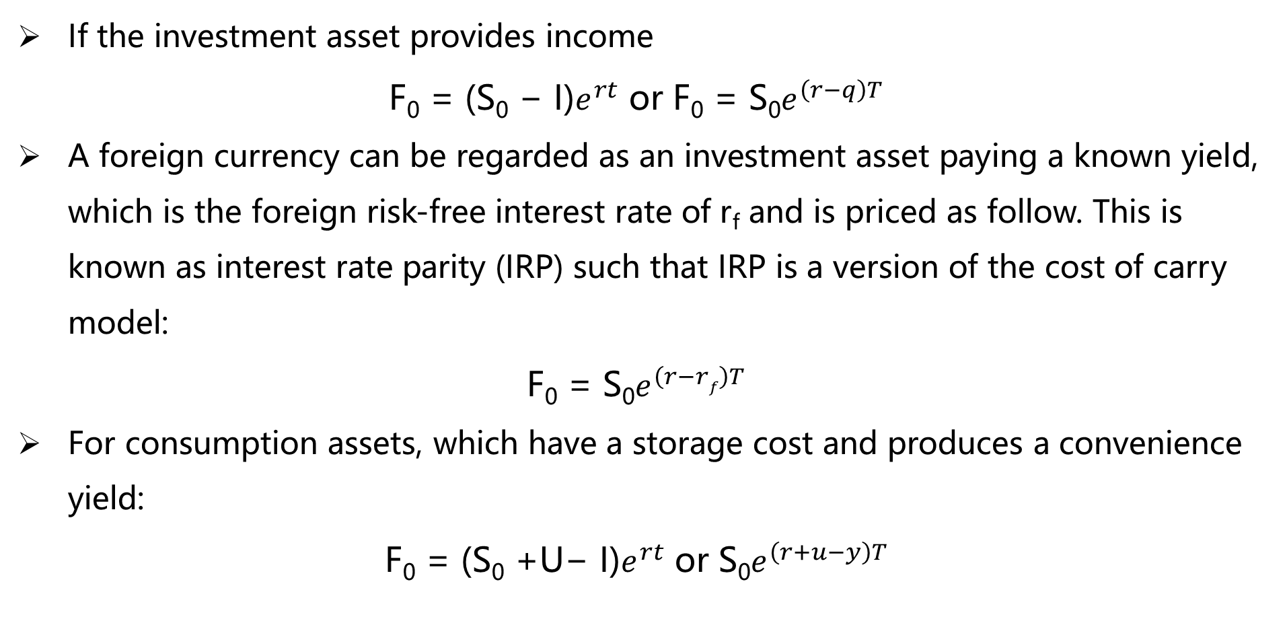
Cost of Carry Model
If the investment asset provides income
F₀ = (S₀ − I)$e^{rt}$ or F₀ = S₀$e^{\left(r−q\right)T}$
A foreign currency can be regarded as an investment asset paying a known yield, which is the foreign risk-free interest rate of r_{f} and is priced as follow. This is known as interest rate parity (IRP) such that IRP is a version of the cost of carry model:
F₀ = S₀$e^{\left(r−rf\right)T}$
For consumption assets, which have a storage cost and produces a convenience yield:
F₀ = (S₀ +U− I)$e^{rt}$ or S₀$e^{\left(r+u−y\right)T}$

Slide 125
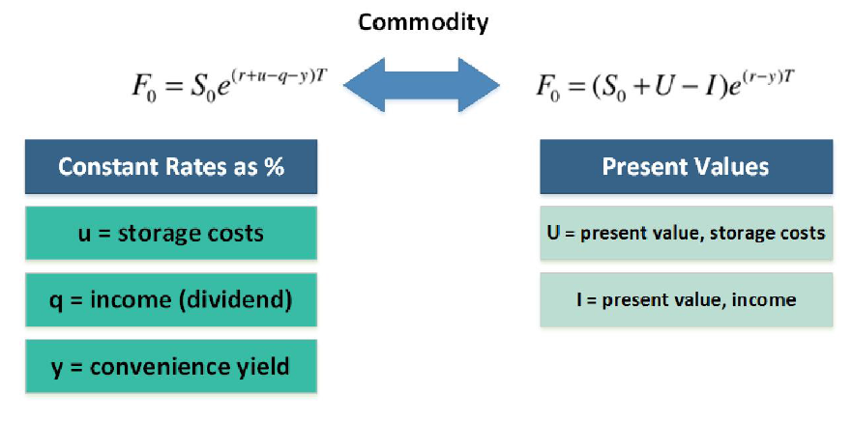
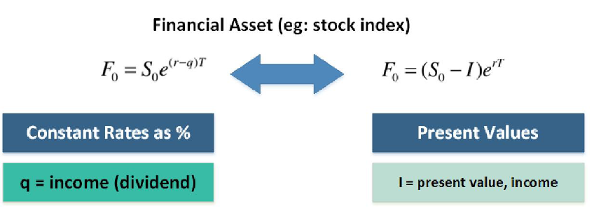
Cost of Carry Model
图不太好看！

Slide 126
Explain the Relationship Between Forward and Futures Prices
Relationship between forward and futures prices
  When asset price increases, an investor who holds a long futures position makes an immediate gain because of the daily settlement procedure. Also, if the interest rates are higher, the gain will tend to be invested at a higher than average rate of interest. Therefore, when there is a correlation between the underlying asset (S) and interest rates：
  If the correlation is strongly positive: futures > forward
  If the correlation is strongly negative: futures < forward
别问我为什么，它的推导过程非常复杂……
见《期权、期货及其他衍生产品》技术性分析

Slide 127
Delivery Options Available In The Futures Markets
Although a forward contract typically specifies the day of delivery, futures contract often allows the short to choose to deliver at any time during a certain period.
  If the futures price is an increasing function of time to maturity, the short should deliver as early as possible. This is because the interest earned on the cash received outweighs the benefits of holding the asset. (And for modeling purposes, here we assume delivery at beginning of period.)
  If the futures price is a decreasing function of time to maturity, the short should deliver as late as possible as the reverse is true. (And for modeling purposes, here we assume delivery at end of period.)

Slide 128
Interest Rate Parity（IRP）
Foreign Exchange Forward/Futures
  Interest Rate Parity
    A no-arbitrage condition representing an equilibrium state under which investors will be indifferent to interest rates available on bank deposits in two countries.
$Forward=Spot(\frac{1+r_{A}}{1+r_{B}})^{T}$ $Forward=Spot ×e^{\left(r_{A}−r_{B}\right)T}$
0时刻
t时刻
存入本国银行，r
1单位本币
e^{rT}单位本币
=
兑换，并进入一份卖出外币的远期合约
=
存入外国银行，r_{f}
执行远期合约
1/S₀单位外币
e^{rfT} /S₀单位外币
F₀ e^{rfT}/S₀单位本币

Slide 129
Differentiate between investment and consumption assets. ★
Define short-selling and calculate the net profit of a short sale of a dividend-paying stock. ★
Describe the differences between forward and futures contracts and explain the relationship between forward and spot prices. ★★★
Calculate the forward price given the underlying asset’s spot price, and describe an arbitrage argument between spot and forward prices. ★★★
Explain the relationship between forward and futures prices. ★★
Explain how an index arbitrage strategy works. ★
Calculate a forward foreign exchange rate using the interest rate parity relationship. ★★★
Define income, storage costs, and convenience yield. ★★★
Calculate the futures price on commodities （income/storage costs and/or convenience yields.） ★★
Calculate, using the cost-of-carry model, forward prices ★★★
Describe the various delivery options available in the futures markets★
Explain the relationship between current futures prices and expected future spot prices★
Define and interpret contango and backwardation, and how they relate to the cost-of-carry model. ★★

Slide 130
Interest Rate Futures
Financial Products

Slide 131
Day Count Conventions
Money Market instruments include | Capital Market Instruments include
Short-term financial instruments | Long-term securities
Treasury bill (government) | US Treasury notes (1-10 yrs) and bonds (> 10 yrs)
Certificate of deposit (bank)
Commercial paper (CP) | Domestic and Eurobonds（国际）
Repurchase agreement (repo) | Euro bond (denominated in Euros)
Day count conventions are used for computing accrued interest. The interest earned
between two dates can be expressed as:
$$\frac{Number of days between dates}{Number of days in reference period}×Interest earned in the reference period$$

Slide 132
Day Count Conventions
  Accrued Interest and Day Count Conventions
  Treasury bonds: actual/ actual
  Corporate and municipal bonds: 30/360
  Money market instruments (Treasury bills): actual/360
  For example, a bond pays a coupon of $4.00 every six months. If coupons are paid on March 1st and September 1st, and we wish to calculate the accrued interest earned between March 1 and July 3, then the following illustrates three different day count conventions applied to the accrued interest (AI) on this bond:
    Actual/actual:124 /184 * $4.00 = $2.696
    30/360:122/180 * $4.00 = $2.711
    Actual/360:124 /180 * $4.00 = $2.756
单独考过，纯属考记忆！

Slide 133
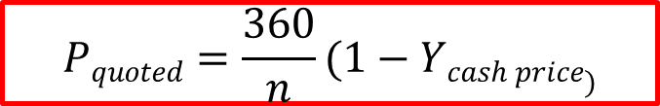
Price Quotations of U.S T-Bills
A US Treasury bill is a discount instrument:
  The discount rate is expressed as a percentage of the face value. Consequently, the discount rate is not a true yield.
  A US Treasury bill is a discount instrument: the discount rate is expressed as a percentage of the face value. Consequently, the discount rate is not a true yield.
$$Pquoted=\frac{360}{n}(1−Ycash price)$$

Slide 134
Clean Price and Dirty Price
The clean and dirty price for a US Treasury bond:
Clean Price
  The clean price (aka, quoted price or flat price or simply “price”) does not reflect the cash price if interest has accrued.
Dirty Price
  The dirty price (aka, full or invoice or cash price) adds accrued interest to the clean price.
dirty price = clean price + accrued interest

Slide 135

Clean Price and Dirty Price
When the accrued interest of a bond is zero (i.e., when the settlement date is a coupon payment date) the flat and full prices of the bond are equal.
  When accrued interest is not zero, the amount paid/received for a bond (i.e., its full price) should equal the present value of its cash flows.
  If P is a bond’s flat price, and AI is the accrued interest, then the full price is the present value (PV) which is given by:
  AI is the accrued interest (we saw it earlier under day count conventions) and is given as:
$$PVfuture cash flows=P+AI$$
$$AI=coupon×\frac{no.of days from last coupon to settlement}{no.of days between coupons}$$

Slide 136
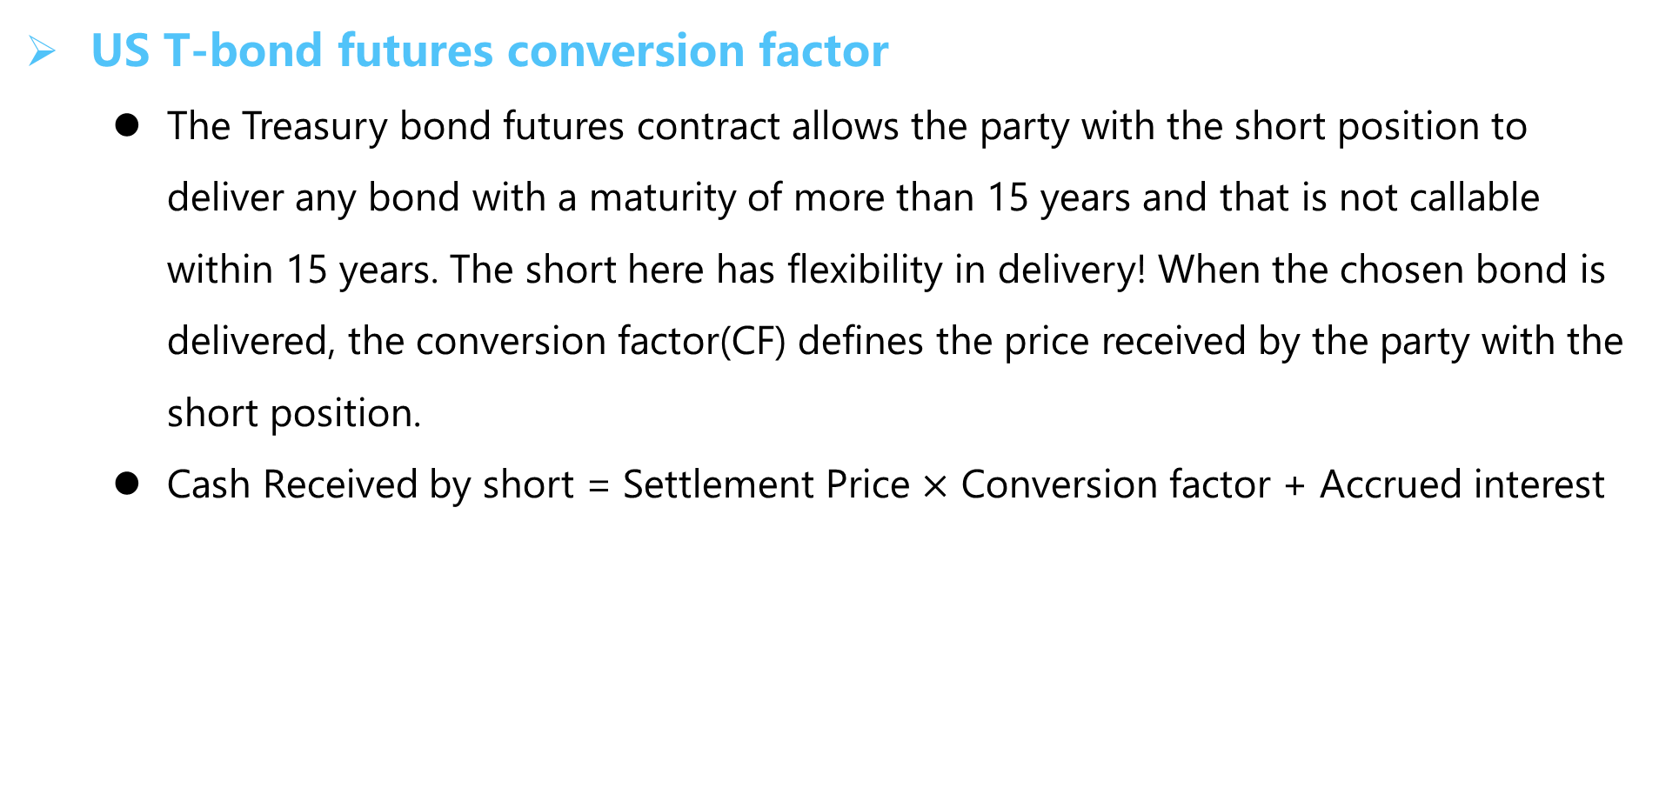
Conversion Factor
US T-bond futures conversion factor
  The Treasury bond futures contract allows the party with the short position to deliver any bond with a maturity of more than 15 years and that is not callable within 15 years. The short here has flexibility in delivery! When the chosen bond is delivered, the conversion factor(CF) defines the price received by the party with the short position.
  Cash Received by short = Settlement Price $×$ Conversion factor + Accrued interest

Slide 137
Cost to Delivering
Cost to delivering a bond into a T-bond futures contract
  During the delivery month, many bonds (with varying coupon and maturity) can be delivered in the Treasury bond futures contract. The party with the short position can choose which of the available bonds is “cheapest” to deliver.
  The cost to deliver by the short position is the dirty price, which is the quoted bond price plus accrued interest (AI). The short position will receive the settlement price times conversion factor plus accrued interest (AI) from the long.
  The cheapest to deliver (CTD) bond is the one which minimizes the difference between the cost paid and the cash received by the short.
送分！
    Cost = quoted bond price – (QFP×CF)

Slide 138
CTD T-Bond
T-Bond Futures (cont’d)
  Example: Assume an investor with a short position is about to deliver a bond and has four bonds to choose from which are listed in the following table. The last settlement price is $95.75 (this is the quoted futures price). Determine which bond is the cheapest-to-deliver.
Bond | Quoted Bond Price | Conversion Factor | Cost
1 | 99 | 1.01 | 2.29
2 | 125 | 1.24 | 6.27
3 | 103 | 1.06 | 1.51
4 | 115 | 1.14 | 5.85

Slide 139
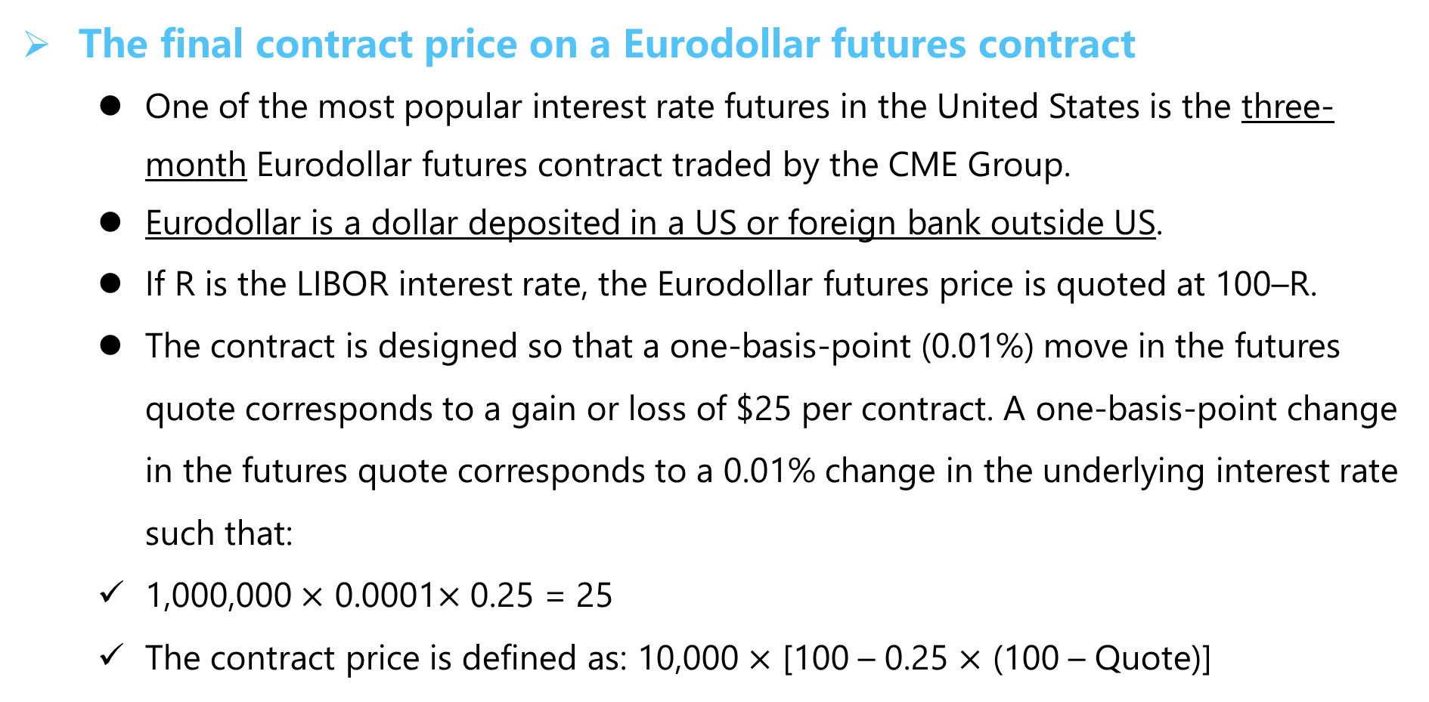
Eurodollar Futures Contract
The final contract price on a Eurodollar futures contract
  One of the most popular interest rate futures in the United States is the three-month Eurodollar futures contract traded by the CME Group.
  Eurodollar is a dollar deposited in a US or foreign bank outside US.
  If R is the LIBOR interest rate, the Eurodollar futures price is quoted at 100–R.
  The contract is designed so that a one-basis-point (0.01%) move in the futures quote corresponds to a gain or loss of $25 per contract. A one-basis-point change in the futures quote corresponds to a 0.01% change in the underlying interest rate such that:
  1,000,000 $×$ 0.0001$×$ 0.25 = 25
  The contract price is defined as: 10,000 $×$ [100 – 0.25 $×$ (100 – Quote)]

Slide 140
Eurodollar Futures Contract
IMPORTANT CONCEPT:
  If the Eurodollar Future quote increases by one (1) basis point, long position gains
  $25 and short position loses $25.
  If the Eurodollar Future quote decreases by one (1) basis point, long position loses
  $25 and short position gains $25.

Slide 141
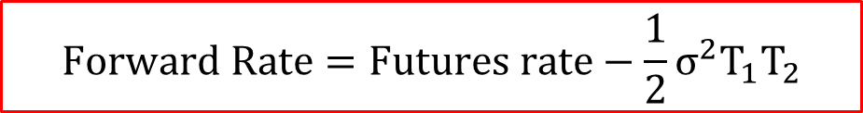
Eurodollar Futures Contract
Eurodollar Futures (cont’d)
  Eurodollar Futures vs. FRA
    With the same underlying and the same maturity, They should be the same if interest rates are perfectly predictable.
    ρ(S, r) < 0, Futures price is lower than forward price.
    For short maturities, the differences are small enough to be ignored.
  Convexity Adjustment
    σ is the standard deviation of the change in the short-term interest rate in one year.
    T₁ is time to maturity of futures contract.
    T₂ is time to maturity of the rate underlying the futures contract.
$$Forward Rate=Futures rate−\frac{1}{2}σ^{2}T_{1}T_{2}$$

Slide 142
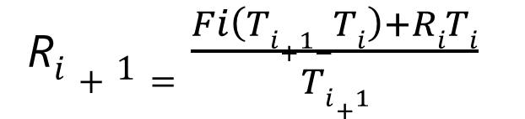
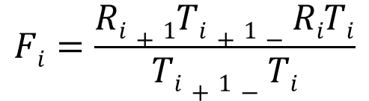
LIBOR Zero Curve
The bootstrap procedure can be used to extend the LIBOR zero curve. We know that the forward interest rate F_{i} is:
From this forward rate, the zero rate can be obtained as:
$$Fi=\frac{Ri+1Ti+1−RiTi}{Ti+1−Ti}$$
R$i+1=\frac{Fi\left(Ti+1−Ti\right)+RiTi}{Ti+1}$
考试基本没有考过！

Slide 143

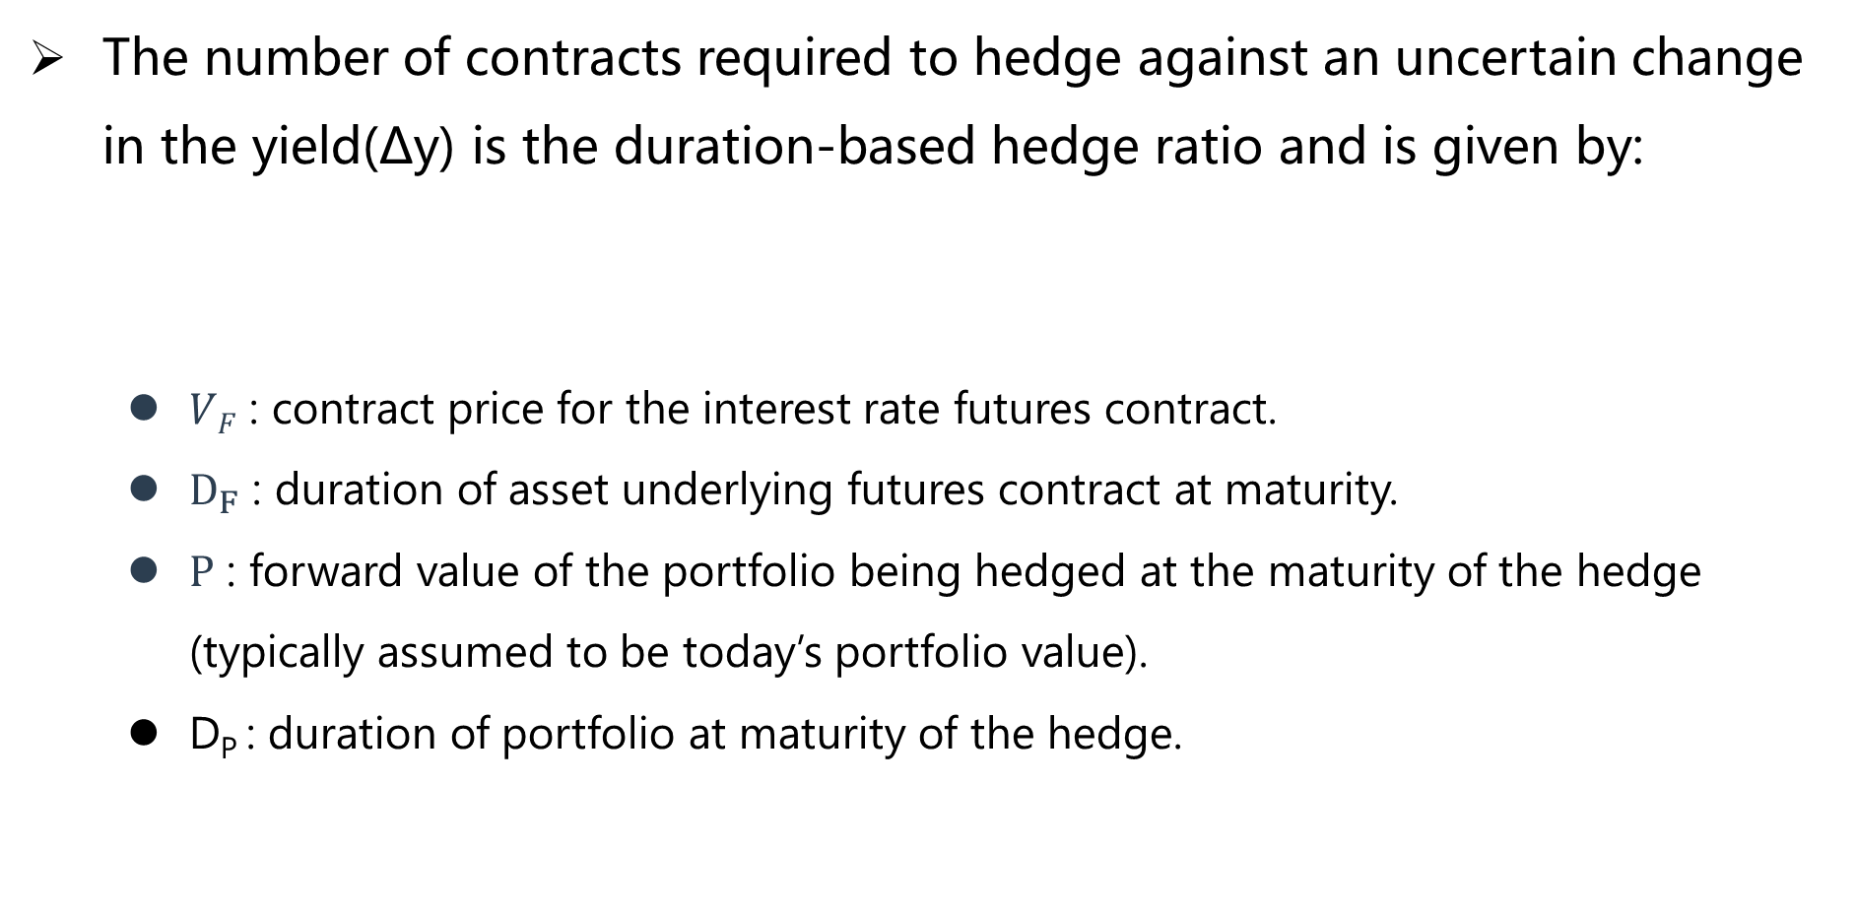
Duration-based hedge ratio and hedging strategy
The number of contracts required to hedge against an uncertain change in the yield(Δy) is the duration-based hedge ratio and is given by:
  $VF$ : contract price for the interest rate futures contract.
  $D_{F}$ : duration of asset underlying futures contract at maturity.
  $P$ : forward value of the portfolio being hedged at the maturity of the hedge (typically assumed to be today’s portfolio value).
  D_{P} : duration of portfolio at maturity of the hedge.
$$N^{∗}=\frac{{PD}_{p}}{VFD_{F}}$$

Slide 144
Duration-based Hedge Ratio and Hedging Strategy
Limitations of a duration based hedging strategy
  Although matching the durations of assets and liabilities is sometimes a first step in asset– liability management (ALM) to monitor exposure to interest rates, this does not protect a bank against non-parallel shifts in the yield curve. This is a weakness of the duration based hedging approach.
    In practice, short-term rates are usually more volatile than, and are not perfectly correlated with, long-term rates.
    Sometimes it even happens that short- and long-term rates move in opposite directions to each other.
  Therefore, additional tools are required to manage interest rate exposure. Tools such as swaps, FRAs, bond futures, Eurodollar futures, and other interest rate derivatives can be used for this purpose.

Slide 145
Identify the most commonly used day count conventions. ★★
Calculate the conversion of a discount rate to a price for a US Treasury bill. ★
Differentiate between the clean and dirty price for a US Treasury bond and AI. ★★★
Explain and calculate a US Treasury bond futures contract conversion factor. ★
Calculate the cost of delivering a bond into a Treasury bond futures contract. ★
Describe the impact of the level and shape of the yield curve on the cheapest-to-deliver Treasury bond decision. ★★★
Calculate the theoretical futures price for a Treasury bond futures contract. ★
Calculate the final contract price on a Eurodollar futures contract. ★★★
Describe and compute the Eurodollar futures contract convexity adjustment. ★★
Explain how Eurodollar futures can be used to extend the LIBOR zero curve. ★
Calculate the duration-based hedge ratio and create a duration-based hedging strategy using interest rate futures. ★★
Explain the limitations of using a duration-based hedging strategy. ★

Slide 146
Swaps
Financial Products

Slide 147
Plain Vanilla Interest Rate Swap
In a plain-vanilla interest-rate swap,:
  One company agrees to pay a predetermined fixed interest rate in exchange for receiving a variable interest rate (pay-fixed and receive floating), and their counterparty agrees to pay a variable rate and receive a fixed interest rate (pay-floating and receive-fixed).
    The counterparty who pays the fixed rate is called the swap payer. This counterparty profits from an increase in interest rates.
    The counterparty who pays the floating rate is called the swap receiver. This counterparty profits from a decrease in interest rates

Slide 148
Plain Vanilla Interest Rate Swap
An illustration given the following assumptions:
  Notional principal: $100 million. It is called notional principal because in the vanilla version of the swap principal is not exchanged.
  Swap agreement: Pay fixed rate of 5.0% and receive 6 month LIBOR rate
  Term (aka, tenor): 3 years with payments every six months
A note on discounting the LIBOR scandal and financial crisis.
  In normal market conditions, it [the LIBOR –OIS spread] is about 10 basis points. During and in the wake of the financial crisis the spread experienced unprecedented volatility, as well as spikes as high as several hundred basis points.
  Banks and financial institutions today do not use LIBOR as the risk-free rate at which they discount cash flows. Rather they use the Overnight Indexed Swap rate (OIS).

Slide 149
Comparative Advantage Argument
 | Fixed | Floating | Comparative Advantage
Citigroup | 4% | Libor +1% | Fixed Market
Apple | 6% | Libor + 2% | Floating Market
4% fixed
4% fixed
Citigroup
Apple
Libor + 0.5%
Libor + 2%
Net Borrowing Rates (i.e., including swap)
 | Fixed | Floating
Citigroup |  | Libor + 0.5%
Apple | 5.5%

Slide 150
Comparative Advantage Argument
Criticism of the comparative advantage argument
  The contrary view concerns arbitrage: if markets were efficient, we would expect the differentials that allow for the comparative advantage in the first place, to erode.
  The reason that spread differentials appear to exist is due to the nature of the contracts available to companies in fixed and floating markets.

Slide 151
Using the Swap to Transform a Liability and An Asset
Using swap to transform a liability:
  A company could use a swap to transform a floating rate loan into a fixed-rate loan.
  Suppose Microsoft (MSFT) can borrow $100.0 million in the floating-rate market at LIBOR plus 10 basis points. Assume Microsoft prefers to borrow instead at fixed rates. Microsoft enters the swap (illustrated below) such that:
    MSFT pays LIBOR plus 0.10% to its lenders.
    Under the terms of the swap, MSFT pays 5.015% fixed
    Under the terms of the swap, MSFT receives LIBOR
    Thus the swap effectively transforms borrowings at a floating rate of LIBOR plus 0.1% into borrowings at a net fixed rate of 5.115%

Slide 152
Using the Swap to Transform a Liability and An Asset
Using swap to transform a liability:
  LIBOR cancels and MSFT pays 5.015% plus 10 basis points. Suppose Intel (INTC) is the swap counterparty. Intel borrows 5.20 in fixed rate markets but prefers to pay a floating rate. After Intel enters into the swap:
    Intel pays 5.20% to its lenders.
    Intel pays LIBOR under the terms of the swap.
    Intel receives 4.985% under the terms of the swap.
  This transforms Intel’s borrowing to a net floating rate of LIBOR + 215 basis point.

Slide 153
Financial Intermediaries in The Swaps Market
Financial intermediaries in the swaps market
  Usually two non-financial swap counterparties do not deal with each other directly. They deal through a financial institution. The financial intermediary may earn about 3 or 4 basis points (0.03% or 0.04%) on a pair of offsetting transactions of a “plain vanilla” LIBOR-for-fixed swaps.
  The spread earned is partly to compensate it for the risk that one of the two companies will default on the swap payments.
  In practice, intermediary is prepared to enter a swap even without having offsetting swap, thereby acting as market makers (known as warehousing swaps).

Slide 154
Role of Confirmation in A Swap Transaction
Role of confirmation
  Confirmation is a legal agreement underlying a swap and is signed by representatives of the two parties.
  Drafting of confirmations is facilitated by the ISDA（国际互换与衍生品协会）.
考纲有要求呀！必须得有~

Slide 155
The Value of A Plain Vanilla Interest Rate Swap
Valuation
  If two companies enter into an interest rate swap arrangement, then one of the companies has a swap position that is equivalent to a long position in floating-rate bond and a short position in a fixed-rate bond.
  The counterparty to the same swap has the equivalent of a long position in a fixed-rate bond and a short position in a floating-rate bond.
  Notes: We only need to value one cash flow on the floating-rate side because, when the next coupon pays, the floating-rate bond must be priced at par!.（这一条很重要！）
V_{swap} = B_{Float} – B_{Fixed}
V_{swap} = B_{Fixed} – B_{Float}

Slide 156
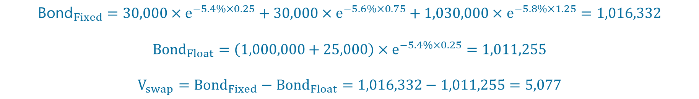
Valuation
  Example:
    Consider a $1 million notional swap that pays a floating rate based on 6-month LIBOR and receives a 6% fixed rate semiannually. The swap has a remaining life of 15 months with pay dates at 3, 9 and 15 months. Spot LIBOR rates are as following: 3 months at 5.4%; 9 months at 5.6%; and 15 months at 5.8%. The LIBOR at the last payment date was 5.0%. Calculate the value of the swap to the fixed-rate receiver using the bond methodology.
$${\text{Bond}}_{Fixed}=30,000×e^{−5.4\%×0.25}+30,000×e^{−5.6\%×0.75}+1,030,000×e^{−5.8\%×1.25}=1,016,332$$
$${Bond}_{Float}=\left(1,000,000+25,000\right)×e^{−5.4\%×0.25}=1,011,255$$
$$V_{swap}={Bond}_{Fixed}−{Bond}_{Float}=1,016,332−1,011,255=5,077$$

Slide 157
Mechanics of A Currency Swap
Currency Swap
  A currency swap exchanges principal and interest in one currency for principal and interest in another currency.
  A currency swap agreement requires the principal to be specified in each of the two currencies. The principal amounts are usually exchanged at the beginning and at the end of the life of the swap.
  For a party paying interest in the foreign currency, the foreign principal is received, and the domestic principal is paid at the beginning of the swap’s life. At the end of the swap’s life, the foreign principal is paid and the domestic principal is received.
  Usually the principal amounts are chosen to be approximately equivalent using the exchange rate at the swap’s initiation. When they are exchanged at the end of the life of the swap, their values may be quite different.

Slide 158
Mechanics of A Currency Swap
Currency Swap
  fixed-for-fixed currency swap
  Fixed-for-floating currency swap
  Floating-for-floating currency swap

Slide 159
Mechanics of A Currency Swap
Currency Swap
  Comparative Advantage Argument
 | USD | AUD | Comparative Advantage
General Electric | 5% | 7.6% | USD Market
Qantas Airways | 7% | 8% | AUD Market
USD 5%
USD 5%
USD 6.3%
General
Electric
Financial
Institution
Qantas
Airways
AUD 6.9%
AUD 8%
AUD 8%
Net Borrowing Rates (i.e., including swap)
 | USD | AUD
General Electric |  | 6.9%
Qantas Airways | 6.3%

Slide 160
Mechanics of A Currency Swap
Valuation
  The valuation of currency swap is given by:
  V_{Swap} = B_{D} – S₀B_{F}
  V_{swap} = S₀B_{F} – B_{D}
其实讲的都是一回事，考试是同一种考法，不会超纲!

Slide 161
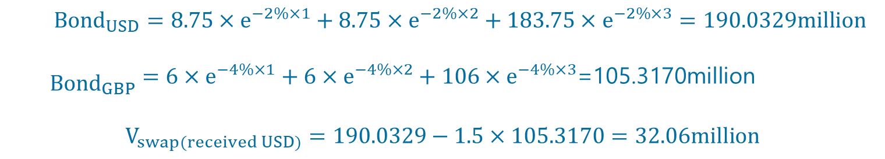
Valuation
  Example:
    At the outset of the swap, company A pays a principal amount to B of USD 175 million, and B pays GBP 100 million to A. Both parties pay the interest rate of the borrowed currency (USD 5%, GBP 6%). At the end of the swap, the principal amounts are re-exchanged. Suppose the yield curves in the United States and Great Britain are flat at 2% and 4%, respectively, and the current spot exchange rate is USD1.50 = GBP1. Value the currency swap just discussed assuming the swap will last for three more years.
${Bond}_{USD}=8.75×e^{−2\%×1}+8.75×e^{−2\%×2}+183.75×e^{−2\%×3}=190.0329million$
${\begin{aligned} \\ Bond\end{aligned}}_{GBP}=6×e^{−4\%×1}+6×e^{−4\%×2}+106×e^{−4\%×3}$=105.3170million
$$V_{swap(received USD)}=190.0329−1.5×105.3170=32.06million$$

Slide 162
Credit Risk Exposure in A Swap Position.
Credit risk
  Because a swap involves offsetting position, there is no credit risk when the swap has negative value. Credit risk only exists when the swap has positive value. A financial institution is liable to lose money if one of the counterparties defaults when it has positive value in its swap because it still has to honor its swap agreement with the other counterparty.
  Note the distinction between credit risk and market risk.
    In the case of a swap, credit risk includes the risk the counterparty defaults; market risk includes the risk that interest rates and/or currency exchanges rates vary unfavorably.
    Market risks can be hedged relatively easily by entering into offsetting contracts; credit risks are less easy to hedge

Slide 163
Other Types of Swaps
Commodity swap
  Firms may enter into commodity swap agreements where they agree to pay a fixed rate for the multi-period delivery of a commodity and receive a corresponding floating rate based on the average commodity spot rates at the time of delivery.
Volatility swap
  An agreement to exchange the realized volatility of an asset for a prespecifed fixed volatility.
Exotic swaps:
  Swaps are limited only by the imagination of financial engineers and the desire of corporate treasurers and fund managers for exotic structures.
  Swaption
  A swaption is an option granting its owner the right to enter into an underlying swap.

Slide 164
Explain the mechanics of a plain vanilla interest rate swap and compute its cash flows. ★★
Explain how a plain vanilla interest rate swap can be used to transform an asset or a liability
Explain the role of financial intermediaries in the swaps market. ★
Describe the role of the confirmation in a swap transaction.
Describe the comparative advantage for the existence of interest rate swaps ★★★
Explain how the discount rates in a plain vanilla interest rate swap are computed. ★
Calculate the value of a plain vanilla interest rate swap ★★★
Calculate the value of a plain vanilla interest rate swap from a sequence of (FRAs).
Explain the mechanics of a currency swap and compute its cash flows. ★★★
Explain how a currency swap can be used to transform an asset or liability
Calculate the value of a currency swap based on two simultaneous bond positions. ★★★
Calculate the value of a currency swap based on a sequence of FRAs.
Describe the credit risk exposure in a swap position. ★
Identify and describe other types of swaps, including commodity, volatility, and exotic swaps. ★

Slide 165
Properties of Stock Options
Financial Products

Slide 166
Six factors
Upper and lower bounds
Put-call parity
Early exercise features of American call and put options.
Summary and practice

Slide 167
Six Factors
Six factors that affect an option's price
Directional Impact of Each Input on Call or Put
Factor | Symbol | Call | Put
Stock price (⬆) | S₀ | ⬆ | ⬇
Strike price(⬆) | K | ⬇ | ⬆
Time to expiration(⬆) | T | ⬆（American) ? (European) | ⬆（American) ? (European)
Volatility(⬆) | σ | ⬆ | ⬆
Risk-free rate(⬆) | r | ⬆ | ⬇
Div. yield(⬆) | D | ⬇ | ⬆
这张表格你没有理由不去记住它！

Slide 168
Six Factors
With respect to each factor（这页可以不看！）
  Stock price: For a call option, a higher stock price implies greater intrinsic value
  Strike price: For a call option, a higher strike price implies less intrinsic value
  Time to expiration: For an American option (call or put), option value is an increasing function with greater time to expiration. For a European option, while value will typically increase with greater time to expiration, the timing of dividends makes the relationship ambiguous (on dividend payout, the stock tends to drop).
  Volatility: Greater volatility increases the value of both a call and a put option
  Risk-free rate: The minimum value of a European call option is the stock price minus the discounted strike price. A higher risk-free rate implies a lower discounted strike price and therefore, in turn, implies an increase in the value of the call option.
  Dividend yield: As dividends have the effect of reducing the stock price on the ex dividend date, a higher dividend reduces the call option’s value.

Slide 169
Upper and Lower Bounds
Upper and Lower Bounds for Option Prices
Option | Proxy | Min Value | Max Value
European call | c | max (0, S₀－ Ke^{-rT}) | S₀
American call | C | max (0, S₀－ Ke^{-rT}) | S₀
European put | p | max (0, Ke^{-rT} －S₀) | Ke^{-rT}
American put | P | max (0 , K－S₀) | K

Slide 170
Upper and Lower Bounds
Upper Bound:
  An American or European call option gives the holder the right to buy one share of a stock for a certain price. No matter what happens, the option can never be worth more than the stock
  An American put option gives the holder the right to sell one share of a stock for K. No matter how low the stock price becomes, the option can never be worth more than K.
  For European put options, at maturity, the option cannot be worth more than K. It follows that it cannot be worth more than the present value of K today

Slide 171
Upper and Lower Bounds
Lower Bound:
  A lower bound for the price of a European call option on a non-dividend-paying stock is the stock price minus discounted strike price. This is the price the Black-Scholes gives if the volatility input is equal to zero. Since the option can at worst expire worthless, it’s value cannot negative。
  For a European put option on a non-dividend-paying stock, lower bound is maximum of zero or discounted strike price minus the stock price

Slide 172



Put-Call Parity
Put–call parity
  Based on a no-arbitrage argument; it can be shown that arbitrage opportunities exist if put–call parity does not hold. Put-call parity is given by:
$$C+Ke^{−rT}=P+S_{0}$$
$$P+S_{0}=c+D+Ke^{−rT}$$
$$S−K≤C−P≤S−Ke^{−rT}$$
$$S_{0}−K−D≤C−P≤S_{0}−Ke^{−rT}$$
这公式每年都会考！（不然没什么而可以考了……)

Slide 173

Early Exercise Features of American Call and Put Options.
All other things being equal, the value of an American style option must be at least as great as a European option with the same features:
The difference between an American call and an American put (C–P) is bounded by the following:
The early exercise becomes more attractive as:
  Stock price decreases,
  Risk-free rate increases, and/or
  Volatility decreases.
$Value$[American option]≥Value[European option]
$$S−K≤C−P≤S−Ke^{−rT}$$

Slide 174
Identify the six factors that affect an option’s price and describe how these six factors affect the price for both European and American options.★★★
Identify and compute upper and lower bounds for option prices on non-dividend and dividend paying stocks. ★★★
Explain put-call parity and apply it to the valuation of European and American stock options with dividends and without dividends. ★★★
Explain the early exercise features of American call and put options. ★★

Slide 175
Trading Strategies
Financial Products

Slide 176
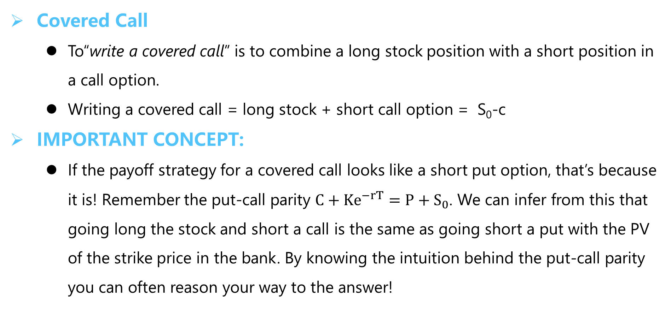
Covered Call and Protective Put
Covered Call
  To“write a covered call” is to combine a long stock position with a short position in a call option.
  Writing a covered call = long stock + short call option = S₀-c
IMPORTANT CONCEPT:
  If the payoff strategy for a covered call looks like a short put option, that’s because it is! Remember the put-call parity $C+Ke^{−rT}=P+S_{0}$. We can infer from this that going long the stock and short a call is the same as going short a put with the PV of the strike price in the bank. By knowing the intuition behind the put-call parity you can often reason your way to the answer!

Slide 177
Covered Call and Protective Put
Protective Put
  A protective put can be thought of as a form of insurance. The investment strategy involves buying a European put option on a stock and the stock itself. Looking at the strategy and the payoff, it looks like we have created a synthetic long call option! Again, the concept of put-call parity comes in handy.
    Writing a Protective Put= long stock + buy put option = S₀+p

Slide 178
Covered Call and Protective Put
Simple Strategies
Profit
Profit
Stock
Stock
0
S_{T}
0
S_{T}
Written Call
Put Option
Covered Call = -C + S
Protective Put = S + P
Income Strategy
Outlook is neutral to bullish
Insurance Strategy

Slide 179
Payoffs of Various Spread Strategies
Spread Strategies
  A spread trading strategy involves taking a position in two or more options of the same type (i.e, two or more calls or two or more puts).
  Spread strategies combine options positions to get a desired payoff. The differences between the options are the strike prices and/or the expiration. The strategies we will discuss here are bull and bear spreads, butterfly spreads, calendar spreads, and diagonal spreads.

Slide 180
Payoffs of Various Spread Strategies
Bull spread (type of vertical spread)
  A bull spread can be created by buying a European call option on a stock with a lower strike price and selling a European call option on the same stock with a higher strike price. Bull spreads can also be created by buying a European put with a low strike price and selling a European put with a high strike price.
Profit
Profit
价差策略的Payoff是要求计算的，但是书上给的表格和方法太麻烦，之后有例题帮助大家理解！
0
S_{T}
0
S_{T}
  Bull Call Spread
  Bull Put Spread

Slide 181
Payoffs of Various Spread Strategies
Bear spread (type of vertical spread)
  A bear spread can be created by buying a European put with a higher strike price and selling a European put with a lower strike price on the same underlying stock. It is important to note that we can create a bear spread using call options also.
Profit
Profit
0
S_{T}
0
S_{T}
  Bear Call Spread
  Bear Put Spread

Slide 182
Payoffs of Various Spread Strategies
Box Spreads
  A box spread is a combination of a bull call spread with strike prices K₁ and K₂ and a bear put spread with the same two strike prices.
    The payoff from a box spread is always K₂ -K₁
    The value of a box spread is therefore always the present value of this payoff
    A value different from this would give rise to an arbitrage opportunity
Profit
0
S_{T}

Slide 183
Payoffs of Various Spread Strategies
Butterfly spread (sideways strategy)
  A butterfly spread involves positions in options with three different strike prices. It can be created using either call or put options.
Profit
Profit
0
S_{T}
0
S_{T}
  Butterfly Spread
  Butterfly Spread

Slide 184
Payoffs of Various Spread Strategies
Calendar Spread
  In a calendar spread, the options have the same strike price but different expiration dates. The calendar spread can be created with calls or puts.
  It can be created from:
    Two calls: The investor sells a call option with a certain strike price and buys a call option with same strike price but with a longer term to maturity.
    Two puts: The investor sells a short-maturity put option and buys a long-maturity put option with the same strike price.

Slide 185
Payoffs of Various Spread Strategies
Calendar Spread
Profit
Profit
0
S_{T}
0
S_{T}
  Calendar Spread

Slide 186
Payoffs of Various Spread Strategies
Diagonal spread
  In a diagonal spread, both the expiration date and the strike price of the calls are different. This increases the range of profit patterns that are possible.

Slide 187
Combination Strategies
A combination strategy
  Involves taking a position in both call(s) and put(s) on the same stock.
Profit
Profit
0
S_{T}
0
S_{T}
  Straddle
  Strangle
A call and a put
Same strike price
Direction neutral
Wants volatility
A call and a put
Different strike price
Like straddle, but cheaper

Slide 188
Combination Strategies
A combination strategy
  Strips and Straps
  Strip consists of a long position in one call and two puts with same strike price and expiration date. Strap consists of a long position in two calls and one put with same strike price and expiration date.
Profit
Profit
0
S_{T}
0
S_{T}
Two puts and one call
Bet on volatility
More bearish
Two calls and one put
Bet on volatility
More bullish
  Strip
  Strap

Slide 189
Conclusion
Simple Strategy | A share and an option
Spread Strategy | Both are call, or both are put
Bull | 2 different K
Bear | 2 different K
butterfly | 3 different K
Calendar | 2 different T
Combination Strategy | Call and put
Straddle & Strangle | Symmetric
Strip & Strap | Asymmetric
有点难+有点烦，麻烦背一背啦!

Slide 190
Explain the motivation to initiate a covered call or a protective put strategy. ★★
Describe the use and calculate the payoffs of various spread strategies. ★★★
Describe the use and explain the payoff functions of combination strategies. ★★★

Slide 191
Exotic Options
Financial Products

Slide 192
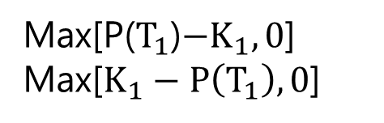
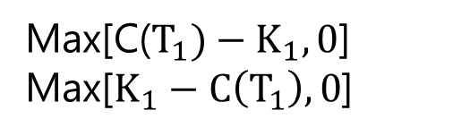
Compound Options
Compound Options
  Compound options are options on options. There are four main types of compound options: a call on a call, a put on a call, a call on a put, and a put on a put.
  The advantages of compound options are that they allow for large leverage and they advantages of compound options . However, if both options are exercised, the total premium will be more than the premium on a single option.
  The payoff structure of the four main types is as follow:
Max[C($T_{1})−K_{1},0$]
Max[$K_{1}−C\left(T_{1}\right),0$]
Max[P($T_{1}$)$−K_{1},0$]
Max[$K_{1}−P\left(T_{1}\right),0$]

Slide 193
Forward Start Options and Chooser Option
Forward Start Options
  A forward start option is an advance purchase of a put or call option that will become active at some specified future time. It is essentially a forward on an option.
  The value of a forward start option will be identical to that of a similar European option with same maturity when the underlying asset is a no-dividend-paying stock.
Chooser Option
  A chooser option has the feature that after a specified period of time, the holder can choose whether the option is a call or a put.
  Suppose that the time when the choice is made is T₁. The value of the chooser option at this time is:
max(c,p)

Slide 194
Barrier Options
Barrier Options
  Payoffs and existence depend on whether the underlying’s asset price reaches a certain barrier level over the life of the option.
  Barrier options are attractive to market participants because they are less expensive than the corresponding regular options. A knock-out option ceases to exist when the underlying asset price reaches a certain barrier while a knock-in option comes into existence only when the underlying asset price reaches a barrier.
  In-out parity is the barrier option’s answer to put-call parity. If we combine one “in” option and one “out” barrier option with the same strikes and expirations, we get the price of a vanilla option. Note that this argument only works for European options.
  Unlike other simpler options, barrier options are path-dependent. That is, the value of the option at any time depends not just on the underlying at that point, but also on the path taken by the underlying.

Slide 195
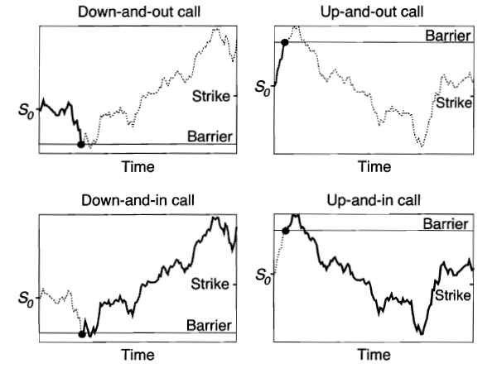
Barrier Options

Slide 196
Binary Options/Digital Option
Binary Options/Digital Option
  Binary option is a type of option where the payoff is either some fixed amount of some asset or nothing at all. Two main types of binary option are cash-or-nothing options and asset-or-nothing option.
  The cash-or-nothing binary option pays some fixed amount of cash if the option expires in-the-money while the asset-or-nothing pays the value of the underlying security.
  A regular European call option is equivalent to a long position in an asset-or-nothing call and a short position in a cash-or-nothing call where the cash payoff in the cash-or-nothing call equals the strike price.
  Similarly, a regular European put option is equivalent to a long position in a cash-or-nothing put and a short position in an asset-or-nothing put where the cash payoff on the cash-or-nothing put equals the strike price

Slide 197
Lookback Options
Lookback Options
  The payoff from lookback options depend on the maximum or minimum asset price reached during the life of the option. There exist two kinds of lookback options: with floating strike and with fixed strike.
Floating lookback call payoff = Final Asset Price – Minimum Price
Fixed lookback call payoff = Maximum Price – Strike
Floating lookback put payoff = Maximum Price – Final Asset Price
Fixed lookback put payoff = Strike – Minimum Asset Price

Slide 198
Shout Options
Shout Options
  A shout option is a European option where the holder can “shout” to the writer at one time during its life. At the end of the life of the option, the option holder receives either the usual payoff from a European option or the intrinsic value at the time of the shout, whichever is greater.

Slide 199
Asian Options
Asian Options
  Options where the payoff depends on the arithmetic average of the price of the underlying asset during the life of the option. There are two types of Asian Options: average price option and average strike option.
  The payoff from an average price call is Max(S_{ave} – K, 0) and that from an average price put is Max(K – S_{ave}, 0)
  An average strike call pays off Max(S_{T} – S_{ave}, 0) and an average strike put pays off Max(S_{ave} – S_{T}, 0)

Slide 200
Define and contrast exotic derivatives and plain vanilla derivatives. ★
Describe some of the factors that drive the development of exotic products.
Explain how any derivative can be converted into a zero-cost product.
Describe how standard American options can be transformed into nonstandard American options. ★
Identify and describe the characteristics and pay-off structure of the following exotic options: gap, forward start, compound, chooser, barrier, binary, lookback, shout, Asian, exchange, rainbow, and basket options. ★★★
Describe and contrast volatility and variance swaps. ★
Explain the basic premise of static option replication and how it can be applied to hedging exotic options. ★

Slide 201
Commodity Forwards and Futures
Financial Products

Slide 202
Commodity Terminology
Lease rate
  The lease rate is to commodities what the dividend is to financial assets: it is the rate received by the owner of a consumption asset from the investor for borrowing the asset. Lease rate payment is clearly a benefit to the owner of the asset. Accordingly, it has the effect of lowering forward price.
  To see this, just imagine that the forward price was not impacted by the lease rate. The owner of the commodity could exploit this by leasing his commodity to a short seller, and turn around in the market and sell the forward at the higher price, thus earning a risk-free payment equal to the present value of the lease rate.
  “It is important to be clear about the reason a lease payment is required for a commodity and not for a financial asset” (McDonald)

Slide 203
Commodity Terminology
Convenience yield
  Convenience yield also affect the pricing relation for a forward or a Futures contract. Think of a commodity, such as oil, where the owner of the oil can derive immediate benefits by using it in, e.g. production. This certainly has some value, and in fact, it serves to reduce the cost of storing the oil. The forward price will thus decrease in the case when there is a convenience yield.

Slide 204
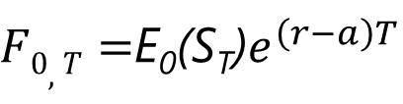
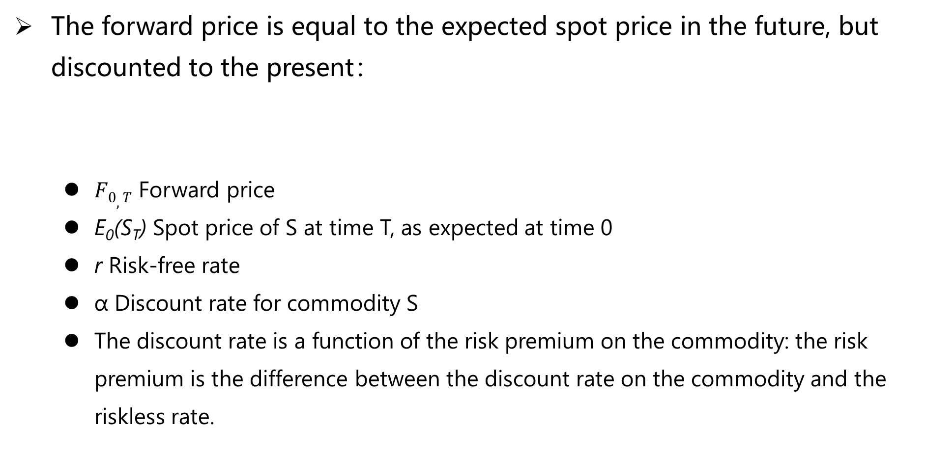
Basic Equilibrium Formula
The forward price is equal to the expected spot price in the future, but discounted to the present：
  $F0,T$ Forward price
  E₀(S_{T}) Spot price of S at time T, as expected at time 0
  r Risk-free rate
  α Discount rate for commodity S
  The discount rate is a function of the risk premium on the commodity: the risk premium is the difference between the discount rate on the commodity and the riskless rate.
$F0,T=$E₀(S_{T})$e^{\left(r−a\right)T}$

Slide 205
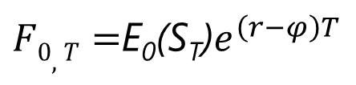
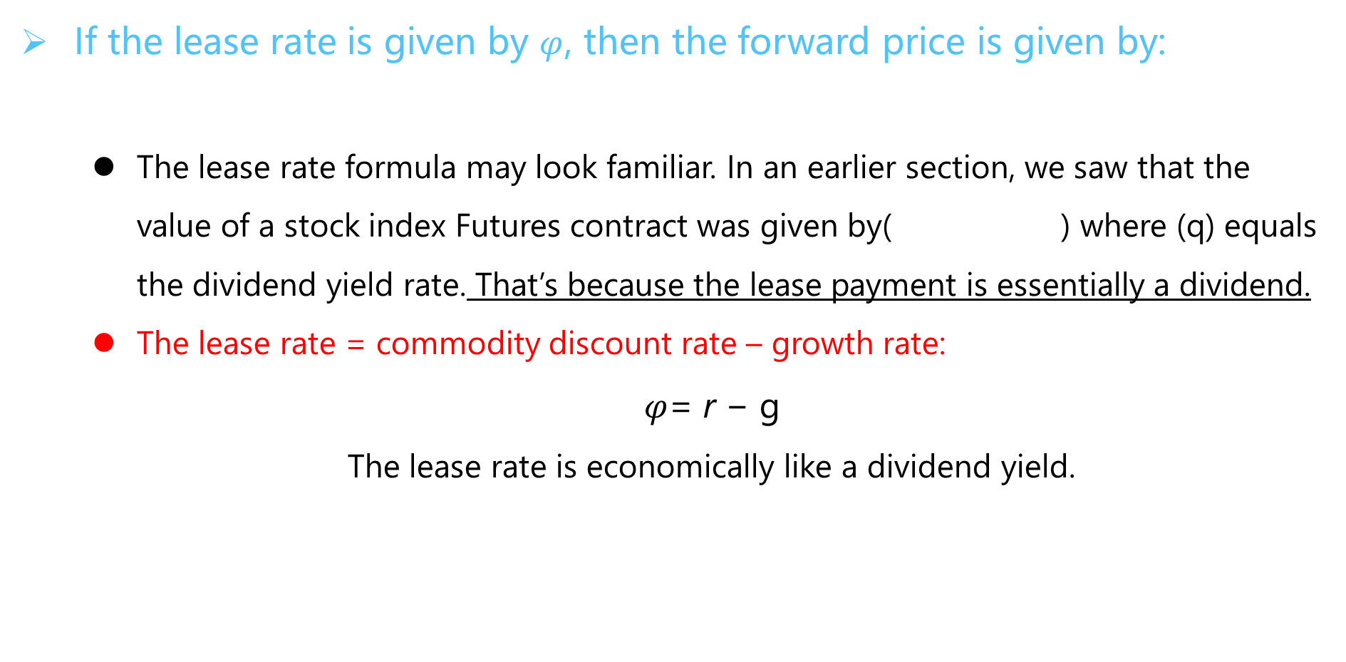
No‐Arbitrage Values
If the lease rate is given by $φ$, then the forward price is given by:
  The lease rate formula may look familiar. In an earlier section, we saw that the value of a stock index Futures contract was given by( ) where (q) equals the dividend yield rate. That’s because the lease payment is essentially a dividend.
  The lease rate = commodity discount rate – growth rate:
  $φ$= r − g
  The lease rate is economically like a dividend yield.
$F0,T=$E₀(S_{T})$e^{\left(r−φ\right)T}$
2017年真题就考过这么XX的知识点！

Slide 206
Contango and Backwardation
The current price of Commodity X in the spot market is $42.47. Forward contracts in one year are trading at a price of $43.11. If the current continuously compounded annual risk-free interest rate is 7.0%, calculate the implicit lease rate for Commodity X. Holding the calculated implicit lease rate constant, would the forward market for Commodity X be in backwardation or contango if the continuously compounded annual risk-free rate immediately fell to 5.0%?
  The implicit lease rate is 1.49%. Holding this rate constant, the forward market would be in contango if the continuously compounded annual risk-free rate immediately fell to 5.0%.
  The implicit lease rate is 5.50%. Holding this rate constant, the forward market would be in backwardation if the continuously compounded annual risk-free rate immediately fell to 5.0%.
  The implicit lease rate is 1.49%. Holding this rate constant, the forward market would be in backwardation if the continuously compounded annual risk-free rate immediately fell to 5.0%.
  The implicit lease rate is 5.50%. Holding this rate constant, the forward market would be in contango if the continuously compounded annual risk-free rate immediately fell to 5.0%.

Slide 207
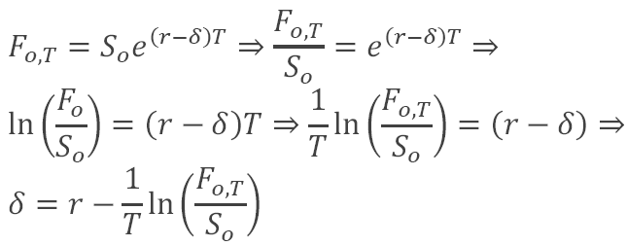
Compare The Lease Rate With The Convenience Yield
If we are given the forward price, we only need to re-arrange the above formula to solve for the implicit lease rate. We re-arrange as follows:

Slide 208
Commodity Spread
Crack Spread
  Crack Spread is a specific spread trade involving simultaneously buying and selling contracts in crude oil and one or more derivative products, typically gasoline and heating oil.
  Oil refineries may trade it to hedge the price risk of their operations, while speculators attempt to profit from changes in the price differential.

Slide 209
Commodity Spread
Crack Spread (cont’d)
  Example: “3 – 2 – 1“ = 3 gallons of oil (input), 2 gallons of gasoline (output) and 1 gallon of heating oil (output)
Short 2 gallons of gasoline at $2.10 = $4.20
Long 3 gallons of oil at $2/gallon = -$6.00
$6.70 - $6.00 = +$0.70
Short 1 gallons of heating oil at $2.50 = $2.50

Slide 210
Apply commodity concepts such as storage costs, carry markets, lease rate, and convenience yield. ★★★
Explain the basic equilibrium formula for pricing commodity forwards. ★★★
Describe an arbitrage transaction in commodity forwards, and compute the potential arbitrage profit. ★★★
Define the lease rate and explain how it determines the no-arbitrage values for commodity forwards and futures. ★★★
Define carry markets, and illustrate the impact of storage costs and convenience yields on commodity forward prices and no-arbitrage bounds. ★★★
Compute the forward price of a commodity with storage costs. ★★★
Calculate a continuous lease rate for a commodity asset. ★★★
Explain the relationship between the lease rate, the convenience yield, and the storage cost. ★★★
Identify factors that impact gold, corn, electricity, natural gas, and oil forward prices. ★
Compute a commodity spread. ★★★
Explain how basis risk can occur when hedging commodity price exposure. ★★★
Evaluate the differences between a strip hedge and a stack hedge and explain how these differences impact risk management. ★★★
Provide examples of cross-hedging, specifically the process of hedging jet fuel with crude oil and using weather derivatives. ★
Explain how to create a synthetic commodity position, and use it to explain the relationship between the forward price and the expected future spot price. ★

Slide 211
EX,OTC,DPCs and SPVs
Financial Products

Slide 212
Counterparty Risk
An exchange is a central financial center
  An exchange promotes market efficiency and enhances liquidity by centralizing trading in a single place.
    An exchange performs several functions:
    Product standardization
    Trading venue : This centralized trading venue provides an opportunity for price discovery.
    Reporting services

Slide 213
The Developments in Clearing That Reduce Risk.
Clearing is the reconciling and resolving of contracts between counterparties.
  Clearing happens between trade execution and trade settlement (when all legal obligations have been made).
    Margining involves exchange members receiving and paying cash or other assets against gains and losses in their positions (variation margin) and providing extra coverage against losses in case they default (initial margin).
    Netting involves the offsetting of contracts, which is useful to reduce the exposure of counterparties and the underlying network to which they are exposed. It reduces the costs of maintaining open positions such as via the margins needing to be posted. Netting can be seen in all of the three forms of clearing that have developed, namely direct clearing, ring clearing and complete clearing.

Slide 214
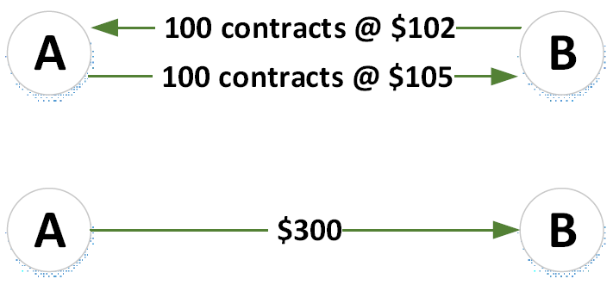
The Developments in Clearing That Reduce Risk.
Three Forms of Clearing
  Direct Clearing refers to a bilateral reconciliation of commitments between the original two counterparties. In direct clearing original counterparties still have exposure to one another, albeit potentially reduced by methods such as payment of differences.

Slide 215
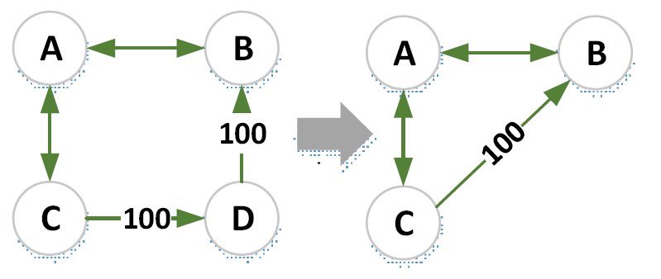
The Developments in Clearing That Reduce Risk.
Clearing Rings
  Were relatively informal means of reducing exposure via a ring of three or more members. In a clearing ring, groups of exchange members agree to accept each other’s contracts and allow counterparties to be interchanged. Clearing rings clearly reduce counterparty risk. They also simplify the dependencies of a member’s open positions and allow them to close out contracts more easily, increasing liquidity. Clearing rings reduce counterparty risk.

Slide 216

The Developments in Clearing That Reduce Risk.
Complete Clearing
  The final stage in the development of clearing is complete clearing where a CCP or ‘clearinghouse’ becomes counterparty to all transactions. Complete clearing reduces counterparty risk further, as a member no longer needs to be concerned about the credit quality of its counterparty.

Slide 217
Exchange-traded and OTC markets
Comparison between exchange-traded and OTC derivatives
 | Exchange-traded | Over-the-counter
Contract Terms | Standardized (maturity, size, strike) | Flexible and negotiable
Maturity | Standard maturities, typically at most a few months | Negotiable and non-standard Often many years
Liquidity | Very good | Limited and sometimes very poor for non-standard or complex products
Credit risk | Guaranteed by CCP | Bilateral

Slide 218
Special Purpose Vehicles (Spvs)
Special purpose vehicles (SPV)
  A Special Purpose Vehicle (SPV) or Special Purpose Entity (SPE) is a legal entity created typically to isolate a firm from financial risk.
  An SPV transforms counterparty risk into legal risk
  SPVs aim effectively to change bankruptcy rules so that, if a derivative counterparty is insolvent, a client can still receive their full investment prior to any other claims being paid out. SPVs are most commonly used in structured notes, where they use this mechanism to guarantee the counterparty risk on the principal of the note to a very high level better than that of the issuer. The creditworthiness of the SPV is assessed by rating agencies who look in detail at the mechanics and legal specifics before granting a rating.

Slide 219
Derivatives product companies
Derivatives product companies(DPCs)
  Are generally triple-A rated entities set up by one or more banks as a bankruptcy-remote subsidiary of a major dealer, which is separately capitalized to obtain a triple-A credit rating.
The triple-A rating of a DPC typically depends on:
  Minimizing market risk
  Support from a parent
  Credit risk management and operational guidelines

Slide 220
• Describe how exchanges can be used to alleviate counterparty risk. ★
• Explain the developments in clearing that reduce risk. ★
• Compare exchange-traded and OTC markets and describe their uses.
• Identify the classes of derivative securities and explain the risk associated with them. ★
• Identify risks associated with OTC markets and explain how these risks can be mitigated.
• Explain the use of special purpose vehicles (SPVs) in the OTC derivatives market and the risks associated with them. ★★

Slide 221
Basic Principles of Central Clearing
Financial Products

Slide 222
Mechanics Of A Central Counterparty (CCP)
Mechanics of a CCP
  CCP can reduce the interconnectedness within financial markets, which may lessen the impact of an insolvency of a participant.
  The CCP being at the heart of trading can provide more transparency on the positions of the members.
  In the central clearing of non-OTC trades, the primary role of the CCP is to standardize and simplify operational processes. In contrast, OTC CCPs have a much more significant role to play in terms of counterparty risk mitigation.

Slide 223
Mechanics Of A Central Counterparty (CCP)
Central Counterparty (cont’d)
  Risk Management Function
    Novation
    Replacement of one contract with one or more other contracts.
    Novation means that the contract between the original parties ceases to exist and they therefore do not have counterparty risk to one another.
    Netting
    Involves offsetting of contracts, which is useful to reduce the exposure of counterparties and the underlying network to which they are exposed.
    Loss Sharing Model/Default Funds
    CCPs developed a loss sharing model. Losses above the resources contributed by the defaulter are shared between CCP members. Default fund is typically used after the defaulter’s own resources to cover losses.

Slide 224


Mechanics Of A Central Counterparty (CCP)

Slide 225
Mechanics Of A Central Counterparty (CCP)
Margining
  It is critical that CCPs have effective risk control and adequate financial resources.
  The most important method for this is via the margins that CCPs charge to cover the market risk of trades. Margin comes in two forms as illustrated below
    Initial margin is charged at the trade’s inception and is designed to cover the worst case close out costs (due to the need to find replacement transactions) in the event a member defaults.
    Variation margin covers the net change in market value of the member’s positions.

Slide 226
  Types of Risks Faced by CCPs
Central Counterparty
  Default Risk
    Default of a clearing member and, more importantly, the possible associated or knock-on effects that this could cause.
    Aftermath of a default event create further problems: Default or distress of other clearing members; Failed auctions; Resignations; Reputational.
  Liquidity Risk
    A CCP faces liquidity risk due to the large quantities of cash that flow through them due to variation margin payments and other cash flows.
    In the event of a default, the CCP must continue to fulfil its obligations to surviving members in a timely manner.

Slide 227
  Types of Risks Faced by CCPs
Central Counterparty
  Model Risk
    Valuation models are required to mark-to-market products for variation margin purposes. The approaches for marking-to-market must be standard and robust across all possible market scenarios.
    Most exposed to model risk via their initial margin approaches. Particular modelling problems could arise from misspecification with respect to volatility, tail risk, complex dependencies and wrong-way risk.
    Another important feature of models is that they generally impose linearity. For example, model-based initial margins will increase in proportion to the size of a position. It is important in this situation to use additional components such as margin multipliers.

Slide 228
  Types of Risks Faced by CCPs
Central Counterparty
  Operational Risk
    CCPs are exposed to operational risks, such as systems failures and fraud.
  Legal Risk
    Aspects such as segregation and the movement of margin and positions can be subject to legal risk from laws in different jurisdictions.
  Investment Risk
    Losses from investments of cash and securities held as margin.
  Other risks
    Settlement and payment risk, foreign exchange risk, custody risk, concentration risk, sovereign risk, and wrong-way risk.

Slide 229
Advantages and Disadvantages of OTC Central Clearing
OTC Central Clearing
  Advantages of OTC Central Clearing
    Transparency
    Offsetting
    Loss mutualisation
    Legal and operational efficiency
    Liquidity
    Default management
  Disadvantages of OTC Central Clearing
    Moral hazard
    Adverse selection
    Bifurcations
    Procyclicality

Slide 230
  Lessons Learned from Prior CCP Failures
Central Counterparty
  Lessons Learned from Prior CCP Failures
    Variation margins should be recalculated frequently and collected promptly (intradaily in volatile markets).
    Initial margin and default funds should be resilient to large negative asset shocks or gaps in market variables and to extreme dependency.
    A CCP should carefully monitor positions, penalize concentration and act quickly in the case of excessively large positions.
    Operational risk must be controlled as much as possible.
    A CCP should have availability to external liquidity sources since it could otherwise default due to being illiquid but not insolvent.

Slide 231
Provide examples of the mechanics of a central counterparty (CCP). ★★
Describe advantages and disadvantages of central clearing of OTC derivatives. ★★
Compare margin requirements in centrally cleared and bilateral markets, and explain how margin can mitigate risk. ★
Compare and contrast bilateral markets to the use of novation and netting. ★★
Assess the impact of central clearing on the broader financial markets. ★
Identify and explain the types of risks faced by CCPs. ★
Identify and distinguish between the risks to clearing members as well as non-members. ★
Identify and evaluate lessons learned from prior CCP failures. ★★

Slide 232
Foreign Exchange Risk
Financial Products

Slide 233
Foreign Exchange Exposure
Foreign Exchange Rates
  Direct quote (US$ Equivalent)
    U.S. dollars per one unit of foreign currency; e.g., 0.9079 USD / CAD
  Indirect quote (Currency per US$)
    Foreign currency per one US dollar; e.g., 1.1015 CAD / $USD

Slide 234
Foreign Exchange Exposure
FX position exposure
  Net exposure_{i} = (FX assets_{i} - FX liabilities_{i}) + (FX bought_{i}- FX sold_{i})
  = Net foreign assets_{i}+ Net FX bought_{i}
  where i = i^{th} currency.
  Positive net exposure ⇒ net long a currency.
  Negative net exposure ⇒ net short a currency.

Slide 235

Foreign Exchange Exposure
To reduce its foreign currency exposure
    Bank can match its foreign currency assets to its liabilities.
    Bank can match buys and sells in trading book.
  Financial holding companies can aggregate their foreign exchange exposure under one umbrella, commercial bank, insurance company, and pension fund.
  The potential size of a bank’s FX exposure given by:
  Dollar loss/gain in currency i = Net exposure in foreign currency i measured in US dollars $×$ Shock (volatility) to the $/foreign currency i exchange rate.

Slide 236
Balance‐sheet hedging
Foreign Exchange Forward/Futures
  Foreign Exchange Risk
    On-Balance-Sheet Hedging involves making changes in the on-balance-sheet assets and liabilities.
    One may choose to remain un-hedged on the balance sheet, and Hedge Off-Balance-Sheet involves no on-balance-sheet changes, but rather involves taking a position in forward or other derivative securities.

Slide 237
Off-Balance-Sheet Hedging
Example:
  Off-Balance-Sheet Hedging
  ABC Bank issues GBP10 million in U.K. CDs to fund its loan portfolio. Given the asset-liability position as follow:
    A promised 1-year rate on the CDs of 7%.
    It invests 50% of its GBP10 million in 1-year U.S. loans at 12% (loans made in USD).
    The bank invests the other 50% in 1-year U.K. loans at 8% .
    At the beginning of the year, the bank sells GBP 5 million for USD in the spot currency markets at an exchange rate of USD1.42/GBP.
    The 1-year forward exchange rate is USD1.40/GBP.

Slide 238
Calculate a financial institution’s overall foreign exchange exposure.
Explain how a financial institution could alter its net position exposure to reduce foreign exchange risk. ★★★
Calculate and explain the effect of an appreciation/depreciation of a currency relative to a foreign currency.
Calculate a financial institution’s potential dollar gain or loss exposure to a particular currency.
Identify and describe the different types of foreign exchange trading activities.
Identify the sources of foreign exchange trading gains and losses.
Calculate the potential gain or loss from a foreign currency denominated investment.
Explain balance-sheet hedging with forwards. ★★
Describe how a non-arbitrage assumption in the foreign exchange markets leads to the interest rate parity theorem, and use this theorem to calculate forward foreign exchange rates. ★★
Explain the purchasing power parity theorem and use this theorem to calculate the appreciation or depreciation of a foreign currency. ★★
Explain why diversification in multi-currency asset liability positions could reduce portfolio risk.
Describe the relationship between nominal and real interest rates.

Slide 239
Corporate bond
Financial Products

Slide 240
Bond Indenture and Corporate Trustee
Bond indenture
  The contract that contains corporate bond issuer promises and investors’ rights. The indenture is made out to corporate trustee, who represents bondholders’ interests.
Corporate trustee
  The corporate trustee is a third party to the contract. The trustee acts in a fiduciary (legal) capacity on behalf of the investors. Typically, the trustee is a bank or trust company with a corporate trust department and officers who are experts in performing trustee functions
  The corporate trustee’s responsibilities include authenticating the bonds issued. Moreover, acting on behalf of the bondholders.

Slide 241
Maturity Date and Main Types of Interest Payment
Maturity date and how it impact bond retirements
  Bond’s maturity: date on which the issuer’s obligation to satisfy the terms of the indenture is fulfilled. Principal is repaid with any premium and accrued interest that may be due.
  However, many issues can be retired prior to maturity.
Main types of interest payment classifications
  1. Straight-coupon bonds (sometimes also referred to as plain-vanilla bonds),
  2. Zero-coupon bonds, and
  3. Floating-rate, or variable-rate, bonds.

Slide 242
Zero-coupon Bonds and Original-issue Discount
Zero-coupon bonds
  Zero-coupon bonds are bonds without coupons or interest rate payments. Zero-coupon bonds pay only the principal portion at some future date.
  Zero-coupon bonds are issued at discounts to par;
  the difference is the return to the bondholder.
  Furthermore, zero-coupon rates play an important role in the construction of a discount curve: it informs the rate of return for the date at which it matures since there is no re-investment risk.

Slide 243
Zero-coupon Bonds and Original-issue Discount
Original-issue-discount
  The difference between the face amount and the offering price when first issued is called the original-issue discount (OID).
  The rate of return depends on the amount of the discount and the period over which it accrues.

Slide 244
Reinvestment Risk
Zero reinvestment risk in a zero
  A zero-coupon bond eliminates reinvestment risk (shifting all of the risk to interest rate risk; e.g., duration) because there is no coupon to reinvest.
    A zero is considered beneficial in declining-interest-rate markets: the zero is discounted less heavily AND we do not worry about having to reinvest any coupon payments at a low rate of interest.
    When interest rates are rising, the opposite is true, we discount the zero more heavily, but we do not receive any coupons that we can reinvest at the higher rate, thus we are stuck with a low-rate bond.

Slide 245
Various security types relevant for corporate bonds
Mortgage bonds（抵押债券）
  A mortgage bond grants bondholders a first-mortgage lien on substantially all its properties.
Collateral trust bonds （担保信托债券）
  When companies cannot pledge fixed assets or other real property, they pledge securities of other companies or Treasury’s instead. To satisfy the desire of bondholders for security, they pledge stocks, notes, bonds, or whatever other kinds of obligations they own. If they are holding companies, the other companies may be their subsidiaries. These assets are termed collateral (or personal property), and bonds secured by such assets are collateral trust bonds.

Slide 246
Various security types relevant for corporate bonds
Equipment trust certificates （设备信托债券）
Debenture bonds (including subordinated and convertible debentures)
  Unsecured bonds are called debentures. With the exception of the utilities and structured products, nearly all other corporate bonds issued are unsecured.
Guaranteed bonds
  Guaranteed bonds: a corporation may guarantee the bonds of another corporation.

Slide 247
Retiring Bonds Before Maturity
There are several mechanisms by which a corporation may go about retiring their debt.
  Call and refunding provisions* （赎回和退款条款）•
  Fixed-price call provision（固定价格提前赎回条款） •
  Make-whole call provision （整体赎回条款）•
  Sinking-fund provision* （偿债基金条款）•
  Maintenance and replacement funds* （维持和更换基金）•
  Redemption through sale of assets （通过出售资产进行赎回）•
  Tender offers*（要约收购）

Slide 248
Retiring Bonds Before Maturity
Call provision
  Corporate bonds with a call provision given contain an embedded option that gives the issuer the right to buy the bonds back at a fixed price prior to maturity, either in whole or in part. The ability to retire debt before its scheduled maturity date is a valuable option for which bondholders will demand compensation ex-ante.
  Ceteris paribus（其他条件不变）, bondholders will pay a lower price for a callable bond than an otherwise identical option-free (i.e., straight) bond.
  The difference between the price of an option-free bond and the callable bond is the value of the embedded call option.

Slide 249
Retiring Bonds Before Maturity
Fixed price
  Bond issuer has the option to buy back some or all of the bond issue prior to maturity at a fixed price (“call price”).
  Call prices generally start at a substantial premium over par and decline toward par over time; in the final years of a bond’s life, the call price is usually par.
Make-whole
  Call price is calculated as the present value of the bond’s remaining cash ﬂows subject to a floor price equal to par value. The discount rate used to determine the present value is the yield on a comparable maturity.

Slide 250
Retiring Bonds Before Maturity
Sinking‐fund provisions
  Money applied periodically to redemption of bonds before maturity.
  Two advantages from the bondholder’s perspective:
    Default risk is reduced
    If bond prices decline as a result of an increase in interest rates, the issuer or its ﬁscal agent may provide price support because it must enter the market on the buy side in order to satisfy the sinking-fund requirement.
  Disadvantage is the bonds may be called at the special sinking-fund call price at a time when interest rates are lower than rates prevailing at time of issuance.

Slide 251
Retiring Bonds Before Maturity
Maintenance and replacement funds
Tender offers
  At any time a firm may execute a tender offer and announce its desire to buy back speciﬁed debt issues.
  Firms employ tender offers to eliminate restrictive covenants or to refund debt

Slide 252
Credit Default Risk and Credit-spread Risk
Credit default risk
  Any bond investment carries with it the uncertainty as to whether the issuer will make timely payments of interest and principal as prescribed by the bond’s indenture. Credit default risk is the risk that a bond issuer will be unable to meet its financial obligations.
Credit-spread risk
  The credit spread is the difference between a corporate bond’s yield and the yield on a comparable-maturity benchmark Treasury security.
  Credit spreads driven by: Macroeconomic forces include such things as the level and slope of the Treasury yield curve, the business cycle, and consumer confidence. Issue-speciﬁc factors include the corporation’s ﬁnancial position and the future prospects of the ﬁrm and its industry.

Slide 253
Event Risk
Event risk
  Is the risk that a transaction (or corporate event) will devalue bondholder’s position:
  Restructurings, recapitalizations, mergers, acquisition, leveraged buyouts, and share repurchase often cause substantial changes in a corporation’s capital structure, greatly increased leverage and decreased equity.

Slide 254
High-yield Bonds
High-yield bonds are those rated below investment grade by the ratings agencies.(junk bonds.)
Types of high-yield bond issuers
  Original Issuers
  Fallen Angels •
  Restructurings and Leverage Buyout
Payment features peculiar to high-yield bonds (deferred-coupon structures)
  Deferred-interest bonds
  Step-up bonds
  Payment-in-kind bonds

Slide 255
Issuer default rate and a dollar default rate
Issuer default rate
  Number of issuers that default divided by total number of issuers. Gives no recognition to amount defaulted nor amount of issuance.
Dollar default rate
  Par value of all defaulted bonds divided by total par value of bonds outstanding during the year (Altman uses this method).
Average annual default rate
  Cumulative $ value of all defaulted bonds ÷ Cumulative $ value of all issuance by weighted average number of years outstanding
Cumulate default rate
  Cumulative $ value of all defaulted bonds ÷ Cumulative $ value of all issuance

Slide 256
Recovery Rates
Measuring the amount recovered is non-trivial. The final distribution to claimants may consist of cash and securities. However, it can often be difficult to track what was received and then additionally, determine the present value of any noncash payments received. Moody’s use the trading price at the time of default as a proxy for the amount recovered. The recovery rate is thus the trading price at that time divided by the par value. Moody’s found that the recovery rate was 38% for all bonds. While default rates are the same regardless of the level of seniority, recovery rates differ. The study found that the higher the level of seniority, the greater is the recovery rate.
（考纲有要求，有兴趣的看一看）

Slide 257
Describe a bond indenture and explain the role of the corporate trustee in a bond indenture.
Explain a bond’s maturity date and how it impacts bond retirements.
Describe the main types of interest payment classifications.
Describe zero-coupon bonds and explain the relationship between original-issue discount and reinvestment risk. ★★
Distinguish among the following security types relevant for corporate bonds: mortgage bonds, collateral trust bonds, equipment trust certificates, subordinated and convertible debenture bonds, and guaranteed bonds.
Describe the mechanisms by which corporate bonds can be retired before maturity. ★★★
Differentiate between credit default risk and credit spread risk.
Describe event risk and explain what may cause it in corporate bonds.
Define high-yield bonds, and describe types of high-yield bond issuers and some of the payment features unique to high yield bonds.
Define and differentiate between an issuer default rate and a dollar default rate.
Define recovery rates and describe the relationship between recovery rates and seniority.

Slide 258
Mortgages and Mortgage-Backed Securities
Financial Products

Slide 259

Types of Residential Mortgage Products
Types of mortgage loans offered by the lenders:
  Residential mortgages typically mature in 15 to 30 years and they are primarily classified on the basis of their securitization mechanism

Slide 260
Types of Residential Mortgage Products
Agency or conforming:
  loans are eligible to be securitized by government entities such as Federal National Mortgage Association (FNMA 房利美), Federal Home Loan Mortgage Corporation (FHLMC), or Government National Mortgage Association (GNMA 吉利美).
  The loans securitized by aforementioned agencies are assessed as relatively more creditworthy. The guidelines for conforming loans comprise of conditions such as maximum size of loans should not exceed a certain amount, the loan-to-value ratio should not fall below 80 per cent and so on.

Slide 261
Types of Residential Mortgage Products
Non-agency or Non-Conforming Loans
  These mortgage loans do not ‘conform’ to the established guidelines by Fannie Mae and Freddie Mac and therefore, are not eligible for purchase by the same agencies. They are part of private-label securitizations. The non-conforming loans are usually offered to those borrowers which do not qualify for conforming loans and the loan type thus carries higher interest charge.
    Jumbos – These loans are larger in size than the prescribed limit for conforming loans but otherwise similar.
    Alt-A – These types of loans deviate from conforming loans in one requirement. The Alt-A loans are positioned between prime & subprime loans. The interest charged on these loans is lesser than subprime lending rate but higher than prime lending rate.
    Subprime – These types of loans largely deviate from the conforming loan guidelines and are offered to borrowers with poor creditworthiness at very high interest rates. Most of the subprime loans are adjustable-rate mortgages (ARMs)

Slide 262

Cash Flow of Mortgage Loans
Fixed rate mortgage payments
    The mortgage loan is fair in the sense that the present value of the monthly mortgage payments, discounted at the monthly compounded mortgage rate, equals the original amount borrowed.
    for a monthly payment X on a T-year mortgage with a mortgage rate y and an original principal amount or loan balance of B(0):
$$X\sum_{n=1}^{12T}{\frac{1}{（1+\frac{y}{12})^{n}}=B\left(0\right);X\frac{12}{y}\left[1−\frac{1}{(1+\frac{y}{12})^{12T}}\right]=B(0)}$$

Slide 263


Cash Flow of Mortgage Loans
Fixed Rate Mortgage Payments (cont’d)
  The fixed monthly payment is often divided into its interest and principal components.
  Letting B(n) be the principal amount outstanding after the mortgage payment due on date n, the interest component on the payment on date n + 1 is:
    In words, the monthly interest payment over a particular period equals the mortgage rate times the principal outstanding at the beginning of that period. The principal component of the monthly payment is the remainder, that is:
B(n)$×\frac{y}{12}$
X-B(n)$×\frac{y}{12}$

Slide 264

Fixed Rate Mortgage Payments
  A homeowner might borrow $100,000 from a bank at 4% and agree to make payments of $477.42 every month for 30 years. The mortgage rate and the monthly payment are related by the following equation:
  In the example, the original balance is $100,000. At the end of the first month, interest at 4% is due on this balance, which comes to $100,000×0.04/12 or $333.33. The rest of the monthly payment, $477.42 - $333.33 or $144.08, is payment of principal. This $144.08 principal payment reduces the outstanding balance from the original $100,000 to $100,000 - $144.08 or $99,855.92 at the end of the first month.
$477.42$\sum_{n=1}^{360}{\frac{1}{(1+\frac{0.04}{12})^{n}}=\$100,000}$

Slide 265
Cash Flow of Mortgage Loans
Fixed Rate Mortgage Payments (cont’d)
  Discounting using the mortgage rate at origination, the present value of the remaining payments equals the principal outstanding. This is a fair pricing condition under the assumptions that term structure is flat and interest rates have not changed since the origination of the mortgage.
    Example: To illustrate this shortcut in this example, after 5 years or 60 monthly payments there remain 300 payments. The present value of these payments at the mortgage rate of 4% is
$477.42$\sum_{n=1}^{300}{\frac{1}{(1+\frac{0.04}{12})^{n}}=\$477.42\frac{12}{0.04}[1−\frac{1}{(1+\frac{0.04}{12})^{300}}]}$=$90,448

Slide 266
Prepayment of Mortgage Loans
Prepayment Option
  Mortgage borrowers have a prepayment option, that is, the option to pay the lender the outstanding principal at any time and be freed of the obligation to make further payments.
  Example: In the example of the previous subsection, the mortgage balance at the end of five years is $ 90,448. At that time, therefore, the borrower can pay the lender this balance and no longer have to make monthly payments.
  The prepayment option is valuable when mortgage rates have fallen. In that case, the present value of the remaining monthly payments exceeds the principal outstanding. Therefore, the borrower gains in present value from paying the principal outstanding in exchange for not having to make further payments.

Slide 267

Prepayment of Mortgage Loans
Prepayment Option
  SMM and CPR
    The single monthly mortality rate at month n, denoted SMM_{n}, is the percentage of principal outstanding at the beginning of month n that is prepaid during month n. The SMM is often annualized to a constant prepayment rate or conditional prepayment rate (CPR). A pool that prepays at a constant rate equal to SMM_{n} has 1 – SMM_{n} of the principal remaining at the end of one month, (1 – SMM_{n})¹² remaining at the end of 12 months, and therefore 1 – (1 – SMM_{n})¹² principal prepaying over those 12 months. Hence, the annualized CPR is related to SMM as follows:
$${CPR}_{n}=1−(1−{SMM}_{n})^{12}$$

Slide 268
Securitization Process of MBS
Participant
  Original Bank: It initially makes a mortgage loan that is part of a pool.
  MBS Issuer: This is the original buyer of the mortgages from the bank and is responsible for the formation of pool and issuing the mortgage backed securities with the underlying pool.
  Mortgage servicers: Manage the flow of cash from borrowers to investors in exchange for a fee taken from those cash flows.
  Mortgage guarantors: Guarantee investors the payment of interest and principal against borrower defaults, also in exchange for a fee.

Slide 269
Securitization Process of MBS
Bank with considerable assets in the form of mortgages sells the portfolio to get early cash to make other loans. （government backed organizations, quasi-governmental or private entities）.
The buyer then groups all the similar mortgages it has already purchased. The mortgages are grouped on the basis of similar characteristics such as loan type, interest rates, maturities, etc. Such kind of grouping is commonly known as pooling of mortgages.
The buyer then issues securities (MBS) that represent an interest in the pool of mortgages called as securitizing the pool.
It sells the MBS to investors in the open market. With the funds from the sale of the MBS, the original buyer of the mortgage pools from the banks can purchase more mortgages and create more MBS.
When the obligors of the mortgage loans make their repayments, the bank & the MBS issuers keep a fee or spread and pass on the rest of the payment to the investors.

Slide 270
Securitization Process of MBS
There are two kinds of MBS.
  The first, called pass-through or participation certificates (PCs) represent a direct claim on the pool of mortgage loans.
  The second kind, called collateralized mortgage obligation (CMOs) or real estate mortgage investment conduits (REMICs) are more complicated. These securities essentially take the interest and principal payments from several MBS and create additional securities with varying maturities and coupons.

Slide 271
Specified pools and TBAs
Trading of Agency Mortgage Pools
  Agency mortgage pools trade in two forms: specified pools and TBAs (To Be Announced)
    In the specified pools market, buyer and sellers agree to trade a particular pool of loans. Consequently, the price of a trade reflects the characteristics of the particular pool.
    Much more liquid, however, is the TBA market, which is a forward market with a delivery option. The TBA seller will pick the cheapest-to-deliver pool, that is, the pool that is worth the least subject to the issuer, maturity, and coupon requirements.

Slide 272
Dollar Rolls
Dollar rolls
  Consider an investor who has just purchased a mortgage pool but wants to finance that purchase over the next month. An alternative for financing mortgages is the dollar roll. The buyer of the roll sells a TBA for one settlement month and buys the same TBA for the following settlement month.
  Value of the Dollar Roll
    Difference in proceeds between: a. Starting with a given pool and buying the roll and; b. Holding that pool over the month.
    If the value of the roll is zero, the roll is said to trade at breakeven.
    If the forward drop is larger so that the value of the roll is positive, the roll is said to trade above carry.

Slide 273
Dollar Rolls
Dollar Rolls (cont’d)
  Example
    Suppose TBA prices of the Fannie Mae 5% for July 12 and August 12 settlements are $102.50 and $102.15.
    The accrued interest to be added to each of these prices is 12 actual/360 days of a month’s worth of a 5% coupon, i.e., 0.167.
    Let the expected total principal pay down comprising of scheduled principal plus prepayments is 2% of outstanding balance and the prevailing short-term rate is 1%.
    A balance of $10 million.

Slide 274
Dollar Rolls
Dollar Rolls (cont’d)
  Example (cont’d)
    Selling the July TBA and investing the proceeds:
    $10M × (102.50 + 0.167)/100 = $10,266,700
    $10,266,700 × 1% × 31/360 = $8,841
    Purchasing the August TBA
    Net proceeds from the roll are:
    Had the investor not rolled, the net proceeds would have been the sum of Coupon and Principal Pay down, derived as:
    The value of the roll: $248,475 - $241,667 = $6,808
$10M × (1 – 2%) × (102.15 + 0.167)/100 = $10,027,066
($10,266,700 + $8,841) - $10,027,066 = $248,475
$10M × (5%/12 + 2%) = $241,667

Slide 275
Refinancing, Turnover, Defaults, and Curtailments.
Refinancing
  In a refinancing a borrower pays off the principal of an existing mortgage with the proceeds of a new one.
  One major motive of refinancing is to reduce cost.
    The most likely reason for a decline in the mortgage rate is the decline in the prevailing level of interest rates
      Decline in the spread of mortgage rates over benchmark rates ▪
      Improvement in the borrower’s credit rating ▪
      Increase in the value of mortgaged property

Slide 276
Refinancing, Turnover, Defaults, and Curtailments.
Refinancing
  Another important motive of refinancing is to extract home equity and is commonly known as cash-out refinancing. If a property value has increased, a borrower takes out a new mortgage with a higher balance than that on the existing mortgage to pay off that existing mortgage and keep some cash for other purposes.
  Modelling the refinancing component of prepayments considers an incentive function for a pool or group of loans in a pool and then defines prepayments due to refinancing as a non-decreasing function of that incentive. Below is an example on estimating an incentive:
  I = (WAC − R) × WALS × A−K （从来没考过）

Slide 277
Refinancing, Turnover, Defaults, and Curtailments.
Turnover
  Turnover drives prepayments due to change in situation/condition of the borrowers such as relocation leading to sale of houses by borrowers, changing needs of borrowers to opt for a bigger or smaller house (due to divorce or addition of family members) or any other personal circumstances.
Defaults
  Default by borrowers leads to prepayment because mortgage guarantors are expected to pay interest and outstanding principal in the event of default by a borrower.
Curtailments
  Curtailments as the name suggests are partial prepayments by a particular borrower.

Slide 278
Valuing MBS using Monte Carlo simulation
Valuing MBS
  Valuing MBSs can not use binomial model while the cash flows of MBSs are strongly linked to prepayment choose.
  The most popular solution to pricing path-dependent claims is Monte Carlo simulation.
  A mortgage security is valued using the Monte Carlo methodology by:
    Modeling interest rate path and refinancing path.
    Calculate the cash flows of the security along each path.
    With forecast in each path, calculate the discounted value of the MBS’s cash flows.
    Compute the value of the MBS as the average of the discounted values across paths.

Slide 279
Option-Adjusted Spread (OAS)
Valuing MBS (cont’d)
  Option-Adjusted Spread (OAS)
    When using simulation to derive the value of MBS, OAS is the yield spread which has to be added to a benchmark yield curve to discount MBS's payments to match its market price.
    OAS is the most popular measure of relative value for MBS.
  OAS vs. Z-Spread
    Zero-Volatility Spread (Z-Spread): The spread is the parallel shift or spread over the zero-coupon Treasury yield curve required for discounting a pre-determined cash flow schedule to arrive at its present market price.
    The implied cost of the embedded prepayment option is called option cost and it is equal to the difference between the OAS and z-spread.

Slide 280
Describe the various types of residential mortgage products. ★
Calculate a fixed rate mortgage payment, and its principal and interest components. ★★★
Describe the mortgage prepayment option and the factors that influence prepayments. ★
Summarize the securitization process of mortgage backed securities (MBS), particularly formation of mortgage pools including specific pools and TBAs. ★★
Calculate weighted average coupon, weighted average maturity, and conditional prepayment rate (CPR) for a mortgage pool. ★★★
Describe a dollar roll transaction and how to value a dollar roll. ★
Explain prepayment modeling and its four components: refinancing, turnover, defaults, and curtailments.
Describe the steps in valuing an MBS using Monte Carlo simulation.
Define Option Adjusted Spread (OAS), and explain its challenges and its uses. ★
Describe the effect of the prepayment option on the price-rate behavior of MBS.

