Slide 1
Foundations of Risk Management
FRM Part I 培训讲义
讲师：Chen

Slide 3
Topic Weightings in FRM Part I
Session NO. | Content | Weights
Study Session 1 | Foundations of Risk Management | 20
Study Session 2 | Quantitative Analysis | 20
Study Session 3 | Financial Markets and Products | 30
Study Session 4 | Valuation and Risk Models | 30

Slide 4
The standard capital asset pricing model
Applying the CAPM to performance measurement
Arbitrage pricing theory
Financial disasters
Deciphering the liquidity and credit crunch 2007-2008
Getting up to speed on the financial crisis
Risk management failures
GARP code of conduct
Risk management: a helicopter view
Corporate risk management: a primer
Corporate governance and risk management
What is ERM?
Risk management and risk taking in banks
Effective data aggregation and risk reporting

Slide 5
Risk Management: a Helicopter View

Slide 6
Is Risk Management Useful?
What is Risk?
The Conflict of Risk and Reward
The Danger of Names
Numbers are Dangerous too
The Risk Manager's
Typology of Risk Exposures

Slide 7
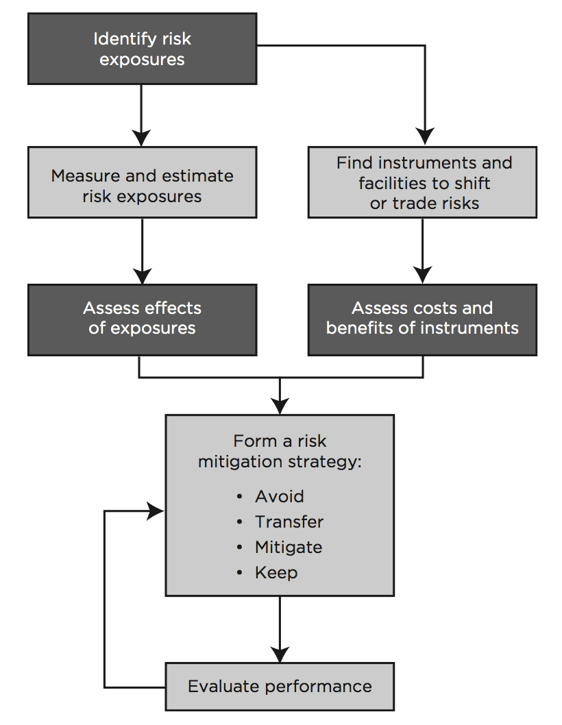
A. Is Risk Management Useful?
Risk management: how firms actively select the type and level of risk that it is appropriate for them to assume.
Risk Management Process

Slide 8
A. Is Risk Management Useful?
Risk management and risk taking aren't opposites, but two sides of the same coin.
  Together they drive all our modern economies.
  It's all about making forward-looking choices about risk in relation to reward.
Blames for Risk Management
  Fail to prevent market disruptions or accounting scandals.
  Derivative markets make it easier to take on large amount of risk.
  Sophisticated financial engineering lead to the violent implosion of firms.
  Only transfer risks to other firms.
  Work to the short-term benefit.

Slide 9
B. What is Risk?
EL And UL
  Expected loss: predictable, incurred in normal times, and already priced into the products.
  Unexpected loss: lumpy, appear unexpectedly, big enough to upset business plans. Correlation risk is a major factor.
  Risk management doesn't aim to controlling and reducing EL but UL.

Slide 10
B. What is Risk?
Old Treatment of Risk VS Stress Testing
  Risk managers: move from a historical-statistical treatments of risk to scenario analysis and stress testing.
A Risk Manager's Job
  NO: control and reduce EL.
  Measure the UL.
  Set sufficient capital to protect against potential UL.
  Achieve appropriate return from the risky activities.
  Clear communication.

Slide 11
C. The Conflict of Risk and Reward
Higher rate of return ⇒ assume more risk
  Risk: variability that can be quantified in terms of probabilities.
  Uncertainty: variability that cannot be quantified

Slide 12
C. The Conflict of Risk and Reward
A Tradeoff between Risks and Rewards
  Poor risk management: powerful business leaders exaggerate returns while diminishing risks.
  Management might leave gaps in risk measurement.
  Risk management failure can be exacerbated by the compensation incentive schemes.
  Trading institutions may manipulate revenues.
  Poor risk measurement techniques: distorted risk.
  Industry regulators can be drawn into the deception.

Slide 13
D. The Danger of Names
The classification of risk creates the potential for missed risks and gaps in responsibilities.
The management of risk within silos is efficient but won't work together efficiently to manage the risks as a whole.
Enterprise-wide risk management (ERM) breaks through risk management silos.

Slide 14
E. Numbers are Dangerous too
Only some kinds of numbers are truly comparable.
Introducing sophisticated models has its own dangers.
A trader might falsify transaction details.
Risk report readers seldom ask tough questions.
All statistical estimation is subject to estimation errors and economic environment changes.
Human psychology.

Slide 15
F. The Risk Manager's Job
Uncover the sources of risk and measure its impact: help make risk management decision.
Balance risk and reward.
Make risk transparent to key decision makers and stakeholders.
Find the right relationship between business leaders and the specialist risk management functions.

Slide 16
G. Typology of Risk Exposures
Market risk is the risk that changes in financial market prices and rates will reduce the value of a security or a portfolio.
  Equity price risk
  Interest rate risk
    Trading risk
      General market risk (systematic risk)
      Specific risk (unsystematic risk)
    Gap risk (the risk that arises in the balance sheet of an institution)
  Foreign exchange risk
  Commodity price risk

Slide 17
G. Typology of Risk Exposures
Credit Risk: the risk of an economic loss from the failure of a counterparty to fulfil its contractual obligations, or from the increased risk of default during the term of the transaction.
  Default risk
  Bankruptcy risk(the risk of actually taking over the collateralized, or escrowed, assets of a defaulted borrower or counterparty)
  Downgrade risk
  Settlement risk

Slide 18
G. Typology of Risk Exposures
Liquidity Risk
  Funding Liquidity Risk: a firm's ability to raise the necessary cash to roll over its debt; to meet the cash, margin, and collateral requirements; and to satisfy capital withdrawals.
  Trading Liquidity Risk: an institution will not be able to execute a transaction at the prevailing market price because there is temporarily no appetite for the deal on the other side of the market.

Slide 19
G. Typology of Risk Exposures
Operational risk refers to potential losses resulting from a range of operational weaknesses including inadequate systems, management failure, faulty controls, fraud, and human errors.
  Human factor risk
    Human factor risk is a special form of operational risk. Such as pushing the wrong button on a computer.
  Technology risk
    Technology risk, principally computer systems risk, also falls into the operational risk category.

Slide 20
G. Typology of Risk Exposures
Legal And Regulatory Risk
  Legal and regulatory risk arises for a whole variety of reasons; it is closely related to operational risk as well as to reputation risk.
    For example, a counterparty might lack the legal or regulatory authority to engage in a risky transaction
  Another aspect of regulatory risk is the potential impact of a change in tax law on the market value of a position.
    For example, when the British government changed the tax code to remove a particular tax benefit during the summer of 1997, one major investment bank suffered huge losses.

Slide 21
G. Typology of Risk Exposures
Systemic Risk:
  Flight to quality
    Simply the perception of increased risk may lead to panic about the soundness of an institution, or to a more general “flight to quality” away from risky assets and toward assets perceived to be less risky.
  Panicked margin call requests
    As a consequence, borrowers may have to sell some of their assets at fire-sale prices, pushing prices further down, and creating further rounds of margin calls and forced sales.
  The Dodd-Frank Act focuses on systemic risk.

Slide 22
G. Typology of Risk Exposures
Business Risk
Reputation Risk
Strategic Risk:
  refers to the risk of significant investments for which there is a high uncertainty about success and profitability.

Slide 23
Corporate Risk Management: A Primer

Slide 24
Why Not to Manage Risk in Theory
Reasons for Managing Risk in Practice
Hedging Operations Versus Hedging Financial Positions
Putting Risk Management into Practice

Slide 25
A. Why Not to Manage Risk in Theory
Franco Modigliani and Merton Miller (M&M):
  The value of a firm cannot be changed merely by means of financial transactions (or risk management).
  Firms should therefore not engage in any risk reduction activity.
  Individual investors can execute on their own.
MM's assumption: the capital markets are perfect.
  Highly competitive; participants are not subject to transaction costs, commissions, or taxes.

Slide 26
A. Why Not to Manage Risk in Theory
CAPM:
  in a world with perfect capital markets, firms only base their investment decisions on systematic risks.
Using hedging tools cannot increase the value of the firm.
Active hedging may distract management from its core business.
A careless risk management strategy can drag a firm down.
Risk management strategy has compliance costs.

Slide 27
B. Reasons for Managing Risk in Practice
The “perfect market” assumption does not hold.
The high fixed costs associated with financial distress and bankruptcy.
Managers have an interest in reducing risks ⇒ to achieve the board's objectives.
Hedging reduces the cost of capital and increases the debt capacity of companies.
A firm can stabilise its costs through hedging.
Purchasing insurance is expensive.

Slide 28
C. Hedging Operations Versus Hedging Financial Positions
A Twofold Conclusion
  Companies should concentrate on business areas in which they have comparative advantages ⇒ firms should risk-manage their operations.
  Firms may also hedge their assets and liabilities, so long as they disclose their hedging policy.

Slide 29
D. Putting Risk Management into Practice
1. Determining The Objective
  The board defines the risk appetite.
2. Mapping The Risks
  Map the specific risks likely to arise from some risk factors.
  Make a record of all assets and liabilities with values that are sensitive to that risk factor.
  Each risk on the list should be characterized in terms of its potential damage and the probability of its occurrence.

Slide 30
D. Putting Risk Management into Practice
3. Instruments For Risk Management
  Naturally hedged? transferable? insurable? not insurable? self-insure?
  Hedge with OTC instruments or exchange-traded instruments?
4. Constructing And Implementing A Strategy
  Static Hedging?
  Dynamic Hedging?
  Accounting issues and tax effects
5. Performance Evaluation

Slide 31
Corporate Governance and Risk Management

Slide 32
A. Introduction
B. Corporate Governance and Risk Management
C. True Risk Governance
D. Committees and Risk Limits
E. Roles and Responsibilities in Practice
F. Limits and Limit Standards Policies
G. Standards for Monitoring Risk
H. What Is the Role of the Audit Function?

Slide 33
A. Introduction
Sarbanes-Oxley Act (SOX)
  Penalise inattention, incompetence, and deliberate malfeasance.
  Ensure the accuracy of company reports filed with the SEC.
  Disclose to the audit committee any deficiencies and material weaknesses.
  The board of the company must include financial experts.

Slide 34
A. Introduction
Key Post-Crisis Corporate Governance Concerns
  Depositors, debt holders, and taxpayers have a much stronger interest in minimizing the risk of bank failure than do most shareholders.
  Board composition: bank boards contain the right balance of independence.
  Regulators have pushed banks to set out a risk appetite that defines the firm's willingness to take risk.
  Compensation: making bonuses a smaller part of the compensation package.

Slide 35
B. Corporate Governance and Risk Management
The Board Should (basic functions)
  Look after the interests of shareholders.
  Be sensitive to the concerns of other stakeholders.
  Alert for any conflict between the interests of management and stakeholders.
  Separate the role of the CEO and the chairman of the board.

Slide 36
B. Corporate Governance and Risk Management
CRO (dual positions)
  Act as a senior member of the management committee and attend board meetings regularly.
  Have a direct reporting line to the board or its risk committees in addition to reporting to the executive team.

Slide 37
C. True Risk Governance
Risk Appetite
  The board characterises the risk appetite.
  Be connected to a firm's overall business strategy and capital plan.
  Clear communication of the firm's risk appetite and risk position.

Slide 38
C. True Risk Governance
Four Basic Choices in Risk Management
  Avoid risk.
  Transfer risk to third parties.
  Mitigate risk.
  Accept risk.

Slide 39
C. True Risk Governance
The Board Should ensure (advanced functions)
  Economic rather than accounting performance.
  “Soft” risks.
  Staff are rewarded based on risk-adjusted performance.
  Major transactions are consistent with the risk authorised.
  Keeping healthy skepticism.

Slide 40
D. Committees and Risk Limits
1. Risk Management Committee
  Translate the overall risk appetite into a set of limits.
  Independently review credit, market, and liquidity risks.
  Report back to the board on a variety of items, such as all loans and credits over a specified dollar limit.
2. Audit Committee of The Board
  Check for infringements, oversee the quality of the processes.
  But only confines to verification function.
  Audit committee members are required to be financially literate.

Slide 41
D. Committees and Risk Limits
3. Risk Advisory Director
  A member of the board who specializes in risk matters.
4. Compensation Committee
  Determine the compensation of top executives.
  Be aligned with the long-term interests of stakeholders, and with risk-adjusted return on capital.
  Removal of guaranteed bonuses.
  Stock-based compensation can encourage risk-taking.

Slide 42
E. Roles and Responsibilities in Practice
Key Lessons from the Financial Crisis
  CROs should not just be after-the-fact risk managers but also risk strategists.
  Be independent of line business management.
  Have a strong enough voice.
  Must evaluate all new financial products to verify that the expected return is consistent with the risks undertaken.

Slide 43
F. Limits and Limit Standards Policies
An appropriate set of limits and authorities must be developed for each portfolio of business and for each type of risk.
Limits should be related to VaR, scenario and stress testing to make sure the bank can survive worst-case scenarios.

Slide 44
G. Standards for Monitoring Risk
How Should a Bank Monitor Those Limits?
  All market risk positions should be valued daily.
  All the assumptions should be verified.
  Timely and meaningful reports.
Data Used in Limit Monitoring Must be
  Independent of the front office.
  Reconciled with the official books of the bank.
  In a proper format.

Slide 45
H. What Is the Role of the Audit Function?
A Key Role of the Audit Function
  Provide an independent assessment of the bank's risk management.
  Examine the integrity of the management information system.
  Verify the accuracy of models through back-testing.
  Examine the documentation relating to compliance.

Slide 46
What is ERM?

Slide 47
ERM Definitions
The Benefits of ERM
The Chief Risk Officer
Components of ERM

Slide 48
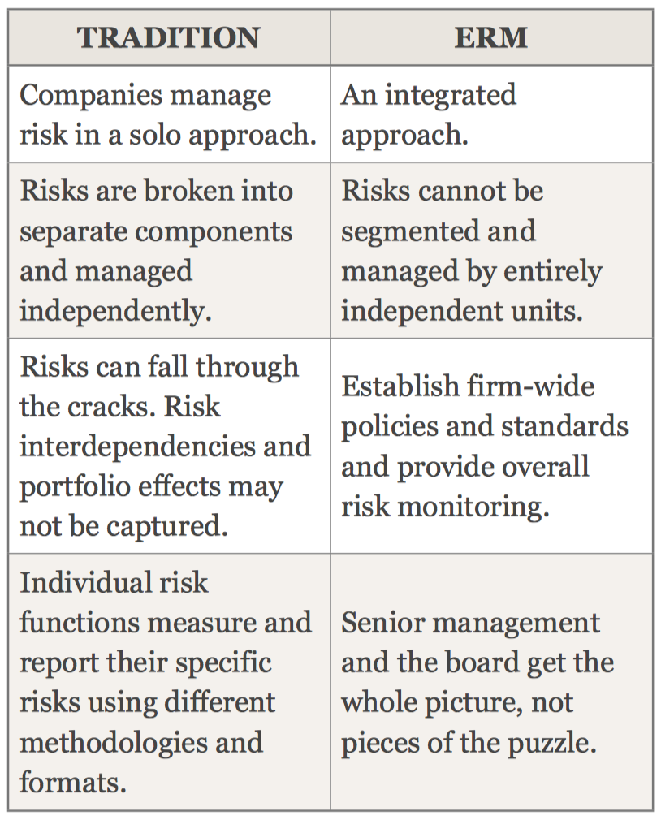
A. ERM Definitions
The Book Author's Definition
  ERM is a comprehensive and integrated framework for managing key risks in order to achieve business objectives, minimize unexpected earnings volatility, and maximize firm value.

Slide 49
B. The Benefits of ERM
ERM Is All About Integration
  ERM requires an integrated risk organization.
  The CRO reports to the CEO and the Board in support of their risk oversight responsibilities.
  ERM requires the integration of risk transfer strategies.
  Take a portfolio view of all types of risk within a company.
  ERM requires the integration of risk management into the business processes of a company.

Slide 50
B. The Benefits of ERM
Three Benefits To ERM
  Organisational Effectiveness
    Various functions work cohesively and efficiently.
  Risk Reporting
    Timely and relevant risk reporting
  Business Performance
    Market value improvement.
    Lower earnings volatility …

Slide 51
C. The Chief Risk Officer
A CRO Is Responsible For
  Providing the overall leadership for enterprise risk management.
  Establishing an integrated risk management framework for all aspects of risks.
  Allocating economic capital to business activities.
  Communicating the company's risk profile to key stakeholders.

Slide 52
C. The Chief Risk Officer
Reporting
  The heads of individual risk department report to the CRO.
  The CRO reports to the CFO or CEO.
  A dotted-line reporting relationship between the CRO and the board.
An Ideal CRO's Superb Skills
  The leadership skills.
  To convert skeptics into believers.
  The stewardship to safeguard the company's assets.
  Having the technical skills.
  Having consulting skills.

Slide 53
D. Components of ERM
Corporate Governance
  Appropriate organizational processes and corporate controls to measure and manage risk.
Line Management
  Align business strategy with corporate risk policy.
Portfolio Management
  Set portfolio targets and risk limits.
  Ensure optimal portfolio returns.

Slide 54
D. Components of ERM
Risk Transfer
  Lower the cost of transferring out undesirable risks.
Risk Analytics
  To quantify the company's risk exposures.
Data and Technology Resources
  Improve the quality of data
Stakeholder Management
  Communicate and report the company's risk information to its key stakeholders.

Slide 55
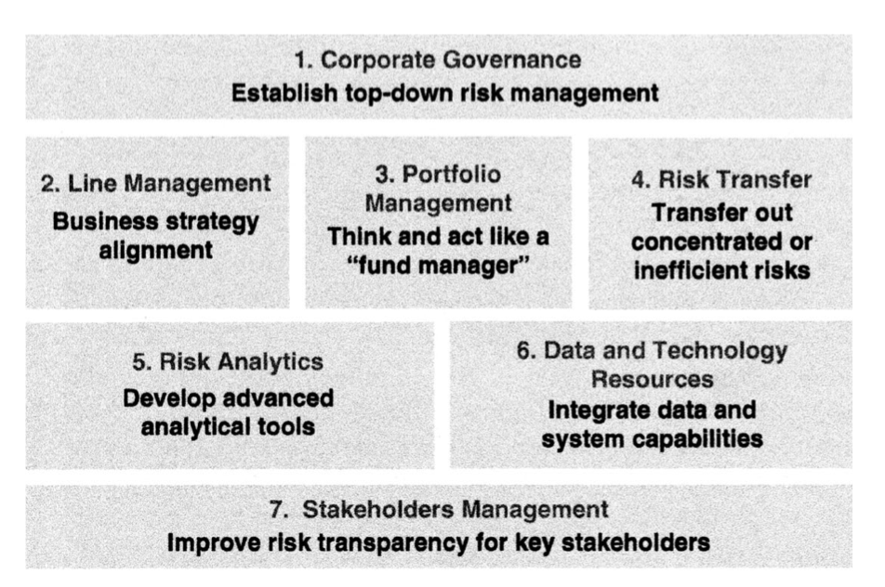
D. Components of ERM

Slide 56
Risk Management and Risk Taking in Banks

Slide 57
How Does Risk Management Add Value?
Determining a Bank's Risk Appetite
Governance and Risk Taking
The Organization of Risk Management
The Limits of Risk Measurement
Incentives, Culture, and Risk Management

Slide 58
A. How Does Risk Management Add Value?
Attitudes Toward Risk
  Good risk
    risks that have a positive expected payoff on a stand-alone basis.
  Bad risk
    risks that can be expected to destroy value on a stand-alone basis.
  Banks cannot succeed without taking risks.

Slide 59
A. How Does Risk Management Add Value?
Modigliani-Miller Theorem
  The value of companies would not be affected by corporate efforts to manage financial risks.
But in the real world:
  Taxes and transaction costs exist.
  Bad outcomes can lead to costly financial distress.
  Companies in distress may lose the ability to carry out their strategies.

Slide 60
A. How Does Risk Management Add Value?
The Goal of Risk Management for Banks
  To determine the optimal level of risk the level that maximizes bank value;
  But subject to the constraints imposed by regulators, laws, and regulations.
A Tradeoff between Return and Risk
  Cost of taking on a single new risk < gain.
  But risk-taking decisions must be assessed in terms of their impact on the overall risk.
  Major challenge: the tradeoff can not be made in real time.

Slide 61
B. Determining a Bank's Risk Appetite
Banks Cannot Operate with too much Risk
  Constrained by laws and regulations.
  Limiting a bank's ability to attract deposits.
  Derivatives counterparties will be reluctant to deal with the bank.
  Difficult to hire potential employees.
Banks have to Take Some Risks
  To create wealth for their shareholders.

Slide 62
B. Determining a Bank's Risk Appetite
A Bank's Optimal Credit Rating Approaches
  Banks targets a certain credit rating.
    the optimal rating of a bank is generally not the highest rating
    Banks with very different strategies, or liability and asset structures, could well end up having very different credit ratings, and different attitudes toward risk.
    A bank with more of a deposit franchise and with more relationship lending is likely to prefer a higher rating than an institution that is engaged in more transactional activities.
  Banks targets a certain PD depending on the bank's business model.

Slide 63
B. Determining a Bank's Risk Appetite
Taking Social Costs into Account
  To maximize value for banks' shareholders ⇒ generate systemic risk to society.
  Regulators therefore impose restrictions (capital).
  Banks have to choose their level of risk subject to external constraints.

Slide 64
C. Governance and Risk Taking
A Good Governance
  Make value-maximizing trade-offs between risk and reward.
  Operate within the constraints imposed by regulation.
  Consistent with the firm's risk appetite.
Better Risk Governance=Better Risk Mgt. Proceed ≠ Less Risk
  Effective risk governance = taking risks rewarding for shareholders ≠ eliminating or even reducing risk-taking.
  Optimal amount of risk for a bank ≠ optimal amount for society.

Slide 65
D. The Organization of Risk Management
Real-world Banks cannot Control Risk
  Limitations in risk measurement technology.
    Real-time risk measures do not exist.
    Risk measurement can be highly imprecise.
    Behavioral biases.
  Limitations of hedging.
    Some risks cannot be hedged.
  Limitations of control resulting from incentives.

Slide 66
D. The Organization of Risk Management
The Right Degree of Independence for Risk Managers
  Risk management is not an audit.
    Auditors only have a verification function.
  If risk managers are viewed as a police ⇒ face obstacles in gathering information.
  The reporting lines of risk managers should be completely separate from the businesses.
    Business lines have a strong commitment to managing risk ⇒ business lines collaborate with risk managers.

Slide 67
E. The Limits of Risk Measurement
Difficulties in Using VaR to Measure Risk at the Firm Level
VaR does not capture all risks.
VaR has substantial model risk.
  Mistakes in correlation estimates.
  Different statistical distributions.
  No sufficient historical data.
Black swans.
Stress testing is added.

Slide 68
F. Incentives, Culture, and Risk Management
Risk Management is not Auditing
  Risk managers must understand the bank's businesses.
  Risk managers also have to determine when risk appetite has to be changed.
  Risk managers: having a dialogue with business units.

Slide 69
F. Incentives, Culture, and Risk Management
Corporate Culture of Risk
  No incentive plan can precisely tell what actions to take in every situation.
  Not all risks can be quantified ⇒ incentive for employees to take risks that are not quantified.
  The ability of a firm to manage risk properly depends on its corporate culture.
  Companies where managers are viewed by their employees as trustworthy are more profitable.
  But good governance changes.

Slide 70
Effective Data Aggregation and Risk Reporting

Slide 71
Introduction
Definition

Slide 72
A. Introduction
A Lesson Learned from the Global Financial Crisis
  Banks' IT and data architectures were inadequate to support the broad management of financial risks because of weak risk data aggregation capabilities and risk reporting practices.
Improving risk data aggregation will:
  Help banks and supervisors anticipate problems ahead.
  Gain in efficiency.
  Reduce probability of losses.

Slide 73
B. Definition
Risk data aggregation
  Defining, gathering and processing risk data according to the bank's risk reporting requirements to enable the bank to measure its performance against its risk tolerance/appetite.

Slide 74
I. Data Architecture and IT Infrastructure
Principle 1
  Governance - A bank's risk data aggregation capabilities and risk reporting practices should be subject to strong governance arrangements consistent with other principles and guidance established by the Basel Committee.
Principle 2
  Data architecture and IT infrastructure - A bank should design, build and maintain data architecture and IT infrastructure which fully supports its risk data aggregation capabilities and risk reporting practices not only in normal times but also during times of stress or crisis, while still meeting the other Principles.

Slide 75
II. Risk data aggregation capabilities
Principle 3
  Accuracy and Integrity – A bank should be able to generate accurate and reliable risk data to meet normal and stress/crisis reporting accuracy requirements. Data should be aggregated on a largely automated basis so as to minimize the probability of errors.
Principle 4
  Completeness – A bank should be able to capture and aggregate all material risk data across the banking group. Data should be available by business line, legal entity, asset type, industry, region and other groupings, as relevant for the risk in question, that permit identifying and reporting risk exposures, concentrations and emerging risks.

Slide 76
II. Risk data aggregation capabilities
Principle 5
  Timeliness – A bank should be able to generate aggregate and up-to-date risk data in a timely manner. The precise timing will also depend on the bank-specific frequency requirements for risk management reporting, under both normal and stress/crisis situations.
Principle 6
  Adaptability – A bank should be able to generate aggregate risk data to meet a broad range of on-demand, ad hoc risk management reporting requests, including requests during stress/crisis situations, requests due to changing internal needs and requests to meet supervisory queries.

Slide 77
III. Risk reporting practices
Principle 7
  Accuracy - Risk management reports should accurately and precisely convey aggregated risk data and reflect risk in an exact manner. Reports should be reconciled and validated.
Principle 8
  Comprehensiveness - Risk management reports should cover all material risk areas within the organization. The depth and scope of these reports should be consistent with the size and complexity of the bank's operations and risk profile, as well as the requirements of the recipients.

Slide 78
III. Risk reporting practices
Principle 9
  Clarity and usefulness - Risk management reports should communicate information in a clear and concise manner. Reports should be easy to understand yet comprehensive enough to facilitate informed decision-making. Reports should include meaningful information tailored to the needs of the recipients.
Principle 10
  Frequency – The board and senior management (or other recipients as appropriate) should set the frequency of risk management report production and distribution. The frequency of reports should be increased during times of stress/crisis.

Slide 79
III. Risk reporting practices
Principle 11
  Distribution - Risk management reports should be distributed to the relevant parties while ensuring confidentiality is maintained.
Principle 12
  Review - Supervisors should periodically review and evaluate a bank's compliance with the eleven Principles above.

Slide 80
IV. Supervisory review, tools and cooperation
Principle 13
  Remedial actions and supervisory measures - Supervisors should have and use the appropriate tools and resources to require effective and timely remedial action by a bank to address deficiencies in its risk data aggregation capabilities and risk reporting practices.
Principle 14
  Home/host cooperation - Supervisors should cooperate with relevant supervisors in other jurisdictions regarding the supervision and review of the Principles, and the implementation of any remedial action if necessary.

Slide 81
The Standard Capital Asset Pricing Model

Slide 82
Foundation of quantitative methods
Markowitz portfolio theory
Effects of correlation on diversification benefits
Markowitz efficient frontier
Minimum variance portfolio
Define an optimal portfolio
Capital Market Line (CML)
Systematic and Unsystematic Risk
Security Market Line (SML)
Capital Asset Pricing Model (CAPM)
Comparing the CML and the SML

Slide 83
A. Foundation of quantitative methods
Expected return / mean / μ
Variance / risk / σ²
Standard deviation /volatility / σ
Covariance / Cov
Correlation / ρ
Expected return and volatility of a two-asset portfolio

Slide 84
B. Markowitz portfolio theory
A rational person
  Risk aversion
  Risk neutral
  Risk preference
E(R)
E(R)
E(R)
σ
σ
σ

Slide 85
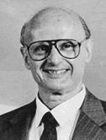
B. Markowitz portfolio theory
Mean Variance Model
  Return: E(R)
  Risk: σ
Risk Aversion
E(R)
Harry M. Markowitz （1927-）
1990年诺贝尔经济学奖获得者
σ

Slide 86
B. Markowitz portfolio theory
Assumptions about a Markowitz investor
  No transaction cost
  The absence of personal income tax
  Assets are infinitely divisible
  An individual cannot affect the price of a stock by his trading
  Investors make decisions solely in term of returns and standard deviation of the returns
  Unlimited short sales are allowed
  Unlimited lending and borrowing at the riskless rate
  All assets are marktable

Slide 87
C. Effects of correlation on diversification benefits
E(R)
100% Stock A
80% A + 20% B
ρ=-0.3
ρ=0.3
ρ=0.8
ρ=+1
ρ=-1
100% Stock B
σ

Slide 88
D. Markowitz efficient frontier
E(R_{P})
Optimal portfolios should lie on this curve (know as the Efficient Frontier)
A portfolio above this curve is impossible
Markowitz efficient frontier
High Risk/High Return
Medium Risk/Medium Return
Portfolios below this curve are not efficient, because for the same risk one should achieve a great return
Low Risk/Low Return
σ_{P}

Slide 89
E. Minimum variance portfolio
Definition: the portfolio with the smallest variance among all possible portfolios on a portfolio possibilities curve.
The shape of the portfolio possibilities curve is best described in two pieces:
  The portion of the portfolio possibility curve that lies above the minimum variance portfolio is concave.
  The portion of the portfolio possibility curve that lies below the minimum variance portfolio is convex.

Slide 90
F. Define an optimal portfolio

Slide 91
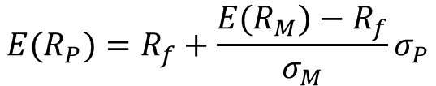
G. Capital Market Line (CML)
E(R_{P})
$${E(R}_{P})=R_{f}+\frac{{E(R}_{M})−R_{f}}{σ_{M}}σ_{P}$$
Capital Market Line
Efficient frontier
M
After the addition of risk-free asset, the allocation decision is between the riskless asset and the market portfolio. The CML is the efficient frontier.
R_{f}
σ_{P}

Slide 92
G. Capital Market Line (CML)
The point of tangency – Portfolio P, is known as the market portfolio. When one can lent or borrow money use riskless rate, investor will hold a combination of the market portfolio and the risk-free asset.
Risk-averse investors will create lower risk portfolios by lending (i.e., investing in the risk-free asset). More risk-tolerant investors will increase portfolio return by borrowing at the risk-free rate.
E(R_{p})
Borrowing
Lending
Portfolio P
Risk(σ_{p})

Slide 93
H. Systematic and Unsystematic Risk
Total risk= systematic risk+ unsystematic risk
Systematic risk is the only important ingredient in determining expected returns and that nonsystematic risk plays no role
E(R_{p})
Capital Market Line
Efficient Frontier
M
●
R_{f}
A
●
Risk(σ_{p})
Unsystematic risk
Systematic risk

Slide 94
H. Systematic and Unsystematic Risk
Risk vs. Number of Portfolio Assets
σ(risk)
Total Risk = unsystematic risk + systematic risk
Unsystematic Risk
Market risk (σ_{mkt})
Systematic Risk
Number of securities in the portfolio ≈ 30

Slide 95

I. Security Market Line (SML)
E(R_{P})
Security Market Line
(SML)
$${E(R}_{P})=R_{f}+β_{P}[E\left(R_{M}\right)−R_{f}]$$
E(R_{mkt})
Market
Portfolio
R_{f}
β_{mkt}=1
Systematic Risk (β_{P})

Slide 96
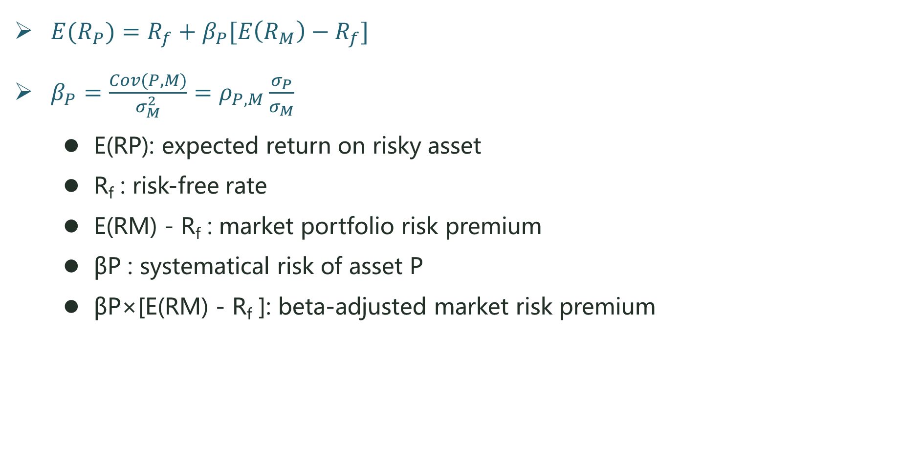
J. Capital Asset Pricing Model (CAPM)
${E(R}_{P})=R_{f}+β_{P}[E\left(R_{M}\right)−R_{f}]$
$β_{P}=\frac{Cov(P,M)}{σ_{M}^{2}}=ρ_{P,M}\frac{σ_{P}}{σ_{M}}$
  E(RP): expected return on risky asset
  R_{f} : risk-free rate
  E(RM) - R_{f} : market portfolio risk premium
  βP : systematical risk of asset P
  βP×[E(RM) - R_{f} ]: beta-adjusted market risk premium

Slide 97
J. Capital Asset Pricing Model (CAPM)
The expected return on the market is 15%, the risk-free rate is 8%, and the beta for stock A is 1.2. Compute the rate of return that would be expected (required) on this stock.
    Answer: E(RA) = 0.08 + 1.2 * (0.15-0.08) = 0.164
    note: βA>1 ⇒ E(RA) > E(Rm)
  The expected return on the market is 15%, the risk-free rate is 8%, and the beta for stock B is 0.8. Compute the rate of return that would be expected (required) on this stock.
    Answer: E(RB) = 0.08 + 0.8 * (0.15-0.08) = 0.136
    note: βB <1 ⇒ E(RB) < E(Rm)

Slide 98
K. Comparing the CML and the SML
CML
E(R)
E(R_{M})
E(R_{M})
E(R_{M})
β=1
R_{f}
R_{f}
R_{f}
σ_{M}
σ_{M}
σ_{M}
σ
σ
σ
E(R)
SML
E(R_{M})
R_{f}
β_{M}=1
β

Slide 99
Practice 1
For a portfolio invested in two risky assets, the higher the correlation of returns between the returns of the risky assets, the:
  Greater the expected return of the portfolio
  Smaller the expected return of the portfolio
  Lower the volatility of portfolio returns.
  Higher the standard deviation of portfolio returns.
  I and IV
  IV only
  II and III
  III only
Correct answer : B

Slide 100
Practice 2
The standard deviation of returns is 0.30 for Stock A and 0.20 for Stock B. The covariance between the returns of A and B is 0.006. The correlation of returns between A and B is:
  0.10
  0.20
  0.30
  0.40
Correct answer : A

Slide 101
Practice 3
Jimmy invests stock A by the CAPM. The information of stock A is as follows:
    Expected marker risk premium 9%
    Risk-free rate 4%
    Historical beta for stock A 1.20
  Jimmy holds that historical beta can not reflect appropriate forecasts of future beta, so he uses the following formula to forecast beta:
  Forecasted beta = 0.70 + 0.20× historical beta
  After making an examination of market trends and the financial statements, Jimmy forecasts that the return for stock A will be 10%. Jimmy should derive the following required return for stock A along with the following valuation decision (undervalued or overvalued):
Valuation CAPM required return
  overvalued 8.7%
  overvalued 12.46%
  undervalued 8.7%
  undervalued 12.46%

Slide 102
Practice 3
Correct answer : B
The CAPM equation is:
  beta forecast = 0.70 + 0.20 × (1.20) = 0.94
The CAPM required return is:
4%+0.94*9%=12.46%
  Jimmy should decide that the stock is overvalued because she forecasts that the return will equal only 10%. whereas the required return (minimum acceptable return) is 12.46%.

Slide 103
Practice 4
There are two analysts Mike and Bob discussed the use of CML.
  Mike thinks that the CML assumes that investors hold two portfolios: 1) the risk-free asset. 2) a risky portfolio ,which is composed of all assets weighted according to their relative market value capitalizations.
  Bob holds that the CML is useful in computing the required return for individual portfolio. Are the statements of Mike and Bob correct?
  Only Mike's statement is correct.
  Only Bob's statement is correct.
  Both statements are correct.
  Neither statement is correct.
Correct answer : A

Slide 104
Applying the CAPM to Performance Measurement

Slide 105
Sharpe ratio
Treynor ratio
Sortino ratio
Information ratio

Slide 106
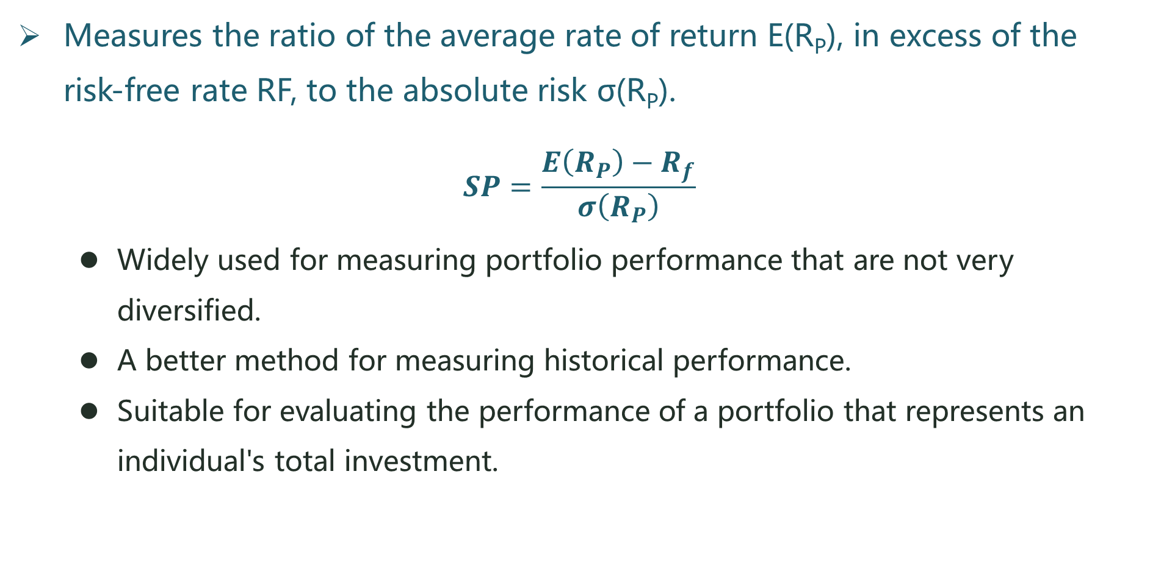
Sharpe ratio
Measures the ratio of the average rate of return E(R_{P}), in excess of the risk-free rate RF, to the absolute risk σ(R_{P}).
$$SP=\frac{E\left(R_{P}\right)−R_{f}}{σ\left(R_{P}\right)}$$
  Widely used for measuring portfolio performance that are not very diversified.
  A better method for measuring historical performance.
  Suitable for evaluating the performance of a portfolio that represents an individual's total investment.

Slide 107

Treynor ratio
Treynor ratio is equal to the risk premium divided by beta (systematic risk)
$$TR=\frac{E(R_{P})−R_{F}}{β_{P}}$$
  More appropriate for comparing well-diversified portfolios and a more forward-looking measure.

Slide 108
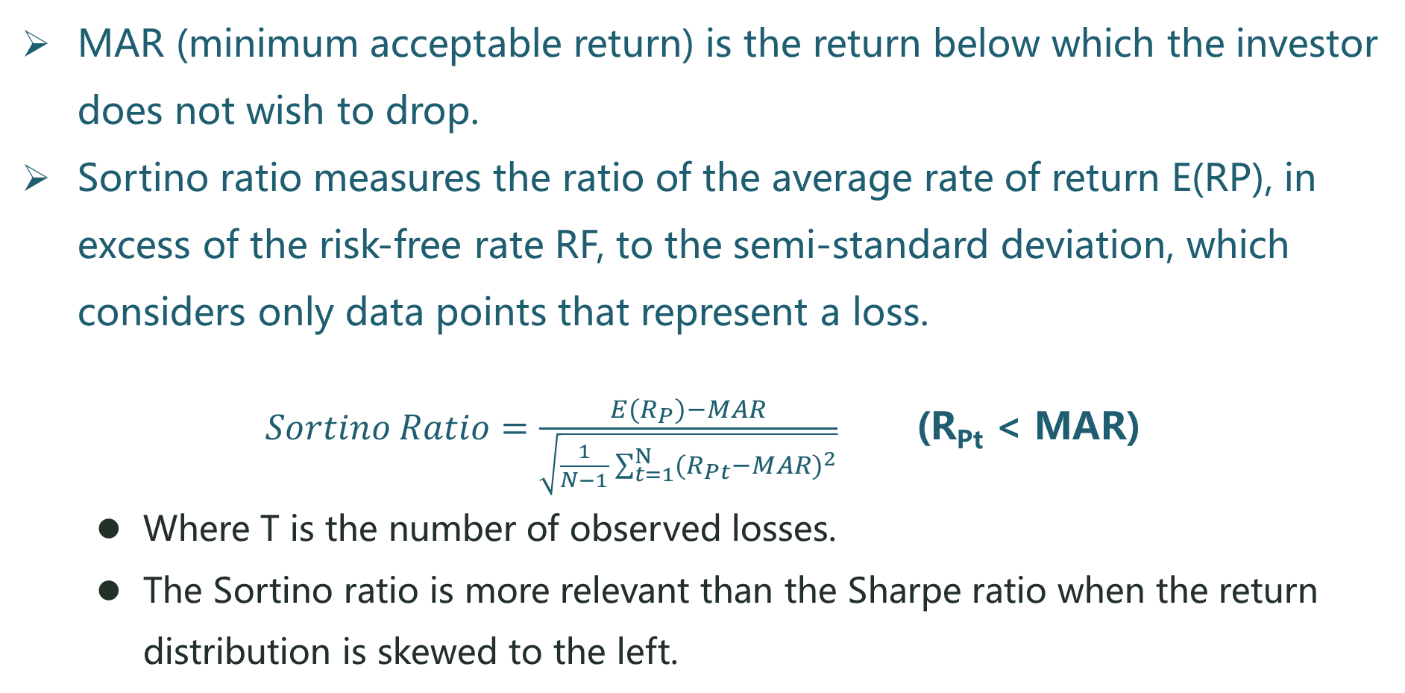
Sortino ratio
MAR (minimum acceptable return) is the return below which the investor does not wish to drop.
Sortino ratio measures the ratio of the average rate of return E(RP), in excess of the risk-free rate RF, to the semi-standard deviation, which considers only data points that represent a loss.
$Sortino Ratio=\frac{E(R_{P})−MAR}{\sqrt{\frac{1}{N−1}\sum_{t=1}^{N}{{(R_{Pt}−MAR)}^{2}}}}$ (R_{Pt} < MAR)
  Where T is the number of observed losses.
  The Sortino ratio is more relevant than the Sharpe ratio when the return distribution is skewed to the left.

Slide 109
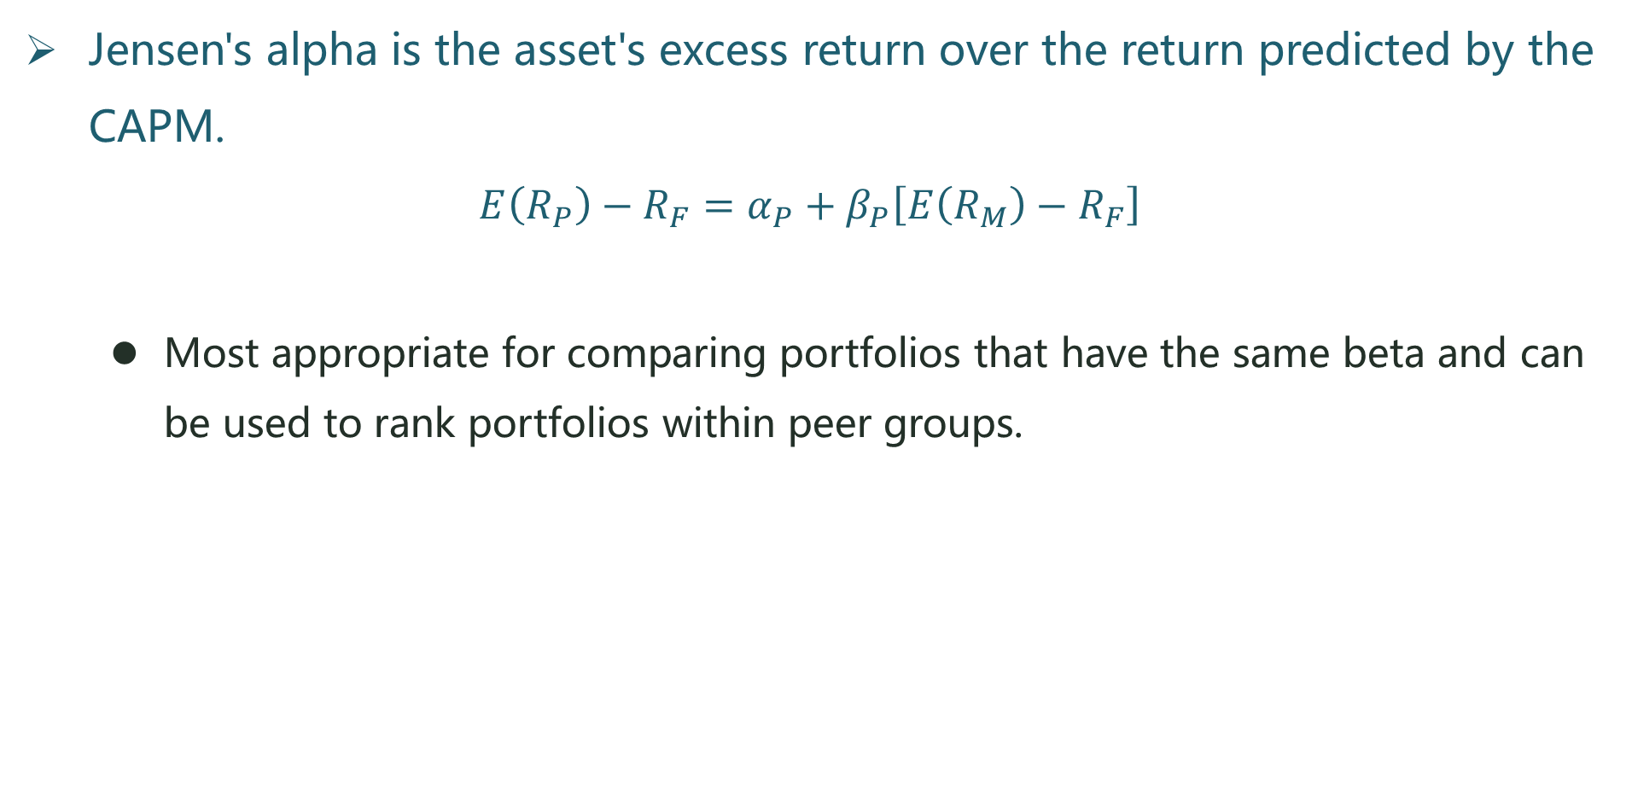
Jensen's alpha
Jensen's alpha is the asset's excess return over the return predicted by the CAPM.
$$E\left(R_{P}\right)−R_{F}=α_{P}+β_{P}\left[E\left(R_{M}\right)−R_{F}\right]$$
  Most appropriate for comparing portfolios that have the same beta and can be used to rank portfolios within peer groups.

Slide 110
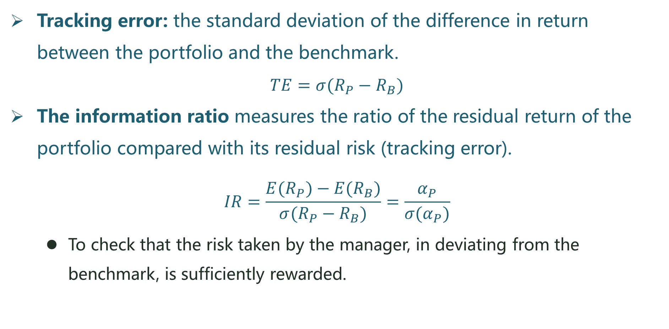
Information ratio
Tracking error: the standard deviation of the difference in return between the portfolio and the benchmark.
$$TE=σ(R_{P}−R_{B})$$
The information ratio measures the ratio of the residual return of the portfolio compared with its residual risk (tracking error).
$$IR=\frac{E(R_{P})−E(R_{B})}{σ(R_{P}−R_{B})}=\frac{α_{P}}{σ(α_{P})}$$
  To check that the risk taken by the manager, in deviating from the benchmark, is sufficiently rewarded.

Slide 111
Arbitrage Pricing Theory

Slide 112
Single-Factor Model
Multifactor Models
Arbitrage Pricing Theory
Arbitrage, Risk Arbitrage, and Equilibrium
Risk premiums
Comparison of CAPM and APT
Fama-French Three-Factor Model

Slide 113
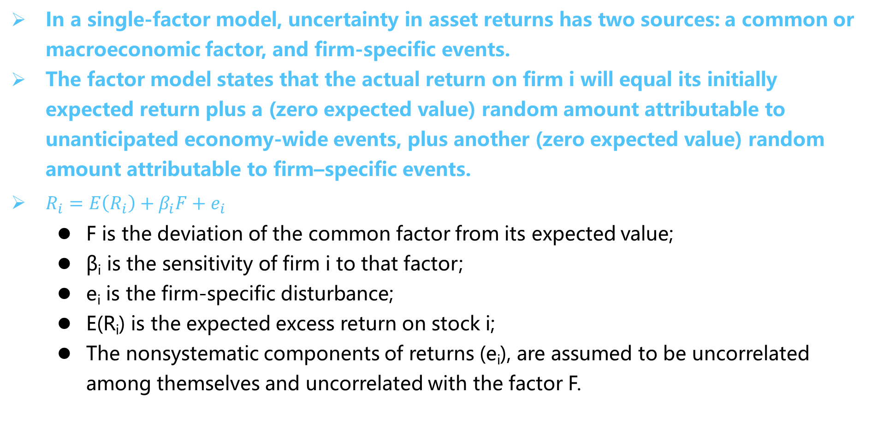
A. Single-Factor Model
In a single-factor model, uncertainty in asset returns has two sources: a common or macroeconomic factor, and firm-specific events.
The factor model states that the actual return on firm i will equal its initially expected return plus a (zero expected value) random amount attributable to unanticipated economy-wide events, plus another (zero expected value) random amount attributable to firm–specific events.
$R_{i}=E\left(R_{i}\right)+β_{i}F+e_{i}$
  F is the deviation of the common factor from its expected value;
  βi is the sensitivity of firm i to that factor;
  ei is the firm-specific disturbance;
  E(Ri) is the expected excess return on stock i;
  The nonsystematic components of returns (ei), are assumed to be uncorrelated among themselves and uncorrelated with the factor F.

Slide 114

A. Single-Factor Model
The expected value of $e_{i}$ for any well-diversified portfolio is zero, and its variance also is effectively zero. We conclude that for a well-diversified portfolio, for all practical purposes
$R_{i}=E\left(R_{i}\right)+β_{i}F$

Slide 115
B. Multifactor Models
Multifactor Model
  Models that allow for several factors can provide better descriptions of security returns.
  Multifactor models of security returns can be used to measure and manage exposure to each of many economy-wide factors such as business-cycle risk, interest or inflation rate risk, energy price risk, and so on.
  Factor models are tools that allow us to describe and quantify the different factors that affect the rate of return on a security during any time period.

Slide 116
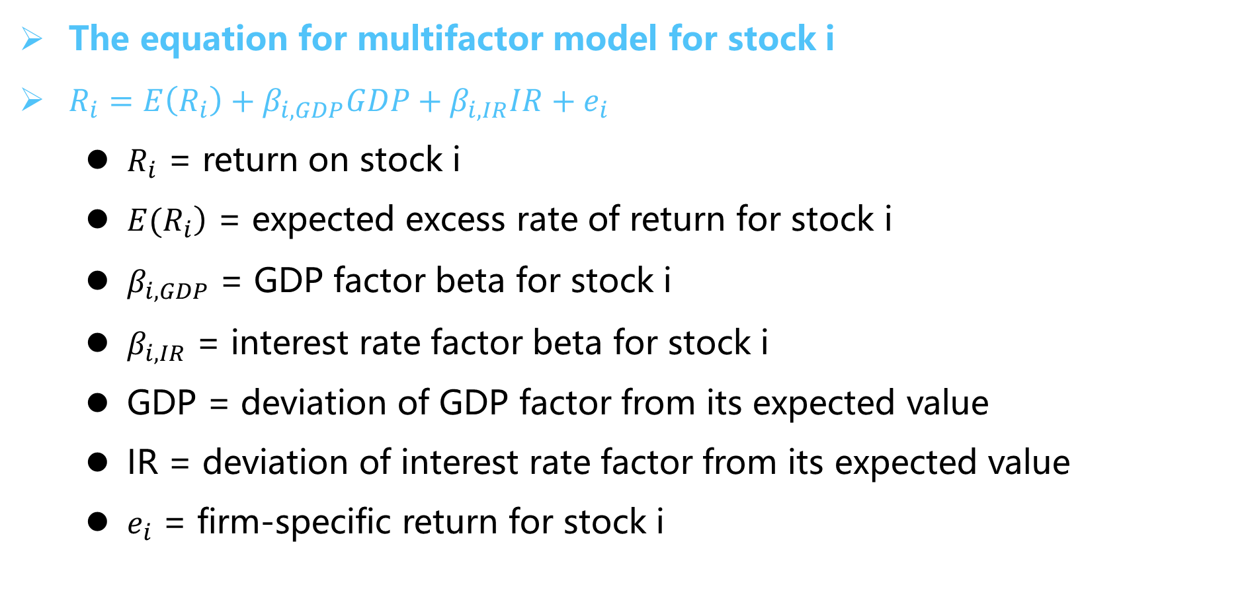
B. Multifactor Models
The equation for multifactor model for stock i
$R_{i}=E\left(R_{i}\right)+β_{i,GDP}GDP+β_{i,IR}IR+e_{i}$
  $R_{i}$ = return on stock i
  $\left.E(R_{i}\right)$ = expected excess rate of return for stock i
  $β_{i,GDP}$ = GDP factor beta for stock i
  $β_{i,IR}$ = interest rate factor beta for stock i
  GDP = deviation of GDP factor from its expected value
  IR = deviation of interest rate factor from its expected value
  $e_{i}$ = firm-specific return for stock i

Slide 117
C. Arbitrage Pricing Theory
Arbitrage pricing theory (APT) is a general theory of asset pricing that holds that the expected return of a financial asset can be modeled as a linear function of various macro-economic factors or theoretical market indices, where sensitivity to changes in each factor is represented by a factor-specific beta coefficient.
Propositions:
  Security returns can be described by a factor model
  There are sufficient securities to diversify away idiosyncratic risk
  Well-functioning security markets do not allow for the persistence of arbitrage opportunities.

Slide 118
C. Arbitrage Pricing Theory
Arbitrage Opportunities
  The APT assumes there are no market imperfections preventing investors from exploiting arbitrage opportunities
  Extreme long and short positions are permitted and mispricing will disappear immediately
  All arbitrage opportunities would be exploited and eliminated immediately

Slide 119
D. Arbitrage, Risk Arbitrage, and Equilibrium
CAPM's argument: If a security is mispriced, then investors will tilt their portfolios toward the underpriced and away from the overpriced securities, each by a relatively small dollar amount.
APT's implication: a few investors who identify an arbitrage opportunity will mobilize large dollar amounts and quickly restore equilibrium.
Arbitrageur often refers to a professional searching for mispriced securities in specific areas such as merger-target stocks

Slide 120
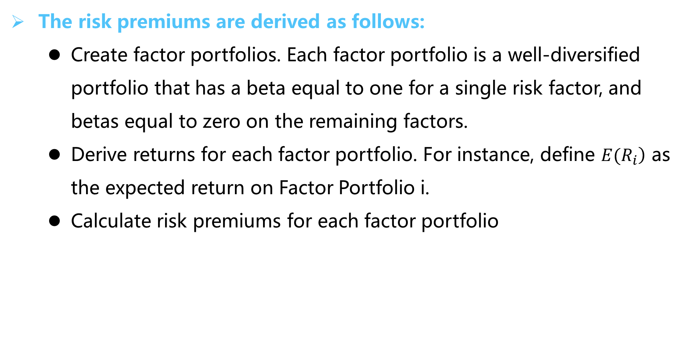
E. Risk premiums
The risk premiums are derived as follows:
  Create factor portfolios. Each factor portfolio is a well-diversified portfolio that has a beta equal to one for a single risk factor, and betas equal to zero on the remaining factors.
  Derive returns for each factor portfolio. For instance, define $\left.E(R_{i}\right)$ as the expected return on Factor Portfolio i.
  Calculate risk premiums for each factor portfolio

Slide 121
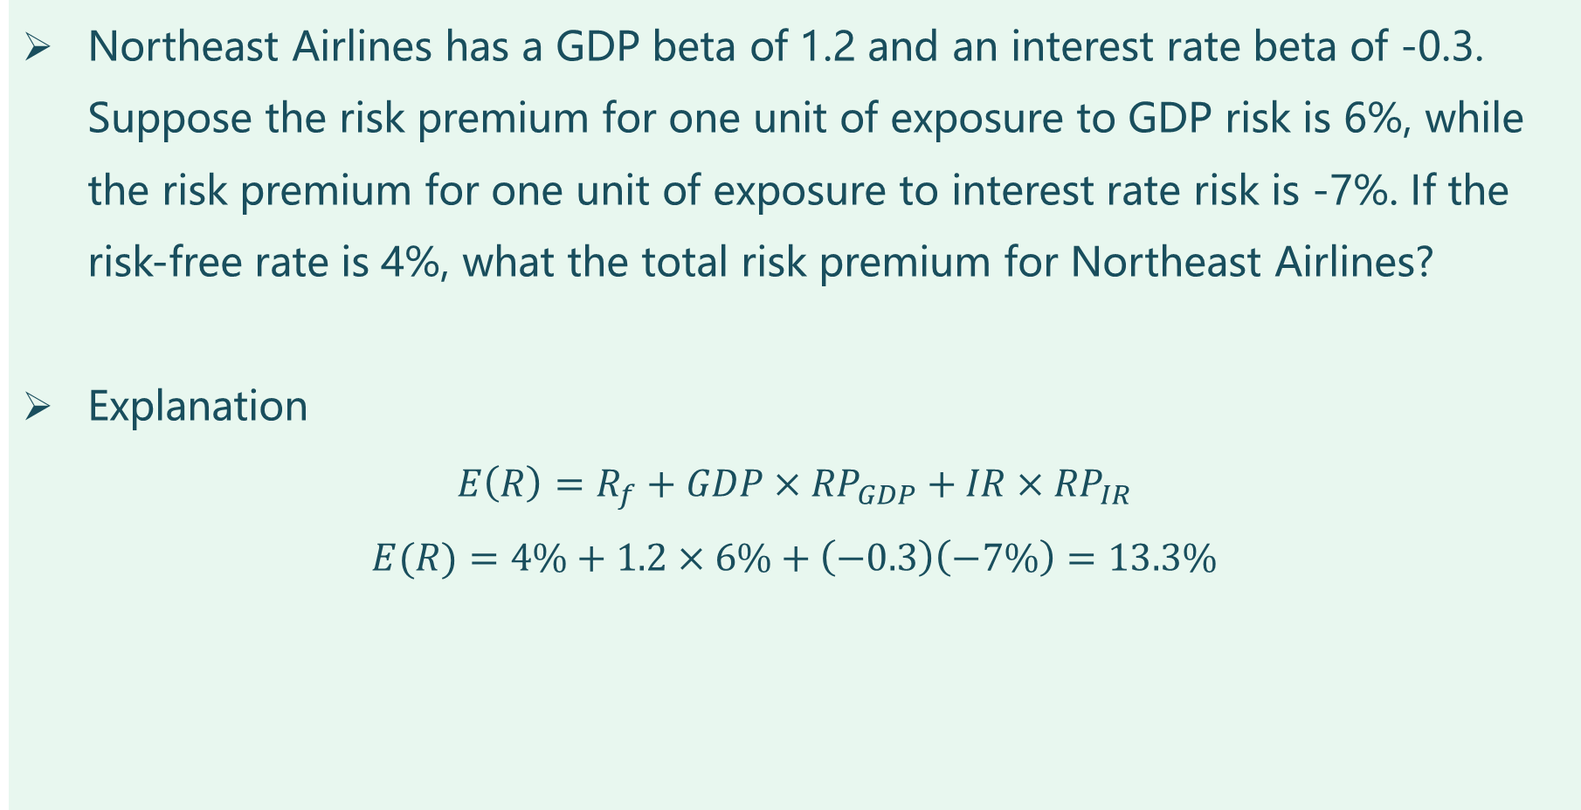
Practice
Northeast Airlines has a GDP beta of 1.2 and an interest rate beta of -0.3. Suppose the risk premium for one unit of exposure to GDP risk is 6%, while the risk premium for one unit of exposure to interest rate risk is -7%. If the risk-free rate is 4%, what the total risk premium for Northeast Airlines?
Explanation
$$E\left(R\right)=R_{f}+GDP×{RP}_{GDP}+IR×{RP}_{IR}$$
$$E(R)=4\%+1.2×6\%+\left(−0.3\right)\left(−7\%\right)=13.3\%$$

Slide 122
F. Comparison of CAPM and APT
 | CAPM | APT
Assumptions | All investors should hold some combination of the market portfolio and the risk-free asset. To control risk, less risk averse investors simply hold more of the market portfolio and less of the risk-free asset. | APT gives no special role to the market portfolio, and is far more flexible than CAPM. Asset returns follow a multifactor process, allowing investors to manage several risk factors, rather than just one.
Conclusions | The risk of the investor's portfolio is determined solely by the resulting portfolio beta. | Investor's unique circumstances may drive the investor to hold portfolios titled away from the market portfolio in order to hedge or speculate on multiple risk factors.

Slide 123
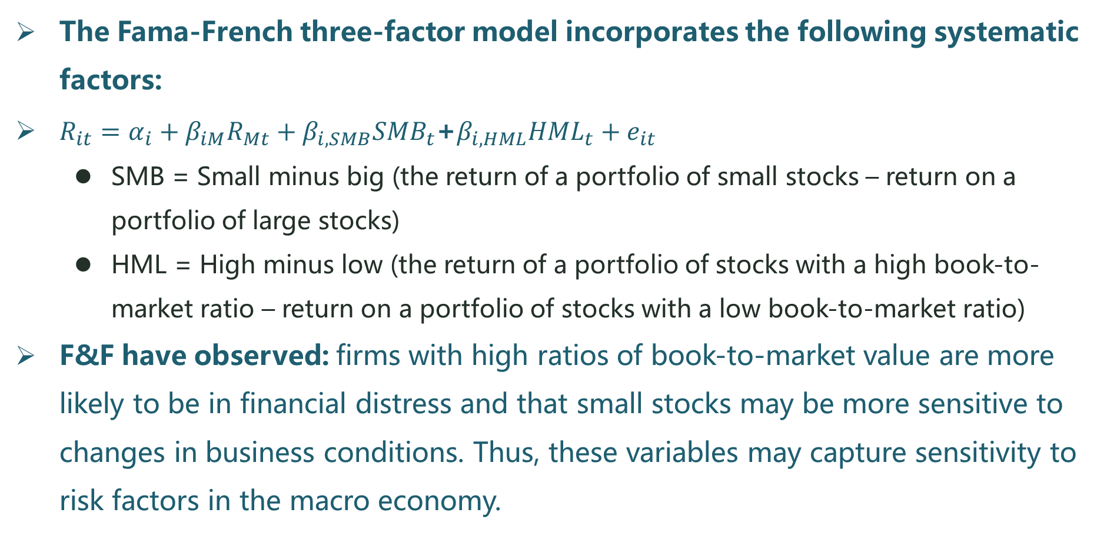
G. Fama-French Three-Factor Model
The Fama-French three-factor model incorporates the following systematic factors:
$R_{it}=α_{i}+β_{iM}R_{Mt}+β_{i,SMB}{SMB}_{t}$+$β_{i,HML}{HML}_{t}+e_{it}$
  SMB = Small minus big (the return of a portfolio of small stocks – return on a portfolio of large stocks)
  HML = High minus low (the return of a portfolio of stocks with a high book-to-market ratio – return on a portfolio of stocks with a low book-to-market ratio)
F&F have observed: firms with high ratios of book-to-market value are more likely to be in financial distress and that small stocks may be more sensitive to changes in business conditions. Thus, these variables may capture sensitivity to risk factors in the macro economy.

Slide 124
Financial Disasters

Slide 125
Drysdale Securities and Chase Manhattan Bank
Kidder Peabody
Barings Bank
Allied Irish Bank
Union Bank of Switzerland
Société Générale
Metallgesellschaft
Long-Term Capital Management (LTCM)
Banker's Trust
JPMorgan, Citigroup, and Enron

Slide 126
A. Drysdale Securities and Chase Manhattan Bank
Incidence
  During 3 months in 1976, Drysdale Government Securities, obtaining unsecured borrowing of about $300 million by exploiting a flaw in the market practices for computing the value of U.S. government bond collateral.
  But Drysdale only have $20 million in capital.
  Drysdale used the borrowed money to take outright positions in bond markets.
  But was unable to repay the borrowed funds because of the decline of the bond value and lost all of the $300 million, then Drysdale went bankrupt.
  Chase Manhattan absorbed almost all of these losses because they had brokered most of Drysdale's securities borrowings.
Results
  Chase experienced reputational damage and an impact on to their stock price.

Slide 127
A. Drysdale Securities and Chase Manhattan Bank
Main Reasons
  Chase failed to detect the unauthorized positions: Chase did not believe the firm's capital was a risk.
  The inexperienced managers in Chase were convinced they were simply acting as middlemen.
  They did not correctly interpret borrowing agreements that made Chase take full responsibility for payments due.
Lessons Learned
  Need for more precise methods for computing the value of collateral.
  Need for better process control. The need for a process that forced areas contemplating new product offerings to receive prior approval from representatives of the principal risk control functions within the firm.

Slide 128
B. Kidder Peabody
Incidence
  Between 1992 and 1994, Joseph Jett, head of the government bond trading desk, entered into a series of trades that were incorrectly reported in the firm's accounting system, artificially inflating reported profits.
  When this was ultimately corrected in April 1994, $350 million in previously reported gains had to be reversed.
Results
  The loss of cash was not actual, but the announcement of such a massive misreporting of earnings triggered a substantial loss of confidence in the competence of the firm's management by customers and General Electric, which owned Kidder.
  In October 1994, General Electric, the owner of the Kidder Peabody, sold Kidder to Paine Webber, which dismantled the firm.

Slide 129
B. Kidder Peabody
Main Reasons
  The computer system used to report government bond trading activity did not account for a forward contract's present value. A trader can get instantly profit by purchasing a bond for cash and delivering the forward contract.
  The system failed to realize that this profit would disappear once financing costs for the cash bond were taken into account.
Lessons to be learned
  Always investigate a stream of large unexpected profits thoroughly and make sure you completely understand the source.
  Periodically review models and systems to see if changes in the way they are being used require changes in simplifying assumptions.

Slide 130
C. Barings Bank
Incident
  The incident involved the loss of roughly $1.25 billion due to the unauthorized trading activities during 1993 to 1995 of a single, relatively junior trader named Nick Leeson.
  The size of the losses relative to Baring's capital along with potential additional losses on outstanding trades forced Barings into bankruptcy in February 1995.

Slide 131
C. Barings Bank
Nick Leeson's strategy 1
  Leeson's trading involved two strategies: selling straddles on the Nikkei 225 and arbitraging price differences on Nikkei 225 futures contracts that were trading on different exchanges.
  A short straddle involves selling calls and puts.
  A short straddle strategy is profitable when the underlying index remains relatively unchanged over the life of the straddle.
  The calls and puts expire worthless, leaving the option writer with the option premium.

Slide 132
C. Barings Bank
Nick Leeson's strategy 2
  The Nikkei 225 futures arbitrage involves taking a long futures position on one exchange where the price is relatively low and hedging with an offsetting short position on another exchange where the price is relatively higher.
  In order to recover the losses, Leeson abandoned the hedged position in the long-short futures arbitrage strategy and initiated a speculative long-long futures positions on both exchanges in hope of profiting from an increase in the Nikkei 225 which finally led to much more loss.
  The Nikkei 225 plunged because the earthquake in Japan, then the huge losses were created.

Slide 133
C. Barings Bank
Main Reasons
  Allowing Leeson to function as a head of trading and the back office at an isolated branch.
  Leeson was able to decide the trade strategy as the floor manager.
  Leeson was able to use the back-office influence to hide the losses, and book the profitable trade to the standard trading accounts, while booking the unprofitable trade to the old error account (Account 88888) to escape reporting to senior management.

Slide 134
C. Barings Bank
The management failed to inquire how a low-risk trading strategy was supposedly generating such a large profit.
  The failure can be attributed to the very poor structuring of management information so that different risk control areas could be looking at reports that did not tie together. This made Leeson receive without question $354 million to meet margin calls from London office.
  Political power struggles and senior management's lack of understanding about Lesson's role eroded oversight and allowed trading losses to be hidden.
Information provided to the credit risk area was not integrated with information provided to funding and showed no such credit extension.

Slide 135
C. Barings Bank
Leeson's to be learned
  Absolute necessity of an independent trading back office.
  The need to make thorough inquiries about unexpected sources of profit (loss) and cash movements.
  The need to establish information, reporting, and control systems.

Slide 136
D. Allied Irish Bank
Incident
  John Rusnak, a currency option trader in charge of a very small trading book in AIB's subsidiary, entered into massive unauthorized trades during the period 1997 through 2002, ultimately resulting in $691 million in losses.
Result
  This resulted in a major blow to AIB's reputation and stock price.

Slide 137
D. Allied Irish Bank
Main Reasons
  Rusnak was able to hide the trading activities from management by creating imaginary trades to offset his real trades, making his trading positions appear small.
  He persuaded back-office personnel not to check these bogus trades.
  He obtained cash to cover his losses by selling deep-in-the-money options, which provided cash up front.
  Rusnak's bullying of operations personnel as part of a general culture of hostility toward control staff.
  AIB's management was so inexperienced that failed to figure out Rusnak's trading activates.
  Rusnak was extremely modest in the amount of false profit he claimed.
  He chose counterparties in the Asian time zone.
  He relied on arguments that costs should be cut be weakening or eliminating key controls.

Slide 138
D. Allied Irish Bank
Lessons to be learned
  This case is similar to Barings. But Rusnak had no dual role.
  Avoid engaging in small ventures in which the firm lacks any depth of expertise.
  Risk management architecture is crucial.
  Relationship between parent and overseas units needs to be clarified.
  Strong and enforceable back-office controls are essential.

Slide 139
E. Union Bank of Switzerland
Incident
  In 1997, UBS lost $400 - $700 million in equity derivatives.
  In 1998, UBS lost $700 million due to a large position in Long Term Capital Management (LTCM).
  The 1997 losses force UBS into a merger on unfavorable terms with Swiss Bank Corp, and the 1998 losses occurred after the merger.

Slide 140
E. Union Bank of Switzerland
Main Reasons
  Less is known about this disaster than the others.
  The equity derivatives business was run without the degree of management oversight that would normally be expected in a firm of the size and sophistication of UBS.
  The senior risk manager authority for the department doubled as the head of quantitative analytics.
  He was contributed to business decisions for which he had review responsibility and his compensation was tied to trading results.

Slide 141
E. Union Bank of Switzerland
The 1997 equity derivatives losses appear to have been due to the following four factors:
  A change in British tax laws, which impacted the value of some long-dated stock options.
  A large position in Japanese bank warrants, that was inadequately hedged.
  An overly aggressive valuation of long-dated options on equity baskets that utilized atypical correlation assumptions.
  Losses on other long-dated basked options, perhaps due to model risk.

Slide 142
F. Société Générale
Incident
  In January 2008, Société Générale reported trading losses of $7.1 billion that the firm attributed to unauthorized activity by a junior trader, Jerome Kerviel.
Result
  The large loss severely damaged Société Générale reputation and required it to raise a large amount of new capital.

Slide 143
F. Société Générale
Jérôme Kerviel's strategy
  Kerviel took very large unauthorized positions in equities and exchange-traded futures. His primary method for concealing these unauthorized positions was to enter fictitious transactions that offset the risk and P&L of his true trades.
  The fictitious nature of these transactions was hidden mostly by creating transactions with forward start dates and then, relying on his knowledge of when control personnel would seek confirmation of a forward-dated trade, canceling the trade prior to the date that confirmation would be sought (Kerviel had previously worked in the middle office of the firm, which may have provided him with particular insight into the actions of control personnel).
  Not surprisingly, given his need to constantly replace canceled fictitious transactions with new ones, there were a large number of these trades, 947 transactions.

Slide 144
F. Société Générale
Main Reasons
  The incorrect handling of trade cancellations.
  Until his immediate manager was replaced in two and a half month, Kerviel's positions were validated.
  The inaction of Kerviel's trading assistant to report fraudulent activity.
  The violation of the bank's vacation policy.
  There were no limits or other monitoring of Kerviel's gross positions, only his net positions.
  Kerviel's unusually high amount of brokerage commissions, related to his high level of gross positions, could also have provided a warning sign.
  The weak reporting system for collateral and cash accounts.
  Kerviel was reporting trading gains in excess of levels his authorized position taking could have accounted for, but an investigation into unexpected reported trading gains was lacked.

Slide 145
F. Société Générale
Lessons to be learned
  Trade Cancellation : Institute systems for monitoring patterns of trade cancellation. Flag any trader who appears to be using an unusually high number of such cancellations.
  Supervision : Control personnel should be aware of situations in which traders are being supervised by temporary or new managers. Tightened control procedures should be employed.
  Trading Assistant : Control personnel must remember that even in situations where there is no suspicion of dishonesty, trading assistants are often under intense pressure from the traders with whom they work closely.

Slide 146
F. Société Générale
Lessons to be learned
  Vacation Policy: Rules for mandatory time away from work should be enforced.
  Cash and Collateral: Cash and collateral requirements should be monitored down to the individual trader level. Better monitoring of cash and credit flows would have also been instrumental in uncovering the Barings and Allied Irish Bank frauds.
  P&L: Any patterns of P&L that are unusual relative to expectations need to be identified and investigated by both management and the control functions.

Slide 147
G. Metallgesellschaft
Incidence
  In 1992, an American subsidiary of MG, Metallgesellachaft Refining and Marketing (MGRM), began a program of entering into long-term contracts to supply customers with gas and oil products at fixed costs and hedge these contracts with short-term gas and oil futures.
Results
  In 1993, when a large decrease in gas and oil prices had resulted in funding needs o f around $900 million, the MG parent responded by closing down the futures positions, leaving unhedged exposure to gas and oil price increases through the customer contracts. Faced with this open exposure, MG negotiated unwinds of these contracts at unfavorable terms.

Slide 148
G. Metallgesellschaft
The Strategy
  MGRM began a program of entering into long-term contracts to supply customers with gas and oil products at fixed costs and to hedge these contracts with short term gas and oil futures.
  The futures being used to hedge were exchange-traded instruments requiring daily cash settlement. The long-term contracts with customers involved no such cash settlement, which can lead to funding liquidity risk.

Slide 149
G. Metallgesellschaft
The Reasons for the Failure of the Strategy
  The market shifted to contango (futures price > spot price) that exploited the basis risk.
    Stack-and-roll hedge exposes to basis risk.
    Shift to contango created losses on roll return.
    Led to cash flow (liquidity) risks.
  German accounting methods required Metallgesellschaft to show futures losses (from futures) but could not recognize unrealized gains from the forward.
    German accounting standards increased the MGRM's perceived credit risk and restricted the company's access to credit, which made the problem worse.
    These reported losses triggered margin calls and a panic, which led to credit rating downgrades.

Slide 150
G. Metallgesellschaft
Lessons to be learned
  It is often a key component of a market maker's business strategy to extend available liquidity in a market.
  The uncertainty of roll cost is a key risk for strategies involving shorter-term hedges against longer-term risk.
  A firm running short-term hedges against longer-term risk requires the flexibility to choose the shorter-term hedge that offers the best trade­off between risk and reward.

Slide 151
H. Long-Term Capital Management (LTCM)
Introduction of LTCM
  LTCM, a hedge fund, was founded in early 1994, generated stellar returns in its first few years of operation.
  The partners worked together at Salomon Brothers and, given their success, decided to start their own fund and proceeded to seek capital from investors. Funding was provided to LTCM despite the secretive nature of its positions.
  The fund was focused on long-term investment strategies. And in the late years of operations, the partners at LTCM invested a large portion of their net worth in the fund since they believed so strongly in the success of their trading strategies.

Slide 152
H. Long-Term Capital Management (LTCM)
The Strategies
  LTCM's investments strategies: relative value, credit spreads, and equity volatility.
    Relative value strategies involved arbitraging price differences, among similar securities and profiting when the prices converged.
    LTCM noticed that credit spread were historically high, they entered into mortgage spreads and international high-yield bond spreads intending to profit when the spreads shrank to more typical historical levels.
    LTCM's equity volatility strategy assumed that volatility on equity options tended to revert to long-term average levels. When volatility implied by equity options was abnormally high, LTCM “sold volatility” until it regressed to normal levels.

Slide 153
H. Long-Term Capital Management (LTCM)
Two major events
  In August of 1998, Russia unexpectedly defaulted on its debt. This economic shock caused the yields on developing nations' debt to increase and a flight to the quality of government bonds in industrialized countries.
    The flight to quality increased, rather the decreased, credit spreads, causing huge losses for LTCM.
  Brazil devalued its currency, thereby further increasing interest rates and risk premiums.
    The general increase in volatility also generated losses in LTCM's equity volatility strategies.

Slide 154
H. Long-Term Capital Management (LTCM)
The Risks faced by LTCM
The insufficient of equity and cash flow crisis.
  The large increase in yield spread caused huge losses and severe cash flow problems caused by realizing marked to market losses and meeting margin calls.
  LTCM lost 44% of its capital in just one month. And the firm's lack of equity created a cash flow crisis and make it necessary to liquidate positions to meet margin calls.

Slide 155
H. Long-Term Capital Management (LTCM)
Model Risk: valuation or trading models are flawed.
  LTCM's model assumed that historical relationships were useful predictors of future relationships, which is often true in the absence of economic shocks. However, external shocks often cause correlations that are historically low to increase sharply.
  The models also assumed that low-frequency/high-severity events were uncorrelated over time.
  One economic shock triggered another so that extremely low probability events were occurring several times per week, and as a result, traditional VaR models underestimated risk in the tails of the distribution.

Slide 156
H. Long-Term Capital Management (LTCM)
Market Risk
  LTCM was diversified across the globe, across different asset classes, and across different trading strategies. However, all of its strategies were based on the notion that risk premiums and market volatility would ultimately decline. And the lack of diversification made LTCM subject to the market risk.
Trading Liquidity Risk
  LTCM considered the possibility of market impact to some extent in its short risk measures, but underestimated the magnitude of its influence on market prices, particularly in the event of forced liquidation.
Limited Reporting Obligation to Regulators
  Although the size of its positions required financial statement reporting and daily position reporting, these reports were incomplete and lacked disclosure of derivative positions and trading strategies.

Slide 157
H. Long-Term Capital Management (LTCM)
The Results
  The Federal Reserve Bank of New York orchestrated a bailout in which 14 leading banks and investment houses invested $3.65 billion for a 90% stake in LTCM.
Lessons to be Learned
  It is essential to require initial margin for counterparties whose principal business is investing and trading.
  To incorporate potential liquidation costs into prices in the event of adverse market condition.
  A push for greater disclosure by counterparties of their trading strategies and positions.
  Better use of stress tests in assessing credit risk.

Slide 158
I. Banker's Trust
Incident
  Procter & Gamble (P&G) and Gibson Greetings sought the assistance of Banker's Trust (BT) to help them reduce funding costs.
  BT used derivative trades, which promised the two companies a high-probability, small reduction in funding costs in exchange for a low-probability, large loss.
  The derivative structures developed by BT were intentionally complex and prevented P&G and Gibson from fully understanding the trade values and risks that were involved.
  The structures were not comparable to other derivative trades making it impossible to get a competitive quote.
  In 1994, P&G and Gibson finally realized that they had been misled after discovering that they had suffered huge losses. As a result, the two companies sued BT.

Slide 159
I. Banker's Trust
Lessons to be Learned
  This case demonstrated the importance of matching trades with a client's needs and providing price quotes that are independent from the front office.
  It also demonstrated the importance of exercising caution with any form of communication that could eventually be made public, as it could damage a firm's reputation if unethical practices are present.

Slide 160
J. JP Morgan, Citigroup, and Enron
Incident
  Citigroup and JP Morgan Chase, the largest and second largest US banks respectively, reached an agreement July 28 2003 with the Securities and Exchange Commission (SEC) to pay a combined $286 million in fines in connection with their involvement in the fraud perpetrated by Enron.
  The SEC charged that the two banks aided defunct energy trading giant Enron in disguising loans as cash in order to defraud investors.

Slide 161
J. JP Morgan, Citigroup, and Enron
Details, Result and Lesson
  Enron had for years been engaging in dubious accounting practices to hide the size of its borrowings from investors and lenders.
  One of the ploys that Enron had used was to disguise a borrowing as an oil futures contract. Sold oil for future delivery, getting cash, and then agreed to buy back the oil that it delivered for a fixed price. When you canceled out the oil part of the trades, what was left was just an agreement for Enron to pay cash later for cash it had received up front - in practice, a loan.
  When this was finally disclosed, JPMorgan Chase and Citigroup, Enron's principal counterparties on these trades, justified their activities by saying that they hade not harmed Enron and that they had no part in determining how Enron had accounted for the transactions on its books. But both JPMorgan and Citigroup clearly knew what Enron's intent was in entering into the transaction. In the end, they agreed to pay a combined $286 million for “helping to commit a fraud” on Enron's shareholders.

Slide 162
J. JP Morgan, Citigroup, and Enron
JP Morgan
$400m + i
$400m
Stoneville Aegean
Gas
Enron
Gas
Mahonia
$400m + i
$400 million
A mask of JP
A mask of JP

Slide 163
J. JP Morgan, Citigroup, and Enron
Citi
Return $200m in 6 months
Loan=$200m
The proceeds of the sale was recorded on Enron's 2000 earnings report
Enron
Assets
Fishtail
Assets
An SPE
$200m
$200m
Controlled by Enron
Controlled by Enron

Slide 164
Practice 1
A stack-and-roll hedge as described in the Metallgesellschaft case is best described as:
  Buying futures contracts of different expirations and allowing them to expire in sequence.
  Buying futures contracts of different expirations and closing out the position shortly before expiration.
  Using short-term futures to hedge a long-term risk exposure by replacing them with longer-term contracts shortly before they expire.
  Using short-term futures contracts with a larger notional value than the long-term risk they are meant to hedge.
Correct answer : C

Slide 165
Practice 2
Past financial disasters have resulted when a firm allows a trader to have dual roles as both the head of trading and the head of the back-office support function. Which of the following case studies did not involve this particular operational risk oversight?
  Drysdale Securities
  Allied Irish Bank
  Barings
  I only
  II and III
  I and II
  I, II, and III
Correct answer : C

Slide 166
Practice 3
Which of the following is a common attribute of the collapse at both Metallgesellschaft and Long-Term Capital Management (LTCM)?
  Cash flow problems caused by large mark to market losses.
  High Leverage.
  Fraud.
  There are no similarities between the causes of the collapse at Metallgesellschaft and LTCM.
  Correct answer : A

Slide 167
Practice 4
In the case of Barings Bank (Barings), Nick Leeson incurred huge trading losses. Which of the following statements correctly describes one of the factors that led to the bankruptcy of Barings?
  Barings had insufficient liquidity to cover marked to market losses.
  Leeson used a long straddle strategy on the Nikkei 225.
  Leeson held speculative double short positions in the market for Nikkei 225 futures contracts.
  There was ambiguity concerning who was responsible for performing specific oversight functions.
Correct answer : D

Slide 168
Deciphering the Liquidity and Credit Crunch 2007-2008

Slide 169
Banking Industry Trends
The Unfolding of the Crisis
Amplifying Mechanisms and Recurring Themes

Slide 170
A. Banking Industry Trends
Trend 1: Securitization. “Originate and distribute” model: banks repackaged loans and passed them on to various other financial investors.
  Collateralized Debt Obligations (CDOs).
  Tranches: senior, equity, mezzanine tranches.
  Credit Default Swaps (CDS): buyers of these tranches can protect themselves by purchasing CDS contracts insuring against the default.

Slide 171
A. Banking Industry Trends
Trend 2: Shortening the Maturity Structure and Resulting the Maturity Mismatch
  Most investors prefer assets with short maturities.
    To withdraw funds at short notice.
  But most investment mortgages have long maturities.
  As a result, banks increasingly financed their asset holdings with shorter maturity instruments.

Slide 172
A. Banking Industry Trends
Shadow Banks
  Raise funds by lending short-term asset-backed commercial paper.
  The short-term assets are backed by a pool of mortgages.
  In the case of default, owners of the asset-backed commercial paper have the power to sell the underlying collateral assets.
  But exposes the banks to funding liquidity risk (borrow short and invest in long).

Slide 173
A. Banking Industry Trends
Short-term Repurchase Agreements (repos)
  Repo: A ﬁrm borrows funds by selling a collateral asset today and promising to repurchase it at a later date.
  Overnight repos: banks have to roll over their funding on a daily basis.
Conclusion
  Leading up to the crisis, any reduction in funding liquidity could thus lead to significant stress for the financial system.

Slide 174
A. Banking Industry Trends
Why the Popularity of Structured Products rises?
  Lowering funding interest rates because risk is transferred.
  Regulatory and ratings arbitrage: banks were able to reduce their capital charges.
  Optimistic forecasts about structured ﬁnance products: low default, low correlation.
  More favourable ratings: higher rating fees, high return.
  Rating agencies collected higher fees for structured products than corporate bond.

Slide 175
A. Banking Industry Trends
Consequences: Cheap Credit and Low Lending Standards
  Teaser rates.
  No-documentation mortgages.
  NINJA (no income, no job or assets) loans.
  Reﬁnance another loan using the increased value of a house.
And housing boom came true!

Slide 176
B. The Unfolding of the Crisis
The Subprime Mortgage Crisis
  House prices and sales continued to drop.
  An increase in subprime mortgage defaults: February 2007
  Rating downgrades.
Asset-Backed Commercial Paper
  Money market participants had become reluctant to lend to each other.
LIBOR: surged upward in times of crises.

Slide 177
B. The Unfolding of the Crisis
Central Banks Step Forward
  To alleviate the liquidity crunch, the Federal Reserve reduced the discount rate, broadened the type of collateral that banks could post, and lengthened the lending horizon.
  However, banks are reluctant to borrow at the Fed's discount window (showing lack of credit-worthiness).
  Therefore, the Fed announced the creation of the Term Auction Facility (TAF): banks could borrow anonymously!

Slide 178
B. The Unfolding of the Crisis
The Monoline Insurers
  On the verge of being downgraded by all three major rating agencies ⇒ triggering a huge sell-off of the assets by money market funds.
Bear Sterns: was acquired by JPMorgan Chase.
Government-Sponsored Enterprises
  Problems at Fannie and Freddie flared up.
  Enjoyed explicit government guarantee.

Slide 179
B. The Unfolding of the Crisis
Lehman Brothers, Merrill Lynch
  Lehman had to declare bankruptcy.
  Merrill Lynch sold itself to Bank of America.
  Lehman's counterparties suffered losses.
  The CDS prices soared.
  Financial non-asset-backed commercial paper experienced a sharp fall.

Slide 180
B. The Unfolding of the Crisis
AIG
  AIG faced a serious liquidity shortage.
  The Federal Reserve quickly bailout AIG.
Coordinated Bailout
  Credit for firms and local and state governments tightened ⇒ infecting the global economy.
  The Treasury Secretary proposed a $700 billion bailout plan.
  The Fed set its target interest rate to 0 ~ 0.25%.

Slide 181
C. Amplifying Mechanisms and Recurring Themes
Liquidity Risk
Funding Liquidity Risk
  Describes the ease with which expert investors and arbitrageurs can obtain funding from financiers.
  Funding liquidity is high when it is easy to raise money.
Market Liquidity Risk
  Market liquidity is low when it is difficult to raise money by selling the asset.

Slide 182
C. Amplifying Mechanisms and Recurring Themes
Loss Spiral And Margin Spiral
Loss Spiral
  Decline in the value of assets ⇒ eroding the investors' net worth ⇒ selling for money ⇒ these sales depressing the price further ⇒ inducing more selling.
Margin/haircut Spiral
  As margins or haircuts rise ⇒ the investor has to sell more assets ⇒ a lower price ⇒ increasing margins further and forcing more sales.

Slide 183
C. Amplifying Mechanisms and Recurring Themes
Lending Channel
Moral Hazard
  Most lending is intermediated by banks.
  The net worth of the intermediaries' stake falls ⇒ intermediaries may then reduce their monitoring effort.
Precautionary Hoarding
  Lenders are afraid that they might suffer from interim shocks ⇒ precautionary hoarding arises ⇒ sharp spikes in LIBOR.

Slide 184
C. Amplifying Mechanisms and Recurring Themes
Runs On Financial Institutions
  Everybody had an incentive to be the first to withdraw funds from a possibly troubled bank.
Network Effects
  Most financial institutions are lenders and borrowers at the same time.
  Gridlock Risk: multilateral netting agreements can stabilise the system.

Slide 185
Getting up to Speed on the Financial Crisis

Slide 186
Overview and Timeline of the Crisis
The Crisis Build-Up
The Panics
Policy Responses
Real Effects of the Financial Crisis

Slide 187
A. Overview and Timeline of the Crisis
Bernanke's Testimony
  Losses on subprime mortgages were a trigger for the crisis.
  But subprime losses were not large enough for the magnitude of the crisis.
  Shadow banking was also the source of key vulnerabilities.
Vulnerabilities in Shadow Banks
  Short-term debt: repurchase agreements, and commercial paper.
  These markets are large, but unregulated.

Slide 188
A. Overview and Timeline of the Crisis
The Progress of the Crisis
  Disruptions in the U.S. short-term debt markets created a shortage of U.S. dollars in global markets.
  The failure of Lehman ⇒ run on money market mutual funds.
  Reduction in policy rates.
  Banks hoarding liquidity ⇒ transmitting the crisis to the real sector.

Slide 189
B. The Crisis Build-Up
Why were Shadow Banks Growing?
  The traditional banking model became less profitable.
  Institutional cash pools have a demand for insured deposit alternatives.
  And the shadow banking system rose to fill this gap.

Slide 190
B. The Crisis Build-Up
Credit Boom (Foreign Factors)
  In the US: national saving < U.S. capital investment.
  Large and persistent capital inflows from foreigners seeking U.S. assets.
  Institutional cash pools had to find substitutes such as repo.
Credit Boom (Domestic Factors)
  The increase in the production of asset-backed securities appears to be a credit boom.
  House prices were rising.

Slide 191
C. The Panics
Briefings
  Two panic periods of the financial crisis: August 2007 and September-October 2008.
  The crisis eventually spread to the real economy.

Slide 192
C. The Panics
1. Asset-backed Commercial Paper
What is ABCP?
Why ABCP Becoming Prevalent?
  More transparent ⇒ lowering funding costs.
  Save on regulatory capital.
ABCP Run
  Lenders are unwilling to refinance CP when it comes due.
  Programs were more likely to experience a run if they had high credit risk or high liquidity risk.

Slide 193
C. The Panics
2. Money Market Mutual Funds
A Chain Effect
  MMFs saw the values of their stakes decline when ABCP yields rose ⇒ were forced to sell their underlying assets ⇒ further downward pressure on asset classes held by many MMFs.
The Lehman bankruptcy was a major shock to MMFs.
  It led to run on many MMFs.
  Investors moved to government-only MMFs.

Slide 194
C. The Panics
3. Repo
  Repo is the shadow-banking equivalent of a deposit market.
  Haircuts continued a steady rise throughout 2007-2008.
  Following the Lehman failure, the haircut rose by an additional 20% to 100%.
Subprime crisis turned into the collapse of global financial institutions.

Slide 195
D. Policy Responses
Liquidity support was effective during the pre-Lehman period.
After the fall of Lehman, capital injections were the most effective policy.

Slide 196
F. Real Effects of the Financial Crisis
The widespread loss of confidence reached the real sector of the economy.
Intermediaries began to hoard cash and stop lending.
Significant impacts on the real economy.

Slide 197
Risk Management Failures

Slide 198
A Typology of Risk Management Failures
Was the Collapse of LTCM a Risk Mgmt. Failure?

Slide 199
A. A Typology of Risk Management Failures
A large loss is not evidence of a risk management failure because a large loss can happen even if risk management is flawless.
1. Mismeasurement of Known Risks
Risk Managers could Make a Mistake in
  Assessing the probability of a loss.
  Using the wrong distribution.
  Correlations may be mis-measured.
  A known risk may not manifest itself in the past.

Slide 200
A. A Typology of Risk Management Failures
2. Mismeasurement Due To Ignored Risks
Ignored known risks
Mistakes in information collection
  Risk is known but did not enter the relevant risk models.
  Losses from risks that were not accounted for (such as business risk).
Unknown risks
  Do not create risk management problems.

Slide 201
A. A Typology of Risk Management Failures
3. Communication Failures
Risk management has to provide timely information to the board and top management.
Right information, at the right time, to the right people.
Hierarchical structures sometimes are filters when information was sent up.

Slide 202
A. A Typology of Risk Management Failures
4. Failures In Monitoring And Managing Risks
Risks can change sharply because of derivatives positions.
Hedges adjusted daily could create large losses.
When liquidity dries up in the markets, many risk-mitigating options can no longer be used.
Individuals may take risks that remain hidden for a while.
The effectiveness of risk monitoring and control depends crucially on an institution's culture and incentives.

Slide 203
A. A Typology of Risk Management Failures
5. Risk Measures and Risk Management Failures
VaR does not capture small-probability losses.
To assess risk, firms have to look at longer horizons and have to take a comprehensive view of their risks. But VaR seems work well with shorter horizons.
When we consider years, crises are not extremely rare events.
During crisis periods, firms will make multiple losses.
Crises involve complicated interactions across risks and across institutions. There is little hope for statistical risk models relying on historical data to capture such complicated situations.

Slide 204
B. Was the Collapse of LTCM a Risk Mgmt. Failure?
Wide discussion. Please review the FRM official book for more details.
In summary, risk management does not prevent losses. With good risk management, large losses can occur when those making the risk-taking decisions conclude that taking large, well-understood risks creates value for their organization.

Slide 205
B. Was the Collapse of LTCM a Risk Mgmt. Failure?
Performance:
  1994: 20%
  1995: 43%
  1996: 41%
  1997: 17%
  August and September, 1998: a loss of more than 70%

Slide 206
B. Was the Collapse of LTCM a Risk Mgmt. Failure?
LTCM wrote to its investors: it expected that the fund would experience a loss in excess of 20% only in one year out of; one year out of 100 can be expected to have a loss of 70%.
Argument: the risk of the fund was poorly managed.
  Risk management could not have been improved in this case.
The managers took risks they should not have, but that is not a risk management issue as long as the risks were properly understood.
Deciding whether to take a known risk is not a decision for risk managers. The decision depends on the risk appetite of an institution. However, defining the risk appetite is a decision for the board and top management.

Slide 207
B. Was the Collapse of LTCM a Risk Mgmt. Failure?
In spite of the cost of losing $3.5 billion for the investors in LTCM, there were no additional costs beyond the direct monetary loss. For most firms, large losses have deadweight costs.
Argument: by increasing its leverage, it could boost the return to its shareholders if things went well at the expense of making more losses if things went poorly.
  The partners of LTCM knew the risks and the rewards from doing so.
Argument: top management had incentives to take too much risk.
  The partners of LTCM collectively had almost $2 billion invested in the fund at the beginning of 1998.

Slide 208
B. Was the Collapse of LTCM a Risk Mgmt. Failure?
Russia defaulted on its domestic debt in August 1998
Argument: Had LTCM taken into account counterparty risk properly, they would have understood that their positions had substantial risk in the event of an adverse shock to the Russian banking system.
  In fact, LTCM did not behave like these other hedge funds. Further, LTCM's Russian exposures were relatively small.

Slide 209
GARP Code of Conduct

Slide 210
Introductory Statement
Code of Conduct
Applicability and enforcement

Slide 211
Introductory Statement
The GARP Code of Conduct (“Code”) sets forth principles of professional conduct for Global Association of Risk Professional (“GARP”) Financial Risk Management program (FRM®) certification and other GARP certification and diploma holders and candidates, GARP's Board of Trustees, its Regional Directors, GARP Committee Members and GARP's staff (hereinafter collectively referred to as “GARP Members”) in support of the advancement of the financial risk management profession.
为了推动风险管理职业的发展，GARP制定了行为准则以约束FRM持证人、其他GARP发证的持证人以及相应的候选人、GARP理事会、区域总监、GARP委员会成员以及协会员工（以下统称为“GARP会员”），该准则旨在推进最高水平的道德行为和信息披露要求，同时为个人和风险管理职业指明方向。
These principles promote the highest levels of ethical conduct and disclosure and provide direction and support for both the individual practitioner and the risk management profession.

Slide 212
Code of Conduct
Principles
Professional Integrity and Ethical Conduct.
  GARP Members shall act with honesty, integrity, and competence to fulfill the risk professional's responsibilities and to uphold the reputation of the risk management profession. GARP Members must avoid disguised contrivances in assessments, measurements and processes that are intended to provide business advantage at the expense of honesty and truthfulness.
  职业道德和操守。GARP会员应当具备诚实，正直以及履行风险管理职责的能力，并维护风险管理职业的声誉。协会会员不得在评估、计量过程中利用掩饰手段，通过歪曲事实来获取商业利益。

Slide 213
Code of Conduct
Conflicts of Interest.
  GARP Members have a responsibility to promote the interests of all relevant constituencies and will not knowingly perform risk management services directly or indirectly involving an actual or potential conflict of interest unless full disclosure has been provided to all affected parties of any actual or apparent conflict of interest. Where conflicts are unavoidable GARP Members commit to their full disclosure and management.
  利益冲突。GARP会员有责任促进有关团体的利益，不能故意直接或间接从事可能导致实际或潜在利益冲突的风险管理服务，除非充分披露所有受影响各方的实际和明显的利益冲突，且这些冲突是无法避免的。
Confidentiality.
  GARP Members will take all reasonable precautionary measures to prevent intentional and unintentional disclosure of confidential information.
  保密性。GARP会员应采取所有合理的预防措施来防止有意或无意的泄漏秘密信息。

Slide 214
Code of Conduct
2. Professional standards
Fundamental Responsibilities
  GARP Members must endeavor, and encourage others, to operate at the highest level of professional skill.
  GARP会员必须努力学习并鼓励他人以达到最高的专业技能水平.
  GARP Members should always continue to perfect their expertise.
  GARP会员应不断完善各自的专长。
  GARP Members have a personal ethical responsibility and cannot out-source or delegate that responsibility to others.
  GARP会员应履行个人的道德责任，不能推卸责任于他人.

Slide 215
Code of Conduct
Best Practices
  GARP Members will promote and adhere to applicable 'best practice standards', and will ensure that risk management activities performed under his/her direct supervision or management satisfies these applicable standards.
  GARP会员要促进和遵守可行的'最佳实践标准'，并确保他/她所负责的风险管理活动满足这些标准。
  GARP Members recognize that risk management does not exist in a vacuum.
  GARP会员务必考虑自己的评估和活动对同事、社区以及工作环境等所带来的广泛影响。
  GARP Members commit to considering the wider impact of their assessments and actions on their colleagues and the wider community and environment in which they work.
  GARP会员在代表企业进行交流活动时须确保所传达的信息是清晰明确、符合实际情况和目标听众、并满足相应的行为标准。

Slide 216
Code of Conduct
Communication and Disclosure
  GARP Members issuing any communications on behalf of their firm will ensure that the communications are clear, appropriate to the circumstances and their intended audience, and satisfy applicable standards of conduct.
  GARP会员在代表企业进行交流活动时须确保所传达的信息是清晰明确、符合实际情况和目标听众、并满足相应的行为标准。

Slide 217
Code of Conduct
3. Rules of conduct
Professional Integrity and Ethical Conduct
  GARP Members Shall act professionally, ethically and with integrity in all dealings with employers, existing or potential clients, the public, and other practitioners in the financial services industry.
  应本着专业、道德和正直的原则与雇主、现有/潜在客户、公众和金融业的其他从业人员进行交往。
  Shall exercise reasonable judgment in the provision of risk services while maintaining independence of thought and direction. GARP Members must not offer, solicit, or accept any gift, benefit, compensation, or consideration that could be reasonably expected to compromise their own or another's independence and objectivity.
  在提供风险管理服务过程中除保持客观独立性外还应做出合理判断，GARP会员应禁止提供、索取或接受任何可能损害自己或他人客观独立性的礼物、利益、补偿或其他安排。

Slide 218
Code of Conduct
  Shall not knowingly misrepresent details relating to analysis, recommendations, actions, or other professional activities.
  不得故意对有关分析、建议、行为或其他职业活动的细节进行错误表述。
  Shall not engage in any professional conduct involving dishonesty or deception or engage in any act that reflects negatively on their integrity, character, trustwort。hiness, or professional ability or on the risk management profession.
  不得从事任何有损于诚实、正直、信任、职业技能或风险管理职业的欺诈活动。
  Shall not engage in any conduct or commit any act that compromises the integrity of the GARP, the (Financial Risk Manager) FRM® designation or the integrity or validity of the examinations leading to the award of the right to use the FRM designation or any other credentials that may be offered by GARP.
  不得从事任何有损于GARP 、FRM称号、FRM考试或可获得GARP授予其他称号的考试的声誉或公正性等活动。

Slide 219
Code of Conduct
  endeavor to be mindful of cultural differences regarding ethical behavior and customs, and to avoid any actions that are, or may have the appearance of being unethical according to local customs. If there appears to be a conflict or overlap of standards, the GARP member should always seek to apply the higher standard.
  应努力注意道德行为和习俗上的文化差异，并避免明显违反当地习俗的活动。如果同时存在多个冲突或重叠的标准，GARP会员应始终遵循更严格的标准。

Slide 220
Code of Conduct
Conflict of Interest
GARP Members:
  Act fairly in all situations and must fully disclose any actual or potential conflict to all affected parties.
  在任何情况下均公平处事并且充分披露所有实际的或潜在的受影响各方的利益冲突。
  Make full and fair disclosure of all matters that could reasonably be expected to impair their independence and objectivity or interfere with their respective duties to their employer, clients, and prospective clients.
  充分且公正的披露所有可能损害客观独立性或涉及对雇主、客户和潜在客户职责的事件。

Slide 221
Code of Conduct
Confidentiality
GARP Members:
  Shall not make use of confidential information for inappropriate purposes and unless having received prior consent shall maintain the confidentiality of their work, their employer or client.
  不得将机密用于非正当目的，应该对工作、雇主和客户的信息保密，除非事先得到同意。
  Must not use confidential information to benefit personally.
  不得使用机密为个人谋利。

Slide 222
Code of Conduct
Fundamental Responsibilities
GARP Members:
  Comply with all applicable laws, rules, and regulations (including this Code) governing the GARP Members' professional activities and shall not knowingly participate or assist in any violation of such laws, rules, or regulations.
  遵守所有适用的法律、法规和规章（包括本准则），不得故意从事违反上述法律法规的活动。
  Have ethical responsibilities and cannot out-source or delegate those responsibilities to others.
  遵守所有适用的法律、法规和规章（包括本准则），不得故意从事违反上述法律法规的活动。
  Understand the needs and complexity of their employer or client, and should provide appropriate and suitable risk management services and advice.
  理解雇主或客户的需求及其复杂性，并提供恰当、合适的风险管理服务及咨询。

Slide 223
Code of Conduct
  Be diligent about not overstating the accuracy or certainty of results or conclusions.
  勤勉尽职，不夸大结论的准确性和确定性。
  Clearly disclose the relevant limits of their specific knowledge and expertise concerning risk assessment, industry practices and applicable laws and regulations.
  清楚地披露自身在风险评估、行业实践和法规方面的专业知识的不足。

Slide 224
Code of Conduct
General Accepted Practices
GARP Members:
  Execute all services with diligence and perform all work in a manner that is independent from interested parties. GARP Members should collect, analyze and distribute risk information with the highest level of professional objectivity.
  勤勉尽职地对待所有工作并且保持客观独立性，GARP会员应当在收集、分析和发布风险管理信息时保持客观性的最高标准。
  Shall be familiar with current generally accepted risk management practices and shall clearly indicate any departure from their use.
  应当熟悉目前广泛接受的风险管理实践，并明确地辨认出与之背离的任何活动。

Slide 225
Code of Conduct
  Shall ensure that communications include factual data and do not contain false information.
  应当确保信息传达过程中使用事实数据且不含错误信息。
  Shall make a distinction between fact and opinion in the presentation of analysis and recommendations.
  应当在提供分析和推荐报告时对事实还是观点进行区分。

Slide 226
Applicability and enforcement
Violation(s) of this Code may result in, among other things, the temporary suspension or permanent removal of the GARP Member from GARP's Membership roles, and may also include temporarily or permanently removing from the violator the right to use or refer to having earned the FRM designation or any other GARP granted designation, following a formal determination that such a violation has occurred.

