Slide 1

我们毕业啦
其实是答辩的标题地方
Travel itinerary planner
Team 03
0 Error 0 Warning
Members
Areej, Conglei Tan, Feng Xiang,
Runmin Zhang, Yanghao Zhou,
Shuang Chen

Slide 2

Task assignment&progress
Front-End Part(almost finished)
“
Prototype Design
Front-End Programming
”
Back-End Part and Data & Rec Part
“
Database Design
Back-End Programming
”
Areej, Conglei Tan, Feng Xiang, Shuang Chen

Slide 3
Subtasks&progress
Overall project plan
-Front-End Part(almost finished)
-Back-end logic Programming
1. Allowing users to input their travel information details
travel dates, preferences, destination city and country
2. Allowing users to input their email address(2nd page)
3. Generating an itinerary for the customer
4. Sending Itinerary to the customers via email.
5. Recommending the activities per day(how to recommend?)
6. Showing off the information of Airlines and Hotels,
and local transportation situation
7. Calculating the Budgets of above all and recommend them
Flights:Best, Cheapest, Direct, Fastest etc.
Hotels: Best Guest Rating or most popular etc.
Average costs for Different manners of Local transportation
8.Converting the itinerary to the pdf doc and
can be downloaded (Testing)
Week3:Prototype Design ,Front-end programming
Week4-6:Logic Programming
Week7: Extra Functions Programming
Week8:Documantation and Programming
Week9-10:Completing the project and preparing the PRE
Week11:Report Submission

Slide 4
Challenges and solutions
Challenges
-How to convey the data correctly to the front-end
-How to recommend the information of airline and hotel
-How to convert the Itinerary to the PDF version
-How to collect and arrange the data and show off
-How to recommend the activities separately(day by day)
-How to send the Itinerary via email instead of PDF Doc
-How to control the version of software
Solutions
-Constructing lots of functions to convey the data
-Using some APIs to show the dynamic information
-We will establish Four Mysql tables for saving data
-Different activities for different days
-Using SMTP Protocol to send the Itinerary
-Using Git to control the version
-Programming the logic functions for different Buttons

Slide 5
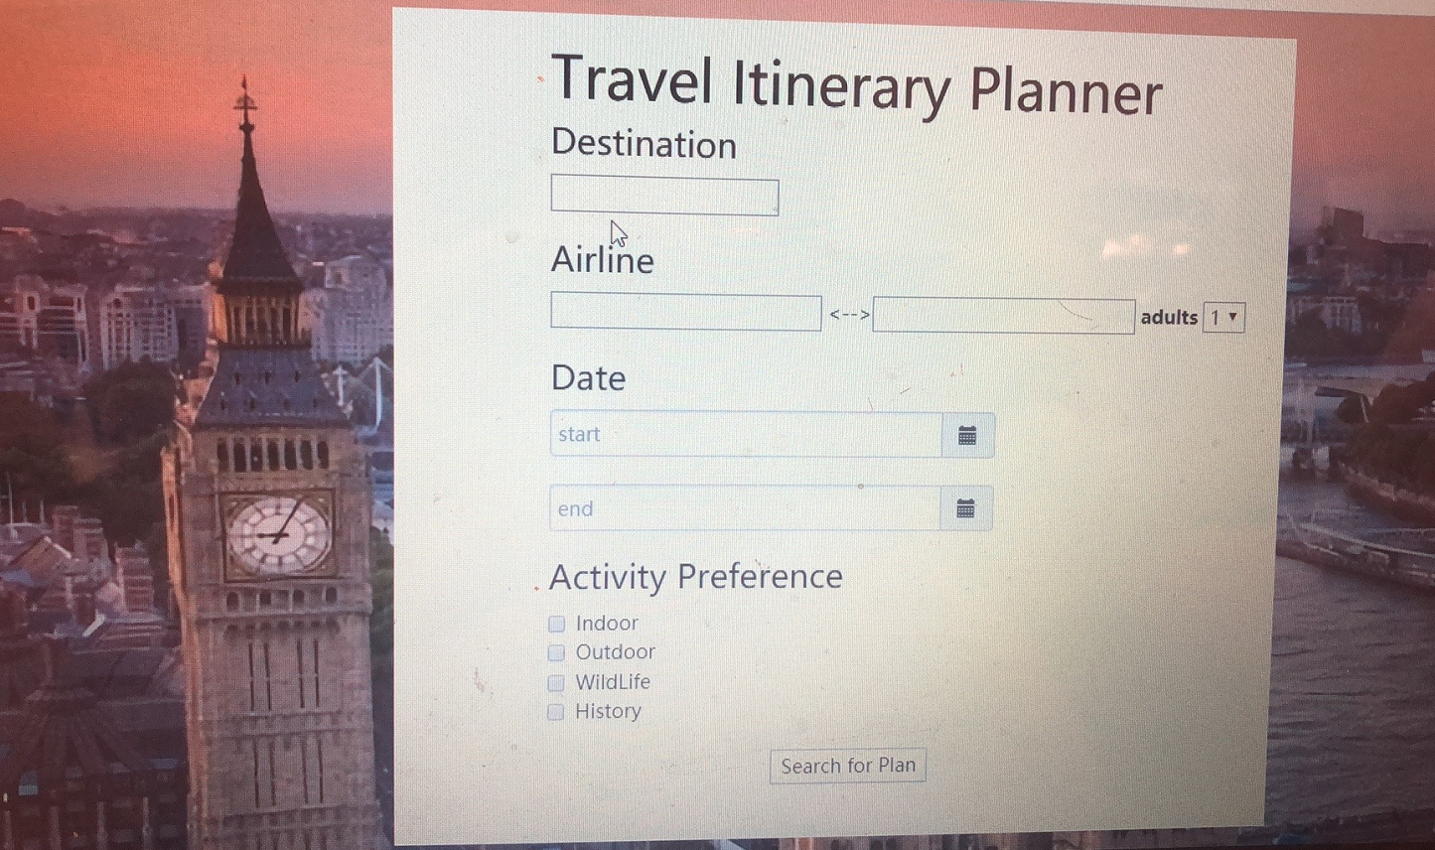
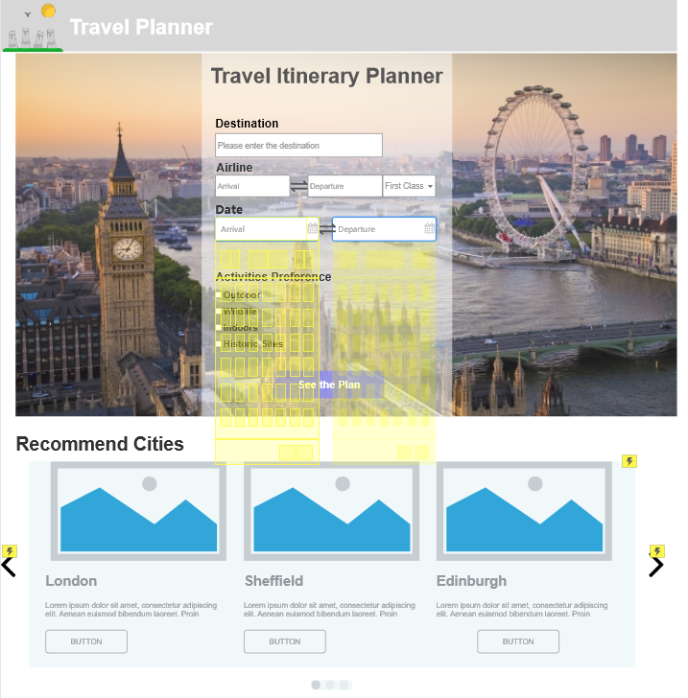
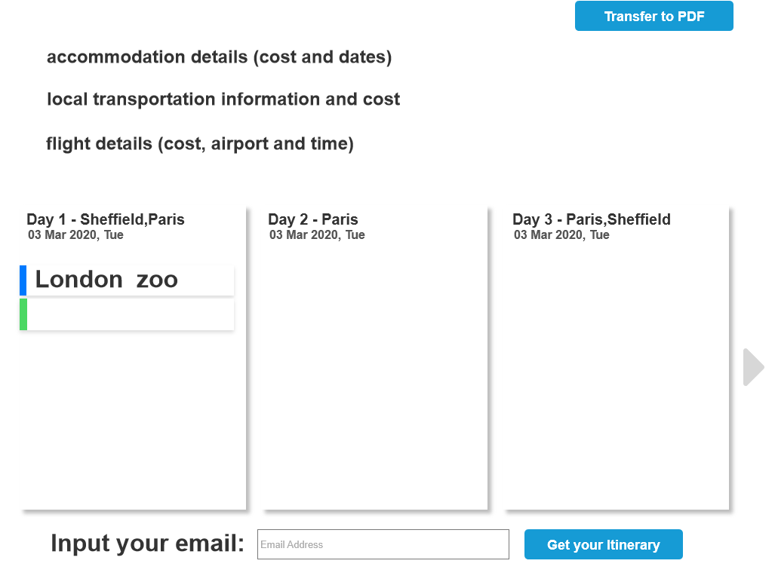
Show and Tell
Front-End Part
Prototype Design by Axure RP9
Front-End programming by Javascript & Bootstrap
Page 1
Page 2
Destination：London, United Kingdom
Programming

Slide 6
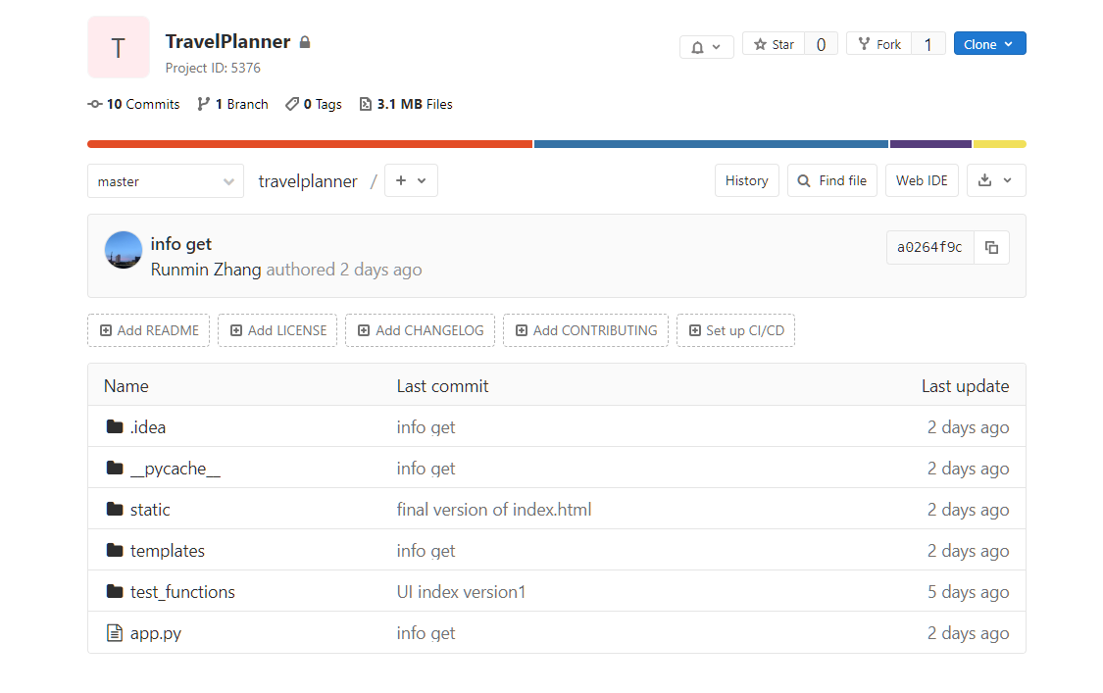
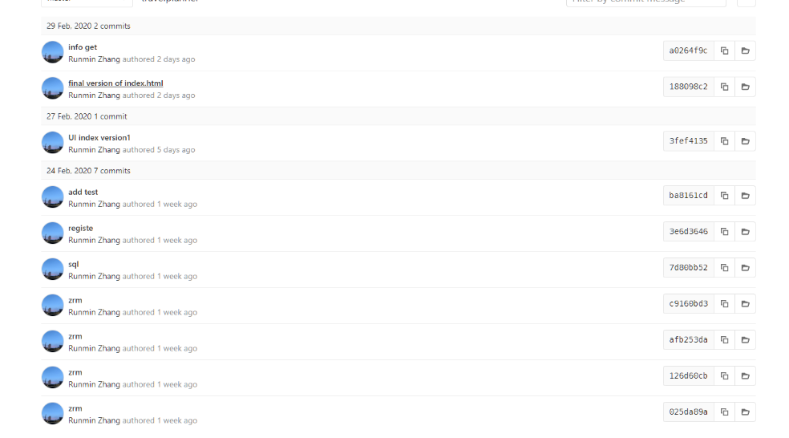
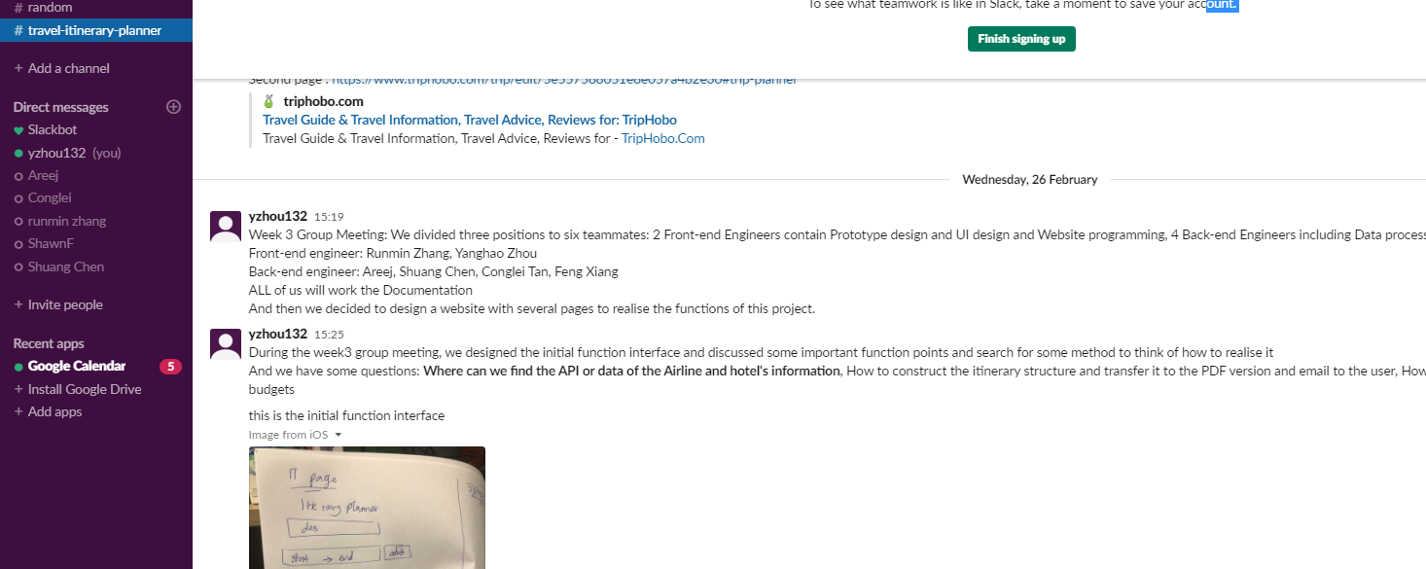
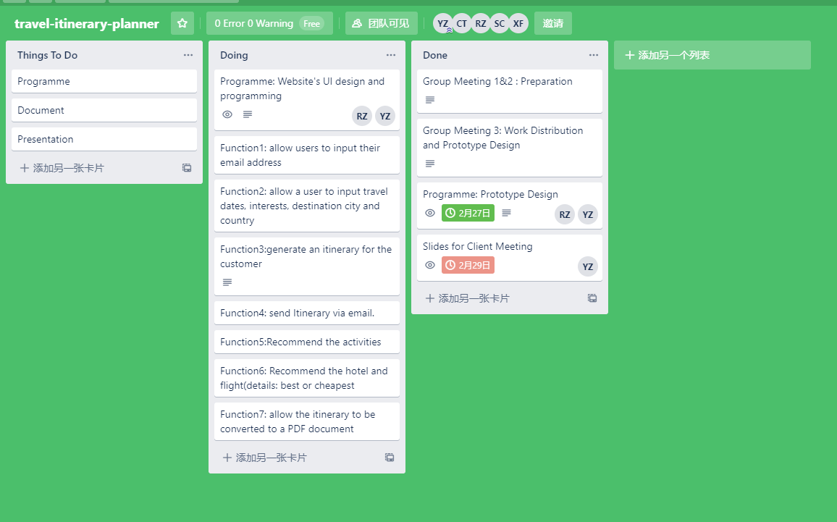
Show and Tell
TeamWork
We used Git, Slack and Trello to teamwork and we have a private group meeting every week. We also shared our work on the GitLab(Already 10 commits)
Agile！

Slide 7
Show and Tell
Data collecting
We submitted the application for the API of Skyscanner Flight and the API of Hotel details
Flight details:
https://rapidapi.com/skyscanner/api/skyscanner-flight-search
But Skyscanner can only call 10 times a day for an account.
Hotel details:
https://developer.bcdtravel.com/apis/hotel-api/#/reference/hotels/getreservationdetails

