Slide 1
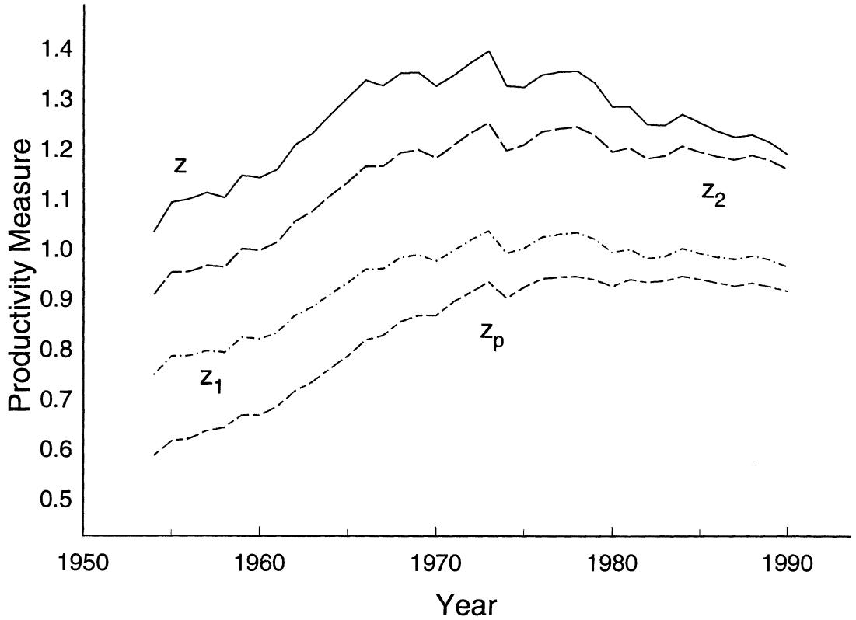




$$γ_{z}=0.39\%$$
$$y=z_{2}k_{e}^{α_{e}}k_{s}^{α_{s}}l^{1−α_{e}−α_{s}} →γ_{z_{2}}=0.68\%$$
$$y=z_{p}l → γ_{z_{p}}=1.24\%$$
$$y=z_{1}k^{α}l^{1−α} →γ_{z_{1}}=0.71\%$$

