Slide 1
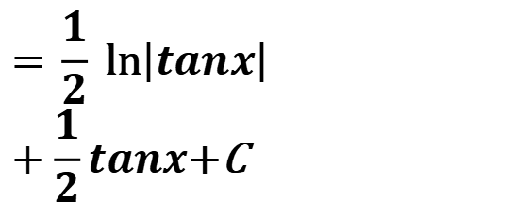

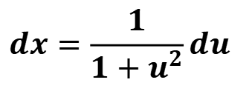
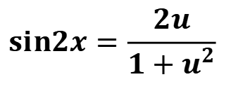

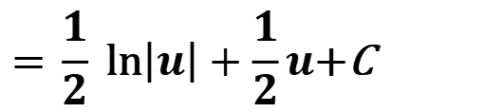
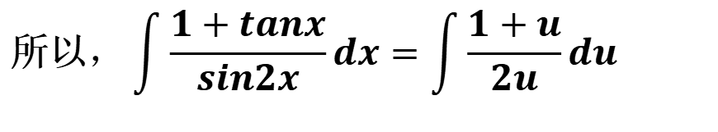
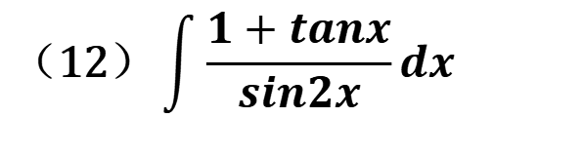
习题4.1：
5. 用换元法计算下列不定积分：
$$\text{（}\text{12}\text{）}\int{\frac{1+tanx}{sin2x}dx}$$
$$dx=\frac{1}{1+u^{2}}du$$
解：
令
$$u=\tan{x}$$
$$x=\arctan{u}$$
$$sin2x=\frac{2u}{1+u^{2}}$$
$$\text{所以}，\int{\frac{1+tanx}{sin2x}dx}=\int{\frac{1+u}{2u}du}$$
$$\text{= }\frac{1}{2} \text{ln}\left|u\right|+\frac{1}{2}u\text{+}\text{C}$$
$$\text{= }\frac{1}{2} \text{ln}\left|tanx\right|+\frac{1}{2}tanx\text{+}\text{C}$$

Slide 2

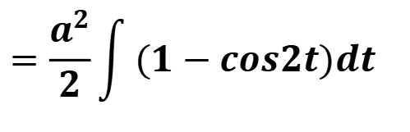
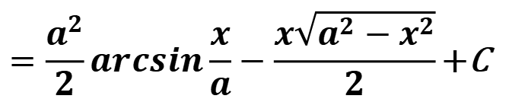


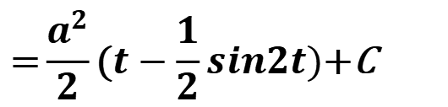
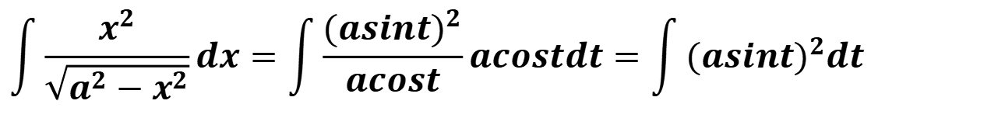
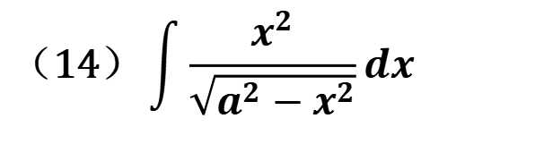
5. 用换元法计算下列不定积分：
$$\text{（}\text{1}\text{4}\text{）}\int{\frac{x^{2}}{\sqrt{a^{2}−x^{2}}}dx}$$
解：
令
$$x=asint$$
$$dx=acostdt$$
$$\text{所以}$$
$$\int{\frac{x^{2}}{\sqrt{a^{2}−x^{2}}}dx}=\int{\frac{({asint)}^{2}}{acost}acostdt}=\int{({asint)}^{2}dt}$$
$$=\frac{a^{2}}{2}\int{(1−cos2t)dt}$$
$$\text{=}\frac{a^{2}}{2}\text{(}t−\frac{1}{2}sin2t)\text{+}\text{C}$$
$$=\frac{a^{2}}{2}arcsin\frac{x}{a}−\frac{x\sqrt{a^{2}−x^{2}}}{2}\text{+}\text{C}$$

Slide 3
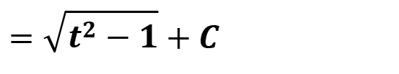
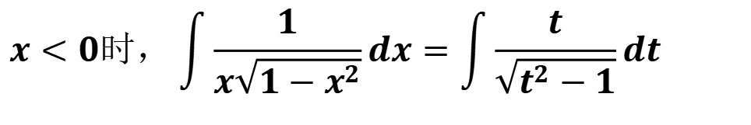
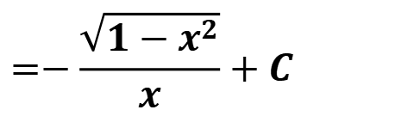
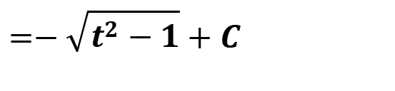
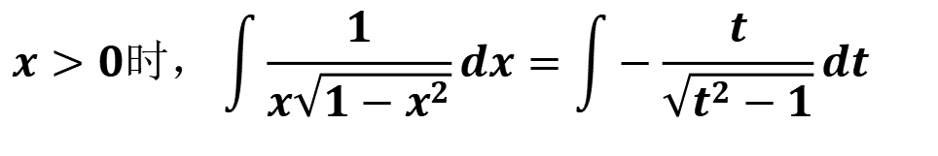

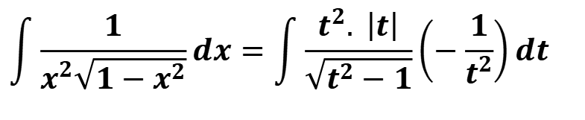
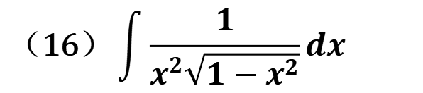
5. 用换元法计算下列不定积分：
$$\text{（}\text{1}\text{6}\text{）}\int{\frac{1}{x^{2}\sqrt{1−x^{2}}}dx}$$
解：
令 $\frac{1}{x}=t$,
$$\int{\frac{1}{x^{2}\sqrt{1−x^{2}}}dx}=\int{\frac{t^{2}. \left|t\right|}{\sqrt{t^{2}−1}}\left(−\frac{1}{t^{2}}\right)dt}$$
$$x>0时，\int{\frac{1}{x\sqrt{1−x^{2}}}dx}=\int{−\frac{t}{\sqrt{t^{2}−1}}dt}$$
$$=−\frac{\sqrt{1−x^{2}}}{x}+C$$
$$=−\sqrt{t^{2}−1}+C$$
$$x<0时，\int{\frac{1}{x\sqrt{1−x^{2}}}dx}=\int{\frac{t}{\sqrt{t^{2}−1}}dt}$$
$$=−\frac{\sqrt{1−x^{2}}}{x}+C$$
$$=\sqrt{t^{2}−1}+C$$

Slide 4
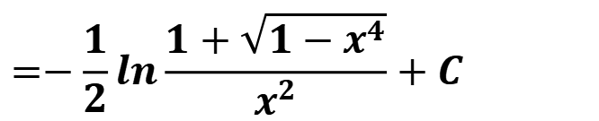
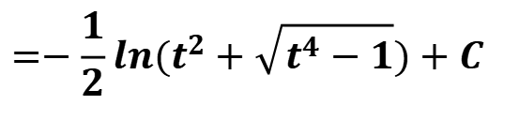
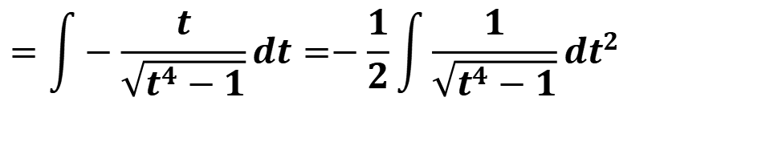
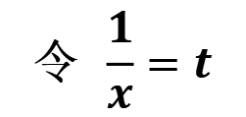
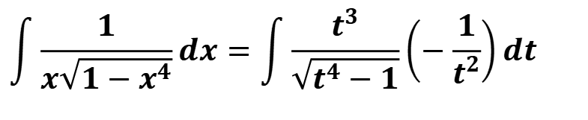
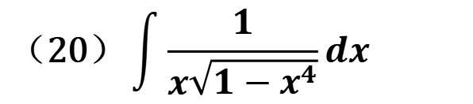
5. 用换元法计算下列不定积分：
$$\text{（}\text{20}\text{）}\int{\frac{1}{x\sqrt{1−x^{4}}}dx}$$
解：
$$\text{令} \frac{1}{x}=t$$
$$\int{\frac{1}{x\sqrt{1−x^{4}}}dx}=\int{\frac{t^{3}}{\sqrt{t^{4}−1}}\left(−\frac{1}{t^{2}}\right)dt}$$
$$=\int{−\frac{t}{\sqrt{t^{4}−1}}dt}=−\frac{1}{2}\int{\frac{1}{\sqrt{t^{4}−1}}dt^{2}}$$
$$=−\frac{1}{2}ln(t^{2}+\sqrt{t^{4}−1})+C$$
$$=−\frac{1}{2}ln\frac{1+\sqrt{1−x^{4}}}{x^{2}}+C$$

Slide 5
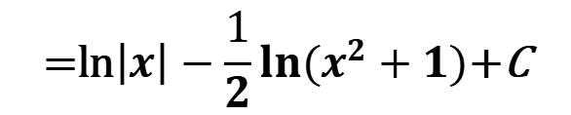
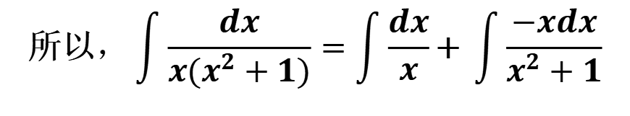
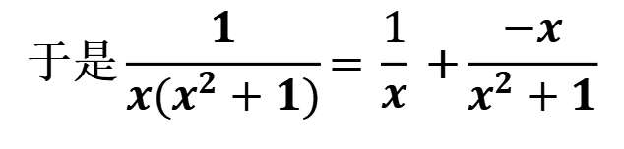


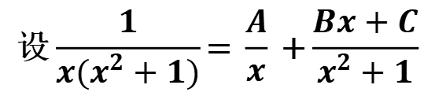
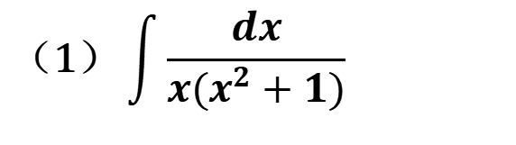
7. 计算下列有理函数积分：
$$\text{（}\text{1}\text{）}\int{\frac{dx}{x(x^{2}+1)}}$$
$$\text{设}\frac{1}{x(x^{2}+1)}\text{=} \frac{A}{x}\text{ +}\frac{Bx+C}{x^{2}+1}$$
解：
消去分母后, $1$= $A(x^{2}+1)$+$x(Bx+C)$
比较$x$同次幂的系数, $A+B=0$, $C$=0, A=1
所以,A=1$,B=−$1, $C$=0
$$\text{于是}\frac{1}{x(x^{2}+1)}\text{=} \frac{1}{x}\text{ +}\frac{−x}{x^{2}+1}$$
$$\text{所以}，\int{\frac{dx}{x(x^{2}+1)}=\int{\frac{dx}{x}}}\text{+} \int{\frac{−xdx}{x^{2}+1}}$$
$$\text{=}\text{ln}\left|x\right|−\frac{1}{2}ln(x^{2}+1)\text{+}\text{C}$$

Slide 6
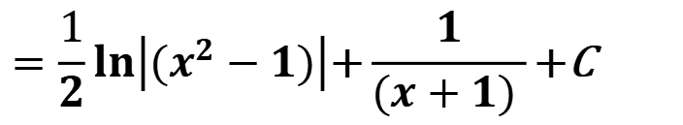
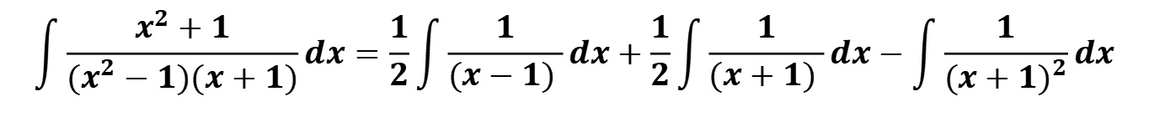
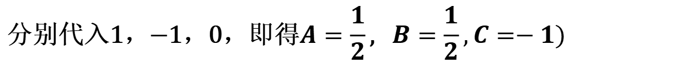
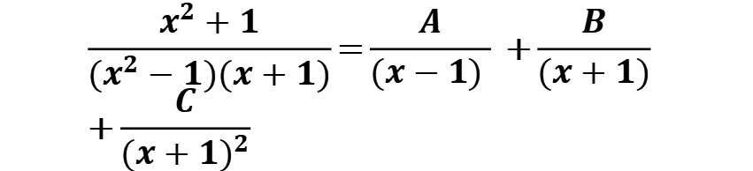
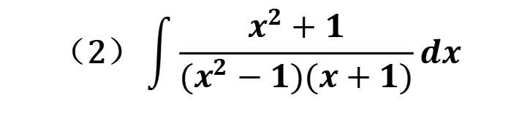
7. 计算下列有理函数积分：
$$\text{（}\text{2}\text{）}\int{\frac{x^{2}+1}{(x^{2}−1)(x+1)}dx}$$
$$\frac{x^{2}+1}{(x^{2}−1)(x+1)}\text{=}\frac{A}{(x−1) }\text{ +}\frac{B}{(x+1)}\text{ +}\frac{C}{{(x+1)}^{2}}$$
解：
消去分母后，$x^{2}+1$= $A{(x+1)}^{2}$+$B(x−1)(x+1)+C(x−1)$
$$\text{分别代入}\text{1}\text{，}\text{−}\text{1}\text{，}\text{0}\text{，即得}A=\frac{1}{2}\text{,} B=\frac{1}{2},C=−1)$$
$$\int{\frac{x^{2}+1}{(x^{2}−1)(x+1)}dx=\frac{1}{2}\int{\frac{1}{(x−1) }dx+\frac{1}{2}\int{\frac{1}{(x+1) }dx−\int{\frac{1}{{(x+1)}^{2}}dx}}}}$$
$$=\frac{1}{2}ln\left|(x^{2}−1)\right|\text{+}\frac{1}{(x+1) }\text{+}\text{C}$$

Slide 7
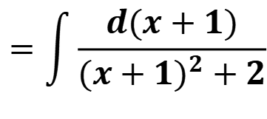
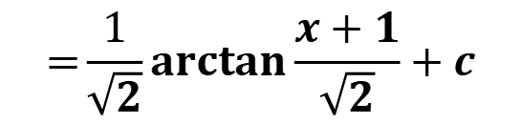
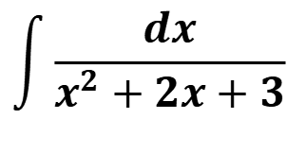
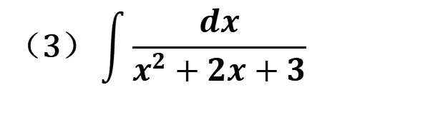
7. 计算下列有理函数积分：
$$\text{（}\text{3}\text{）}\int{\frac{dx}{x^{2}+2x+3}}$$
$$\int{\frac{dx}{x^{2}+2x+3}}$$
$$=\int{\frac{d(x+1)}{{(x+1)}^{2}+2}}$$
解：
$$\text{=}\frac{1}{\sqrt{2}}arctan\frac{x+1}{\sqrt{2}}+c$$

Slide 8
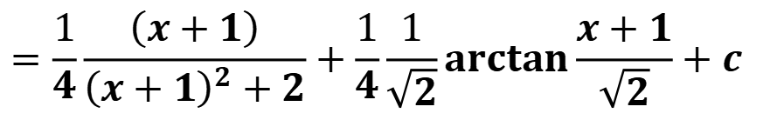
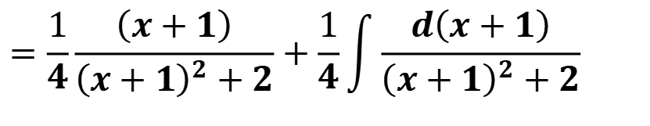
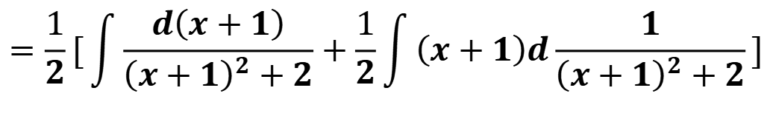
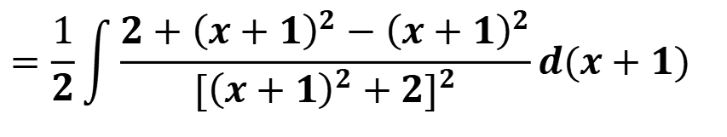
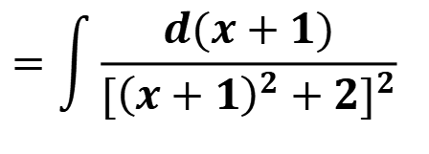
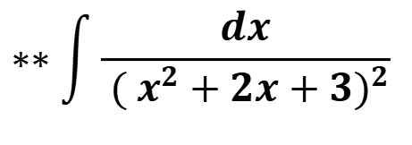
$$∗∗\int{\frac{dx}{{ ({ x}^{2}+2x+3)}^{2}}}$$
$$=\int{\frac{d(x+1)}{{[{\left(x+1\right)}^{2}+2]}^{2}}}$$
$$=\frac{1}{2}\int{\frac{2+{\left(x+1\right)}^{2}−{\left(x+1\right)}^{2}}{{[{\left(x+1\right)}^{2}+2]}^{2}}d(x+1)}$$
$$=\frac{1}{2}[\int{\frac{d\left(x+1\right)}{{\left(x+1\right)}^{2}+2}}+\frac{1}{2}\int{\left(x+1\right)d\frac{1}{{\left(x+1\right)}^{2}+2}}]$$
$$=\frac{1}{4}\frac{\left(x+1\right)}{{\left(x+1\right)}^{2}+2}+\frac{1}{4}\int{\frac{d\left(x+1\right)}{{\left(x+1\right)}^{2}+2}}$$
$$=\frac{1}{4}\frac{\left(x+1\right)}{{\left(x+1\right)}^{2}+2}+\frac{1}{4}\frac{1}{\sqrt{2}}arctan\frac{x+1}{\sqrt{2}}+c$$

Slide 9
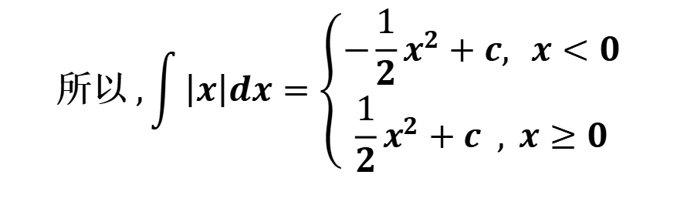
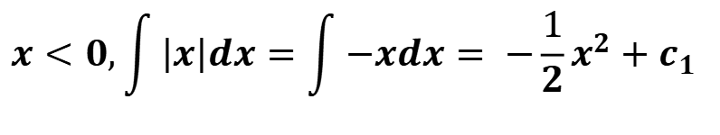
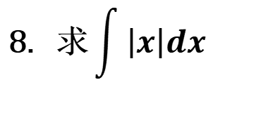

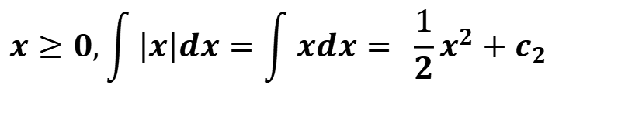
$$\text{8}\text{. }\text{求}\int{\left|x\right|dx}$$
$$x<0,\int{\left|x\right|dx}=\int{−xdx}= \text{−}\frac{1}{2}x^{2}+c_{1}$$
解：
$$x≥0,\int{\left|x\right|dx}=\int{xdx}= \frac{1}{2}x^{2}+c_{2}$$
由连续性知$c_{1}=c_{2}$
$$\text{所以} ,\int{\left|x\right|dx}=\left\{\begin{aligned}\text{−}\frac{1}{2}x^{2}+c, x<0 \\ \frac{1}{2}x^{2}+c , x≥0\end{aligned}\right.$$

Slide 10
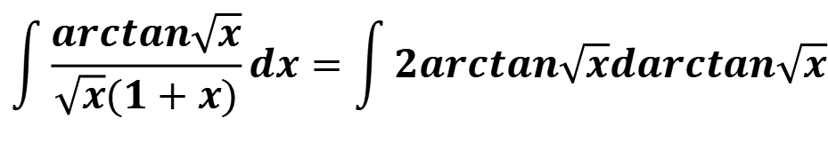
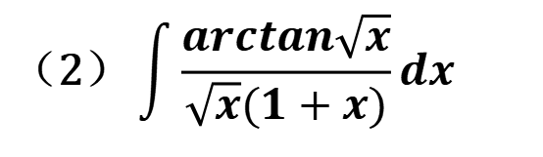








**9. 用合适的方法求下列积分：
$$\text{（}\text{1}\text{）}\int{\frac{arcsin\sqrt{x}}{\sqrt{x}}dx}$$
$$\int{\frac{arcsin\sqrt{x}}{\sqrt{x}}dx=\int{2arcsin\sqrt{x}d\sqrt{x}}}$$
$$=\int{2arcsintdt} (令t=\sqrt{x})$$
解：
$$=2tarcsint−\int{\frac{2t}{\sqrt{1−t^{2}}}dt}$$
$$=2tarcsint\text{+} \int{\frac{1}{\sqrt{1−t^{2}}}d(1−t^{2})}$$
$=2tarcsint$+$2\sqrt{1−t^{2}}+$c
$=2\sqrt{x}arcsin\sqrt{x}$+$2\sqrt{1−x}+$c
$$\text{（}\text{2}\text{）}\int{\frac{arctan\sqrt{x}}{\sqrt{x}(1+x)}dx}$$
解：
$$\int{\frac{arctan\sqrt{x}}{\sqrt{x}(1+x)}dx=\int{2arctan\sqrt{x}darctan\sqrt{x}}}$$
${=(arctan\sqrt{x})}^{2}$+c

Slide 11






$$\text{（}\text{3}\text{）}\int{\frac{1}{x^{4}+1}dx}$$
$$\int{\frac{1}{x^{4}+1}dx=\frac{1}{2}\int{\frac{x^{2}+1}{x^{4}+1}dx}−\frac{1}{2}\int{\frac{x^{2}−1}{x^{4}+1}dx}}$$
解：
$$=\frac{1}{2}\int{\frac{1+\frac{1}{x^{2}}}{x^{2}+\frac{1}{x^{2}}}dx−\frac{1}{2}\int{\frac{1−\frac{1}{x^{2}}}{x^{2}+\frac{1}{x^{2}}}dx}}$$
$$=\frac{1}{2}\int{\frac{d(x−\frac{1}{x})}{{(x−\frac{1}{x})}^{2}+2}dx−\frac{1}{2}\int{\frac{d(x+\frac{1}{x})}{{(x+\frac{1}{x})}^{2}−2}dx}}$$
$$=\frac{1}{2\sqrt{2}}arctan\frac{(x−\frac{1}{x})}{\sqrt{2}}−\frac{1}{4\sqrt{2}}ln\frac{ \left(x+\frac{1}{x}−\sqrt{2}\right)}{\left(x+\frac{1}{x}+\sqrt{2}\right)}+c$$
$$=\frac{1}{2\sqrt{2}}arctan\frac{(x−\frac{1}{x})}{\sqrt{2}}−\frac{1}{4\sqrt{2}}ln\frac{x^{2}−\sqrt{2}x+1}{x^{2}+\sqrt{2}x+1}+c$$

Slide 12









**9. 用合适的方法求下列不定积分：
$$\text{（}\text{4}\text{）}\int{\frac{x−1}{x^{2}}e^{x}dx}$$
$$\int{\frac{x−1}{x^{2}}e^{x}dx}=\int{\frac{1}{x}e^{x}dx+\int{\frac{−1}{x^{2}}e^{x}dx}}$$
解：
$$=\int{\frac{1}{x}e^{x}dx+\int{e^{x}d\frac{1}{x}}}$$
$$=\int{\frac{1}{x}e^{x}dx+{\frac{1}{x}e}^{x}−\int{{\frac{1}{x}e}^{x}dx}}$$
$$={\frac{1}{x}e}^{x}\text{+}\text{C}$$
$$\text{10}\text{. }\text{已知 }\text{f} \text{(}\text{x}\text{)}\text{的一个原函数为}\text{ln}\text{2}\text{x}\text{，求}\int{xf′(x)dx}$$
$$\int{xf′(x)dx}=\int{xdf(x)}$$
$$=xf \left(x\right)−\int{f(x)dx}$$
解：
$$=2\text{ln}\text{x} −\text{ln}\text{2}\text{x}\text{+}\text{C}$$

Slide 13











$$\text{11}\text{. }\text{已知}\int{xf(x)dx}=arcsinx+C\text{，求}\int{\frac{1}{f(x)}dx}$$
$$xf(x)=\frac{1}{\sqrt{1−x^{2}}}$$
$$\frac{1}{f(x)}=x\sqrt{1−x^{2}}$$
解：
$$\int{\frac{1}{f(x)}dx}=\int{x\sqrt{1−x^{2}}dx}$$
$$=−\frac{1}{3}{\left(1−x^{2}\right)}^{\frac{3}{2}}+C$$
$$\text{1}\text{2}\text{. }设 f(lnx)=\frac{ln\left(1+x\right)}{x}\text{，}计算\int{f(x)dx}$$
$$\int{f(x)dx}=\int{f(lnt)∙\frac{1}{t}dt=\int{\frac{ln\left(1+t\right)}{t^{2}}dt}}$$
解：
$$(x=lnt)$$
$$=−\frac{ln\left(1+t\right)}{t}+\int{\frac{1}{t\left(1+t\right)}dt}$$
$$=−\frac{ln\left(1+t\right)}{t}+ln\frac{t}{\left(1+t\right)}+C$$
$$=x−(1+e^{−x})ln\left(1+e^{x}\right)+C$$

Slide 14







$$\text{13}\text{.} \text{设}f\left(sin2x\right)=\frac{x}{sinx}\text{，求}\int{\frac{\sqrt{x}}{\sqrt{1−x}}f\left(x\right)dx}$$
解：
令$x=sin2u$
$$\int{\frac{\sqrt{x}}{\sqrt{1−x}}f\left(x\right)dx=\int{\frac{sinu}{cosu}∙\frac{u}{sinu}∙2sinucosudu}}$$
$$=\int{2usinudu}$$
$$=\int{−2udcosu}$$
$=−2ucosu$+2sinu+c
$$=−2\sqrt{1−x}arcsin\sqrt{x}\text{+}\text{2}\sqrt{x}\text{+}\text{c}$$

Slide 15





习题4.2：
8. 求下列极限：
$$\left(4\right) \lim_{x→0}{\frac{\int_{0}^{x}{ [ \int_{0}^{u^{2}}{arctan(1+t)}dt]}du}{x(1−cosx)}}$$
$$\lim_{x→0}{\frac{\int_{0}^{x}{ [\int_{0}^{u^{2}}{arctan(1+t)}dt]}du}{x(1−cosx)}=\lim_{x→0}{\frac{\int_{0}^{x}{[\int_{0}^{u^{2}}{arctan(1+t)}dt]}du}{\frac{1}{2}x3}}}$$
解：
$$=\lim_{x→0}{\frac{\int_{0}^{x^{2}}{arctan(1+t)}dt}{\frac{3}{2}x2}}$$
$$=\lim_{x→0}{\frac{2xarctan(1+x^{2})}{3x}}$$
$$=\frac{2}{3}∙\frac{π}{4}=\frac{π}{6}$$

Slide 16





11.设函数 f (x)在[a,b]上连续，在(a,b)内可导，且f $\text{′}$(x) $≤$ 0
$$\text{若}F(x)=\frac{1}{x−a}\int_{a}^{x}{f(t)dt},\text{证明在}\text{(}\text{a}\text{,}\text{b}\text{)}\text{内}有F\text{′}\left(x\right)≤ \text{0}$$
$$F\text{′}=\frac{\text{f} \text{(}\text{x}\text{)}\left(x−a\right)−\int_{a}^{x}{f(t)dt}}{(x−a)2}$$
证明：
$$=\frac{\text{f} \text{(}\text{x}\text{)}\left(x−a\right)−\text{f} \text{(}ξ\text{)}\left(x−a\right)}{(x−a)2} ， ξε\text{(}\text{a}\text{,} \text{x}\text{)}$$
$$=\frac{\left(x−a\right)\text{(}\text{f} \text{(}\text{x}\text{)} −\text{f} \text{(}ξ\text{)}\text{)} }{(x−a)2}， ξε\text{(}\text{a}\text{,} \text{x}\text{)}$$
f '(x) $≤$ 0, 所以函数 f (x)单调减少.
所以$F\text{′}\left(x\right)≤ \text{0}$

Slide 17







12. 设函数 f (x), g(x) 在[a,b]上连续，且g(x) $>$ 0
$$\text{证明存在一点}ξε\text{[}\text{a}\text{,}\text{b}\text{]}\text{，使}\int_{a}^{b}{\text{f} \text{(}\text{x}\text{) }\text{g}\text{(}\text{x}\text{)}dx=\text{f} \text{(}ξ\text{)}\int_{a}^{b}{\text{g}\text{(}\text{x}\text{)}dx}}$$
证明：
$\text{f} \text{(}\text{x}\text{)}\text{ 在}\text{[}\text{a}\text{,}\text{b}\text{]}\text{上连续，}$所以存在最大最小值M, m
m$≤\text{f} \text{(}\text{x}\text{)}≤\text{M}$
又g(x) $>$ 0
所以，m $\text{g}\text{(}\text{x}\text{)} ≤ \text{f} \text{(}\text{x}\text{)}\text{g}\text{(}\text{x}\text{)}≤\text{Mg}\text{(}\text{x}\text{)}$
$$\text{m}\int_{a}^{b}{\text{g}\text{(}\text{x}\text{)}dx}≤\int_{a}^{b}{\text{f} \text{(}\text{x}\text{) }\text{g}\text{(}\text{x}\text{)}dx≤\text{M}\int_{a}^{b}{\text{g}\text{(}\text{x}\text{)}dx}}$$
$$\text{m}≤\frac{\int_{a}^{b}{\text{f} \text{(}\text{x}\text{) }\text{g}\text{(}\text{x}\text{)}dx}}{\int_{a}^{b}{\text{g}\text{(}\text{x}\text{)}dx}}≤\text{M}$$
$$\text{由介值定理}，\text{存在一点}ξε\text{[}\text{a}\text{,}\text{b}\text{]}\text{，使}\text{f} \text{(}ξ\text{)}=\frac{\int_{a}^{b}{\text{f} \text{(}\text{x}\text{) }\text{g}\text{(}\text{x}\text{)}dx}}{\int_{a}^{b}{\text{g}\text{(}\text{x}\text{)}dx}}$$
结论成立

Slide 18





$$\text{14}\text{.}\text{设函数 }\text{f} \text{(}\text{x}\text{), }\text{在}\text{[}\text{a}\text{,}\text{b}\text{]}\text{上连续 }\text{, }\text{且}\text{f}\text{(}\text{x}\text{)}>\text{0}\text{, }F\left(x\right)=\int_{a}^{x}{\text{f} \text{(}\text{t}\text{)} dt+\int_{b}^{x}{\frac{1}{\text{f} \text{(}\text{t}\text{)}}dt}}$$
$$\text{证明}\text{: }\text{(}\text{1}\text{)} \text{F}\text{′}\text{(}\text{x}\text{) }≥2；$$
$$\text{(}\text{2}\text{)} \text{方程}\text{F}\text{(}\text{x}\text{) }\text{=} \text{0}\text{在区间}\text{(}\text{a}\text{,}\text{b}\text{)}\text{内有且仅有一个根}$$
$$\text{(}\text{1}\text{)} \text{F}\text{′}\text{(}\text{x}\text{) }\text{=}\text{f}\text{(}\text{x}\text{)}+\frac{1}{\text{f} \text{(}\text{x}\text{)}}≥2$$
证明：
$$\text{(}\text{2}\text{)} \text{F}\text{(}\text{a}\text{)} =\int_{b}^{a}{\frac{1}{\text{f} \text{(}\text{t}\text{)}}dt}\text{<}\text{0}\text{,} F(b)=\int_{a}^{b}{\text{f} \text{(}\text{t}\text{)} dt>0}$$
由介值定理$\text{(}\text{a}\text{,}\text{b}\text{)}\text{内有根}，$
又$\text{F}\text{′}\text{(}\text{x}\text{) }\text{>}0$， $\text{F}\text{(}\text{x}\text{) }$单增，
所以$\text{F}\text{(}\text{x}\text{) }\text{=} \text{0}\text{在区间}\text{(}\text{a}\text{,}\text{b}\text{)}\text{内有且仅有一个根}$

Slide 19




$$\text{15}\text{.}\text{设 }\text{f} \text{(}\text{x}\text{)}\text{是以}\text{l}\text{为周期的连续函数，证明}\int_{a}^{a+l}{\text{f} \text{(}\text{x}\text{)}\text{d}\text{x}}\text{的值与}\text{a}\text{无关}\text{.}$$
$$\text{证明}: \int_{a}^{a+l}{\text{f} \text{(}\text{x}\text{)}\text{d}\text{x}}=\int_{a}^{0}{\text{f} \text{(}\text{x}\text{)}\text{d}\text{x}\text{+}}\int_{0}^{l}{\text{f} \text{(}\text{x}\text{)}\text{d}\text{x}\text{+}\int_{l}^{a+l}{\text{f} \text{(}\text{x}\text{)}\text{d}\text{x}}}$$
$$\int_{l}^{a+l}{\text{f} \text{(}\text{x}\text{)}\text{d}\text{x}=\int_{0}^{a}{\text{f} \text{(} \text{t}\text{+}\text{l} \text{)}\text{d}\text{t}}}$$
$$=\int_{0}^{a}{\text{f} \text{(}\text{t}\text{)}\text{dt}\text{=}\int_{0}^{a}{\text{f} \text{(}\text{x}\text{)}\text{d}\text{x}}}$$
$$\text{所以}\int_{a}^{a+l}{\text{f} \text{(}\text{x}\text{)}\text{d}\text{x}}=\int_{0}^{l}{\text{f} \text{(}\text{x}\text{)}\text{d}\text{x}，\text{与}\text{a}\text{无关}\text{.}}$$

Slide 20






$$\text{16}\text{. }\text{求下列定积分}$$
$$\text{(}\text{5}\text{)} \int_{1}^{e}{\text{sin}\text{(}\text{lnx}\text{)}\text{dx} }$$
解：
$$\int_{1}^{e}{\text{sin}\text{(}\text{lnx}\text{)}\text{dx} =\int_{0}^{1}{\text{sin}\text{t}e^{t}\text{d}\text{t}=\frac{e\left(sin1−cos1\right)+1}{2}}}$$
两次分部积分，移项整理
$$\text{(}6\text{)} \int_{\frac{1}{e}}^{e}{\left|\text{ln}x\right|\text{dx} }$$
$$\int_{\frac{1}{e}}^{e}{\left|\text{ln}x\right|\text{dx} }=\int_{\frac{1}{e}}^{1}{\text{(}−\text{ln}x)\text{dx} }+\int_{1}^{e}{\text{ln}\text{x}\text{dx} }$$
解：
$$\text{=}\text{2}−\frac{2}{e}$$

Slide 21






$$\text{17}\text{. }\text{设}f\left(x\right)=\left\{\begin{aligned}\frac{1}{1+e^{x}} , x<0 \\ \frac{1}{1+x}, x≥0\end{aligned}\right.,\text{求}\int_{0}^{2}{f\left(x−1\right)dx}$$
解：
令$t=x−1$
$$\int_{0}^{2}{f\left(x−1\right)dx}=\int_{−1}^{1}{f\left(t\right)dt}$$
$$=\int_{−1}^{0}{\frac{1}{1+e^{t}}dt}+\int_{0}^{1}{\frac{1}{1+t}dt}$$
$$=\int_{−1}^{0}{\frac{1+e^{t}−e^{t}}{1+e^{t}}dt}+\int_{0}^{1}{\frac{1}{1+t}dt}$$
= $\ln\left(1+e^{ }\right)$

Slide 22







18. 求下列极限：
$$\left(1\right)\lim_{n→∞}\frac{1}{n}(\sqrt{1+\frac{1}{n}}+\sqrt{1+\frac{2}{n}}+⋯+\sqrt{1+\frac{n}{n}})$$
$$\text{原式}=\int_{0}^{1}{\sqrt{1+x}}dx$$
$$=\frac{2 }{3}({1+x)}^{\frac{3}{2}}\left| _{0}^{\begin{aligned}1 \\ \\ \end{aligned}}\right.=\frac{2 }{3} (2^{\frac{3}{2}}\text{−}\text{1}\text{)}$$
解：
$$\left(2\right)\lim_{n→∞}\int_{0}^{1}{\frac{x^{n}}{1+x}}dx$$
$$\text{0}\text{<}\frac{x^{n}}{1+x}\text{< }x^{n}$$
$$\text{0}\text{<}\int_{0}^{1}{\frac{x^{n}}{1+x}}dx\text{<}\int_{0}^{1}{x^{n}}dx= \frac{1 }{n+1}$$
解：
$$\text{由夹逼准则得}： \lim_{n→∞}\int_{0}^{1}{\frac{x^{n}}{1+x}}dx=0$$

Slide 23








19. 求下列各题：
$$\left(1\right)\frac{d }{dx}\int_{0}^{x}{{sin(x−t)}^{2}}dt$$
$$\text{令}u=x−t,\int_{0}^{x}{{sin(x−t)}^{2}}dt=\int_{0}^{x}{{sinu}^{2}}du$$
$$\frac{d }{dx}\int_{0}^{x}{{sin(x−t)}^{2}}dt={sinx}^{2}$$
解：
$$\left(2\right)设f\left(x\right)有一个原函数\frac{sinx }{x},求\int_{\frac{π}{2}}^{π}{xf′(x)}dx$$
$$\int_{\frac{π}{2}}^{π}{xf′(x)}dx=xf\left(x\right)\left| _{\frac{\begin{aligned} \\ π\end{aligned}}{2}}^{\begin{aligned}π \\ \\ \end{aligned}}\right. −\int_{\frac{π}{2}}^{π}{f(x)}dx$$
解：
$$\text{=}(x∙\frac{xcosx−sinx }{x^{2}}−\frac{sinx }{x})\left| _{\frac{\begin{aligned} \\ π\end{aligned}}{2}}^{\begin{aligned}π \\ \\ \end{aligned}}=−1+\frac{4 }{π}\right.$$
$$(3)\int_{0}^{1}{\sqrt{2x−x^{2}}dx}$$
$$=\int_{0}^{1}{\sqrt{1−(x−{1)}^{2}}dx}=\frac{π }{4} (几何意义或三角代换)$$

Slide 24





$$\text{20}.\text{已知}f\left(x\right)\text{连续},\int_{0}^{x}{tf (x−t)}dt=1−cosx,求\int_{0}^{\frac{π}{2}}{f (x)}dx$$
解：
$$\int_{0}^{x}{tf (x−t)}dt=\int_{0}^{x}{(x−u)f (u)}du$$
令$u=x−t,$
$$=x\int_{0}^{x}{f (u)}du−\int_{0}^{x}{uf (u)}du=1−cosx$$
$$(两边求导) \int_{0}^{x}{f (u)}du=sinx$$
$$所以 \int_{0}^{\frac{π}{2}}{f (x)}dx=sinx\left| _{0}^{\begin{aligned}\frac{\begin{aligned} \\ π\end{aligned}}{2} \\ \end{aligned}} =1\right.$$

Slide 25







$$21.设S\left(x\right)=\int_{0}^{x}{\left|cost\right|dt}$$
(1)当n为正整数，且nπ≤x ≤ (n+1)π时，证明2n≤ S (x) ≤ 2(n+1)
(2).求$\lim_{x→∞}\frac{\text{S}\text{ (}\text{x}\text{)}}{\text{x}}$
$S\left(x\right)$单增，
S (nπ) ≤ S (x) ≤ S ((n+1)π)
(1)证明：
$$\text{S}\text{ (}\text{n}\text{π}\text{) }=\int_{0}^{\text{n}\text{π}}{\left|cost\right|dt}=n\int_{−\frac{\begin{aligned} \\ π\end{aligned}}{2}}^{\frac{\begin{aligned} \\ π\end{aligned}}{2}}{costdt=2n}$$
所以$，\text{2}\text{n}\text{≤} \text{S}\text{ (}\text{x}\text{)} \text{≤} \text{2}\text{(}\text{n}\text{+}\text{1}\text{)}$
$$\text{(}\text{2}\text{)}\text{.}\text{解}： \frac{\text{2}\text{n}}{x}\text{≤} \frac{\text{S}\text{ (}\text{x}\text{)}}{x} \text{≤ } \frac{\text{2}\text{(}\text{n}\text{+}\text{1}\text{)}}{x}$$
$\lim_{x→∞}\frac{\text{S}\text{ (}\text{x}\text{)}}{\text{x}}=$ $\frac{\text{2}}{\text{π}}$
两端极限均为 $\frac{\text{2}}{\text{π}}$，由夹逼准则得

Slide 26







$$22.\text{设} \text{f} \text{(}\text{x}\text{)}\text{在}\text{[}0\text{,}\text{1}\text{]}\text{上连续}\text{, }\text{在}\text{(}0\text{,}\text{1}\text{)}\text{内可导}\text{, }\text{且}\text{满足}\text{f}\text{(}\text{1}\text{)}=3\int_{0}^{\frac{\text{1}}{3}}{e^{1−x^{2}}f(x)dx}$$
$$\text{证明}\text{: }\text{存在}\text{ξ}\text{∊} \text{(}0\text{,}\text{1}\text{)} \text{，使得}\text{f} ′ \text{(}\text{ξ}\text{)=}\text{2} \text{ξ} \text{f} \text{(}\text{ξ}\text{)}$$
$$\text{f}\text{(}\text{1}\text{) }=e^{1−η^{2}}f(η)，η\text{∊}\text{ (}0\text{,}\frac{1}{3}\text{)}$$
证明：
$$\text{令}\text{F}\text{ (}\text{x}\text{) }=e^{1−x^{2}}f(x)$$
$${F ′\text{(}\text{x}\text{)}=−2\text{x}e}^{1−{\text{x}}^{2}}f(\text{x})+ e^{1−{\text{x}}^{2}}f^{′}\left(\text{x}\right)$$
$$\text{F}\text{ (}\text{1}\text{) }=\text{f}\text{(}\text{1}\text{) }=F(η)$$
由罗尔定理
存在ξ∊ $\text{(}η\text{,}\text{1}\text{)}⊂\text{(}0\text{,}\text{1}\text{)}$，使得$F ′ \text{(}\text{ξ}\text{)}$ $=$0
$即$ ${−2\text{ξ}e}^{1−{\text{ξ}}^{2}}f(\text{ξ})+$ $e^{1−{\text{ξ}}^{2}}f^{′}\left(\text{ξ}\right)=0$
整理得 $\text{f} ′ \text{(}\text{ξ}\text{)}$=2 ξ $\text{f} \text{(}\text{ξ}\text{)}$

Slide 27





$$23.\text{已知两曲线 }\text{y} = \text{f} \text{(}\text{x}\text{)}\text{与 }\text{y}\text{=}\int_{0}^{\text{arctan}x}{e^{−t^{2}}dt}\text{在点}\text{(}\text{0}\text{,}\text{0}\text{)}\text{处的切线相同，}$$
$$\text{写出此切线方程，并求极限}\lim_{n→∞}nf(\frac{2}{n})$$
证明：
由已知条件知f(0) $=0$
$\text{f} ′ \text{(}0\text{)}$= $e^{−{(\text{arctan}x)}^{2}}∙\frac{1}{1+x^{2}}\left| _{x=0}^{\begin{aligned} \\ \\ \end{aligned}}\right.=1$
所以切线方程为: y=x
$$\lim_{n→∞}nf\left(\frac{2}{n}\right)=\lim_{n→∞}\frac{f\left(\frac{2}{n}\right)−f\left(0\right)}{\frac{2}{n}}.2$$
=$2\text{f} ′ \text{(}\text{0}\text{)}$=2

