Slide 1
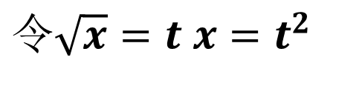
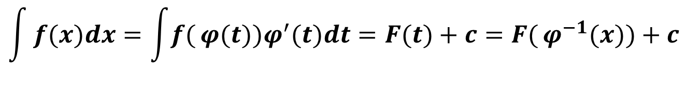

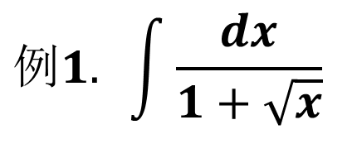
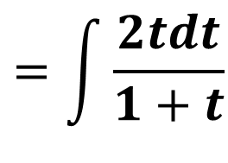
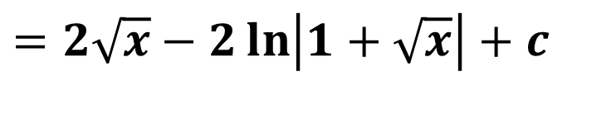

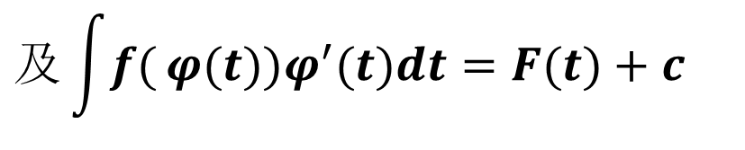
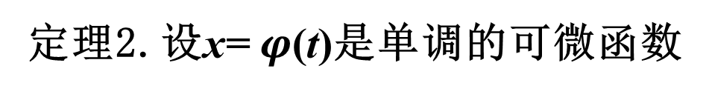
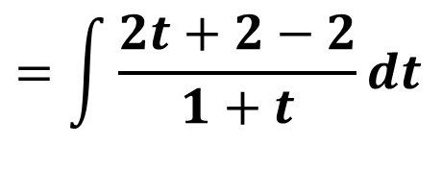
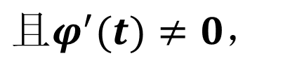

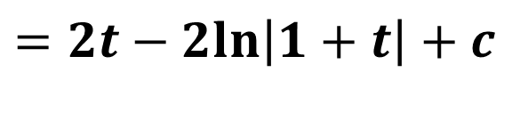
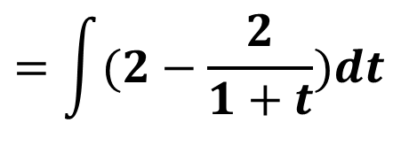
2. 第二换元积分法
$$x=φ(t)$$
令
$$t=φ^{−1}(x)$$
定理2.设x= $φ$(t)是单调的可微函数
$$及\int{f(}φ(t))φ^{′}(t)dt=F(t)+c$$
$$且φ^{′}(t)≠0，$$
$$则$$
$$\int{f(x)dx=\int{f(}φ(t))φ^{′}(t)dt=F(t)+c=F(}φ^{−1}(x))+c$$
$$例1. \int{\frac{dx}{1+\sqrt{x}}}$$
$$令\sqrt{x}=t x=t^{2}$$
$$=\int{\frac{2tdt}{1+t}}$$
$$=\int{\frac{2t+2−2}{1+t}}dt$$
$$=\int{(2−\frac{2}{1+t}})dt$$
$$=2t−2ln\left|1+t\right|+c$$
$$=2\sqrt{x}−2\ln\left|1+\sqrt{x}\right|+c$$

Slide 2
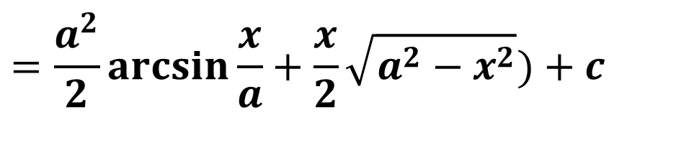

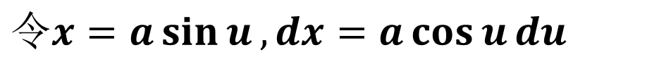
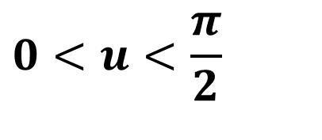

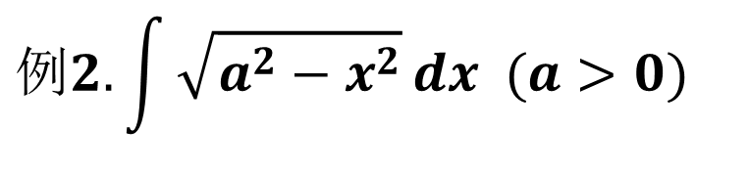
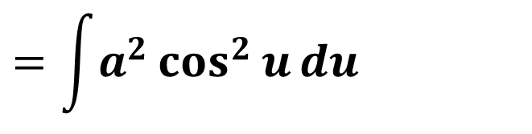

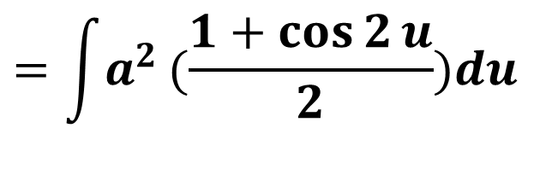

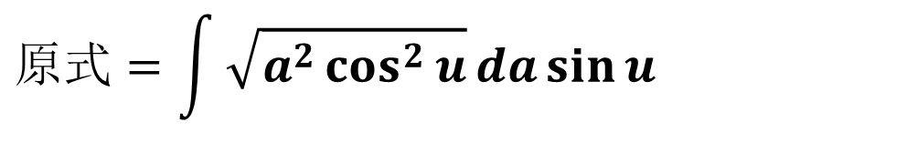
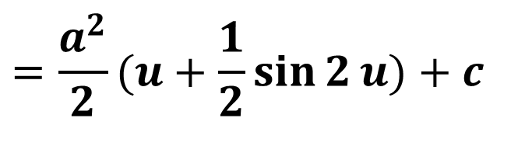
$$例2.\int{\sqrt{a^{2}−x^{2}}}dx (a>0)$$
$$0<u<\frac{π}{2}$$
$$令x=a\sin{u}, dx=a\cos{u}du$$
$$原式=\int{\sqrt{a^{2}\cos^{2}{u}}}da\sin{u}$$
$$=\int{a^{2}\cos^{2}{u}}du$$
$$=\int{a^{2}}(\frac{1+\cos{2}u}{2})du$$
$$=\frac{a^{2}}{2}(u+\frac{1}{2}\sin{2}u)+c$$
$$a$$
$$u$$
$$x$$
$$=\frac{a^{2}}{2}\arcsin{\frac{x}{a}}+\frac{x}{2}\sqrt{a^{2}−x^{2}})+c$$
$$\sqrt{a^{2}−x^{2}}$$

Slide 3

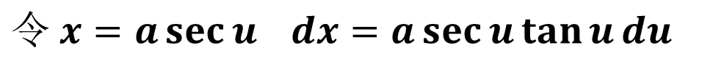

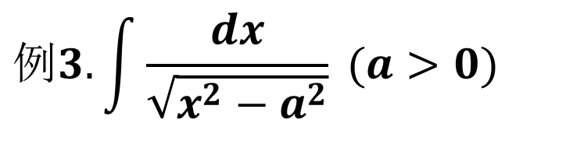

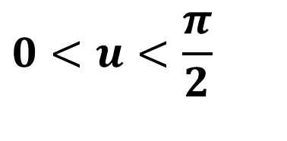

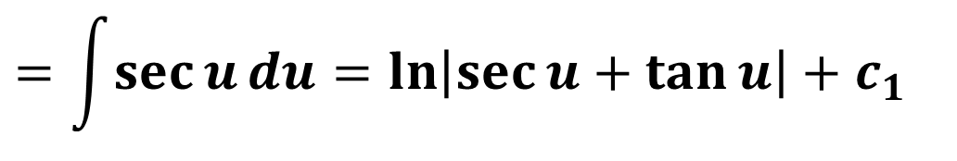
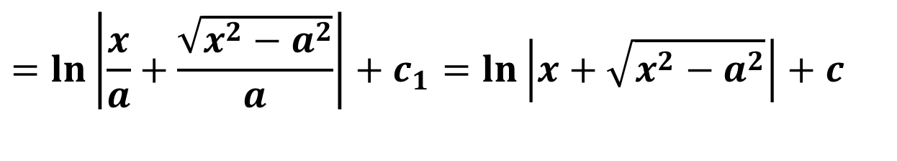
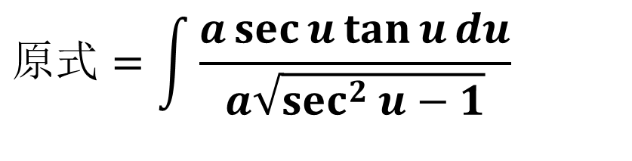
$$例3. \int{\frac{dx}{\sqrt{x^{2}−a^{2}}} }(a>0)$$
$$0<u<\frac{π}{2}$$
$$令 x=a\sec{u} dx=a\sec{u}\tan{u}du$$
$$原式=\int{\frac{a\sec{u}\tan{u}du}{a\sqrt{\sec^{2}{u}−1}}}$$
$$x$$
$$\sqrt{x^{2}−a^{2}}$$
$$=\int{\sec{u}du=\ln\left|\sec{u}+\tan{u}\right|}+c_{1}$$
$$u$$
$$a$$
$$=\ln\left|\frac{x}{a}+\frac{\sqrt{x^{2}−a^{2}}}{a}\right|+c_{1}=\ln\left|x+\sqrt{x^{2}−a^{2}}\right|+c$$

Slide 4

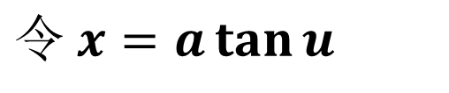

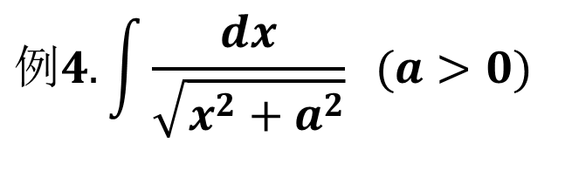

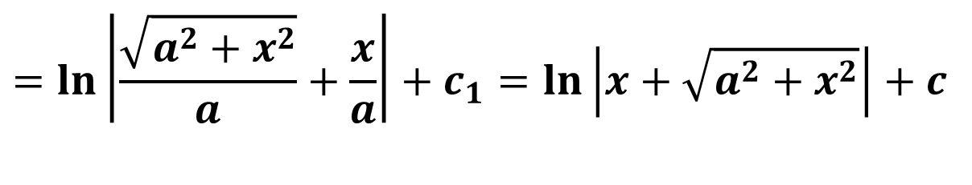
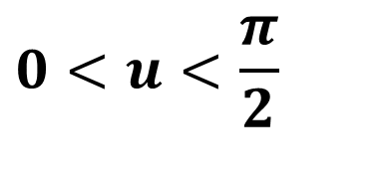
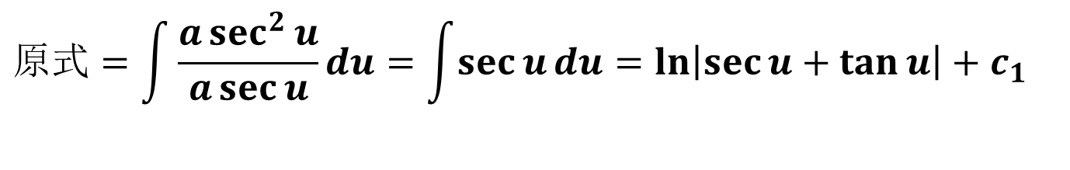

$$例4. \int{\frac{dx}{\sqrt{x^{2}+a^{2}}}} (a>0)$$
$$0<u<\frac{π}{2}$$
$$令 x=a\tan{u}$$
$$原式=\int{\frac{a\sec^{2}{u}}{a\sec{u}}du=\int{\sec{u}du=\ln\left|\sec{u}+\tan{u}\right|}}+c_{1}$$
$$=\ln\left|\frac{\sqrt{a^{2}+x^{2}}}{a}+\frac{x}{a}\right|+c_{1}=\ln\left|x+\sqrt{a^{2}+x^{2}}\right|+c$$
$$\sqrt{a^{2}+x^{2}}$$
$$x$$
$$u$$
$$a$$

Slide 5
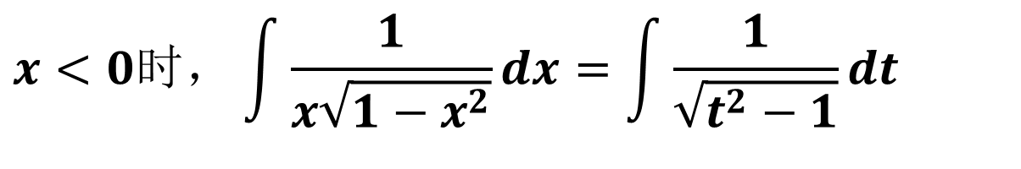
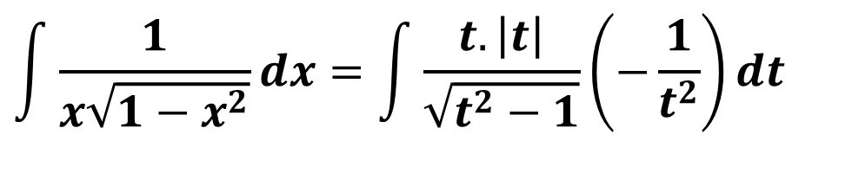
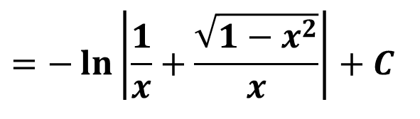
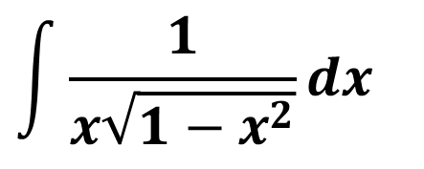
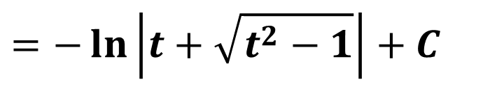
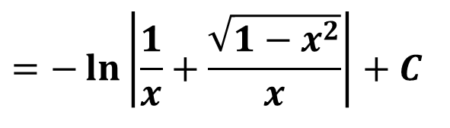
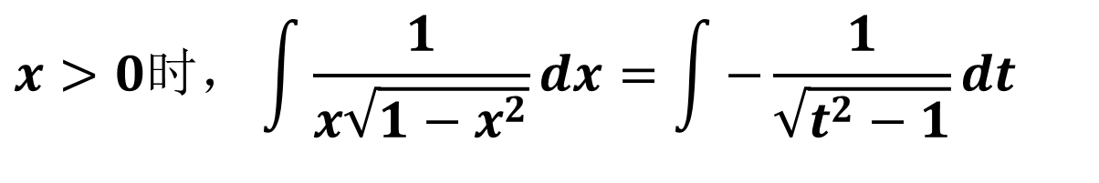
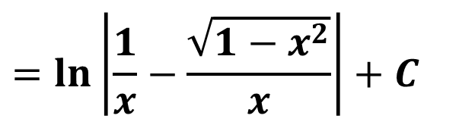
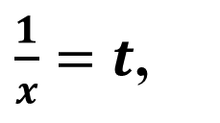
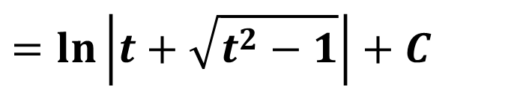
$$\int{\frac{1}{x\sqrt{1−x^{2}}}dx}$$
例5
$$\int{\frac{1}{x\sqrt{1−x^{2}}}dx}=\int{\frac{t. \left|t\right|}{\sqrt{t^{2}−1}}\left(−\frac{1}{t^{2}}\right)dt}$$
解：
$\frac{1}{x}=t$,
令
$$x>0时，\int{\frac{1}{x\sqrt{1−x^{2}}}dx}=\int{−\frac{1}{\sqrt{t^{2}−1}}dt}$$
$$=−\ln\left|\frac{1}{x}+\frac{\sqrt{1−x^{2}}}{x}\right|+C$$
$$=−\ln\left|t+\sqrt{t^{2}−1}\right|+C$$
$$x<0时，\int{\frac{1}{x\sqrt{1−x^{2}}}dx}=\int{\frac{1}{\sqrt{t^{2}−1}}dt}$$
$$=\ln\left|\frac{1}{x}−\frac{\sqrt{1−x^{2}}}{x}\right|+C$$
$$=−\ln\left|\frac{1}{x}+\frac{\sqrt{1−x^{2}}}{x}\right|+C$$
$$=\ln\left|t+\sqrt{t^{2}−1}\right|+C$$

Slide 6
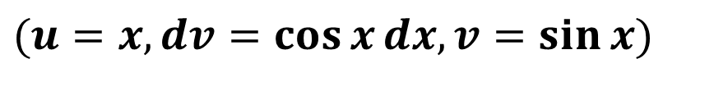
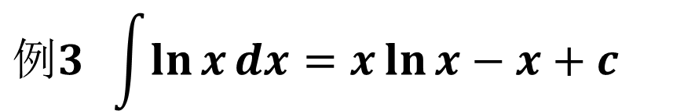
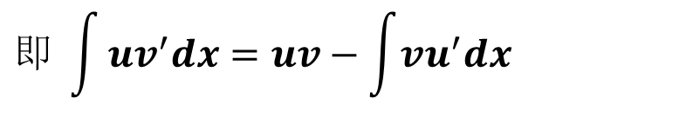
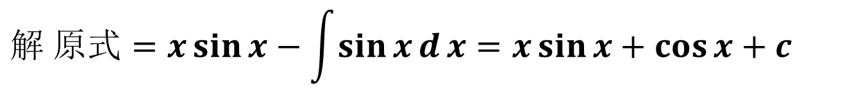


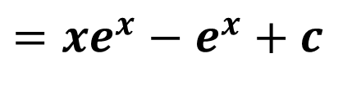
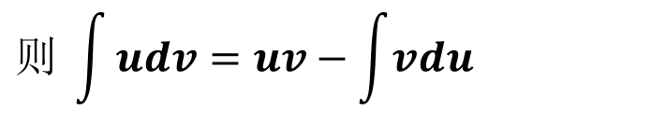
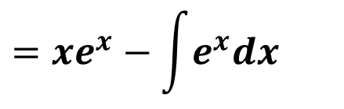

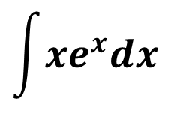
3.分布积分法
$$定理. 设函数u(x),$$
$$v(x)具有连续的导数u^{′}(x),v^{′}(x),$$
$$则 \int{udv=uv−\int{vdu}}$$
$$即 \int{uv^{′}dx=uv−\int{vu^{′}dx}}$$
$$例 1 \int{x\cos{x}dx}$$
$$(u=x,dv=\cos{x}dx,v=\sin{x})$$
$$解 原式=x\sin{x}−\int{\sin{x}d}x=x\sin{x}+\cos{x}+c$$
例2
$$\int{xe^{x}dx}$$
$$=xe^{x}−\int{e^{x}dx}$$
$$=xe^{x}−e^{x}+c$$
$$例3 \int{\ln{x}dx}=x\ln{x}−x+c$$

Slide 7
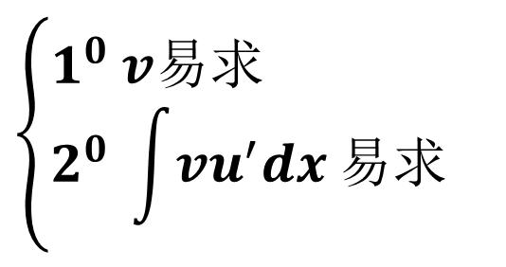

$$总之,u和v^{′}的选取要符合$$
$$\left\{\begin{aligned}&1^{0} v易求 \\ &2^{0} \int{vu^{′}dx}易求\end{aligned}\right.$$
通常我们可按“反对幂三指”的顺序
(即反三角函数、对数函数、幂函数、三角函数、指数函数)
排在前面的那类函数选作u, 排在后面的与dx结合在一起为dv

Slide 8







$$例3 \int{x\ln{x}dx}$$
$$(u=\ln{x}, dv=xdx, v=\frac{x^{2}}{2})$$
$$解:原式=\frac{x^{2}}{2}\ln{x}−\int{\frac{x^{2}}{2}\frac{1}{x}}dx$$
$$=\frac{x^{2}}{2}\ln{x}−\frac{x^{2}}{4}+c$$
$$例4 \int{\arctan{x}dx}$$
$$=x\arctan{x}−\int{\frac{x}{1+x^{2}}}dx$$
$$=x\arctan{x}−\frac{1}{2}\ln{(}1+x^{2})+c$$

Slide 9







$$例5 \int{e^{x}\sin{x}dx}$$
$$=\int{\sin{x}de^{x}}$$
$$=e^{x}\sin{x}−\int{e^{x}\cos{x}dx}$$
$$=e^{x}\sin{x}−\int{\cos{x}de^{x}}$$
$$=e^{x}\sin{x}−(e^{x}\cos{x}+\int{e^{x}\sin{x}dx)}$$
$$=e^{x}\sin{x}−e^{x}\cos{x}−\int{e^{x}\sin{x}dx}$$
$$∴\int{e^{x}\sin{x}dx}=\frac{1}{2}(e^{x}\sin{x}−e^{x}\cos{x})+c$$

Slide 10










$$\int{\sec^{3}{x}}dx$$
$$=\int^{ }{secx\sec^{2}{x}dx}$$
$$=\int{\sec{x}d\tan{x}}$$
例6
$$=\sec{x}\tan{x}−\int{\tan^{2}{x}\sec{x}}dx$$
$$=\sec{x}\tan{x}−\int{(\sec^{2}x{ }}−1)\sec{x}dx$$
$$=\sec{x}\tan{x}−\int{(\sec^{3}{x }}−\sec{x})dx$$
$$=\sec{x}\tan{x}−\int{\sec^{3}{x}}dx+\ln\left|\sec{x}+\tan{x}\right|$$
$$2\int{\sec^{3}{x}}dx$$
$$=\sec{x}\tan{x}+\ln\left|\sec{x}+\tan{x}\right|$$
$$\int{\sec^{3}{x}}dx=\frac{1}{2}[\sec{x}\tan{x}+\ln\left|\sec{x}+\tan{x}\right|]+c$$

Slide 11








$$例5\int{x\sin{x}dx}$$
$$(若u=x,dv=\sin{x}dx)$$
$$=−x\cos{x}−\int{(−\cos{x})dx=−x\cos{x}+\sin{x}+c}$$
$$(若u=x\sin{x},dv=dx)$$
$$=x^{2}\sin{x}−\int{x(\sin{x}+x\cos{x})dx}$$
$$变复杂$$
$$(若u=\sin{x},dv=xdx)$$
$$=\frac{1}{2}x^{2}\sin{x}−\frac{1}{2}\int{x^{2}\cos{x}dx}$$

Slide 12






$$例6\int{x^{3}}e^{x^{2}}dx$$
$$(若u=x^{2},dv=xe^{x^{2}}dx,v=\frac{1}{2}e^{x^{2}})$$
$$=\frac{1}{2}x^{2}e^{x^{2}}−\int{xe^{x^{2}}dx=\frac{1}{2}x^{2}e^{x^{2}}−\frac{1}{2}e^{x^{2}}+c}$$
$$(若u=x^{3},dv=e^{x^{2}}dx),$$
$$v求不出，无法解决$$
$$(若u=x^{3}e^{x^{2}},dv=dx)，变复杂$$

Slide 13









$$I_{n}=\int{\frac{dx}{{\left(x^{2}+a^{2}\right)}^{n}}}$$
例7 求
其中n 为整数
解 当 时有
$$n>1$$
$$I_{n}=\frac{1}{a^{2}}\int{\frac{a^{2}dx}{{\left(x^{2}+a^{2}\right)}^{n}}}$$
$$=\frac{1}{a^{2}}\int{\frac{x^{2}+a^{2}−x^{2}}{{\left(x^{2}+a^{2}\right)}^{n}}dx}$$
$$=\frac{1}{a^{2}}I_{n−1}+\frac{1}{a^{2}}\int{\frac{x}{2(n−1)}d\frac{1}{{\left(x^{2}+a^{2}\right)}^{n−1}}}$$
$$=\frac{1}{a^{2}}I_{n−1}+\frac{1}{a^{2}}\frac{x}{2(n−1)}\frac{1}{{\left(x^{2}+a^{2}\right)}^{n−1}}−\frac{1}{a^{2}}\frac{1}{2(n−1)}\int{\frac{1}{{\left(x^{2}+a^{2}\right)}^{n−1}}dx}$$
$$=\frac{1}{a^{2}}\frac{1}{2(n−1)}[(2n−3)I_{n−1}+\frac{x}{{\left(x^{2}+a^{2}\right)}^{n−1}}$$
以此作递推公式，
并由$I_{1}=\frac{1}{a}\arctan{\frac{x}{a}}+c$
可得$I_{n}$

Slide 14






四、 有理函数的积分
$$\frac{Q_{m}(x)}{P_{n}(x)}$$
两个多项式 与 之商 称为有理式。
而有理函数的积分可以分解为下面几种有理函数的积分。
$$P_{n}(x)$$
$$Q_{m}(x)$$
几类简单有理函数的积分
$$1) \int{\frac{dx}{x−a}}=\ln\left|x−a\right|+c$$
$$2) \int{\frac{dx}{{\left(x−a\right)}^{k}}}=\frac{1}{1−k}{\left(x−a\right)}^{−k+1}+c$$
$$3)\int{\frac{dx}{x^{2}+px+q}}=\left\{\begin{aligned}&\int{\frac{du}{u^{2}+a^{2}}=\frac{1}{a}\arctan{\frac{u}{a}}+c} \\ &\int{\frac{du}{u^{2}−a^{2}}=\frac{1}{2a}\ln\left|\frac{u−a}{u+a}\right|+c}\end{aligned}\right.$$

Slide 15






$$4) \int{\frac{(Mx+N)dx}{(x^{2}+px+q)}}$$
$$=k_{1}\int{\frac{(x^{2}+px+q)^{′}}{(x^{2}+px+q)}}dx+k_{2}\int{\frac{dx}{(x^{2}+px+q)}}$$
$$5) \int{\frac{dx}{(x^{2}+px+q)^{k}}}$$
$$=\int{\frac{du}{(u^{2}+a^{2})^{k}}}$$
$$6) \int{\frac{(Mx+N)dx}{(x^{2}+px+q)^{k}}}$$
$$=k_{1}\int{\frac{(x^{2}+px+q)^{′}}{(x^{2}+px+q)^{k}}}dx+k_{2}\int{\frac{dx}{(x^{2}+px+q)^{k}}}$$

Slide 16

代数基本定理
定理1 任何一个$n$ 次多项式 $p_{n}(x)$可以分解成下面的形式
$$p_{n}(x)=(x−a_{1})^{α_{1}}(x−a_{2})^{α_{2}}⋯(x^{2}+p_{1}x+q_{1})^{β_{1}}(x^{2}+p_{2}x+q_{2})^{β_{2}}⋯$$
其中$a_{1},a_{2}⋯$为实数根， $α_{1},α_{2},⋯$ 为实数根的重数；
$(x^{2}+p_{1}x+q_{1})^{ },(x^{2}+p_{2}x+q_{2})^{ },⋯$分别对应于一对复根，
$$β_{1},β_{2}⋯\text{为其复根重数，且}α_{1}+α_{2}+⋯+2β_{1}+2β_{2}+⋯=n$$
定理2 若有理真分式 $\frac{Q_{m}(x)}{P_{n}(x)}$ 的分母 $P_{n}(x)$ 分解成定理1
的形式，则有理真分式可展开成

Slide 17






$$\frac{Q_{m}(x)}{P_{n}(x)}=\frac{A_{1}}{(x−a_{1})^{α_{1}}}+\frac{A_{2}}{(x−a_{1})^{α_{1}−1}}+⋯\frac{A_{a_{1}}}{(x−a_{1})}+$$
$$+\frac{B_{1}}{(x−a_{2})^{α_{2}}}+\frac{B_{2}}{(x−a_{2})^{α_{2}−1}}+⋯\frac{B_{α_{2}}}{(x−a_{2})}+$$
$$⋯⋯$$
$$+\frac{N_{1}x+M_{1}}{(x^{2}+p_{1}x+q_{1})^{β_{1}}}+\frac{N_{2}x+M_{2}}{(x^{2}+p_{1}x+q_{1})^{β_{1}−1}}+⋯\frac{N_{β_{1}}x+M_{β_{1}}}{x^{2}+p_{1}x+q_{1}}$$
$$⋯⋯$$
$$+\frac{R_{1}x+S_{1}}{(x^{2}+px+q)^{μ}}+\frac{R_{2}x+S_{2}}{(x^{2}+px+q)^{μ−1}}+⋯\frac{R_{μ}x+S_{μ}}{x^{2}+px+q}$$
其中 $A_{i},⋯B_{i},M_{i},N_{i},⋯R_{i},S_{i}$等都是未定常数,可通过比较多项式系数而定出。

Slide 18



例8
$$\frac{Q_{m}(x)}{P_{n}(x)}=\frac{1}{(x−1)^{2}(x^{2}+1)}=\frac{A_{1}}{(x−1)^{2}}+\frac{A_{2}}{(x−1)}+\frac{Nx+M}{x^{2}+1}$$
$$1=A_{1}(x^{2}+1)+A_{2}(x−1)(x^{2}+1)+(Nx+M)(x−1)^{2}$$
$$\frac{Q_{m}(x)}{P_{n}(x)}=\frac{1}{(x+2)(x+1)^{2}(x^{2}+2x+3)^{2}}$$
$$=\frac{A}{(x+2)}+\frac{B_{1}}{(x+1)^{2}}+\frac{B_{2}}{(x+1)}+\frac{N_{1}x+M_{1}}{(x^{2}+2x+3)^{2}}+\frac{N_{2}x+M_{2}}{(x^{2}+2x+3)}$$

Slide 19






例9
$$\frac{x+3}{x^{2}−5x+6}=\frac{x+3}{(x−2)(x−3)}$$
$$=\frac{A}{x−2}+\frac{B}{x−3}$$
$$A(x−3)+B(x−2)=x+3$$
$$\left\{\begin{aligned}&A+B=1 \\ &−3A−2B=3\end{aligned}\right.$$
$$A=−5,B=6$$
$$\frac{2x+3}{x^{3}+x^{2}−2x}=\frac{2x+3}{x(x−1)(x+2)}$$
$$=\frac{A}{x}+\frac{B}{x−1}+\frac{C}{x+2}$$
例10
$$A(x−1)(x+2)+Bx(x+2)+Cx(x−1)=2x+3$$

Slide 20










$$3=2A, A=−\frac{3}{2}$$
令
$$x=0$$
得
$$x=1$$
得
$$3B=5, B=\frac{5}{3}$$
令
令
$$x=−2$$
$$6C=−1,C=−\frac{1}{6}$$
得
$$\frac{2x+3}{x^{3}+x^{2}−2x}=\frac{2x+3}{x(x−1)(x+2)}$$
$$=−\frac{3}{2x}+\frac{5}{3(x−1)}−\frac{1}{6(x+2)}$$
$$\int{\frac{2x+3}{x^{3}+x^{2}−2x}dx}=\int{\frac{2x+3}{x(x−1)(x+2)}dx}$$
$$=\int{[\frac{3}{2x}+\frac{5}{3(x−1)}−\frac{1}{6(x+2)}]dx}=⋯$$

Slide 21




$$\frac{2x^{5}+6x^{3}+1}{x^{4}+3x^{2}}=2x+\frac{1}{x^{4}+3x^{2}}$$
例11
$$\frac{1}{x^{4}+3x^{2}}=\frac{A}{x}+\frac{B}{x^{2}}+\frac{Cx+D}{x^{2}+3}$$
$$1=Ax(x^{2}+3)+B(x^{2}+3)+x^{2}(Cx+D)$$
$$\left\{\begin{aligned}&A=0 \\ &B=\frac{1}{3} \\ &C=0 \\ &D=−\frac{1}{3}\end{aligned}\right.$$
$$\left\{\begin{aligned}&A+C=0 \\ &D+B=0 \\ &3A=0 \\ &3B=1\end{aligned}\right.$$

Slide 22



$$\int{\frac{2x^{5}+6x^{3}+1}{x^{4}+3x^{2}}dx}=\int{[}2x+\frac{1}{x^{4}+3x^{2}}]dx$$
$$=x^{2}+\int{\frac{1}{x^{4}+3x^{2}}dx}=x^{2}+\int{[}\frac{1}{3x^{2}}−\frac{1}{3(x^{2}+3)}]dx$$
$$=x^{2}−\frac{1}{3x}−\frac{1}{3\sqrt{3}}\arctan{\frac{x}{\sqrt{3}}}+c$$

Slide 23




$$\int{\frac{x−2}{x^{2}+2x+3}dx}$$
例12
$$=\frac{1}{2}\int{\frac{(x^{2}+2x+3)^{′}}{x^{2}+2x+3}}dx−3\int{\frac{dx}{x^{2}+2x+3}}$$
$$=\frac{1}{2}\ln{(}x^{2}+2x+3)−3\int{\frac{d(x+1)}{(x+1)^{2}+(\sqrt{2})^{2}}}$$
$$=\frac{1}{2}\ln{(}x^{2}+2x+3)−\frac{3}{\sqrt{2}}\arctan{\frac{x+1}{\sqrt{2}}}+c$$

Slide 24





五、三角函数有理式的积分
三角函数有理式是指由三角函数和常数经过有限四则运
算所构成的函数，由于各种三角函数都可用 及
的有理式表示，故三角函数有理式也就是
的有理式，记作
$$\sin{x}$$
$$\cos{x}$$
$$\sin{x},\cos{x}$$
$$R(\sin{x},\cos{x})$$
$$\int{\frac{1+\sin{x}}{\sin{x}(1+\cos{x})}}dx$$
例13 求
有三角公式知 $\sin{x}$ 与 $\cos{x}$ 都可以用 $\tan{\frac{x}{2}}$ 的有理式表示，即

Slide 25








$$\sin{x}=2\sin{\frac{x}{2}}\cos{\frac{x}{2}}=\frac{2\tan{\frac{x}{2}}}{\sec^{2}{\frac{x}{2}}}=\frac{2\tan{\frac{x}{2}}}{1+\tan^{2}{\frac{x}{2}}}$$
$$=\frac{1−\tan^{2}{\frac{x}{2}}}{\sec^{2}{\frac{x}{2}}}=\frac{1−\tan^{2}{\frac{x}{2}}}{1+\tan^{2}{\frac{x}{2}}}$$
$$\cos{x}=\cos^{2}{\frac{x}{2}}−\sin^{2}{\frac{x}{2}}$$
$$u=\tan{\frac{x}{2}}$$
$$dx=\frac{2}{1+u^{2}}du$$
令
$$x=2\arctan{u}$$
$$\sin{x}=\frac{2u}{1+u^{2}}$$
$$\cos{x}=\frac{1−u^{2}}{1+u^{2}}$$

Slide 26






$$=\int{\frac{(1+\frac{2u}{1+u^{2}})}{\frac{2u}{1+u^{2}}(1+\frac{1−u^{2}}{1+u^{2}})}}\frac{2du}{1+u^{2}}$$
$$\int{\frac{1+\sin{x}}{\sin{x}(1+\cos{x})}dx}$$
于是
$$=\frac{1}{2}\int{(u+2+\frac{1}{u}})du=\frac{1}{2}(\frac{u^{2}}{2}+2u+\ln\left|u\right|)+c$$
$$=\frac{1}{4}\tan^{2}{\frac{x}{2}}+\tan{\frac{x}{2}}+\frac{1}{2}\ln\left|\tan{\frac{x}{2}}\right|+c$$
$$u=\tan{\frac{x}{2}}$$
一般地对于三角有理式的积分，令
$$\int{R(\sin{x},\cos{x})dx=\int{R(\frac{2u}{1+u^{2}},\frac{1−u^{2}}{1+u^{2}}}})\frac{2}{1+u^{2}}du$$

Slide 27










六、简单无理函数的积分
$$R(x,\sqrt[n]{\frac{ax+b}{cx+e}})$$
$$R(x,\sqrt[n]{ax+b})$$
主要讨论 及
$$\int{\frac{\sqrt{x−1}}{x}dx}$$
例1
令
$$\sqrt{x−1}=t$$
$$\int{\frac{dx}{1+\sqrt[3]{x+2}}}$$
例2
令
$$\sqrt[3]{x+2}$$
$$\int{\frac{dx}{(1+\sqrt[3]{x})\sqrt{x}}}$$
例3
令
$$x=t^{6}$$
$$\int{\frac{1}{x}}\sqrt{\frac{1+x}{x}}dx$$
$$\sqrt{\frac{1+x}{x}}=t, x=\frac{1}{t^{2}−1}$$
令
例4

Slide 28





$$\int{\frac{\sqrt{x−1}}{x}dx}$$
例1
令
$\sqrt{x−1}=t$, x= $1+t^{2}$
解：
$$\int{\frac{t.2tdt}{1+t^{2}}}$$
$$=\int{(2−\frac{2}{1+t^{2}})dt}$$
$$=2t−2arctant+C$$
$$=2\sqrt{x−1}−2arctan\sqrt{x−1}+C$$

Slide 29






$$\int{\frac{dx}{1+\sqrt[3]{x+2}}}$$
例2
令
$\sqrt[3]{x+2}=t$, x = $t^{3}−2$
解：
$$\int{\frac{3t^{2}dt}{1+t}}$$
$$=3\int{(t−1+\frac{1}{1+t})dt}$$
$$=3[\frac{1}{2}t^{2}−t+ln\left|1+t\right|] +C$$
$$=3[ \frac{1}{2}{\left(\sqrt[3]{x+2}\right)}^{2}−\sqrt[3]{x+2}+ln\left|1+\sqrt[3]{x+2}\right|]+C$$

Slide 30






$$\int{\frac{dx}{(1+\sqrt[3]{x})\sqrt{x}}}$$
例3
令
x= $t^{6}$
解：
$$\int{\frac{6t^{5}dt}{(1+t^{2})t^{3}}}$$
$$=\int{(6−\frac{6}{1+t^{2}})dt}$$
$$=6t−6arctant+C$$
$$=6\sqrt[6]{x}−6arctan\sqrt[6]{x}+C$$

Slide 31






$$\int{\frac{1}{x}}\sqrt{\frac{1+x}{x}}dx$$
例4
$$\sqrt{\frac{1+x}{x}}=t, x=\frac{1}{t^{2}−1}$$
解：
令
$$\int{\left(t^{2}\text{−}\text{1}\right)∙t∙\frac{−2t}{{\left(t^{2}\text{−}\text{1}\right)}^{2}}dt}$$
$$=\int{(−2−\frac{2}{t^{2}\text{−}\text{1}})dt}$$
$$=−2t+ln\left(t+1\right)−ln\left|t−1\right|+C$$
$$=−2\sqrt{\frac{1+x}{x}}+ln\left(\sqrt{\frac{1+x}{x}}+1\right)−ln\left|\sqrt{\frac{1+x}{x}}−1\right|+C$$

