Slide 1

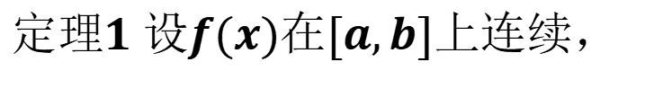
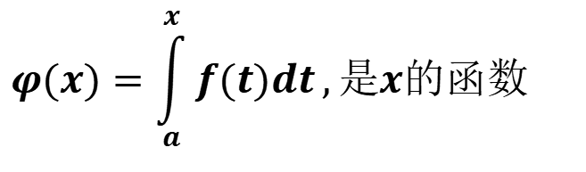



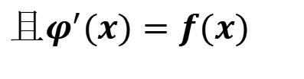

微积分基本定理(定积分与原函数的关系)
一.变上限的定积分及其导数
$$设函数f(x)在区间[a,b]上连续，$$
$$y=f(t)$$
$$取x∈[a,b],现在考察变上限的定积分，$$
$$φ(x)=\int_{a}^{x}{f(t)dt},是x的函数$$
$$a$$
$$x$$
$$b$$
$$定理1 设f(x)在[a,b]上连续，$$
$$则函数φ\left(x\right)=\int_{a}^{x}{f\left(t\right)}dt,x∈\left[a,b\right]在上可导,$$
$$且φ^{′}(x)=f(x)$$

Slide 2
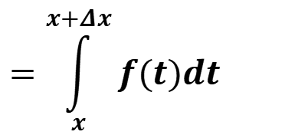



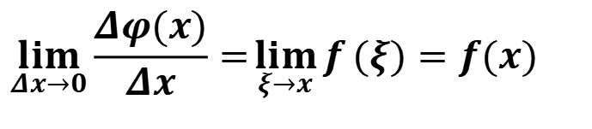
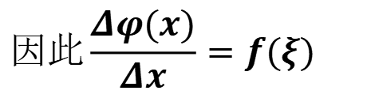
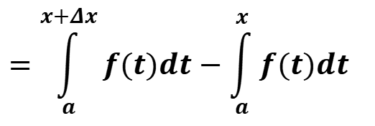
$$证明：$$
$$若x∈\left(a,b\right), x+Δx∈(a,b)$$
$$则, φ(x+Δx)−φ(x)=Δφ(x)$$
$$=\int_{a}^{x+Δx}{f(t)dt}−\int_{a}^{x}{f(t)dt}$$
$$=\int_{x}^{x+Δx}{f(t)dt}$$
$$因此\frac{Δφ(x)}{Δx}=f(ξ)$$
$$\lim_{Δx→0}{\frac{Δφ(x)}{Δx}}=\lim_{ξ→x}{f}(ξ)=f(x)$$

Slide 3
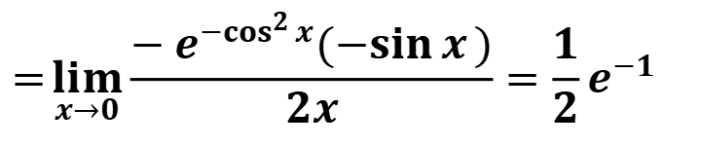
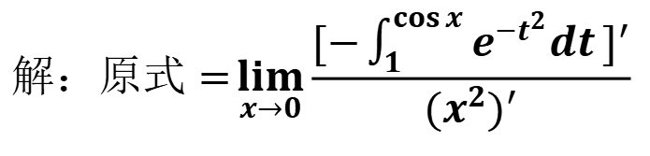
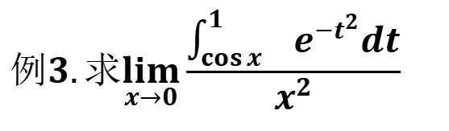


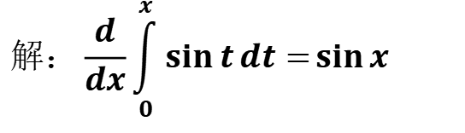
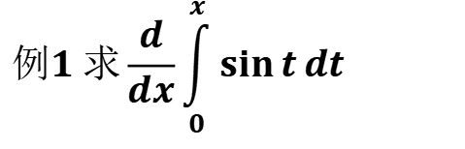
$$例1 求\frac{d}{dx}\int_{0}^{x}{\sin{t}dt}$$
$$解：\frac{d}{dx}\int_{0}^{x}{\sin{t}dt}=\sin{x}$$
$$例2 求\frac{d}{dx}\int_{0}^{x^{2}}{\sin{\sqrt{t}}dt} (x>0)$$
$$解：原式=\sin{\sqrt{x^{2}}}(x^{2})^{′}=2x\sin{x}$$
$$例3.求\lim_{x→0}{\frac{\int_{\cos{x}}^{1}{ e^{−t^{2}}dt}}{x^{2}}}$$
$$解：原式=\lim_{x→0}{\frac{[−\int_{1}^{\cos{x}}{e^{−t^{2}}dt}]^{′}}{(x^{2})^{′}}}$$
$$=\lim_{x→0}{\frac{−e^{−\cos^{2}{x}}(−\sin{x})}{2x}}=\frac{1}{2}e^{−1}$$

Slide 4

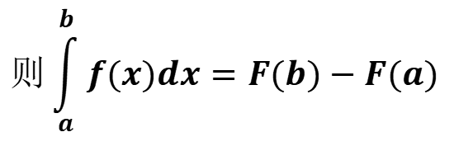



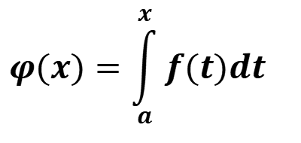
$$定理2.$$
$$如果函数f(x)在区间[a,b]上连续,$$
$$φ(x)=\int_{a}^{x}{f(t)dt}$$
$$则函数$$
$$就是f(x)在[a,b]上的一个原函数$$
定理表明:
(1)连续函数一定存在原函数
(2)把定积分与原函数之间
建立起联系
二.牛顿-莱布尼兹公式
$定理3$.
$$如果函数F(x)是连续函数f(x)在区间[a,b]上的一个原函数,$$
$$则\int_{a}^{b}{f(x)dx=F(b)−F(a)}$$

Slide 5
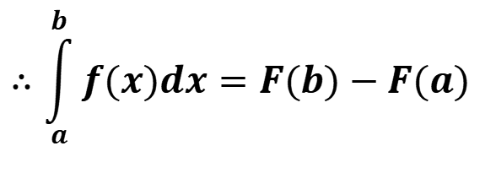
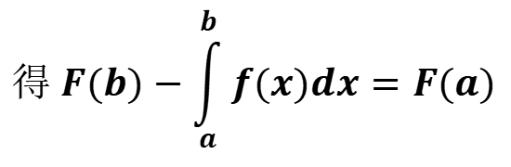
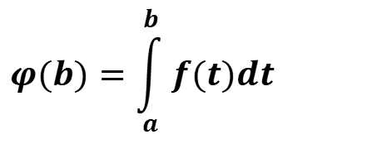

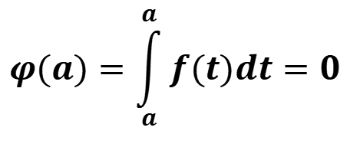

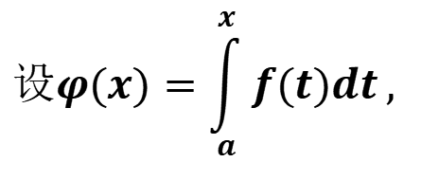
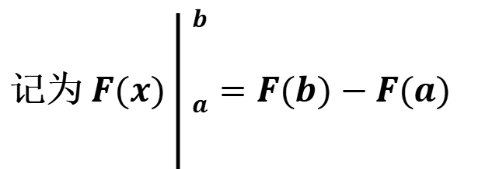



$$设φ(x)=\int_{a}^{x}{f(t)dt},$$
$$证明:$$
$$因为F(x)与φ(x)都是f(x)的一个原函数,$$
$$所以,F(x)−φ(x)=c$$
$$φ(a)=\int_{a}^{a}{f(t)dt=0}$$
$$当x=a时,$$
$$F(a)=c$$
$$φ(b)=\int_{a}^{b}{f(t)dt}$$
$$得 F(b)−\int_{a}^{b}{f(x)dx}=F(a)$$
$$当x=b时$$
$$∴\int_{a}^{b}{f(x)dx}=F(b)−F(a)$$
记为 $F(x)\left| _{a}^{\begin{aligned}b \\ \\ \end{aligned}}\right.=F(b)−F(a)$

Slide 6


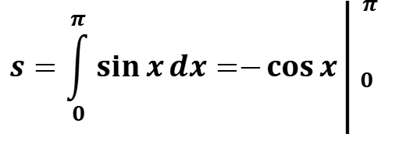



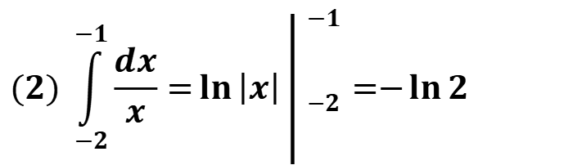

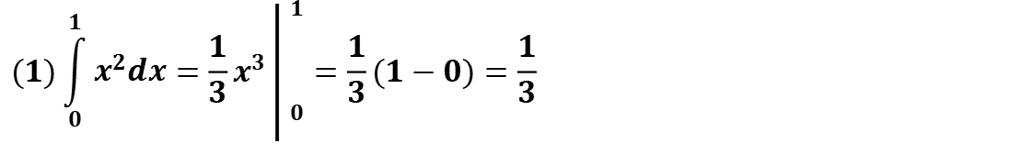
$${例1 }_{ }计算下列定积分$$
$$(1)\int_{0}^{1}{x^{2}dx}=\frac{1}{3}x^{3}\left| _{\begin{aligned} \\ 0\end{aligned}}^{\begin{aligned}1 \\ \\ \end{aligned}}\right.=\frac{1}{3}(1−0)=\frac{1}{3}$$
$$y=\sin{x}$$
$$(2) \int_{−2}^{−1}{\frac{dx}{x}}=\ln\left|x\right|\left| _{−2}^{\begin{aligned}−1 \\ \\ \end{aligned}}\right.=−\ln{2}$$
$$0$$
$$π$$
$$(3)^{ }计算正弦曲线y=\sin{x}在[0,π]上与x轴所围成的平面图形的面积$$
$$s=\int_{0}^{π}{\sin{x}dx}=−\cos{x}\left| _{0}^{\begin{aligned}π \\ \\ \end{aligned}}\right.$$
$$解:$$
$$=−[(\cos{π})−\cos{0}]=2$$

Slide 7
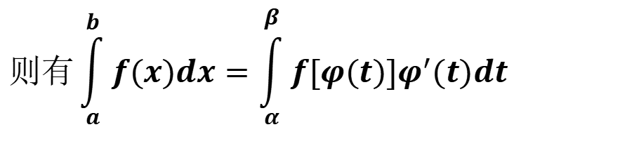

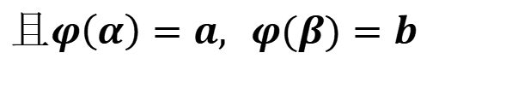

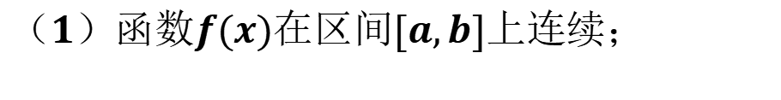


定积分的计算
一.定积分的换元积分法
$$定理：$$
$$设$$
$$（1）函数f(x)在区间[a,b]上连续；$$
$$（2）函数x=φ(t)在区间[α,β]上是单值的$$
$$且有连续的导数;$$
$$（3）当t在区间[α,β]（或[β,α]）上变化时，$$
$$x=φ(t)的值在[a,b]变化，$$
$$且φ\left(α\right)=a, φ(β)=b$$
$$则有\int_{a}^{b}{f(x)dx}=\int_{α}^{β}{f[φ(t)]φ^{′}(t)dt}$$

Slide 8
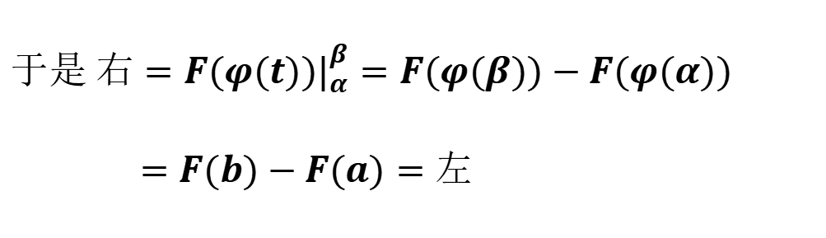


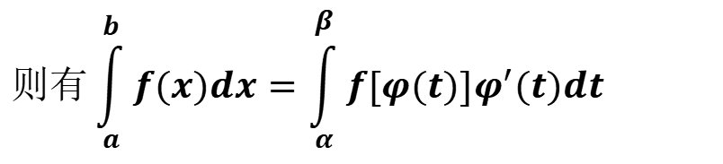
$$则有\int_{a}^{b}{f(x)dx}=\int_{α}^{β}{f[φ(t)]φ^{′}(t)dt}$$
证明:
$$令 F^{′}(x)=f(x)$$
$$则有{[F}^{ }(φ(t))]′=f[φ(t)]φ^{′}(t)$$
$$于是 右=F(φ(t))|_{α}^{β}=F(φ(β))−F(φ(α)) \\ =F(b)−F(a)=左$$
注意:换元的同时一定要换限

Slide 9
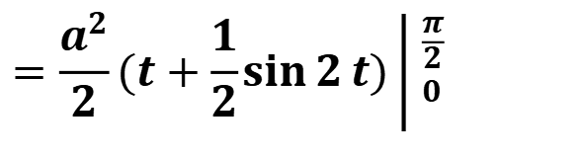
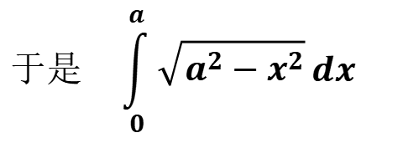
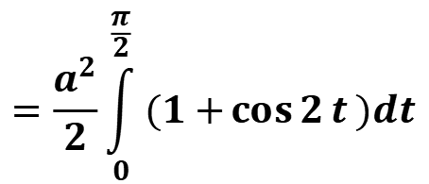
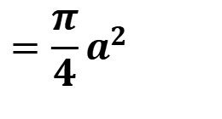
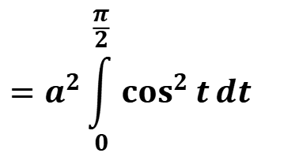
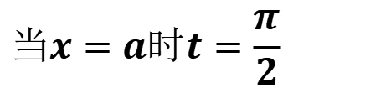


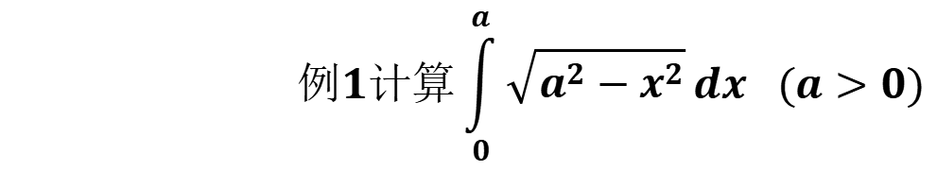
$$例1计算\int_{0}^{a}{\sqrt{a^{2}−x^{2}}}dx_{}(a>0)$$
$$解_{}\underset{}{}设x=a\sin{t},则dx=a\cos{t}dt$$
$$当x=a时t=\frac{π}{2}$$
$$当x=0时,t=0;$$
$$=a^{2}\int_{0}^{\frac{π}{2}}{\cos^{2}{t}}dt$$
$$于是\underset{}{}\int_{0}^{a}{\sqrt{a^{2}−x^{2}}}dx$$
$$=\frac{a^{2}}{2}\int_{0}^{\frac{π}{2}}{(1+\cos{2}t})dt$$
$$=\frac{a^{2}}{2}(t+\frac{1}{2}\sin{2}t)\left| _{0}^{\frac{π}{2}}\right.$$
$$=\frac{π}{4}a^{2}$$
亦可用几何意义求解

Slide 10
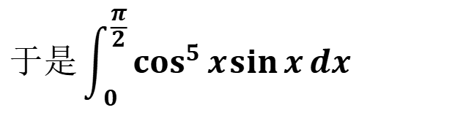
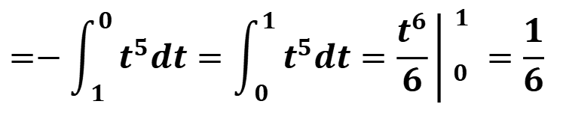
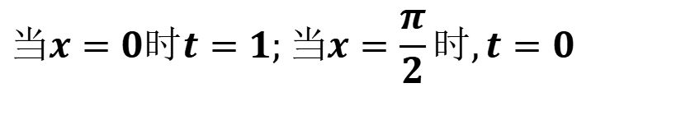
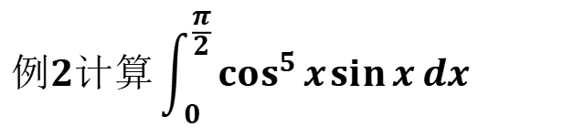
$$例2计算\int_{0}^{\frac{π}{2}}{\cos^{5}{x}\sin{x}dx}$$
$$解 设t=\cos{x},则dt=−\sin{x}dx$$
$$当x=0时t=1;当x=\frac{π}{2}时,t=0$$
$$于是\int_{0}^{\frac{π}{2}}{\cos^{5}{x}\sin{x}dx}$$
$$=−\int_{1}^{0}{t^{5}dt}=\int_{0}^{1}{t^{5}dt}=\frac{t^{6}}{6}\left| _{0}^{\begin{aligned}1 \\ \end{aligned}}\right.=\frac{1}{6}$$

Slide 11
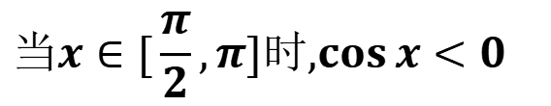
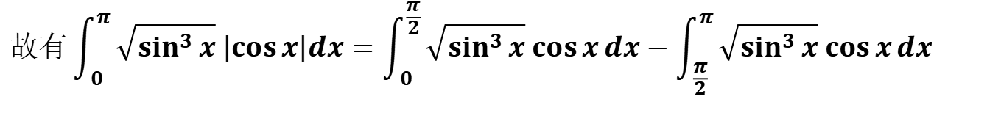
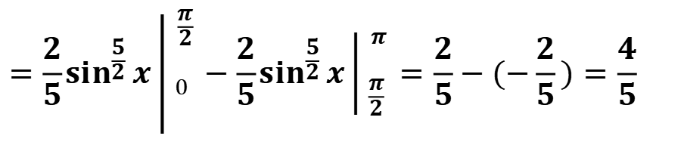
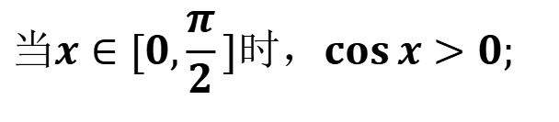
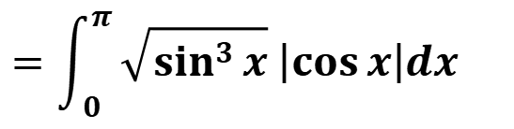
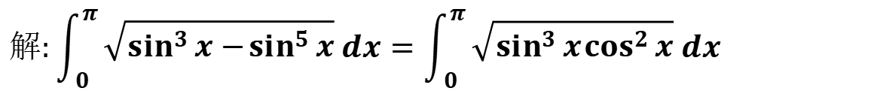
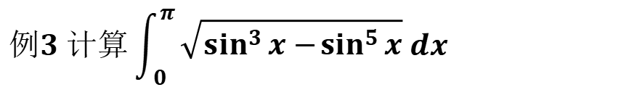
$$例3 计算\int_{0}^{π}{\sqrt{\sin^{3}{x}−\sin^{5}{x}} dx}$$
$$解:\int_{0}^{π}{\sqrt{\sin^{3}{x}−\sin^{5}{x}} dx}=\int_{0}^{π}{\sqrt{\sin^{3}{x}\cos^{2}{x}} dx}$$
$$=\int_{0}^{π}{\sqrt{\sin^{3}{x}} \left|\cos{x}\right|dx}$$
$$当x∈[0,\frac{π}{2}]时，\cos{x}>0;$$
$$当x∈[\frac{π}{2},π]时,\cos{x}<0$$
$$故有\int_{0}^{π}{\sqrt{\sin^{3}{x}} \left|\cos{x}\right|dx}=\int_{0}^{\frac{π}{2}}{\sqrt{\sin^{3}{x}} \cos{x}dx}−\int_{\frac{π}{2}}^{π}{\sqrt{\sin^{3}{x}} \cos{x}dx}$$
$$=\frac{2}{5}\sin^{\frac{5}{2}}{x\left| _{0}^{\begin{aligned}\frac{π}{2} \\ \end{aligned}}\right.}−\frac{2}{5}\sin^{\frac{5}{2}}{x}\left| _{\frac{π}{2}}^{\begin{aligned}π \\ \end{aligned}}\right.=\frac{2}{5}−(−\frac{2}{5})=\frac{4}{5}$$

Slide 12

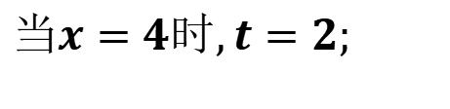
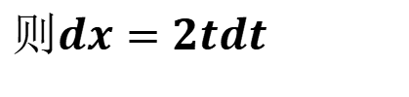
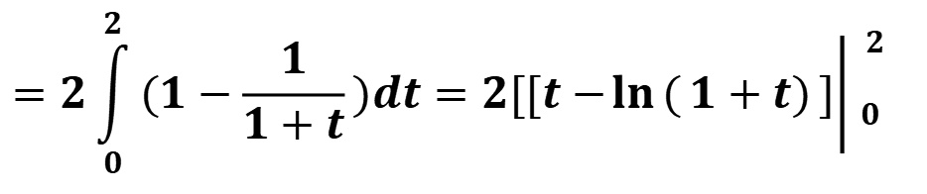
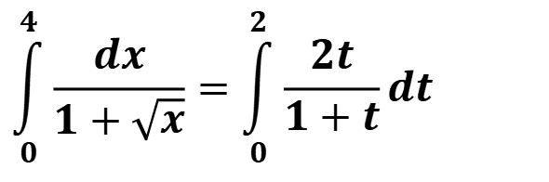




$$例4.{}_{}^{}计算\int_{0}^{4}{\frac{dx}{1+\sqrt{x}}}$$
$$解:令x=t^{2},$$
$$则dx=2tdt$$
$$当x=0时,t=0;$$
$$当x=4时,t=2;$$
$$\int_{0}^{4}{\frac{dx}{1+\sqrt{x}}}=\int_{0}^{2}{\frac{2t}{1+t}dt}$$
$$所以$$
$$=2\int_{0}^{2}{(1−\frac{1}{1+t})dt=2[[t−\ln{(}1+t)}]{\left| _{0}^{\begin{aligned}2 \\ \end{aligned}}\right.}_{ }$$
$$=2(2−\ln{3})$$

Slide 13













$$例5:证明$$
$$(1) 若f(x)在[a,b]上连续且为偶函数，$$
$$\int_{−a}^{a}{f(x)dx}=2\int_{0}^{a}{f(x)dx}$$
$$则$$
$$则 \int_{−a}^{a}{f(x)dx}=0$$
$$(2)\underset{}{}若f(x)在[a,b]上连续且为奇函数,$$
$$因为\int_{−a}^{a}{f(x)dx}=\int_{−a}^{0}{f(x)dx}+\int_{0}^{a}{f(x)dx}$$
$$证:$$
$$对积分\int_{−a}^{0}{f(x)dx}作代换,x=−t,则得$$
$$\int_{−a}^{0}{f(x)dx}=−\int_{a}^{0}{f(−t)dt}=\int_{0}^{a}{f(−t)dt}=\int_{0}^{a}{f(−x)dx}$$
$$\int_{−a}^{a}{f(x)dx}=\int_{0}^{a}{f(−x)dx}+\int_{0}^{a}{f(x)dx}$$
$$=\int_{0}^{a}{[f(x)+f(−x)]dx}$$
$$于是$$

Slide 14










$$\int_{−a}^{a}{f(x)dx}=\int_{0}^{a}{[f(x)+f(−x)]dx}$$
$$(1)\underset{}{}若f(x)为偶函数,$$
$$即f(−x)=f(x),$$
$$从而\int_{−a}^{a}{f(x)dx}=2\int_{0}^{a}{f(x)dx}$$
$$则$$
$$f(x)+f(−x)=2f(x)$$
$$(2)\underset{}{}若f(x)为奇函数,即f(−x)=−f(x),$$
$$从而\int_{−a}^{a}{f(x)dx}=0$$
$$则$$
$$f(x)+f(−x)=0$$

Slide 15










$$例6\underset{}{}若f(x)在[0,1]上连续，$$
$$证明:$$
$$(1)\int_{0}^{\frac{π}{2}}{f(\sin{x})dx}=\int_{0}^{\frac{π}{2}}{f(\cos{x})dx}$$
$$\int_{0}^{π}{\frac{x\sin{x}}{1+\cos^{2}{x}}}dx$$
$$(2)\int_{0}^{π}{xf(\sin{x})dx}=\frac{π}{2}\int_{0}^{π}{f(\sin{x})dx},$$
$$由此计算$$
$$证:(1)\underset{}{}设x=\frac{π}{2}−t,则dx=−dt,$$
$$当x=0时,t=\frac{π}{2};当x=\frac{π}{2}时,t=0$$
$$\int_{0}^{\frac{π}{2}}{f(\sin{x})dx}=−\int_{\frac{π}{2}}^{0}{f[\sin{(}\frac{π}{2}−t)]dt}$$
$$=\int_{0}^{\frac{π}{2}}{f(\cos{t})dt}=\int_{0}^{\frac{π}{2}}{f(\cos{x})dx}$$

Slide 16












$$(2)设\underset{}{}x=π−t,则dx=−dt,$$
$$当x=0时,t=π,当x=π时,t=0.$$
$$\int_{0}^{π}{xf(\sin{x})dx}=−\int_{π}^{0}{(π−t)f(\sin{(}π−t))dt}$$
$$于是$$
$$=\int_{0}^{π}{(π−t)f(\sin{t})dt}$$
$$=π\int_{0}^{π}{f(\sin{t})dt}−\int_{0}^{π}{tf(\sin{t})dt}$$
$$=π\int_{0}^{π}{f(\sin{x})dx}−\int_{0}^{π}{xf(\sin{x})d}x$$
$$所以\int_{0}^{π}{xf(\sin{x})dx}=\frac{π}{2}\int_{0}^{π}{f(\sin{x})dx}$$
$$\int_{0}^{π}{\frac{x\sin{x}}{1+\cos^{2}{x}}}dx=\frac{π}{2}\int_{0}^{π}{\frac{\sin{x}}{1+\cos^{2}{x}}}dx$$
$$=−\frac{π}{2}\int_{0}^{π}{\frac{d\cos{x}}{1+\cos^{2}{x}}}$$
$$利用上述结论，即得$$
$$=−\frac{π}{2}[\arctan{(}\cos{x})]\left| _{0}^{\begin{aligned}π \\ \end{aligned}}\right.$$
$$=−\frac{π}{2}(−\frac{π}{4}−\frac{π}{4})=\frac{π^{2}}{4}$$

Slide 17










二.定积分的分布积分法
$$设函数u(x),v(x)在区间[a,b]上具有连续导数$$
$$u^{′}(x),v^{′}(x),$$
$$则有$$
$$(uv)^{′}=u^{′}v+uv^{′}$$
$$分别求这等式两端在[a,b]上的定积分,$$
$$\int_{a}^{b}{(uv)^{′}dx}=\int_{a}^{b}{[u^{′}v+uv^{′}]}dx$$
$$[uv]\left| _{a}^{\begin{aligned}b \\ \end{aligned}}\right.=\int_{a}^{b}{u^{′}vdx}+\int_{a}^{b}{uv^{′}dx}$$
$$=\int_{a}^{b}{vdu}+\int_{a}^{b}{udv}$$
$$得$$
$$\int_{a}^{b}{udv=[uv]\left| _{a}^{\begin{aligned}b \\ \end{aligned}}\right.−\int_{a}^{b}{vdu}}$$
$$移项,$$
$$这就是定积分的分布积分公式$$

Slide 18












$$(1)\int_{0}^{π}{x\sin{x}dx}$$
$$例7. 计算下列定积分$$
$$解：$$
$$设u=x,$$
$$dv=\sin{x}dx=d(−\cos{x}),$$
$$\int_{0}^{π}{x\sin{x}dx}=\int_{0}^{π}{xd(−\cos{x})}$$
$$则$$
$$=−x\cos{x}\left| _{\begin{aligned} \\ 0\end{aligned}}^{π}\right.−\int_{0}^{π}{(−\cos{x})dx}$$
$$=π+\sin{x}\left| _{\begin{aligned} \\ 0\end{aligned}}^{π}\right.=π$$
$$(2)\int_{1}^{e}{\ln{x}dx}$$
$$=x\ln{x}\left| _{\begin{aligned} \\ 1\end{aligned}}^{e}\right.−\int_{1}^{e}{x∙\frac{1}{x}}dx$$
$$=e−x\left| _{\begin{aligned} \\ 1\end{aligned}}^{e}\right.=1$$

Slide 19





$$(3){ J}_{n}=\int_{0}^{\frac{π}{2}}{\sin^{n}{x}dx}$$
$$=\int_{0}^{\frac{π}{2}}{\sin^{n−1}{x}d(−\cos{x})}$$
$$=−\cos{x}\sin^{n−1}{x}\left| _{\begin{aligned} \\ 0\end{aligned}}^{π}\right.+\int_{0}^{\frac{π}{2}}{(n−1)}\sin^{n−2}{x}\cos^{2}{x}dx$$
$$=(n−1)\int_{0}^{\frac{π}{2}}{\sin^{n−2}{x}(1−\sin^{2}{x})dx=(n−1)J_{n−2}}−(n−1)J_{n}$$
$$J_{n}=\frac{n−1}{n}J_{n−2}$$

Slide 20





$$J_{n}=\frac{n−1}{n}J_{n−2}$$
$$\frac{(n−1)(n−3)(n−5)⋯2}{n(n−2)(n−4)⋯3}J_{1}{}_{}^{}n为奇数$$
$$∴\int_{0}^{\frac{π}{2}}{\sin^{n}xdx{ }}=\int_{0}^{\frac{π}{2}}{\cos^{n}xdx{ }}=\left\{\begin{aligned}& \\ & \\ & \\ &\end{aligned}\right.$$
$$\frac{(n−1)(n−3)(n−5)⋯3⋅1}{n(n−2)(n−4)⋯4⋅2}J_{0}{}_{}^{}n为偶数$$
$$J_{0}=\int_{0}^{\frac{π}{2}}{\sin^{0}{x}dx}=\frac{π}{2}$$
$$J_{1}=\int_{0}^{\frac{π}{2}}{\sin{x}dx}=1,$$

Slide 21



例如
$$\int_{0}^{\frac{π}{2}}{\cos^{5}{x}}dx=\frac{(5−1)(5−3)}{5(5−2)}=\frac{8}{15}$$
$$\int_{0}^{\frac{π}{2}}{\sin^{8}{x}}dx=\frac{(8−1)(8−3)(8−5)(8−7)}{8(8−2)(8−4)(8−6)}\frac{π}{2}$$
$$=\frac{105}{384}⋅\frac{π}{2}$$

