Slide 1
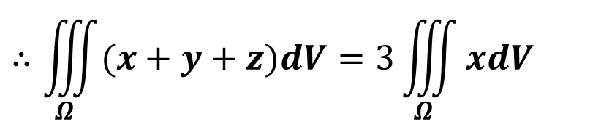
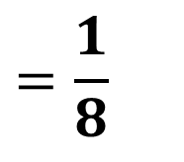
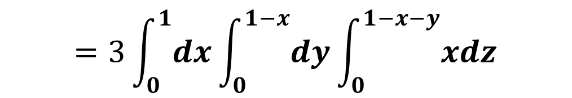
习题9.4
2. 计算下列三重积分：
(1). $\iiint_{Ω}{(x+y+z)dV}$, $Ω$是由平面x+y+z=1与三个坐标面围成
解
由对称性知
$$∴\iiint_{Ω}{(x+y+z)dV}=3\iiint_{Ω}{xdV}$$
$$=3\int_{0}^{1}{dx}\int_{0}^{1−x}{dy}\int_{0}^{1−x−y}{xdz}$$
$$=\frac{1}{8}$$

Slide 2
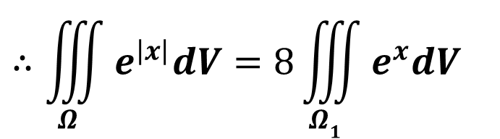
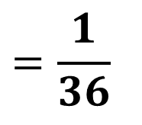

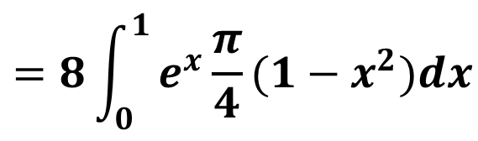
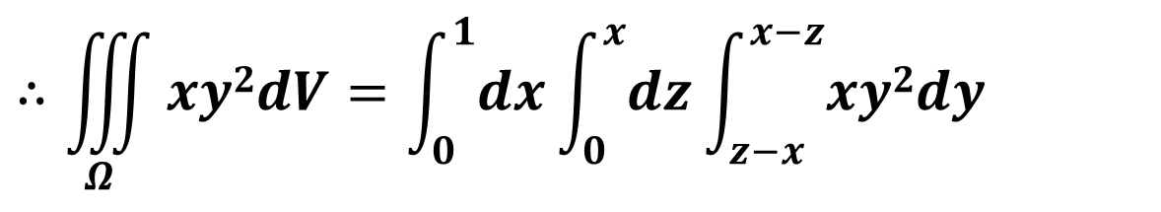
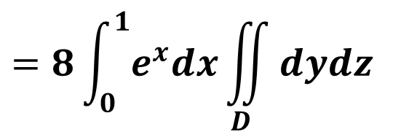
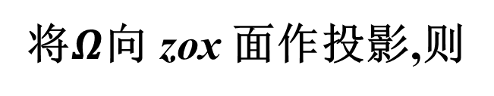
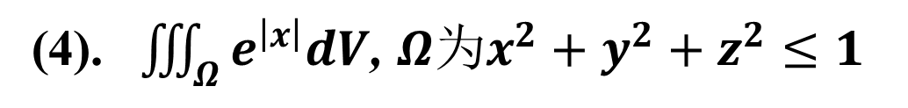
2. 计算下列三重积分：
(3). $\iiint_{Ω}{xy2dV}$, $Ω$是由平面z=0, x+y-z=0, x-y-z=0及 x=1围成
解
将$Ω$向 zox 面作投影,则
$$Ω:0≤x≤1,0≤z≤x, z−x≤y≤x−z$$
$$∴\iiint_{Ω}{xy2dV}=\int_{0}^{1}{dx}\int_{0}^{x}{dz}\int_{z−x}^{x−z}{xy2dy}$$
$$=\frac{1}{36}$$
(4). $\iiint_{Ω}{e^{\left|x\right|}dV}$, $Ω为x^{2}+y^{2}+z^{2}≤1$
$$∴\iiint_{Ω}{e^{\left|x\right|}dV}=8\iiint_{Ω1}{e^{x}dV}$$
$$=8\int_{0}^{1}{e^{x}dx}\iint_{D}{dydz}$$
解
由对称性知
$$=8\int_{0}^{1}{e^{x}\frac{π}{4}(1−x^{2})dx}$$
$$=2π$$

Slide 3
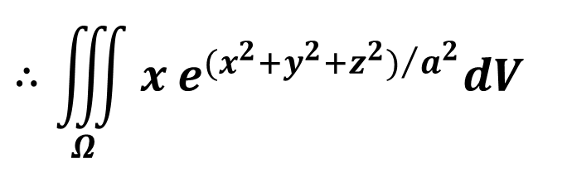

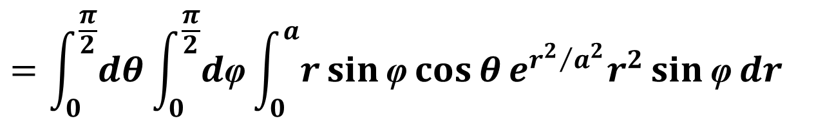
4. 利用柱面坐标或球面坐标变换，计算下列三重积分：
(4). $\iiint_{Ω}{x^{ }e^{{(x^{2}+y^{2}+z^{2})}/{a^{2}}}dV}$, $Ω为x^{2}+y^{2}+z^{2}≤a^{2}$, x≥0, y≥0, z≥0,
解
由球面坐标变换知
$$∴\iiint_{Ω}{x^{ }e^{{(x^{2}+y^{2}+z^{2})}/{a^{2}}}dV}$$
$$=\int_{0}^{\frac{π}{2}}{dθ}\int_{0}^{\frac{π}{2}}{d\text{φ}}\int_{0}^{a}{r\sin{\text{φ}}cos{θ}e^{{r^{2}}/{a^{2}}}r^{2}\sin{\text{φ}}dr}$$
$$=\frac{π}{8}a^{4}$$

Slide 4
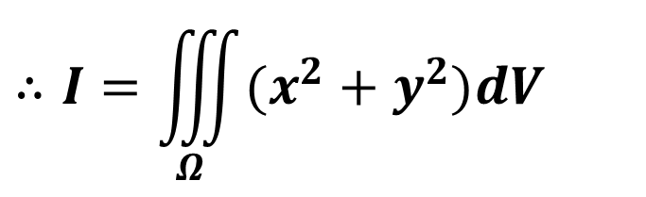
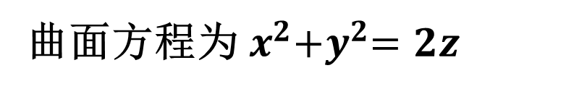
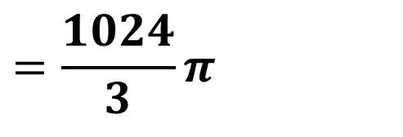
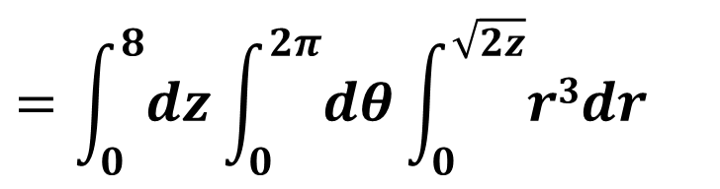
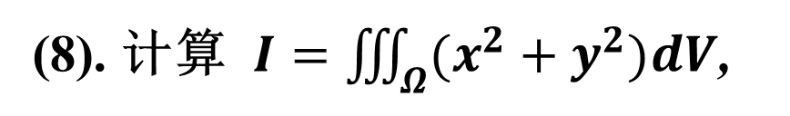
(8). 计算 $I=\iiint_{Ω}{(x^{2}+y^{2})dV}$,
其中$Ω为$由$\left\{\begin{aligned}y^{2}=2z \\ x=0\end{aligned}\right.$ 绕$z$轴旋转一周形成的曲面与z=8所围成的区域
解
曲面方程为 $x^{2}{+y}^{2}=2z$
$$∴I=\iiint_{Ω}{(x^{2}+y^{2})dV}$$
8
$$=\int_{0}^{8}{dz}\int_{0}^{2π}{dθ}\int_{0}^{\sqrt{2z}}{r3dr}$$
$$=\frac{1024}{3}π$$

Slide 5
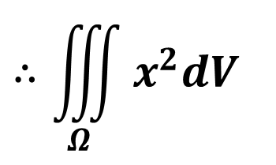
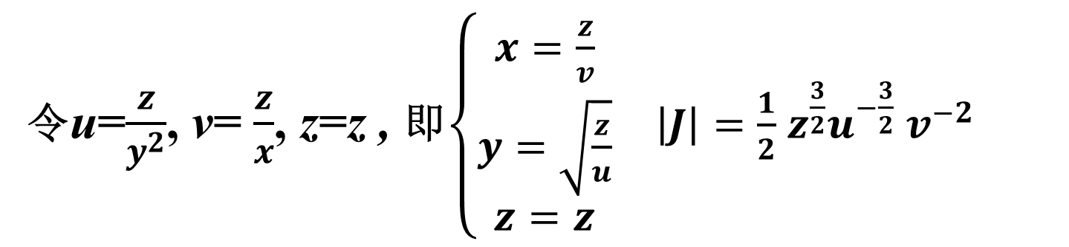
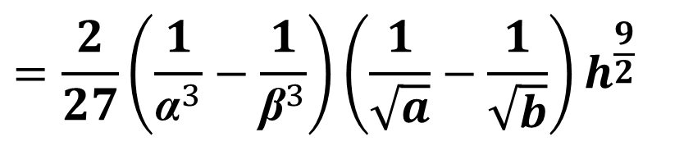
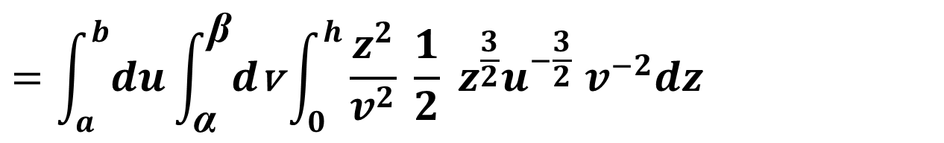
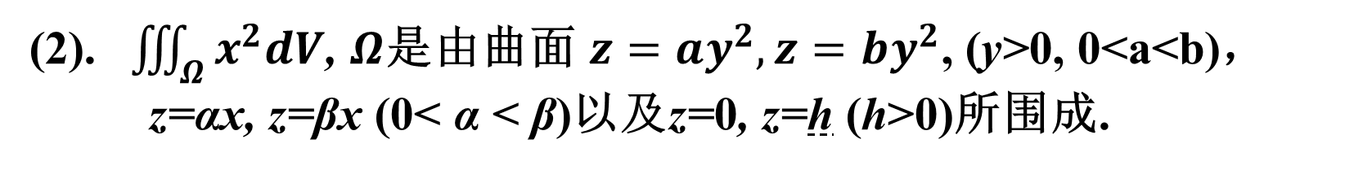
5. 作适当的变量代换，计算下列三重积分：
(2). $\iiint_{Ω}{x^{2}dV}$, $Ω\text{是由曲面} z=ay^{2},z=by^{2}$, (y>0, 0<a<b)，
z=αx, z=βx (0< α < β)以及z=0, z=h (h>0)所围成.
令u=$\frac{z}{y^{2}}$, v= $\frac{z}{x}$, z=z , 即$\left\{\begin{aligned}\begin{aligned}x=\frac{z}{v} \\ y=\sqrt{\frac{z}{u}}\end{aligned} \\ z=z\end{aligned}\right.$ $\left|J\right|=\frac{1}{2}$ $z^{\frac{3}{2}}u^{−\frac{3}{2}}$ $v^{−2}$
解
$$∴\iiint_{Ω}{x^{2}dV}$$
$$=\int_{a}^{b}{du}\int_{\text{α}}^{\text{β}}{d\text{v}}\int_{0}^{h}{\frac{z^{2}}{v^{2}} \frac{1}{2} z^{\frac{3}{2}}u^{−\frac{3}{2}} v^{−2}dz}$$
$$=\frac{2}{27}{\left(\frac{1}{{\text{α}}^{3}}−\frac{1}{{\text{β}}^{3}}\right)\left(\frac{1}{\sqrt{a}}−\frac{1}{\sqrt{b}}\right)h}^{\frac{9}{2}}$$

Slide 6
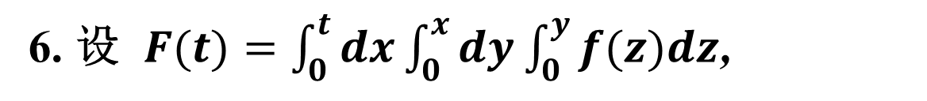
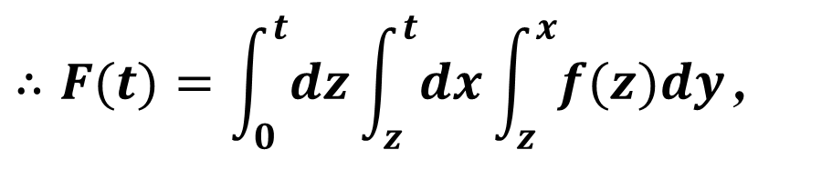
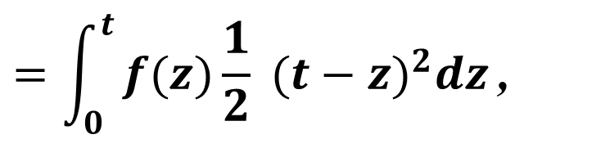
6. 设 $F(t)=\int_{0}^{t}{dx}\int_{0}^{x}{dy}\int_{0}^{y}{f(z)dz}$,
其中f(z) 连续，
试把F(t) 化成对z的定积分，并求F'''(t)
解：
积分区域如图
交换积分次序
$$∴F(t)=\int_{0}^{t}{dz}\int_{z}^{t}{dx}\int_{z}^{x}{f(z)dy}\text{,}$$
t
$$=\int_{0}^{t}{f(z)\frac{1}{2} {(t−z)}^{2}dz}\text{,}$$
由原式可得 F'''(t) = f(t)

Slide 7
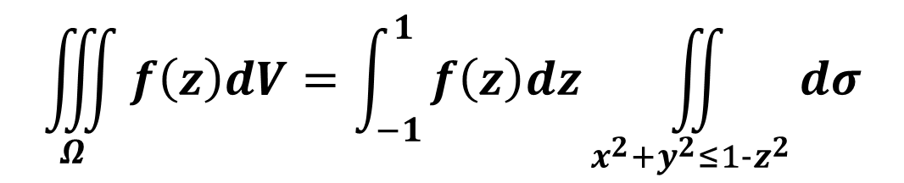
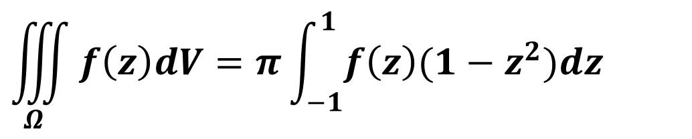
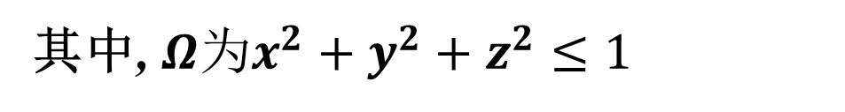
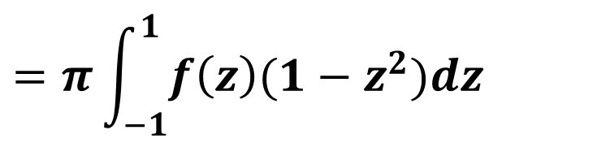
7. 设f(z) 在[-1,1]连续, 证明：
$$\iiint_{Ω}{f\left(z\right)dV=π\int_{−1}^{1}{f\left(z\right)(1−z^{2})dz}}$$
其中, $Ω为x^{2}+y^{2}+z^{2}≤1$
证明：
区域z轴投影知
$$\iiint_{Ω}{f\left(z\right)dV=\int_{−1}^{1}{f\left(z\right)dz\iint_{x^{2}+y^{2}≤1−z^{2}}^{ }{dσ}}}$$
$$=π\int_{−1}^{1}{f\left(z\right)(1−z^{2})dz}$$

Slide 8
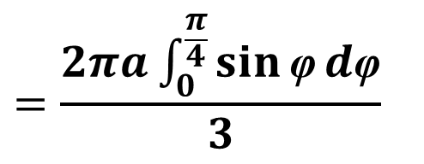
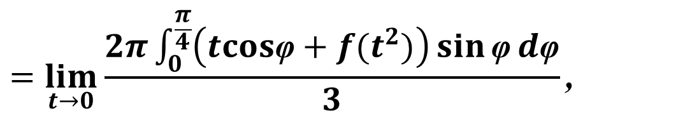
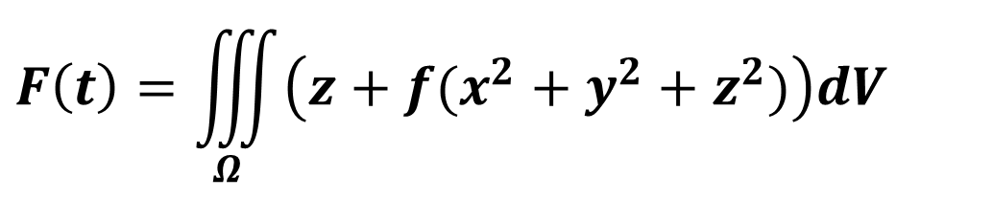
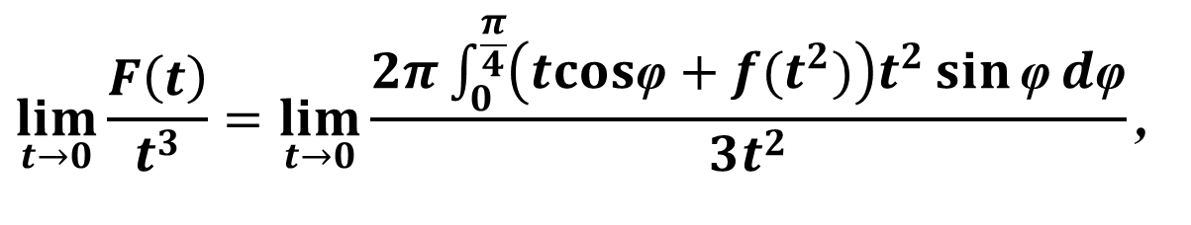
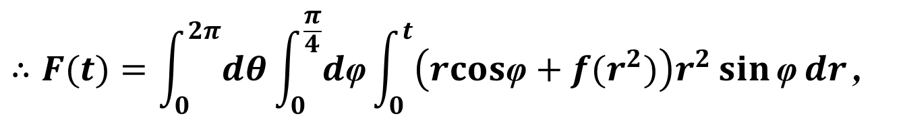
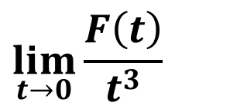
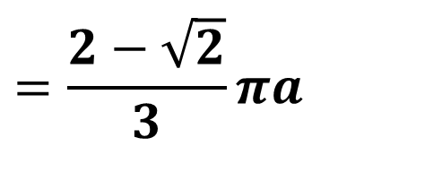
8. 设f(x) 连续, f(0)=a
$$F\left(t\right)=\iiint_{Ω}{\left(z+f(x^{2}+y^{2}+z^{2})\right)dV}$$
$$\lim_{t→0}{\frac{F\left(t\right)}{t^{3}}}$$
其中, $Ω为0≤z≤\sqrt{t^{2}{−x}^{2}−y^{2}}$及 z ≥$\sqrt{x^{2}+y^{2}}$
求
$$∴F(t)=\int_{0}^{2π}{dθ}\int_{0}^{\frac{π}{4}}{d\text{φ}}\int_{0}^{t}{\left(rcos\text{φ}+f(r^{2})\right)r^{2}\sin{\text{φ}}dr}\text{,}$$
解：
$$\lim_{t→0}{\frac{F\left(t\right)}{t^{3}}}=\lim_{t→0}{\frac{2π\int_{0}^{\frac{π}{4}}{\left(tcos\text{φ}+f(t^{2})\right)t^{2}\sin{\text{φ}}d\text{φ}}}{3t^{2}}}\text{,}$$
$$=\lim_{t→0}{\frac{2π\int_{0}^{\frac{π}{4}}{\left(tcos\text{φ}+f(t^{2})\right)\sin{\text{φ}}d\text{φ}}}{3}}\text{,}$$
$$=\frac{2πa\int_{0}^{\frac{π}{4}}{\sin{\text{φ}}d\text{φ}}}{3}$$
$$=\frac{2−\sqrt{2}}{3}πa$$

Slide 9
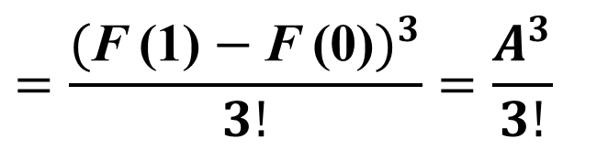
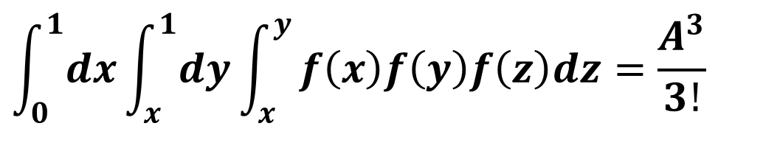
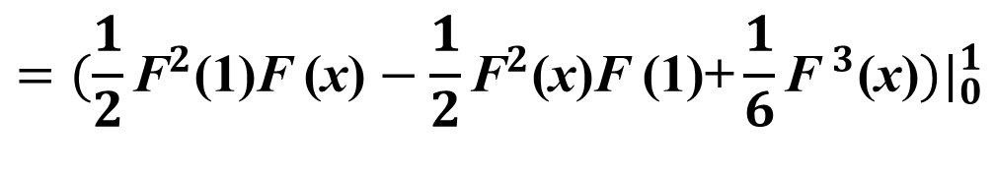
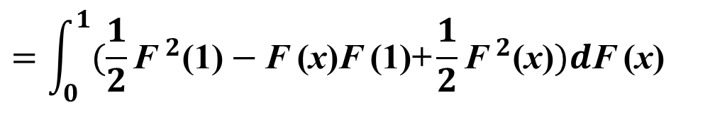
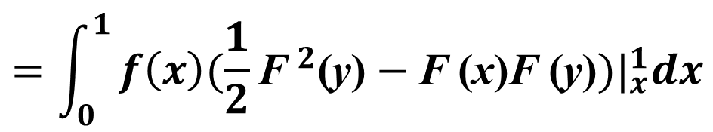
9. 设f(x) 在[0,1]连续, $\int_{0}^{1}{f\left(x\right)dx=A, }$证明：
$$\int_{0}^{1}{dx}\int_{x}^{1}{dy}\int_{x}^{y}{f\left(x\right)f\left(y\right)f\left(z\right)dz=\frac{A^{3}}{3!}}$$
证明：
令F'(x) = f(x)
$$\int_{0}^{1}{dx}\int_{x}^{1}{dy}\int_{x}^{y}{f\left(x\right)f\left(y\right)f\left(z\right)dz=\int_{0}^{1}{dx}\int_{x}^{1}{f\left(x\right)f\left(y\right)(\text{F} \text{(}\text{y}\text{)}\text{−}\text{F} \text{(}\text{x}\text{)})dy}}$$
$$=\int_{0}^{1}{f\left(x\right){(\frac{1}{2}{\text{F} }^{2}\text{(}\text{y}\text{)}−\text{F} \text{(}\text{x}\text{)}\text{F} \text{(}\text{y}\text{)})|}_{x}^{1}dx}$$
$$=\int_{0}^{1}{(\frac{1}{2}{\text{F} }^{2}\text{(1)}−\text{F} \text{(}\text{x}\text{)}\text{F} \text{(1)}\text{+}\frac{1}{2}{\text{F} }^{2}\text{(}\text{x}\text{)})d\text{F} \text{(}\text{x}\text{)}}$$
$$={(\frac{1}{2}{\text{F}}^{2}\text{(1)}\text{F} \text{(}\text{x}\text{)}−\frac{1}{2}{\text{F}}^{2}\text{(}\text{x}\text{)}\text{F} \text{(1)+}\frac{1}{6}{\text{F} }^{3}\text{(}\text{x}\text{)})|}_{0}^{1}$$
$$=\frac{{(\text{F} \text{(1)}−\text{F} \text{(}\text{0}\text{)})}^{3}}{3!}=\frac{A^{3}}{3!}$$

Slide 10
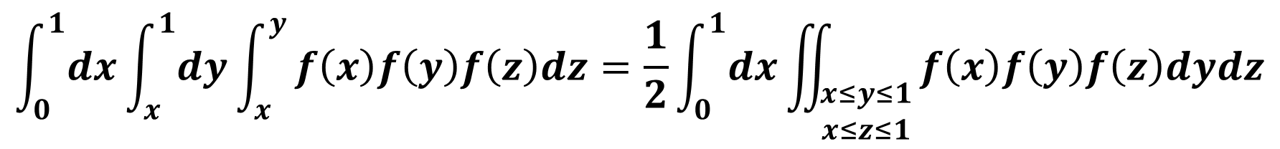
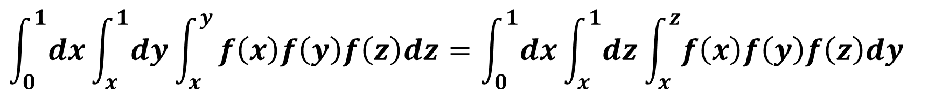
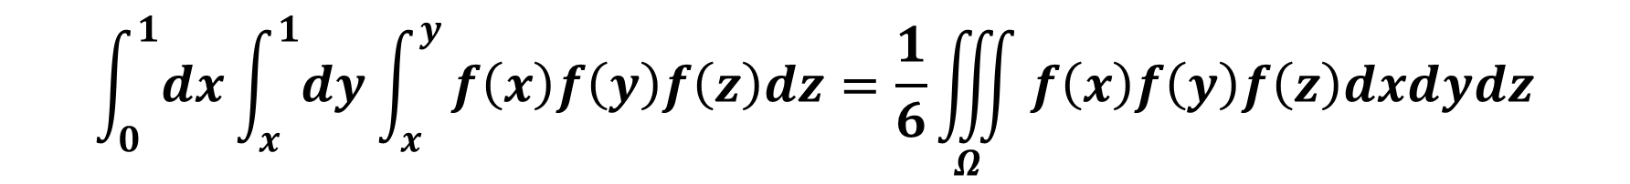
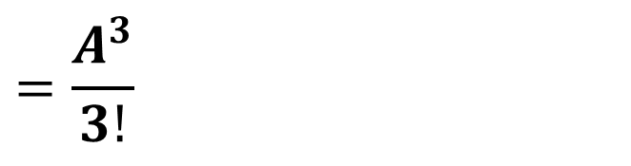
另法：
1
$$\int_{0}^{1}{dx}\int_{x}^{1}{dy}\int_{x}^{y}{f\left(x\right)f\left(y\right)f\left(z\right)dz=\int_{0}^{1}{dx}\int_{x}^{1}{dz}\int_{x}^{z}{f\left(x\right)f\left(y\right)f\left(z\right)dy}}$$
$$\int_{0}^{1}{dx}\int_{x}^{1}{dy}\int_{x}^{y}{f\left(x\right)f\left(y\right)f\left(z\right)dz=\frac{1}{2}\int_{0}^{1}{dx}\iint_{\begin{aligned}x≤y≤1 \\ x≤z≤1\end{aligned}}^{ }{f\left(x\right)f\left(y\right)f\left(z\right)dydz}}$$
$$\int_{0}^{1}{dx}\int_{x}^{1}{dy}\int_{x}^{y}{f\left(x\right)f\left(y\right)f\left(z\right)dz=\frac{1}{6}\iiint_{Ω}^{ }{f\left(x\right)f\left(y\right)f\left(z\right)dxdydz}}$$
$$=\frac{A^{3}}{3!}$$

Slide 11
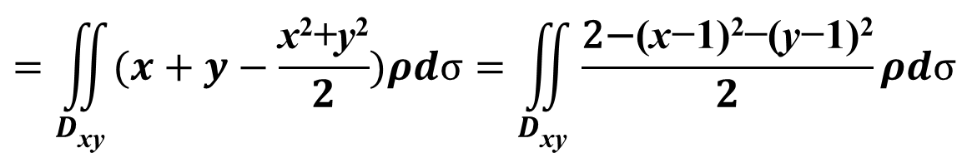
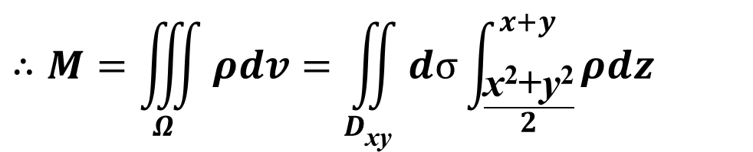
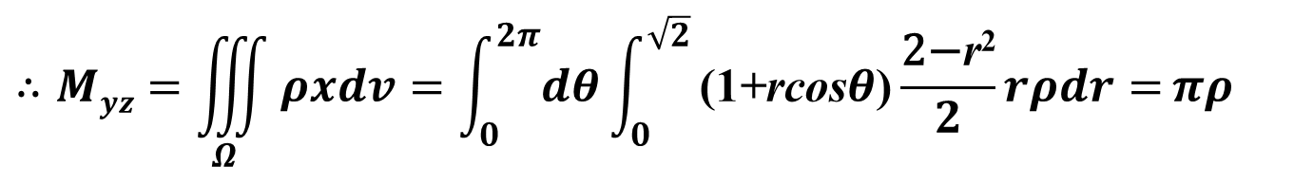
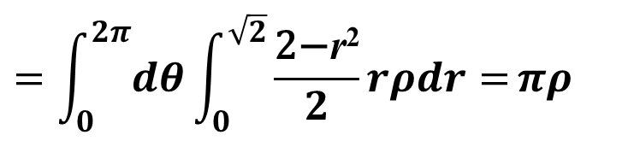
习题9.5
2. 求下列曲面所包围的均匀物体的质心：
(2). x²+y²=2z , x+y=z
解
在xy面上的投影D_{xy}: (x-1)²+(y-1)² ≤ 2
$$∴M=\iiint_{Ω}{ρdv}=\iint_{D\text{xy}}{dσ\int_{\frac{\text{x}\text{2}\text{+}\text{y}\text{2}}{2}}^{x+y}{ρdz}}$$
$$=\iint_{D\text{xy}}{(x+y−\frac{\text{x}\text{2}\text{+}\text{y}\text{2}}{2})ρdσ=\iint_{D\text{xy}}{\frac{\text{2−}\text{(}\text{x}\text{−}\text{1)}\text{2}\text{−(}\text{y}\text{−}\text{1)}\text{2}}{2}ρdσ}}$$
$$=\int_{0}^{2π}{dθ}\int_{0}^{\sqrt{2}}{\frac{\text{2−}\text{r}\text{2}}{2}rρdr=}πρ$$
$$∴Myz=\iiint_{Ω}{ρxdv}=\int_{0}^{2π}{dθ}\int_{0}^{\sqrt{2}}{\text{(}\text{1}\text{+}\text{rcos}θ\text{)}\frac{\text{2−}\text{r}\text{2}}{2}rρdr=}πρ$$

Slide 12





同理：
$$∴Mzx=\iiint_{Ω}{ρydv}=\int_{0}^{2π}{dθ}\int_{0}^{\sqrt{2}}{\text{(}\text{1}\text{+}\text{rsin}θ\text{)}\frac{\text{2−}\text{r}\text{2}}{2}rρdr=}πρ$$
$$∴Mxy=\iiint_{Ω}{ρzdv}=\iint_{D\text{xy}}{dσ\int_{\frac{\text{x}\text{2}\text{+}\text{y}\text{2}}{2}}^{x+y}{ρzdz}}$$
$$=\iint_{D\text{xy}}{(\frac{\text{(}x+y\text{)}\text{2}}{2} −\frac{\text{(}\text{x}\text{2}\text{+}\text{y}\text{2}\text{)}\text{2}}{2∙4})ρdσ}$$
利用平方差公式：
$$=\int_{0}^{2π}{dθ}\int_{0}^{\sqrt{2}}{\frac{\text{2−}\text{r}\text{2}}{4}(\frac{\text{r}\text{2}}{2}+3)rρdr=\frac{\text{5}}{3}}πρ$$
$$\bar{x}=\bar{y}=1;\bar{z}=\frac{\text{5}}{3}$$

Slide 13





4. 求闭曲线(x²+y²)³ = a² (x⁴+y⁴)所围图形的面积(a>0)
解
闭曲线的极坐标形式为:
r²=a²(cos⁴$θ$+ sin⁴$θ$) = a²(1-2cos²$θ$sin²$θ$)
=a²(1- $\frac{\text{1}}{\text{2}}$sin²2$θ$) =a²($\frac{\text{3}}{\text{4}}$+ $\frac{\text{1}}{\text{4}}$cos4$θ$)
$$S=\iint_{D}{dσ=\int_{0}^{2π}{dθ}\int_{0}^{\sqrt{\text{a}\text{2}\text{(}\frac{\text{3}}{\text{4}} \text{+} \frac{\text{1}}{\text{4}} \text{cos}\text{4}θ\text{)}}}{rdr}}$$
$$=\int_{0}^{2π}{\frac{\text{1}}{\text{2}}\text{a}\text{2}\text{(}\frac{\text{3}}{\text{4}} \text{+} \frac{\text{1}}{\text{4}} \text{cos}\text{4}θ\text{)}dθ}$$
$$=\frac{\text{3}}{\text{4}}π\text{a}\text{2}$$

Slide 14









9. 设由半径为R的球体，P₀是此球表面上的定点，球体上任一点的密度与该点到P₀距离的平方成正比(比例系数k>0), 求球体的质心坐标.
解:
设球面方程为: $x^{2}+y^{2}+z^{2}=R^{2}$ , P₀(R, 0, 0)
由对称性知$\bar{y}=\bar{z}=0$
$$∴M=\iiint_{Ω}{k({(x−R)}^{2}+y^{2}+z^{2})dv}$$
P₀
$$=\iiint_{Ω}{k\left(x^{2}+y^{2}+z^{2}\right)dv+\iiint_{Ω}{kR^{2}dv}}$$
$$=\frac{\text{3}2}{15}kπ\text{R}\text{5}$$
$$∴Myz=\iiint_{Ω}{xk({(x−R)}^{2}+y^{2}+z^{2})dv}$$
$$=−2kR\iiint_{Ω}{x^{2}dv}$$
$$=−\frac{2}{3}kR\iiint_{Ω}{\left(x^{2}+y^{2}+z^{2}\right)dv}$$
$$=−\frac{\text{8}}{15}kπ\text{R}\text{6}$$
$$\bar{x}=−\frac{\text{R}}{4}$$

Slide 15



补1. 化三重积分为累次积分：
I$=\iiint_{Ω}{f(\sqrt{x^{2}+y^{2}+z^{2}})dV}$,
$Ω$是由 z= $\sqrt{{3(x}^{2}+y^{2})}$, $x^{2}+y^{2}−y$=0, z=0围成
解:
将$Ω$向 xoy 面作投影, 利用柱面坐标得
$$∴\text{I}=\int_{0}^{π}{dθ}\int_{0}^{sinθ}{dr}\int_{0}^{\sqrt{3}r}{f(\sqrt{r^{2}+z^{2}})rdz}$$

Slide 16



补2. 计算：
I$=\iiint_{Ω}{z\sqrt{x^{2}+y^{2}}dV}$, $Ω$是由 y= $\sqrt{{2x−x}^{2}}$, $z$=0, z=a (a>0)围成
z
解:
将$Ω$向 zox 面作投影, 利用柱面坐标得
$$∴\text{I}=\int_{0}^{\frac{π}{2}}{dθ}\int_{0}^{2cosθ}{dr}\int_{0}^{a}{zr2dz}$$
y
O
1
x
$$=\frac{8}{9}a2$$

Slide 17



补3. 计算：
I$=\iiint_{Ω}{zdV}$,
$Ω$: $x^{2}+y^{2}+\left(z−a\right)2 ≤a2$, $x^{2}+y^{2}≤z2$
解:
将$Ω$向 xoy 面作投影, 利用柱面坐标得
$$∴\text{I}=\int_{0}^{2π}{dθ}\int_{0}^{\frac{π}{4}}{dφ}\int_{0}^{2acosφ}{rcosφr2sinφdr}$$
$$=\frac{7}{6}πa4$$

Slide 18




补4. 计算：
I$=\iiint_{Ω}{\left|\sqrt{x^{2}+y^{2}+z2}−1\right|dV}$, $Ω$: $z=\sqrt{x^{2}+y^{2}}$, $z=1$围成
解:
用$球面x^{2}+y^{2}+z2=1 将Ω$分成两部分
$$∴\text{I}=\int_{0}^{2π}{dθ}\int_{0}^{\frac{π}{4}}{dφ}\int_{0}^{1}{(1−r)r2sinφdr}$$
$$+\int_{\frac{1}{\sqrt{2}}}^{1}{dz}\int_{0}^{2π}{dθ}\int_{\sqrt{1−z^{2}}}^{z}{\left(\sqrt{r^{2}+z2}−1\right)rdr}$$
$$=\frac{\sqrt{2}−1}{6}π$$

