Slide 1
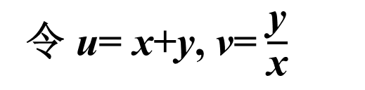
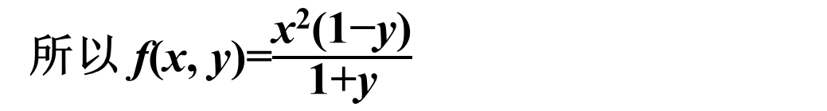
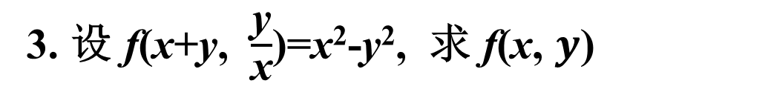
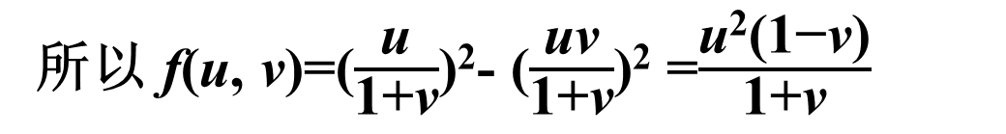
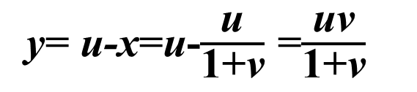
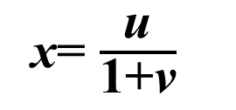
习题 8.1
3. 设 f(x+y, $\frac{\text{y}}{\text{x}}$)=x²-y², 求 f(x, $y$)
解:
令 u= x+y, v= $\frac{\text{y}}{\text{x}}$
则 y= xv
所以 u= x+xv,
x= $\frac{\text{u}}{\text{1}\text{+}\text{v}}$
y= u-x=u-$\frac{\text{u}}{\text{1+}\text{v}}$ =$\frac{\text{uv}}{\text{1+}\text{v}}$
所以 f(u, v)=($\frac{\text{u}}{\text{1+}\text{v}}$)²- ($\frac{\text{uv}}{\text{1+}\text{v}}$)² =$\frac{\text{u}\text{2}\text{(1−}\text{v}\text{)}}{\text{1+}\text{v}}$
所以 f(x, y)=$\frac{\text{x}\text{2}\text{(1−}\text{y}\text{)}}{\text{1+}\text{y}}$

Slide 2
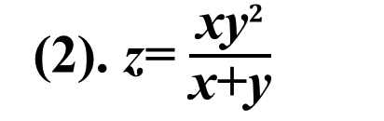
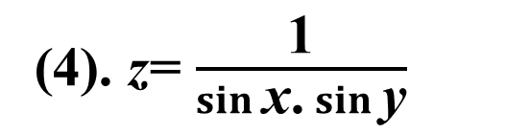
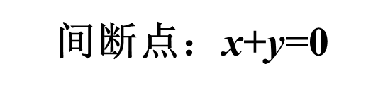
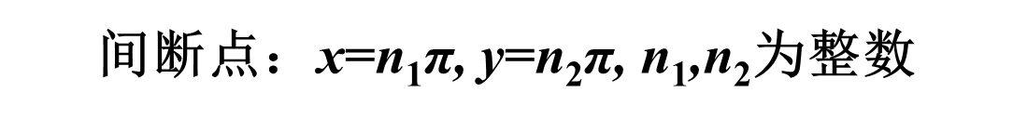
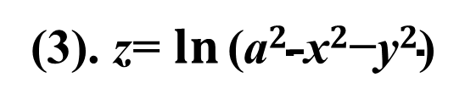
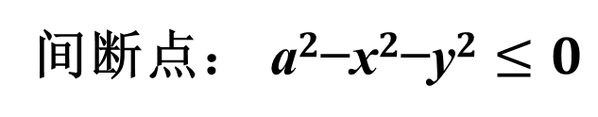
5. 求下列函数的间断点：
(2). z= $\frac{\text{xy}2}{\text{x}\text{+}\text{y}}$
间断点：$\text{x}\text{+}\text{y}$=0
间断点： $\text{a}2\text{−}\text{x}2\text{−}\text{y}2≤0$
(3). z= $\ln{\text{(}\text{a}2\text{−}\text{x}2\text{−}\text{y}2\text{)} }$
(4). z= $\frac{\text{1}}{\sin{\text{x}}\text{.}\sin{\text{y}}}$
间断点：$\text{x}$=n₁π, $\text{y}$=n₂π, n₁,n₂为整数

Slide 3
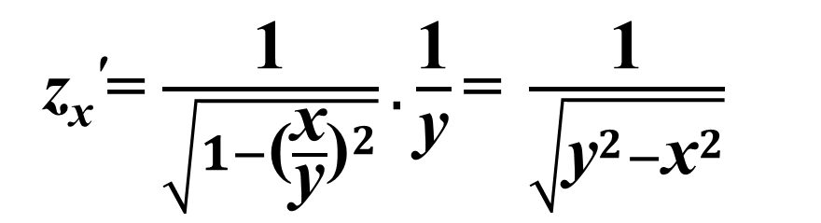
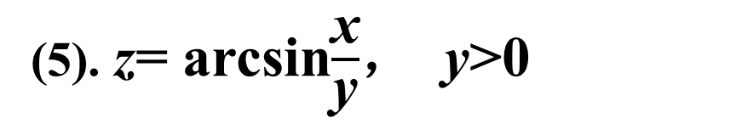
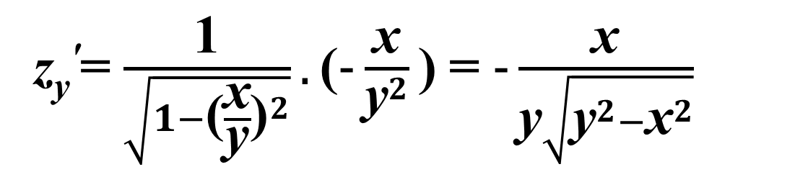
习题 8.2
2. 求下列函数的一阶偏导数：
(5). z= arcsin$\frac{\text{x}}{\text{y}}$， y>0
z_{x}'=$\frac{\text{1}}{\sqrt{1−{\text{(}\frac{\text{x}}{\text{y}}\text{)}}^{2}}}.\frac{\text{1}}{\text{y}}\text{=} \frac{\text{1}}{\sqrt{{\text{y}}^{2}−{\text{x}}^{2}}}$
解:
z_{y}'=$\frac{\text{1}}{\sqrt{1−{\text{(}\frac{\text{x}}{\text{y}}\text{)}}^{2}}}.\text{(}−\frac{\text{x}}{{\text{y}}^{2}}\text{)} \text{=} −\frac{\text{x}}{\text{y}\sqrt{{\text{y}}^{2}−{\text{x}}^{2}}}$

Slide 4
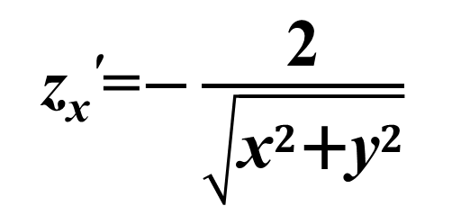
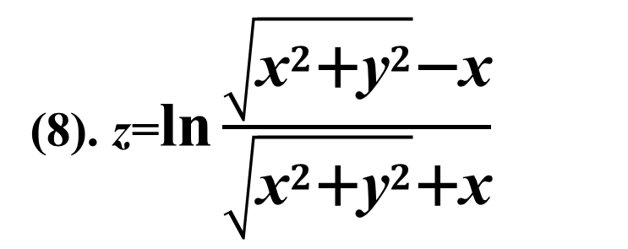
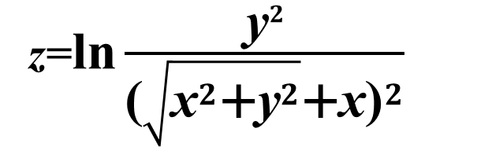
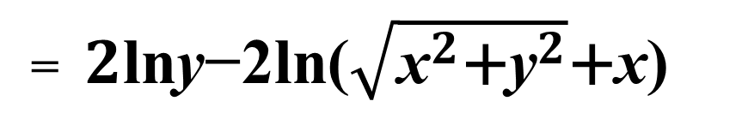
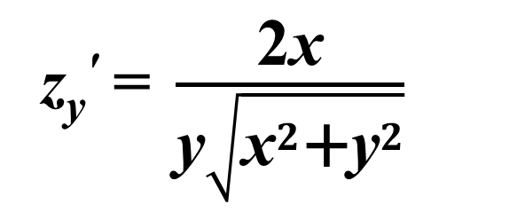
(8). z=$\text{ln}{\frac{\sqrt{{{\text{x}}^{2}\text{+}\text{y}}^{2}}\text{−}\text{x}}{\sqrt{{{\text{x}}^{2}\text{+}\text{y}}^{2}}\text{+}\text{x}}}$
z=$\text{ln}{\frac{\text{y}2}{{\text{(}\sqrt{{{\text{x}}^{2}\text{+}\text{y}}^{2}}\text{+}\text{x}\text{)}}^{2}}}$
解:
=${2\text{ln}\text{y}\text{−}\text{2}\text{ln}\text{(}\sqrt{{{\text{x}}^{2}\text{+}\text{y}}^{2}}\text{+}\text{x}\text{)}}$
z_{x}'=$−\frac{\text{2}}{\sqrt{{{\text{x}}^{2}\text{+}\text{y}}^{2}}}$
z_{y}'$\text{=} \frac{\text{2}\text{x}}{\text{y}\sqrt{{{\text{x}}^{2}\text{+}\text{y}}^{2}}}$

Slide 5
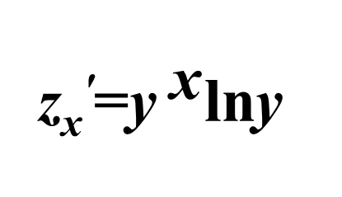
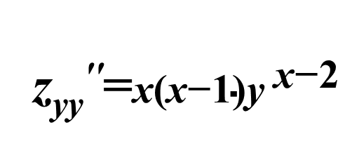
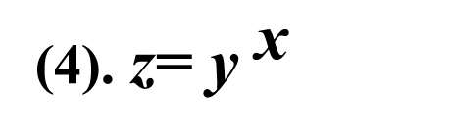
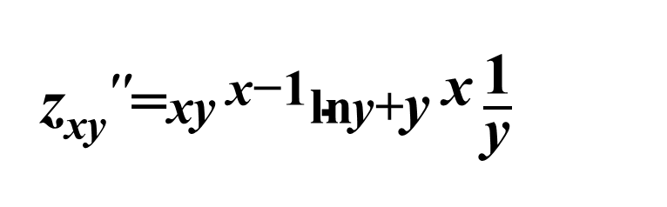
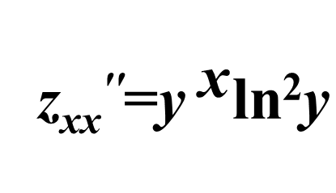
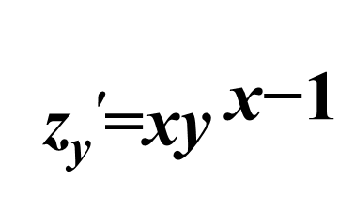
3. 求下列函数的二阶偏导数：
(4). z= ${\text{y} }^{\text{x}}$
z_{x}'=${\text{y}}^{ \text{x}}\text{ln}\text{y}$
z_{y}'=$\text{x}{\text{y}}^{ \text{x}\text{−}\text{1}}$
解:
z_{xx}''=${\text{y}}^{ \text{x}}\text{ln}\text{2}\text{y}$
z_{xy}''=$\text{x}{\text{y}}^{ \text{x}\text{−}\text{1}}\text{ln}\text{y}\text{+}{\text{y}}^{ \text{x}}\frac{\text{1}}{\text{y}}$
z_{yy}''=$\text{x}\text{(}\text{x}\text{−}\text{1}\text{)}{\text{y}}^{ \text{x}\text{−}\text{2}}$

Slide 6
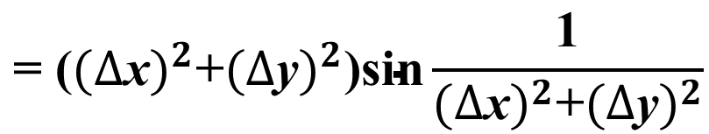

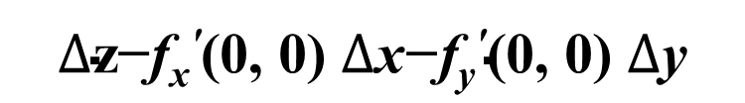
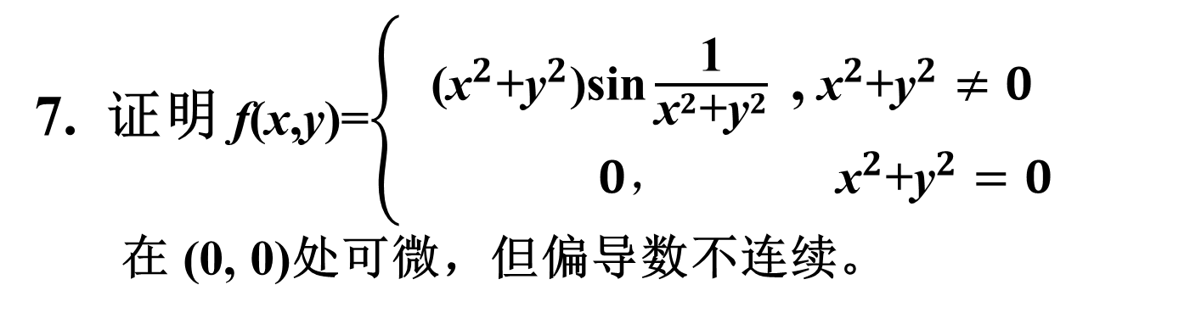
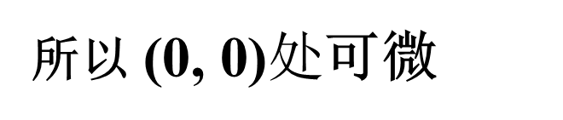
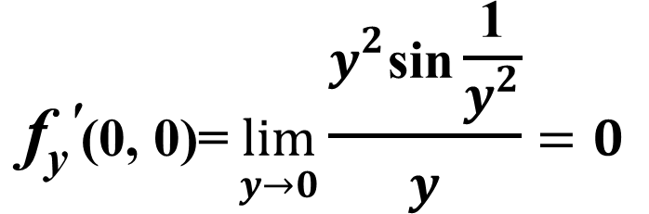
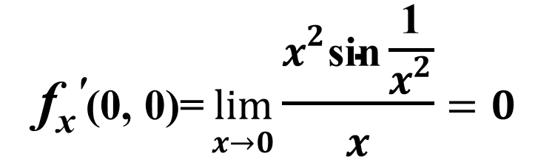
7. 证明 f(x,y)=$\left\{\begin{aligned} \text{(}{{\text{x}}^{2}\text{+}\text{y}}^{2}\text{)}\text{sin}\frac{\text{1}}{{{\text{x}}^{2}\text{+}\text{y}}^{2}}\text{ ,} {{ \text{x}}^{2}\text{+}\text{y}}^{2}≠0 \\ 0，{{ \text{x}}^{2}\text{+}\text{y}}^{2}=0\end{aligned}\right.$
在 $\text{(0, 0)}\text{处可微，但偏导数不连续}$。
解:
易知 $\text{(0}\text{, }\text{0)}\text{连续}$
$$\text{f}\text{x}\text{′}\text{(0, 0)=}\lim_{x→0}{\frac{x^{2}\text{sin}\frac{\text{1}}{x^{2}}}{x}=0}$$
$$\text{f}\text{y}\text{′}\text{(0, 0)=}\lim_{y→0}{\frac{y^{2}\text{sin}\frac{\text{1}}{y^{2}}}{y}=0}$$
$$∆\text{z}\text{−}\text{f}\text{x}\text{′}\text{(0, 0)} ∆\text{x}\text{−}\text{f}\text{y}\text{′}\text{(0, 0)} ∆\text{y}$$
$$\text{= (}{(∆\text{x})}^{2}\text{+}{(∆\text{y})}^{2}\text{)}\text{sin}\frac{\text{1}}{{(∆\text{x})}^{2}\text{+}{(∆\text{y})}^{2}}$$
$$\lim_{ρ→0}{\frac{∆\text{z}\text{−}\text{f}\text{x}\text{′}\text{(0, 0)} ∆\text{x}\text{−}\text{f}\text{y}\text{′}\text{(0, 0)} ∆\text{y}}{ρ}=\lim_{ρ→0}{\sqrt{{(∆\text{x})}^{2}\text{+}{(∆\text{y})}^{2}}\text{sin}\frac{\text{1}}{{(∆\text{x})}^{2}\text{+}{(∆\text{y})}^{2}}=0}}$$
所以 $\text{(0}\text{, }\text{0)}处$可微

Slide 7
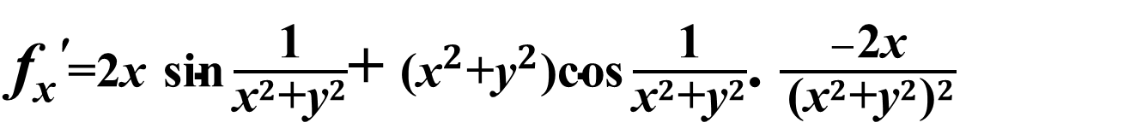
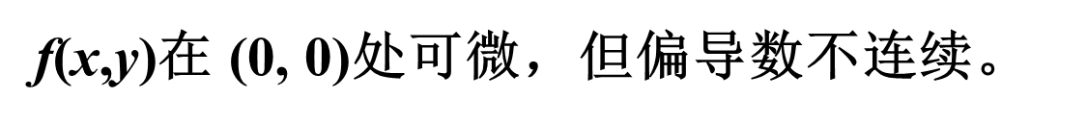

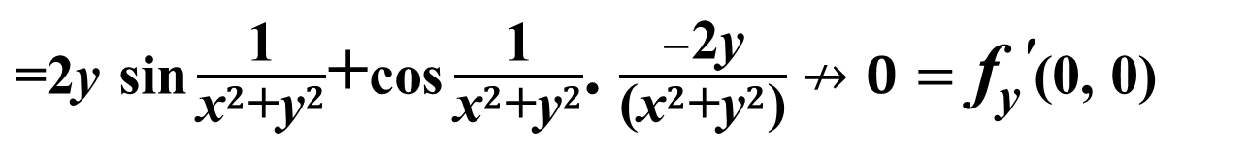
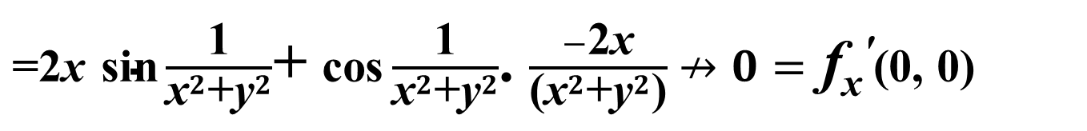
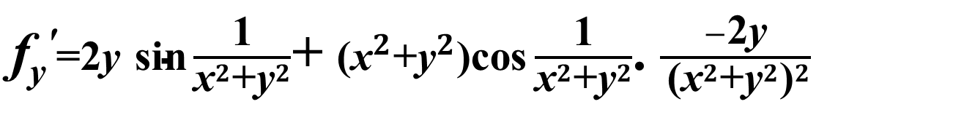
$\text{(}\text{x}\text{, }\text{y}\text{)}≠\text{(0, 0)}\text{时}$
$\text{f}\text{x}\text{′}\text{=2}\text{x}$ $\text{sin}\frac{\text{1}}{{{\text{x}}^{2}\text{+}\text{y}}^{2}}$+ $\text{(}{{\text{x}}^{2}\text{+}\text{y}}^{2}\text{)}\text{cos}\frac{\text{1}}{{{\text{x}}^{2}\text{+}\text{y}}^{2}}$. $\frac{−\text{2}\text{x}}{{ \text{(}{{\text{x}}^{2}\text{+}\text{y}}^{2}\text{)}}^{2}}$
$\text{=2}\text{x}$ $\text{sin}\frac{\text{1}}{{{\text{x}}^{2}\text{+}\text{y}}^{2}}$+ $\text{cos}\frac{\text{1}}{{{\text{x}}^{2}\text{+}\text{y}}^{2}}$. $\frac{−\text{2}\text{x}}{\text{(}{{\text{x}}^{2}\text{+}\text{y}}^{2}\text{)}}$ $↛0=$ $\text{f}\text{x}\text{′}\text{(0, 0)}$
$\text{f}\text{y}\text{′}\text{=2}\text{y}$ $\text{sin}\frac{\text{1}}{{{\text{x}}^{2}\text{+}\text{y}}^{2}}$+ $\text{(}{{\text{x}}^{2}\text{+}\text{y}}^{2}\text{)}\text{cos}\frac{\text{1}}{{{\text{x}}^{2}\text{+}\text{y}}^{2}}$. $\frac{−\text{2}\text{y}}{{ \text{(}{{\text{x}}^{2}\text{+}\text{y}}^{2}\text{)}}^{2}}$
$\text{=2}\text{y}$ $\text{sin}\frac{\text{1}}{{{\text{x}}^{2}\text{+}\text{y}}^{2}}$+$\text{cos}\frac{\text{1}}{{{\text{x}}^{2}\text{+}\text{y}}^{2}}$. $\frac{−\text{2}\text{y}}{\text{(}{{\text{x}}^{2}\text{+}\text{y}}^{2}\text{)}}$ $↛0=$ $\text{f}\text{y}\text{′}\text{(0, 0)}$
f(x,y)在 $\text{(0, 0)}\text{处可微，但偏导数不连续}$。

Slide 8
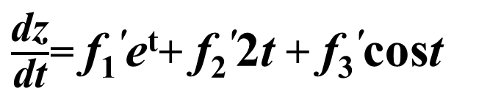
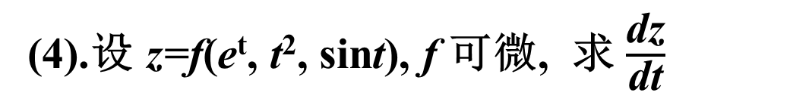
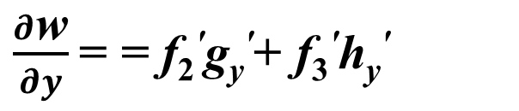
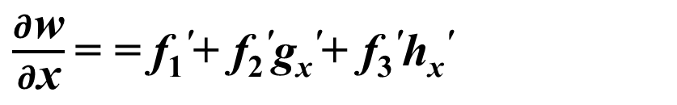
习题 8.3
1. 求下列函数的导数或偏导数：
(4).设 z=f(e^{t}, t², sint), f 可微, 求 $\frac{\text{dz}}{\text{dt}}$
解:
$\frac{\text{dz}}{\text{dt}}$= $\text{f}\text{1}\text{′}\text{e}\text{t}$+ $\text{f}\text{2}\text{′}\text{2}\text{t}$ + $\text{f}\text{3}\text{′}\text{cos}\text{t}$
(6).设 w=f(x, u, v), u=g(x,y), v=h(x,y), 求 $\frac{∂\text{w}}{∂\text{x}},\frac{∂\text{w}}{∂\text{y}}$
解:
$\frac{∂\text{w}}{∂\text{x}}$= = $\text{f}\text{1}\text{′}$+ $\text{f}\text{2}\text{′}\text{g}\text{x}\text{′}$+ $\text{f}\text{3}\text{′}\text{h}\text{x}\text{′}$
$\frac{∂\text{w}}{∂y}$= = $\text{f}\text{2}\text{′}\text{g}\text{y}\text{′}$+ $\text{f}\text{3}\text{′}\text{h}\text{y}\text{′}$

Slide 9
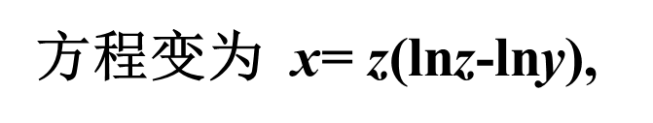
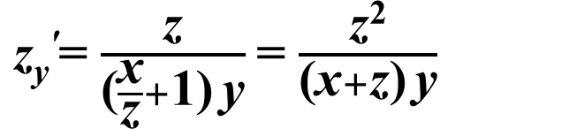
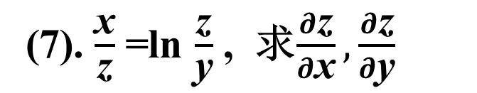
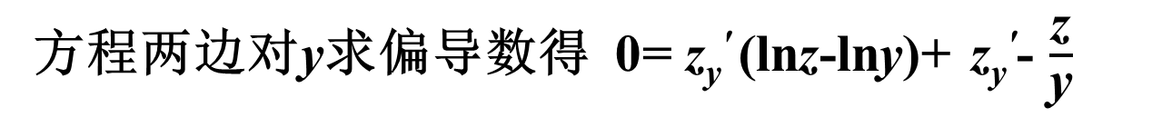
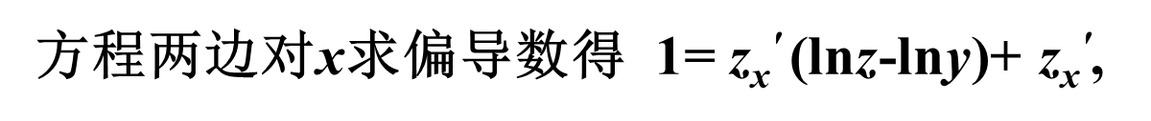
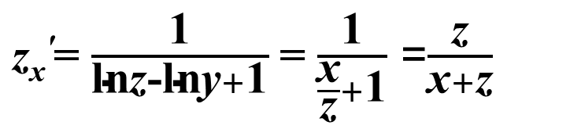
3. 求下列方程所确定的隐函数的导数或偏导数：
(7). $\frac{\text{x}}{\text{z}}$=ln $\frac{\text{z}}{\text{y}}$ , 求$\frac{∂\text{z}}{∂\text{x}},\frac{∂\text{z}}{∂\text{y}}$
解:
方程变为 $\text{x}$= z(ln$\text{z}$-ln$\text{y}$),
方程两边对$\text{x}$求偏导数得 1= $\text{z}\text{x}\text{′}$(ln$\text{z}$-ln$\text{y}$)+ $\text{z}\text{x}\text{′}$,
$\text{z}\text{x}\text{′}$= $\frac{\text{1}}{\text{ln}\text{z}\text{−}\text{ln}\text{y}+\text{1}}$= $\frac{\text{1}}{\frac{\text{x}}{\text{z}}+\text{1}}$ =$\frac{\text{z}}{\text{x}+\text{z}}$
方程两边对$\text{y}$求偏导数得 0= $\text{z}\text{y}\text{′}$(ln$\text{z}$-ln$\text{y}$)+ $\text{z}\text{y}\text{′}$- $\frac{\text{z}}{\text{y}}$
$\text{z}\text{y}\text{′}$= $\frac{\text{z}}{\text{(}\frac{\text{x}}{\text{z}}+\text{1)} \text{y}}$= $\frac{\text{z}\text{2}}{\text{(}\text{x}+\text{z}\text{)} \text{y}}$

Slide 10
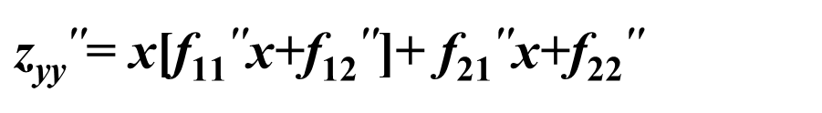
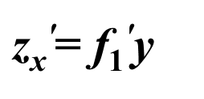
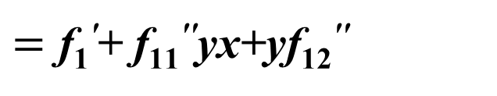





5. 求下列函数的二阶偏导数(其中f为二阶可微函数) ：
(2). $\text{z}$=f(xy, y)
解:
$\text{z}\text{x}\text{′}$= $\text{f}\text{1}\text{′}\text{y}$
$\text{z}\text{y}\text{′}$= x$\text{f}\text{1}\text{′}$+ $\text{f}\text{2}\text{′}$
$\text{z}\text{xx}\text{′}\text{′}$=$\text{f}\text{11}\text{′′}\text{y}\text{2}$
$\text{z}\text{x}\text{y}\text{′′}\text{=}$ $\text{f}\text{1}\text{′}$+$\text{y}\text{[}\text{f}\text{11}\text{′′}\text{x}\text{+}\text{f}\text{1}\text{2}\text{′′}$]
$=\text{f}\text{1}\text{′}$+$\text{f}\text{11}\text{′′}\text{y}\text{x}\text{+}\text{yf}\text{1}\text{2}\text{′′}$
$\text{z}\text{yy}\text{′′}\text{=}$ $\text{x}\text{[}\text{f}\text{11}\text{′′}\text{x}\text{+}\text{f}\text{1}\text{2}\text{′′}$]+ $\text{f}\text{2}\text{1}\text{′′}\text{x}\text{+}\text{f}\text{2}\text{2}\text{′′}$
$$=\text{x}\text{2}\text{f}\text{11}\text{′′}\text{+}\text{2}\text{x}\text{f}\text{1}\text{2}\text{′′}\text{+}\text{f}\text{22}\text{′′}$$

Slide 11




8. 设函数$\text{z}$=f(x, y)在 (1,1)处可微, 且 f(1,1) =1：
$\frac{∂\text{f}}{∂\text{x}}|\text{(1,1}\text{)}\text{=2}, \frac{∂\text{f}}{∂\text{y}}|\text{(1,1}\text{)}\text{=}\text{3},$ φ(x)= f(x, f(x, x))
求$\frac{d}{d\text{x}}$φ³(x) $|\text{x}\text{=}\text{1}$
解:
$\frac{d}{d\text{x}}\text{φ}\text{3}\text{(}\text{x}\text{)}\text{=}$ $\text{3}\text{φ}\text{2}\text{(}\text{x}\text{)}\text{[}\text{f}\text{1}\text{′}\text{(}\text{x}\text{, }\text{f}\text{(}\text{x}\text{, }\text{x}\text{))}\text{+}\text{f}\text{2}\text{′}\text{(}\text{x}\text{, }\text{f}\text{(}\text{x}\text{, }\text{x}\text{))}\text{[}\text{f}\text{1}\text{′}\text{(}\text{x}\text{,} \text{x}\text{)+}\text{f}\text{2}\text{′}\text{(}\text{x}\text{, }\text{x}\text{)}\text{]]}$
φ(1)= f(1, f(1, 1))=1
$∴\frac{d}{d\text{x}}\text{φ}\text{3}\text{(}\text{x}\text{) }|\text{x}\text{=1}$=3.1².[2+3(2+3)]
$$=\text{51}$$

Slide 12







习题 8.4
1. 求下列曲线在给定点处的切线方程与法平面方程
(3). $\left\{\begin{aligned} {{\text{x}}^{2}\text{+}\text{y}}^{2}=10 \\ {{ \text{y}}^{2}\text{+}\text{z}}^{2}=25\end{aligned} 点\text{(}1.3.4\text{)}\right.$
$$\left\{\begin{aligned} {\text{2}\text{x}\text{+}\text{2}\text{y}\text{y}}^{′}=0 \\ {\text{2}\text{yy}}^{′}+{\text{2}\text{zz}}^{′}=0\end{aligned}\right.$$
解:
方程组两边对x求导数得
解得 $\left\{\begin{aligned} {\text{y}}^{′}=−\frac{1}{3} \\ {\text{z}}^{′}=\frac{1}{4}\end{aligned}\right.$
$$\left\{\begin{aligned} {1\text{+}3\text{y}}^{′}=0 \\ {3\text{y}}^{′}+{4\text{z}}^{′}=0\end{aligned}\right.$$
将$\text{(}1.3.4\text{)}$代入得
切向量可取为$T=\{12,−4,3\}$
所以切线方程为 $\frac{x−1}{12}$ =$\frac{y−3}{−4}$ =$\frac{z−4}{3}$
法平面方程为 12x-4y+3z-12=0

Slide 13





6. 证明：曲面 xyz=a³(a>0)上任一点的切平面与三个坐标面
所围成的四面体的体积为一定数
证明:
设(x₀, y₀, z₀)曲面 上任一点
令F=xyz-a³
则,${ \text{F}\text{x}}^{′}$=yz, ${ \text{F}\text{y}}^{′}$=zx, ${ \text{F}\text{z}}^{′}$=xy
(x₀, y₀, z₀)处,${ \text{F}\text{x}}^{′}$=y₀z₀ , ${ \text{F}\text{y}}^{′}$=z₀x₀, ${ \text{F}\text{z}}^{′}$=x₀y₀
(x₀, y₀, z₀)处的切平面为: y₀z₀ (x-x₀)+z₀x₀(y-y₀) $+$x₀y₀ (z-z₀)=0
即: y₀z₀ x+z₀x₀y$+$x₀y₀z=3a³
截距式方程为： $\frac{\text{x}}{\text{3}\text{x}\text{0}}$ +$\frac{\text{y}}{\text{3}\text{y}\text{0}}$ +$\frac{\text{z}}{\text{3}\text{z}\text{0}}$=1
切平面在三个坐标面上的截距分别为:$\text{3}\text{x}\text{0}$, $\text{3}\text{y}\text{0}$, $\text{3}\text{z}\text{0}$
四面体的体积为: V= $\frac{\text{1}}{\text{6}}$ $.\text{3}\text{x}\text{0}$.$\text{3}\text{y}\text{0}$.$\text{3}\text{z}\text{0}$= $\frac{\text{9}}{\text{2}}$a³ 定数

Slide 14








习题 8.5
6. 求内接于半径为a的球且有最大体积的长方体.
解:
设长方体的长宽高分别为: $\text{2}\text{x}$,$\text{2}\text{y}$,$\text{2}\text{z}$
则有$\text{x}\text{2}$+$\text{y}\text{2}$+$\text{z}\text{2}=\text{a}\text{2} \text{V}\text{=8}\text{xyz}$ 条件极值
令 $L=\text{xyz}+λ\text{(}\text{x}\text{2}\text{+}\text{y}\text{2}\text{+}\text{z}\text{2}\text{−}\text{a}\text{2}\text{)}$
$$L_{x}^{′}=\text{yz}+λ\text{2}\text{x}=0$$
$$L_{y}^{′}=\text{z}\text{x}+λ\text{2}\text{y}=0$$
$$L_{z}^{′}=x\text{y}+λ\text{2}\text{z}=0$$
解得驻点 $\text{(}\frac{a}{\sqrt{3}}\text{,}\frac{a}{\sqrt{3}}\text{,}\frac{a}{\sqrt{3}}\text{)}$
$$L_{λ}^{′}=\text{x}\text{2}\text{+}\text{y}\text{2}\text{+}\text{z}\text{2}\text{−}\text{a}\text{2}=0$$
长方体的最大体积为 $\text{V}\text{=8}\text{xyz}$= $\frac{\text{8}\text{a}\text{3}}{\text{3}\sqrt{\text{3}}}$

Slide 15










7. 求曲线y= $\sqrt{\text{x}}$上的动点到 (a,0)的最小距离.
解:
设曲线上的动点坐标为: (x,y)
则有y= $\sqrt{\text{x}}\text{ , }\text{d}\text{2}\text{=}\text{(}\text{x}\text{−}\text{a}\text{)}\text{2}\text{+}\text{y}\text{2}$条件极值
令$L\text{=}\text{(}\text{x}\text{−}\text{a}\text{)}\text{2}\text{+}\text{y}\text{2}+λ\text{(}\text{y}\text{2}\text{−}x\text{)}$
$$x=\text{a}\text{−}\frac{\text{1}}{\text{2}}$$
$$L_{x}^{′}=\text{2}\text{(}\text{x}\text{−}\text{a}\text{)}−λ=0$$
$$x=0$$
解得驻点
$$L_{y}^{′}=\text{2}\text{y}+λ\text{2}\text{y}=0$$
$L_{λ}^{′ }\text{ = }\text{y}\text{2}\text{−}x$=0
$y$=0
$y$= $\sqrt{\text{a}\text{−}\frac{\text{1}}{\text{2}}}\text{ ,}$
a$≥$ $\frac{\text{1}}{\text{2}}时,$ $\text{d}$_{min}$\text{2}$= $\text{a}\text{−}\frac{\text{1}}{\text{4}}$, $\text{d}$_{min}=$\sqrt{\text{a}\text{−}\frac{\text{1}}{\text{4}}}$
a$<$ $\frac{\text{1}}{\text{2}}时,$ $\text{d}$_{min}$\text{2}$=$\text{a}\text{2}$, $\text{d}$_{min}=$\left|a\right|$
$\text{亦可}\text{d}\text{2}\text{=}\text{(}\text{x}\text{−}\text{a}\text{)}\text{2}\text{+}\text{x}\text{=}\text{x}\text{2}\text{+}\text{(1−2}\text{a}\text{)}\text{x}\text{+}\text{a}\text{2}$ 讨论其最小值

Slide 16








10. 求抛物线y=x²和直线 x-y-2=0之间的最小距离.
到直线的距离为 d=$\frac{\left|\text{x}\text{−}\text{y}\text{−2}\right|}{\sqrt{\text{2}}}$,
解:
设(x,y)为抛物线上的点，
$\text{d}\text{2}\text{=}\frac{\text{(}\text{x}\text{−}\text{y}\text{−2}\text{)}\text{2}}{\text{2}}$ 条件极值
令$L=\frac{\text{(}\text{x}\text{−}\text{y}\text{−2}\text{)}\text{2}}{\text{2}}+λ\text{(}\text{y}\text{−}\text{x}\text{2}\text{)}$
$$L_{x}^{′}=\text{(}\text{x}\text{−}\text{y}\text{−}\text{2}\text{)}−\text{2}\text{x}λ=0$$
$$x=\frac{\text{1}}{\text{2}}$$
$$L_{y}^{′}=\text{−}\text{(}\text{x}\text{−}\text{y}\text{−2}\text{)}+λ=0$$
$L_{λ}^{′ } \text{= } \text{y}\text{−}\text{x}\text{2}$=0
解得驻点
$y$= $\frac{\text{1}}{\text{4}}$
$\text{d}$_{min}= $\frac{\text{7}}{\text{8}} \sqrt{2}$

