Slide 1
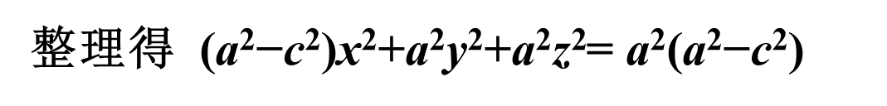
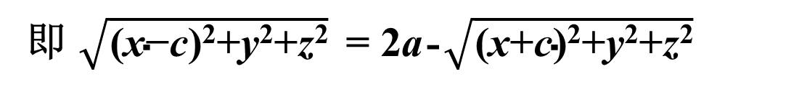
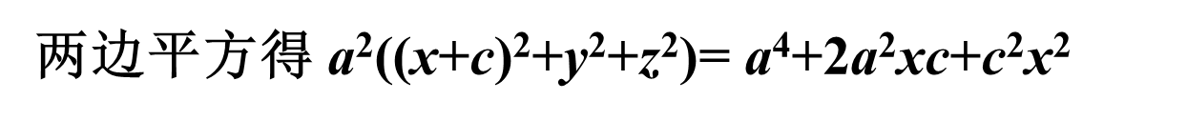
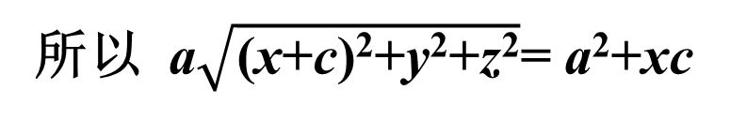
习题7.3
4. 求到两定点(c,0,0),(-c,0,0)距离之和为2a的动点的轨迹方程.(a>c>0)
解：设动点的坐标为(x,y,z)，
$\text{由题意得}$： $\sqrt{\text{(}\text{x}\text{−}\text{c}\text{)}\text{2}\text{+}\text{y}\text{2}\text{+}\text{z}\text{2}}$+ $\sqrt{\text{(}\text{x}\text{+}\text{c}\text{)}\text{2}\text{+}\text{y}\text{2}\text{+}\text{z}\text{2}}$ = 2a
即 $\sqrt{\text{(}\text{x}\text{−}\text{c}\text{)}\text{2}\text{+}\text{y}\text{2}\text{+}\text{z}\text{2}}$ = 2a-$\sqrt{\text{(}\text{x}\text{+}\text{c}\text{)}\text{2}\text{+}\text{y}\text{2}\text{+}\text{z}\text{2}}$
两边平方得 $\text{(}\text{x}\text{−}\text{c}\text{)}\text{2}\text{+}\text{y}\text{2}\text{+}\text{z}\text{2}$= 4a² + $\text{(}\text{x}\text{+}\text{c}\text{)}\text{2}\text{+}\text{y}\text{2}\text{+}\text{z}\text{2}$-$\text{4}\text{a}\sqrt{\text{(}\text{x}\text{+}\text{c}\text{)}\text{2}\text{+}\text{y}\text{2}\text{+}\text{z}\text{2}}$
所以$\text{a}\sqrt{\text{(}\text{x}\text{+}\text{c}\text{)}\text{2}\text{+}\text{y}\text{2}\text{+}\text{z}\text{2}}$= a²$\text{+}\text{xc}$
两边平方得 a²($\text{(}\text{x}\text{+}\text{c}\text{)}\text{2}\text{+}\text{y}\text{2}\text{+}\text{z}\text{2}\text{)}$= a⁴$\text{+}\text{2}\text{a}\text{2}\text{xc}\text{+}\text{c}\text{2}\text{x}\text{2}$
整理得 ($\text{a}\text{2}\text{−}\text{c}\text{2}\text{)}\text{x}\text{2}\text{+}\text{a}\text{2}\text{y}\text{2}\text{+}\text{a}\text{2}\text{z}\text{2}$= a²$\text{(}\text{a}\text{2}\text{−}\text{c}\text{2}\text{)}$
所以动点的轨迹方程为 $\frac{\text{x}\text{2}}{\text{a}\text{2}}$+ $\frac{\text{y}\text{2}}{\text{b}\text{2}}$ $+\frac{\text{z}\text{2}}{\text{b}\text{2}}$= 1, b²=$\text{(}\text{a}\text{2}\text{−}\text{c}\text{2}\text{)}$

Slide 2
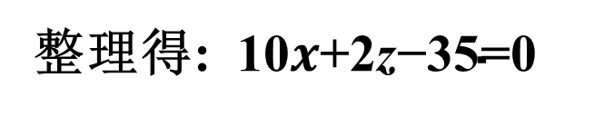
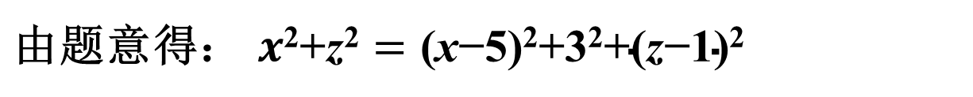
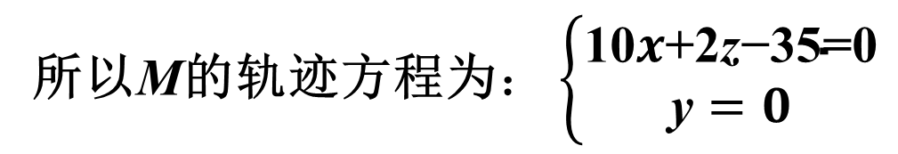
5. 动点M在xoz面上, M到原点和到点A(5, -3, 1) 等距离, 求M的轨迹方程
解：设动点M的点坐标为M(x,0,z)，
$\text{由题意得}$： $x\text{2}\text{+}\text{z}\text{2}=\text{(}\text{x}\text{−5)}\text{2}\text{+3}\text{2}\text{+(}\text{z}\text{−1)}\text{2}$
整理得: 10$x\text{+}\text{2}\text{z}\text{−}\text{3}\text{5}\text{=0}$
所以M的轨迹方程为$：\left\{\begin{aligned}\text{10}x\text{+2}\text{z}\text{−35=0} \\ \text{y}=0\end{aligned}\right.$

Slide 3
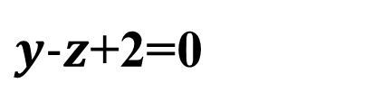
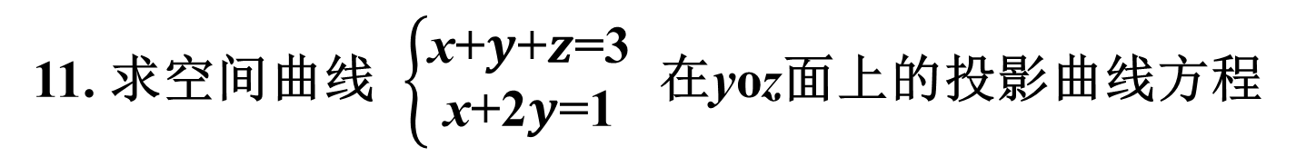
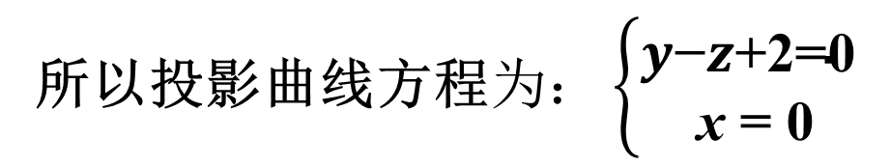
11. 求空间曲线 $\left\{\begin{aligned}\text{x}\text{+}y\text{+}z\text{=}\text{3} \\ \text{x}\text{+}\text{2}y\text{=}\text{1}\end{aligned}\right.$ 在yoz面上的投影曲线方程
解：消掉 x,得投影平面方程为
$y−z\text{+2=}$0
所以投影曲线方程$为：\left\{\begin{aligned}y\text{−}z\text{+2=0} \\ \text{x} \text{=} \text{0}\end{aligned}\right.$

Slide 4
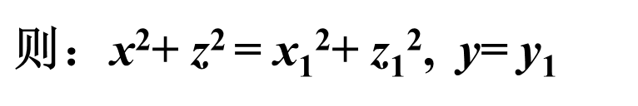
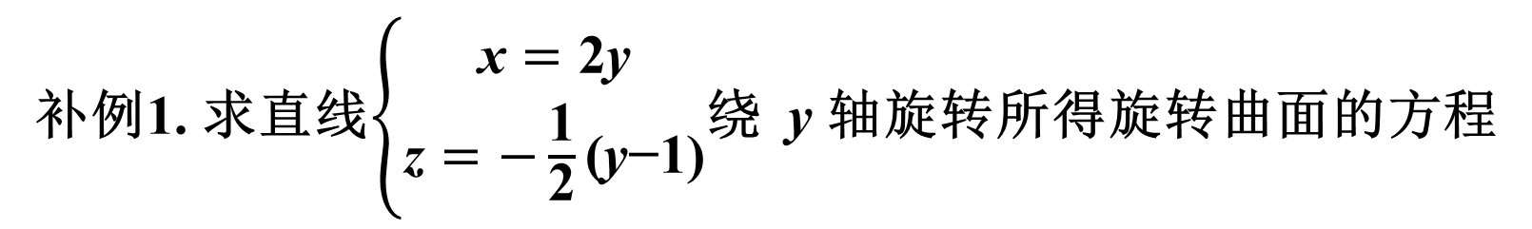
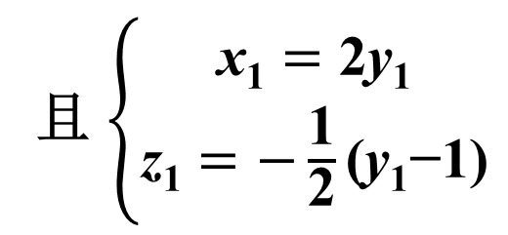
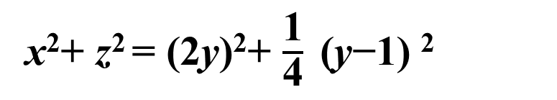
补例1. 求直线$\left\{\begin{aligned}\text{x}=\text{2}\text{y} \\ \text{z}=−\frac{\text{1}}{\text{2}}\text{(}\text{y}\text{−1}\text{)}\end{aligned}\right.$绕 y 轴旋转所得旋转曲面的方程
解：设旋转曲面上的点(x,y,z)是由直线上的(x₁,y₁,z₁)旋转所得
且 $\left\{\begin{aligned}\text{x}\text{1}=\text{2}\text{y}\text{1} \\ \text{z}\text{1}=−\frac{\text{1}}{\text{2}}\text{(}\text{y}\text{1}\text{−1}\text{)}\end{aligned}\right.$
$\text{则}$：x²+ z² = x₁²+ z₁², y= y₁
消掉 x₁, y₁, z₁ 得旋转曲面的方程为
x²+ z² = (2y)²+ $\frac{\text{1}}{\text{4}} \text{(}\text{y}\text{−1)}$²

