Slide 1



SKYOPT-BOOK YOUR FLIGHT!

Slide 2
TEAM MEMBERS
Poorvika Girish Babu
Sakshi Parikh
Dhruv Desai
Fenil Vaghasiya

Slide 3
INTRODUCTION
This project is a comprehensive flight booking application designed to help users find the best deals on flights.
It includes features such as a user-friendly login page, flight booking with customizable filters (date, from and to locations), and special offer which user new user get on initial booking.
Stripe payment is also integrated which allows user to pay and book flight.

Slide 4
FEATURES
Login Page: Secure login for users to access their flight booking account.
Flight Search: Search flights by origin, destination, dates, and other filters.
Booking Flights: Ability to book flights based on search results.
First User Discounts: First-time user discount system, this will provide a discount of x%.
Export to CSV: User can export data to CSV to analysis there spending of his past booking.
User Dashboard: Manage and view booking details, canceled flights, and other preferences.

Slide 5


TECH STACK

Slide 6
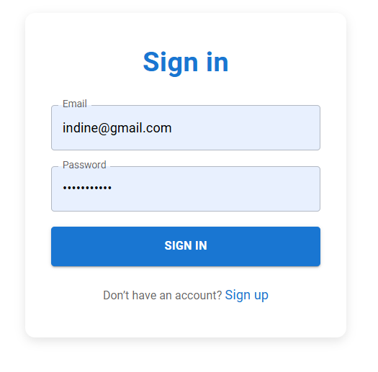
SCREENSHOTS

Slide 7
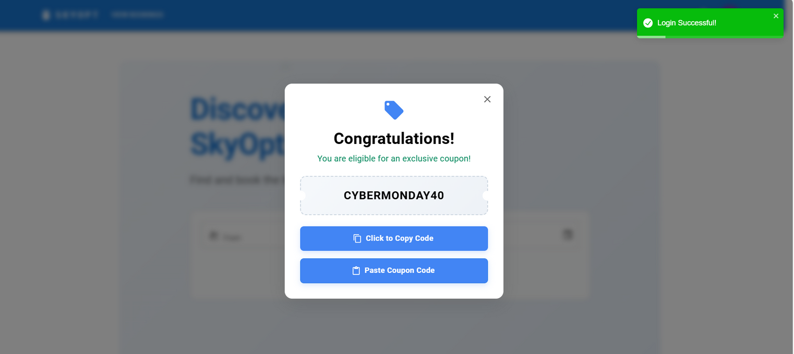
SCREENSHOTS

Slide 8
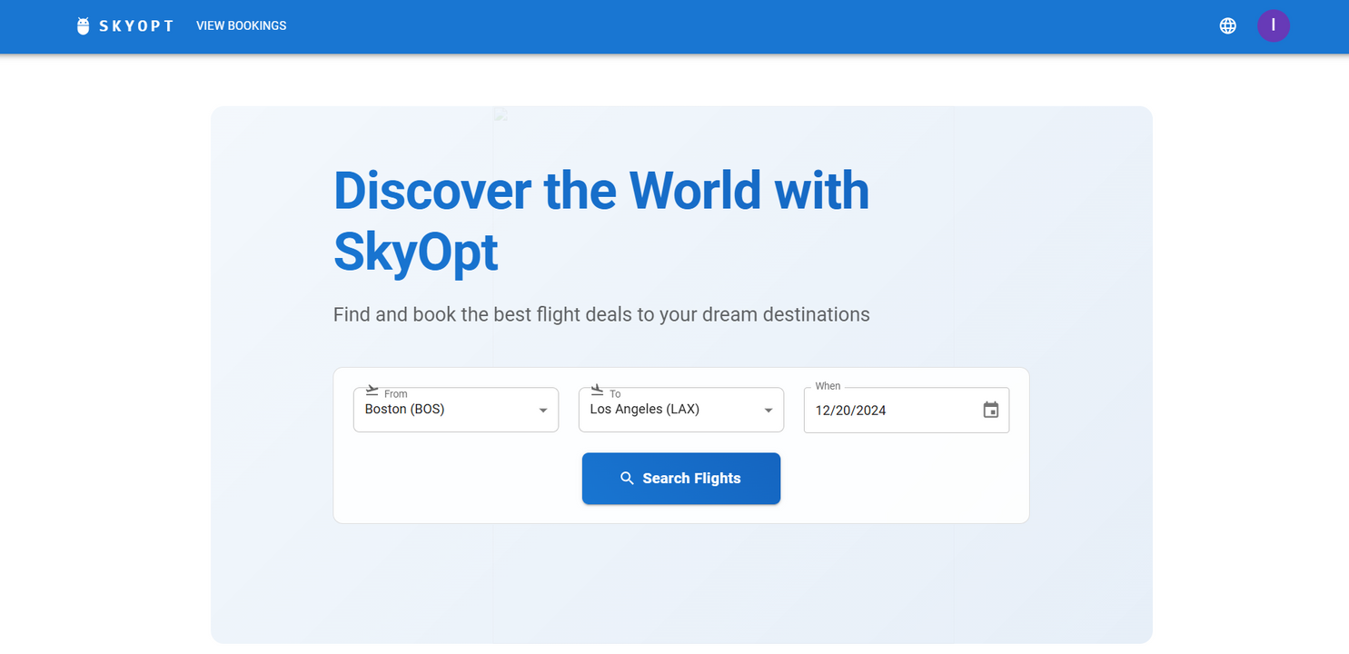
SCREENSHOTS

Slide 9
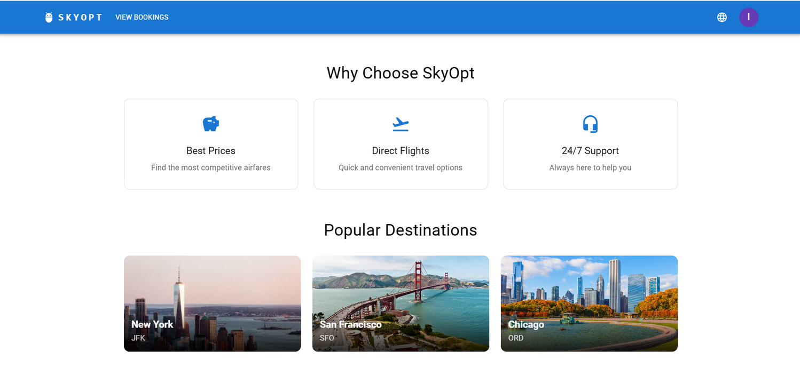
SCREENSHOTS

Slide 10
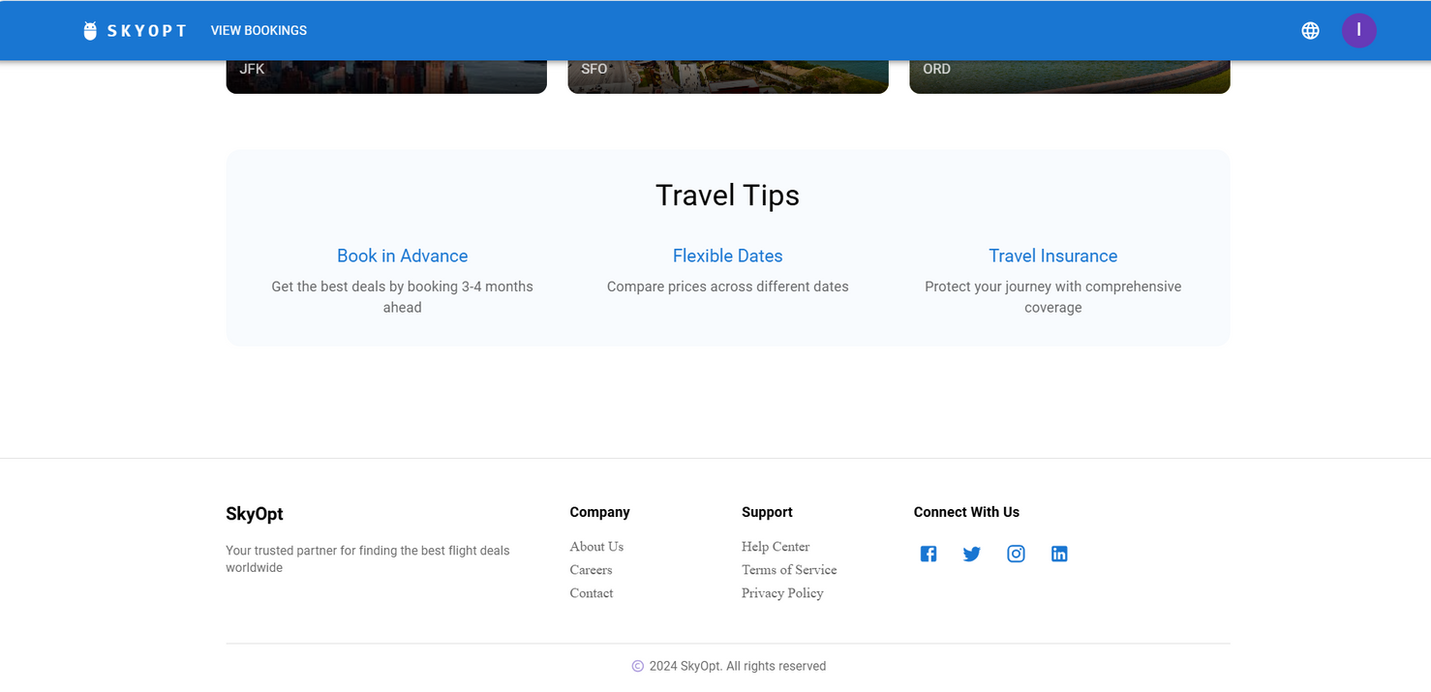
SCREENSHOTS

Slide 11
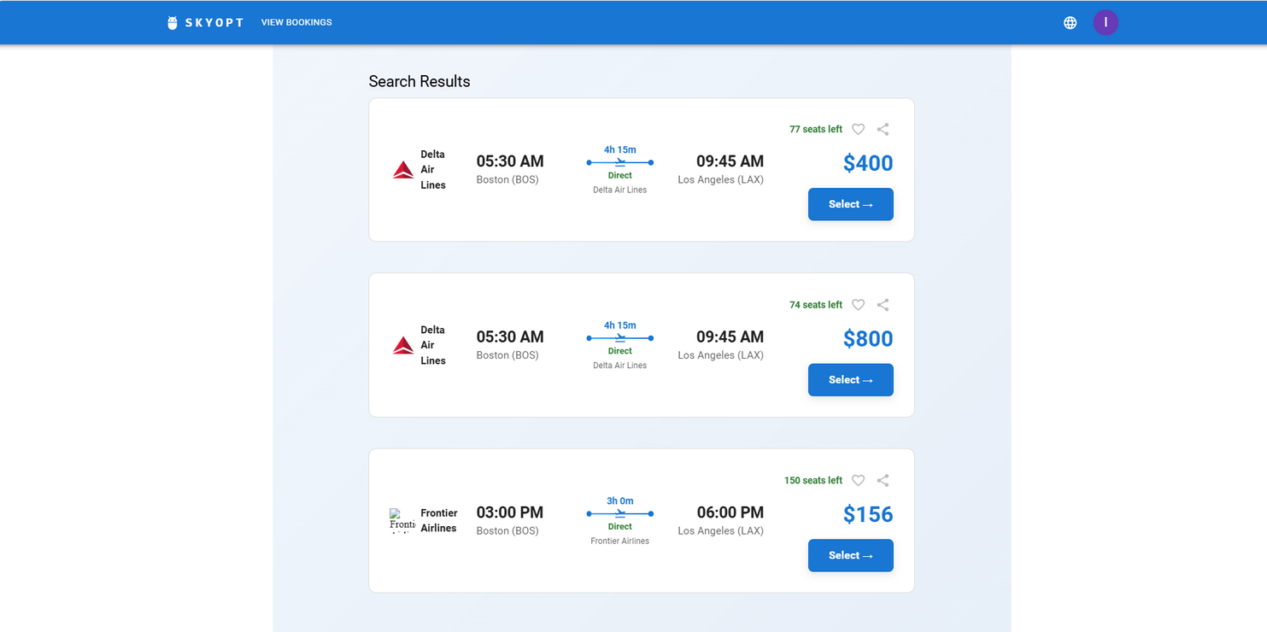
SCREENSHOTS

Slide 12
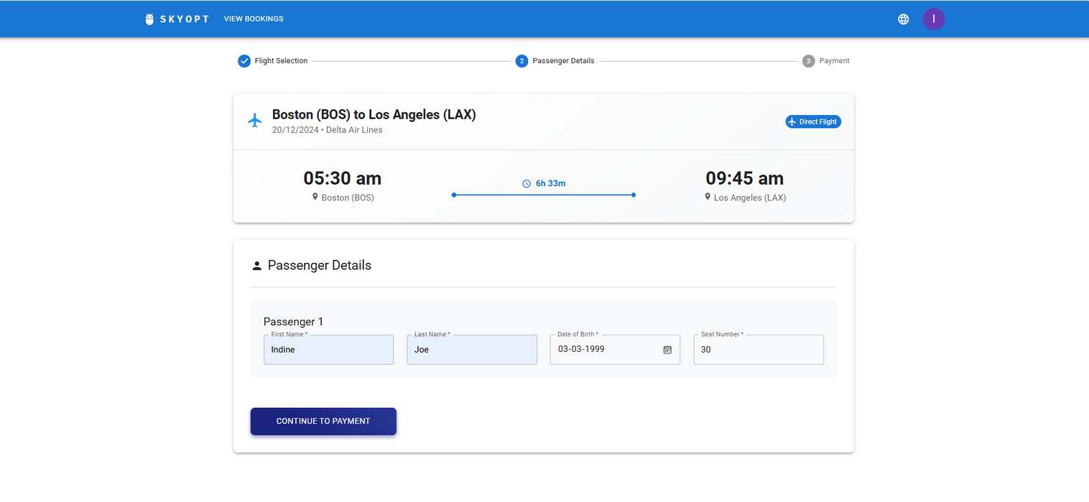
SCREENSHOTS

Slide 13
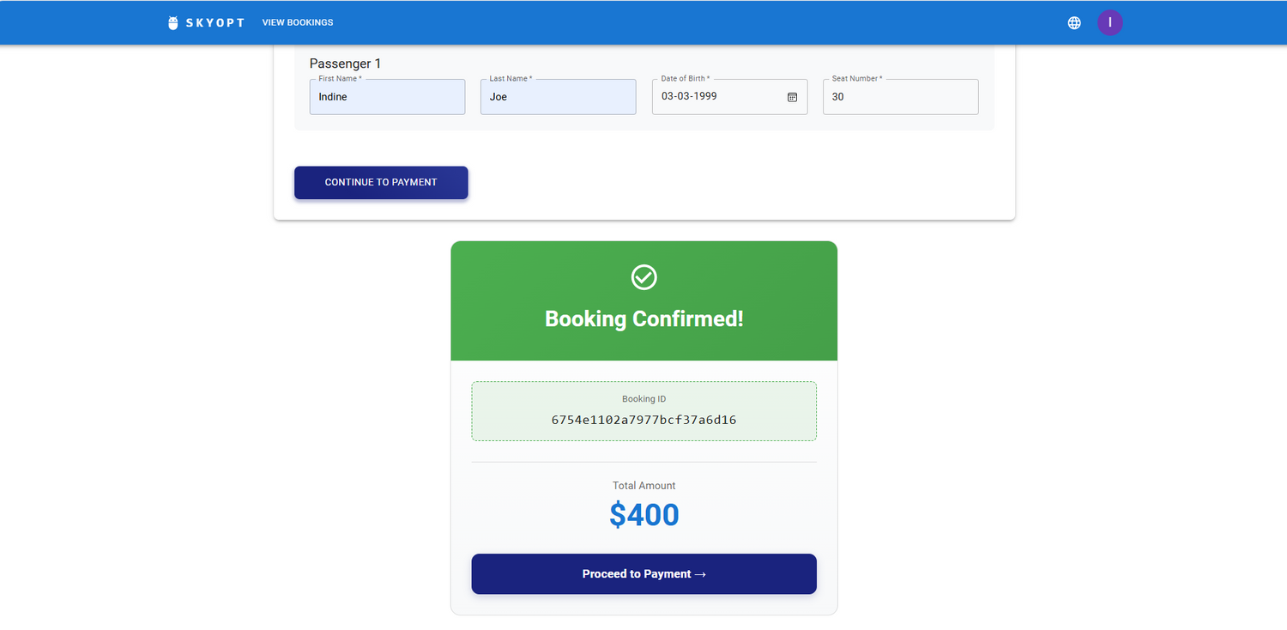
SCREENSHOTS

Slide 14
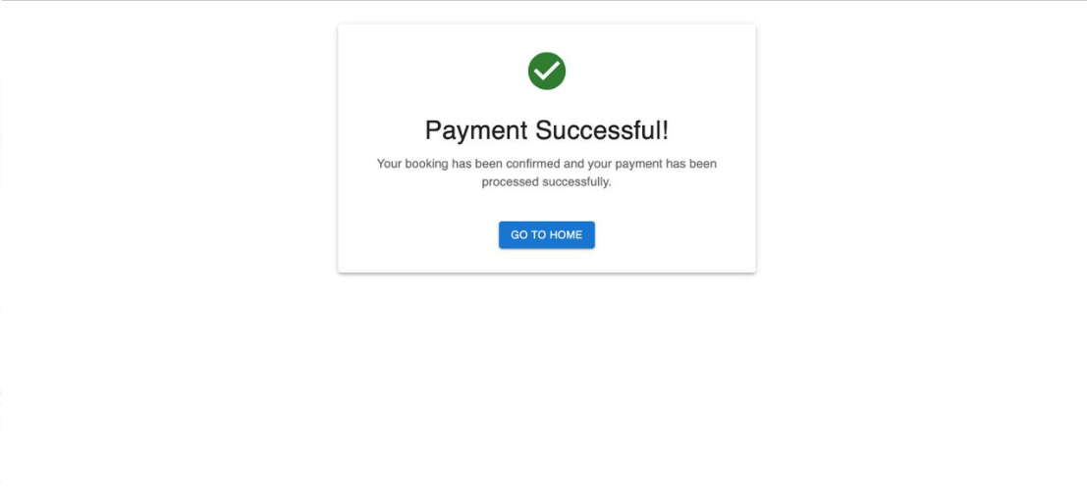
SCREENSHOTS

Slide 15
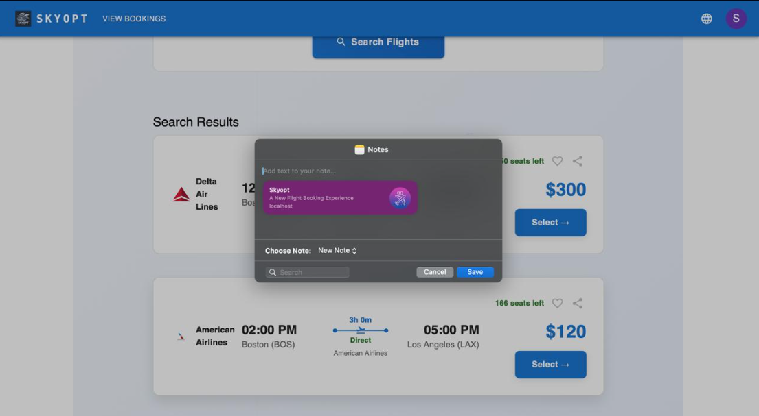
SCREENSHOTS

Slide 16
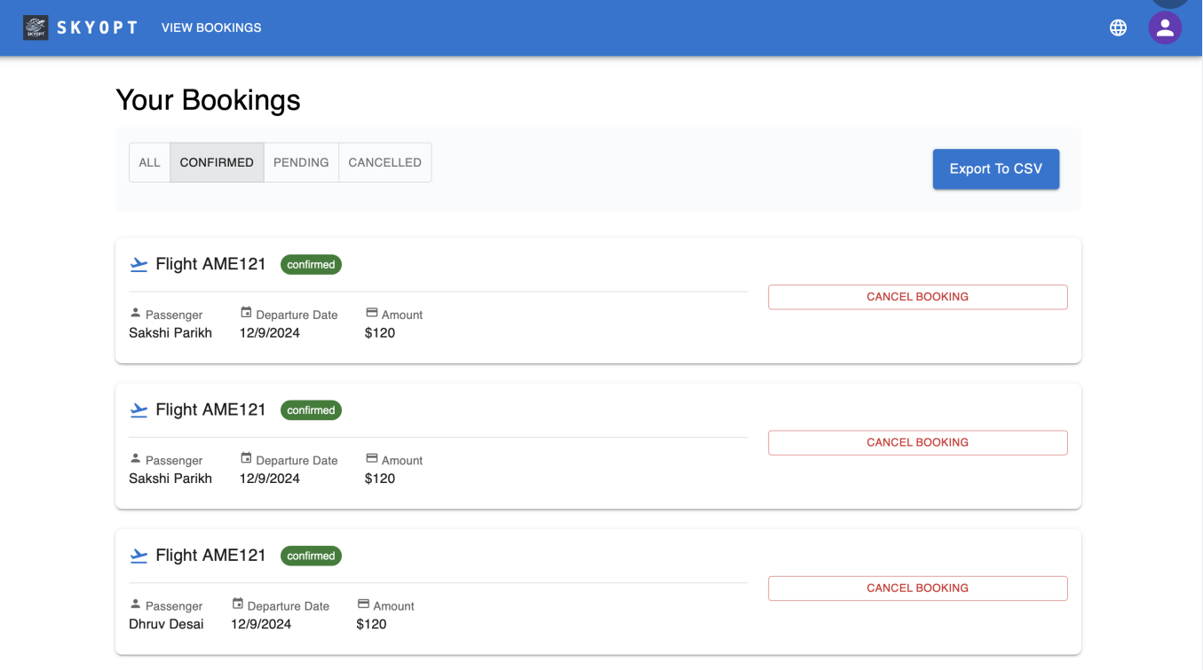
SCREENSHOTS

Slide 17
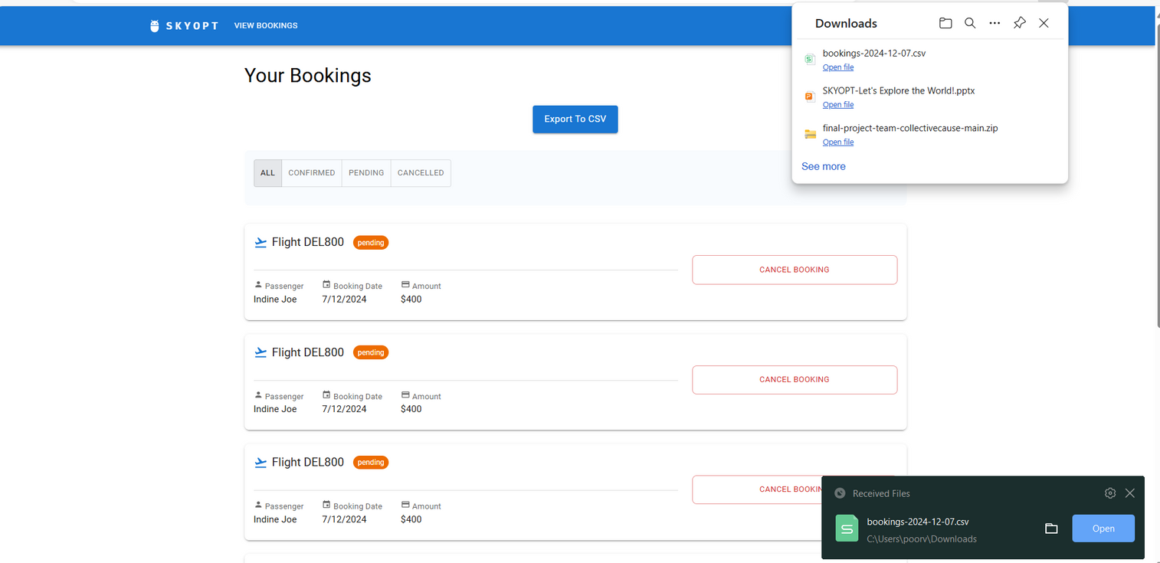
SCREENSHOTS

Slide 18
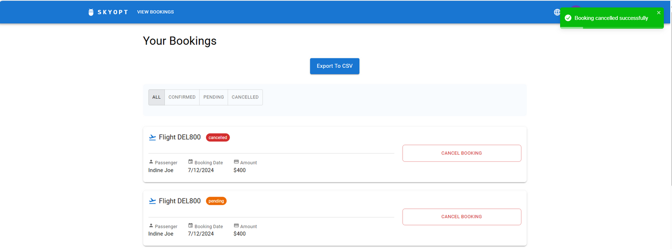
SCREENSHOTS

Slide 19
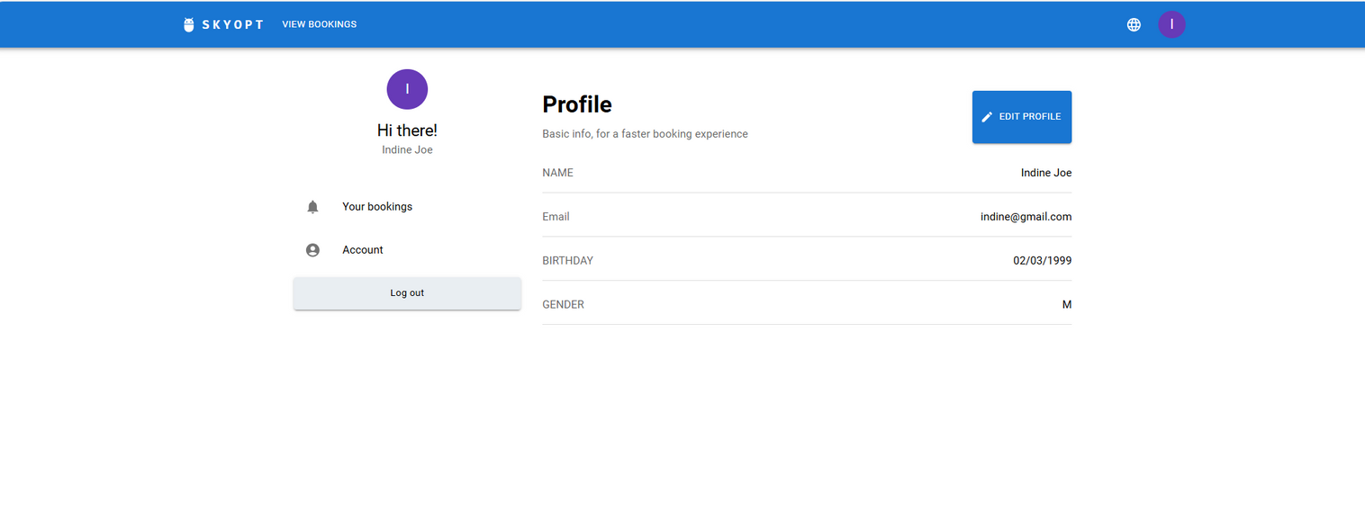
SCREENSHOTS

Slide 20
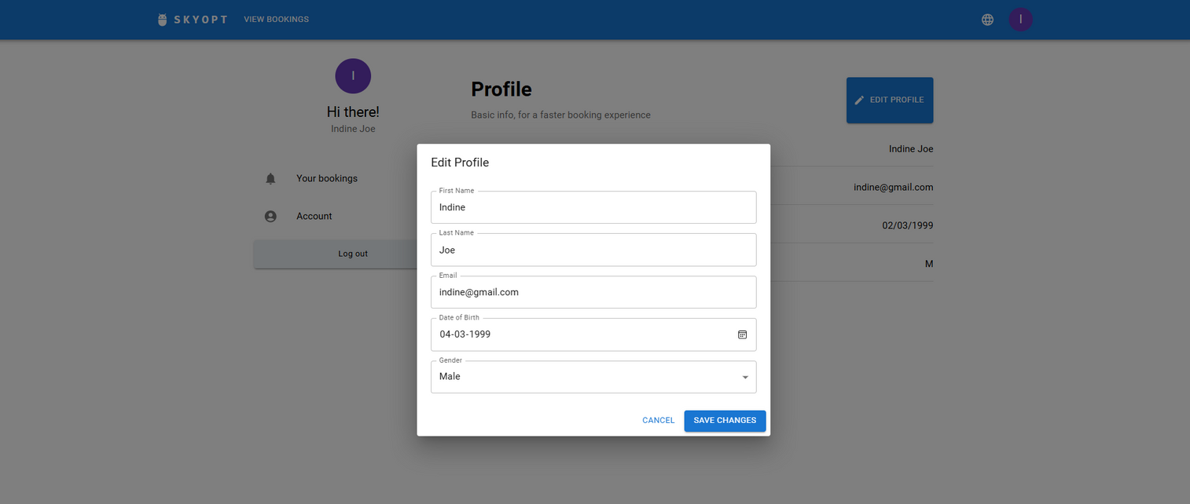
SCREENSHOTS

Slide 21
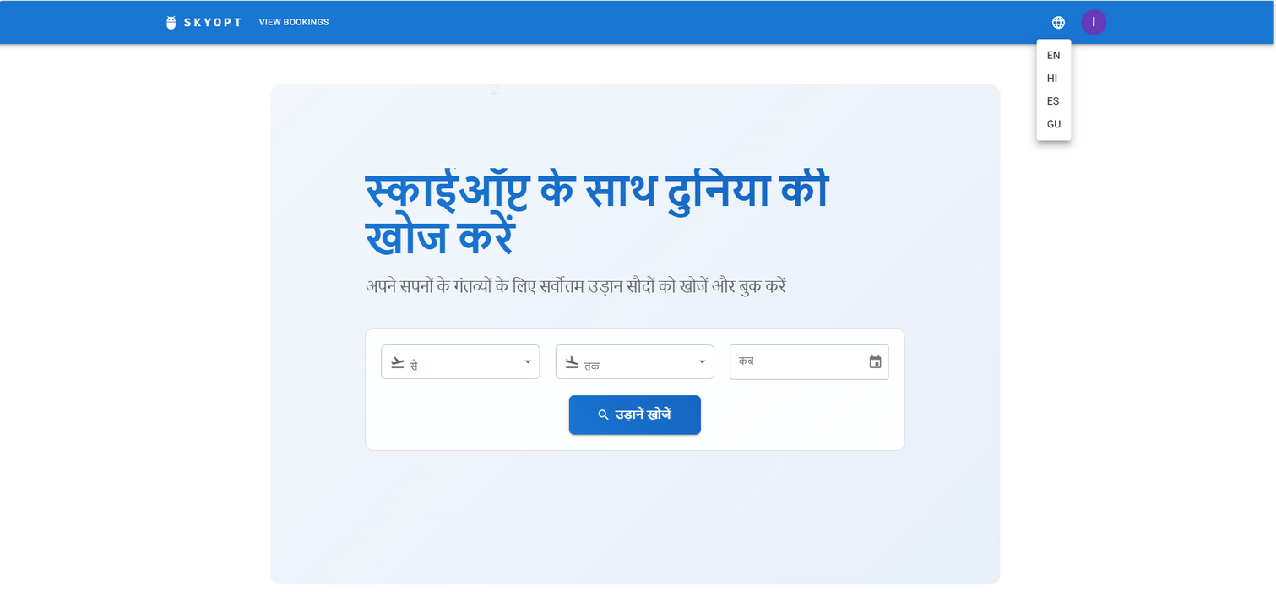
SCREENSHOTS

