Slide 1
Bitcoin
Fenil Rana

Slide 2
Objectives
What is Bitcoin?
Who invented Bitcoin?
How Bitcoin Transaction works
Pro and Con associate with Bitcoin
Future of Bitcoin
Conclusion

Slide 3
What is Bitcoin?
Bitcoin is Peer to Peer technology
Decentralized digital currency
Users can send/receive money without interference of government or central bank.

Slide 4

Why Bitcoin invented?
Satoshi Nakamoto created Bitcoin in 2008
He wanted to create trust-less cash system
Removes third party costs in transactions.

Slide 5
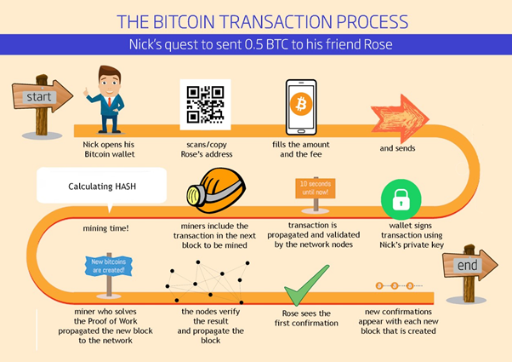
How Transaction works?

Slide 6
Pros and Cons
Pros
Cons
Accessibility
Low transaction fee
Freedom of payment
Not accepted everywhere
Volatility
Vulnerable to cyberattacks
Notes:
https://www.aplustopper.com/bitcoin-advantages-and-disadvantages/

Slide 7
Future of Bitcoins
Lot of companies will accept bitcoin such as Netflix and Subways
Experts predicts Bitcoin will reach $100,000 by end of 2023.

Slide 8
Conclusion
Decentralized digital currency
Free from government/central bank interference
Accessible anytime anywhere
Less transaction cost as compared to bank transaction cost

Slide 9
References
https://samarakoon-gayan.medium.com/bitcoin-fundamentals-a5d62fe98bac
https://www.aplustopper.com/bitcoin-advantages-and-disadvantages/
https://jacobjoseph.net/evolution-of-money-through-the-ages/

