Slide 1
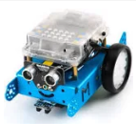
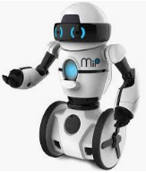
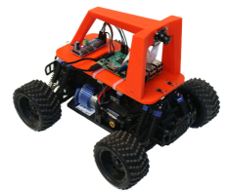
Kids Robots!
Kids love robots! – motors - movement – sensors – lights -> FUN!
Robots are perfect tools for teaching kids about computers
CoderDojo’s best practices:
Have a mentor (2 hours every other week)
Let kids design their own robots (project based learning)
Have kids build things in teams (social constructivism)
Minimize remote control robots and focus on programming robots
You can build your own programmable robot for under $25
Start with simple wheels, batteries and motors
Learn Scratch to program simple movement patterns
Learn Arduino programming
Advance to Autonomous Vehicles and AI with a Raspberry Pi and the Donkey Car. Join an AI Racing League
$25 Arduino Nano DIY Robot Kit
(Scratch, Soldiering)
$70 mBot
(Scratch)
$225 Pi
Donkey Car
(Python, AI)
$75 MIP
(Scratch)
Kids Robot Resources
CoderDojo TC (8-16 years) http://coderdojotc.org
Instructables $25 Robot Kit: http://bit.ly/25-robot
Rebecca CoderDojo (Arduino): https://codesavvy.org/rebecca-coderdojo/
CoderDojo Robots Sample Code: http://bitly.com/coderdojo-robots
MIT Scratch: https://scratch.mit.edu/
Makeblock mbot: https://www.makeblock.com/steam-kits/mbot
Donkey Car: http://www.donkeycar.com/

