Slide 1



Team TITANS
Team TITANS
Kesha Shah
Varun Vaswani
Saurabh Agarwal
Nishit Patira
Varun Vaswani
Saurabh Agarwal
Nishit Patira
University
DA-IICT, India
Guide
Guide
Bob Bales
Bob Bird
Testing Automation of Ushahidi Application
With
Systers, an Anita-Borg Institute Community
Sponsors - IM
Mentors:
Suryadip Chakraborty
Rosario Robinson
Sponsors - IM
Amar Kaul
Shashank Srivastava
Amar Kaul
Shashank Srivastava

Slide 2

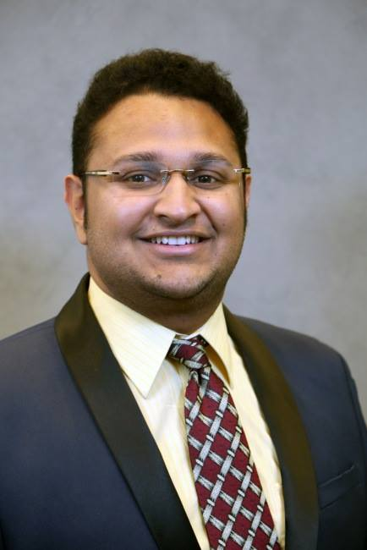

Profiles:
Student:
Kesha Shah
kesha.shah1106@gmail.com
Student (B.Tech)
DA-IICT, India (UTC + 0530)
Mentor:
Suryadip Chakraborty
suryadip.chakraborty@gmail.com
Researcher (Ph.D)
University of Cincinnati, (UTC - 0400)

Slide 3
Background:
Ushahidi:
Ushahidi, Inc. is a non-profit software company that develops free and open-source software (LGPL) for information collection, visualisation, and interactive mapping. The organisation uses the concept of crowdsourcing for social activism and public accountability. [1]
Goals:
The objective of this project is to create, maintain and execute automated tests for Ushahidi Web application deployed on http://pc-crowdmap-dev.systers.org. The aim is to create reusable and automated scripts for regression testing.
[1] https://en.wikipedia.org/wiki/Ushahidi
Notes:
Started with Kenya
The deployed version contains crowdsourcing Guyana deaf community

Slide 4




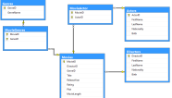
Identifying the core:
Tests:
Feature Testing
User Interface Testing
Database Testing
Load Balance Testing
Performance Testing
Pages:
Login Page
Opportunities Page
Report Page
Contact Us Page
FAQ Page
UI
Ushahidi
Database
UI
Ushahidi
Ushahidi
Server
UI

Slide 5
Why Automated Testing?
Efficiency
Quality
Reusability
Consistency
Decrease of Costs
Advance a Tester´s Motivation and Efficiency
Increase of Test Coverage
Optimization of Speed
Less Error-prone

Slide 6
Tech Stack:
Tools and Technologies:
Language: Java
Database: MySQL
Testing: Selenium (Junit Test Framework)
Reporting: Surefire
IDE: Eclipse
Build Tool: Maven
Version Control: Github
Continuous Integration: Jenkins
Web Browser: Google Chrome
O.S: Windows-8 (64-bit)

Slide 7
Selenium :
Definition:
Selenium is a portable software testing framework for web applications.
It is a tool or framework to automate web-browsers.
Think of Selenium as a uniform API for different browsers !!
It can be downloaded from [2].
Resources:
http://www.seleniumhq.org/docs/
http://www.pluralsight.com/courses/selenium
http://www.pluralsight.com/courses/automated-testing-framework-selenium
http://keshaassysters.blogspot.in/2015/06/making-simple-selenium-testing-app.html
[1] http://www.seleniumhq.org/
[2] http://www.seleniumhq.org/download/

Slide 8

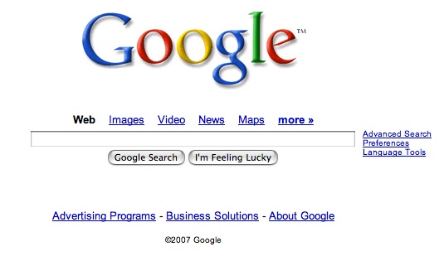
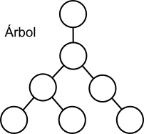


Architecture :
Inspect
Xpath/Id/Class/CSS/Name
Browser
Webpage
WebElement
Page Reference Model

Slide 9
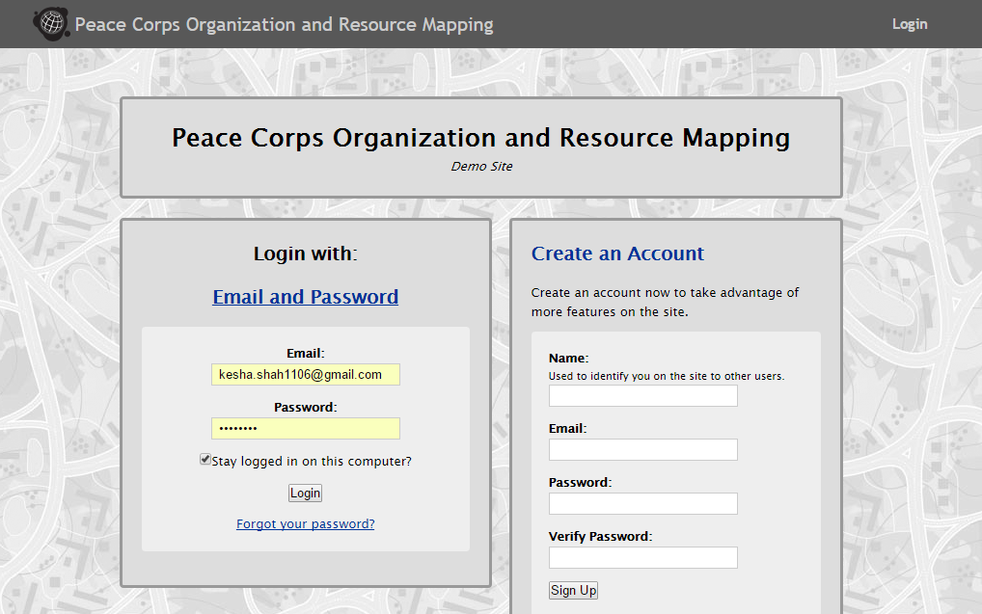
Login Tests Summary:
# Features Tests: 32
# Database Tests: 5

Slide 10
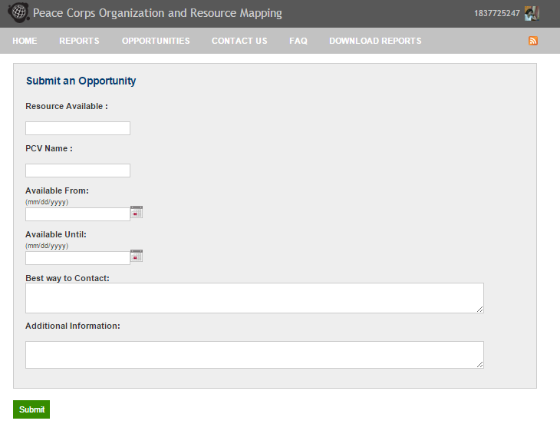
Opportunities Tests Summary:
# Features Tests: 12
# Database Tests: 9

Slide 11
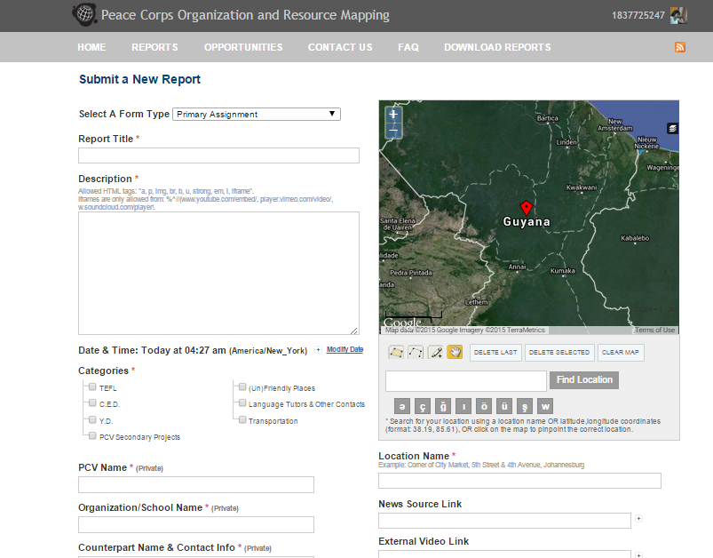
Report Tests Summary:
# Features Tests: 25
# Database Tests: 15

Slide 12
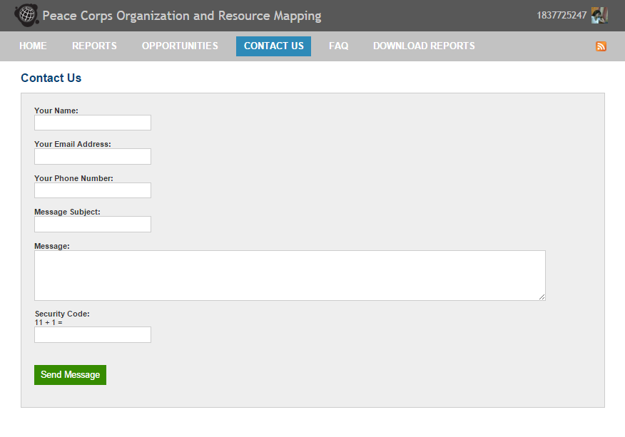
Contact Us Summary:
# Features Tests: 7

Slide 13
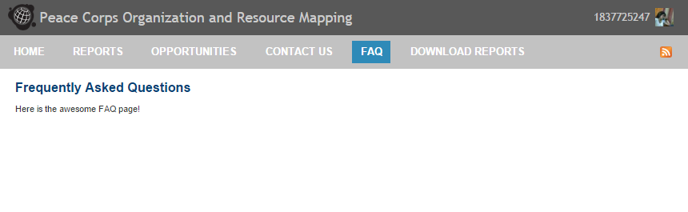
FAQ Summary:
# Features Tests: 2

Slide 14
Before Firm Pencils Down:
Admin Testing
Report Generation – surefire plugin
Code Cleanup –logger factory, output test name, DRY,
Documentation Revise
Selenium Screenshot on failure plugin

Slide 15
Future Work:
Performance Tests, Load Balance Test, Cross Platform Testing, Different browsers
Performance – independent tests – spawn threads
Bring passwords securely into the code
Support with reading test data from excel/ csv file/ xml file
Spring architecture?
More rigorous test cases for Reports, Opportunities, etc

Slide 16
Learning:
Flip bits, not burgers!
Selenium and building production level application from scratch.
Co-ordinating with other developers.
Contributing to Open source.
Writing production grade code.
Multiple timezone – Time management
Communication and soft skills

Slide 17
Issues raised on Github:
Opportunities Page doesn't populate Available Until field properly
https://github.com/systers/crowdmap/issues/23
Contact Us- Message not being sent
https://github.com/systers/crowdmap/issues/24
No checkbox when sending email –yet in error message
https://github.com/systers/crowdmap/issues/25
Make the design of Contact Us Page more verbose
https://github.com/systers/crowdmap/issues/26
Add content to FAQ Page
https://github.com/systers/crowdmap/issues/28

Slide 18
Links:
Proposal:
https://docs.google.com/document/d/1yBlxyV4Fslci9fdRIuKs4XaTjthO8MKafaG1-ojgaj0/edit?usp=sharing
Documentation:
https://docs.google.com/document/d/1MA3mHGmHmlKmTpfv-cmuxpcTvKhrATHiaX9wpngR-bU/edit?usp=sharing
Github:
https://github.com/systers/automated-testing/tree/develop/UshahidiTests
Weekly Reports:
Archives of Systers-dev mailing list
Blog:
http://keshaassysters.blogspot.in/
Test Videos:
Zing links from the documentation

Slide 19
Acknowledgements:
Google Summer of Code Program
Systers Community, an Anita Borg Institute
Mentor: Suryadip Chakraborty
Co-mentor: Rosario Robinson - @rosariorobinson
Ushahidi - Devs:
Divya Upadhyay -@divyaupadhyay
Julia Proft - @jproft
Jennifer - @jenpaff

Slide 20

Questions?

Slide 21

Thank You !

