Slide 1



An Empirical Ethics Scale for Technology Assessment: Challenges and Perspectives for a Real Time Ethics Lab Meeting, Keller Research Group, Monday 06/27/2022
Dr. Philipp Höfele, DAAD-P.R.I.M.E.-Fellow
Julius Fenn, PhD Candidate in the DFG Research Training Group "Statistical Modeling in Psychology"
Freie Universität Berlin
Institute for Philosophy
Habelschwerdter Allee 30
14195 Berlin, Germany
e-mail: philipp.hoefele@fu-berlin.de
Pennsylvania State University
Department of Philosophy
240 Sparks Building
University Park, PA 16802, USA
e-mail: pmh5437@psu.edu
Albert-Ludwigs-Universität Freiburg
Institute of Psychology, Cognition, Action, and Sustainability
Engelbergerstr. 41, 79085 Freiburg, Germany
e-mail: julius.fenn@psychologie.uni-freiburg.de

Slide 2


An Empirical Ethics Scale for Technology Assessment
Structure of our presentation:
(1) Challenges for technology assessment and flood risk management: stakeholder attitudes
(2) Responses: inter- and transdisciplinarity, empirical ethics, and real-time ethics
(3) Methodological implementation: ethics scale on six key ethics types
(4) Validation of developed scale
(5) Statistical opportunities
(6) Conclusions
An Empirical Ethics Scale for Technology Assessment, Lab Meeting, Keller Research Group, 06/27/2022

Slide 3
(1) Challenges for technology assessment and flood risk management: stakeholder attitudes
Great Acceleration in the Anthropocene (accelerating technological developement, waste, carbon dioxide,…)
Emerging technologies with normative uncertainties
Ethical decisions are required that involve various stakeholder groups as well as the perspectives of future generations
Slide by Parker and Tuana, NCAR
An Empirical Ethics Scale for Technology Assessment, Lab Meeting, Keller Research Group, 06/27/2022

Slide 4
(2) Responses: Inter- and transdisciplinarity, empirical ethics, and real-time ethics
(a) Empirical ethics
cooperation of moral psychology and ethics
descriptive and normative
description, interpretation, explanation, evaluation and change of social practices by using empirical data
identification of external conditions that influence the process of ethical decision making
(b) Inter- and transdisciplinarity
involvement of various societal groups and sciences to research in emerging technologies
interdisciplinary evaluation at the technology level, the artifact level and the application level
Incorporation of transdisciplinary perspectives (perspectives from various social groups)
(c) Real-time ethics
technology assessment at an early stage is often based on insufficient information (possible side-effects on society and nature)
“Collingridge dilemma” (inverse proportionality between sufficient information and possibilities for revision)
reduction of the normative uncertainty of emerging technologies
An Empirical Ethics Scale for Technology Assessment, Lab Meeting, Keller Research Group, 06/27/2022

Slide 5
(3.1) Methodological implementation: ethics scale on six key ethics types
Questionnaire to determine the test persons’ ethical judgement of a technology
Most validated Ethics Scales:
Multidimensional Ethics Scale by Reidenbach & Robin 1988, 1990
Shortcomings in terms of content and psychometrics
central moral theories are missing
based on too few items
Background in business ethics
→ limitations in the context of technology assessment
Benefits of an Empirical Ethics Scale for Technology Assessment
Ethical assessment of a technology in terms of several moral principles
Online studies reaching out to people with
a) no expertise, b) interactional expertise and c) contributory expertise
Inclusion of public perspectives and values brings ethical conflicts between groups of actors to the surface
An Empirical Ethics Scale for Technology Assessment, Lab Meeting, Keller Research Group, 06/27/2022

Slide 6
(3.2) Methodological implementation: ethics scale on six key ethics types
Ethical input in the form of questions on six key types of ethics (attention is directed in a specific direction by experts) and at the same time integration of the societal perspectives of ethical laypersons:
Deontology
Question 1
Deontology | A technology is morally right if it respects basic principles and duties.
Utilitarianism | A technology is morally right if it leads to the greatest good for the greatest number.
Hedonism | A technology is morally right if it increases pleasure, well-being or promotes a good life of an individual agent.
Virtue ethics | The developer is a genuinely virtuous person and has developed the technology taking into account her virtuous characteristics.
Contractualism | A technology is morally right if it does not violate moral norms that arise from mutual consensus.
Relativism | The moral judgement of a technology depends on the personal, societal or cultural contexts, which influence the standards of justification and procedures of justification.
Question …
Utilitarianism
Empirical Ethics Scale of Technology Assessment (ESTA)
Hedonism
Virtue ethics
Contractualism
Relativism
Question …
Question 51
Fenn, J.*, Höfele P.*, Livanec S., Reuter, L., Müller, O. & Kiesel, A. (in prep.). An Empirical Ethics Scale for Technology Assessment: Challenges and Perspectives for a Real Time Ethics for Emerging Technologies.
An Empirical Ethics Scale for Technology Assessment, Lab Meeting, Keller Research Group, 06/27/2022

Slide 7
(3.3) Methodological implementation: ethics scale on six key ethics types
Relativism
Contractiualism
Hedonism
Utilitarianism
different stakeholder groups
different age
different origin
different levels of education
…
Deontology
Virtue ethics
Fenn, J.*, Höfele P.*, Livanec S., Reuter, L., Müller, O. & Kiesel, A. (in prep.). An Empirical Ethics Scale for Technology Assessment: Challenges and Perspectives for a Real Time Ethics for Emerging Technologies.
An Empirical Ethics Scale for Technology Assessment, Lab Meeting, Keller Research Group, 06/27/2022

Slide 8
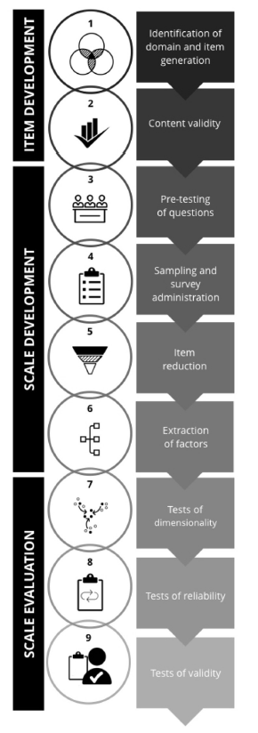
(4) Forthcoming: validation study
Validation of the “Ethics Scale of Technology Assessment”
Study 1: Item generation and item review
> Pretest developed items qualitatively
Study 2: Examining dimensionality
> Get dimensionality of scale, scale purification
Study 3: Examining the nomological net
> Determine construct validity
Fenn, J., Höfele, P., Gros, W., Helm, J., Müller, O. & Kiesel, A. (in prep.). The Ethics Scale of Technology Assessment: Validation of a Measure for the Empirical Assessment of Emerging Technologies.
An Empirical Ethics Scale for Technology Assessment, Lab Meeting, Keller Research Group, 06/27/2022
Figure 1 from Boateng et al., 2018

Slide 9



(5) Statistical opportunities: collecting data
Possible study design:
A scenario-text is presented to the participants
Afterwards they will answer the “Ethics Scale of Technology Assessment” (and additional questions)
An Empirical Ethics Scale for Technology Assessment, Lab Meeting, Keller Research Group, 06/27/2022

Slide 10
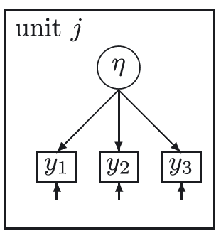
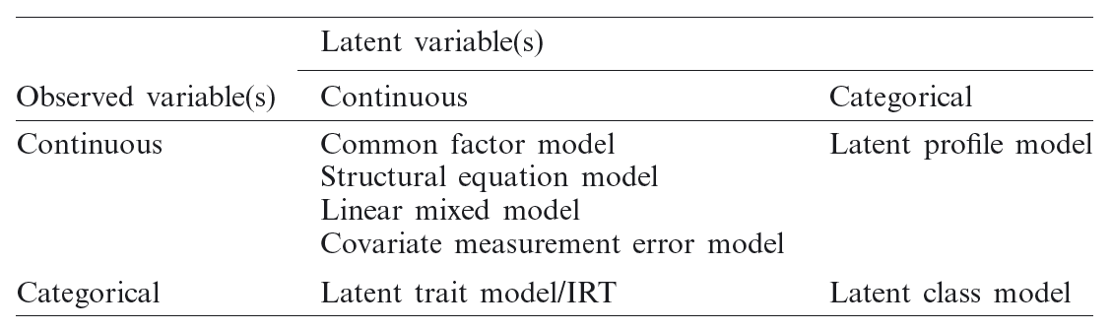
(5) Statistical opportunities: latent variable models
Reflexive measurement model assumes that the answer to the questions of a construct η (like Hedonism) are considered to be caused by that construct
Figure 1 from Skrondal & Rabe-Hesketh, 2007
> we can apply the framework of latent variable models
Table 1 from Skrondal & Rabe-Hesketh, 2007
An Empirical Ethics Scale for Technology Assessment, Lab Meeting, Keller Research Group, 06/27/2022

Slide 11
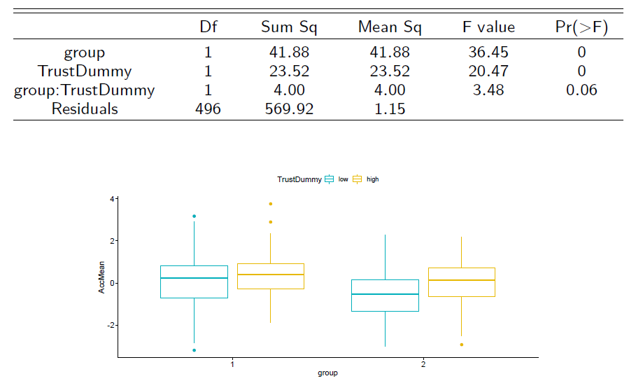
(5.1) mean comparison
Are there significant mean differences in the ethical evaluation of technologies between laypersons vs. experts?
Test for mean differences* between different stakeholder groups:
* precondition: (partial) scalar measurement invariance
An Empirical Ethics Scale for Technology Assessment, Lab Meeting, Keller Research Group, 06/27/2022

Slide 12

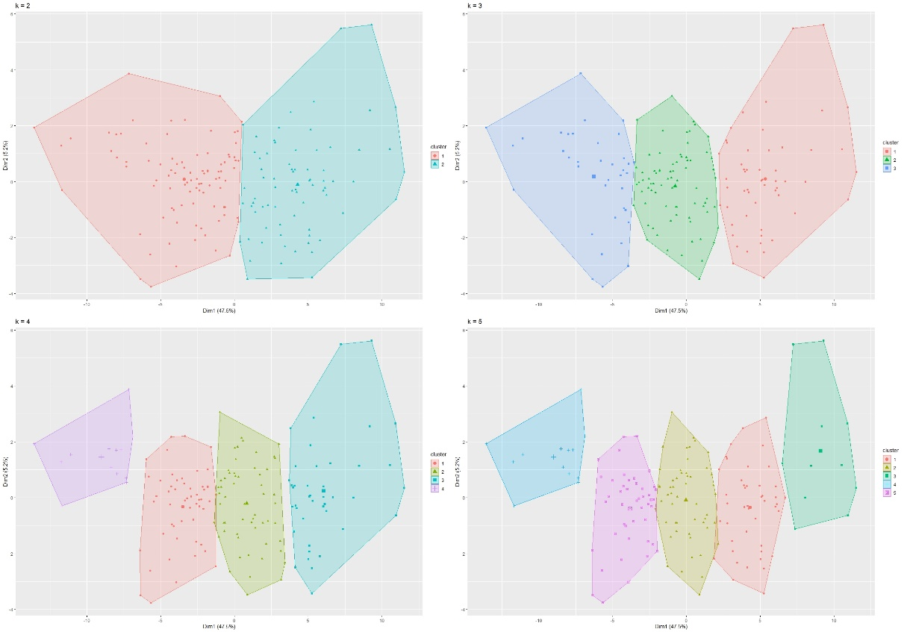
(5.2) latent class analyis / cluster analysis
Are technologies ethically evaluated differently by participants (or laypersons vs. experts)?
Apply latent class analysis or cluster analysis (like k-means clustering)
Cluster | Relativism | Contractualism | Utilitarianism | Deontology | Virtue ethics | Hedonism
1 | 2.43 | 2.58 | 3.32 | 2.79 | 3.14 | 2.94
2 | 3.79 | 4 | 4.71 | 3.89 | 4.36 | 4.2
3 | 5.22 | 5.29 | 5.77 | 5.01 | 5.43 | 5.39
An Empirical Ethics Scale for Technology Assessment, Lab Meeting, Keller Research Group, 06/27/2022

Slide 13
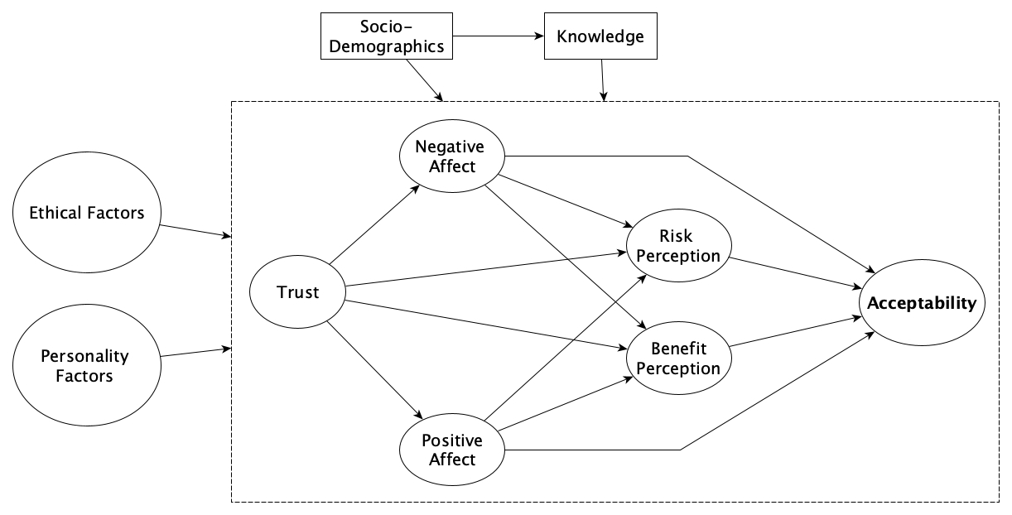
(5.3) structural equation model
What is the effect of the ethical evaluation of a technology on its acceptability?
Test the direct and indirect effects on pre-assumed causal relationships:
An Empirical Ethics Scale for Technology Assessment, Lab Meeting, Keller Research Group, 06/27/2022

Slide 14
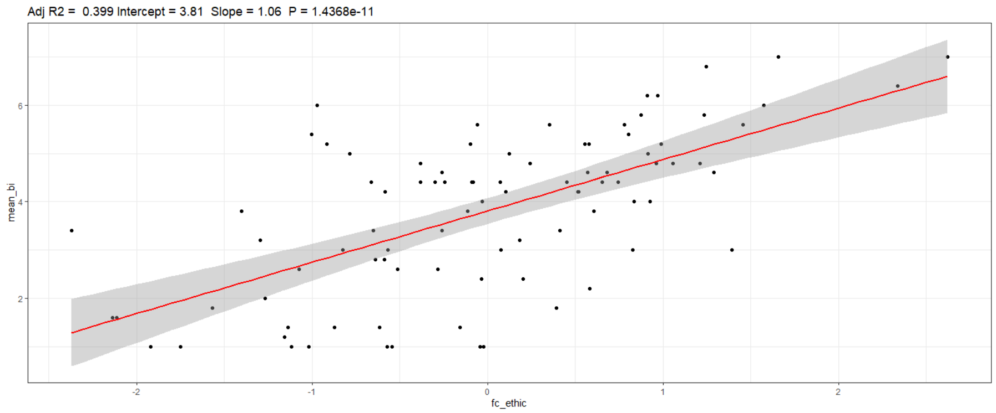
(5.3) ethic predict acceptability
We conceptualize ESTA as the degree respondents believe a technology is morally acceptable regarding multiple ethical theories
An Empirical Ethics Scale for Technology Assessment, Lab Meeting, Keller Research Group, 06/27/2022

Slide 15
(6) Conclusions
The “Ethics Scale of Technology Assessment” allows a highly economic assessment of possible ethical concerns of different stakeholders
only represents a “broad early warning system”, needs to be supplemented by decision analysis, impact analysis or risk assessment, … (Keller et al., 2021)
To the best of our knowledge it is the first time possible to test if technologies are evaluated ethically differently
like iPhones are evaluated more strongly on hedonistic aspects (“the iPhone maximizes my pleasure”) vs. nuclear power plants are evaluated more strongly in a utilitarian perspective (“the nuclear power plant produces more benefits than harm for society”)
Preliminary results showing the importance of the ethical evaluation on acceptability
An Empirical Ethics Scale for Technology Assessment, Lab Meeting, Keller Research Group, 06/27/2022

Slide 16
Bibliography
Thank you for your attention!
Questions?
Bessette, D. L., Mayer, L. A., Cwik, B., Vezér, M., Keller, K., Lempert, R. J., & Tuana, N. (2017). Building a values‐informed mental model for new orleans climate risk management. Risk Analysis, 37(10), 1993-2004.
Boateng, G. O., Neilands, T. B., Frongillo, E. A., Melgar-Quiñonez, H. R., & Young, S. L. (2018). Best Practices for Developing and Validating Scales for Health, Social, and Behavioral Research: A Primer. Frontiers in Public Health, 6, 149-149.
Fenn, J.*, Höfele P.*, Livanec S., Reuter, L., Müller, O. & Kiesel, A. (in prep.). An Empirical Ethics Scale for Technology Assessment: Challenges and Perspectives for a Real Time Ethics for Emerging Technologies.
Keller, K., Helgeson, C., & Srikrishnan, V. (2021). Climate risk management. Annual Review of Earth and Planetary Sciences, 49, 95-116.
Möller, M*, Höfele, P*, Kiesel, A, Speck, O 2021. Reactions of sciences to the Anthropocene: Highlighting inter- and transdisciplinary practices in biomimetics and sustainability research. Elem Sci Anth, 9: 1. DOI: https://doi.org/10.1525/elementa.2021.03Tuana 2019.
Reidenbach, R. E., & Robin, D. P. 1988. Some initial steps toward improving the measurement of ethical evaluations of marketing activities. J Bus Ethics, 7, 871–879. https://doi.org/10.1007/BF00383050.
Reidenbach, R. E., & Robin, D. P. 1990. Toward the development of a multidimensional scale for improving evaluations of business ethics. Journal of Business Ethics, 9(8), 639–653. https://doi.org/10.1007/BF00383391.
Skrondal, A., & Rabe‐Hesketh, S. (2007). Latent variable modelling: A survey. Scandinavian Journal of Statistics, 34(4), 712-745.
An Empirical Ethics Scale for Technology Assessment, Lab Meeting, Keller Research Group, 06/27/2022

Slide 17
Ethic Scale I
Ethics | Item number | negative (left) | positive (right)
Relativism | "relativist01" | "...is culturally unacceptable" | "...is culturally acceptable"
 | "relativist02" | "...is unacceptable to my family" | "...is acceptable to my family"
 | "relativist03" | "...is traditionally unacceptable" | "...is traditionally acceptable"
 | "relativist04" | "...is individually unacceptable" | "...is individually acceptable"
 | "relativist05" | "...is unacceptable to people I most admire" | "...is acceptable to people I most admire"
Contractualism | "contractualist01" | "...is unjust" | "...is just"
 | "contractualist02" | "...is unfair" | "...is fair"
 | "contractualist03" | "…respects an unwritten contract" | "...does not respect an unwritten contract"
 | "contractualist04" | "…respects an unspoken promise" | "...does not respect an unspoken promise"
 | "contractualist05" | "...does not result in an equal distribution of good and bad" | "...results in an equal distribution of good and bad"
 | "contractualist06" | "...violates my ideas of fairness" | "...does not violate my ideas of fairness"
 | "contractualist07" | "...impedes political rights" | "...supports political rights"
An Empirical Ethics Scale for Technology Assessment, Lab Meeting, Keller Research Group, 06/27/2022

Slide 18
Ethic Scale II
Ethics | Item number | negative (left) | positive (right)
Hedonism | "hedonism01" | "...is personally unsatisfactory " | "...is personally satisfactory"
 | "hedonism02" | "...would be selfish for me to use" | "...would not be selfish for me to use"
 | "hedonism03" | "...requires me to make sacrifices in order to use it" | "...does not require me to make sacrifices in order to use it"
 | "hedonism04" | "...is not in the best interests of my person" | "...is in the best interests of my person"
 | "hedonism05" | "...minimizes my pleasure" | "...maximizes my pleasure"
 | "hedonism06" | "...is a hindrance to a good personal life" | "...promotes a good personal life"
 | "hedonism07" | "...harms my health" | "...promotes my health"
 | "hedonism08" | "...harms my freedom" | "...promotes my freedom"
 | "hedonism09" | "...harms my safety" | "...promotes my safety"
Utilitarianism | "utilitarian01" | "…provides the least utility for society" | "…provides the greatest utility for society"
 | "utilitarian02" | "...minimizes benefits for society" | "...maximizes benefits for society"
 | "utilitarian03" | "...maximizes harm for society" | "...minimizes harm for society"
 | "utilitarian04" | "...tends overall to be bad for society" | "...tends overall to be good for society"
 | "utilitarian05" | "...is not OK if actions can be justified by their consequences for society" | "...is OK if actions can be justified by their consequences for society"
 | "utilitarian06" | "...leads to the least good for the greatest number" | "...leads to the greatest good for the greatest number"
 | "utilitarian07" | "...leads to the greatest ill for the greatest number" | "...leads to the least ill for the greatest number"
 | "utilitarian08" | "...results in a negative cost-benefit ratio for society" | "...results in a positive cost-benefit ratio for society"
 | "utilitarian09" | "...is inefficient for society" | "...is efficient for society"
 | "utilitarian10" | "...leads to future harm for society" | "...provides for future benefit society"
An Empirical Ethics Scale for Technology Assessment, Lab Meeting, Keller Research Group, 06/27/2022

Slide 19
Ethic Scale III
Ethics | Item number | negative (left) | positive (right)
Deontology | "deontology01" | "...does not imply a moral obligation to act in a certain way" | "...implies a moral obligation to act in a certain way"
 | "deontology02" | "…harms the autonomy of users" | "…promotes the autonomy of users"
 | "deontology03" | "…obliges a certain immoral behaviour" | "...obliges a certain moral behaviour"
 | "deontology04" | "...is not morally right" | "...is morally right"
 | "deontology05" | "…goes against an important moral rule by which I live" | "...does not go against an important moral rule by which I live"
 | "deontology06" | "...implies a moral obligation to act otherwise" | "...implies no moral obligation to act otherwise"
 | "deontology07" | "...prevents treatment with respect in interactions" | "...ensures treatment with respect in interactions"
 | "deontology08" | "...prevents treatment with dignity in interactions" | "...ensures treatment with dignity in interactions"
 | "deontology09" | "...attacks the intrinsic value of nature" | "...protects the intrinsic value of nature"
 | "deontology10" | "...attacks the value of the ecological environment" | "…protects the value of the ecological environment"
 | "deontology11" | "...attacks the value of the cultural environment" | "...protects the value of the cultural environment"
An Empirical Ethics Scale for Technology Assessment, Lab Meeting, Keller Research Group, 06/27/2022

Slide 20
Ethic Scale IV
Ethics | Item number | negative (left) | positive (right)
Virtue ethics | "virtue01" | "…is developed by someone who has wrong motivations" | "…is developed by someone who has good motivations"
 | "virtue02" | "…is developed by someone who has wrong desires" | "…is developed by someone who has good desires"
 | "virtue03" | "...is developed by someone who has a bad character" | "...is developed by someone who has a good character"
 | "virtue04" | "...is developed by someone who is not prudent" | "...is developed by someone who is prudent"
 | "virtue05" | "...is developed by someone who is not reasonable" | "...is developed by someone who is reasonable"
 | "virtue06" | "...is developed by someone who is not striving for professional excellence" | "...is developed by someone who is striving for professional excellence"
 | "virtue07" | "...is developed by someone who is indifferent towards nature" | "…is developed by someone who is respectful towards nature"
 | "virtue08" | "…is developed by someone who is insensitive to interactions with society" | "…is developed by someone who is sensitive to interactions with society"
 | "virtue09" | "...is developed by someone who is acting on ill intentions" | "...is developed by someone who is acting on good intentions"
An Empirical Ethics Scale for Technology Assessment, Lab Meeting, Keller Research Group, 06/27/2022

Slide 21
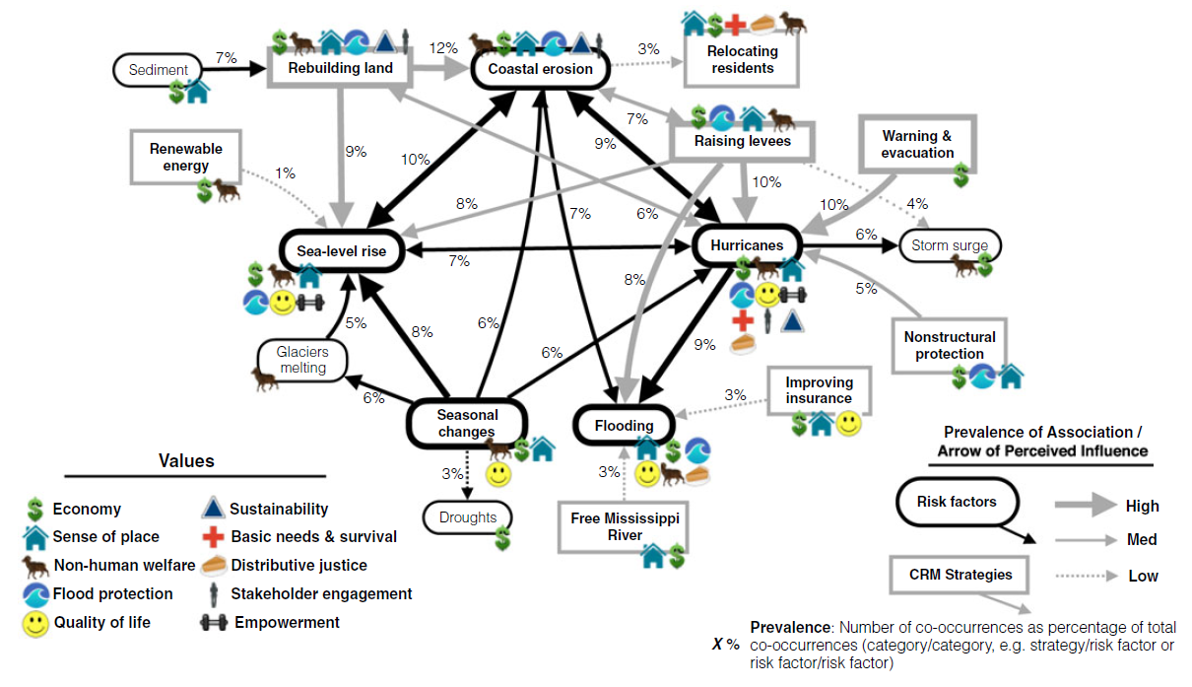
Additional methods currently researched
Cognitive-Affective Maps <-> Values-Informed Mental Model
Figure 1 from Bessette et al., 2017
An Empirical Ethics Scale for Technology Assessment, Lab Meeting, Keller Research Group, 06/27/2022

