Slide 1
Modular Neural Networks
CPSC 533
Franco Lee
Ian Ko

Slide 2
Modular Neural Networks
What is it?
Different models of neural networks combined into a single system. Each single network is made into a module that can be freely intermixed with modules of other types in that system.

Slide 3
Agenda
1) Issues leading to the development of modular neural networks
2) Problems in Neural Network Modeling
3) Cascade Correlation
- characteristics
- algorithm
- mathematical background
- examples

Slide 4
Issues Leading to Modular Networks
-> Reducing Model Complexity
-> Incorporating Knowledge
-> Data Fusion and Prediction Averaging
-> Combination of Techniques
-> Learning Different Tasks Simultaneously
-> Robustness and Incrementality

Slide 5
Problems in Neural Network Modeling:
-> The selection of the appropriate number
of hidden units
-> Inefficiencies of Back-Propagation: 1) Slow Learning
2) Moving Target problem

Slide 6
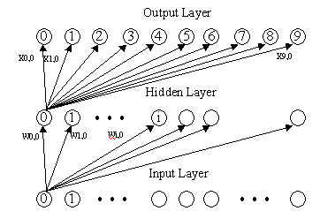
Problems in Neural Network Modeling:
Selection of hidden units:
Courtesy of Neural Nets Using Back-propagation presentation - CPSC 533

Slide 7
Problems in Neural Network Modeling:
Slow Learning:
When training a network with back-propagation, all input weights into the hidden units must be re-adjusted to minimize the residual error.

Slide 8
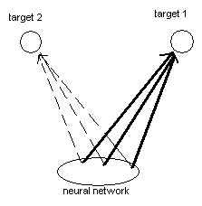
Problems in Neural Network Modeling:
Moving Target Problem:
Each unit within the network is trying to evolve into a feature detector but input problems are changing constantly. This causes all hidden units to be in a chaotic state, and it takes a long time to settle down.

Slide 9
Problems in Neural Network Modeling:
Moving Target Problem:
The Herd Effect: Suppose we have a number of hidden units to solve two tasks. Each unit can not communicate with one another, so they must decide independently which task to tackle. If one task generates a larger error signal, then all units tend to solve this task and ignore the other. Once it has been solved, then all units moves to the second task, but the first problem will re-appear.

Slide 10
Cascade Correlation (CC):
Characteristics
-> supervised learning algorithm
- evaluated on its performance via external source
-> a network that determines its own size and
topology
- starts with input/output layer
- builds a minimal multi-layer network by creatingits own hidden layer

Slide 11
Cascade Correlation (CC):
Characteristics
-> recruits new units according to the residual
approximation error
- trains and adds hidden units one by one to tackle new tasks, hence “Cascade ”
- the residual error “Correlation ” between the new units and its output is maximized
- input weights going into the new hidden unit
become frozen (fixed)

Slide 12
Cascade Correlation (CC)
-> CC combines two ideas:
- cascade architecture:
hidden units added one at a time and is frozen
- learning algorithm:
trains and installs new hidden units

Slide 13
CC Algorithm
-> starts with minimal network consisting of a input and output layer.
-> train the network with a learning algorithm (ie. Gradient Descent, Simulating Annealing)
-> train until no significant error reduction can be measured
-> add new hidden unit to reduce residual error

Slide 14
CC Algorithm
-> hidden units are added one by one to the network which is connected by all input units and to every pre-existing hidden unit
-> freeze all incoming weights of the hidden unit
-> repeat until desired performance is reached

Slide 15
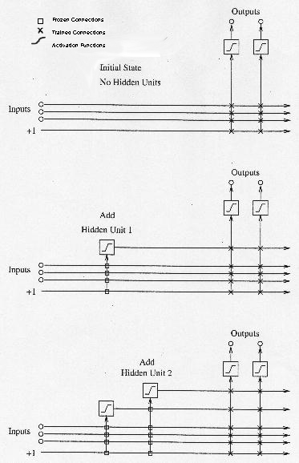
Cascade Correlation - Diagram

Slide 16
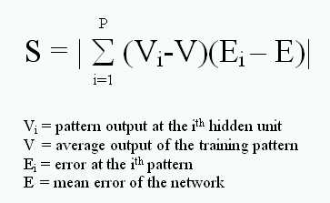
CC Mathematical Background
We want to maximize ‘S’ where S is the sum of all output units. This leads to the creation of very powerful and organized feature detectors (the hidden units).

Slide 17
Example: Speech Recognition
The difficulties with speech recognition:
-> deciphering different phonetics sounds
-> everyone has a different voice!

Slide 18
Example: Speech Recognition
A simple example:
Designing a network which can classify speech data into one of 10 different phonemes.

Slide 19
Example: Speech Recognition
-> train 10 hidden units separately, put them
together and train the output unit one by one
-> adding new phoneme: train new hidden units for this phoneme and add to the network, and then retrain the output layer

Slide 20
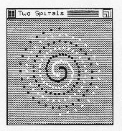
Example: Two-Spirals Problem
A primary benchmark for the back-propagation algorithms because it is an extremely hard problem to solve.

Slide 21
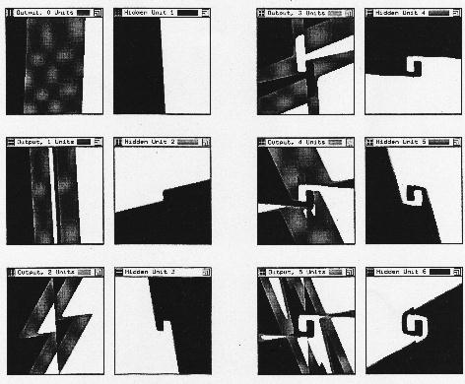
Example: Two-Spirals Problem

Slide 22
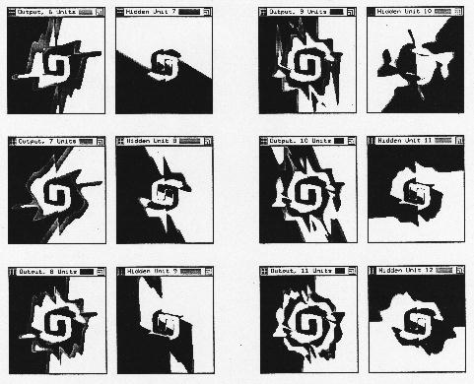

Example: Two-Spirals Problem

Slide 23
Cascade Correlation (CC)
Advantages:
-> reduces learning time
-> transparent
-> creates a structured network

Slide 24
Cascade Correlation (CC)
Disadvantages:
Can lead to specialization of just the training sets.

Slide 25
Cascade Correlation References
1. Rojas, R. (1996). Neural Networks - A Systematic Introduction. Springer - Verlag Berlin Heidelberg.
2. http://www.mass.u-bordeaux2.fr/~corsini/SNNS_Manual/node164.html
3. ftp://archive.cis.ohio-state.edu/pub/neuroprose/fahlman.cascor-tr.ps.Z

