Slide 1
Team 3
Xiangwei Wang
Jiahui Geng
Ruiming Huang
Yu Qiao

Slide 2



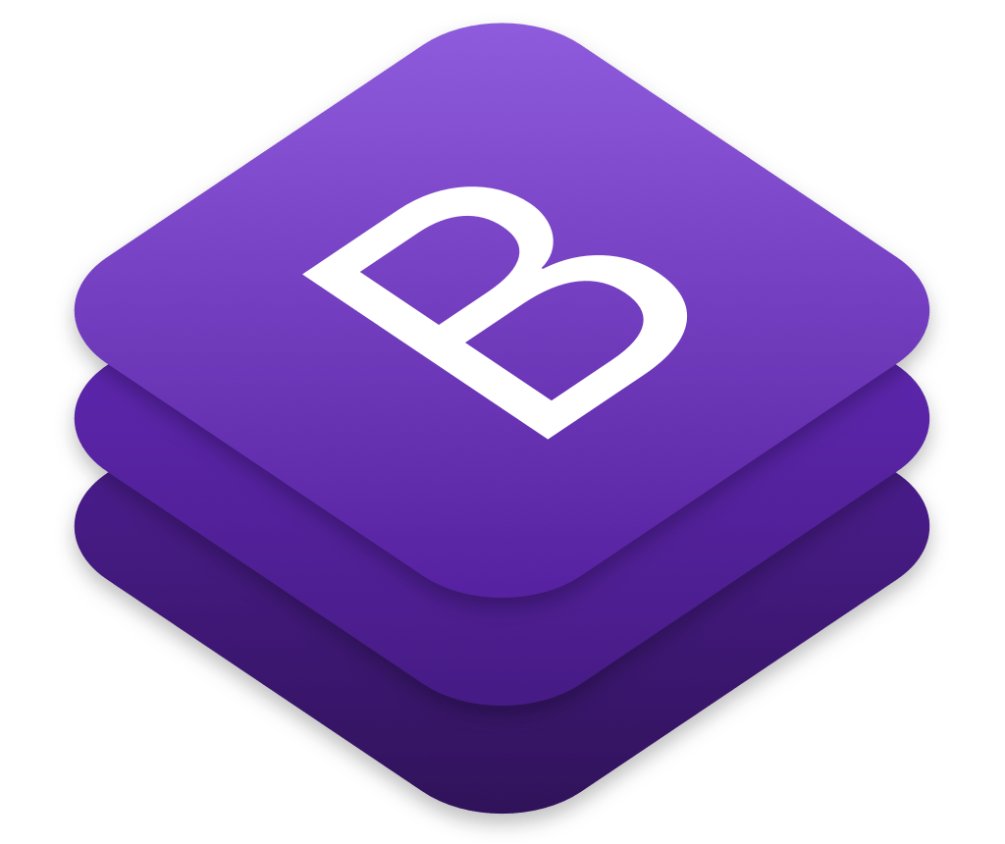

Technical Overview

Slide 3

CouchDB
Document Storage
NoSQL database
ACID Properties
Authentication and Session Support
keep authentication via session cookie

Slide 4
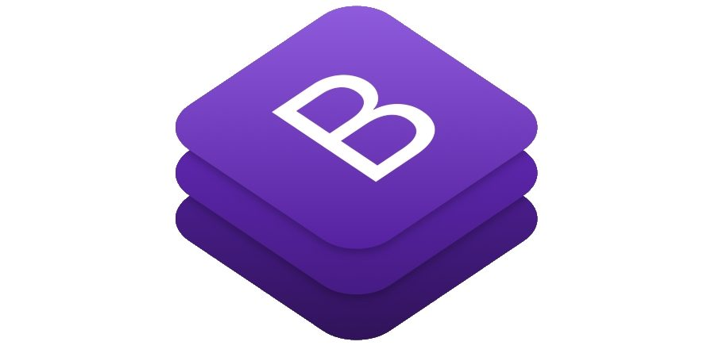

Socket.IO
Socket.IO enables real-time bidirectional event-based communication
Real-time analysis
Instant messaging and chat
Binary streaming
Document collaboration

Slide 5
Bootstrap
The most popular HTML, CSS, and JS library in the world.
Why Use Bootstrap?
Easy to use
Responsive features
Mobile-first approach
Browser compatibility

Slide 6

Consensus
Enlightened by Hyperleger Fabric

Slide 7
Consensus
1. Frontend raise proposal to Database
2. Database “accept” or “refuse” the propose
3. If the proposal is accepted by Databse, frontend forward the response of Database to Orderer
4. Orderer takes care of consenus. Orderer will push the “Order” either when a certain num of proposal comes or it comes to a certain time.
5. Orderer send order to Database, Database computes the final “update set”, modifies the CouchDB and at the same time send the Set to Frontend
1
Frontend
Database
2,5
3
4
CouchDB
Orderer

Slide 8
Flexibility
The “Orderer” can be replaced by any framework ideals with massage and streaming.
e.g. Apache Kafa

Slide 9
Scalability
By using framework, we can make “Orderer” into a cluster.
With a some change at “Frontend”, the “Database” can also be a cluster.

Slide 10
TODO
“Guarded ticket”
Acctually a mini blockchain network.
Use Apache Kafka

