Slide 1
A Generalized Reduction of Ordered Binary Decision Diagram
(GroBdd)
Joan Thibault

Slide 2
Reduced Ordered Binary Decision Diagram (ROBDD)
Applications
  Computer Aided Design (e.g. equivalence checking)
  Knowledge Representation (e.g. Artificial Intelligence)
  Combinatorial Problems (e.g. N-Queens problem)
What are required operation ?
  Compact representation
  Operations (e.g. composing, concatening, evaluation)
  Operators (e.g. AND, XOR, ITE, NOT)
  Reductions (e.g. quantification, partial evaluation, SAT)

Slide 3
Shanon’s Binary Decision Tree
F
= if False
= if True
= False
= True

Slide 4
Binary Decision Diagram
(We merged isomorphic sub-trees)
F
= if False
= if True
= False
= True
For aesthetic reasons, we do not merge all terminals

Slide 5
Reduced Ordered Binary Decision Diagram (ROBDD)
F
= if False
= if True
= False
= True
4
3
3
2
2
2
2
1
1
1
1
For aesthetic reasons, we do not merge all terminals

Slide 6
ROBDD : reduction rule
= if False
= if True
= False
= True
x
y
y
For aesthetic reasons, we do not merge all terminals

Slide 7
Reduced Ordered Binary Decision Diagram (ROBDD)
F
= if False
= if True
= False
= True
4
3
3
2
2
2
2
1
1

Slide 8
“output negation” : reduction rule (N1)
= if False
= if True
= False
= True
complemented edge
For aesthetic reasons, we do not merge all terminals

Slide 9
“output negation” : reduction rule (N2)
= if False
= if True
= False
= True
= Not
x
x
y
z
y
z
For aesthetic reasons, we do not merge all terminals

Slide 10
“output negation” : reduction rule (N3)
= if False
= if True
= False
= True
= Not
For aesthetic reasons, we do not merge all terminals

Slide 11
ROBDD + “output negation”
F
= if False
= if True
= False
= True
= Not
4
3
3
2
2
1

Slide 12
Zero supressed Binary Decision Diagram (ZBDD)
F
= if False
= if True
= False
= True
4
3
3
2
2
2
2
1
1
1
1
For aesthetic reasons, we do not merge all terminals

Slide 13
ZBDD : reduction rule (Z1)
= if False
= if True
= False
= True
x
For aesthetic reasons, we do not merge all terminals

Slide 14
ZBDD : reduction rule (Z2)
= if False
= if True
= False
= True
x
y
y
For aesthetic reasons, we do not merge all terminals

Slide 15
Zero supressed Binary Decision Diagram (ZBDD)
F
= if False
= if True
= False
= True
4
3
3
2
2
2
1
1
For aesthetic reasons, we do not merge all terminals

Slide 16
ZBDD + “output negation”
F
= if False
= if True
= False
= True
4
3
3
2
2
2
1
1
For aesthetic reasons, we do not merge all terminals

Slide 17

ZBDD + “output negation”
F
= if False
= if True
= False
= True
4
3
3
2
2
2
1
1
For aesthetic reasons, we do not merge all terminals

Slide 18
ZBDD + “output negation”
F
= if False
= if True
= False
= True
NOT CANONICAL
4
3
3
2
2
2
1
1
For aesthetic reasons, we do not merge all terminals

Slide 19
Generalized Reduction of Ordered
Binary Decision Diagram
(GroBdd)
NU-X
NU
U
N
Z

Slide 20
Generalized Reduction of Ordered
Binary Decision Diagram
(GroBdd)
GroBdd:
“output negation” +
“useless variables extraction”
+ “1-prediction extraction”
NU-X
GroBdd:
“output negation” +
“useless variables extraction”
NU
U
N
Z
GroBdd:
“useless variables extraction”
ROBDD +
“output negation”
ZBDD

Slide 21
GroBdd
Useless variables extraction: model U
“output Negation” + U = NU
NU + “1-prediction extraction” = NU-X
Results
Conclusion
Theory of GroBdd
input Negation and output Negation Invariant extraction: model NNI

Slide 22
Binary Decision Diagram
F
= if False
= if True
= False
= True
For aesthetic reasons, we do not merge all terminals

Slide 23
Section 1 : model U
F
= if False
= if True
= False
= True
Functions of arity 4
SSSS
Functions of arity 3
S = significant
SSS
SSS
Functions of arity 2
SS
SS
SS
SS
Functions of arity 1
S
S
S
S
S
S
Functions of arity 0
For aesthetic reasons, we do not merge all terminals

Slide 24
“Useless variables extraction” : reduction rule (U1)
= if False
= if True
= False
= True
SS...S
S = significant
U = useless
US...S
S...S
S...S
A
A
For aesthetic reasons, we do not merge all terminals

Slide 25
“Useless variables extraction” : reduction rule (U2)
(i+1)-th variable
= if False
= if True
= False
= True
SSSSS
SSSSU
S = significant
U = useless
USSU
SUSU
USS
SUS
A
B
A
B
i-th variable
For aesthetic reasons, we do not merge all terminals

Slide 26
Section 1 : model U
F
= if False
= if True
= False
= True
SSSS
S = significant
U = useless
SSS
SSS
SS
SS
SS
SS
S
S
S
S
S
S
S
S
Apply U1
For aesthetic reasons, we do not merge all terminals

Slide 27
Section 1 : model U
F
= if False
= if True
= False
= True
SSSS
S = significant
U = useless
SSS
SSS
SS
SS
SS
SS
S
S
S
S
S
S
U
U
Apply U1
For aesthetic reasons, we do not merge all terminals

Slide 28
Section 1 : model U
F
= if False
= if True
= False
= True
SSSS
S = significant
U = useless
SSS
SSS
SS
SS
SS
SS
S
S
S
S
U
U
U
U
Apply U2
For aesthetic reasons, we do not merge all terminals

Slide 29
Section 1 : model U
F
= if False
= if True
= False
= True
SSSS
S = significant
U = useless
SSS
SSS
SS
SS
SS
SU
S
S
S
S
U
U
Apply U2
For aesthetic reasons, we do not merge all terminals

Slide 30
Section 1 : model U
F
= if False
= if True
= False
= True
SSSS
S = significant
U = useless
SSS
SSS
SS
SS
SU
SU
S
S
S
S
Apply U2
For aesthetic reasons, we do not merge all terminals

Slide 31
Section 1 : model U
F
= if False
= if True
= False
= True
SSSS
S = significant
U = useless
SSS
SSU
SS
SS
S
S
S
S
S
S
For aesthetic reasons, we do not merge all terminals

Slide 32
Section 1 : model U
F
= if False
= if True
= False
= True
Functions of arity 4
SSSS
Functions of arity 3
S = significant
U = useless
SSS
SSU
Functions of arity 2
SS
SS
Functions of arity 1
S
S
S
S
S
S
Merge
Functions of arity 0
For aesthetic reasons, we do not merge all terminals

Slide 33
Section 1 : model U
F
= if False
= if True
= False
= True
Functions of arity 4
SSSS
Functions of arity 3
S = significant
U = useless
SSS
SSU
Functions of arity 2
SS
SS
Functions of arity 1
S
S
S
S
Functions of arity 0
For aesthetic reasons, we do not merge all terminals

Slide 34
Section 1 : model U
F
= if False
= if True
= False
= True
Functions of arity 4
SSSS
Functions of arity 3
S = significant
U = useless
SSS
SSU
Functions of arity 2
SS
SS
Functions of arity 1
S
S
S
S
Functions of arity 0
For aesthetic reasons, we do not merge all terminals

Slide 35
“output negation” : reduction rule (N1)
= if False
= if True
= False
= True
complemented edge
For aesthetic reasons, we do not merge all terminals

Slide 36
“output negation” : reduction rule (N2)
= if False
= if True
= False
= True
= Not
x
x
y
z
y
z
For aesthetic reasons, we do not merge all terminals

Slide 37
“output negation” : reduction rule (N3)
= if False
= if True
= False
= True
= Not
For aesthetic reasons, we do not merge all terminals

Slide 38
Section 2 : model NU
F
= if False
= if True
= False
= True
= Not
Functions of arity 4
SSSS
Functions of arity 3
S = significant
U = useless
SSS
SSU
Functions of arity 2
SS
SS
Functions of arity 1
S
S
S
S
Apply N1
Functions of arity 0
For aesthetic reasons, we do not merge all terminals

Slide 39
Section 2 : model NU
F
= if False
= if True
= False
= True
= Not
Functions of arity 4
SSSS
Functions of arity 3
S = significant
U = useless
SSS
SSU
Functions of arity 2
SS
SS
Functions of arity 1
S
S
S
S
Apply N2
Functions of arity 0
For aesthetic reasons, we do not merge all terminals

Slide 40
Section 2 : model NU
F
= if False
= if True
= False
= True
= Not
Functions of arity 4
SSSS
Functions of arity 3
S = significant
U = useless
SSS
SSU
Functions of arity 2
SS
SS
Functions of arity 1
S
S
S
S
Apply N2
Functions of arity 0
For aesthetic reasons, we do not merge all terminals

Slide 41
Section 2 : model NU
F
= if False
= if True
= False
= True
= Not
Functions of arity 4
SSSS
Functions of arity 3
S = significant
U = useless
SSS
SSU
Functions of arity 2
SS
SS
Functions of arity 1
S
S
S
S
Apply N2
Functions of arity 0
For aesthetic reasons, we do not merge all terminals

Slide 42
Section 2 : model NU
F
= if False
= if True
= False
= True
= Not
Functions of arity 4
SSSS
Functions of arity 3
S = significant
U = useless
SSS
SSU
Functions of arity 2
SS
SS
Functions of arity 1
S
S
S
S
Apply N3
Functions of arity 0
For aesthetic reasons, we do not merge all terminals

Slide 43
Section 2 : model NU
F
= if False
= if True
= False
= True
= Not
Functions of arity 4
SSSS
Functions of arity 3
S = significant
U = useless
SSS
SSU
Functions of arity 2
SS
SS
Functions of arity 1
S
S
S
S
Merge
Functions of arity 0
For aesthetic reasons, we do not merge all terminals

Slide 44
Section 2 : model NU
F
= if False
= if True
= False
= True
= Not
Functions of arity 4
SSSS
Functions of arity 3
SSS
S = significant
U = useless
SSU
Functions of arity 2
SS
SS
Functions of arity 1
S
S
Functions of arity 0
For aesthetic reasons, we do not merge all terminals

Slide 45
N vs NU
F
F
= if False
= if True
= False
= True
= Not
SSSS
4
S = significant
U = useless
SSS
3
3
SSU
SS
SS
2
2
S
S
1
N =
ROBDD + “output negation”
Model NU

Slide 46
N vs NU: Example 2
= if False
= if True
= False
= True
= Not
S = significant
U = useless
F
G
F
G
2
US
SU
1
N =
ROBDD + “output negation”
Model NU

Slide 47
N vs NU: Example 3
= if False
= if True
= False
= True
= Not
H = ITE(3, F, G)
H
SSS
S = significant
U = useless
3
2
US
SU
1
N =
ROBDD + “output negation”
Model NU

Slide 48
N vs NU: Example 4
H
H’
H
H
UUUSSS
SSSUUU
6
5
4
3
2
US
SU
1
N =
ROBDD + “output negation”
Model NU

Slide 49
“1-prediction” : reduction rule (X1-’1’)
= if False
= if True
= False
= True
= Not
SS...S
1S...S
S = significant
U = useless
1 = If 0 then 0
0 = If 1 then 0
I = If 0 then 1
O = If 1 then 1
U...U
S...S
A
A
For aesthetic reasons, we do not merge all terminals

Slide 50
“1-prediction” : reduction rule (X1-’O’)
= if False
= if True
= False
= True
= Not
SS...S
OS...S
S = significant
U = useless
1 = If 0 then 0
0 = If 1 then 0
I = If 0 then 1
O = If 1 then 1
S...S
U...U
A
A
For aesthetic reasons, we do not merge all terminals

Slide 51
“1-prediction” : reduction rule (X2-’0’)
= if False
= if True
= False
= True
= Not
SSSSS
SSSS0
S = significant
U = useless
1 = If 0 then 0
0 = If 1 then 0
I = If 0 then 1
O = If 1 then 1
1SS0
S1S0
1SS
S1S
A
B
A
B
For aesthetic reasons, we do not merge all terminals

Slide 52
Section 2 : model NU
F
= if False
= if True
= False
= True
= Not
Functions of arity 4
SSSS
Functions of arity 3
SSS
S = significant
U = useless
1 = If 0 then 0
0 = If 1 then 0
I = If 0 then 1
O = If 1 then 1
SSU
Functions of arity 2
SS
SS
Functions of arity 1
S
S
Apply X1-’1’
Functions of arity 0
For aesthetic reasons, we do not merge all terminals

Slide 53
Section 3 : model NU-X
F
= if False
= if True
= False
= True
= Not
SSSS
SSS
S = significant
U = useless
1 = If 0 then 0
0 = If 1 then 0
I = If 0 then 1
O = If 1 then 1
SSU
SS
SS
S
S
Compose (apply N3)
1
1
For aesthetic reasons, we do not merge all terminals

Slide 54
Section 3 : model NU-X
F
= if False
= if True
= False
= True
= Not
SSSS
SSS
S = significant
U = useless
1 = If 0 then 0
0 = If 1 then 0
I = If 0 then 1
O = If 1 then 1
SSU
SS
SS
Apply N2
1
1
For aesthetic reasons, we do not merge all terminals

Slide 55
Section 3 : model NU-X
F
= if False
= if True
= False
= True
= Not
SSSS
SSS
S = significant
U = useless
1 = If 0 then 0
0 = If 1 then 0
I = If 0 then 1
O = If 1 then 1
SSU
SS
SS
Apply N2
1
1
For aesthetic reasons, we do not merge all terminals

Slide 56
Section 3 : model NU-X
F
= if False
= if True
= False
= True
= Not
SSSS
SSS
S = significant
U = useless
1 = If 0 then 0
0 = If 1 then 0
I = If 0 then 1
O = If 1 then 1
SSU
SS
SS
Apply N3
1
1
For aesthetic reasons, we do not merge all terminals

Slide 57
Section 3 : model NU-X
F
= if False
= if True
= False
= True
= Not
SSSS
SSS
S = significant
U = useless
1 = If 0 then 0
0 = If 1 then 0
I = If 0 then 1
O = If 1 then 1
SSU
SS
SS
1
1
For aesthetic reasons, we do not merge all terminals

Slide 58
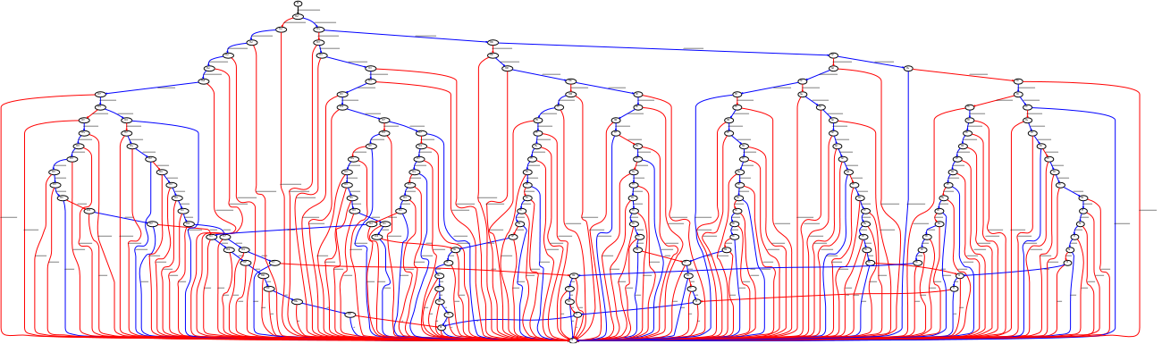
5-Queens: N or NU

Slide 59
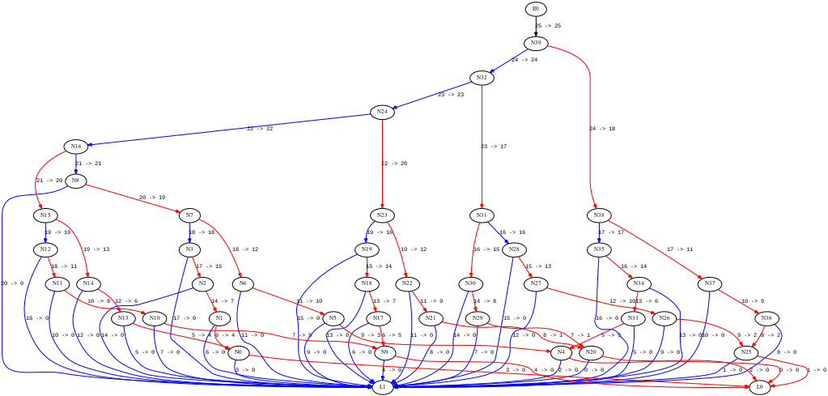
5-Queens: ZBDD

Slide 60
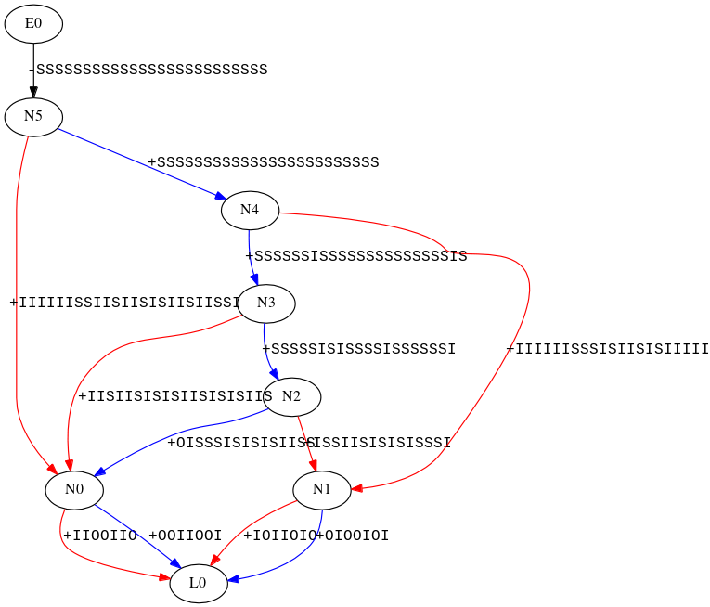
5-Queens: NU-X

Slide 61
Can we go further ?
“input/output negation”
+ “1-prediction extraction”
NNI-X
“input/output negation”
“output negation” +
“useless variables extraction”
+ “anti-variables extraction”
+ “1-prediction extraction”
NNI
NUA-X
“output negation” +
“useless variables extraction”
+ “anti-variables extraction”
“output negation” +
“useless variables extraction”
+ “1-prediction extraction”
NUA
NU-X
NU
U
N
Z

Slide 62
Results
Average reduction of the {number of nodes / estimated memory cost} on four benchmarks
 | Circuits (dense functions) |  |  |  | CNF formulas (sparse functions)
 | lgsynth91 |  | iscas99 |  | uf20-91 |  | uf50-218
variants | #node | mem | #node | mem | #node | mem | #node | mem
Z | +233% | +233% | +162% | +162% | -41% | -41% | -42% | -42%
NU | -26% | -39% | -25% | -20% | -3% | +7% | -3% | +22%
NNI | -60% | -63% | -56% | -49% | -30% | -10% | -39% | +5%
NU-X | -64% | -67% | -55% | -46% | -96% | -95% | -97% | -96%

Slide 63
Conclusion
NNI-X
Software implemented in OCaml:
  https://github.com/JoanThibault/DAGaml/tree/grobdd-dev
  ~ 12 000 lines of OCaml
Fewer nodes & Less memory
Future Work
  Quantify the dependency between variables’ order and #node
  Solve & Implement NUA-X and NNI-X versions
TO DO
  Parallelism & hardware acceleration
  Quantification Operators
  Variable Reordering
Other Applications
  Apply similar strategies to compress other DAG
    DAG / Graph isomorphism
    Unification
NNI
NUA-X
NUA
NU-X
NU
U
N
Z

Slide 64
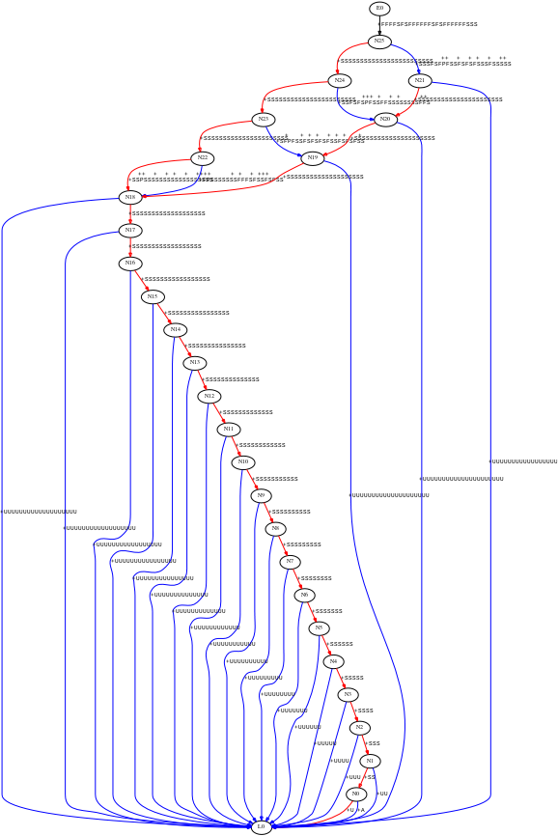
5-Queens: NNI

