Slide 1
The Next Amazon.com
— Plans for Accessibility —

Slide 2
Images and Keyboard Navigation
WCAG Success Criterion 1.1 and 2.1
All images will have alt tags to be identifiable by assistive technologies.
All purely decorative, format and/or otherwise inconsequential images will be implemented in a way to be ignorable by assistive technologies.
The page will be implemented in a way that can be wholly accessed and navigated through with only the keyboard.

Slide 3
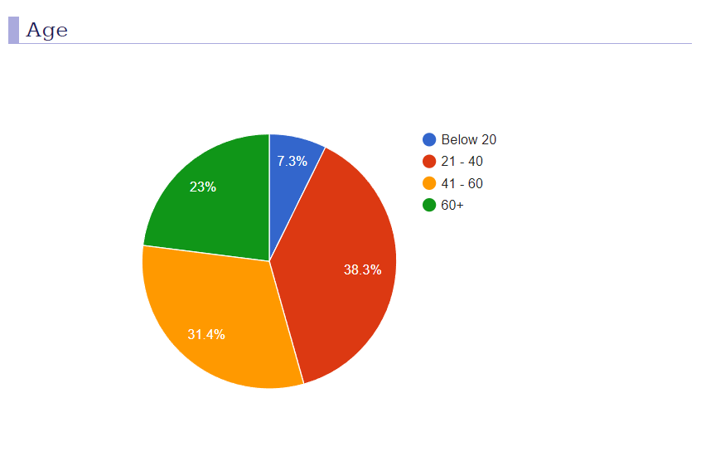
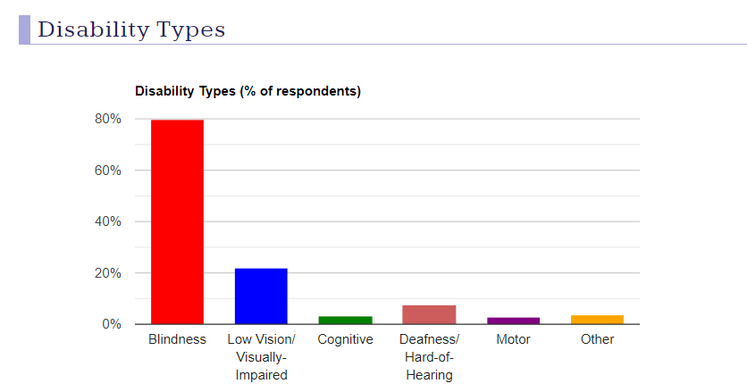
Screen Reader
WCAG Success Criterion 1.1.1 - Non-text content (sensory)
Ensure the website is perceivable to visually disabled or impaired
Make alt tags/headers/titles descriptive and robust if necessary
Implement “ARIA roles” for navigation
Challenge: Thoroughness and organization
*Graphics by https://webaim.org/projects/screenreadersurvey9/

Slide 4
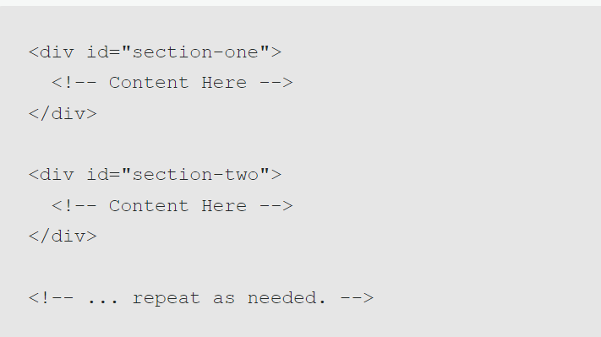
Continuous Scroll Links
WCAG Success Criterion 2.4.9 - Link Purpose
Ensure the site is navigable through reliable links and consistent structure
Label each associating section’s link with appropriate and descriptive text in the link making the purpose clear to the user

Slide 5
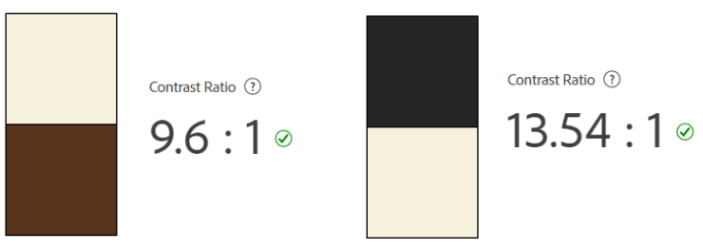
Color Contrast
WCAG SC 1.4.3 - “The visual presentation of text and images of text has a contrast ratio of at least 4.5:1, except for [certain logos, unimportant images or large text].”
We plan to use colors with high contrast ratios (for both light and dark mode options) to ensure that it is easy to see for all viewers regardless of potential vision impairments.

Slide 6
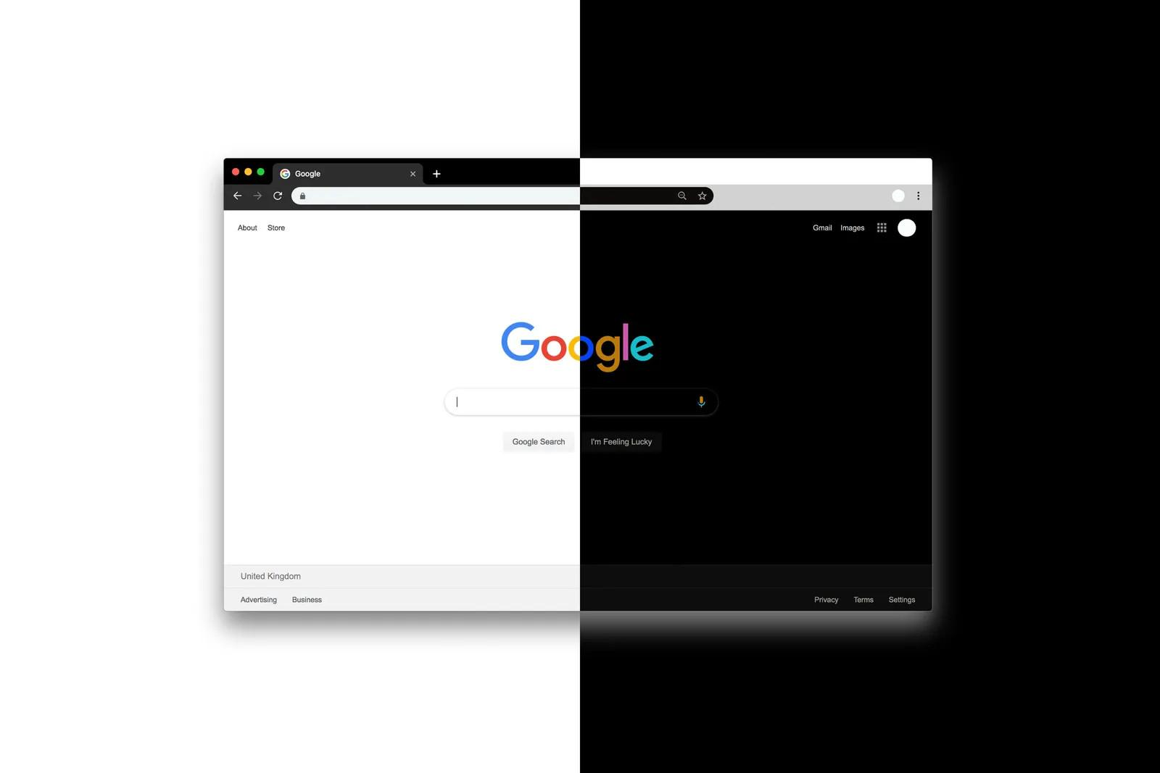
Light/Dark Mode
WCAG Visual Presentation 1.4.8 - user selectable foreground and background
Plans to implement light and dark mode to make site more accessible to those who color may effect.
Will give user control over whether they need the light or dark theme. Will implement button to change theme with distinct color making the accessibility options easier to find.

Slide 7
Adjustable Font Sizing
WCAG Success Criterion 1.4.4 - Resize Text
Rendered text including text-based controls can be scaled successfully so that it can be read directly by people with mild visual disabilities without the use of assistive technology.
Goals for our website-
Ensure text in every feature can be increased
Content is operational when magnified up to 200 percent without loss of content or functionality
Providing controls on the web page that allows users to incrementally change the size of all text

Slide 8
Interactive Elements Zoom
WCAG Success Criterion 1.4.13
“The additional content remains visible until the hover or focus trigger is removed”
Certain interactive elements (such as menu buttons) will enlarge slightly upon hover and and will stay enlarged until the user decides to no longer hover.
Makes it more clear to the user the significance of the element and that it is interactive (i.e. a link, button, etc.)

Slide 9
Animation Optionality
WCAG Success Criterion 2.3.1 and 2.3.3
Any animations not critical to the functioning of the page will have the option to be disabled by the user.
No animations will have more than three “flashes” (relative changes in brightness/size/etc.) within a one second period.

Slide 10
Well Implemented Form
WCAG Success Criterion 1.3.5
Our “Contact Us” form will be properly implemented and labeled such that it is easy to use/navigate/understand even for those with assistive technologies.

Slide 11
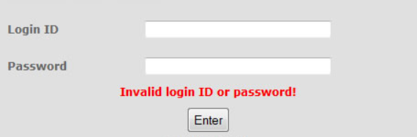
Input/Errors
WCAG Success Criterion 3.3.1 and 3.3.5 - Input Assistance
Ensure website is understandable by providing clear input assistance
Prevention: Use text to specify expected input for admin login (adding placeholder)
If error occurs: Provide text indicating the required fields that were unsatisfactory

