Slide 1
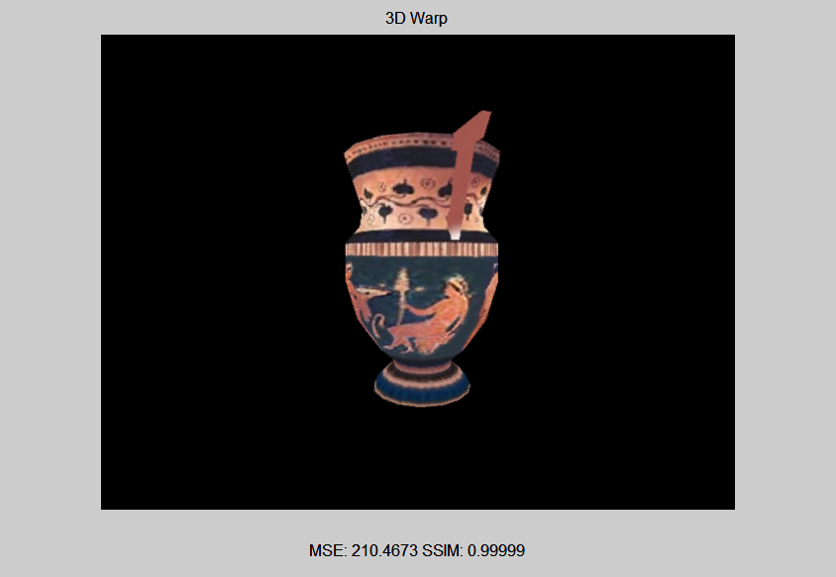
Critically Sampled

Slide 2
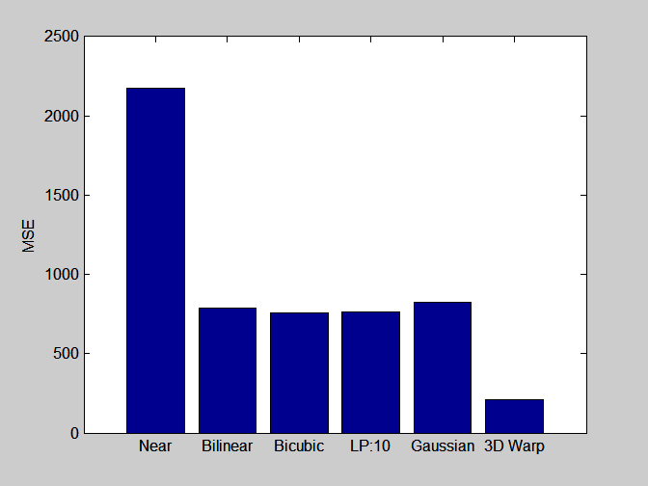
Critically Sampled

Slide 3
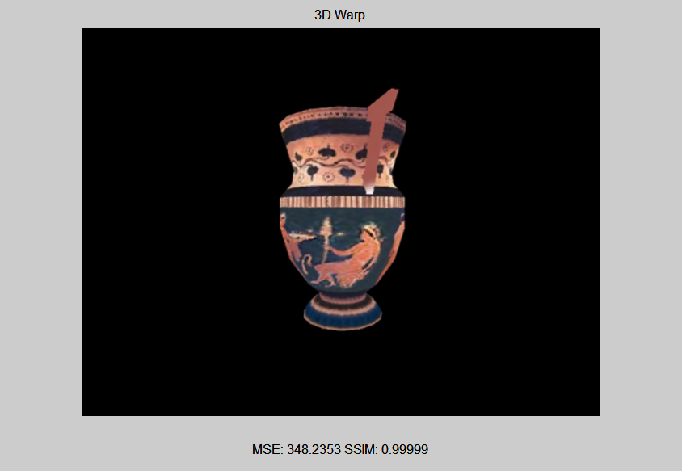
Oversampled by 2

Slide 4
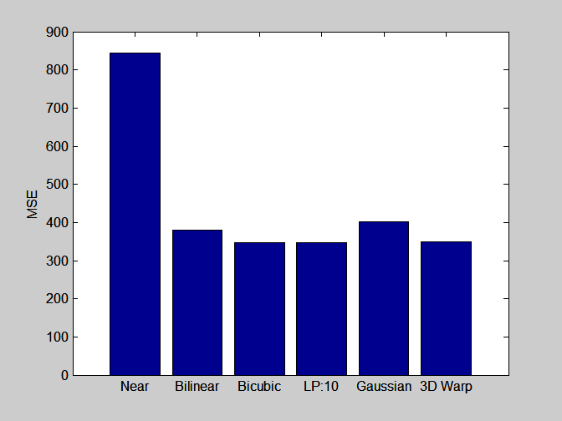
Oversampled by 2

Slide 5
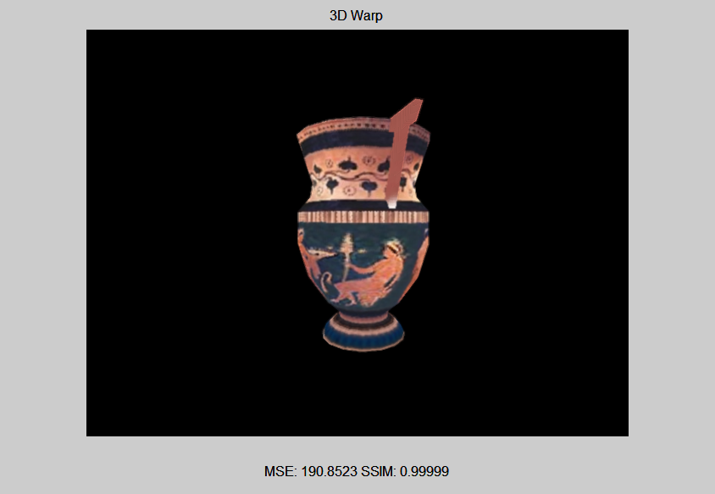
Undersampled by 2

Slide 6
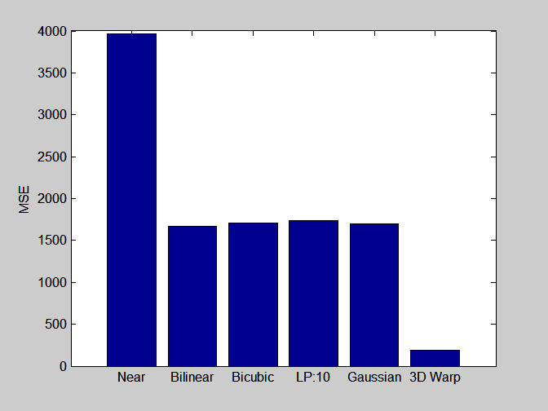
Undersampled by 2

Slide 7
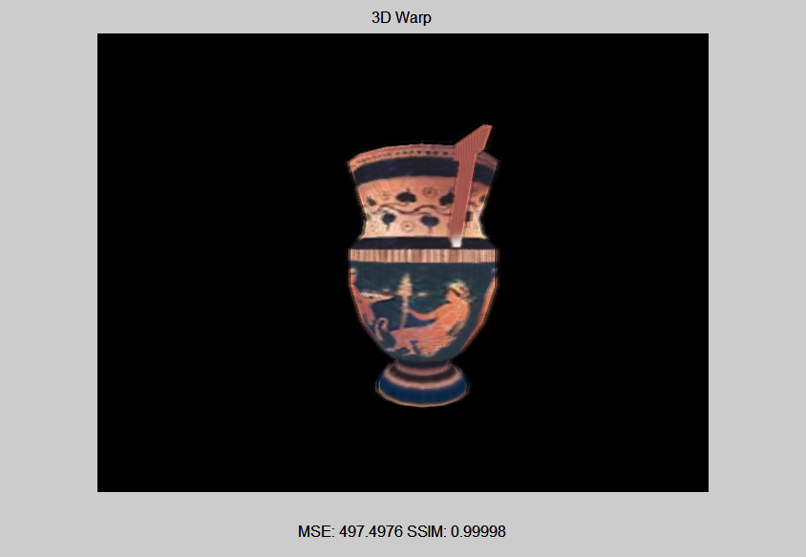
Undersampled by 5

Slide 8
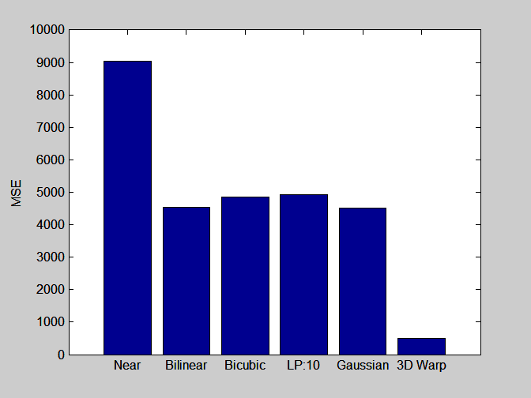
Undersampled by 5

Slide 9
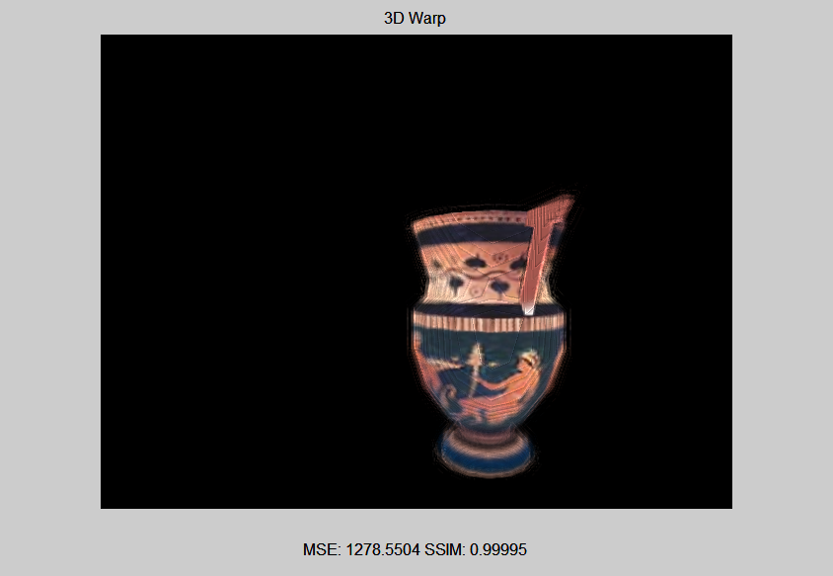
Undersampled by 20

Slide 10
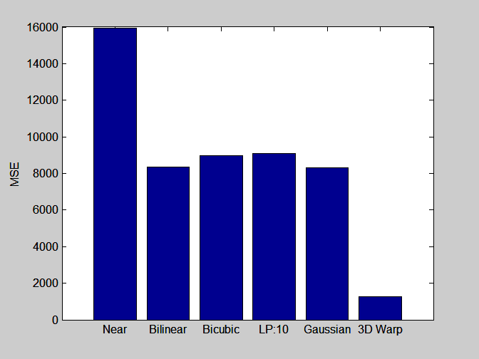
Undersampled by 20

Slide 11

Undersampled by 20, 256 level z

Slide 12

Undersampled by 20, 256 level z

Slide 13
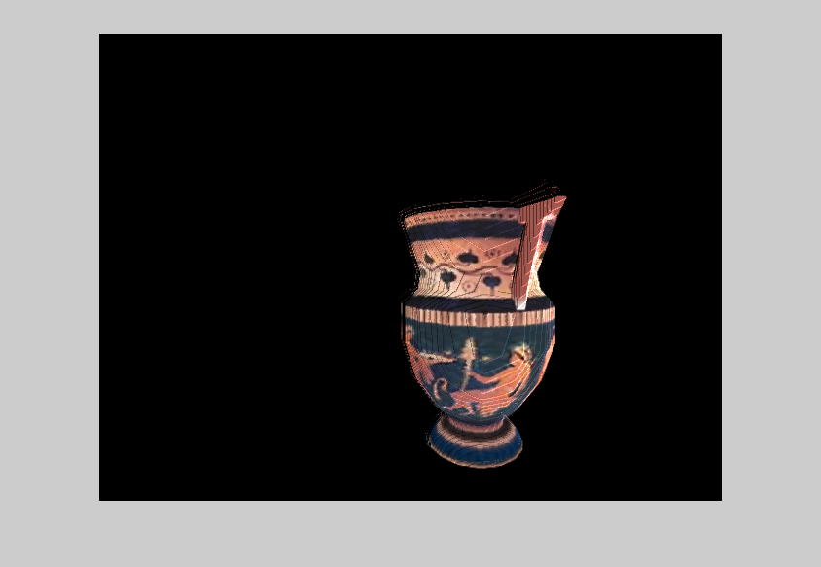
Single large warp, 64 level z

