Slide 1

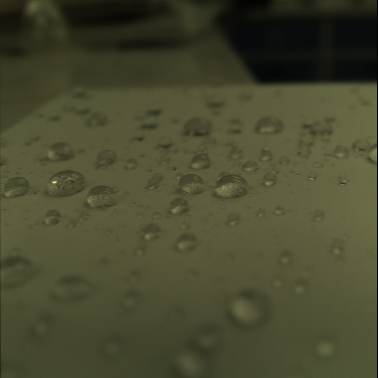
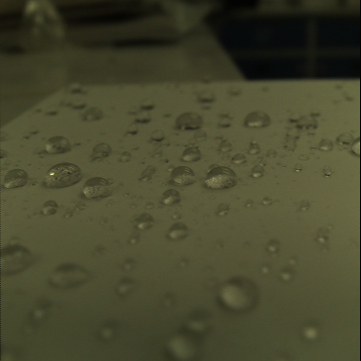
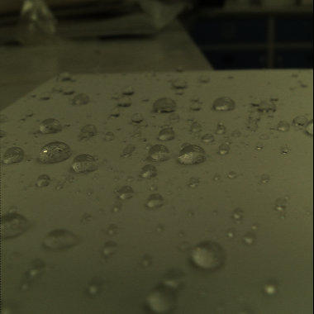
Top left: 9 angles
Top right: 7 angles
SSIM: 1.000
Bottom left:
5 angles
SSIM: .9766
Bottom right:
3 angles
SSIM: .9405
1 angle
SSIM: .8821

Slide 2

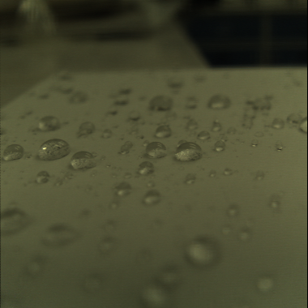
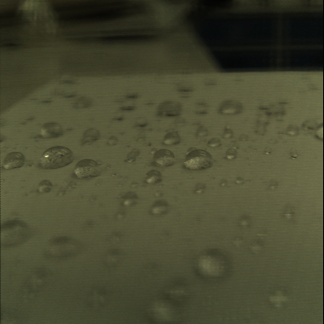
Top left: 9 angles
Top right: 5 angles
1,3,5,7,9
SSIM: .9952
Bottom left:
3 angles
1,4,7
SSIM: .9854
Bottom right:
3 angles
1,5,9
SSIM: .9508

