Slide 1
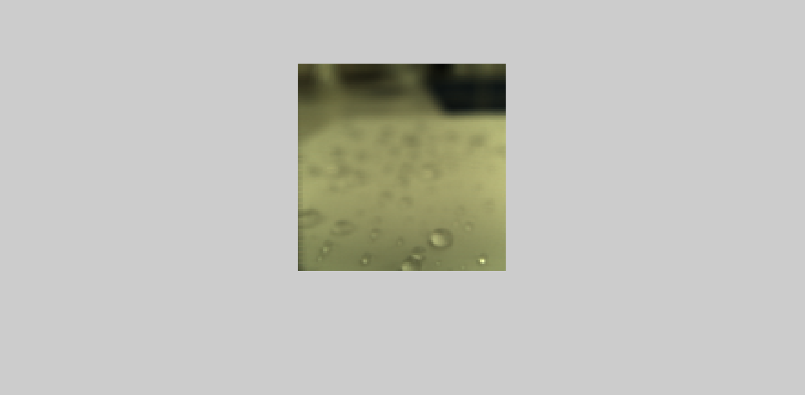
alpha = .3

Slide 2

alpha = .45

Slide 3
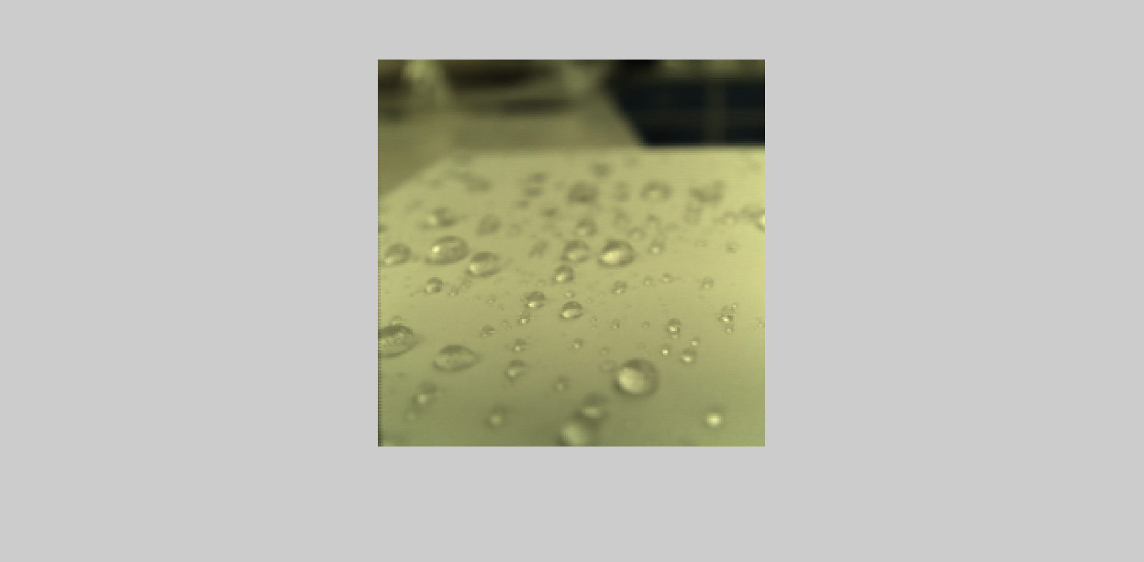
alpha = .6

Slide 4
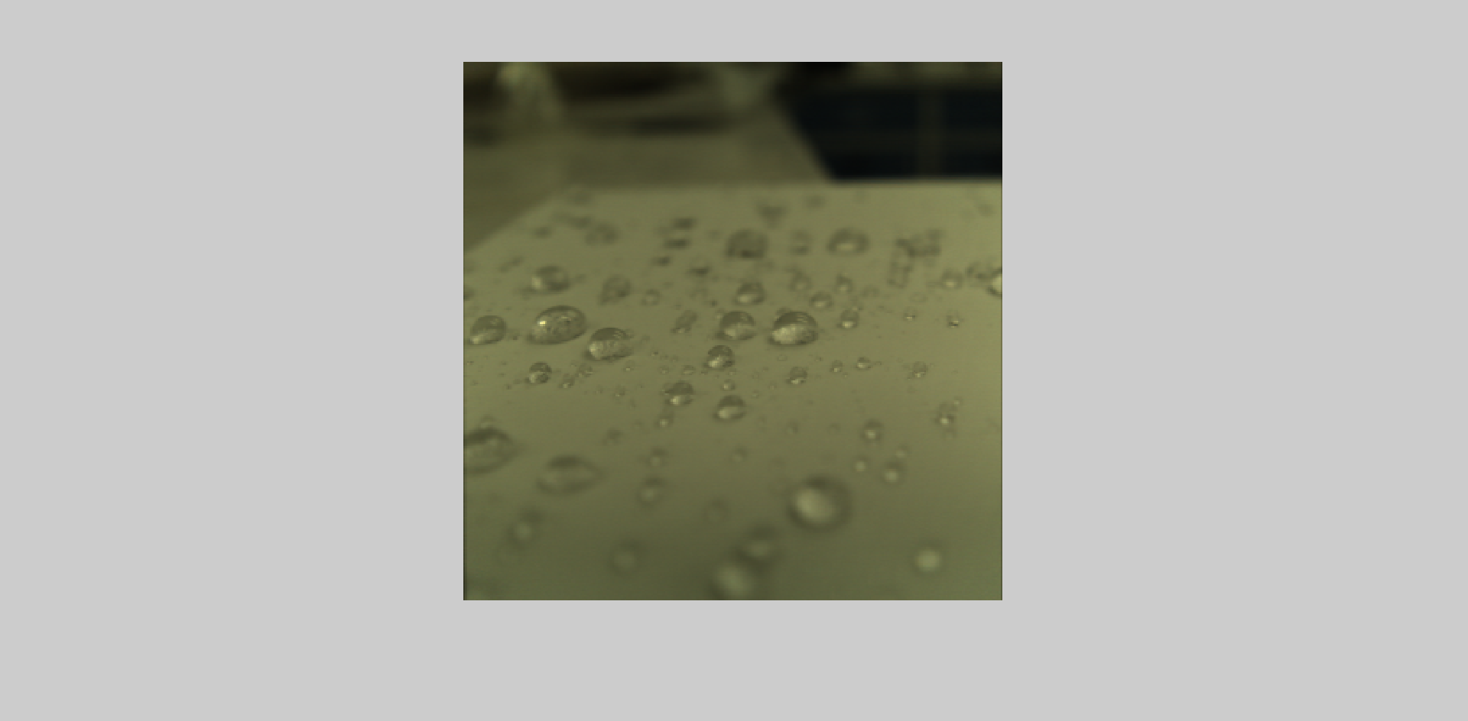
alpha = .8

Slide 5
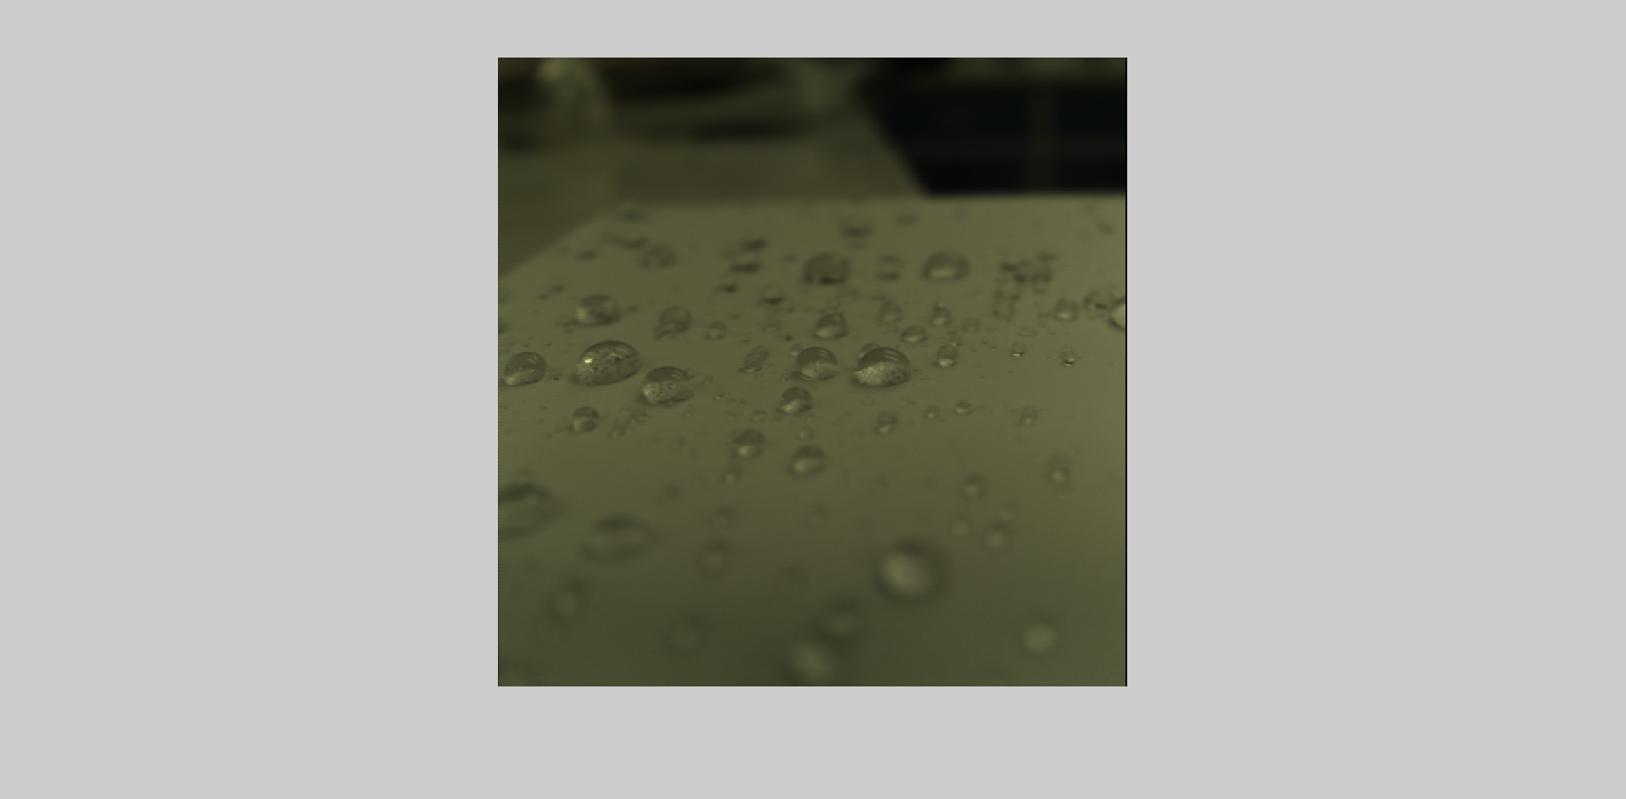
alpha = 1

Slide 6
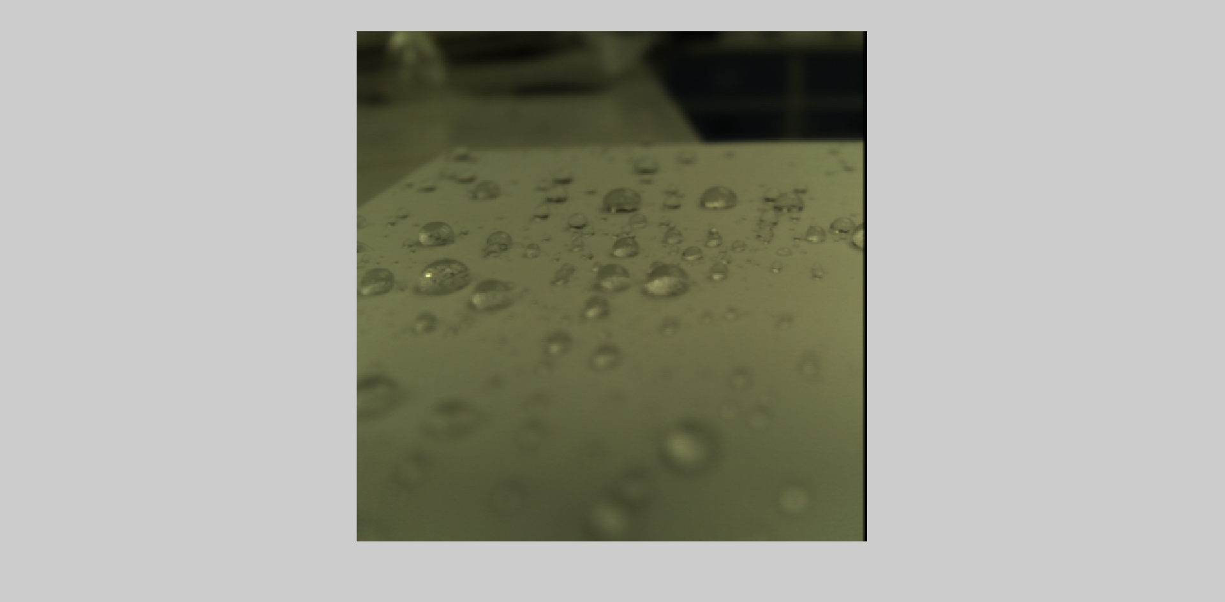
alpha = 1.5

Slide 7
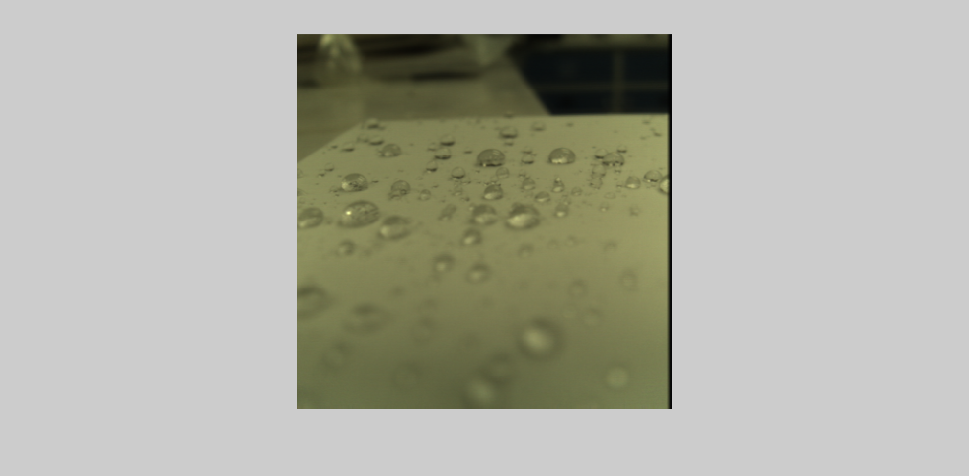
alpha = 2

Slide 8
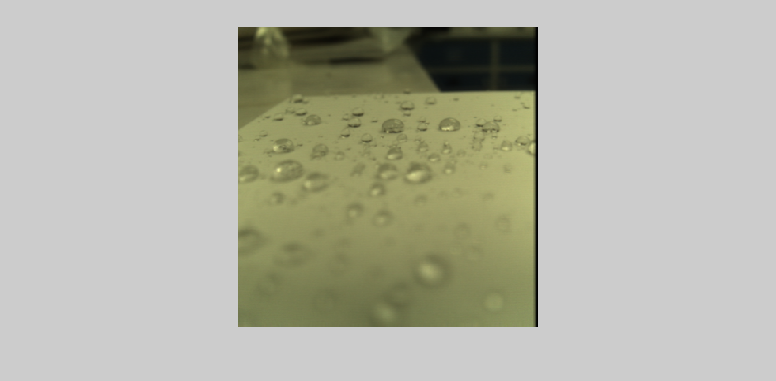
alpha = 3

Slide 9
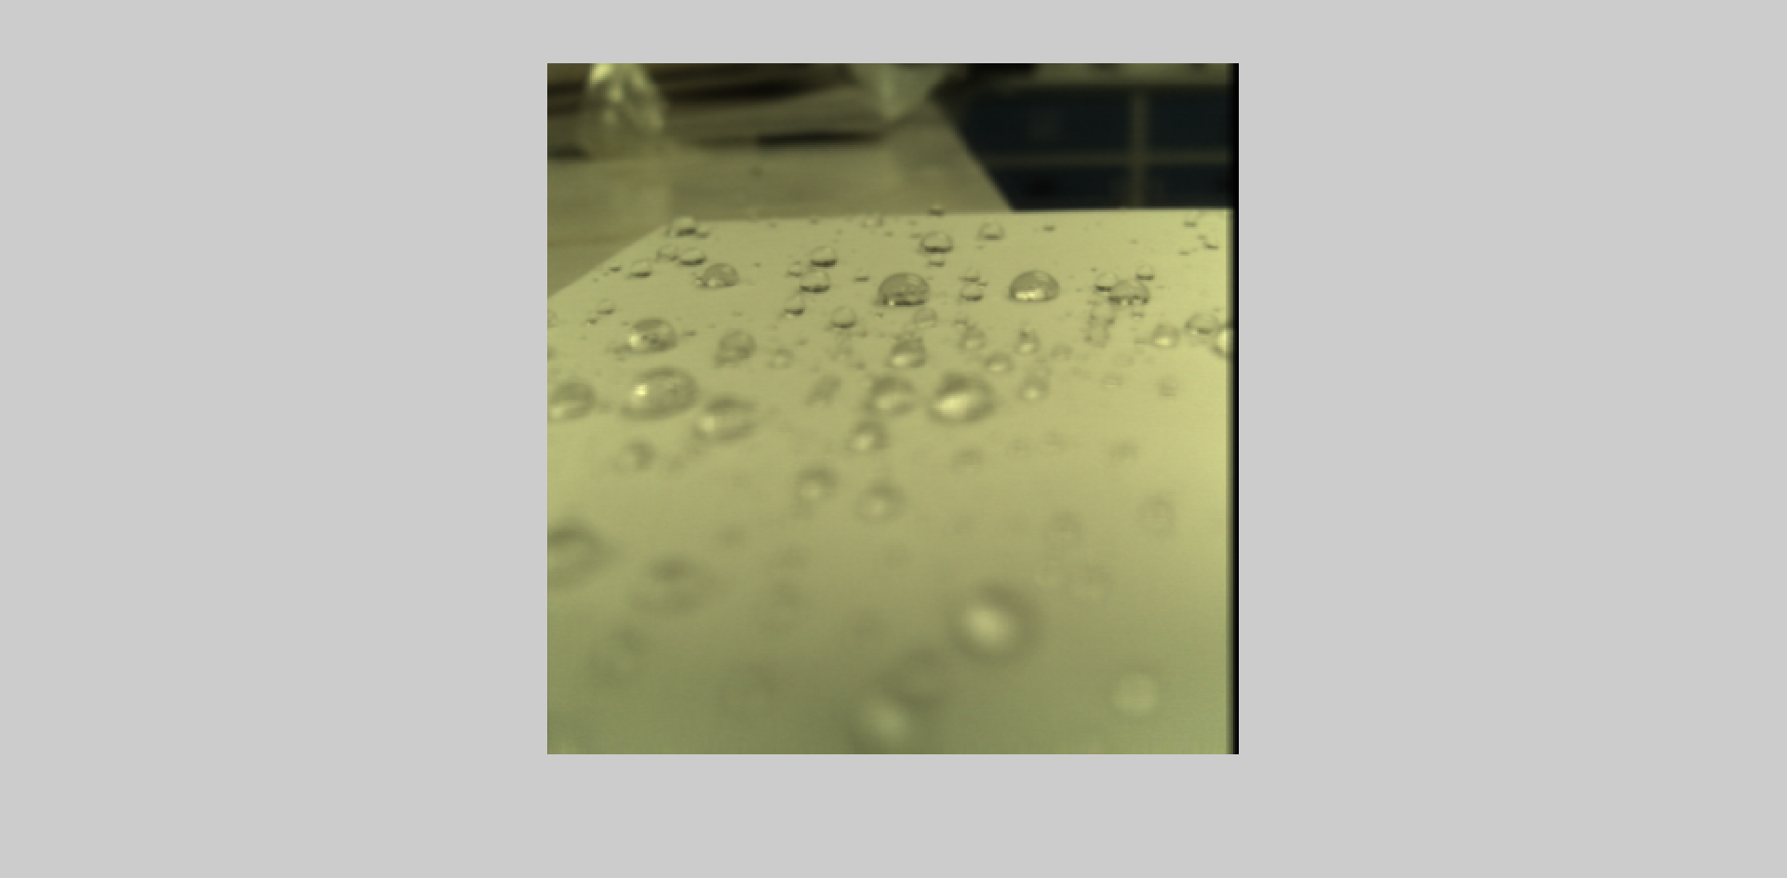
alpha = 5

Slide 10
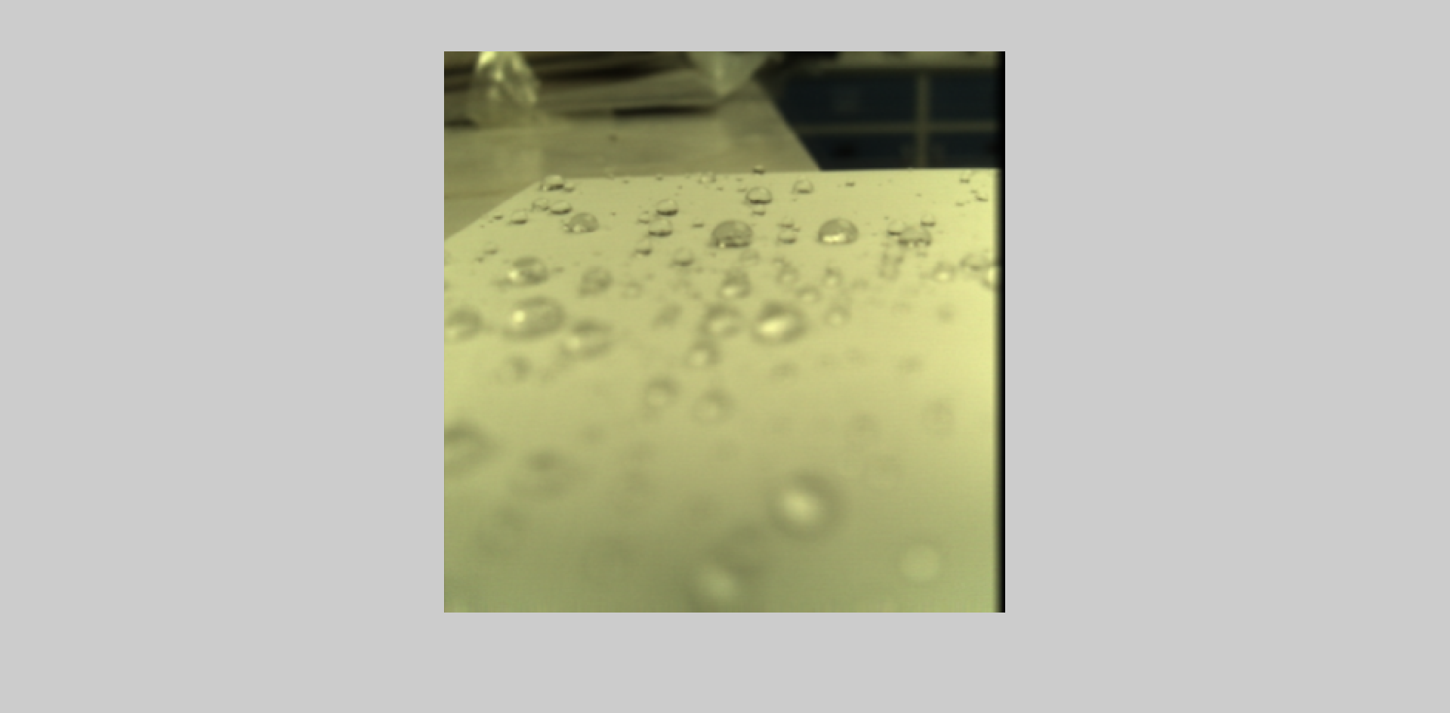
alpha = 20

Slide 11
alpha = 100

