Slide 1
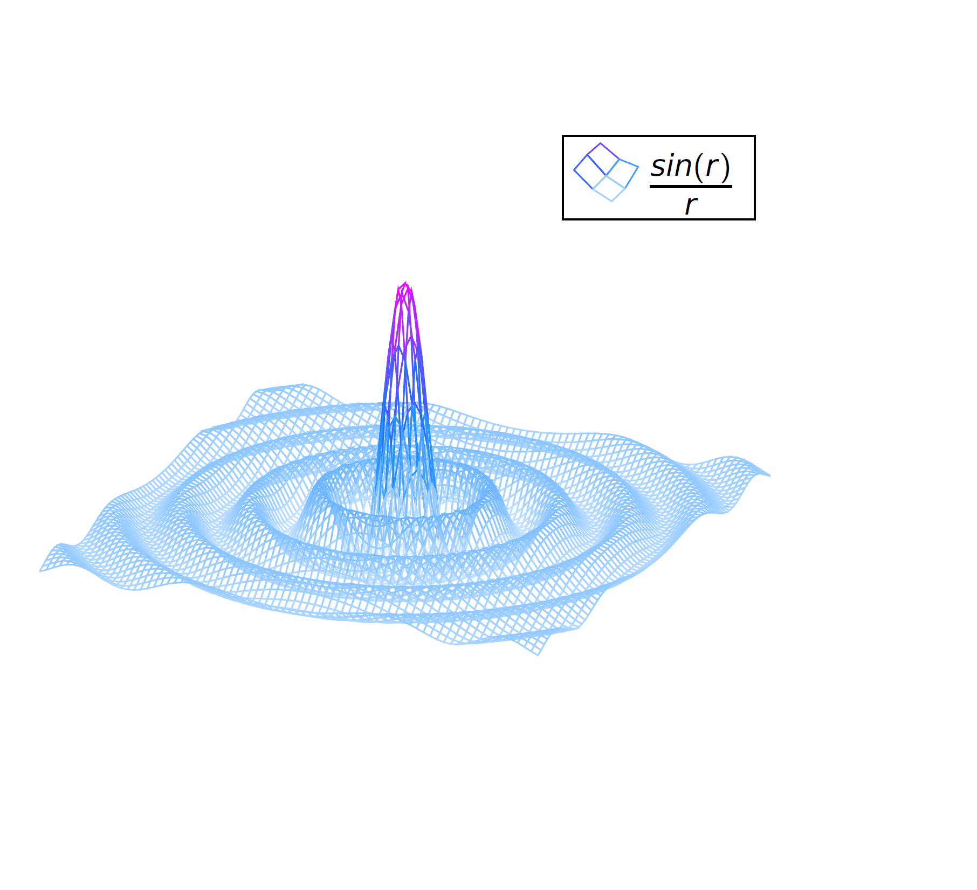
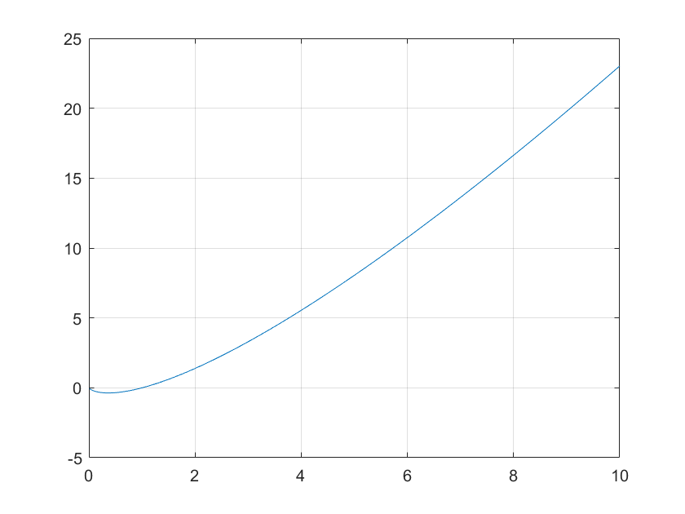

Scientific Calculation Bot

Slide 3
Scientific Calculation Bot

