Slide 1
Data preprocess
First, I resize all images to a uniform size so they can be properly fed into the network.
For data preprocessing, I apply two techniques:
1.Random horizontal flip
2.Normalization
These techniques help increase data diversity and reduce variance, allowing the model to generalize better across different types of images.
Finally, I split the dataset into a training set and a validation set to evaluate the model’s performance during training.

Slide 2
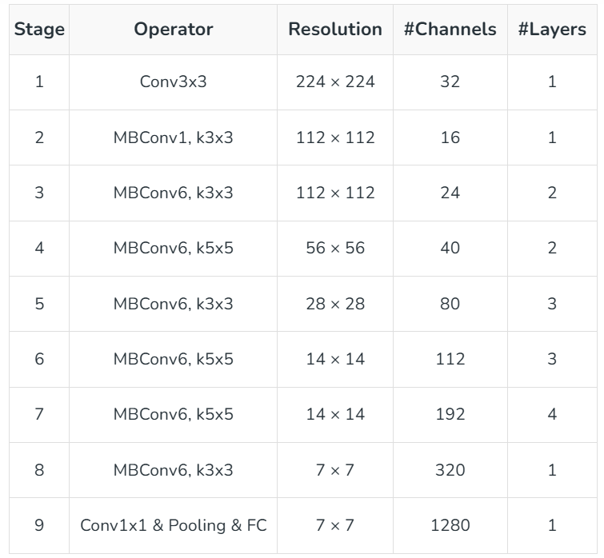
Model
I use the EfficientNet models provided by torchvision to train my classifier.
Among different variants, I compared EfficientNet-B7 and EfficientNet-B5, and ultimately selected B7 as the architecture for my model.
To illustrate the idea, consider the structure of EfficientNet-B0.
EfficientNet scales a network efficiently by jointly increasing its depth, width, and input resolution according to a compound scaling coefficient 𝜙
Larger variants, such as EfficientNet-B7, use a higher value of 𝜙, which expands the network along all three dimensions in a balanced way and leads to better representational capacity.

Slide 3
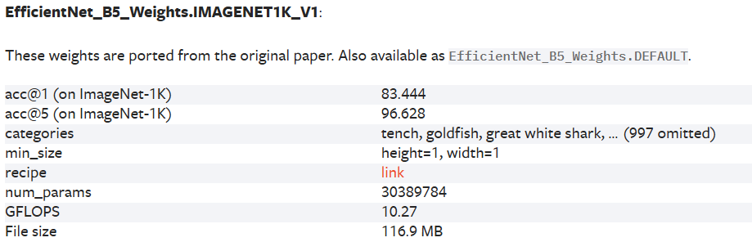
Model
Because EfficientNet-B7 has more parameters than B7, it is more precise to train on the dataset provided by the TA. In my experiments, B7 also achieved better performance than B5. The larger network capacity allows it to capture more complex features and patterns that smaller models, like B5, may miss.

Slide 4
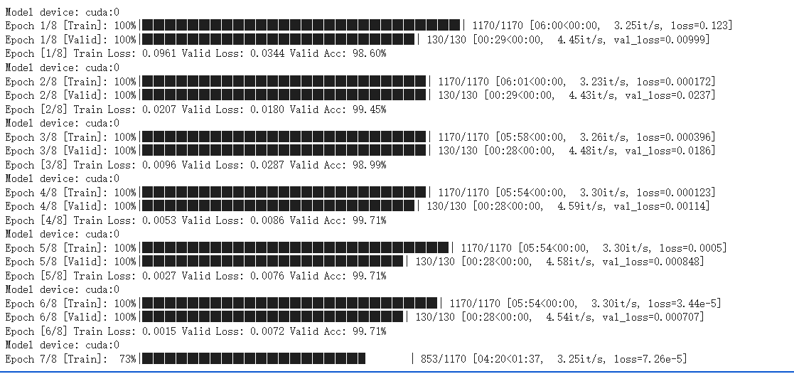
Training
I use cross-entropy loss to quantify the discrepancy between the predicted and true labels during training.
For optimization, I employ SGD, which provides a more robust and stable training process. Additionally, I incorporate a learning rate decay schedule to reduce the risk of overfitting and improve generalization.

Slide 5
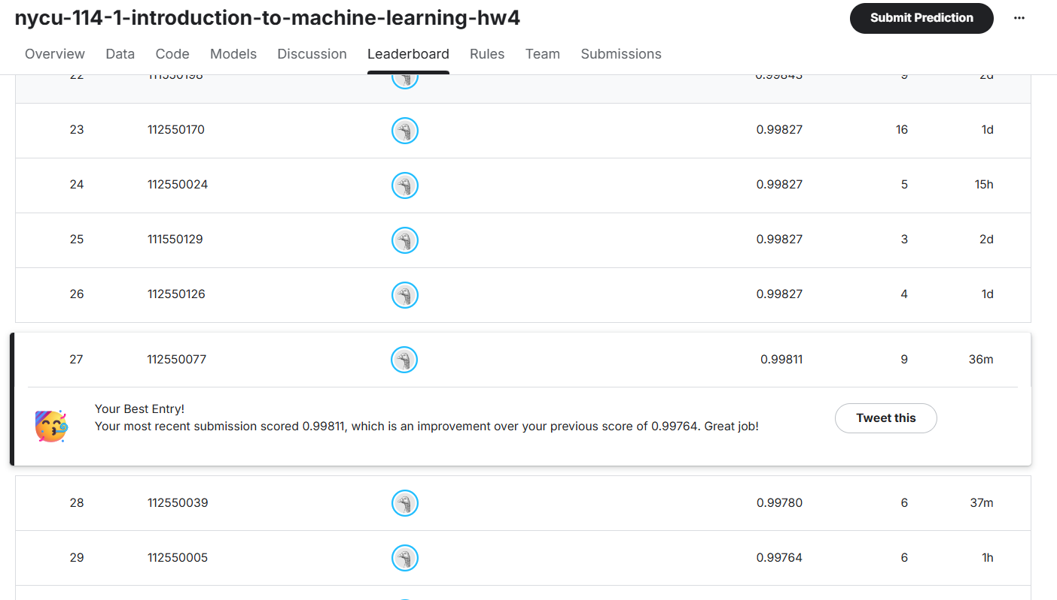
Appendix

